Slide 1
GENED 1079 Section 3 Confidence Intervals

Slide 2
Upcoming / Reminders
Janice’s office hour TONIGHT 6-7PM
Unit Assignment 1: due Sept 25 (Friday) at 5pm ET on Canvas

Slide 3
Agenda
Review of confidence interval concepts
Confidence interval practice questions
  Practice Question 1
  Practice Question 2
Group Activity

Slide 4
Confidence Intervals – Review
95% confidence interval is:
The range of values we are 95% sure some true population parameter lies in between, given our assumptions about the data we observe (e.g., it was randomly collected).
  Or: the range of values that is likely to include a parameter that we are trying to estimate from a sample. It means that if the experiment or test were repeated 100 times, 95 of those CIs would contain the true population parameter we are trying to estimate.
It is based on 3 elements:
  (1) The estimate, (2) how much the data varies, and (3) the sample size.
How can you get a more accurate estimate of the confidence interval:
  Increase the sample size
Notes:
- A confidence interval gives us a range of plausible values for the true population parameter. It’s not saying there’s a 95% chance the parameter itself moves around; the parameter is fixed, but our interval from the sample varies.
- The estimate: mean, proportion, etc.
- The 95% comes from imagining that we repeated the sampling process many times. Each time, we would calculate a new confidence interval. About 95% of those intervals would contain the true population parameter.
Whiteboard example: average income
In reality, we usually only take one sample. So we only get one sample mean and one confidence interval. The “95%” describes how well our method would work if we could repeat the sampling process many times.
Increasing N makes the CI narrower
https://www.youtube.com/watch?v=ENnlSlvQHO0

Slide 5
Central Limit Theorem – Review
Central Limit Theorem (CLT) states that…
  As the sample size grows, the distribution of sample means converges to a normal distribution. This is what we typically use to calculate confidence intervals.
What do we use CLT and confidence intervals for?
  We can use confidence intervals for statistical tests (e.g., are patients taking drug X more likely to experience viral suppression from HIV than patients taking drug Y?)
  To tell how “good” an estimate is → larger CI means more caution must be taken
Notes:
Intuition: CLT connects sample data to population inference. It’s the bridge that lets us do inference in practice.
- Normal distribution good for us because properties of the normal distribution are well-understood. We can use it to calculate probabilities, SEs, Cis, hypothesis tests, etc.
https://onlinestatbook.com/stat_sim/sampling_dist/index.html

Slide 6
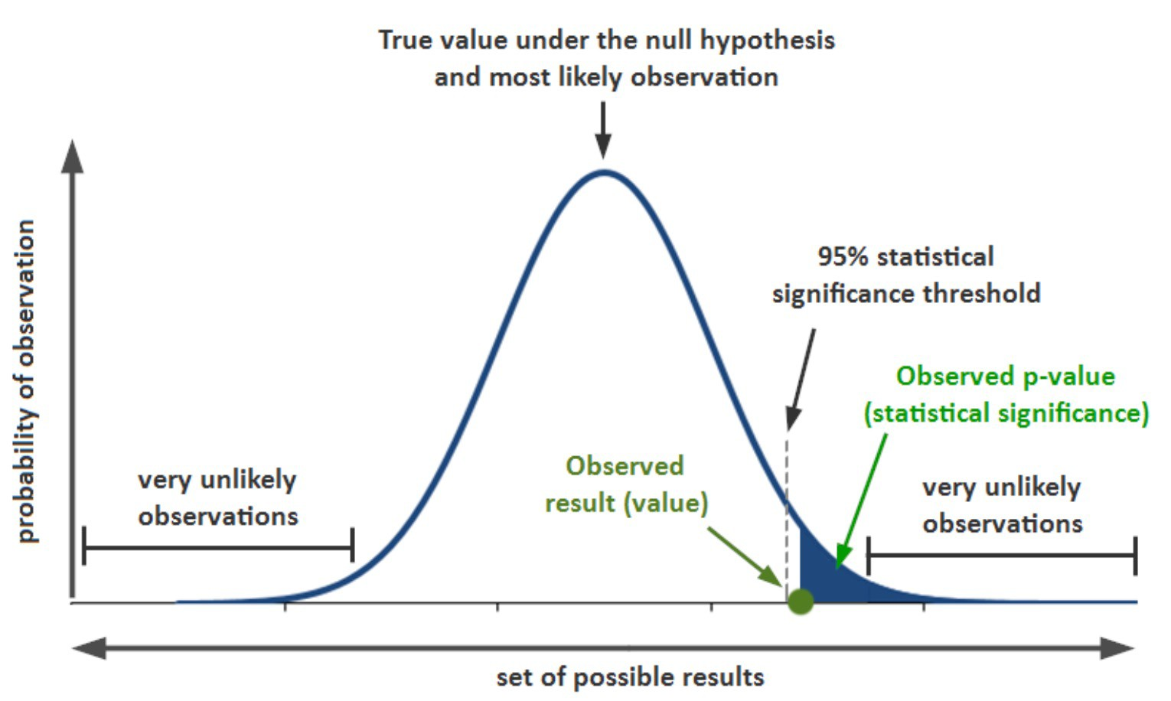
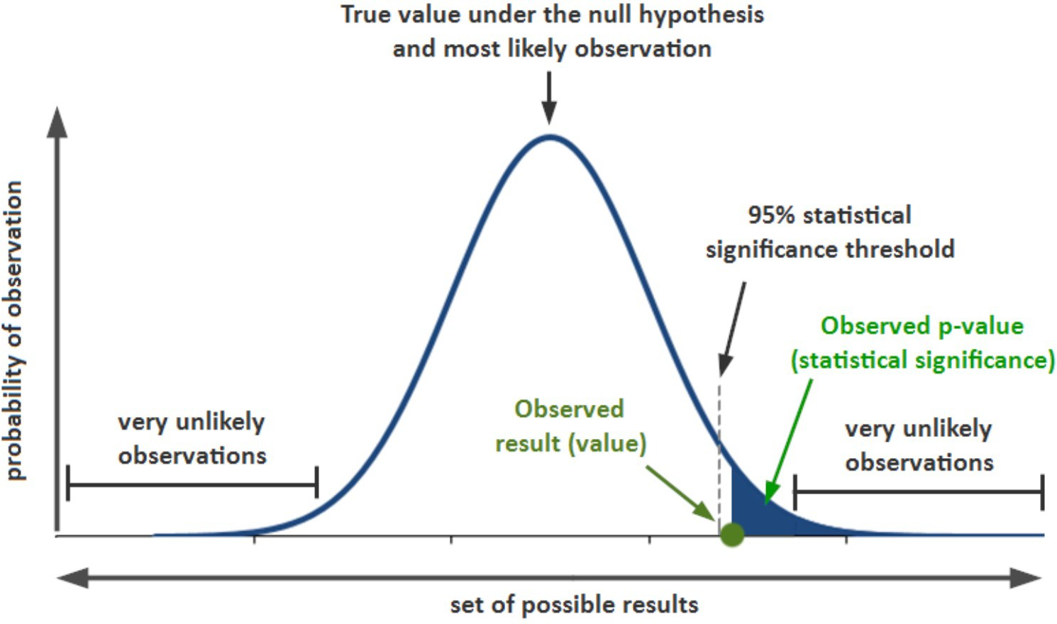
Confidence Intervals and CLT - Review

Slide 7
Practice Question 1
A sample of college students was surveyed about whether they have ever pulled an all- nighter to study for an exam or finish an assignment. A 95% confidence interval for the proportion of all college students who have ever pulled an all-nighter was computed to be [0.512, 0.668]. How would you interpret this confidence interval?

Slide 8
Practice Question 1
A sample of college students was surveyed about whether they have ever pulled an all- nighter to study for an exam or finish an assignment. A 95% confidence interval for the proportion of all college students who have ever pulled an all-nighter was computed to be [0.512, 0.668]. How would you interpret this confidence interval?
The interpretation of this confidence interval is that we are 95% confident that the proportion of all college students who have ever pulled an all-nighter in the population is between
0.512 and 0.668.

Slide 9
Practice Question 2
In 2016, pollsters routinely reported confidence intervals for support for Trump ranging between 40 and 46 percent. Ignoring electoral college issues, what might explain their incorrect predictions in the election outcome?
Notes:
Confidence intervals account for random error but not for systematic error (bad sampling, biased methods).

Slide 10
Practice Question 2
In 2016, pollsters routinely reported confidence intervals for support for Trump ranging between 40 and 46 percent. Ignoring electoral college issues, what might explain their incorrect predictions in the election outcome?
Possible answers:
Systematic bias in polling (i.e., sampling was not random)
Was the population correctly defined (i.e., did pollsters sample from the “voting” population?)
Remember that even if you are 95% sure of something, there is still 5% probability of experiencing a tail event.
Notes:
Confidence intervals account for random error but not for systematic error (bad sampling, biased methods).

Slide 11
Confidence Intervals and Statistical Significance
If the two confidence intervals do not overlap, we can conclude that there is a statistically significant difference in the two population values at the given level of confidence
  Note: if the confidence intervals *do* overlap, it does not prove there is *not* a statistically significant difference
  Use overlapping CI as a “rule of thumb” only
If the confidence interval for the difference does not contain zero, we can conclude that there is a statistically significant difference in the two population values at the given level of confidence.
Notes:
Example:
Group A: Mean = 10, 95% CI = [8, 12]
Group B: Mean = 12, 95% CI = [10, 14]
These intervals overlap (10–12).
But if we compute the difference (A–B = –2), its 95% CI might be [–3.5, –0.5].
This CI does not include 0 → significant difference
So even though the original CIs overlap, the groups are still statistically different.

Slide 12
Statistical Significance vs Substantive Significance
What is the difference between statistical and substantive significance?
Statistical significance shows that an effect exists in a study, using various significance levels (=analytical decision, sample size can play a role)
Substantive significance (also called practical or clinical significance) shows that the effect is large enough to be meaningful in the real world. Statistical significance is denoted by p- values/confidence intervals, whereas practical significance is represented by effect sizes.
What are some examples that highlight the difference?
Notes:
Medical example: A drug reduces blood pressure by 1 mmHg with p < 0.001 (statistically significant). But in practice, that reduction is too small to improve patient health → not substantively significant.
Education example: A new teaching method raises test scores by 10 points on average, but the p-value = 0.12. Substantively, that effect could be meaningful for students, but the study didn’t have enough power.

Slide 13
Confidence Intervals: Group Activity
The abstracts for two studies social media use and mental health are on the next two slides. For each study, answer the following question:
What are the primary outcomes?
What is the treatment?
What treatment effects do they find for each outcome? Report the 95% CI for each outcome.
What are two potential explanations that can explain why the studies arrived at different results?
Notes:
Break into groups in 3 or 4

Slide 14
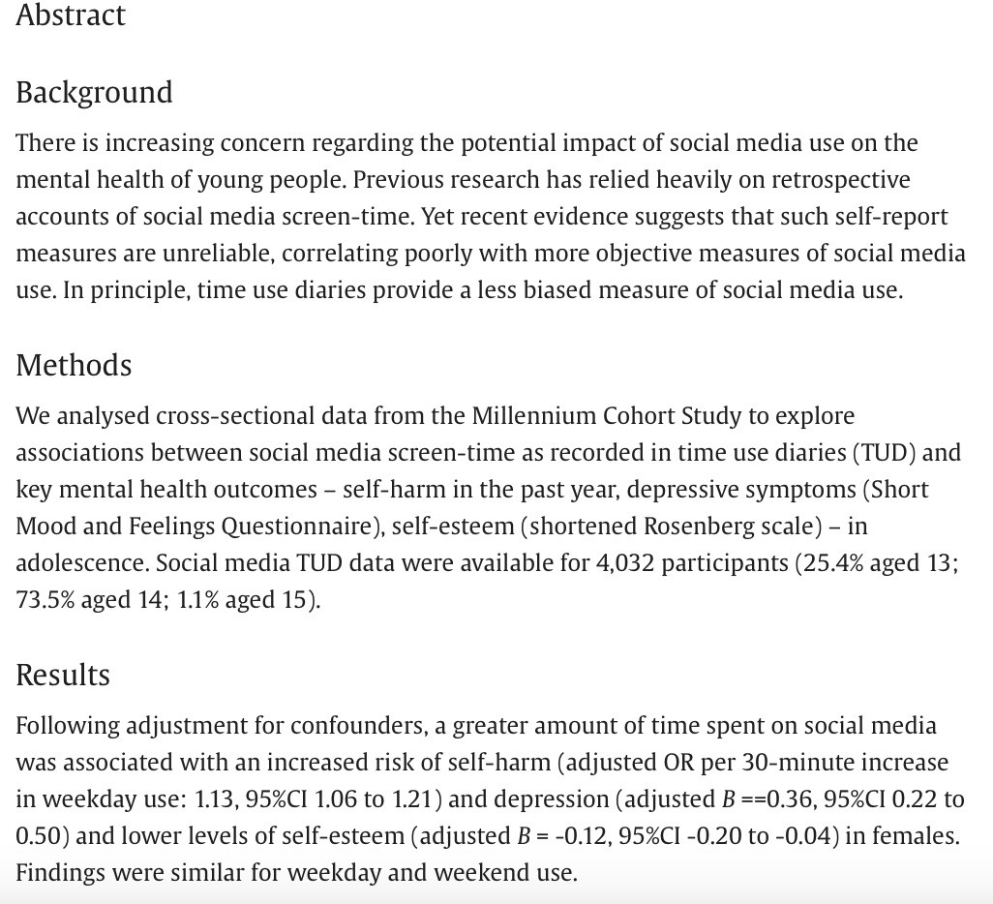
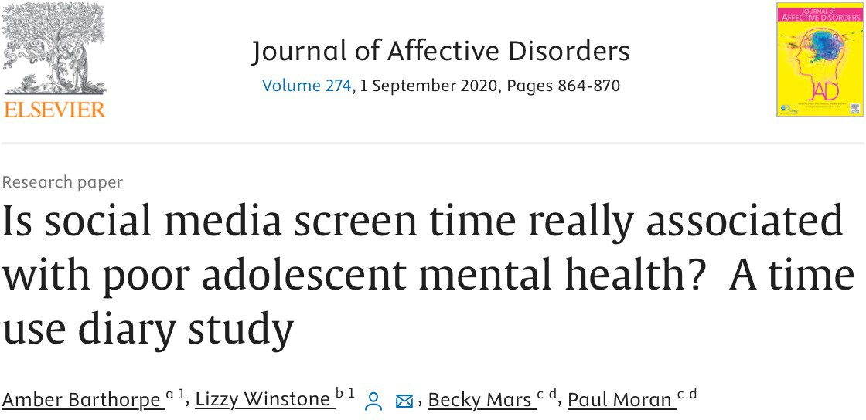
Study 1
Barthorpe, Amber, et al. "Is social media screen time really associated with poor adolescent mental health? A time use diary study." Journal of affective disorders 274 (2020): 864-870.

Slide 15
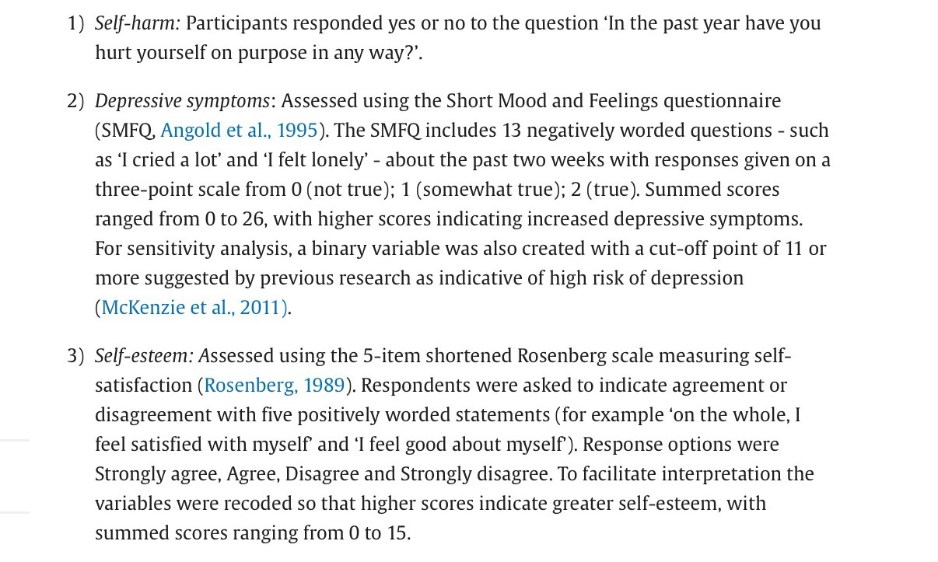

Slide 16
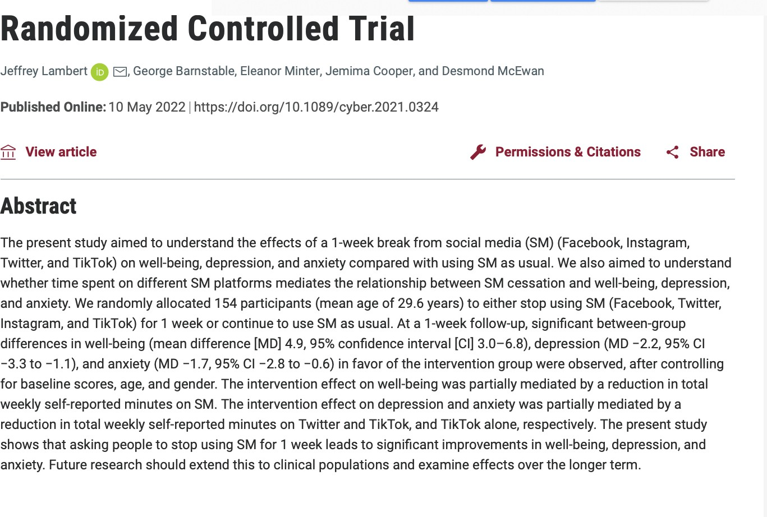
Study 2
Lambert, Jeffrey, et al. "Taking a one-week break from social media improves well- being, depression, and anxiety: a randomized controlled
trial." Cyberpsychology, Behavior, and Social
Networking 25.5 (2022): 287-293

Slide 17
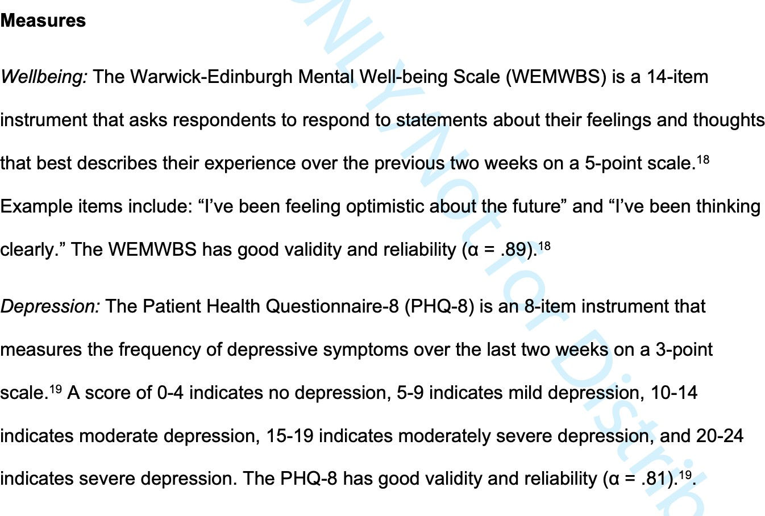

Slide 18
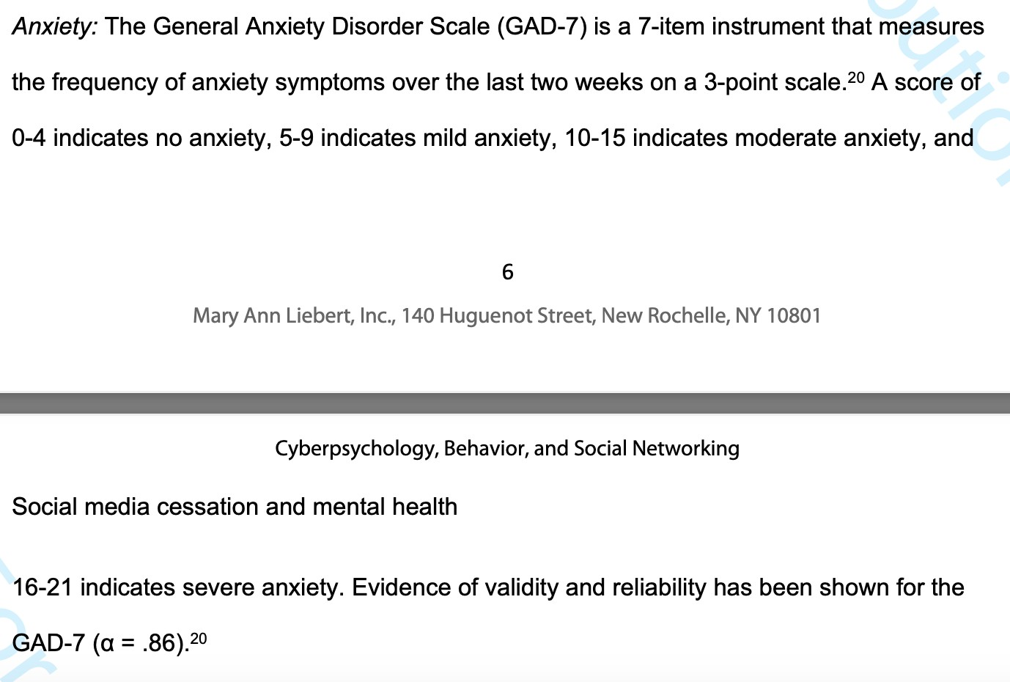

Slide 19
Study 1 Answers
“Is social media screen time really associated with poor adolescent mental health? A time use diary study.”
The primary outcomes are: likelihood of self harm in the past year, depression (score on SMFQ ), self esteem levels (shortened Rosenberg scale)
Treatment: 30 minute increase in weekday screen use
Odds ratios
  Self harm: 1.13 (CI: 1.06 – 1.21) → 30 minutes extra of weekday SM associated with 13% greater likelihood to self harm
Betas:
  Depression 0.36 (CI: 0.22 -0.50) → 30 minute increase in weekday SM use associated with 0.36 point (/26) increase in SMFQ score
  Self Esteem -0.12 (CI: -0.20 – 0.04) → 30 minute increase in weekday SM use associated with 0.12 (/15) reduction in self esteem on Rosenberg scale

Slide 20
Study 2 Answers
"Taking a one-week break from social media improves well-being, depression, and anxiety: a randomized controlled trial."
The primary outcomes are: well-being (WEMWBS scale), depression (PHQ-8 scale), anxiety (GAD-7 scale)
Treatment: 1 week SM (Facebook, Twitter, Instagram, and TikTok) break
  comparison: normal use
Well-being: 4.9 (CI : 3.0–6.8) → 1 week SM break associated with 4.9 (/70) increase in well-being score on WEMWBS scale
Depression −2.2 (CI :−3.3- −1.1) → 1 week SM break associated with 2.2 (/24) reduction in depression score on PHQ-8 scale
Anxiety −1.7 (CI: −2.8 - −0.6) → 1 week SM break associated with 1.7 (/24) reduction in anxiety on GAD-7 scale

Slide 21
Why might the study results differ?
Studies have different designs
  Different outcomes: some differences in outcomes (self harm and self-esteem in study 1, well- being and anxiety in study 2)
  Different instruments are used to measure the common outcomes depression
  Different methods: study 1 is a prospective observational study, study 2 is a randomized controlled trial
Different study populations
  Different ages:
    Study 1 had a mean age of 14
    Study 2 had a mean age of 29.6
  Others?

Slide 22
Final Questions
Based on these two studies, does social media use have a significant effect on the likelihood of depression, anxiety, and low-self esteem?
Based on these two studies, does social media use have a substantive effect on the likelihood of depression, anxiety, and low-self esteem?
Do you believe these findings?
Which study do you think is better?

Slide 23
Solutions
Yes, treatment effect statistically significant for all outcomes
  Study 1:
    Self harm: 1.13 (CI: 1.06 – 1.21) → 1 not in CI
    Depression 0.36 (CI: 0.22 -0.50) → 0 not in CI
    Self Esteem -0.12 (CI: -0.20 – 0.04) → 0 not in CI
  Study 2:
    Well-being: 4.9 (CI : 3.0–6.8) → 0 not in CI
    Depression −2.2 (CI :−3.3- −1.1) → 0 not in CI
    Anxiety −1.7 (CI: −2.8 - −0.6) → 0 not in CI
Would like to know the baseline means in order to determine in they’re substantive. Other factors?
  First study results seem quite small, but less so when you consider they’re for 30 mins of SM time; second study effects seem larger in magnitude
Other factors to consider:
  Sample size
  RCT vs observation study
  External vs internal validity
  CI range
Convinced? Would want to know what they control for as confounders. Might worry about selection. For example, social media break is voluntary and it might be the
case that people who are able to give up social media more easily or use less social media have more fulfilling hobbies outside of social media. We’ll come back to these topics when we talk about causality.

