Slide 1
GENED 1079 Section 4

Slide 2
Agenda
Review of economics of pharmaceuticals (~30 min)
Practice problem (~45 min)

Slide 3
Quick pulse check – who has taken Ec10?
Notes:
For the TF

Slide 4
Economics of pharmaceuticals: Basics
Price – what the drug company receives for each unit sold.
Copay – what an insured patient pays out of pocket for each unit sold. The insurer pays the rest (price – copay).
Willingness to pay – the most a person would be willing to pay for that drug. Above that price, they won’t buy.
  Depends on how much they value the drug
  … and on what they can afford: money spent on a drug can’t go towards rent or food (opportunity cost)
  Also includes willingness to let others (i.e. insurance) pay
Notes:
Price is from the company's side: what it gets per unit. If you're insured, you don't pay that price directly. You pay a copay, and your insurer covers the difference.
Example: $500 price, $20 copay, insurer pays $480.
Willingness to pay is the key idea for today. It's the maximum someone would pay. If you'd buy at $50 but not at $51, your WTP is $50.
Two things drive it.
First, how much you value the drug: you won't pay more than it's worth to you.
Second, what you can afford. A patient may value a drug enormously but still not be able to pay $10,000 for it, because that money has to cover rent and food. So WTP isn't the same as need. We'll come back to that in the practice problem.
Insurance matters here too. Because the insured patient only pays the copay, they'll buy at prices well above what they could pay on their own. In effect, the insurer's willingness to pay gets added to theirs.

Slide 5
Economics of pharmaceuticals: Basics
Demand: How many units people will buy at each price (based on willingness-to-pay)
Supply: How many units the company will sell at each price.
Companies want to maximize (expected) profits:
Π=(𝑃− 𝑀)∗𝑄−𝐹
P = price that the company charges per unit
M or MC = marginal cost, i.e., the cost to make one more unit
Q = number of units sold at that price
F = fixed costs, i.e., upfront costs (R&D, clinical trials) paid no matter how many units sell
Notes:
Demand comes from willingness to pay: at each price, how many people would buy? Lower the price and more people buy.
Supply is the company's side. In this class we keep it simple: the company will sell any number of units as long as the price covers MC. So on our graphs, supply is just a flat line at MC.
Read the profit formula from left to right:
Price − MC is what the company makes on each pill after paying to produce it.
Multiply by Quantity to get total earnings from sales.
Subtract Fixed cost: R&D and clinical trials, paid whether the company sells one pill or a million.
Quick example: price $100, MC $10, 1 million pills sold, $50M in R&D.
Profit = ($100 − $10) × 1M − $50M = $40M.
Lecture called price the "static" choice and fixed cost part of the "dynamic" choice. The next slide asks which costs matter for which decision.

Slide 6
Understanding the Profit Formula
Profits of pharmaceutical companies: Π=(𝑃−𝑀)∗𝑄−𝐹
P = price, M = marginal cost, Q = quantity demanded/supplied, F = fixed costs
What are examples of fixed costs?
What are examples of marginal costs?
Which costs matter for deciding whether to develop a drug?
Which costs matter for deciding how to price a drug?
Notes:
Give them 1–2 minutes with a partner, then take answers to each question before moving on.
If they're stuck on 1 and 2: a fixed cost is one you'd pay even if you sold zero pills. A marginal cost is the extra cost of making one more pill.
If they're stuck on 3 and 4, ask: "Is this decision made before or after the drug exists?"

Slide 7
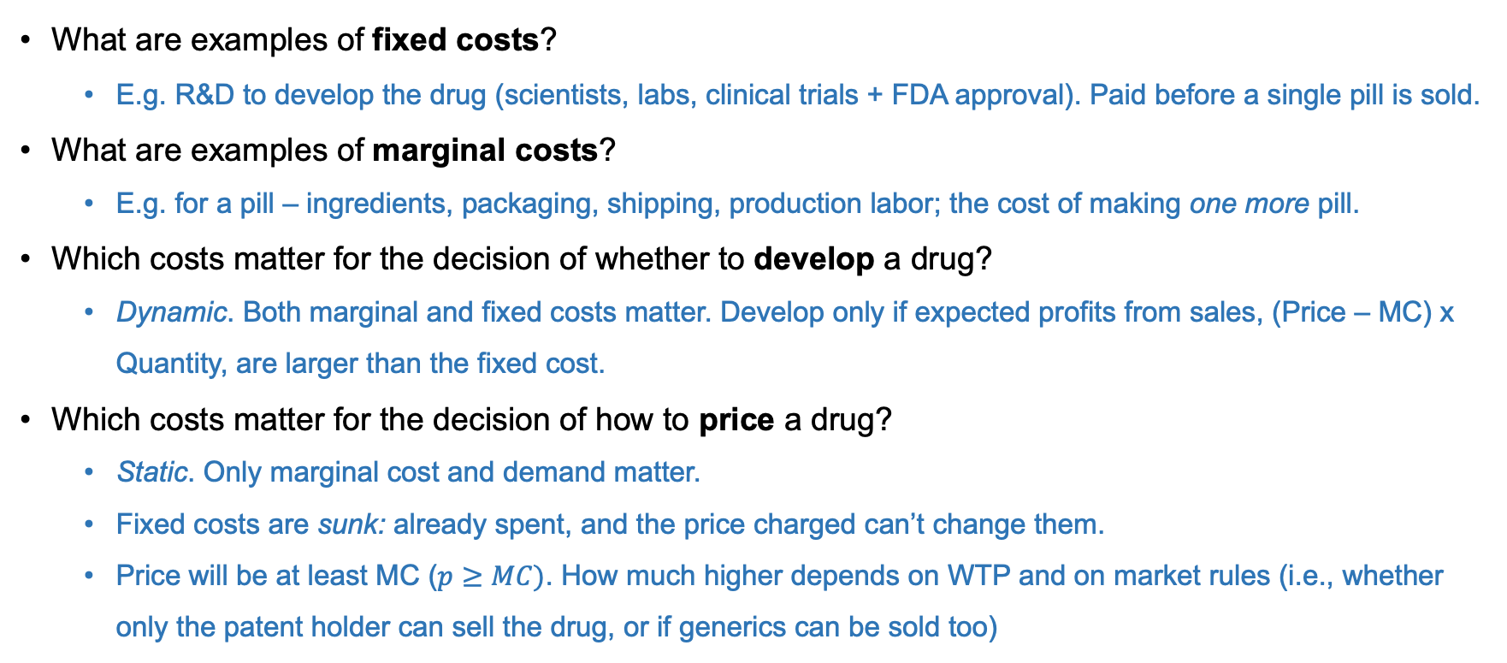
Understanding the Profit Formula
What are examples of fixed costs?
  E.g. R&D to develop the drug (scientists, labs, clinical trials + FDA approval). Paid before a single pill is sold.
What are examples of marginal costs?
  E.g. for a pill – ingredients, packaging, shipping, production labor; the cost of making one more pill.
Which costs matter for the decision of whether to develop a drug?
  Dynamic. Both marginal and fixed costs matter. Develop only if expected profits from sales, (Price – MC) x Quantity, are larger than the fixed cost.
Which costs matter for the decision of how to price a drug?
  Static. Only marginal cost and demand matter.
  Fixed costs are sunk: already spent, and the price charged can’t change them.
  Price will be at least MC ($p≥MC)$. How much higher depends on WTP and on market rules (i.e., whether only the patent holder can sell the drug, or if generics can be sold too)
Notes:
Pharma is unusual: fixed costs are huge and marginal costs are small. Developing one successful drug costs roughly $2.5 billion, partly because companies also pay for all the drugs that fail in trials. Once the drug exists, a pill might cost pennies to a few dollars to make.
Some drugs, called biologics, cost more to make per dose. Keytruda, from the upcoming practice problem, is one. Fixed costs still dominate even for those.
The key point is Q3 vs Q4, the static/dynamic distinction from lecture:
Before the drug exists: "Will we earn enough, after production costs, to cover the R&D bill?"
After the drug exists: the R&D money is gone whatever happens. Ask: "If you've already spent $2.5B, does charging $100 instead of $200 get any of it back?" No. So the price only depends on MC (never sell below it) and on what people are willing to pay.
Takeaway: "We spent a lot on R&D" isn't the economic reason a drug's price is high. The price is high because people are willing to pay it. R&D costs decide whether the drug gets made at all.

Slide 8
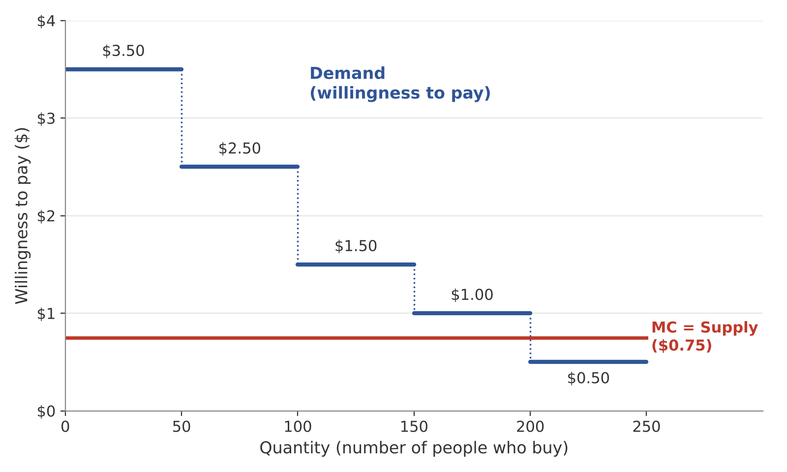
Understanding “Willingness to Pay”
Imagine 250 people, lined up from highest to lowest willingness-to-pay. (Assume each person wants to buy 1 unit.)
Each step = a group of 50 people with the same WTP.
The red line (MC) = the cost to make one more unit
Notes:
The first 50 people would pay up to $3.50. The next 50 would pay up to $2.50, and so on down to the last 50, who would only pay $0.50.
Ask:
"If the price is $2, who buys?" The first 100 people, because their willingness to pay is at least $2.
"At $1?" 200 people. So a lower price means more buyers. That's all a demand curve is.
The red line is MC: what it costs the company to make one more unit.
Ask:
"Would the company ever sell to the last group?" No. They'd pay $0.50, and each unit costs $0.75 to make, so the company would lose money on every sale.
Remember from slide 4: willingness depends on ability. The people on the right aren't necessarily people who need the drug less. They may just be able to pay less.

Slide 9
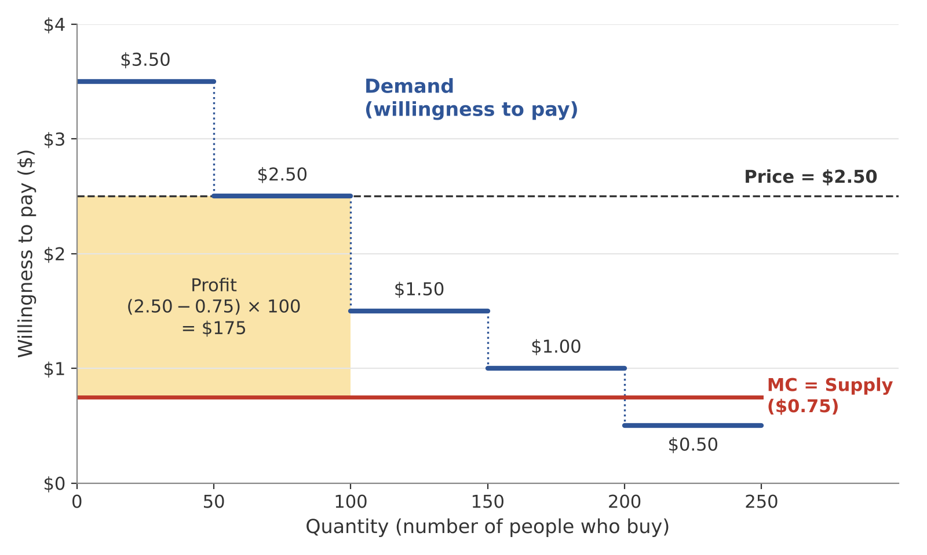
Choosing one price
The company usually can’t charge each person a different price, so it picks one price for everyone.
Price | Units | Profit = (Price- MC) * Units
$3.50 | 50 | $137.50
$2.50 | 100 | $175 ← best
$1.50 | 150 | $112.50
$1.00 | 200 | $50
$0.50 | 250 | Loses money
Tradeoff: a higher price means more profit on each unit, but fewer buyers.
Notes:
Last slide we saw the demand curve. Now: if you're the company and you have to pick ONE price, which do you pick?
Only the step heights are worth considering. Pricing between steps just leaves money on the table. For example, at $2.00 you still only get the first 100 people, so you might as well charge $2.50.
Walk through the table, or have them call out answers:
- $3.50: only 50 buyers, but $2.75 profit on each = $137.50
- $2.50: 100 buyers × $1.75 = $175 ← best
- $1.50: 150 × $0.75 = $112.50
- $1.00: 200 × $0.25 = $50
- $0.50: everyone buys (all 250), but each sale loses $0.25 = −$62.50. The company would never price this low.
Point at the shaded box: profit is the rectangle. Height = Price − MC, width = number of buyers. Raising the price makes the box taller but narrower.
Key takeaway: selling to the most people doesn't mean making the most money. Here, the best price isn't the highest one either. In the practice problem (Part 1), you'll do the same comparison for Keytruda, and the answer comes out differently.
Notice who's left out: 150 people who would pay more than it costs to make the drug ($1.50 and $1.00 groups) don't get it. Keep that in mind for Part 2, when the company CAN charge different prices.
(Optional, if time allows: this is the static view. A high price today also funds R&D for future drugs. That's the dynamic tradeoff from lecture.)

Slide 10
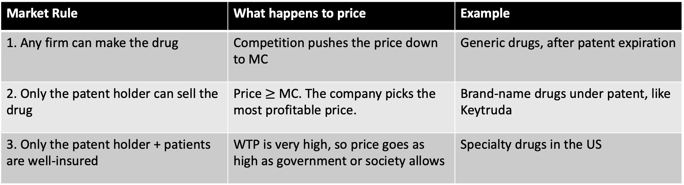
Who sets the price?
Recall market rules from lecture:
Company’s dream: Charge each person their own WTP.
  → We’ll explore this in the practice problem!
Market Rule | What happens to price | Example
1. Any firm can make the drug | Competition pushes the price down to MC | Generic drugs, after patent expiration
2. Only the patent holder can sell the drug | Price $≥$ MC. The company picks the most profitable price. | Brand-name drugs under patent, like Keytruda
3. Only the patent holder + patients are well-insured | WTP is very high, so price goes as high as government or society allows | Specialty drugs in the US
Notes:
Slide 9 assumed the company could pick any price it wanted. That's only true if no one else can sell the drug. This slide puts that in context using the three market rules from lecture.
Rule 1: Anyone can make it. If I charge $2.50 and it only costs $0.75 to make, a competitor can charge $2.40 and take all my customers. Then I go to $2.30, and so on. Each firm figures some profit is better than none, so they keep undercutting until the price is close to MC. This is what happens when a drug goes generic.
Rule 2: Only the patent holder. This is slide 9: the company picks the price that maximizes profit. Lecture added one nuance. If demand isn't responsive to price, the company charges close to the maximum willingness to pay. Lecture's example was antiretrovirals for rich patients, who need the drug and will pay almost anything. If demand is responsive, like antihypertensives, which have substitutes, the price ends up lower.
Rule 3: Patent + good insurance. Remember from slide 4: an insured patient only pays the copay, so they'll accept almost any price. With nothing pulling the price down, it rises until the government or public outrage pushes back.
Last line: what if the company could charge everyone a different price? That's exactly what we'll explore in Part 2 of the practice problem.
(Optional, if a student asks: willingness to pay also depends on information. Patients who don't fully understand a drug's benefits may undervalue it. Even well-educated people make this kind of mistake. Studies of how employees choose insurance plans find they focus on upfront costs rather than total expected costs.)

Slide 11
Is a drug worth its price? → cost-effectiveness
Value of a statistical life year in the US?
  Common rule of thumb: $100,000 per year in perfect health
Two ways to ask the same question:
Example from lecture: Provenge costs $93,000 and adds 4 months (⅓ year) of life
  Benefit = ⅓ × $100K ≈ $33K, which is less than the $93K price ✗
  Cost per year = $93K ÷ ⅓ = $279K, which is more than $100K ✗
  → Not cost-effective, and both methods agree
 | Calculate | Worth it if…
Benefit vs. price (lecture) | Benefit = Years Gained x $100k | Benefit > Price
Cost per year gained | Price ÷ Years Gained | Cost per year < $100k
Notes:
**important to note this is a very simplified intro to cost-effectiveness analysis…
First, where does $100K come from?
Ask students to explain it in plain English.
Answer: we look at how much people pay to lower their risk of dying a little, and scale it up. Lecture's airbag example: if you'd pay $3,000 for an airbag that has a 1-in-10,000 chance of saving your life, then across 10,000 people that's $30 million for one expected life saved. Spread over remaining years of life, researchers end up at roughly $100K per year in perfect health.
"Statistical" means it's not the value of saving your life for certain. Nobody would sell their life for $100K. It's the value of small reductions in risk spread across many people.
Then the two tests. They're the same comparison, just rearranged:
Benefit vs. price: Is (years gained × $100K) bigger than the price?
Cost per year: Is (price ÷ years gained) smaller than $100K?
If one says yes, the other does too. Walk through Provenge both ways to show they agree.
Common mistake to warn about: comparing the benefit to $100K. The benefit is already in dollars, so it gets compared to the price. Only cost per year gets compared to $100K.

Slide 12
Practice Problem Prompt
There are about 1-2 million of people living with melanoma (skin cancer) in the US. One person dies of melanoma every hour. New cancer drugs, called checkpoint inhibitors, remove the ability of some cancer cells to hide from the immune system. One checkpoint inhibitor, Keytruda, manufactured by Merck, increases survival of cancer patients significantly. In a clinical trial using Keytruda against melanoma, while the life expectancy of people not taking the drug was about 1 year, people taking the drug lived on average 3 years (this is simplified here for the purpose of this exercise). Some patients have been completely cured.
Assume that the development cost (the fixed cost) for Keytruda was $2.6 billion and the manufacturing cost is $1000 for the entire course of treatment. Assume that people’s willingness to pay for Keytruda varies with the seriousness of the disease in the following way: for people with advanced metastatic cancer, Keytruda may be the only promising treatment option, and they are willing to pay more than people with less advanced forms of the disease.
Notes:
Send students handout before section.
Point out why WTP is higher for the sickest patients: they have no other options. This is the "demand not responsive to price" case from lecture (slide 10), and it's why the answer in Part 1 comes out differently from slide 9.

Slide 13
Part 1: Merck can only charge one price
In the following exercise, consider a population of 10,000 people and ignore the fixed costs.
  400 have advanced metastatic cancer and are willing to pay $300,000
  600 have a less advanced form of cancer and are willing to pay $100,000
  1,000 have a less advanced form of the disease and they are not insured and are willing to pay $1,000.
  1,000 have a less advanced form of the disease and they are not insured and are willing to pay $500.
Q1: On a graph with quantity on the X axis and price on the Y axis, draw the supply and demand curves.
Q2: What price will Merck charge? Who gets Keytruda?
Notes:
Give them about 5 minutes in groups.
Hints if they're stuck on the graph:
- Same step graph as slide 8. The tallest step goes on the left.
- The x-axis counts people cumulatively: the first step ends at 400, the next at 400 + 600 = 1,000, then 2,000, then 3,000.
Supply is a flat line at MC = $1,000.
Hint if they're stuck on the price: same method as slide 9. Try each step's price and compute (Price − MC) × number of buyers.
Something to point out afterward: the third group's willingness to pay is exactly MC, and the fourth group's is below it.

Slide 14
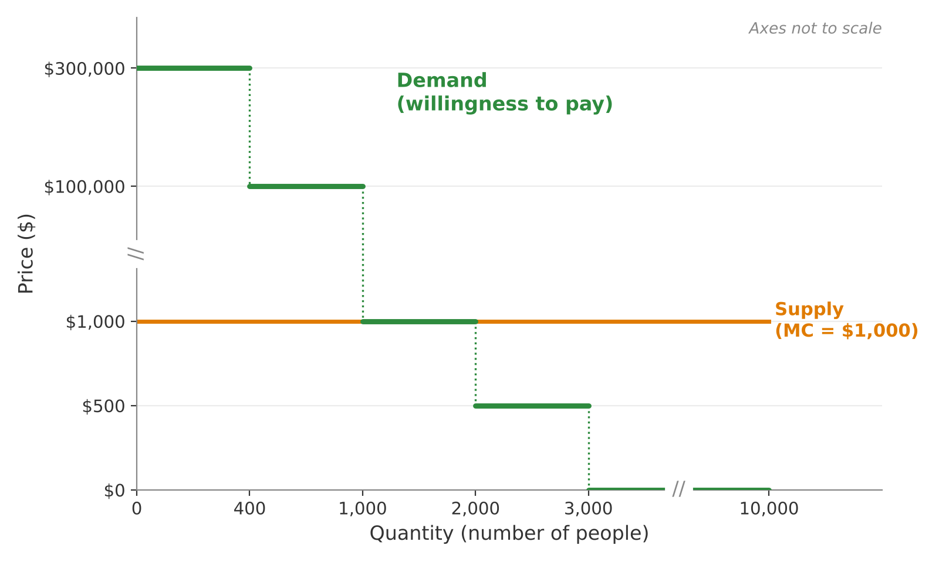
Part 1: Merck can only charge one price
Q1: On a graph with quantity on the X axis and price on the Y axis, draw the supply and demand curves.
Notes:
Walk through how to build the graph step by step:
- Put the group with the highest willingness to pay first: 400 people at $300,000.
- The x-axis is cumulative. The next group of 600 ends at 400 + 600 = 1,000. Then 2,000, then 3,000.
- The 7,000 people without melanoma are at $0, from 3,000 out to 10,000.
Supply is a flat line at MC = $1,000.
Common mistakes to check for:
- Putting 600 instead of 1,000 on the x-axis for the second step. The x-axis counts everyone so far, not just that group.
Forgetting to label the numbers on the axes.
Trying to draw it to scale. You don't need to. Just make sure the steps go in the right order.
Point out that the $1,000 group sits exactly on the MC line, and the $500 group is below it.
Ask: "Would Merck ever sell to the $500 group?" No, every sale would lose money.

Slide 15
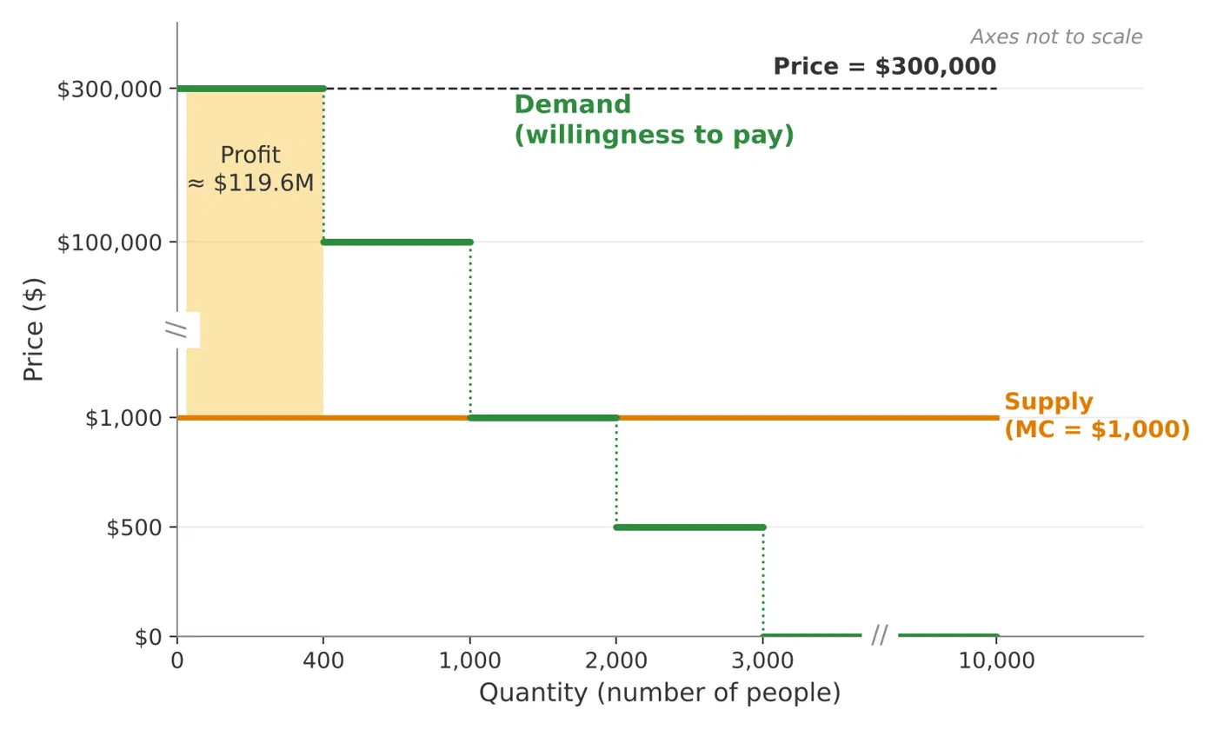
Part 1: Merck can only charge one price
Q2: What price will Merck charge?
Price | Units | Profit = (Price- MC) * Units
$300k | 400 | $119.6M ← Best
$100k | 1,000 | $99M
$1k | 2,000 | $0
$500 | 3,000 | -$1.5M (losing money)
--> Merck charges $300k
Notes:
Compare with slide 9, where the best price was not the highest one!
Ask: "Why is it different here?”
The sickest patients' willingness to pay is so much higher ($300K vs. $100K) that losing the other 600 buyers costs less than charging the top group less would. This is the "demand not responsive to price" case from lecture: very sick patients with no other options will pay almost anything.
If a student asks about the $2.6B fixed cost: we're told to ignore it, because it doesn't change which price is best. Subtracting $2.6B from every row lowers every profit by the same amount, so $300K still wins.

Slide 16
Part 1: Merck can only charge one price
Q2: Who gets Keytruda?
Only the 400 patients with advanced cancer.
The other 2,600 patients with melanoma go without, including 600 who were willing-to-pay $100k, far above what it costs to make.
Notes:
Q2 is the uncomfortable part. 600 people would pay $100,000 for a drug that costs $1,000 to make, and they still don't get it. Hold that thought for Part 2.
If a student asks about the $2.6B fixed cost: we're told to ignore it, because it doesn't change which price is best. Subtracting $2.6B from every row lowers every profit by the same amount, so $300K still wins.

Slide 17
Part 2: Merck can charge different prices
Now, Merck can charge different prices to different groups for the same drug. Assume Merck can stop people from reselling it.
In the following exercise, consider a population of 10000 people and ignore the fixed costs.
  400 have advanced metastatic cancer and are willing to pay $300,000
  600 have a less advanced form of cancer and are willing to pay $100,000
  1,000 have a less advanced form of the disease and they are not insured and are willing to pay $1,000.
  1,000 have a less advanced form of the disease and they are not insured and are willing to pay $500.
Q1: What price will Merck charge each group? What are its total profits? Who gets Keytruda now?
Q2: Does Merck make more profits when it can charge one price or differentiated prices?
Q3: Give one pro and one con of differentiated pricing for Merck, and one each for patients.
Notes:
Give them about 5 minutes in groups.
Hints if they're stuck on Q1:
- If Merck can charge anyone any price, what's the most it can get from each group? Their willingness to pay.
Should Merck sell to a group at all? Only if their willingness to pay is at least MC.
Watch for the $1,000 group. Their willingness to pay equals MC exactly, so Merck makes $0 on them whether it sells or not. Either answer gets the same total profit. The convention is that Merck sells when price ≥ MC.
For Q3, suggest a 2×2 grid (Merck / patients × pro / con).

Slide 18
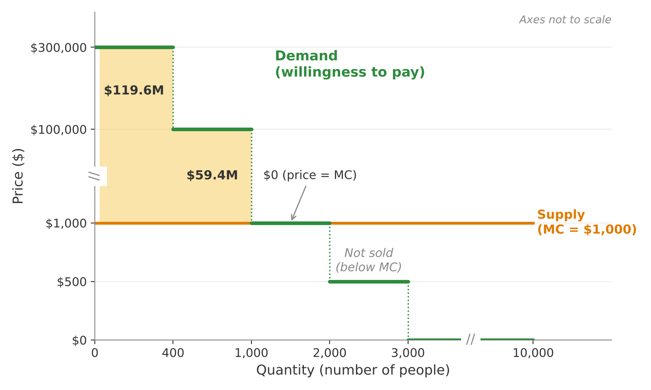

Part 2: Merck can charge different prices
Q1: What price will Merck charge?
Each group pays its own willingness-to-pay, as long as it’s $≥$ MC
Group | Units | Price | Profit per unit = (Price- MC) | Total profit
Advanced | 400 | $300k | $299k | $119.6M
Less advanced | 600 | $100k | $99k | $59.4M
Uninsured | 1,000 | $1k | $0 | $0
Uninsured, lower WTP | 1,000 | Not sold (below MC) | -- | --
Total |  |  |  | $179M
Notes:
The logic: if Merck can charge each person whatever it wants, it charges each group the most they'll pay, which is their WTP. It sells to a group as long as that price is at least MC.
Go through the groups:
- The top two groups produce all the profit: $119.6M + $59.4M = $179M.
- The $1,000 group pays exactly MC, so Merck makes nothing on them. Selling or not selling gives the same profit. By convention, they get the drug "at cost."
- The $500 group still doesn't get it. Merck would lose money on every sale.
Point at the graph: in Part 1 there was one profit box. Now the second group adds a box of its own. That second box is the extra profit Merck gains from charging different prices.

Slide 19
Part 2: Merck can charge different prices
Q1: Who gets Keytruda now?
2,000 people, up from 400 in Part 1!
Notes:
2,000 people now get Keytruda, up from 400 in Part 1. The $1,000 group gets it at cost, and only the $500 group is still left out.
Hold onto this for Q3: more profit AND more patients treated. Is that good for everyone?

Slide 20
Part 2: Merck can charge different prices
Q2: Does Merck make more profits with one price or with different prices?
Different prices win, by $59.4M
Why? With one price, Merck had to choose between a high price (few buyers) and a low price (many buyers). With different prices, it doesn’t have to choose. It charges the sickest patients $300k and still sells to everyone else who’s willing to pay at least MC.
Economists call this differentiated pricing “price discrimination.”
Notes:
Put the two graphs next to each other. The only difference is the second profit box, $59.4M from the 600 insured patients with less advanced cancer. That box is the whole gain.
Ask: "Could differentiated pricing ever give Merck less profit than one price?"
No. Merck could always just charge everyone $300,000 and get back to Part 1. Being able to charge different prices only adds options.
Link back to slide 9 the price–quantity tradeoff was the reason the company had to leave buyers out. Differentiated pricing removes that tradeoff.
Also point out that access improved too: 2,000 patients get the drug instead of 400. That sets up Q3. More profit and more patients treated sounds like it's good for everyone. Is it?

Slide 21
Part 2: Merck can charge different prices
Q3: What are pros and cons of differentiated prices for Merck and for the patients?
 | Pro | Con
Merck
Patients
Notes:
Give groups a couple of minutes to fill in the 2×2 grid (Merck / patients × pro / con), then take answers before revealing the next slide.
If stuck, ask: "What could go wrong for Merck if the uninsured group pays $1,000 and the sickest group pays $300,000?"

Slide 22
Part 2: Merck can charge different prices
Q3: What are pros and cons of differentiated prices for Merck and for the patients?
 | Pro | Con
Merck | Higher profits ($179M vs. $119.6M) | Hard to pull off: Merck has to know who will pay what and stop people from reselling cheap doses to others. Also potential legal or public backlash.
Patients | More people get the drug (2,000 vs. 400) | Feels unfair: sicker patients pay much more for the same drug, and every patient pays the most they’re willing and able to pay.
Notes:
Get answers from the groups first, then reveal the grid.
Merck's con, explained concretely: if the uninsured group pays $1,000, what stops them from reselling to an insured patient for $50,000? Differentiated pricing only works if Merck can block that kind of resale. That's why lecture said "if it can prevent resale.”
On patients, push a little:
Is any patient worse off than in Part 1? No. The sickest group pays $300K either way, and everyone else gets the drug at a price they're willing to pay.
Is anyone better off on price? Not really. Every group pays its maximum, so Merck keeps all the extra value. The gain for patients is access, not a lower price.
Real-world connection: drug companies do versions of this. They charge different prices in different countries and run patient assistance programs for people who can't pay.

Slide 23
Part 3: Is Keytruda cost-effective?
Recall:
  Price is $300k (from Part 1)
  Life expectancy without Keytruda: 1 year
  Life expectancy with Keytruda: 3 years
Q1: Calculate the cost per year of life gained
Q2: Is Keytruda cost-effective, based on the value of a statistical life from class (~$100k per year)?
Q3: What are the pros and cons of an insurer or national health plan using cost-effectiveness to decide whether to cover Keytruda?
Notes:
Give them about 5 minutes. Q1 and Q2 should be quick; save most of the time for Q3.
Common mistakes to watch for on Q1:
Dividing by 3 (life expectancy with the drug) instead of 2 (years gained). Ask: "How much longer does the drug make people live?”
Using a price from Part 2. Part 3 uses the single price from Part 1.
For Q3, if they're stuck, ask: "Who wins and who loses if the insurer says no?"

Slide 24
Part 3: Is Keytruda cost-effective?
Q1: Cost per life year gained.
Years gained: 3 – 1 = 2 years
Cost per year gained = Price / Years gained
  = $300k / 2
  = $150k per life year gained
Alternative method: Benefit = 2 years * 100k = $200k, which is less than the $300k price
Notes:
Step 1 is where people slip: the drug adds 2 years, because patients go from living 1 year to living 3. We divide by the years the drug adds, not by total life expectancy.
Say the units out loud: "$150,000 per year of life gained." A bare "$150,000" is easy to confuse with the price.
Remind students this is an average. Some patients are completely cured, and some gain very little. Cost-effectiveness analysis works with averages.
The check line is optional, but it's a good moment to show that slide 11's two methods give the same answer: the benefit ($200K) is less than the price ($300K), and the cost per year ($150K) is more than $100K. Either way, the answer is "not worth it at this price."

Slide 25
Part 3: Is Keytruda cost-effective?
Q2: Is Keytruda cost-effective, based on the value of a statistical life from class (~$100k per year)?
$150k > $100k, so not cost effective
Keytruda costs $150,000 per year of life gained, which is more than the roughly $100,000 per year that we value an additional year of life at, so it is not cost-effective at a price of $300,000.
What price would make it cost-effective? 2 years × $100K = $200,000 or less
Notes:
Emphasize "at this price." The drug clearly works: it gives people 2 extra years. What fails the test is the $300K price. Ask: "What price would make it pass?" → $200K. Anything at or below that works.
If time allows, two points from lecture:
- $100K is a rule of thumb. Lecture gave a range of about $75K–$200K. Ask: "If we used $200K, would Keytruda pass?" Yes, because $150K < $200K. So the conclusion depends on the threshold we pick.
Other countries pick lower thresholds. The UK uses about $60K per year, so Keytruda would fail by even more there.
This leads into Q3: if an insurer refused to pay more than $200K, what would Merck do?

Slide 26
Part 3: The cost effectiveness of Keytruda
Q3: What are the pros and cons of an insurer or national health plan using cost-effectiveness to decide whether to cover Keytruda?
Pros | Cons
Notes:
Ask the groups for answers before revealing anything. If they're stuck: "Who wins and who loses if the insurer says no to Keytruda?"

Slide 27
Part 3: The cost effectiveness of Keytruda
Q3: What are the pros and cons of an insurer or national health plan using cost-effectiveness to decide whether to cover Keytruda?
Pros | Cons
Money goes where it buys the most health. The same dollars might save more years of life spent on other treatments. | Patients lose access to a drug that works. Including the sickest, who may have no other option.
Pressures companies to lower prices, e.g., Keytruda to $200k or less. | The $100k threshold is a judgment call.
One consistent rule for every drug, instead of case-by-case lobbying. | It works with averages, but some patients are cured and others gain little
Keeps premiums and taxes down, since everyone pays for coverage, | Lower expected profits → less incentive to develop new drugs.
Notes:
Things to draw out:
- "Better spent elsewhere" is the key idea behind cost-effectiveness. An insurer has a fixed budget, so $300K on one Keytruda patient is $300K not spent on, say, blood pressure drugs for many people.
- Pressure on price: if insurers won't pay more than $200K, Merck faces a choice between lowering its price and losing those sales. This is roughly how countries like the UK negotiate drug prices.
- The innovation con ties back to slide 7. Lower prices today mean lower expected profits, and that affects the "whether to develop" decision for future drugs. Today's patients vs. future patients is the static vs. dynamic tradeoff from lecture.

Slide 28
Wrap up
Any questions?
Reminders:
  Problem set 2 is due on Oct 12 (Mon) at 5pm.
  Unit 2 assignment is due on Oct 23 (Fri) at 5pm.

Slide 29
Appendix

Slide 30
Understanding “Willingness to Pay”
Willingness to pay (dollars)
W_{rich}
Willingness to pay of rich
Imagine that the X-axis is a group of 100 people, ordered by the amount of money they’d pay for your product:
the left-most person would offer to pay the most and the right-most person would offer to pay the least
W_{poor}
Willingness to pay of poor
MC
Quantity

Slide 31
Understanding “Willingness to Pay”
Willingness to pay (dollars)
W_{rich}
Willingness to pay of rich
Our firm can’t sell for less than MC (marginal cost); otherwise, we will lose money at any quantity
W_{poor}
Willingness to pay of poor
MC
Quantity

