Slide 1
Brink — Music, but social. 🎶
A social app built on what you actually listen to.
brink-xg7p.onrender.com
Andrea Vreugdenhil (backend) · Jonah Walker (analytics) · Sebastian Arguedas Soley (frontend)
McGill Desautels — MMA
Notes:
ANDREA (0:20): Hi everyone — this is Brink. It's a social app built around the music you actually listen to on Spotify. I worked on the backend, Jonah did the analytics, and Sebastian did the frontend. It's deployed and running, so we'll show you the real thing at the end.

Slide 2
ANDREA · 1:00
The idea
• On most apps, what you post is the highlight reel — a version of yourself.
• What you listen to is more honest: it's just what you played.
So we built the feed on that — and used it to find who listens like you.
• Two questions run through the whole app: what do you listen to, and who matches you?
Notes:
ANDREA (1:00): The starting point was simple. On most social apps, what you post is a choice — you show the version of yourself you want people to see. Your listening history is different: it's just what you actually played. We thought that was a more honest thing to build a feed around. So on Brink you share the songs you're really listening to, people react and comment, and then we use that listening data to figure out whose taste actually lines up with yours.

Slide 3
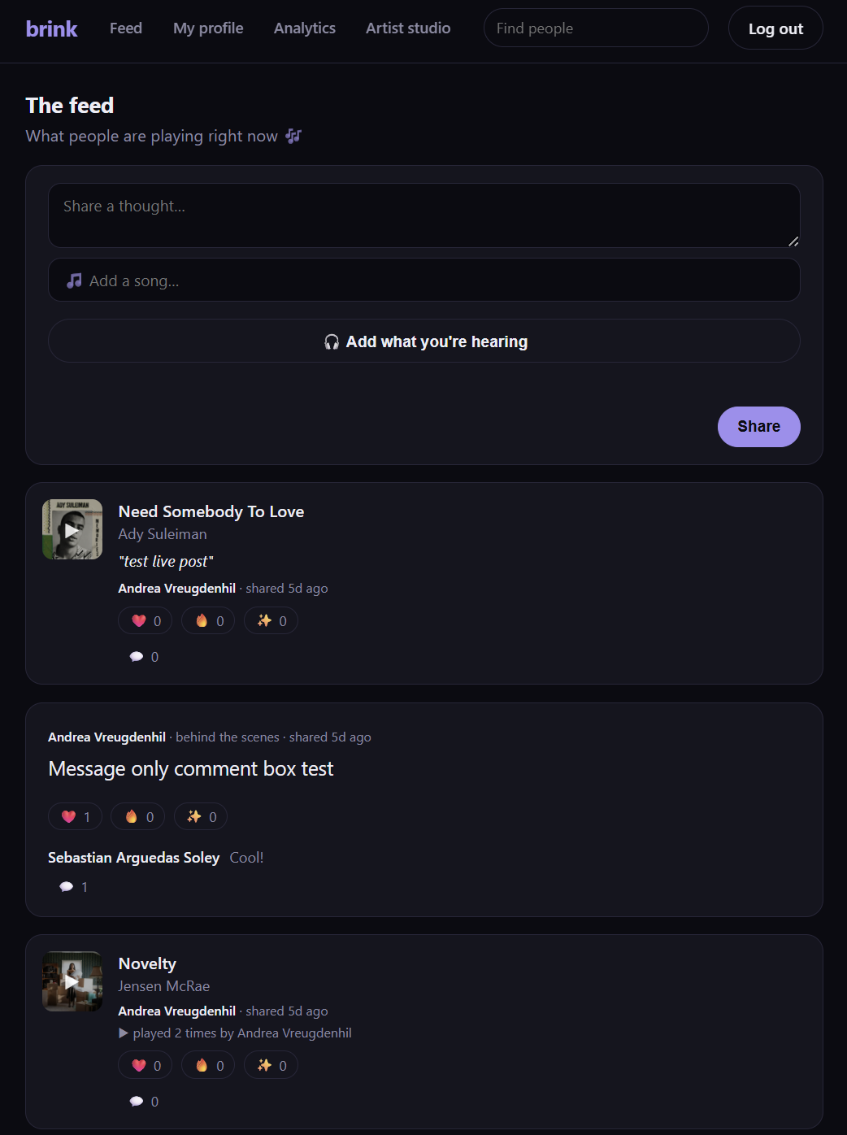
ANDREA · 1:00
What Brink is
Feed — songs that play right in the card, with reactions & comments
Taste communities — a group our model puts you in
Compatibility — how close two people's taste is
Artist portal — behind-the-scenes posts to fans
• It's all one live app — everything we planned is built.
Notes:
ANDREA (1:00): Concretely, Brink is four things. A feed of songs that play right there in the card, with reactions and comments. A taste community for each person — a group our model puts you in. A compatibility score between any two people. And a small artist portal. It's all one live app, and everything we set out to build is built. But the part we actually want to talk about is how three of us built it.

Slide 4
ANDREA · 1:30
What we really set out to do
• A big goal was to see how far we could get by leaning on AI coding agents.
• We learned fast: AI is only as good as the context you give it.
• So the job was two things — give the agents rich context, and be exact about what to build.
Our first couple of weeks were planning, not code: ADRs, tickets, and project governance.
• That groundwork is what let everything after it move quickly.
Notes:
ANDREA (1:30): Honestly, one of our real goals on this project was to see how far we could get by leaning on AI coding agents — to build as much as we possibly could as a team of three. And what we learned early is that AI is only as good as the context you give it. If you're vague, you get vague. So the whole job became two things: give the agents as much context as possible, and be really precise about exactly what we wanted built. That's why our first couple of weeks weren't spent writing app code at all — we were setting up what we call our ADRs, our tickets, and our project governance. That planning is what made everything afterwards move fast.

Slide 5
ANDREA · 1:30
The scaffolding that let AI build
ADRs
Every real decision, written down with the reasoning.
So an agent — or a teammate — knows why things are the way they are.
Append-only: we supersede, never quietly edit.
Tickets
One clear piece of work at a time.
The agent builds exactly that — nothing more.
Each one traces back to a requirement.
Governance
Guardrails around every change: one PR at a time.
CI runs tests + a secret scan automatically.
A check fails if you change code but not its docs.
Notes:
ANDREA (1:30): So what does that scaffolding actually look like. ADRs are architecture decision records — every real decision written down with the reasoning behind it, so anyone picking up the work, an agent or one of us, knows why things are the way they are. Tickets break the work into one clear piece at a time, so the agent builds exactly that and nothing else. And governance is the guardrails — every change is a pull request, tests and a secret-scanner run automatically, and we even have a check that fails if you change code without updating its docs. All of that is context and clarity — which is exactly what the agents needed to be useful.

Slide 6
ANDREA · 1:00
Two times we changed our minds
• Backend: TypeScript / Vercel → Python / FastAPI (ADR-0010)
• Frontend: React app → simpler server-rendered pages (ADR-0013)
Why both times: the security-sensitive parts were in a stack we couldn't all read.
• Now it's one Python codebase all three of us can actually read and defend.
Notes:
ANDREA (1:00): There were two moments where we changed our minds, and they're worth sharing because the reasoning was the same both times. We started the backend in TypeScript and the frontend as a separate React app. But the security-sensitive parts — logins, encrypting people's tokens — were in a stack not all three of us could confidently read. For a graded project, that's a real risk. So we moved the backend to Python, and later replaced the React app with simpler server-rendered pages. Now it's one Python codebase all of us can read and defend. Both of those are written up as ADRs, so you can see the reasoning.

Slide 7
ANDREA · 1:00
How it fits together
Spotify
logins · listening · catalog
Your browser
web pages + light JS
OAuth · now playing
HTTPS · same-origin
FastAPI app · Render
Web pages
Jinja
JSON API
Auth
JWT · AES-256
Inference
on read
SQLModel ORM
Supabase
Analytics pipeline
GitHub Actions · nightly trains K-means → writes gold
Postgres
public + bronze/silver/gold
Auth
Storage
writes gold
One app is everything the user touches. A nightly job trains the model on the side; the app just reads the results.
Notes:
ANDREA (1:00): Here's how it all fits together. Everything the user touches is one app — a FastAPI service on Render that serves both the web pages and the API, so there's no separate frontend to deploy. It talks to Supabase for the database, logins, and file storage. Off to the side, a Python job runs every night on GitHub Actions, trains our model, and writes the results into the database — and the app just reads those results when someone loads a page. And Spotify is where the logins and the listening data come from.

Slide 8
ANDREA · 0:50
The data behind it (~14 tables)
Social: users, posts, reactions, comments, the follow graph
Music & model: tracks, plays, and the taste communities the model produces
• A person's community and compatibility aren't stored — we work them out on the spot,
• so they're never stale and always reflect the latest listening.
Notes:
ANDREA (0:50): Behind it is about 14 tables. The social side is what you'd expect — users, posts, reactions, comments, who follows whom. The music side holds the tracks, everyone's plays, and the taste communities the model produces. One thing we're a little proud of: a person's community and their compatibility with you aren't saved anywhere — we work them out on the spot when you load the page, so they're never out of date.

Slide 9
ANDREA · 0:45
Keeping accounts safe
• We check every login on our server — we never hold a master key.
Spotify tokens are encrypted before they're stored (AES-256-GCM).
• Limits on how fast anyone can post, and a secret-scanner on every commit.
• Security was the reason we moved to Python — so we took it seriously.
Notes:
ANDREA (0:45): On security — we validate every login on our own server and never hold a master secret. The tokens we keep for Spotify are encrypted before they ever touch the database. There are limits on how fast anyone can post, and a scanner runs on every single commit to make sure we never accidentally check in a password or key. Security was the reason we moved to Python in the first place, so we didn't cut corners here. I'll hand over to Jonah for the analytics.

Slide 10
JONAH · 1:15
How the data is organised
Raw — everything exactly as it arrives (Spotify pulls, dataset rows)
Cleaned — tidied into the tables the app actually uses
Model output — the communities and the trained model itself
• It's a standard 'medallion' pattern. A bit more structure than we strictly needed —
• but everything stays traceable, which is the point.
Notes:
JONAH (1:15): The data side is organised in three layers — people call it a medallion. The first layer is raw: everything exactly as it arrives, the Spotify listening pulls and the raw dataset rows. The second is that data cleaned up into the tables the app actually uses. And the third is the output of our model — the communities and the model itself. It's a common data-engineering pattern, and honestly at our scale it's a little more structure than we strictly needed — but it keeps everything traceable, and it's the right way to do it.

Slide 11
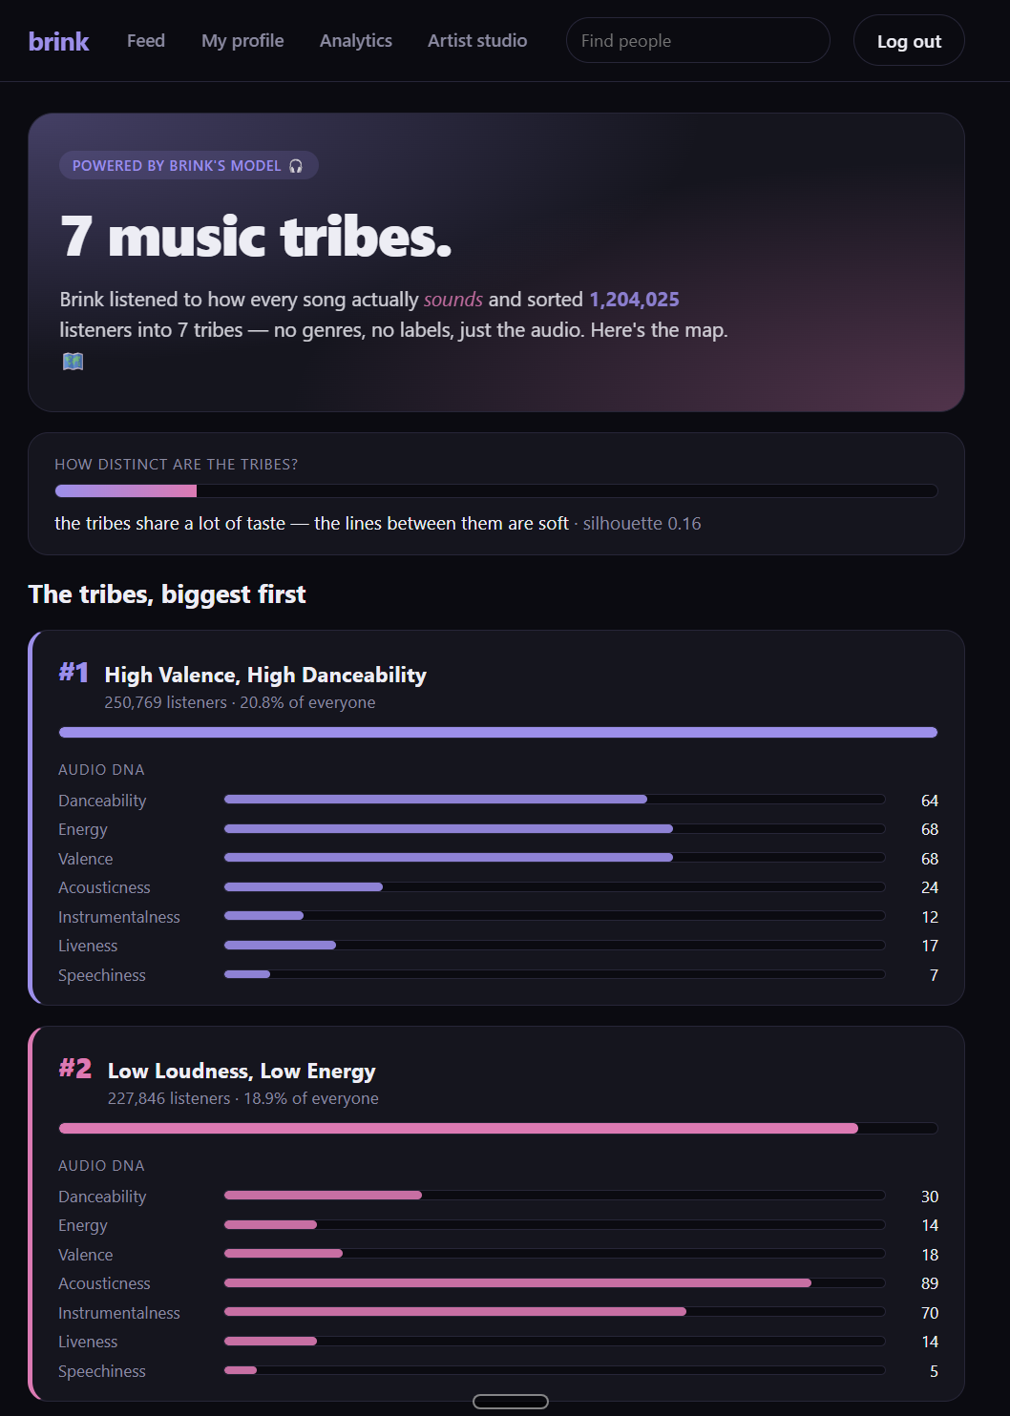
JONAH · 1:30
The model, in two parts
Once a night: we cluster ~1.2M songs by their sound
• (danceable, energetic, upbeat…) into 7 taste communities.
When you open a profile: we place that person's songs against
• the communities and find where they fit.
• Compatibility = how close two people's taste profiles are.
• Nothing's hard-coded — retrain tonight, the app updates tomorrow.
Notes:
JONAH (1:30): The model is in two parts. Once a night, we train a clustering model on about 1.2 million songs, using audio features like how danceable or energetic or upbeat a track is — that sorts songs into seven taste communities. Then, when you actually open someone's profile, we take the songs they've played, place them against those communities, and find where they fit. Compatibility between two people is just how close their two taste profiles are. And nothing is hard-coded — if we retrain the model tonight, the app picks up the new version tomorrow. This page is that model's output, live.

Slide 12
JONAH · 0:45
Being honest about the limits
• The math actually liked just 2 groups — we chose 7 on purpose, and we say so.
• Only ~a quarter of songs matched our dataset — we report that, we don't hide it.
We planned a second model (song popularity) and cut it — the data couldn't support it.
• We wrote down why. We'd rather show the real picture than a polished one.
Notes:
JONAH (0:45): We also want to be upfront about the limits, because we think that matters. The math actually suggested only two groups was cleanest — but two isn't very interesting as 'communities,' so we chose seven on purpose, and we say that openly. Only about a quarter of songs matched our dataset, and we report that honestly rather than hiding it. And we'd planned a second model to predict song popularity, but the data just couldn't support it honestly, so we cut it — and wrote down why. We'd rather show you the real picture than a polished one. Sebastian will show where all this shows up in the app.

Slide 13
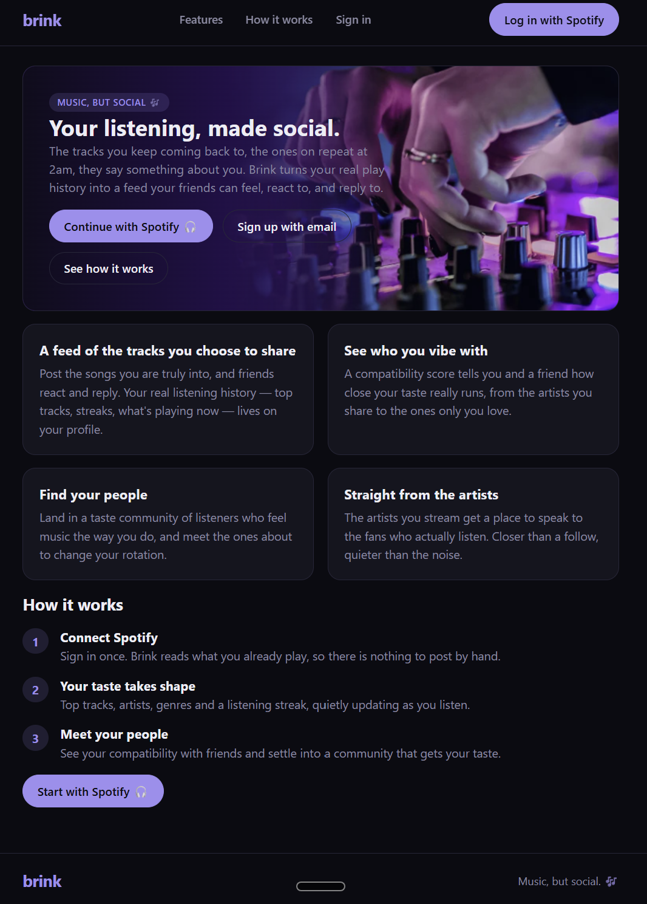
SEBASTIAN · 1:00
One look, five pages
• Dark, calm, music-first — a lavender & pink accent throughout.
Landing · Feed · Profile · Artist studio · Analytics
• No separate app to build — the pages come from the same server,
• with light JavaScript for the interactive bits.
• That kept it fast, and simple for a small team to maintain.
Notes:
SEBASTIAN (1:00): The whole frontend has one consistent look — dark, calm, music-first, with a lavender-and-pink accent. There are five pages: the landing page, the feed, profiles, an artist studio, and the analytics page. There's no separate app to build — the pages come straight from the same server, with just a bit of JavaScript for the interactive parts. That kept everything fast to load and simple for a small team to keep up with.

Slide 14
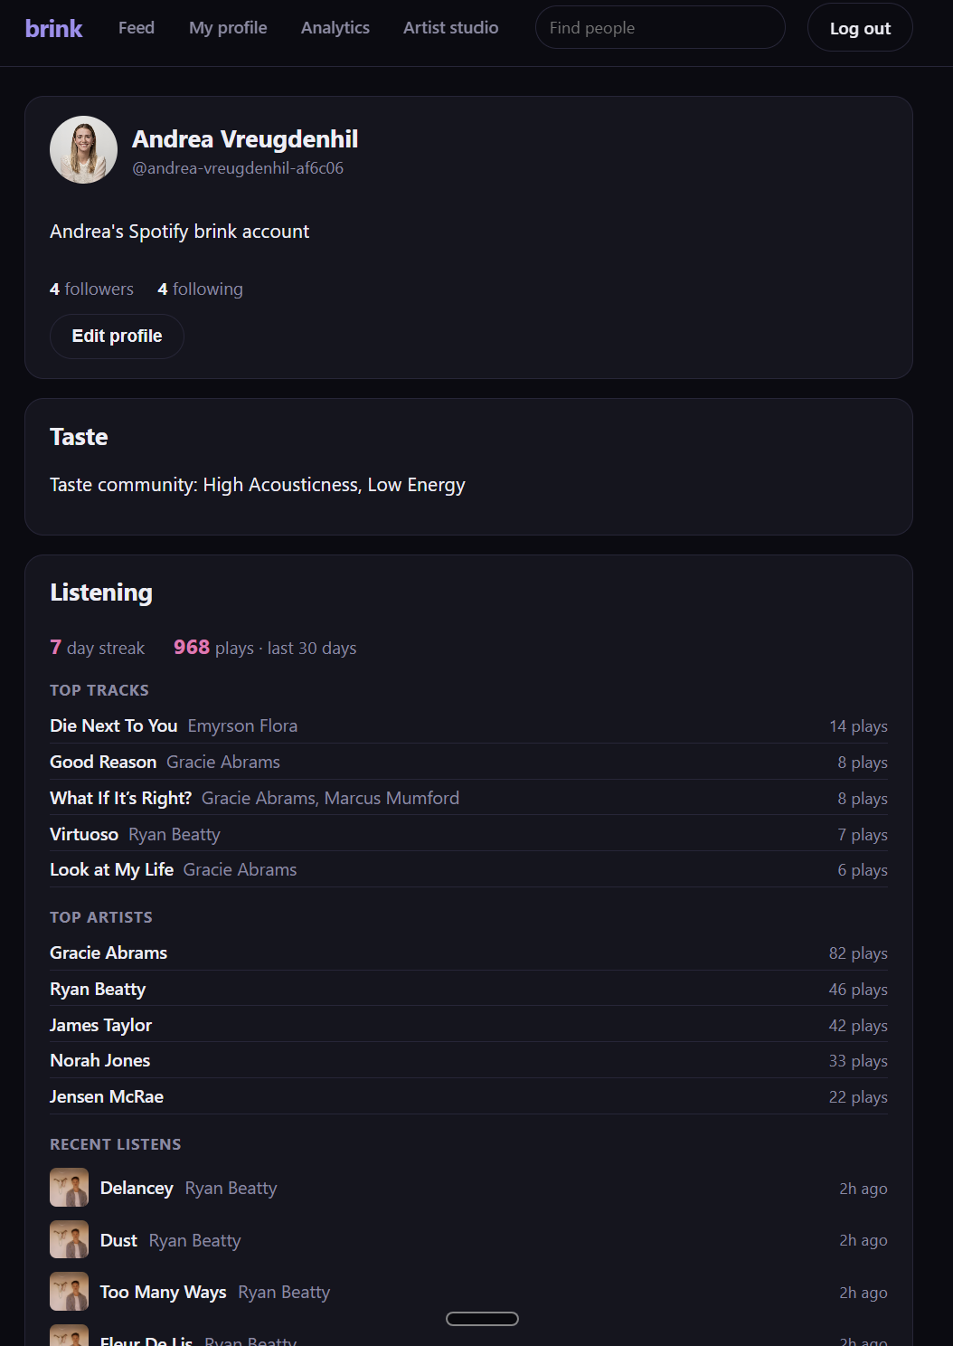
SEBASTIAN · 0:45
The small touches
Tap the album art — a Spotify player opens right in the card.
A 'liked by' line, and double-tap to heart, like you'd expect.
One tap to share whatever you're playing right now.
• Every empty screen has a friendly nudge, not a blank space.
Notes:
SEBASTIAN (0:45): The small touches are what make it feel like a real social app. Tap the album art and a Spotify player opens right there in the card. There's a 'liked by' line, and you can double-tap to heart a song like you'd expect. There's a one-tap button to share whatever you're playing right now. And every empty screen — no posts yet, nothing playing — has a friendly nudge instead of a blank space. Let me just show you the real thing.

Slide 15
SEBASTIAN drives · Jonah + Andrea narrate · 2:30
Let's look at the real thing
• brink-xg7p.onrender.com
• 1. Feed — scroll, tap the art to play, react and comment
• 2. Share — post the track I'm listening to right now
• 3. Profile — taste community + how compatible we are (Andrea)
• 4. Analytics — the 7 communities and their 'audio DNA' (Jonah)
Warm the site up first. The next slides are screenshots, as a backup.
Notes:
SEBASTIAN drives (~2:30). Pre-warm the site so there's no wait. 1) Feed: 'this is the live app' — scroll, tap album art so a song plays in the card, react and drop a comment. 2) Share: use the one-tap 'share what you're playing' and post it. 3) Profile (Andrea narrates): open someone else's profile — their streak, top tracks, their taste community, and since it's not me, a compatibility score, all worked out live. 4) Analytics (Jonah narrates): the seven communities, how distinct they are, and each one's audio DNA — real numbers from last night's run. IF ANYTHING BREAKS: switch to the screenshots on the next slides.

Slide 16
Landing — sign in; your listening becomes the feed
Notes:
Demo backup / reference: Landing — sign in; your listening becomes the feed

Slide 17
Feed — songs play in place, with reactions & comments
Notes:
Demo backup / reference: Feed — songs play in place, with reactions & comments

Slide 18
Profile — taste community + how compatible you are
Notes:
Demo backup / reference: Profile — taste community + how compatible you are

Slide 19
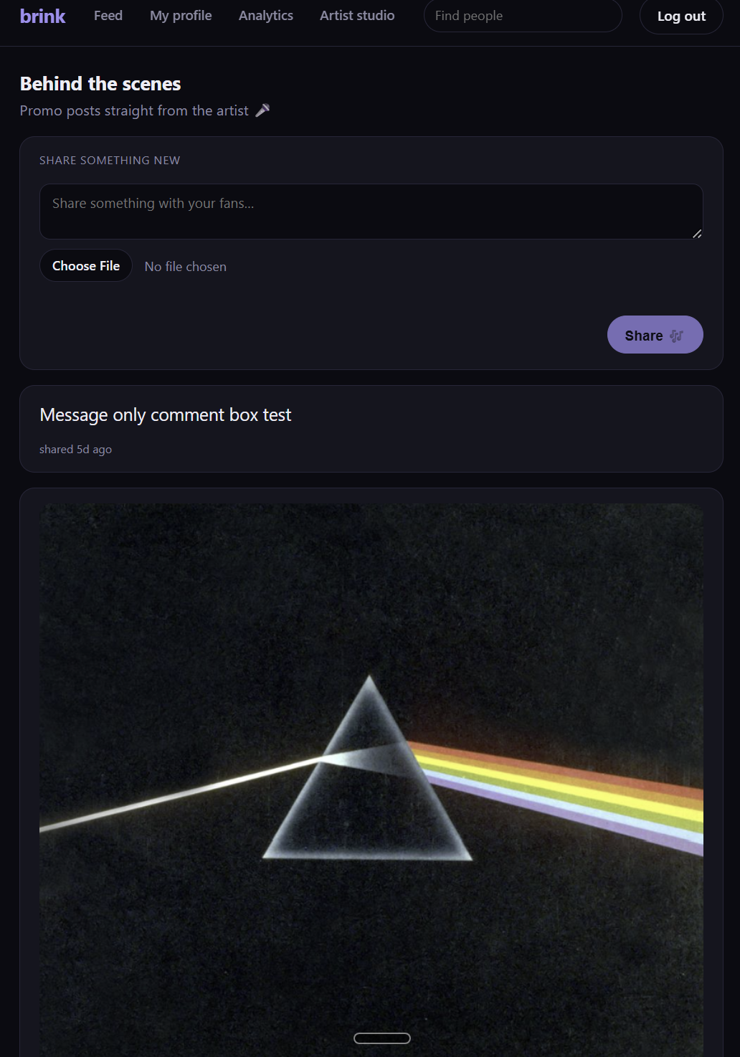
Artist studio — behind-the-scenes posts
Notes:
Demo backup / reference: Artist studio — behind-the-scenes posts

Slide 20
Analytics — the model's real output: communities & audio DNA
Notes:
Demo backup / reference: Analytics — the model's real output: communities & audio DNA

Slide 21
ALL · 0:45
What we took away
The AI was only as good as the context and structure we gave it. (Andrea)
Being honest about the model's limits made it more convincing, not less. (Jonah)
One codebase and one look let three people move without stepping on each other. (Sebastian)
Notes:
ALL (0:45), one line each. ANDREA: the biggest lesson for me was that the AI was only ever as good as the context and structure we gave it — the planning up front was the whole game. JONAH: being honest about the model's limits made it more convincing, not less. SEBASTIAN: keeping it to one codebase and one consistent look is what let three of us move fast without stepping on each other.

Slide 22
Brink — Music, but social. 🎶
Thanks — happy to take questions.
brink-xg7p.onrender.com
Notes:
ANDREA (0:15): That's Brink — live, and built by the three of us. Thanks for listening — we're happy to take any questions.

