Slide 1
Studio Visitor web app
Jessica Kincaid
@j-kincaid

Slide 2
Description
A virtual tour guide to complement the experience of attending an art event. Specifically, to assist attendees of an Open Studios event where the public is invited to tour a shared artists’ work space.

Slide 3
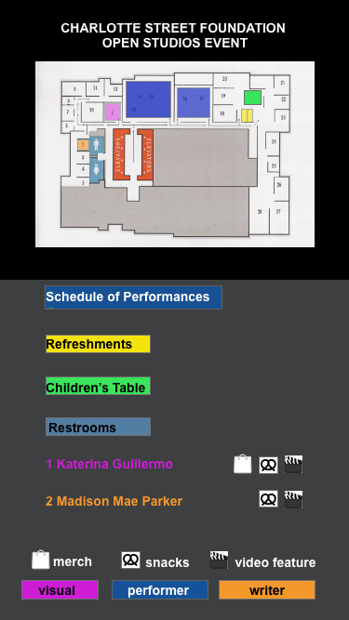
Features
Interactive studio map
Menu locating Refreshments, Restrooms and Children’s area
Directory for artists
by name, corresponding to highlighted locations on map
Link to
Performance schedule page

Slide 4
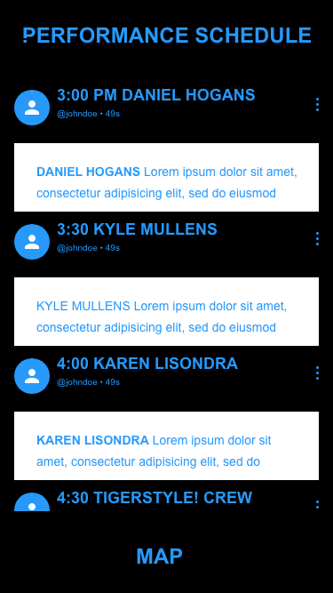
Features
Schedule of performances, updating in real time

Slide 5
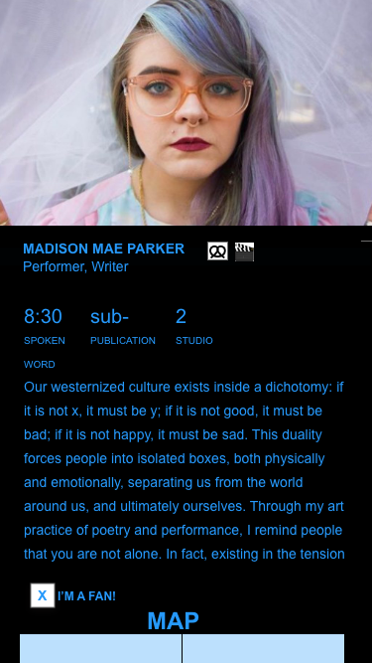
Features
Profile page for each artist
by name, with 120-word bio and profile image. Small icons indicate snacks, items for sale, and presence in video compilation.

Slide 6
Planning- User Stories
The user can locate Refreshments, Restrooms and Children’s area on map
The User can select an artist by name and find their space on the map
The user can link to the performance schedule

Slide 7
Planning- User Stories
The User can create an account to sign up for newsletter/raffle
The User can track if they have visited each artist by checking “I’m a fan!”

Slide 8
Technology Stack
JavaScript/jQuery
React JS
Firebase for visitors to track which studios they have visited
Visit tracking uses cookies only while visitors are at event
Optional signup for raffle and newsletter (connects with “I’m a fan!” checkbox)

Slide 9
What I am learning
Interviewing a client
React
Creating user stories
Firebase

Slide 10
What’s Next
Collect artist profile content from client
Map interactivity
User Account Creation
Cookies

