Slide 1
Global Variation in Sequence Accessions Over Time
Implications for the Cali Fund and DSI Benefit-Sharing
13 October 2026

Slide 2
Why this matters
The multilateral mechanism for benefit-sharing from digital sequence information (DSI), agreed at COP16 in Cali, includes a fund to which users of DSI are expected to contribute.
A central question is how to allocate those funds among eligible countries. One proposed basis is the geographic distribution of sequence records in public databases: countries that are the source of many sequenced organisms might be considered to have contributed more to the global commons.
This report tests whether INSDC provenance data are fit for that purpose. It does not prescribe a formula. Rather, it examines whether the data are complete enough, fair enough, and stable enough to support an allocation methodology.
INSDC: International Nucleotide Sequence Database Collaboration, comprising ENA (Europe), DDBJ (Japan), and NCBI (USA). The three databases exchange data daily.

Slide 3
Methodology: Data source and scope
What was counted and what was excluded
All counts were obtained from the European Nucleotide Archive (ENA) Portal API, which provides programmatic access to metadata for biological samples deposited in INSDC databases. ENA is the European partner of INSDC, which also includes DDBJ and NCBI. The three databases exchange data daily, so counts from ENA are representative of global holdings.
The analysis uses the sample record type, corresponding to one record per biological sample deposited. This is the appropriate unit for provenance questions because a single sample may generate multiple sequencing runs, and counting runs would inflate the numbers.
Three categories of records were excluded:
  Human organism records, which are not relevant to biodiversity benefit-sharing
  Human microbiome samples, where the host organism is a human
  Synthetic constructs, which do not correspond to biological genetic resources
After applying these filters, the total record count was 30,313,212. This figure was verified by an independent query to the ENA API on the same date and matches exactly.

Slide 4
Methodology: Country attribution
How records were assigned to countries
Each record has a country of collection recorded in a geographic location field. The analysis queried 378 distinct values: 296 from the INSDC controlled vocabulary plus 82 additional values identified through systematic sampling (alternative country names, locality names, placeholders).
The database uses token-based matching: a query for a short country name matches any record where that name appears as a word anywhere in the field. This creates false matches, for example when querying Mexico and matching records from USA: New Mexico.
Twenty collision exclusions were applied to prevent these false matches, covering cross-country pairs (Guinea matching Papua New Guinea), sub-national pairs (Mexico matching the US state of New Mexico), and ocean name overlaps (China matching South China Sea).
Raw values were aggregated onto 267 sovereign countries using UN M.49 and World Bank income classifications. Historical names with multiple successor states (USSR, Yugoslavia) were set aside.

Slide 5
Methodology: Temporal anchor
How records were assigned to years
Each record was assigned to a year based on the date it was first made publicly available. This date is set by the database, not by the submitter, and is therefore a reliable indicator of when the record entered the public domain.
Annual counts cover 2018 through 2026, with 2026 including only January to October because the snapshot was taken on 13 October 2026. A pre-2018 bucket captures older records, and an undated bucket captures records with no public release date.
Approximately 21.5 per cent of records have no date recorded. These undated records are reported separately rather than being distributed across years. This means that annual counts are partial censuses, not complete enumerations.
The dated share varies by country, which introduces temporal bias. Countries with poor date metadata will appear to have fewer records in annual counts relative to their true total.

Slide 6
What can be attributed to a country?
Nearly two-thirds of records; the rest cannot be assigned
Attribution status | Record count | Per cent of total
Attributed to a sovereign country | 18,987,186 | 62.6%
No country field present | 7,695,501 | 25.4%
Non-country value (oceans, placeholders) | 3,920,292 | 12.9%
Historical (multi-successor states) | 20,143 | 0.1%
Total | 30,313,212 | 100%
38.3 per cent of all records cannot be attributed to any country. This is either because no country was recorded, the recorded value is a placeholder such as missing or NULL, or the value is a geographic feature such as an ocean rather than a political jurisdiction.
This is a critical finding for any proposal to use these data as an allocation basis: more than a third of records would be excluded from a country-level formula, and the excluded fraction is not randomly distributed.

Slide 7
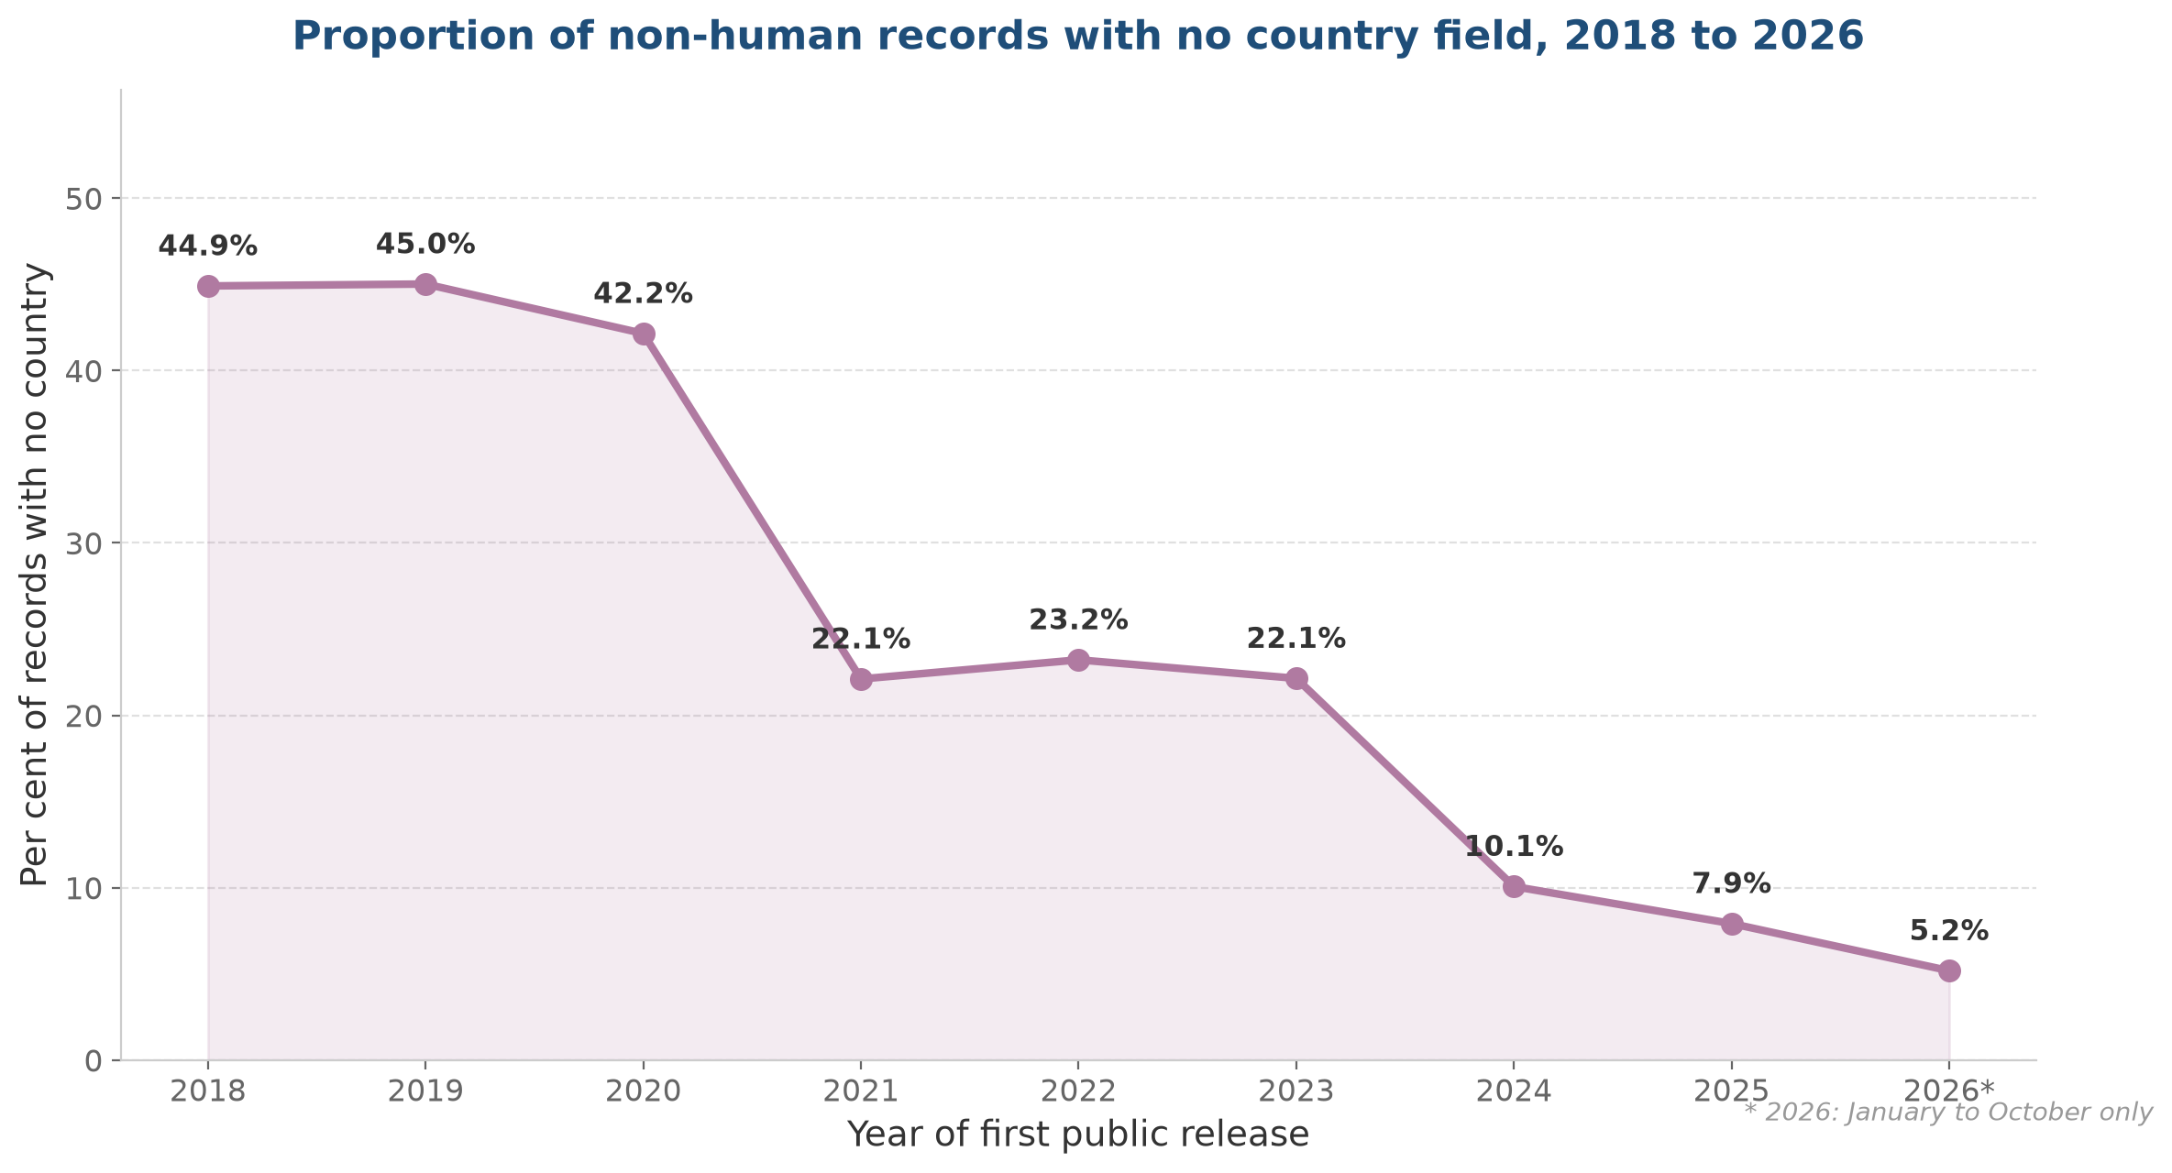
Records without a country field over time
Share of annual records with no country recorded, 2018 to 2026
What this shows
The share of records with no country field has fallen dramatically, from 44.9 per cent in 2018 to 5.2 per cent in 2026.
The sharpest drop occurred in 2021, when COVID-19 surveillance records flooded the database. These records typically included proper country metadata.
The trend suggests improving data submission practices over time, which is encouraging for future use of these data.
However, the overall figure of 38.3 per cent without a country (across all years) reflects the historical backlog of poorly annotated records.
Source: ENA Portal API, 13 October 2026. *2026 covers January to October only. Percentage is unattributed records divided by total records for each year.

Slide 8
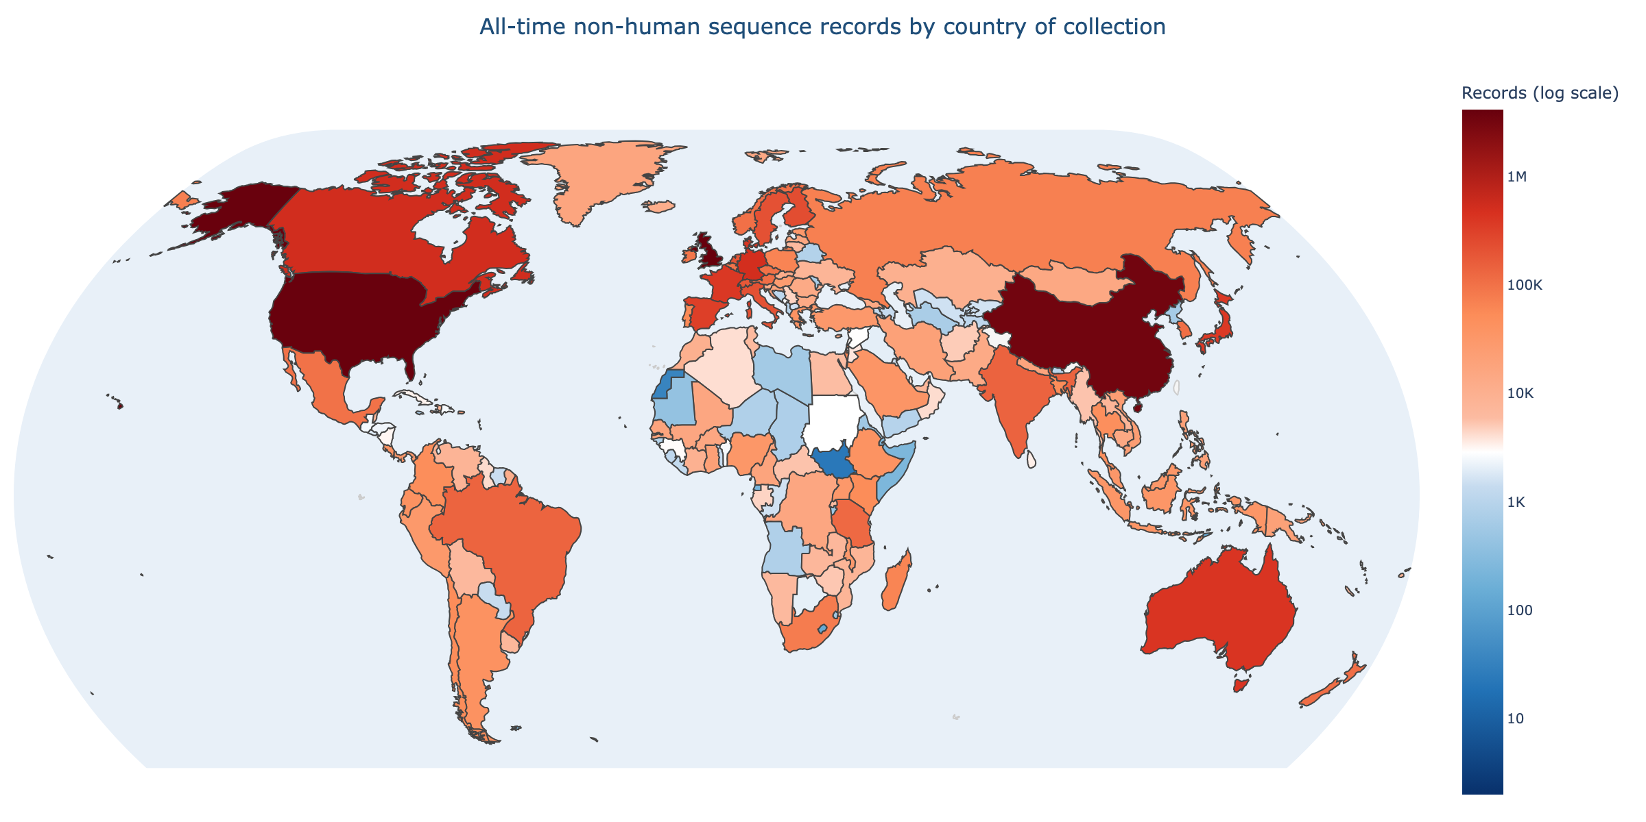
All-time sequence records by country
Total non-human records attributed to each country, all years combined
Colour scale is logarithmic and identical on both maps: dark blue indicates the fewest records (around 2), white indicates approximately 4,000 records (the median country), and dark red indicates the most records (over 4 million). Using the same scale on both maps allows direct visual comparison: a country that appears lighter on the post-2023 map has fewer recent records than its all-time total.

Slide 9
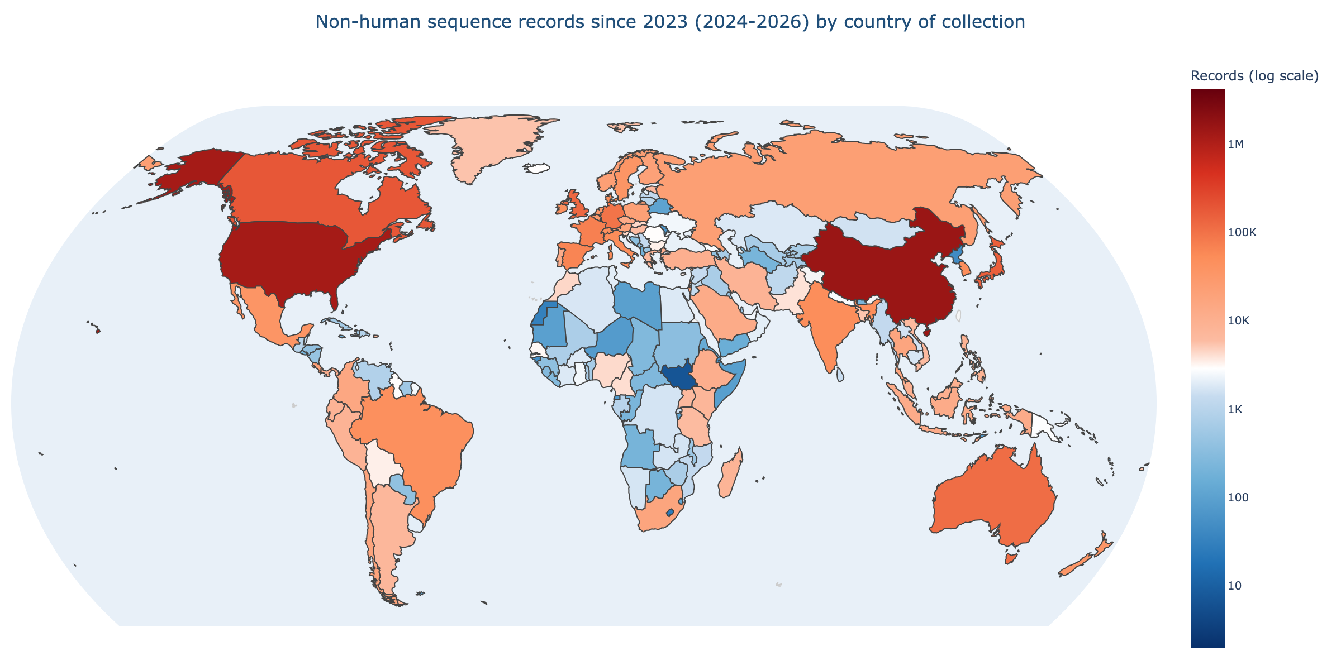
Sequence records since 2023 by country
Records with a first public release date in 2024, 2025, or 2026 (January to October)
Same colour scale as the all-time map above, allowing direct comparison. Countries that appear lighter on this map have fewer recent records than their all-time total. The dominance of the United Kingdom is greatly reduced because COVID-19 surveillance records were deposited primarily in 2021 to 2023. China and the United States remain dominant, while emerging activity is visible in Brazil, India, and several African countries.

Slide 10
Developed versus developing countries
The gap is narrowing, but from a very high level
Year | Developed | Developing | Developed share
2018 | 384,484 | 133,652 | 74.2%
2020 | 774,188 | 331,632 | 69.9%
2021 | 2,272,486 | 454,492 | 83.3%
2024 | 998,971 | 723,822 | 58.0%
2026 (Jan-Oct) | 561,709 | 540,012 | 50.9%
Overall, developed countries hold 70.4 per cent of all country-attributed records and developing countries hold 29.5 per cent.
The developed-country share fell from 74.2 per cent in 2018 to 50.9 per cent in the first ten months of 2026. This is a genuine shift, but it is not smooth.
The 2021 surge to 83.3 per cent was caused by COVID-19 genomic surveillance, particularly the COG-UK consortium in the United Kingdom.
The convergence visible in 2026 is driven primarily by rapid growth in China and a handful of other upper middle income countries, not by broad-based gains across the developing world.

Slide 11
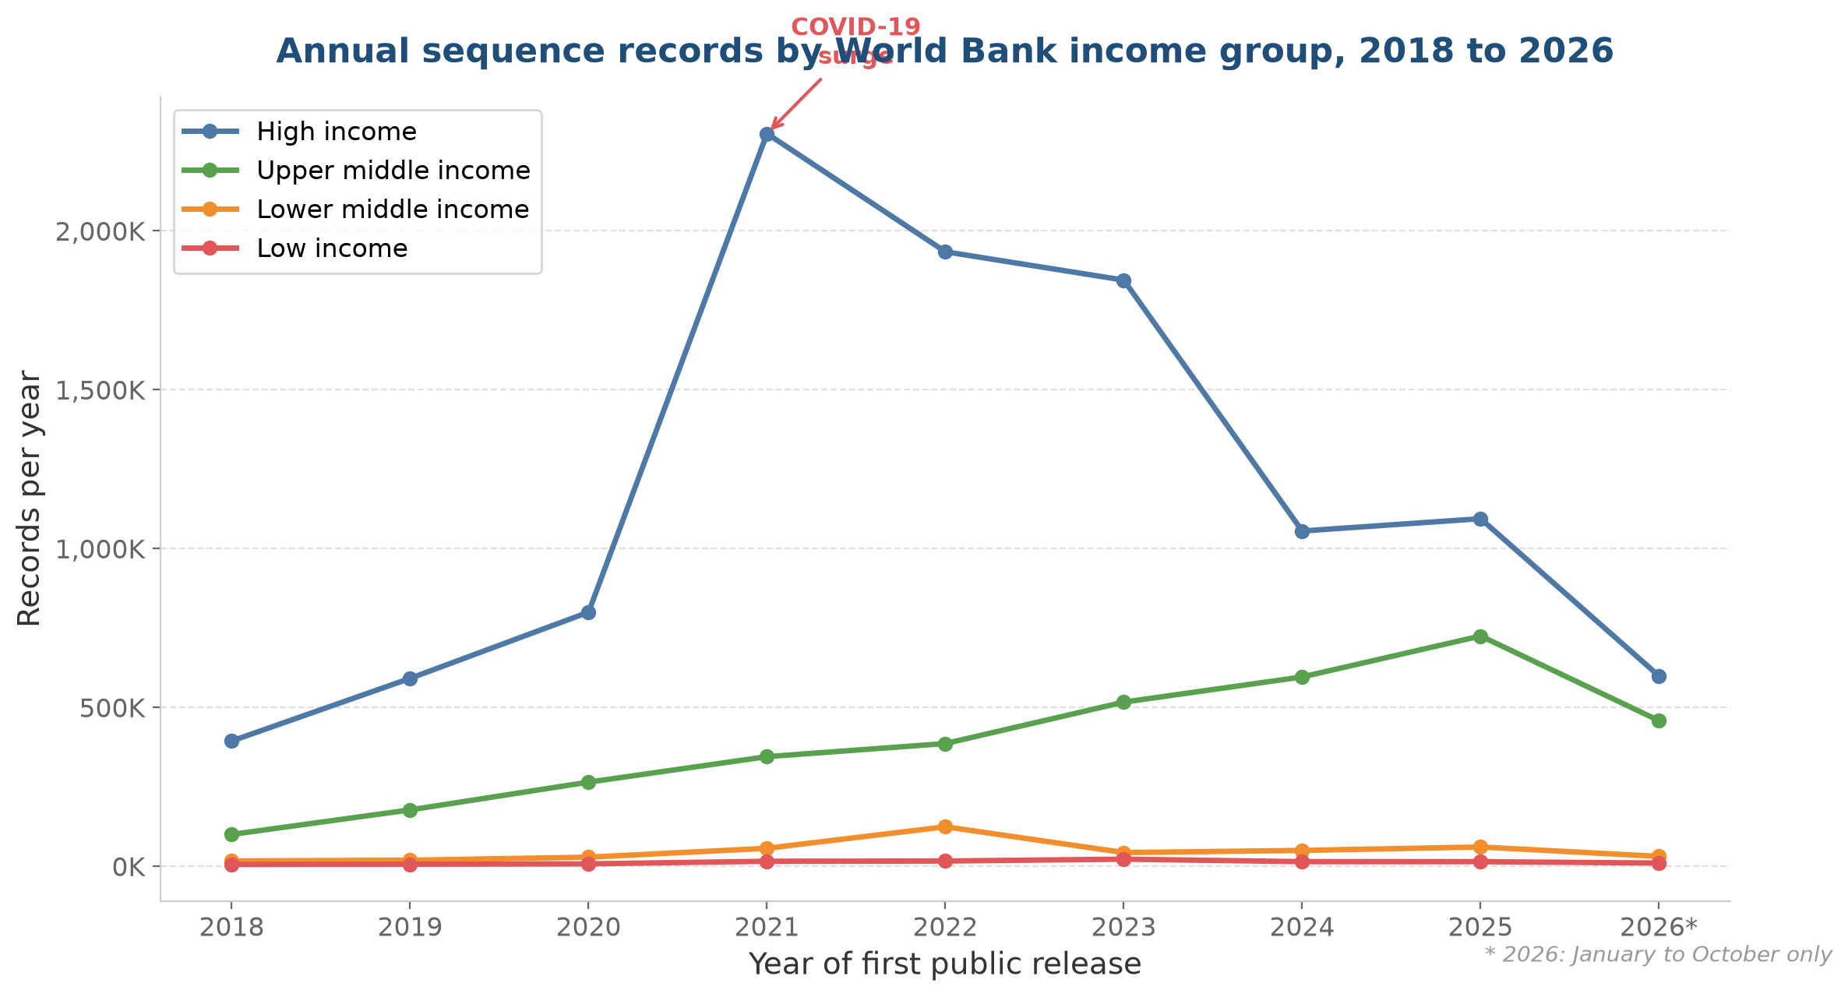
Trends over time by income group
Annual record counts by World Bank income classification, 2018 to 2026
What this shows
High-income countries (blue) dominate throughout, but their annual output peaked in 2021 during the COVID-19 surge and has since declined sharply.
Upper middle income countries (green), led by China, have grown steadily and are now approaching parity with high-income countries.
Lower middle income and low-income countries (orange and red) remain far behind, together accounting for only 5 per cent of annual records.
The convergence is the clearest structural trend, but it is driven substantially by a single country.
Source: ENA Portal API, 13 October 2026. *2026 covers January to October only.

Slide 12
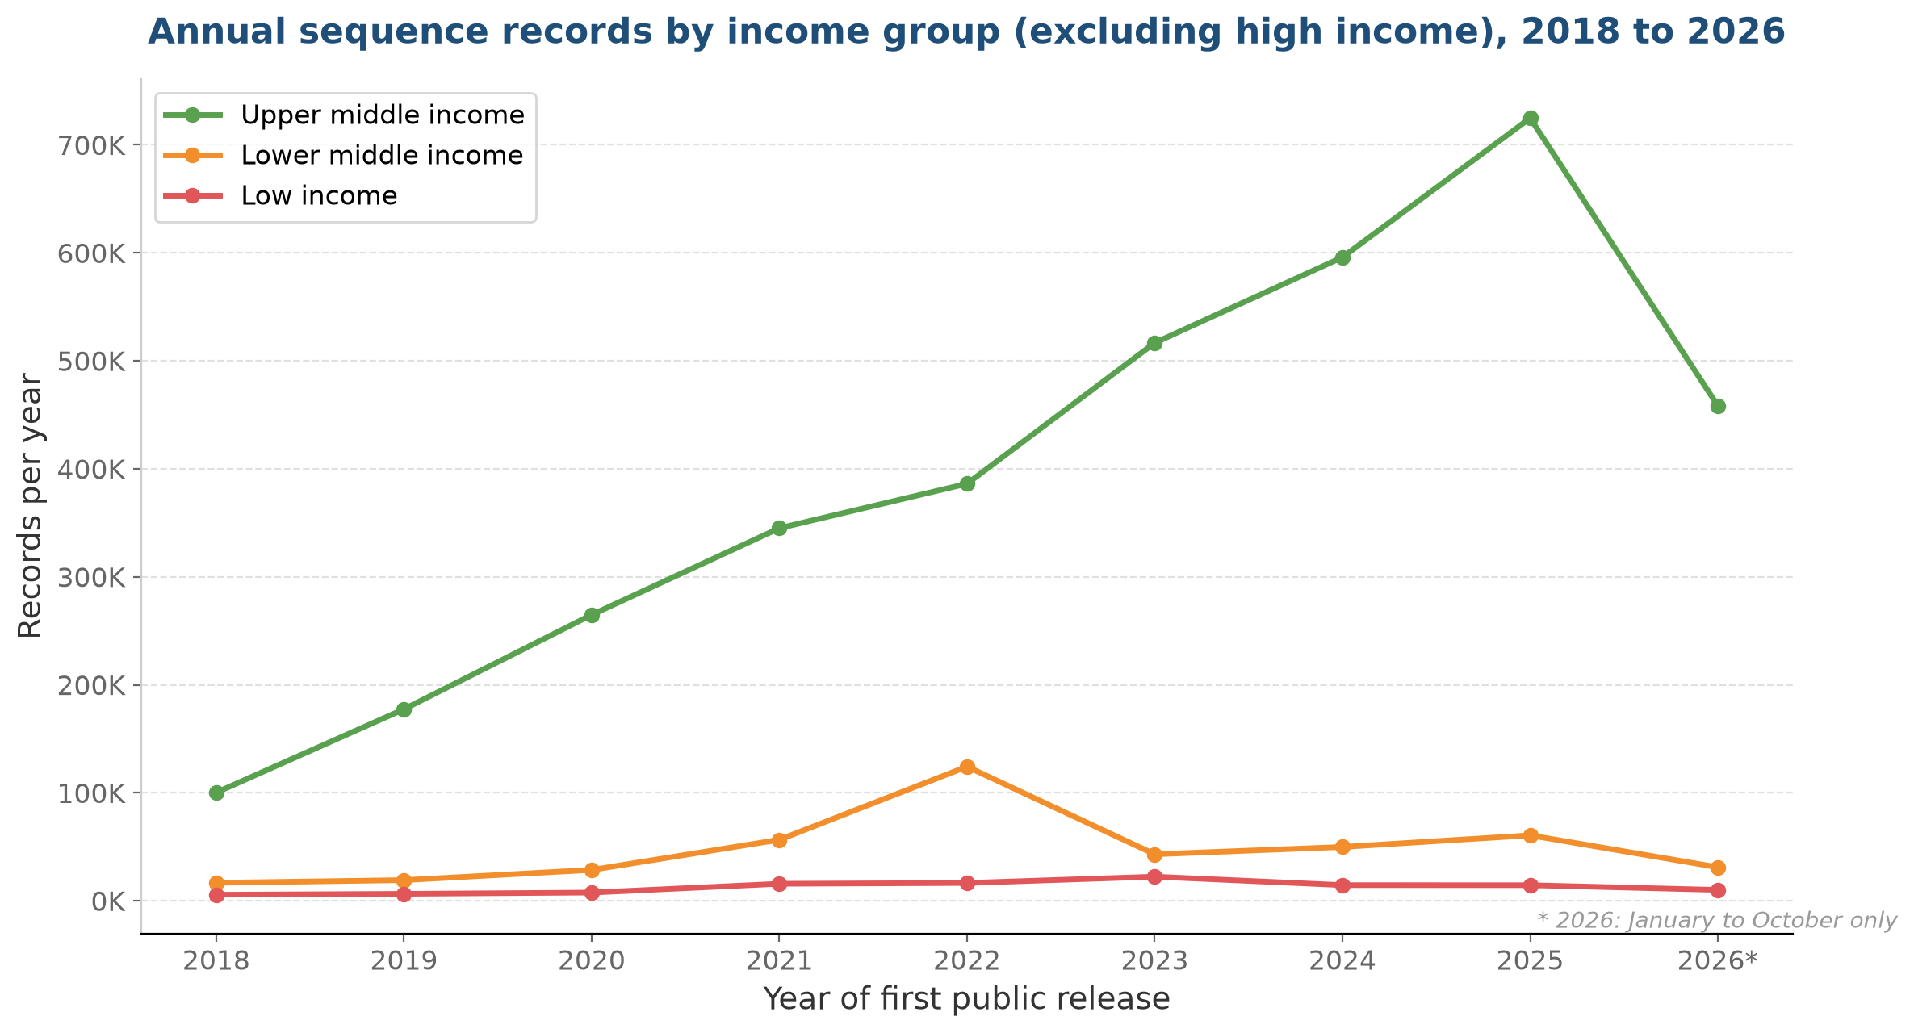
Income group trends excluding high income
Annual record counts for upper middle, lower middle, and low income countries, 2018 to 2026
What this shows
With high-income countries removed, the scale differences between the remaining three groups become visible.
Upper middle income countries (green) dominate this view, reaching over 700,000 records per year by 2025, driven largely by China.
Lower middle income countries (orange) peaked in 2022 at 124,000 records, partly from a single large project, then fell back.
Low-income countries (red) remain below 25,000 records per year throughout. The gap between upper middle and low income is roughly 30-fold.
Source: ENA Portal API, 13 October 2026. *2026 covers January to October only. High-income countries excluded to show scale differences among the remaining groups.

Slide 13
Income group distribution
Concentration at the top, scarcity at the bottom
Income group | Countries | Records | Share
High income | 82 | 13,806,686 | 72.7%
Upper middle income | 54 | 4,163,957 | 21.9%
Lower middle income | 52 | 684,992 | 3.6%
Low income | 26 | 261,334 | 1.4%
High-income countries hold nearly three-quarters of all records. Upper middle income countries, led by China, hold just under a quarter. Lower middle income and low-income countries together account for only 5.0 per cent, despite containing 78 countries between them.
Comparing 2021-2023 with 2024-2026, upper middle income countries grew by 43 per cent on an annualised basis, while high-income countries declined by 55 per cent. This is the strongest evidence of a structural shift, though the decline is partly the natural end of the COVID-19 surge.

Slide 14
Vulnerable country groups
LDCs, SIDS, and LLDCs remain far behind
Group | Countries | Records | Share
LDCs | 47 | 527,519 | 2.8%
SIDS | 51 | 218,743 | 1.2%
LLDCs | 32 | 235,701 | 1.2%
The Canada comparison
47 LDCs combined: 527,519 records
Canada alone: 530,725 records
LDC records are highly volatile. A 407 per cent surge in 2022 was driven by a few large projects, not broad-based capacity growth. The following year, LDC records fell by 71 per cent. This illustrates how dependent these counts are on individual projects and funding cycles, rather than durable institutional capacity.
The thin margin between 47 LDCs and a single G7 economy (approximately 3,200 records) could reverse with one large deposition. This fragility is itself a finding relevant to the Cali Fund equity objectives.

Slide 15
Regional distribution
Europe dominates, Africa persists at the bottom
Region | Countries | Records | Share
Europe | 49 | 7,768,889 | 40.9%
Americas | 53 | 5,217,623 | 27.5%
Asia | 50 | 4,654,034 | 24.5%
Africa | 58 | 688,721 | 3.6%
Oceania | 26 | 605,378 | 3.2%
Europe holds 40.9 per cent of all country-attributed records, more than any other region. This is heavily influenced by the United Kingdom, which alone accounts for 21.8 per cent of the country total, mostly from the COG-UK pandemic surveillance programme.
Without the UK, Europe share would fall to approximately 19 per cent, closer to the Americas and Asia.
Africa, despite having 58 classified countries, holds only 3.6 per cent of records. This share has remained roughly constant throughout the period studied.
At the sub-regional level, Northern Europe and Northern America together hold over half of all records.

Slide 16
Three countries dominate
UK, USA, and China account for over 60 per cent of records
Rank | Country | Records | Share
1 | United Kingdom | 4,143,928 | 21.8%
2 | United States | 4,018,537 | 21.2%
3 | China | 3,357,157 | 17.7%
4 | Canada | 530,725 | 2.8%
5 | Germany | 510,489 | 2.7%
6 | Australia | 424,457 | 2.2%
7 | Denmark | 403,788 | 2.1%
8 | France | 388,062 | 2.0%
9 | Japan | 380,094 | 2.0%
10 | Spain | 331,748 | 1.7%
The United Kingdom, the United States, and China together account for 60.7 per cent of all country-attributed records. No other country reaches 3 per cent.
This concentration is a critical consideration for any allocation formula. A formula based on raw record counts would channel most benefits to a small number of countries that already have substantial sequencing capacity, undermining the equity objectives of the Cali Fund.
The UK count is inflated by the COG-UK consortium, which deposited over 1.5 million SARS-CoV-2 records in 2021. Without these pandemic records, the UK would rank below China and the USA.

Slide 17
The COVID-19 distortion
Pandemic surveillance severely distorts temporal trends
In 2021, UK records jumped from 162,561 to 1,651,232, a tenfold increase driven by the COVID-19 Genomics UK (COG-UK) consortium. Similar surges occurred in the United States and other developed countries with large genomic surveillance programmes.
This single event inflated the developed-country share by approximately 13 percentage points, from 69.9 per cent in 2020 to 83.3 per cent in 2021. The pandemic records are SARS-CoV-2 sequences, not biodiversity DSI, and they are not representative of the underlying trend.
The decline from 2021 onwards reflects two forces: the winding down of pandemic surveillance in developed countries, and continued growth in developing-country sequencing, particularly from China. It is not yet clear whether the convergence visible in 2026 will be sustained once pandemic records are no longer distorting the baseline.
To assess genuine trends in biodiversity DSI, a sensitivity view excluding SARS-CoV-2 records would be needed. This was not available for this report but should be a priority for future analysis.

Slide 18
Temporal trends: Three periods compared
Pre-pandemic, pandemic, and post-pandemic annual averages
Group | 2018-2020/yr | 2021-2023/yr | Change | 2024-2026/yr | Change
Developed | 577,721 | 1,985,212 | +244% | 865,856 | -56%
Developing | 229,487 | 556,709 | +143% | 709,245 | +27%
LDCs | 10,796 | 57,817 | +436% | 22,009 | -62%
SIDS | 9,617 | 24,792 | +158% | 20,408 | -18%
LLDCs | 7,292 | 19,763 | +171% | 14,088 | -29%
The pandemic period saw dramatic growth across all groups, but the growth was far larger for developed countries (+244 per cent) than for developing countries (+143 per cent). This widened the absolute gap even as it temporarily increased the developed-country share.
In the post-pandemic period, developed-country records declined by 56 per cent from their pandemic peak, while developing-country records continued to grow, by 27 per cent. For the first time in the period studied, developing countries are generating more records per year than developed countries, though the 2026 figure is based on partial-year data.
All vulnerable country groups saw their records decline from pandemic peaks, suggesting that pandemic-era growth was project-specific and temporary.

Slide 19
Can INSDC data support allocation?
Four problems stand out
1. Incompleteness
  38.3 per cent of records cannot be attributed to any country, and 21.5 per cent have no date. The excluded fraction is not random.
2. Concentration
  Three countries account for 60.7 per cent of records. A formula based on raw counts would channel benefits to countries that already have substantial sequencing capacity.
3. Distortion
  COVID-19 pandemic records severely distort temporal trends. The UK alone deposited 1.65 million records in 2021, ten times its 2020 count.
4. Mismatch
  The country field records where a sample was collected, not who sequenced it. A Kenyan sample sequenced in the UK appears as Kenya.

Slide 20
Conclusion and policy implications
INSDC provenance data should inform, but not determine, Cali Fund allocation decisions.
The data are useful for identifying broad patterns of inequality, for monitoring trends over time, and for highlighting the specific needs of regions and country groups. They are not suitable as a direct input to an allocation formula because they are too incomplete, too concentrated, and too distorted by external events.
A more robust approach might combine INSDC data with other indicators:
  Biodiversity richness (for example, species counts from GBIF)
  Sequencing capacity (for example, number of sequencing facilities per country)
  Economic need (for example, GDP per capita or LDC/SIDS/LLDC status)
The Cali Fund allocation methodology should be a matter for Parties to negotiate, informed by evidence but not determined by it.

Slide 21
Limitations
Snapshot: All counts are a point-in-time snapshot taken on 13 October 2026. The database grows daily.
Partial year: 2026 covers January to October only.
Undated records: 21.5 per cent have no public release date. Annual counts are partial censuses.
Data quality: The country field is submitter-populated and not standardised.
Metagenomes: Environmental metagenomes (27.7 per cent) are included and inflate counts for some countries.
Collection versus contribution: The country field records collection locality, not the sequencing institution.

Slide 22
Thank you
Questions and discussion welcome
Full report: Global Variation in Sequence Accessions Over Time
13 October 2026

