Slide 1
Global Variation in Sequence Accessions Over Time
[DRAFT]
Implications for the Cali Fund and DSI Benefit-Sharing
Jasmine Kindness, TierraViva AI, 16 October 2026

Slide 2
Why this matters
The multilateral mechanism for benefit-sharing from digital sequence information (DSI), agreed at COP16 in Cali, includes a fund to which users of DSI are expected to contribute.
A central question is how to allocate those funds among eligible countries. One proposed basis is the geographic distribution of sequence records in public databases: countries that are the source of many sequenced organisms might be considered to have contributed more to the global commons.
This report tests whether INSDC provenance data are fit for that purpose. It examines whether the data are complete enough, fair enough, and stable enough to support an allocation methodology.
This analysis was conducted to provide the best information possible in the time available. It has not been peer reviewed.

Slide 3
Methodology: Data source and scope
What was counted and what was excluded
All counts were obtained from the European Nucleotide Archive (ENA) Portal API, which provides programmatic access to metadata for biological samples deposited in INSDC databases. ENA is the European partner of INSDC, which also includes DDBJ and NCBI. The three databases exchange data daily, so counts from ENA are representative of global holdings.
The analysis uses the sample record type, corresponding to one record per biological sample deposited. This is the appropriate unit for provenance questions because a single sample may generate multiple sequencing runs, and counting runs would inflate the numbers.
Three categories of records were excluded:
  Human organism records, which are not relevant to biodiversity benefit-sharing
  Human microbiome samples, where the host organism is a human
  Synthetic constructs, which do not correspond to biological genetic resources
After applying these filters, the total record count was 30,313,212.

Slide 4
Methodology: Country attribution
How records were assigned to countries
Each record has a country of collection recorded in a geographic location field. The analysis queried 378 distinct values: 296 from the INSDC controlled vocabulary plus 82 additional values identified through systematic sampling (alternative country names, locality names, placeholders).
The database uses token-based matching: a query for a short country name matches any record where that name appears as a word anywhere in the field. This creates false matches, for example when querying Mexico and matching records from USA: New Mexico.
Twenty collision exclusions were applied to prevent these false matches, covering cross-country pairs (Guinea matching Papua New Guinea), sub-national pairs (Mexico matching the US state of New Mexico), and ocean name overlaps (China matching South China Sea).
Raw values were aggregated onto 267 sovereign countries using UN M.49 and World Bank income classifications. Historical names with multiple successor states (USSR, Yugoslavia) were set aside.

Slide 5
Methodology: Temporal anchor
How records were assigned to years
Each record was assigned to a year based on the date it was first made publicly available. This date is set by the database, not by the submitter, and is therefore a reliable indicator of when the record entered the public domain.
Annual counts cover 2018 through 2026, with 2026 including only January to October because the snapshot was taken on 13 October 2026. A pre-2018 bucket captures older records, and an undated bucket captures records with no public release date.
Approximately 21.5 per cent of records have no date recorded. These undated records are reported separately rather than being distributed across years. This means that annual counts are partial censuses, not complete enumerations.
The dated share varies by country, which introduces temporal bias. Countries with poor date metadata will appear to have fewer records in annual counts relative to their true total.

Slide 6
What can be attributed to a country?
Nearly two-thirds of records; the rest cannot be assigned
Attribution status | Record count | Per cent of total
Attributed to a sovereign country | 18,934,645 | 62.5%
No country field present | 7,695,501 | 25.4%
Non-country value (oceans, placeholders) | 3,662,923 | 12.1%
Historical (multi-successor states) | 20,143 | 0.1%
Total | 30,313,212 | 100%
37.5 per cent of all records cannot be attributed to any country. This is either because no country was recorded, the recorded value is a placeholder such as 'missing' or 'NULL', or the value is a geographic feature such as an ocean rather than a political jurisdiction.
The implication for using these data as an allocation basis: more than a third of records would be excluded from a country-level formula.

Slide 7
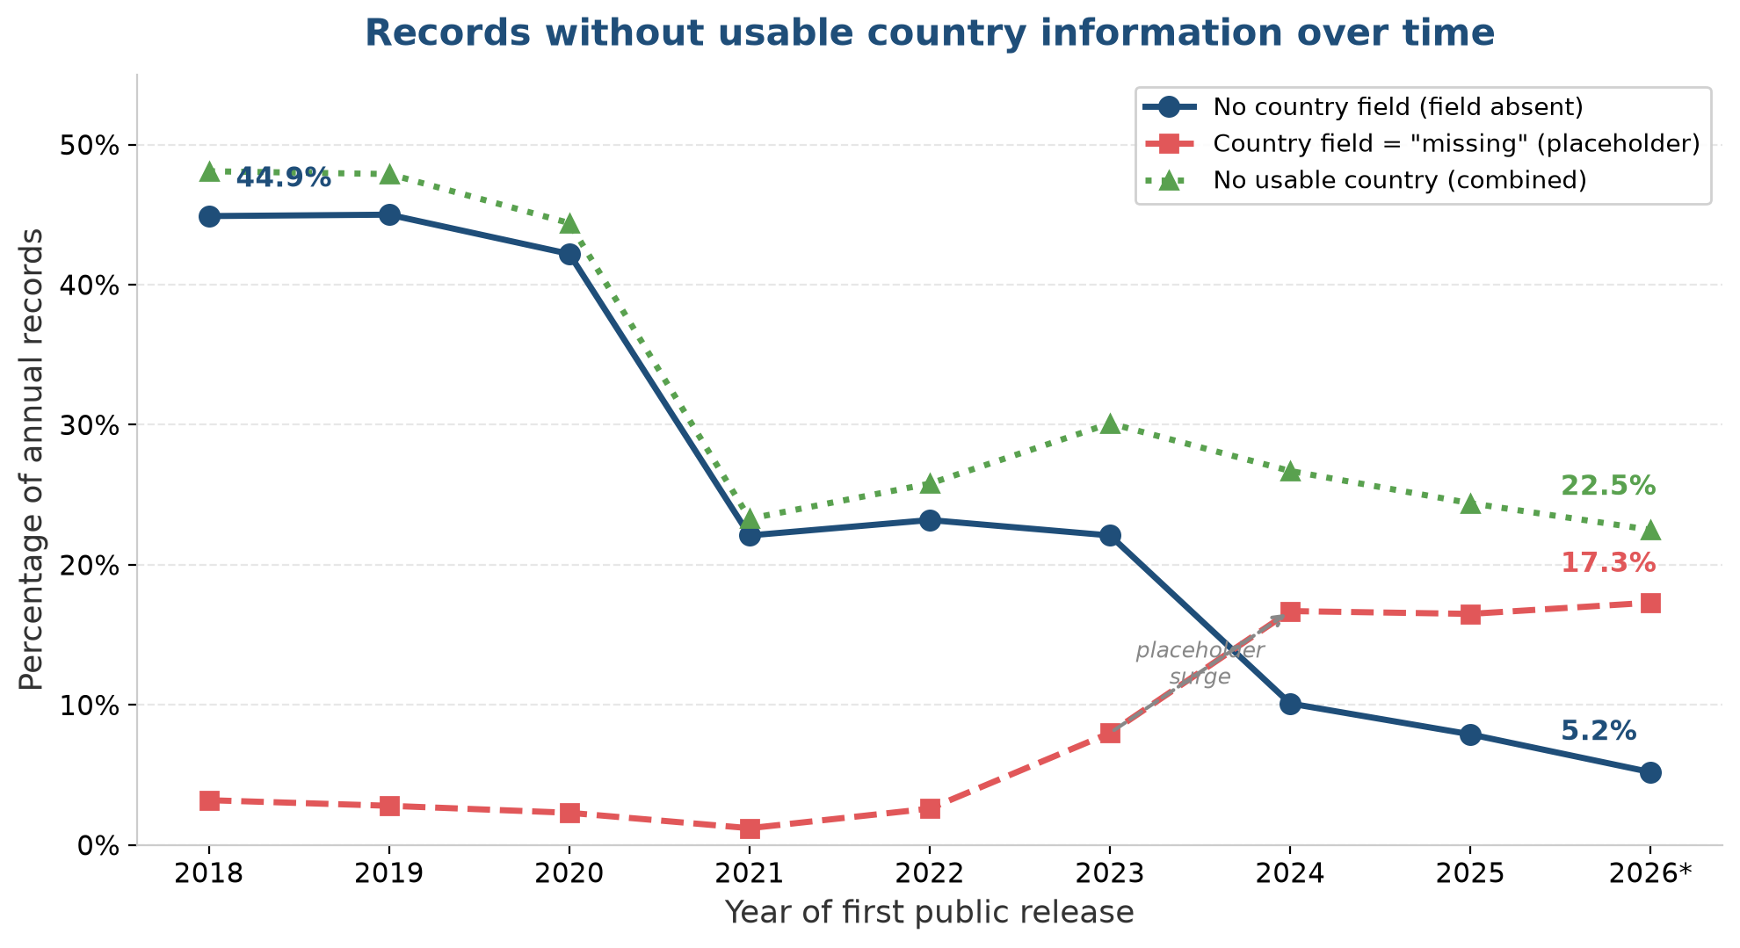
Records without usable country information over time
Three measures of missing geographic data, 2018 to 2026
What this shows
Blue line: records with no country field at all, falling from 44.9 per cent to 5.2 per cent.
Red line: records where the field exists but contains the placeholder value “missing”, rising from 3.2 per cent to 17.3 per cent.
Green line: the combined total with no usable country, falling from 48.1 per cent to 22.5 per cent.
The country field became compulsory, so submitters now include it. But many put “missing” as the value.
Source: ENA Portal API, 13 October 2026. *2026 covers January to October only. Percentages are calculated against total records first published in each year.

Slide 8
The substitution effect
Making the field compulsory reduced absences but created placeholders
The country field is now compulsory in ENA submissions. This has worked: the share of records with no country field at all fell from 44.9 per cent in 2018 to 5.2 per cent in 2026.
However, a new problem has emerged in its place. The share of records where the field is present but contains the value “missing” rose from 3.2 per cent in 2018 to 17.3 per cent in 2026. The surge began in 2023, coinciding with the introduction of the mandatory requirement.
INSDC does provide a structured missing-value reporting framework: submitters who genuinely cannot provide a country should use “missing: ” followed by a specific reason, such as “missing: lab stock” for model organisms, “missing: restricted access” for endangered species, or “missing: not collected”. Some “missing” records are therefore legitimate.
However, many submitters use bare “missing” without a reason, or “missing:missing”, both of which are non-compliant. Without granular reporting, we cannot distinguish legitimate omissions from compliance-without-substance.
Implication for allocation: any formula based on country-level counts must decide how to handle the 22.5 per cent of recent records with no usable country. The inability to distinguish legitimate from non-compliant omissions makes this harder.

Slide 9
Controlled vocabulary in theory, free text in practice
The country field specification is not adequately enforced
The INSDC specification defines the country field (geo_loc_name) as a controlled vocabulary. The country portion must be one of approximately 296 approved values, with an optional free-text region and locality after a colon, for example “Canada:Vancouver”.
In practice, enforcement is weak:
  82 non-vocabulary country values were found in the database, including alternative names (“UK” instead of “United Kingdom”), misspellings (“Columbia” instead of “Colombia”), and locality names entered without a country prefix.
  The value “missing” is an approved INSDC term, but the specification requires it to be used with a reporting-level reason (e.g., “missing: lab stock”). Many submitters use bare “missing” or the invalid “missing:missing”, both non-compliant.
  5.2 per cent of 2026 records have no country field at all, despite the field being compulsory since 2024.
  The free-text region and locality portion causes token-matching collisions, for example “USA: New Mexico” matching a query for “Mexico”.
Recommendation: enforce both the controlled vocabulary for country names and the missing-value reporting format at submission time, rejecting records where the country portion is not from the approved list and where “missing” is used without a valid reporting-level term. This would improve data quality for all downstream uses, including any future allocation methodology under the Cali Fund.
Source: INSDC geo_loc_name qualifier specification and INSDC missing value reporting terms (insdc.org), ENA Portal API verification (13 October 2026).

Slide 10
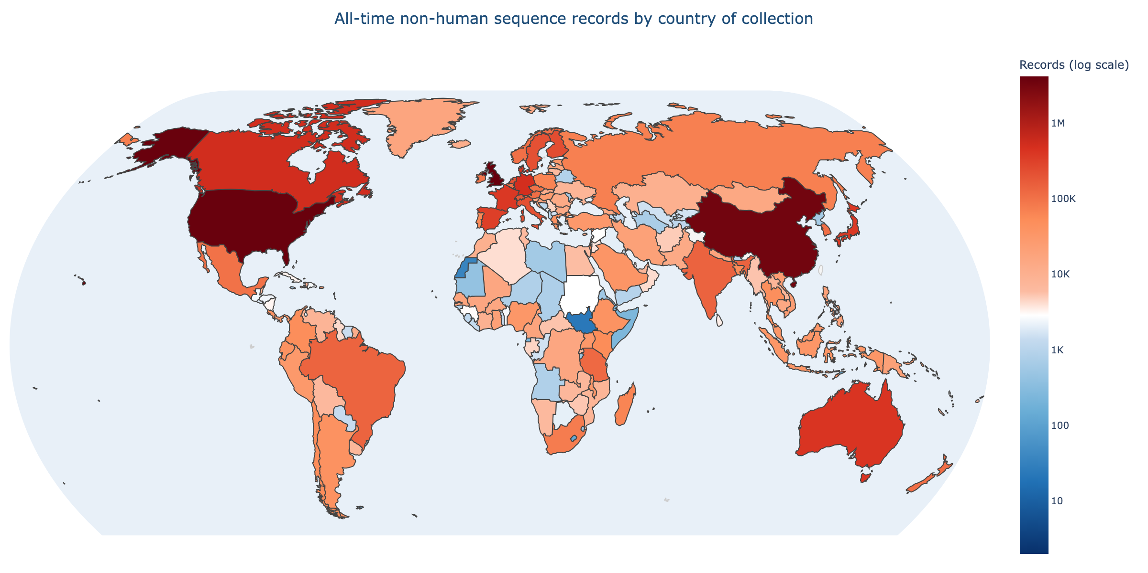
All-time sequence records by country
Total non-human records attributed to each country, all years combined
Colour scale is logarithmic: dark blue indicates the fewest records (around 2), white indicates approximately 4,000
records (the median country), and dark red indicates the most records (over 4 million).

Slide 11
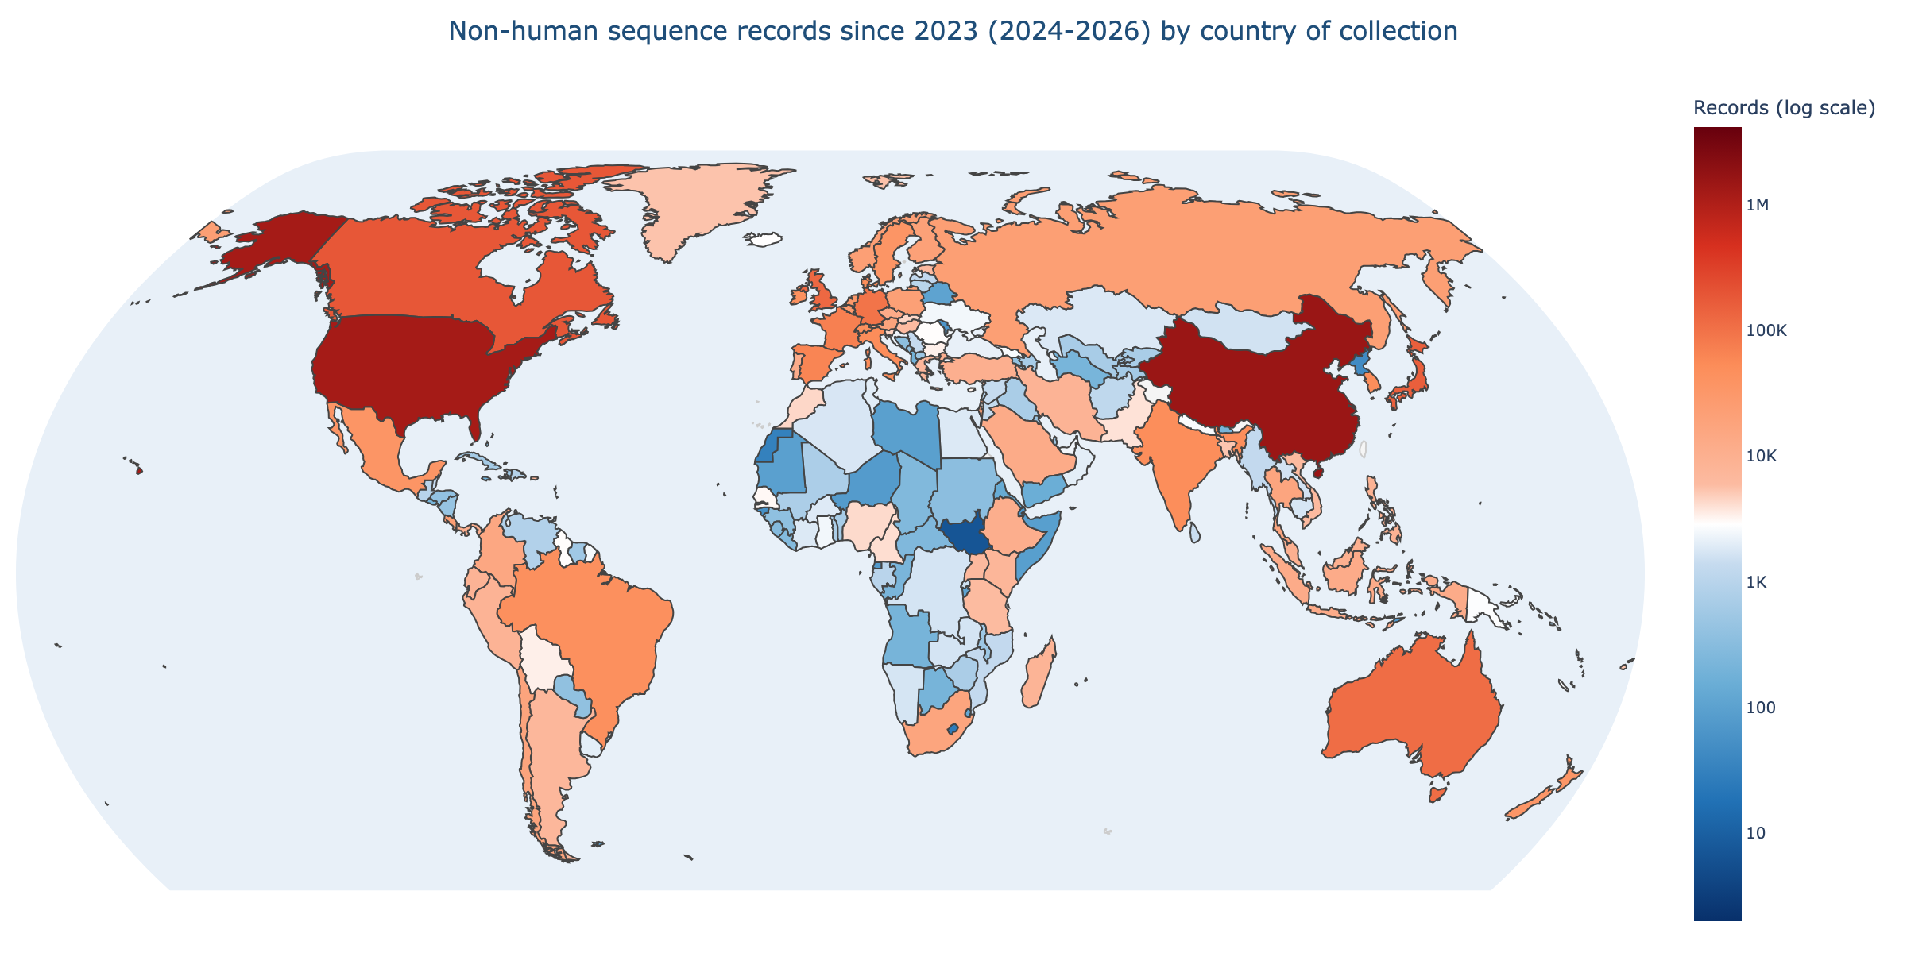
Sequence records since 2023 by country
Records with a first public release date in 2024, 2025, or 2026 (January to October)
Same logarithmic colour scale as the all-time map above, allowing direct comparison.

Slide 12
Developed versus developing countries
The gap is narrowing, but from a very high level
Year | Developed | Developing | Developed share
2018 | 384,484 | 133,652 | 74.2%
2020 | 774,188 | 331,632 | 70.0%
2021 | 2,272,486 | 454,492 | 83.3%
2024 | 998,971 | 723,822 | 58.0%
2026 (Jan-Oct) | 561,709 | 540,012 | 51.0%
Overall, developed countries hold 70.5 per cent of all country-attributed records and developing countries hold 29.5 per cent.
The developed-country share fell from 74.2 per cent in 2018 to 51.0 per cent in the first ten months of 2026. This is a genuine shift, but it is not smooth.
The 2021 surge to 83.3 per cent was caused in part by COVID-19 genomic surveillance, particularly the COG-UK consortium in the United Kingdom.
The convergence visible in 2026 is driven primarily by rapid growth in China and a handful of other upper middle income countries, not by broad-based gains across the developing world.

Slide 13
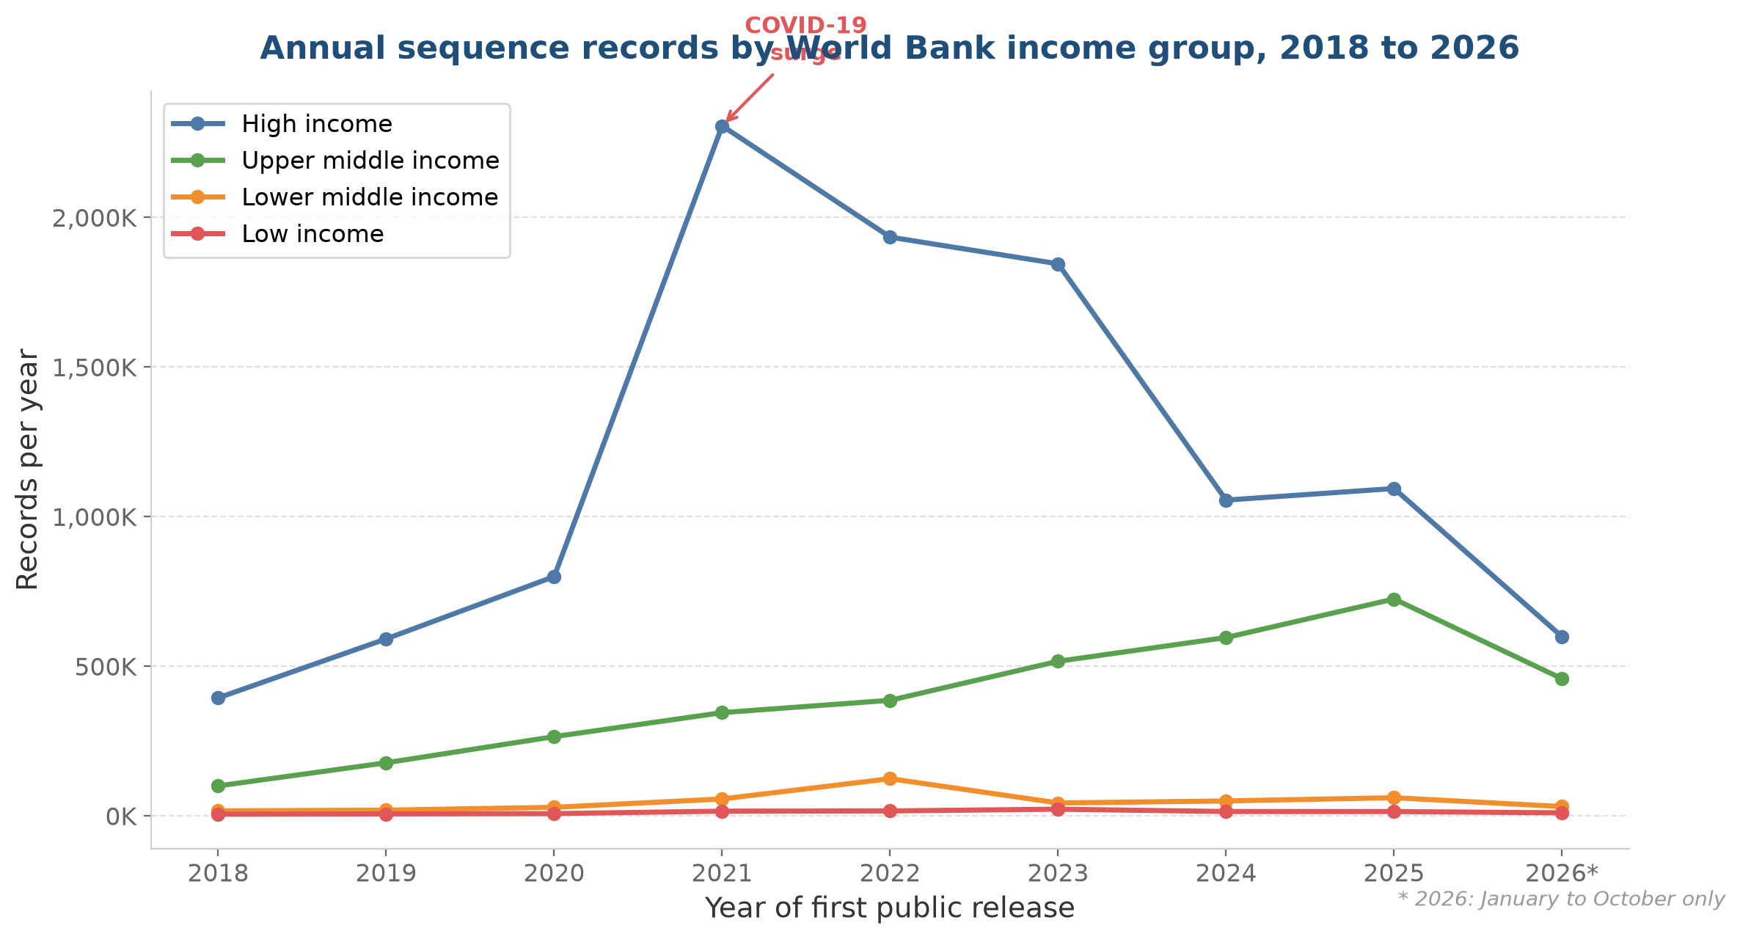
Trends over time by income group
Annual record counts by World Bank income classification, 2018 to 2026
What this shows
High-income countries (blue) dominate throughout, but their annual output peaked in 2021 during the COVID-19 surge and has since declined sharply.
Upper middle income countries (green), have grown steadily and are now approaching parity with high-income countries.
Lower middle income and low-income countries (orange and red) remain far behind, together accounting for only 5 per cent of annual records.
Source: ENA Portal API, 13 October 2026. *2026 covers January to October only.

Slide 14
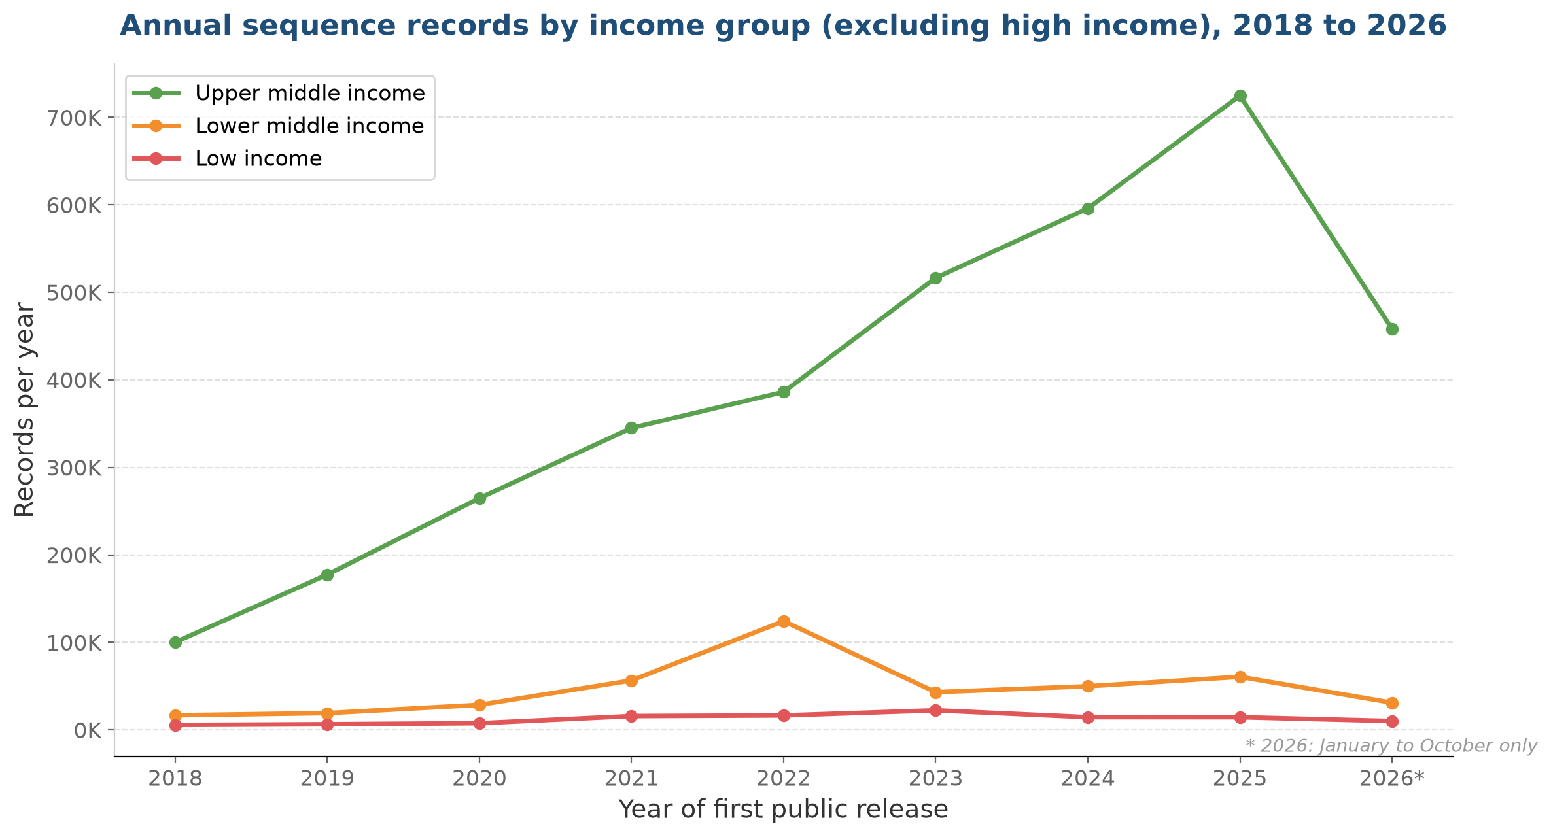
Income group trends excluding high income
Annual record counts for upper middle, lower middle, and low income countries, 2018 to 2026
What this shows
With high-income countries removed, the scale differences between the remaining three groups become visible.
Upper middle income countries (green) dominate this view, reaching over 700,000 records per year by 2025.
Lower middle income countries (orange) peaked in 2022 at 124,000 records, then fell back.
Low-income countries (red) remain below 25,000 records per year throughout. The gap between upper middle and low income is roughly 30-fold.
Source: ENA Portal API, 13 October 2026. *2026 covers January to October only. High-income countries excluded to show scale differences among the remaining groups.

Slide 15
Income group distribution
Concentration at the top, scarcity at the bottom
Income group | Countries | Records | Share
High income | 82 | 13,806,686 | 72.7%
Upper middle income | 54 | 4,163,957 | 21.9%
Lower middle income | 52 | 684,992 | 3.6%
Low income | 26 | 261,334 | 1.4%
High-income countries hold nearly three-quarters of all records. Upper middle income countries, led by China, hold just under a quarter. Lower middle income and low-income countries together account for only 5.0 per cent, despite containing 78 countries between them.
Comparing 2021-2023 with 2024-2026, upper middle income countries grew by 43 per cent on an annualised basis, while high-income countries declined by 55 per cent. This is the strongest evidence of a structural shift, though the decline may partly be the natural end of the COVID-19 surge.

Slide 16
Annual share of records by income group
Percentage of each year’s total records, by World Bank income classification
Year | High income | Upper middle | Lower middle | Low income | Total
2018 | 76.3% | 19.4% | 3.2% | 1.1% | 516,745
2019 | 74.5% | 22.3% | 2.4% | 0.8% | 794,388
2020 | 72.7% | 24.1% | 2.6% | 0.7% | 1,100,590
2021 | 84.7% | 12.7% | 2.1% | 0.6% | 2,723,151
2022 | 78.6% | 15.7% | 5.0% | 0.7% | 2,460,898
2023 | 76.0% | 21.3% | 1.8% | 0.9% | 2,426,790
2024 | 61.5% | 34.7% | 2.9% | 0.8% | 1,715,389
2025 | 57.8% | 38.3% | 3.2% | 0.8% | 1,893,694
2026* | 54.5% | 41.7% | 2.8% | 0.9% | 1,098,070
The high-income share has fallen from 76.3 per cent in 2018 to 54.5 per cent in 2026, while upper middle income countries have risen from 19.4 per cent to 41.7 per cent. In 2026, for the first time, upper middle income countries are generating nearly as many records as high-income countries.
Lower middle income and low-income countries have remained below 6 per cent combined throughout the entire period, showing almost no structural change in their share despite year-to-year fluctuations.
Source: ENA Portal API, 13 October 2026. Percentages exclude records with unknown income classification. *2026 covers January to October only.

Slide 17
Vulnerable country groups
LDCs, SIDS, and LLDCs remain far behind
Group | Countries | Records | Share
LDCs | 47 | 527,519 | 2.8%
SIDS | 51 | 218,743 | 1.2%
LLDCs | 32 | 235,701 | 1.2%
47 LDCs combined: 527,519 records
Canada alone: 530,725 records
LDC records are highly volatile. A 407 per cent surge in 2022 was driven by a few large projects, not broad-based capacity growth. The following year, LDC records fell by 71 per cent. This illustrates how dependent these counts are on individual projects and funding cycles, rather than durable institutional capacity.

Slide 18
Regional distribution
Europe dominates, Africa persists at the bottom
Region | Countries | Records | Share
Europe | 49 | 7,768,889 | 40.9%
Americas | 53 | 5,217,623 | 27.5%
Asia | 50 | 4,654,034 | 24.5%
Africa | 58 | 688,721 | 3.6%
Oceania | 26 | 605,378 | 3.2%
Europe holds 40.9 per cent of all country-attributed records, more than any other region. This is heavily influenced by the United Kingdom. Without the UK, Europe share would fall to approximately 19 per cent, closer to the Americas and Asia.
Africa, despite having 58 classified countries, holds only 3.6 per cent of records. This share has remained roughly constant throughout the period studied.
At the sub-regional level, Northern Europe and Northern America together hold over half of all records.

Slide 19
Three countries dominate
UK, USA, and China account for over 60 per cent of records
Rank | Country | Records | Share
1 | United Kingdom | 4,143,928 | 21.9%
2 | United States | 4,018,537 | 21.2%
3 | China | 3,357,157 | 17.7%
4 | Canada | 530,725 | 2.8%
5 | Germany | 510,489 | 2.7%
6 | Australia | 424,457 | 2.2%
7 | Denmark | 403,788 | 2.1%
8 | France | 388,062 | 2.0%
9 | Japan | 380,094 | 2.0%
10 | Spain | 331,748 | 1.8%
The United Kingdom, the United States, and China together account for 60.8 per cent of all country-attributed records. No other country reaches 3 per cent.
This concentration is a critical consideration for any allocation formula. A formula based on raw record counts would channel most benefits to a small number of countries that already have substantial sequencing capacity, undermining the equity objectives of the Cali Fund.

Slide 20
The COVID-19 distortion
Pandemic surveillance severely distorts temporal trends
In 2021, UK records jumped from 165,918 to 1,593,869, nearly a tenfold increase driven by the COVID-19 Genomics UK (COG-UK) consortium. Similar surges occurred in the United States and other developed countries with large genomic surveillance programmes.
This single event inflated the developed-country share by approximately 13 percentage points, from 70.0 per cent in 2020 to 83.3 per cent in 2021. The pandemic records are SARS-CoV-2 sequences, not biodiversity DSI, and they are not representative of the underlying trend.
The decline from 2021 onwards reflects two forces: the winding down of pandemic surveillance in developed countries, and continued growth in developing-country sequencing, particularly from China. It is not yet clear whether the convergence visible in 2026 will be sustained once pandemic records are no longer distorting the baseline.
To assess genuine trends in biodiversity DSI, a sensitivity view excluding SARS-CoV-2 records would be needed. This should be a priority for future analysis.

Slide 21
Temporal trends: Three periods compared
Pre-pandemic, pandemic, and post-pandemic annual averages
Group | 2018-2020/yr | 2021-2023/yr | Change | 2024-2026/yr | Change
Developed | 577,721 | 1,985,213 | +244% | 865,857 | -56%
Developing | 229,488 | 556,709 | +143% | 709,245 | +27%
LDCs | 10,796 | 57,817 | +436% | 22,010 | -62%
SIDS | 9,618 | 24,792 | +158% | 20,408 | -18%
LLDCs | 7,292 | 19,763 | +171% | 14,088 | -29%
The pandemic period saw dramatic growth across all groups, but the growth was far larger for developed countries (+244 per cent) than for developing countries (+143 per cent). This widened the absolute gap even as it temporarily increased the developed-country share.
In the post-pandemic period, developed-country records declined by 56 per cent from their pandemic peak, while developing-country records continued to grow, by 27 per cent. For the first time in the period studied, developing countries are generating more records per year than developed countries, though the 2026 figure is based on partial-year data.
All vulnerable country groups saw their records decline from pandemic peaks, suggesting that pandemic-era growth was project-specific and temporary.

Slide 22
Can INSDC data support allocation?
Four problems stand out
1. Incompleteness
  37.5 per cent of records cannot be attributed to any country, and 21.5 per cent have no date. The excluded fraction is not random.
2. Concentration
  Three countries account for 60.8 per cent of records. A formula based on raw counts would channel benefits to countries that already have substantial sequencing capacity.
3. Distortion
  COVID-19 pandemic records severely distort temporal trends.

Slide 23
Conclusion and policy implications
INSDC provenance data should inform, but not determine, Cali Fund allocation decisions.
The data are useful for identifying broad patterns of inequality, for monitoring trends over time, and for highlighting the specific needs of regions and country groups. They are not suitable as a direct input to an allocation formula because they are too incomplete, too concentrated, and too distorted by external events.
A more robust approach might combine INSDC data with other indicators:
  Biodiversity richness (for example, species counts from GBIF)
  Sequencing capacity (for example, number of sequencing facilities per country)
  Economic need (for example, inverted UN Scale of Assessment or inverted GNI or LDC/SIDS/LLDC status)
The Cali Fund allocation methodology should be a matter for Parties to negotiate, informed by evidence but not determined by it.

Slide 24
Limitations
Rapid assessment: This analysis was conducted to provide the best information possible in the time available. It has not been peer reviewed.
Snapshot: All counts are a point-in-time snapshot taken on 13 October 2026. The database grows daily.
Partial year: 2026 covers January to October only.
Undated records: 21.5 per cent have no public release date. Annual counts are partial censuses.
Data quality: The country field is submitter-populated and not standardised.
Metagenomes: Environmental metagenomes (27.7 per cent) are included and inflate counts for some countries.
Collection versus contribution: The country field records collection locality, not the sequencing institution.
Token-matching collisions: The ENA search engine indexes the country field as a text field and cannot distinguish the country portion from the locality portion. Twenty collision exclusions were applied, but individual country counts may contain small errors from undiscovered collisions where a country name appears as a locality in another country’s records.
COVID-19 Distortion: SARS-CoV-2 samples bias the dataset

Slide 25
Thank you
Questions and discussion welcome

