Slide 1
Jonathan Lévy
Master Thesis Defence
Acceleration of Seed Extension for BWA-MEM DNA Alignment Using GPUs

Slide 2
Preamble
Cancer detection with DNA analysis
Time-consuming: needs acceleration
Speed-up with parallel computing
Goals:
  Speed
  Adaptability
  Maintainability
  Correctness

Slide 3

Plan
Introduction: DNA, mapping, GPU
Accelerator design
Implementation
Results

Slide 4
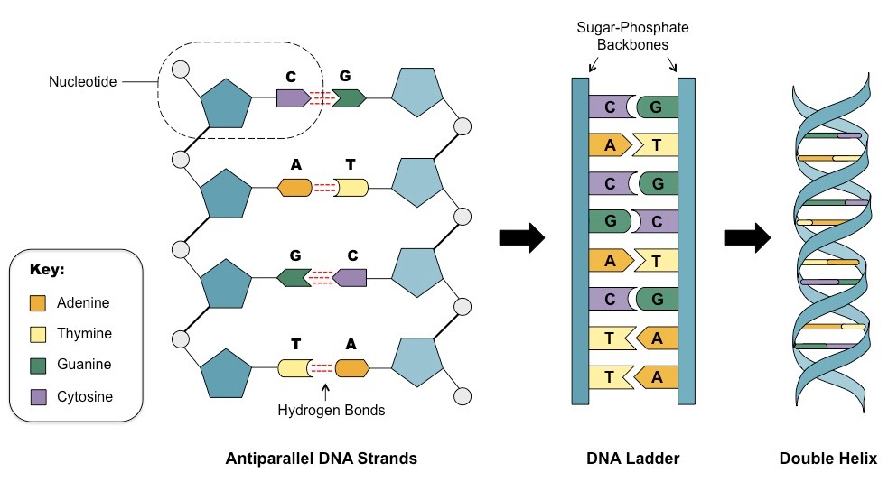
1) Introduction: DNA
DNA: code that defines species
4 bases: Adenine, Thymine, Cytosine, Guanine
Paired 2 by 2:
  A – T
  C – G
Double-stranded helix

Slide 5
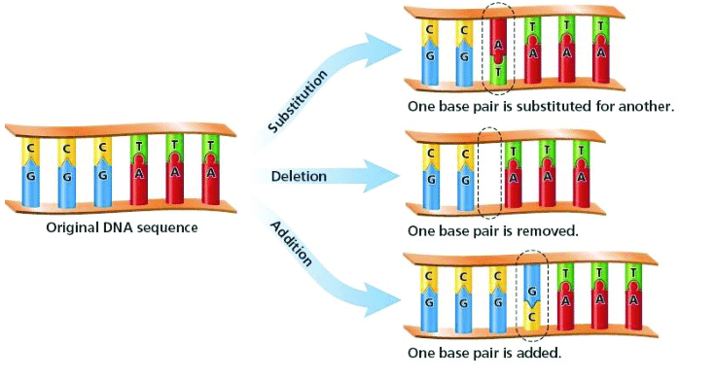
1) Introduction: DNA mapping
Mutation: DNA modification, can be harmful
Get DNA sample
  Sample: set of fragments “reads”
Find matches in a reference genome
  Find location
  Quantify how well it matches

Slide 6
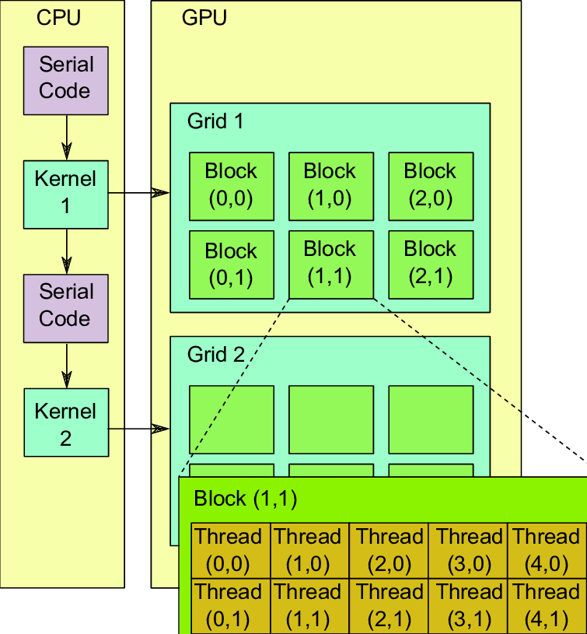
1) Introduction: parallel processing
Millions of strings, unrelated
Parallel processing on GPU
  Graphics Processing Units
  Parallel hardware
  Can be programmed for any kind of computation
CPU launches kernels on GPU

Slide 7
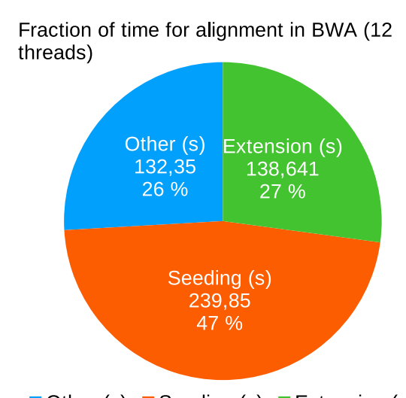
1) Introduction: seed-and-extend
Mapping a read with seed-and-extend:
Find matching area – seeding
  Find small (~20 bases) substrings in reference genome
Align rest of the read – seed-extension (~30% of time)
  For each substring, align left and right parts
  Query (from read) & target (from reference)
  Compute dynamic programming matrix (Smith-Waterman algorithm)

Slide 8
2) Accelerator design: programs
BWA-MEM
DNA mapper
Uses seed-and-extend
CPU threads (12~24)
GASAL2
CUDA library, aligns DNA
  Runs the seed-extension
Smith-Waterman & others
Compresses data on GPU
GPU threads (2000~3000)
Integrate GASAL2 in BWA-MEM

Slide 9
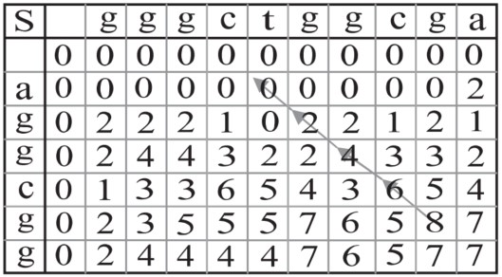
2) Accelerator design: task
Local alignment:
  Compute matrix of scores
  Bases match → score
  Bases mismatch → score
  Maximum score = end position of the alignment
Start with non-zero score
Affine gap penalty

Slide 10
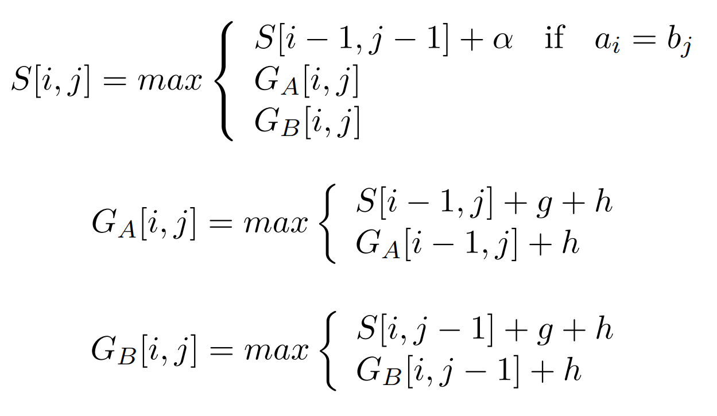
2) Accelerator design: task
Affine gap penalty
α > 0 : bases match
g < 0 : cost to open a gap
h < 0 : cost to widen a gap
i-1, j-1
i-1, j
i, j-1
i, j

Slide 11
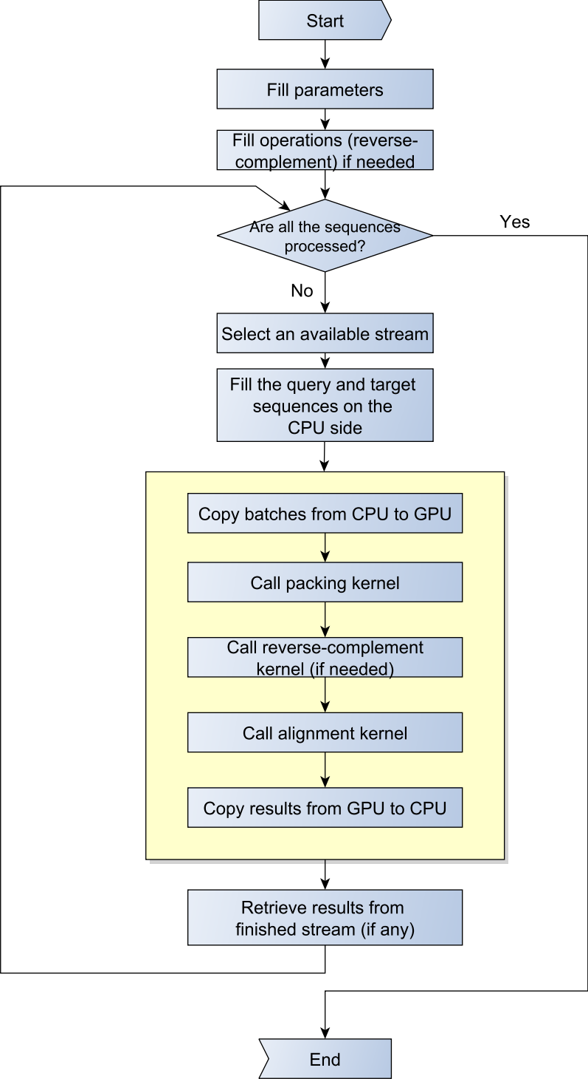
2) Accelerator design: workflow
GASAL2 Data flow
  Initialise structures
  Fill an available stream
  Launch kernel for stream
  Retrieve any finished stream
  Repeat for all batches of sequences

Slide 12
2) Accelerator design: specifications
Reproduce original BWA-MEM behaviour
Have dynamic memory allocation
Compute 2 sides in parallel
Provide effective speed-up
Provide minimum difference in output
Measures:
Execution time (s)
Output difference (%)
Resources use:
  Memory (MB)
  SM utilisation (%)

Slide 13
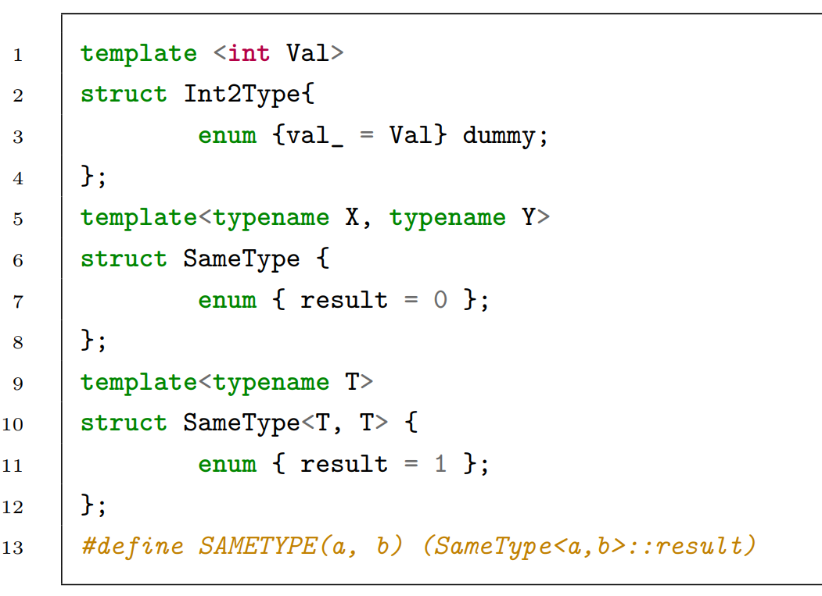
3.1) Implementation: maintainability
C++ templates
Values as types
  Resolution by compiler
Reduces code amount
Generates specialised kernels
→ no branch resolution at runtime

Slide 14
3.1) Implementation: C++ port
GASAL2: needs to process batches
Modified BWA-MEM with batches: GASE-GASAL2
Ported GASE-GASAL2 to C++
Integrated new GASAL2

Slide 15
3.2) Implementation: kernel
Reproduce BWA-MEM behaviour “ksw_extend”
Custom Smith-Waterman
  Non-zero start score
  Cell skipping
  Z-dropoff
Simple kernel implementation
Added speed-up cell-skipping
Added z-droppoff
Compared: outputs same results

Slide 16
3.3) Implementation: library integration
Left-right dependency
  Left starts with seed score
  Right starts with left score
Introducing: “seed-only” paradigm
Start score = seed score
Both sides in parallel
Could bring minor differences
seed

Slide 17
3.3) Implementation: library integration
Compute left & right in parallel
  2 batches
  Grouping by long/short instead of left/right
  More instructions executed
CPU thread: packs of 4000
  Split in batches of 1000
  Generates 100 000 seeds
  Generates 180 000 alignments
  Split in 2 batches depending on length (long/short)
  Computed by a GPU stream
seed

Slide 18
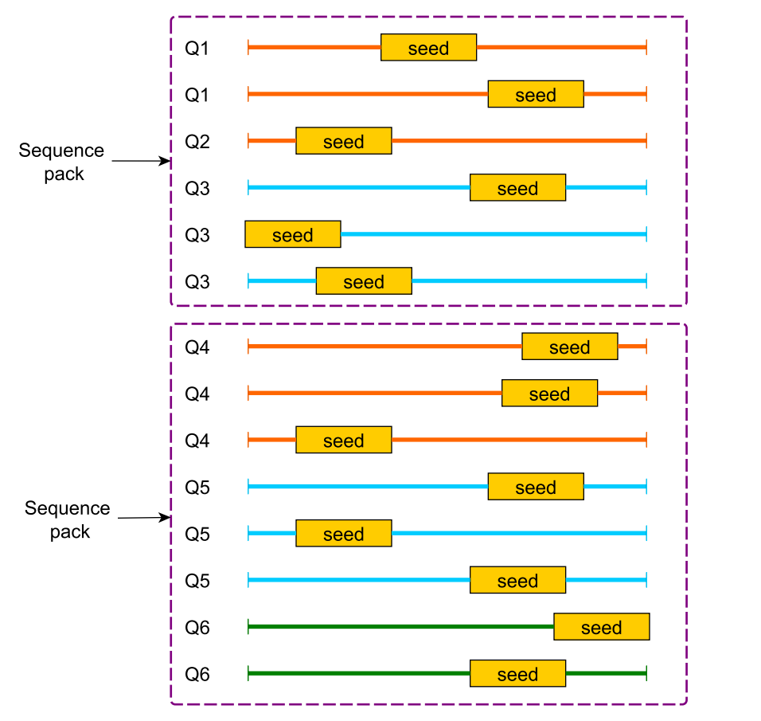
3.3) Implementation: library integration
Sequence pack = 4000 seq.
Same colour = same GPU stream
Ex. with 2 streams:
  Orange: Stream #1
  Blue: Stream #2
  Green: Stream #1

Slide 19
3.4) Implementation: memory
GASAL2: max memory at initialisation
Unacceptable
  Unknown number of seeds
  Unknown length of parts to align
Dynamic memory
2 different memory schemes
  Simple CudaRealloc for metada fields
  Extensible structure for DNA strings

Slide 20
3.4) Implementation: memory
Metadata:
Implemented a CudaRealloc
  CUDA fields: no “realloc”
  Creates bigger field
  copies content
  frees previous
User checks if overflow, call resizer
DNA strings:
Linked-list structure
  Grows bigger nodes
  No memory copies
  No in-between frees
  Fast & efficient
Library concern
Interface for user

Slide 21
3.5) Score comparison
Diff UNIX utility
Difference percentage
Remove secondary scores
Enormous files (~GB), sed too slow
Wrote C program for files processing

Slide 22
4.1) Results
Test machine specifications
Component | Reference
CPU | 2x Intel Xeon E3-2620 (Total 12 physical cores, 24 logical cores)
RAM | 32GB DDR3
GPU | NVIDIA Tesla K40c (2880 CUDA cores, VRAM 12GB GDDR5)
Operating System | GNU/Linux Red Hat Enterprise Linux 7
CUDA version | 10.1.105
GCC version | 4.8

Slide 23
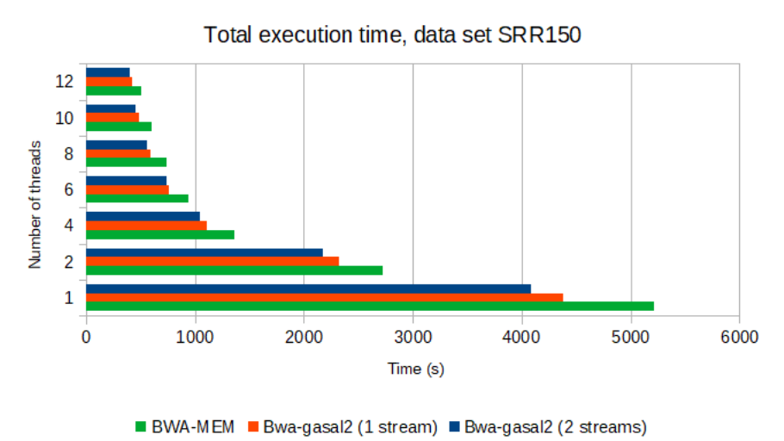
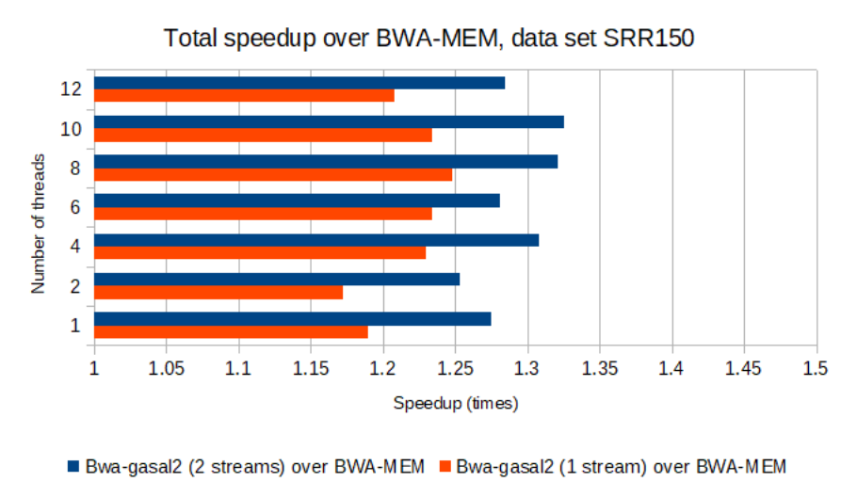
4.2) Results: speed-up
12 threads kernel speed-up:
1.21x with a single stream
1.28x with 2-streams (1.37x theoretical max)

Slide 24
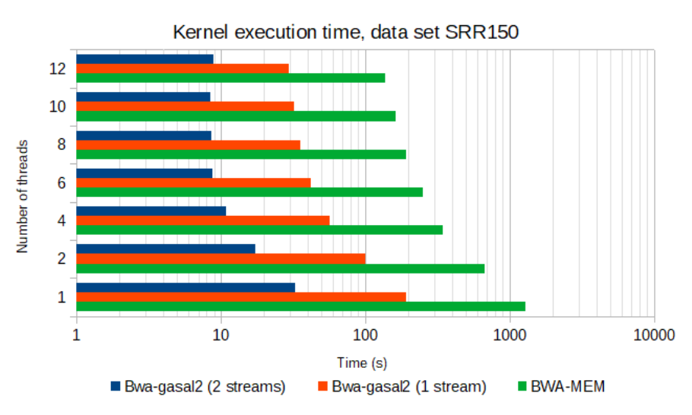
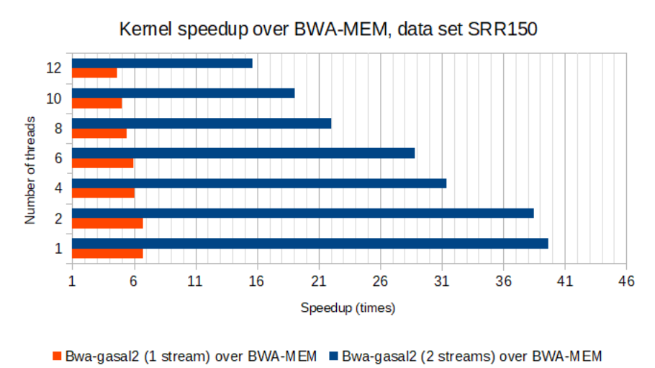
4.2) Results: kernel speed-up
12 threads kernel speed-up:
4.8x with a single stream
16x with 2-streams

Slide 25
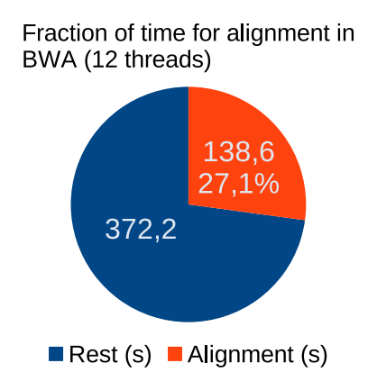
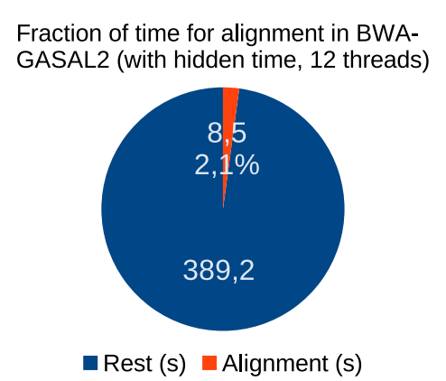
4.2) Results: speed-up

Slide 26
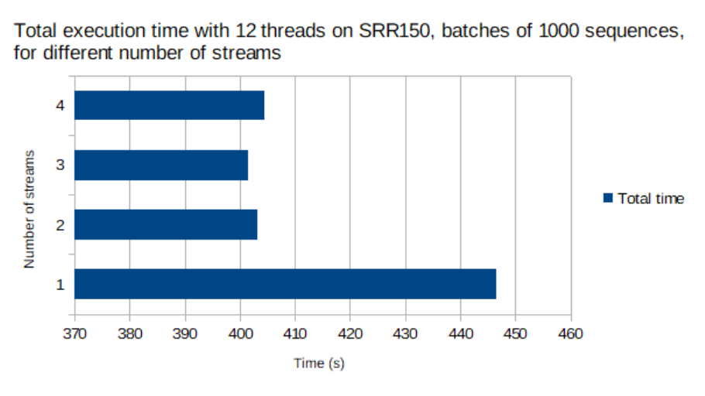
4.2) Results: streams and overlap
No speed-up after 2 streams → sufficient for CPU-GPU overlapped execution

Slide 27
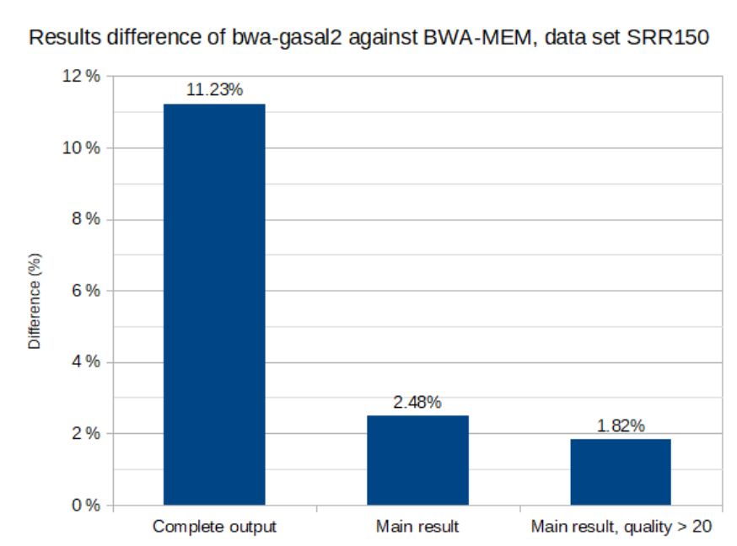
4.3) Results: Correctness
Total differences: 11.23%
Main score only: 2.48%
Main score, good quality alignments: 1.82%
  → few differences
  → result is acceptable

Slide 28
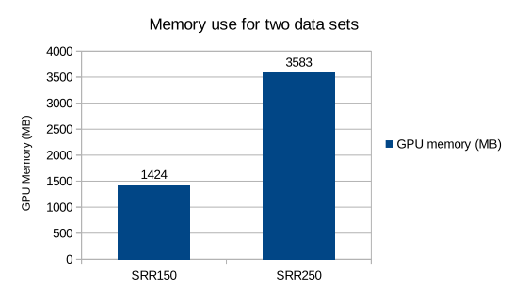
4.4) Results: resources use
Dynamic allocation
  Reasonable memory use
  Room to accelerate another part of calculation
  Lower-end hardware use is possible

Slide 29
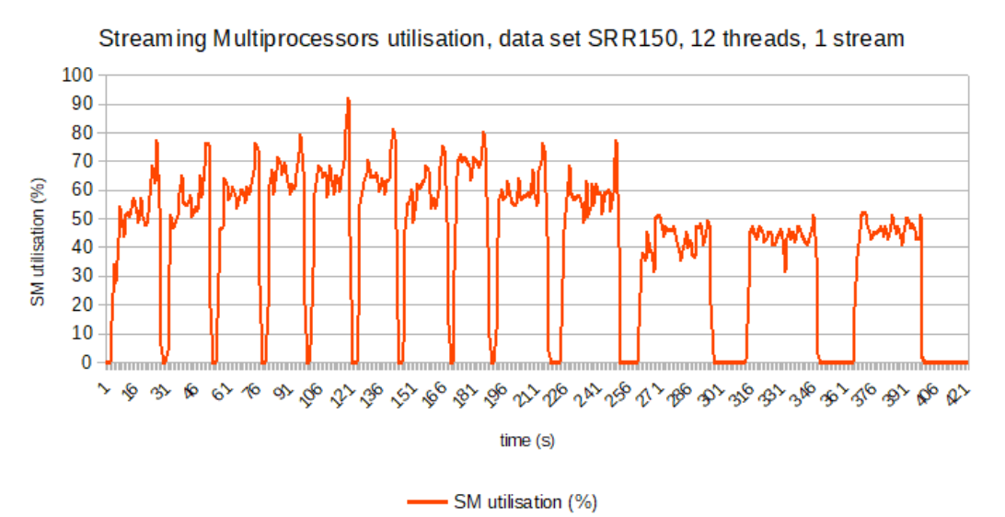
4.4) Results: resources use

Slide 30
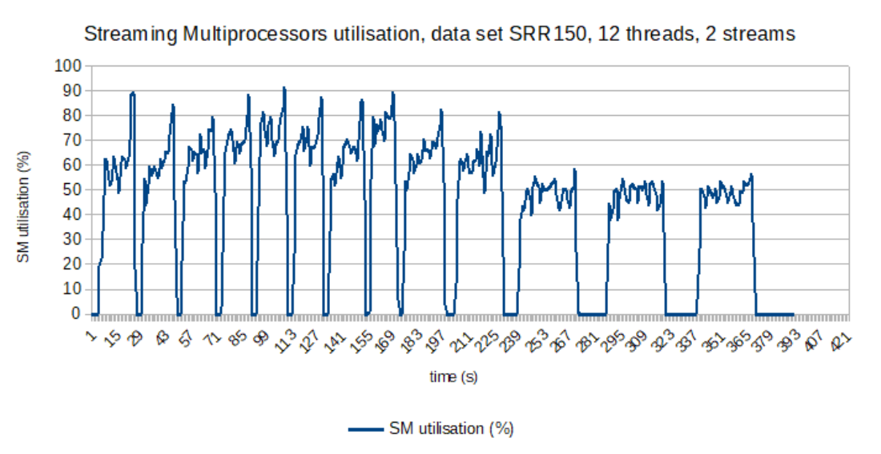
4.4) Results: resources use

Slide 31
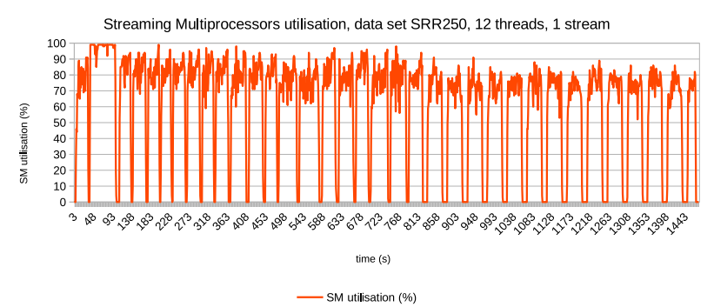
4.4) Results: resources use

Slide 32
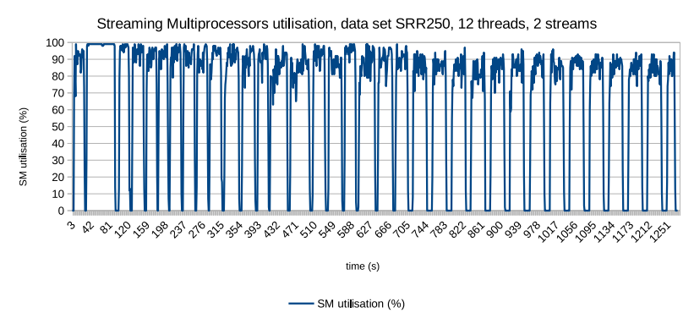
4.4) Results: resources use

Slide 33
Wrap-up
Integrated GASAL2 in BWA-MEM
Effective speed-up 1.28x (close to max. 1.37x)
“Seed-only” paradigm to compute left/right in parallel
Dynamic memory management, needed for seed-extension
98.2% of main results are exactly matching
Good use of resources, but there is room for more

Slide 34
Future works
Optimise kernel
Reduce overhead caused by memory copies
Enhance asymmetric processing
  Provide more streams for long batches than shorts
Accelerate another part of the mapping

Slide 35
Thank you for your attention.

Slide 36
1) Introduction: DNA mutation
Modification of DNA: mutation
Random, can provide new traits
  Bonus: gets propagated to heirs across population
  Malus: doesn’t
Principle of evolution
Cancer: local genetic malfunction
Detection for treatment

