Slide 1
Predicting Prison Recidivism with Supervised Learning Models
Max Barry
February 13, 2019

Slide 2
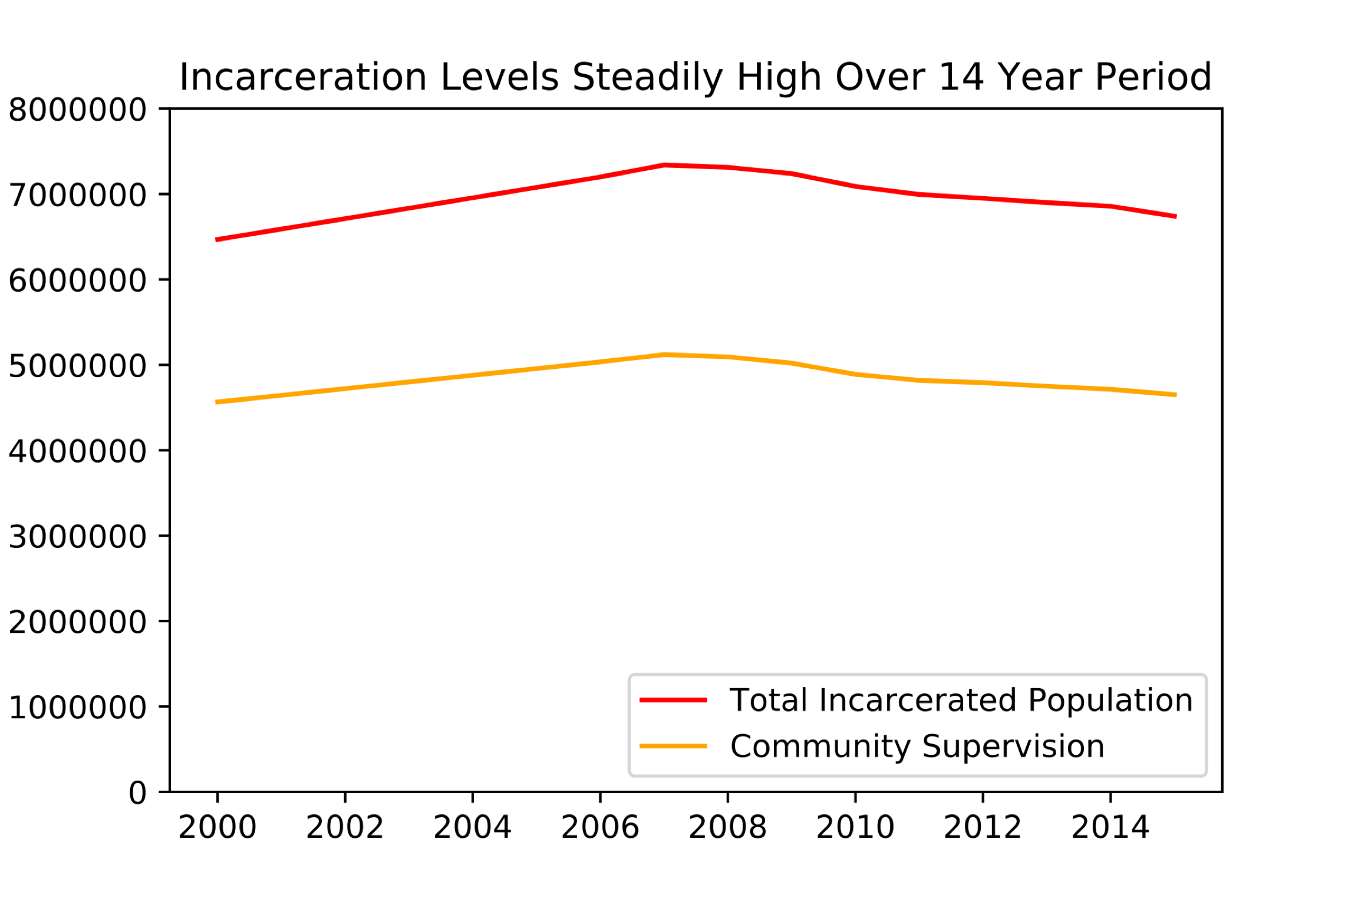
Notes:
626,024 Prisoners released in 2016, https://www.bjs.gov/index.cfm?ty=nps
28, 615 released in Illinois in 2016, https://www.bjs.gov/index.cfm?ty=nps
29,428 on parole in Illinois in 2016
874,777 parole in 2016
Maybe get a graph that has probation taken out.

Slide 3
Better Allocation of Resources

Slide 4
Motivation
Ranking | Title | Prison Population Total
1 | United States of America | 2 121 600
2 | China | 1 649 804
3 | Brazil | 700 432
4 | Russian Federation | 563 166
5 | India | 419 623
6 | Thailand | 375 763
7 | Turkey | 260 000
8 | Indonesia | 256 051
9 | Iran | 230 000
10 | Mexico | 204 422
Source: World Prison Brief,
Accessed, Feb. 10, 2019
Notes:
U.S. has a prison prison population rate of 655 prisoners per 100000, http://www.prisonstudies.org/sites/default/files/resources/downloads/wppl_12.pdf
World prison population rate is 145 per 100,000, http://www.prisonstudies.org/sites/default/files/resources/downloads/wppl_12.pdf

Slide 5
Data - Source
3-Year Recidivism for Offenders Released from Prison in Iowa
Notes:
24150 Individual Records

Slide 6
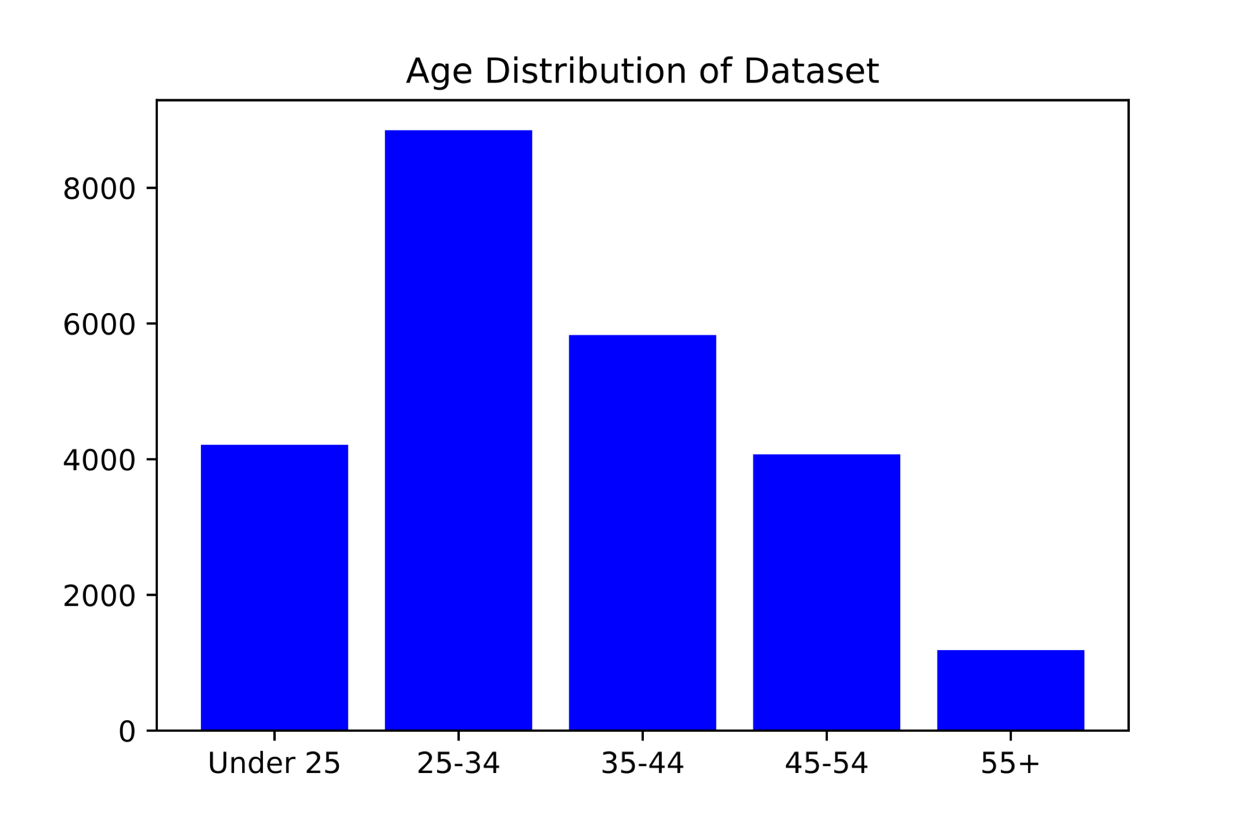

Slide 7
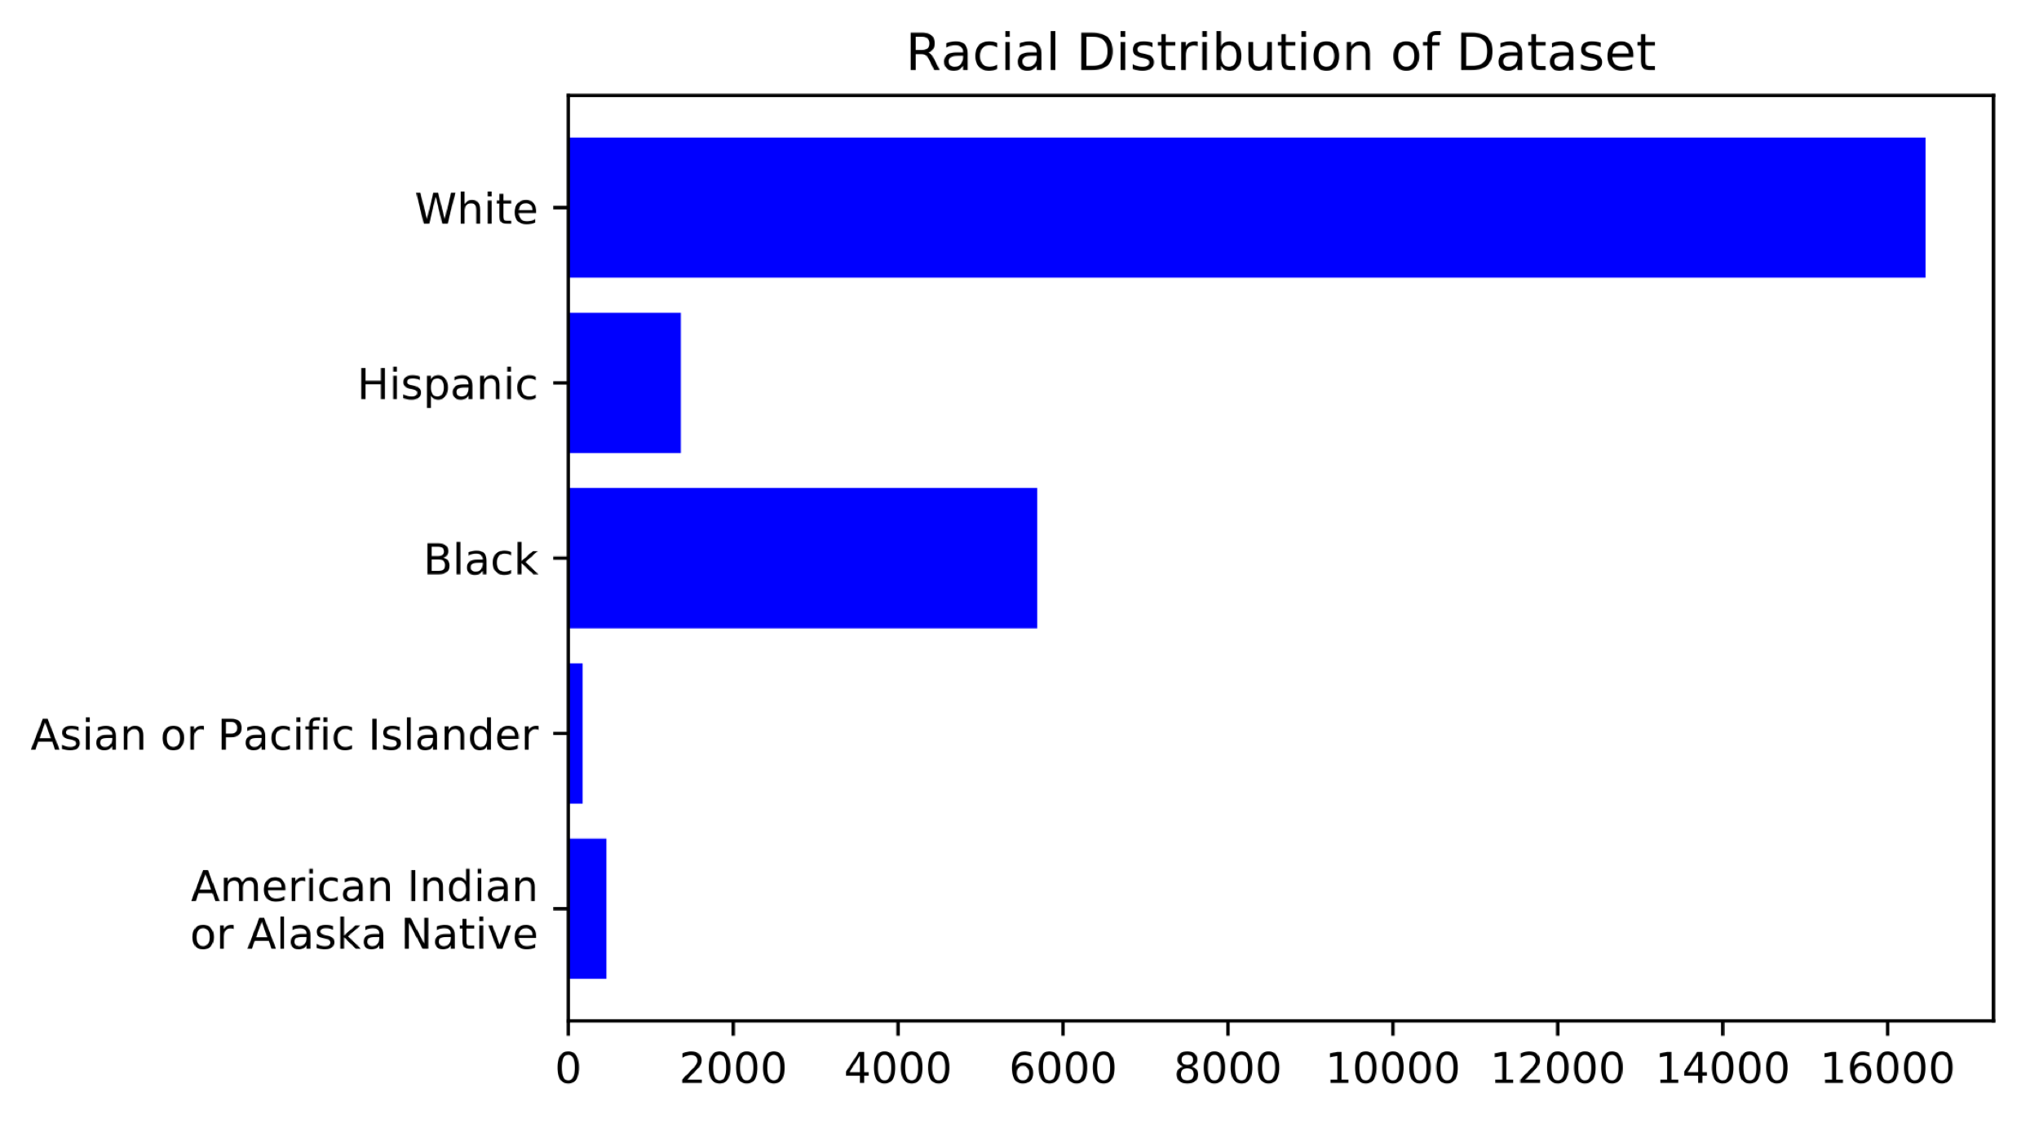

Slide 8
Offense Subtypes
Alcohol | Forgery/Fraud | Stolen Property
Animals | Kidnap | Theft
Arson | Murder/Manslaughter | Traffic
Assault | Prostitution/Pimping | Trafficking
Burglary | Robbery | Vandalism
Drug Possession | Sex | Weapons
Flight/Escape | Sex Offender Registry

Slide 9
Results

Slide 10
Results

Slide 11
Conclusions

Slide 12
Conclusions

Slide 13
Future Work

Slide 14
Appendix

