Slide 1
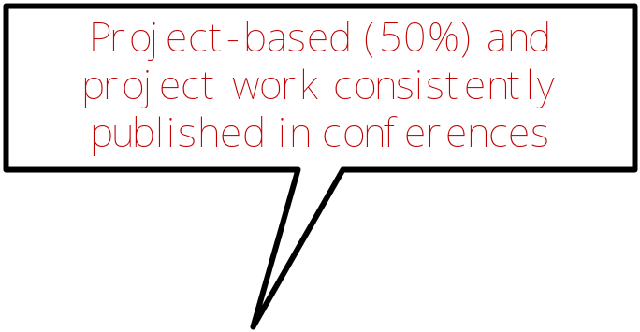
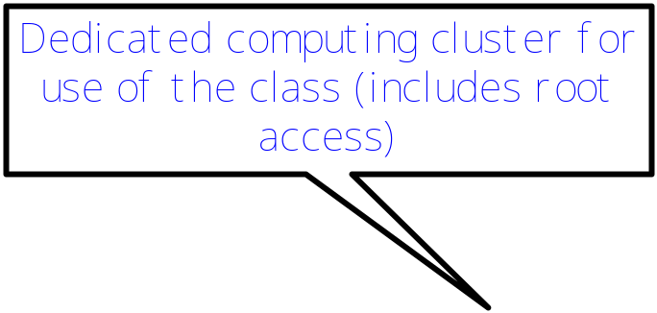


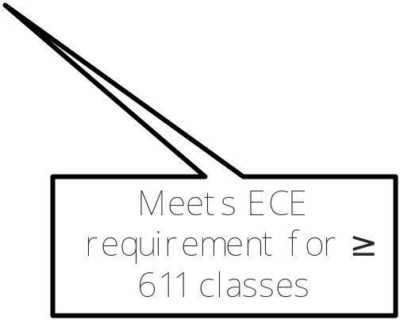
ECE 695: Fault-tolerant Computer System Design
Which course will give you all of these?
ECE 695
Instructor: Saurabh Bagchi
Meets: T R 4.30-5.45
Grissom 166

Slide 2
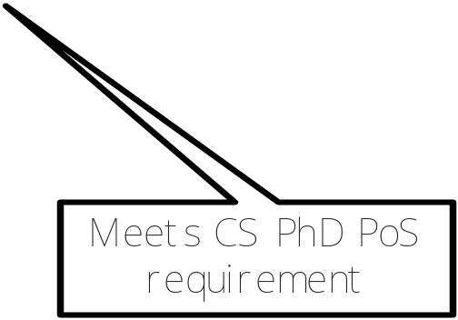
CS 59000 FTD: Fault-tolerant Computer System Design
Which course will give you all of these?
CS 59000 FTD
Instructor: Saurabh Bagchi
Meets: T R 4.30-5.45
Grissom 166

Slide 3
Questions:
Prof. Saurabh Bagchi sbagchi@purdue.edu
Course URL: https://engineering.purdue.edu/ee695b

