Slide 1
Computer Science 105
Deconstructing a Computer
Outline:
What is inside the computer ?
What is memory?
What is Booting up?
What is Machine Cycle?

Slide 2
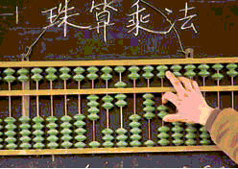
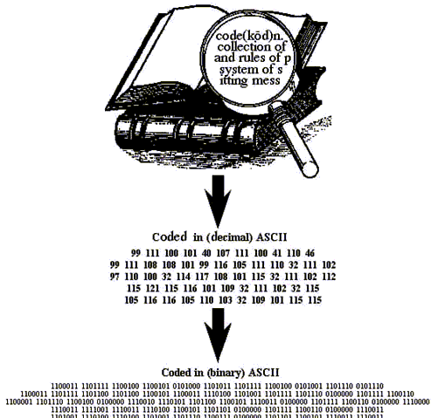
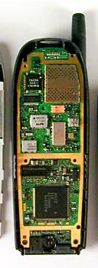
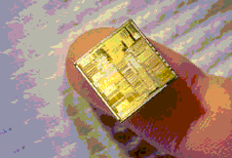
What is a computer?
ENIAC
Midsize IBM
Punch cards
This course only deals with
electronic computing machines

Slide 3
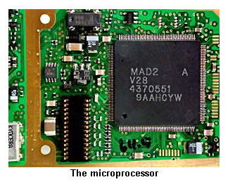
Microprocessor
Brain of the computer
Brain of the cell phone
Brain of the PDA
Course Guide page 41

Slide 4
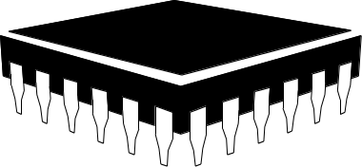

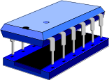
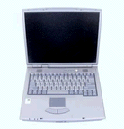

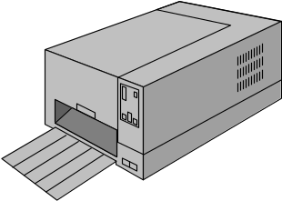
Hardware
Inputs
CPU on a chip – the Microprocessor (s)
MP3 file from the Internet
ROM built in, BIOS
RAM Chips
Outputs
Notes:
Summary Overview
Hardware consists of all the machinery and equipment that make up the computer system. Some hardware, like the central processing unit, are internal. External hardware, also called a peripheral device, is any additional piece of equipment that is connected to a computer, such as a monitor or keyboard.
Categories of Hardware
Input. These are devices that allow people to put data into the computer in form that the computer can use. The three most common input devices are: keyboards - typewriter and special function keys; mouse, trackball, & joystick - devices for moving a cursor or object around on the screen; and, scanning devices - which convert pictures, graphics, or text from paper into digital form.
Output. These are devices that translate computer information into a form that people can understand. Common output devices include: a screen, or monitor, that displays images of numbers and graphics much like a TV screen; a printer, which forms letters, numbers, and images out of dots or other technology such as lasers; sound, from speakers and even high-quality devices with stereo capability.
Processing and Memory. Inside the computer system unit (the box!) are the central processing unit (CPU) which controls and manipulates data to produce information. Memory used for working storage during processing is called RAM (for random access memory) and is located on chips mounted, like the CPU on the system board.
Secondary Storage. This type of storage holds the results of processing and is discussed in greater detail on the following slide.
Communications. These are the devices used to share and exchange information with other computers. This topic is covered in greater detail on a subsequent slide.

Slide 5
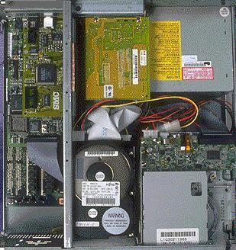
Inside the Computer (link)
CPU (s)
Expansion Slots
Floppy drive
Hard disk
Memory chip
Motherboard
CD-ROM/DVD-ROM
Power Supply

Slide 6
We will cover secondary storage at the end of the course
Secondary storage includes hard drives, CD-ROMs, DVDs, and Flash Memory cards like you find in cell phones, digital cameras, etc.
Secondary storage will maintain its data without any external source of power.
Course Guide page 43

Slide 7
Random Access Memory (RAM) also called __________ or Primary Memory
Stores program instructions and data needed for processing--the working memory (short-term memory) of a computer (like a human’s memory)
The primary storage area for programs and data in active use
It is volatile.

Slide 8

Analogy for RAM
Imagine you are sitting at a desk. The size of your work area determines how many projects you can handle at once.
RAM is somewhat like that surface – the number of applications that you can run is limited by the size of RAM.
RAM is good—get lots of it!

Slide 9

Booting a computer
Bootstrapping: “to lift yourself up by your own bootstraps.”
ROM is built-in memory, doesn’t change, needed when the power comes on.
BIOS is a kind of Flash Memory, and can have some settings changed. Its name comes from basic input/output system (BIOS)
Finally, software loaded into RAM

Slide 10
Preset stations on your car’s radio
If you turn the ignition off, a car radio still pulls a tiny amount of current from the battery. It saves its data in its RAM.
That is why the car radio will lose its preset stations if your car battery dies or the wires are disconnected.
Car radios ought to use Flash Memory—maybe one day they will.

Slide 11
The Machine Cycle
Instruction
Cycle
Main Memory
1
Control Unit
Fetch
2
Decode
cpu
RAM
Execution
Cycle
3
Execute
4
Store
Arithmetic/Logic Unit
Notes:
This acetate relates to the material on pp. 196-197 and corresponds to Panel 13 on p. 197.
Note: The Figure on the slide is a generic representation of the machine cycle example in Panel 13.
Summary Overview
The machine cycle refers to the series of operations performed to execute a single program instruction. The machine cycle consists of two parts: an instruction cycle, which fetches and decodes, and an execution cycle, which executes and stores.
Discussion Note: Students can begin to appreciate the speed of a computer when they realize that each command is executed before any results appear on the monitor. Remember that a single keystroke may need multiple commands to be executed before a change on the screen occurs.
The Machine Cycle
The Instruction Cycle. During the I-cycle, the control unit:
Fetches - or gets an instruction from main memory, and;
Decodes - or determines what it means in terms of operations to be performed
The Execution Cycle. During the E-cycle the ALU:
Executes - or performs the operations on the data required by the decoded instructions, and:
Stores - or performs the processed results in main memory.

Slide 12
The End of the Day
Slides courtesy of Prof. Woodbury &
Prof. Gambill of UIUC Computer Science

