Slide 1

A Personal and Opinionated View of Grad School in the US (and Canada too)
Saurabh Bagchi
Purdue University
School of Electrical and Computer Engineering
Department of Computer Science
Director, Center for Resilient Infrastructures, Systems and Processes (CRISP)
Director, Army Assured Autonomy Innovation Institute (A2I2)
Founder and CTO, KeyByte

Slide 2
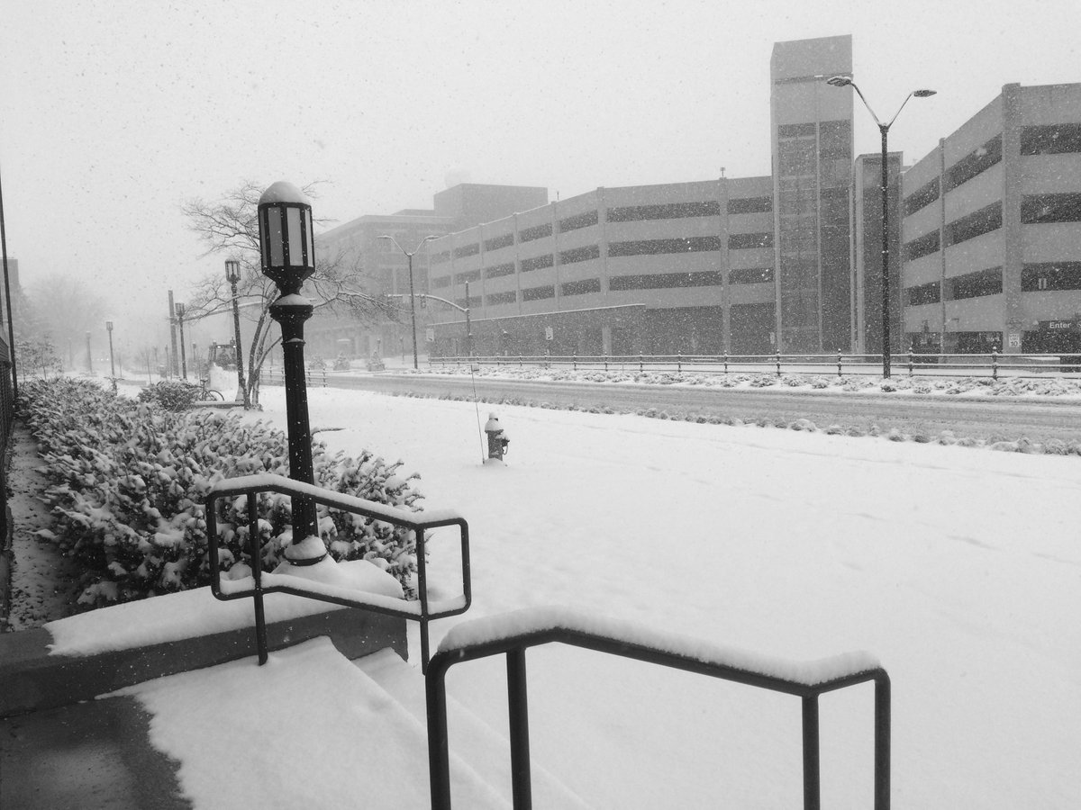
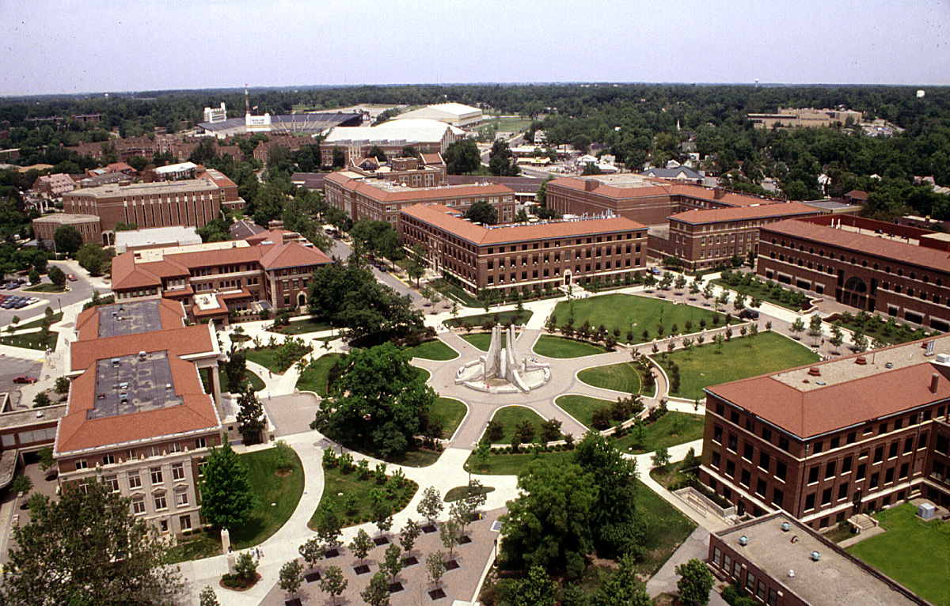
Greetings come to you from …

Slide 3
My Story
B.Tech. from IIT Kgp in CSE
MS from U. of Illinois at Urbana-Champaign in CS
PhD from U. of Illinois at Urbana-Champaign in CS
Researcher at IBM T. J. Watson Research Center in New York
Faculty at Purdue University in ECE and CS
Visiting Scientist at 2-5 companies
2013-15: Founder of startup company in embedded system reliability (SensorHound)
2021-now: Founder and CTO of startup company in cloud computing (KeyByte)
Most fun: Working with the graduated 25 PhD students, ~50 MS thesis students, and current group of 20 researchers

Slide 4
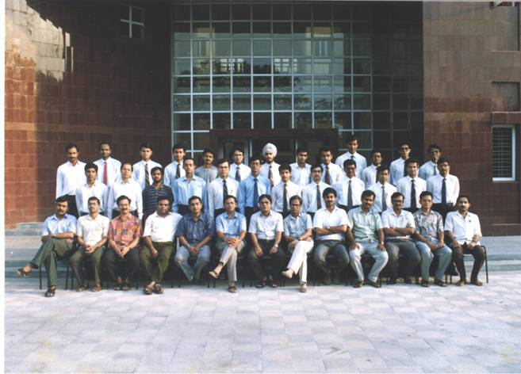
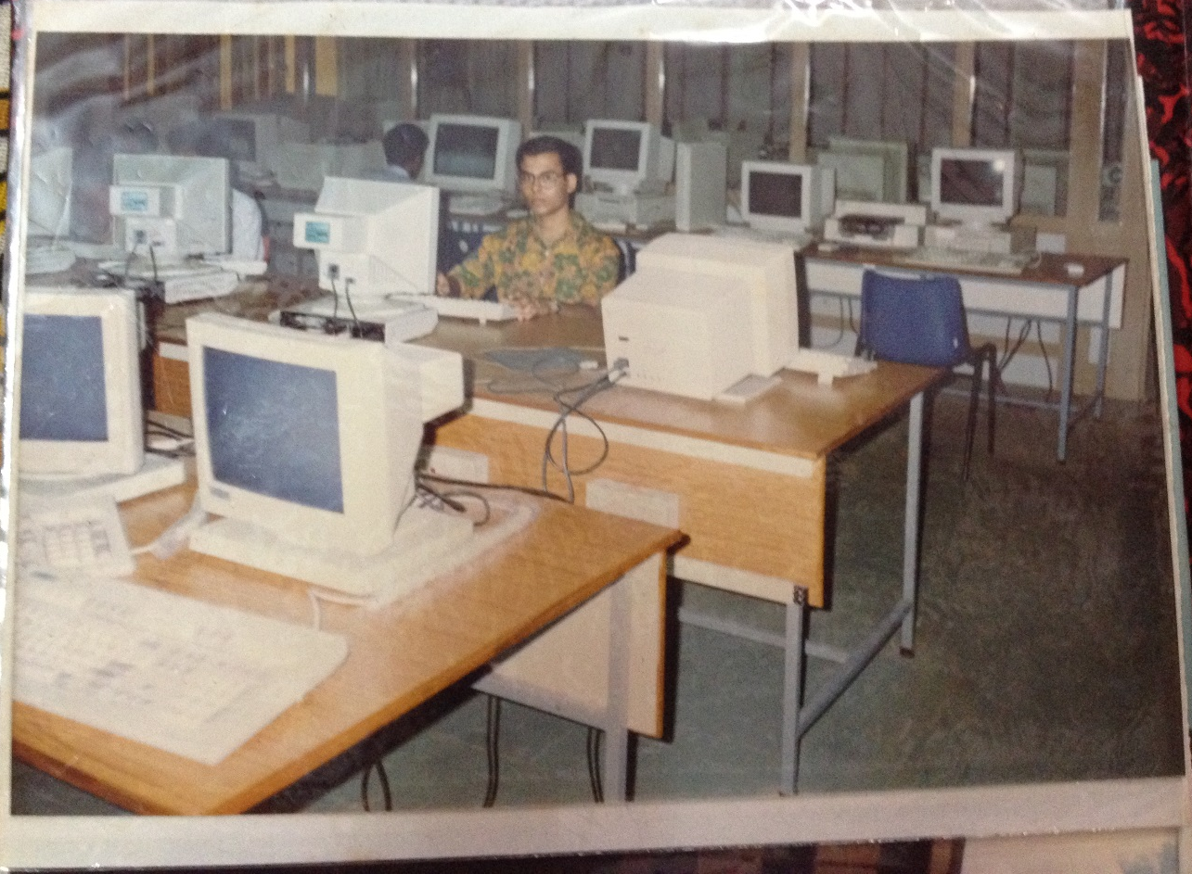
Where It All Started

Slide 5
A few words about Purdue University
One of the largest graduate schools in engineering
  500 faculty, 16,000 students, US News rank: 4th (3 years running)
  First engineering degree awarded 1878
50,000 students at its main campus in West Lafayette
Electrical and Computer Engineering @ Purdue
  130 faculty, 1300 graduate students, 2000 undergraduate students
  Largest ECE department in the US
  US News rank: 10th (Computer Engineering), 8th (Electrical/Electronics Engineering)
Computer Science @ Purdue
  85 faculty, 550 graduate students, 2500 undergraduate students
  US News rank: 20th

Slide 6
Why Should I Think of Grad School in the US?
You want to become an expert in an area of your choice
You want to have thoughts and ideas that no one has ever had before
You want to have enough resources to translate these ideas into concrete instantiations
You want to hob-nob with world class researchers from academia and industry, and leading industrial practitioners
You want to sample an environment where bright minds from all over the world come together
Notes:
When I say US, I also include the 2-3 of the top schools in Canada
First one to have the thought among the 106B people who have ever lived on this earth, starting from the Homo Sapiens 50,000 years ago.

Slide 7
Why Should I Not Think of Grad School in the US?
You will be leaving a milieu that you have lived in from your birth
You will spend an extended period of time away from family (and your favorite roadside eatery)
You will be in a challenging academic environment – many swim, but some do sink
It is a significant investment of financial resources
If you end up going to a not-so-top department, you may be severely disappointed with the quality of education and research
Notes:
So goodbye to roadside cricket, 24 hour NDTV or MTV India coverage
Favorite eatery – Heritage or PAN Loop Food Center. The latter is higher rated.

Slide 8
Terminology
Admit = The bare minimum – admission ticket to a department
Funding offer = This pays your tuition ($20K-50K/year) + your living expenses ($2-3K/month)
RA = Research Assistantship – type of funding offer – you get paid for doing research, typically tied to some specific project the professor has gotten funding for
TA = Teaching Assistantship – type of funding offer – you get paid for helping with a class
Fellowship = Type of funding offer – we will give you this just for coming to our univ – you are just that good

Slide 9
What do Professors Look for in Admitting Grad Students?
Caveat emptor: Ask 10 professors, you will get 20 answers to this question
A top undergrad place – you got this one covered
Prior research experience – published
Good grades in key courses – in addition to, or sometime rather than, overall GPA
Expression of interest in specific projects in the professor’s group
Strong, specific letters of recommendation – great if the letter writer is known to folks in the US department
Notes:
2. Does not have to be in that prof’s area of work
3. Does not matter what grade you got in the Underwater Basket Weaving class

Slide 10
What do Departments Look for in Giving TAs?
Caveat emptor: Ask 10 department chairs/associate chairs, you will get 2-3 different answers to this question
All of the points to the previous question
GRE Verbal score that does not completely stink
A good TOEFL score
A good to very good TOEFL Speaking score (27 or higher)
Sometime the department arranges a Skype/Zoom interview specifically to test teaching skills

Slide 11
What Should I Put in to Make a Killer App?
“App” as in “Graduate School Application”
All of the points mentioned in the previous two slides – to impress the professors looking to hire RAs and the department folks looking to hire TAs
All the humdrum, but terribly important, points in the instructions for the app
Have a CV where you clearly spell out your research and publications
Have a Statement of Purpose where you say which professors you want to work with and why
Do not put all your eggs in one basket

Slide 12
What Kinds of Schools Should I Apply To?
Temptation is to apply to a wide bunch
But … it costs money, effort, and pestering letter writers
Apply to ≥ 2 stretch schools
  See where Kgp-ites have gone in the recent past and seem to be doing well
  See where there are Kgp alums as faculty
Apply to schools where you have gotten some definite guidance/encouragement from faculty
Think of where you would absolutely not go to
Geographical considerations
  Almost no one thinks of them before applying,
  But they play a big factor in how enjoyable your grad school is
Notes:
Geographical consideration – UCLA story
Hate cold … Minnesota is not the place for you

Slide 13
What is Research in Computer Science Like?
Presumably some have gotten a taste of it here
It is what you want it to be
  Modulo your advisor’s wishes and whims
  Sometime dictated by the source of funding for the project
Good case scenario
  A problem you are passionate about and have some training in
  A problem somebody cares about
  Something that you can publish at a top conference in 1-2 years
Bad case scenario
  Force fit by your advisor
  No one cares if you solve the problem
  Many before have tried and failed

Slide 14

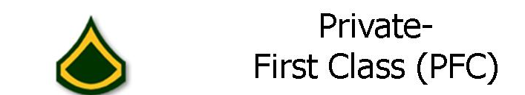




A Profile of University Professors
Three facets of professors you should consider before signing on
OR
OR
OR
Notes:
Big shot or starting assistant professor
Serenity (and detached some) or Super involved (and harried perhaps)

Slide 15
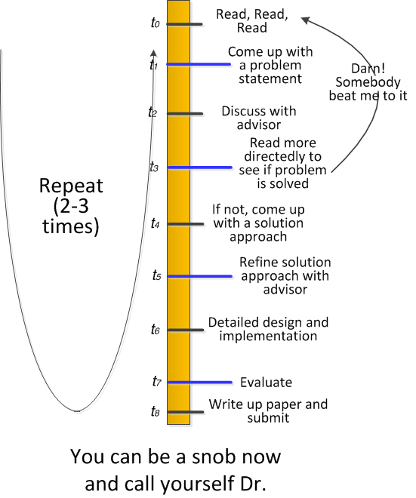
A Simplified View of the Research Process

Slide 16
What are career prospects for me after Grad School in CS?
If from a top 25 school, then very, very good in today’s economic climate (and has been for the last 25 years)
After Masters
  Leading-edge industry job
  Doing specialized work
  Prospects for fast upward movement in organization
  Significant job mobility
After PhD
  Leading-edge industry job, OR
  Post-doc at a top department (1-2 years), OR
  Tenure-track faculty position
  First line of people to be called on for research-y, high risk, high return projects in companies
Notes:
Graduates from my group routinely have 3-4 offers (Masters) and 5-6 offers (PhDs) from leading edge large or startup companies.

Slide 17
Summing It Up
We have covered
What are the factors to take into account before deciding to apply to grad school in the US?
What are important factors in your background for an RA position or a TA position?
What are the things to keep in mind to develop a compelling application?
What kinds of schools should I apply to?
What kind of academic work should I expect?
What are the traits of professors that I should keep in mind before picking my advisor?
This is my very subjective, very opinionated view
It is drawn from my experiences at Purdue, UIUC, and talking to colleagues at other top US institutions

Slide 18
Presentation available on:
Research group web page engineering.purdue.edu/dcsl

