Slide 1


Dependability for Computer Systems meets Data Analytics
Saurabh Bagchi
School of Electrical and Computer Engineering
Department of Computer Science
Director, Center for Resilient Infrastructures, Systems and Processes (CRISP)
Purdue University
Presentation available from: https://goo.gl/3X9mTz

Slide 2

Roadmap
Dependability basics
  System design principles
  Terminology and basic approaches
Context for our work
  Dependability in the small
  Dependability in the large
Dependability in data centers
Dependable sensing using crowds
Presentation available from: https://goo.gl/3X9mTz

Slide 3
Timeline
Founding Director, Purdue College of Engineering Center for Resilient Infrastructures, Systems, and Processes (CRISP) (2017-current)
Professor, Purdue University (2013-current)
Associate Professor, Purdue University (2008-2013)
Co-founder, SensorHound Inc., startup on reliable and secure IoT (2012-14)
Assistant Professor, Purdue University ECE (2002-2008)
Research Staff Member, IBM T. J. Watson Research Center (2001-2002)
PhD (2001, University of Illinois at Urbana-Champaign)

Slide 4
What is Dependable Computing?
Dependability: Property that the computer system meets its specification despite the presence of faults
  Faults can be due to natural causes (bugs, defects in hardware), or
  Maliciously induced (attacks from external or internal sources)
Property is characterized by how many concurrent faults and of what type can the system handle
Crash
Omission
Byzantine
(malicious)
Timing
Incorrect
Computation
Notes:
Failure is externally visible.
Fault tolerance is based on detecting latent errors before they become active and then replacing the erroneous part of the state with an error-free state.
Example: A programmer’s mistake is a fault in the written software. When the system executes the erroneous instructions with certain data values, say x < 0, the fault becomes active and produces an error – say some pixels in error. If the output of the program deviates from the correct value as a result of this error, that will be called a failure. But if finally the image is cropped and the erroneous pixels are left out, then it does not become a failure.

Slide 5
3 Most Important Things in Dependability
Redundancy
Redundancy
Redundancy
How much redundancy?
Where to put the redundancy?
How to validate the redundant operation?
Means of achieving dependability
Contain
Prevent
Detect
Repair
Diagnose

Slide 6
Roadmap
Dependability basics
  System design principles
  Terminology and basic approaches
Context for our work
  Dependability in the small
  Dependability in the large
Dependability in data centers
Dependable sensing using crowds
Presentation available from: https://goo.gl/3X9mTz

Slide 7
High-Level Context of Research
Our approach: Dependable system design through data analytics and at large scales (large # processes, large amounts of data)
Dependability solutions driven by 2 emerging trends
  Execution environments are changing: “All components are developed in‐house, are open source and well‐understood” → “Systems are made up of third‐party software components, some of which are partially opaque to the system owner and interactions amongst the components have many evolving patterns”
  Dependability solutions are found fragile: “Rule-based, always on, not adaptive to dynamic workloads” → “Data analytics based monitoring for correctness, which adapts to heterogeneous architectures and new workloads”

Slide 8

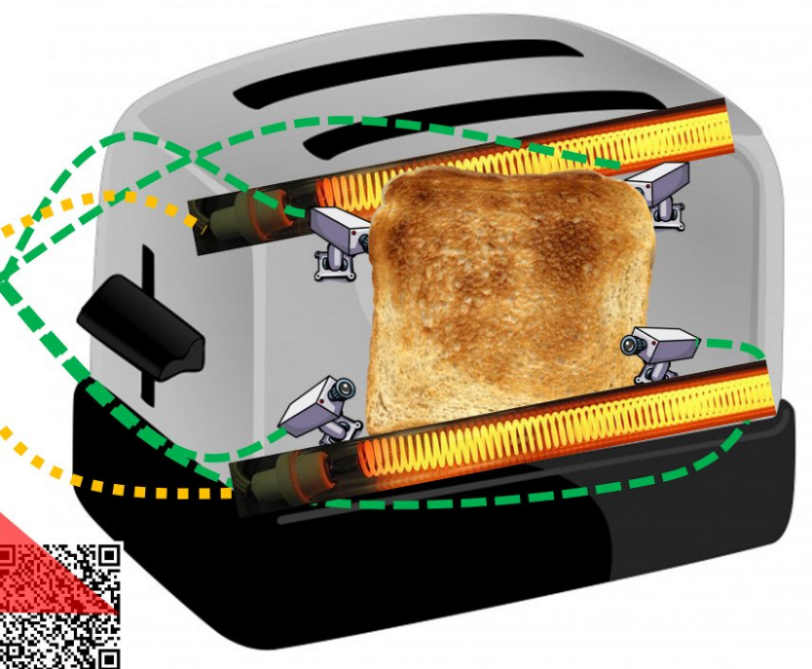
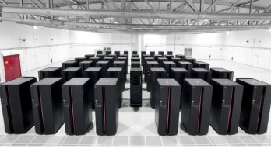
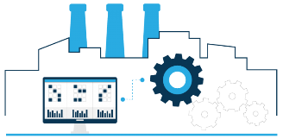

Foundation and Applications of Our Work
Application Domains (Current)
Edge & data center computing
Comp genomics
Scientific computing
Smart factory
IoT & Mobile
Application Domains (Current)
Foundational Pieces
Interpretable Data Analytics
Dependable System
Distributed Software
Scalable Design

Slide 9
Dependability in the Small: Record, Replay, Reprogram
Objective:
Embedded systems can suffer from many unpredictable errors in the field
Maintain as much of the execution trace in the field as possible
Goal is to enable record and replay:
  Capture remote execution (control flow and data flow)
  Faulty execution can be replayed through traces in a gdb-like environment
Reprogram network of wireless embedded nodes while deployed in situ
Technical Contributions:
First lossless system-level record & replay purely in software
  No timing perturbation to embedded application
  Led to detection of subtle timing bugs in distributed protocols for time synchronization and data collection; also used to detect inefficiency in network protocol stack
Fastest wireless reprogramming protocol
  Compiler and runtime techniques to minimize amount of network traffic generated due to network reprogramming
  Delta sent over and recreated on node without use of linker and loader
Failure characterization of smartphones and wearables
  Changes to software architecture of Android─adopted by Google (KitKat version, 2013)
  First study of software reliability of Android Wear-based wearable devices
Historical Context:
Extreme resource constraints – energy, network bandwidth, memory
Close interactions with surrounding physical environment and other sources of non-determinism
Complementary techniques for embedded system debugging:
Simulation and emulation; Formal verification; Language-enforced safety
Challenges with reprogramming in situ:
For correctness, all nodes in the network should receive the code completely - Reliable dissemination using unreliable wireless channels is challenging
For performance, code upload should minimize reprogramming time (functionality of network is unavailable during reprogramming) and reprogramming energy
Impact/Milestones:
Large project on community IoT testbeds for smart agriculture and smart manufacturing: $38.9M (2017-2022) funded by Lilly Endowment and a consortium of companies
Large city-wide wireless mesh network testbed for environmental monitoring in South Bend, IN (2008-current) operated by private organization EmNet LLC with support for reprogramming from our lab
Startup company out of the lab: Sensorhound Inc. (Founded 2012); 2 US patents
Sensys Best Paper Award 2011
Significant publications (last 5 years): DSN (2), IPSN, Infocom, TMC, Elsevier Ad Hoc Networks, TPDS
Include one telling breakthrough image

Slide 10
Dependability in the Small: Record, Replay, Reprogram
Objective:
Embedded systems can suffer from many unpredictable errors in the field
Maintain as much of the execution trace in the field as possible
Goal is to enable record and replay:
  Capture remote execution (control flow and data flow)
  Faulty execution can be replayed through traces in a gdb-like environment
Reprogram network of wireless embedded nodes while deployed in situ
Impact/Milestones:
Large project on community IoT testbeds for smart agriculture and smart manufacturing: $38.9M (2017-2022) funded by Lilly Endowment and a consortium of companies
Large city-wide wireless mesh network testbed for environmental monitoring in South Bend, IN (2008-current) operated by private organization EmNet LLC with support for reprogramming from our lab
Startup company out of the lab: Sensorhound Inc. (Founded 2012); 2 US patents
Sensys Best Paper Award 2011
Significant publications (last 5 years): DSN (2), IPSN, Infocom, TMC, Elsevier Ad Hoc Networks, TPDS

Slide 11
Dependability in the Small: Secure IoT Nodes and Networks
Objective:
Proliferation of Internet of Things (IoT) is bringing new levels of connectivity and automation to embedded systems
Exposes embedded systems to network-based attacks
Nodes execute a single binary image providing both OS functionality & application logic, with full privileges throughout
Well-understood server-class protections are difficult to apply
  Tight resource constraints and no availability of virtual memory, MMU, etc.
  Software design pattern that shuns abstractions and allows all code to access all data and peripherals
Apply behavioral economics to see how humans decide to invest in security for connected CPS with different owners
Technical Contributions:
Privilege separation and compartmentalization
  Automatically provided through static analysis & dynamic compartment switching
  Does not require application modification and applies to legacy code
  Leverages software pattern of embedded applications
Optimal defense computation for large-scale CPS with interconnected assets belonging to multiple owners
  Game-theoretic framework enables one-shot & moving target defense
  Decentralized computation with imperfect knowledge, using hypergames
Optimal monitoring in a fully decentralized setting
  Uses overhearing of the wireless channel & accounts for imperfections of the channel
  Applicable to networks with multiple wireless channels
Historical Context:
Conventional security principles, e.g., least privileges or process isolation are missing in low-end embedded systems
Functionality and non-functional properties (e.g., security) are deeply entangled thus hampering adoption
Little effort at compartmentalization of software components; recent efforts (e.g., ARM mBedOS) are too coarse
Strategic decision making needed to decide on security investments for interconnected CPS; decision making under imperfect knowledge of threats & other stakeholders’ decisions; prior work assumes perfect rationality and knowledge
Impact/Milestones:
Triggered commercial effort at ARM (μVisor)
Recent grants from Sandia, NSF SaTC (2)
News coverage on game theory for embedded security in Nov 2017 [ WWW ] [ WWW ] [ WWW ] [ WWW ]
GE center@Purdue: PRIAM (2015-20) on data analytics from sensor streams in their “Brilliant Factory” initiative; role as co-PI
Significant publications (last 5 years): DSN-17, Security&Privacy-17, Book chapter (game theory in embedded security)-18, GameSec-16, TMC-16, CNS-13
Include one telling breakthrough image

Slide 12
Dependability in the Small: Secure IoT Nodes and Networks
Objective:
Proliferation of IoT is bringing new levels of connectivity & automation to embedded systems
Exposes embedded systems to network-based attacks
Nodes execute a single binary image providing both OS functionality & application logic, with full privileges throughout
Well-understood server-class protections are difficult to apply
  Tight resource constraints and no availability of virtual memory, MMU, etc.
  Software design pattern that shuns abstractions and allows all code to access all data and peripherals
Apply behavioral economics to see how to protect systems when all assets cannot be protected
Richard Thaler (2017 Nobel Prize speech): “I discovered the presence of human life in a place not far, far away, where my fellow economists thought it did not exist: the economy.”
Impact/Milestones:
Triggered commercial effort at ARM (μVisor)
Recent grants from Sandia, NSF SaTC (2)
News coverage on game theory for embedded security in Nov 2017 [ WWW ] [ WWW ] [ WWW ] [ WWW ]
GE center@Purdue: PRIAM (2015-20) on data analytics from sensor streams in their “Brilliant Factory” initiative; role as co-PI
Significant publications (last 5 years): DSN-17, Security&Privacy-17, Book chapter (game theory in embedded security)-18, GameSec-16, TMC-16, CNS-13
Notes:
2002 Nobel Prize: Daniel Kahnemann
2017 Nobel Prize: Richard Thaler

Slide 13
Dependability in the Large: Data Centers and Edge Computing
Objective:
Software for data centers have many configuration options
  Large search space & dependencies among parameters
  Static configurations are not optimal with changing workloads
  Distributed software must be reconfigured with cost-benefit analysis (cost: degradation due to reconfig; benefit: better fit for new workload)
Predictions for performance or hard failures are uncertain
  Making proactive decisions (such as, initiating failover) must take into account uncertainty of prediction
  Prediction confidence often dependent on query content
Some bugs surface only at large scale
  Detecting and diagnosing such bugs is challenging
  How to recover scalably from multiple concurrent failures, e.g., in storage subsystem
Technical Contributions:
Distributed reconfiguration of data center software
  Configuration predictor demonstrated for NoSQL datastore for HPC and genomics workloads; Extended to handle distributed NoSQL clusters preserving consistency and availability guarantees
  Configuration predictor for application-level configuration demonstrated which can mitigate effect of interference due to co-location of VMs
Dependability mechanism developed for dealing with uncertainty in prediction
  Approximate computation can be run based on content of query/request
  Prediction has uncertainty quantification, feeds into dependability decision
Scale-dependent bugs and correlated failure handling
  Data analytic model developed to predict when scale-dependent bugs crop up at runtime; inversion of model allows for root cause analysis
  Distributed software to deal with data center scale failures in storage subsystem; relieves pressure on network due to repair traffic
Historical Context:
Configuring distributed data center software was done automatically based on predicted workload
  When workload changes, some automated tools can predict new optimal parameters – domain-specific techniques
  Often switching to new configuration without considering cost of the switch degrades performance
Proactive dependability mechanisms binarized predictions
  Led to fragile dependability responses – works well for predictions made on dataset identical to that seen at training
  Some work on making decisions based not just on structure of query but also on summarized data content of query
Scale-dependent bug handling in ad-hoc manner
  Little theory for detection & diagnosis of scale-dependent bugs
  Repair in storage sub-system can lead to pathological repair network traffic
Impact/Milestones:
AT&T Labs VURI Award (2016) based on work on handling failures at data center scale; Led to current commercialization effort in concurrent failure repair in Ceph file system
Visioning committee that is contributing to report on Grand Challenges in Computer Systems Research, supported as an NSF Workshop (Mar 2018)
Solution for reconfiguration in data centers – currently deployed in DOE Magellan private cloud; benefits MG-RAST, largest metagenomics portal
Significant publications (last 5 years): Middleware-17 & -14, CGO-17, Eurosys-16, PACT-15, HPDC-13, Bioinformatics-17
Include one telling breakthrough image

Slide 14
Dependability in the Large: Data Centers and Edge Computing
Objective:
Dealing with performance and hard failures in data centers
  Software is complex and has many configuration options
  Performance failures happen due to sub-optimal parameter settings
  Hard failures happen due to many causes including failure cascades
Predictions for performance or hard failures are uncertain
  Making proactive decisions (such as, initiating failover) must take into account uncertainty of prediction
  Prediction confidence often dependent on workload
Some bugs surface only at large scale
  Detecting and diagnosing such bugs is challenging
  How to recover scalably from multiple concurrent failures, e.g., in storage subsystem
Details in the talk
Details in the talk
Impact/Milestones:
AT&T Labs VURI Award (2016) based on work on handling failures at data center scale; Led to current commercialization effort in concurrent failure repair in Ceph file system
Visioning committee that is contributing to report on Grand Challenges in Computer Systems Research, supported as an NSF Workshop (Mar 2018)
Solution for reconfiguration in data centers – currently deployed in DOE Magellan private cloud; benefits MG-RAST, largest metagenomics portal
Significant publications (last 5 years): Usenix ATC-18, Middleware-17 & -14, CGO-17, Eurosys-16, PACT-15, HPDC-13
Include one telling breakthrough image

Slide 15
Dependability in the Large: Supercomputing Applications
Objective:
Current techniques for resilience are insufficient for exascale
  Radical changes are needed across the entire software stack because the rate of errors system-wide will rise
  Otherwise, exascale systems will often compute unreliable scientific results
Replication‐based approaches in software have promise
  But blind replication of all tasks will blow the performance and energy budget
  A less blunt instrument is needed; Allow large‐scale runtime to isolate regions where faults occur and replicate only those parts
Monitoring for subtle errors at scale
  Detecting and diagnosing errors such as data corruptions, cascading performance degradation, etc. is challenging
  How to do this in heterogeneous architecture machines is unknown
Technical Contributions:
Scalable and flexible techniques to detect errors (Heisenbugs, anomalies in runtime execution environment)
  Technique to accurately identify silent data corruptions based on the simple insight that there exist spatial and temporal locality within most variables in a parallel program (Sirius)
  Technique for root cause analysis of hangs through determining relative progress among parallel tasks via dynamic analysis (Prodometer)
  Practical tools can scale to sizes of the large supercomputing applications
Application portability to CPU-GPU clusters while preserving resilience
  Developed Domain Specific Language (DSL) and toolset for development of scalable computational genomics applications
  Scalable algorithm to correct errors due to sequencing instruments, without needing a reference dataset
  Identification of optimal parameters for GPU kernels in such applications
Historical Context:
Debugging large-scale parallel applications is a daunting task
  Human cognition cannot cope with large number of execution units
  Active work in the last ~8 years to provide semi-automated tools (starting with our DSN-10, SC-11 papers)
  Key insight: Although there is a large # tasks in a large-scale application, # behavioral equivalence classes is much smaller and does not grow with the scale of the application (i.e., task counts and input data)
  Behavioral equivalence classes can be identified using control flow graph
  Isolate any task, or tasks, that deviates from its assigned behavior class due to bug or anomaly in runtime environment
Application portability while preserving resilience
  How to port applications to heterogeneous computing environments while ensuring they still compute correctly
  Application focus on scaling out genomics applications that need to use the large supercomputing clusters due to sharp increase in data sizes
Impact/Milestones:
Prodometer and AutomaDeD are part of standard software stack on DOE supercomputers (LLNL, ANL); 2013 Gordon Bell Prize was given for the largest fluid dynamics simulation run at LLNL and AutomaDeD was acknowledged as the debugging tool [ WWW ]
Part of the DOE-organized committee that wrote the report on “Addressing failures in exascale computing” (2014)
Best paper award: ACM BCB (2015) – on distributed, fault-tolerant software for pattern mining in genomics data
Significant publications (last 5 years): BCB-15 & 17, ICS-16, PLDI-14, PACT-12, TPDS-15, Nucleic Acids Research-15
CACM Contributed Article “Debugging High-Performance Computing Applications at Massive Scales” with community of co-authors (2015)
Funding from DOE and NIH R01
Include one telling breakthrough image

Slide 16
Dependability in the Large: Supercomputing Applications
Objective:
Current techniques for resilience are insufficient for exascale
  Radical changes are needed across the entire software stack because the rate of errors system-wide will rise
  Otherwise, exascale systems will often compute unreliable scientific results
Replication‐based approaches in software have promise
  But blind replication of all tasks will blow the performance and energy budget
  A less blunt instrument is needed; Allow large‐scale runtime to isolate regions where faults occur and replicate only those parts
Monitoring for subtle errors at scale
  Detecting and diagnosing errors like data corruptions, cascading performance degradation, etc. is challenging
  How to do this in heterogeneous architecture machines is unknown
Impact/Milestones:
Prodometer and AutomaDeD are part of standard software stack on DOE supercomputers (LLNL, ANL); 2013 Gordon Bell Prize was awarded for the largest fluid dynamics simulation run at LLNL and AutomaDeD was acknowledged as the debugging tool [ WWW ]
Part of DOE-organized committee that wrote the report on “Addressing failures in exascale computing” (2014)
Best paper award: ACM BCB (2015) – on distributed, fault-tolerant software for pattern mining in genomics data
Significant publications (last 5 years): BCB-15 & 17, ICS-16, PLDI-14, PACT-12, TPDS-15, Nucleic Acids Research-15
CACM Contributed Article “Debugging High-Performance Computing Applications at Massive Scales” with community of co-authors (2015)
Funding from DOE and NIH R01
Include one telling breakthrough image

Slide 17
Roadmap
Dependability basics
Context for our work
Dependability in data centers [Usenix ATC-18, Middleware-17, Eurosys-16]
Dependable sensing using crowds
Presentation available from: https://goo.gl/3X9mTz

Slide 18
Roadmap
Dependability basics
Context for our work
Dependability in data centers [Usenix ATC-18, Middleware-17, Eurosys-16]
  Problem of big data
  Problem of repair of big data
  Our solution: Partial parallel repair (PPR)
  Evaluation
Dependable sensing using crowds
Presentation available from: https://goo.gl/3X9mTz

Slide 19
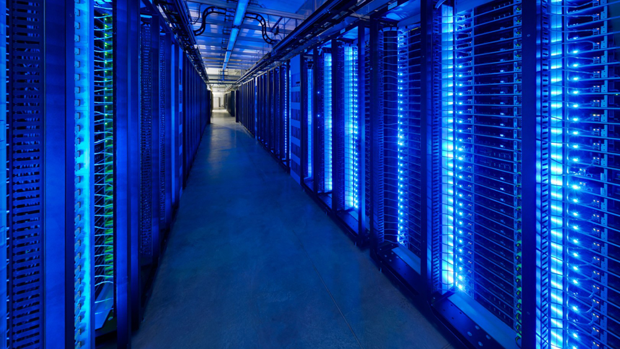


Problem of (Storing) Big Data
Data center storages are frequently affected by unavailability events
Unplanned unavailability:
  - Component failures, network congestions, software glitches, power failures
Planned unavailability:
  - Software/hardware updates, infrastructure maintenance
How storage redundancy helps ?
Prevents permanent data loss (Reliability)
Keeps the data accessible to the user (Availability)
Notes:
Datacenters are frequently affected by outages or unavailability events when some parts of the datacenter stops working. Few of these cases even make it to the headlines.
Some of these unavailability events are results of component failures, software bugs, power outages etc. However, there can be planned unavailability events as well caused by planned updates and infrastructure maintenance.
Some amount of storage redundancy is crucial to cope with these unavailability events.
Redundancy provides reliability, i.e. it can prevent permanent data loss. It also increases availability, i.e., keeps the data accessible to the user even under certain failures.

Slide 20
Replication for storage redundancy
With us since the dawn of computing and so very well engineered
Data
Keep multiple copies of the data in different machines
Data is divided in chunks
Each chunk is replicated multiple times
But replication is not well suited for big data storage
  Triple replication requires 2X storage redundancy
  Storage overhead becomes cost prohibitive for large volume of data
Notes:
Replication is the most widely used storage redundancy technique. The Key idea is to store multiple replicas on different machines in such a way so that not all the copies will be lost at the same time in case of an unavailability event. They way it is done in practice is to divide the data into chunks. Then each chunk is replicated multiple times for fault tolerance.
For example, triple replication can tolerate up to 2 failures out of the 3 available chunk replicas.

Slide 21
Erasure coded (EC) storage
Data
Stripe
k data chunks
m parity chunks
Can survive up to m chunk failures
Reed-Solomon (RS) is the most popular coding method
Erasure coding has much lower storage overhead while providing same or better reliability
Example for 10 TB of data
Redundancy method | Total storage required | Reliability
Triple Replication | 30 TB | 2 Failures
RS (k=6, m=3) | 15 TB | 3 Failures
RS (k=12, m=4) | 13.34 TB | 4 Failures
Notes:
Erasure coding has come out as a very attractive alternative to replication in the area of distributed storage. In Erasure coded storage …data is first divided into “k” number of chunks. Then another set of “m” parity chunks are calculated using some mathematical operations. The total ensemble of “k+m” chunks can survive upto “m” failures.
RS (k=6, m=3). 10 TB data is stored as 10*(6+3)/6 = 15 TB. Can survive m=3 failures.
Of course failures in RS and failures in simple replication are not totally comparable. In RS*6, 3), can tolerate 3 failures out of 9, in triple replication can tolerate 2 failures out of 3.

Slide 22
Roadmap
Dependability basics
Context for our work
Dependability in data centers [Usenix ATC-18, Middleware-17, Eurosys-16]
  Problem of big data
  Problem of repair of big data
  Our solution: Partial parallel repair (PPR)
  Evaluation
Dependable sensing using crowds
Presentation available from: https://goo.gl/3X9mTz

Slide 23
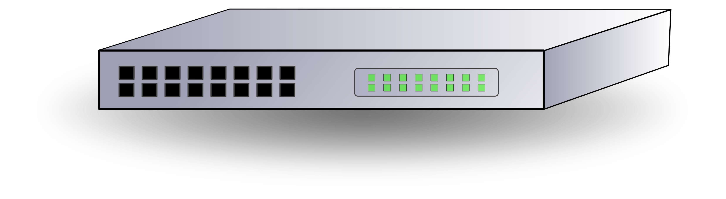
The Repair Problem in EC Storage
(4, 2) RS code
Chunk size = 256MB
Bottleneck
S1
S2
S3
S4
S5
S6
S7
Data chunks
Parity chunks
Crashed
New destination
Network bottleneck slows down the repair process
Notes:
However, there is a key problem that prohibits wide scale adaptation of the erasure coded storage. The reconstruction time for a missing chunk is very long.
Through an example, I will describe the reason behind this repair problem.
Lets say we have a (4, 2) Reed-Solomon coding and the chunks are distributed over several servers.
Now if server S1 goes down, the missing chunk will be recreated in S7 using chunks from servers S1 through S5. At first S7 collects all the data and then performs some mathematical operation to recreate it.

Slide 24
The Repair Problem in EC Storage
Repair time in EC is much longer than replication
Example for 10 TB of data
Redundancy method | Total storage required | Reliability
Triple Replication | 30 TB | 2 Failures
RS (k=6, m=3) | 15 TB | 3 Failures
RS (k=12, m=4) | 13.33 TB | 4 Failures
# chunks transferred during a repair
1
6
12
For a chunk size of 256MB this would be a 12 x 256 MB > 3 GB of data transfer over a particular link!
Notes:
If you compare it with replication, it is much worse.
If a chunk fails in replication, we can just get a copy from its replica. In erasure coded storage, we need multiple chunk transfers over a network link.
Often chunk sizes are large, for example, 256MB. So we are talking about 12 x 256MB > 3 GB of data transfer over a link.

Slide 25
What Triggers a Repair?
Monitoring process finds unavailable chunks
  Regular repairs
  Chunk is re-created in a new server
Client finds missing or corrupted chunks
  Degraded reads
  Chunk is re-created in the client
  On the critical path of the user application
Notes:
There can be one of two ways how such repairs are triggered. Either a monitoring process finds about a missing chunk and initiates a repair. We call it regular repairs.
Or a client while trying to read the data discovers the chunk is missing and initiates a repair. We call degraded reads.
Bullet 2: Cat video

Slide 26
Existing Solutions
Keep additional parities: Need additional storage
Huang et al. (ATC-2012), Sathiamoorthy et al. (VLDB-2013)
Mix of both replication and erasure code: Higher storage overhead than EC
Xia et al. (FAST-2015), Ma et al. (INFOCOM-2013)
Repair friendly codes: Restricted parameters
Khan et al. (FAST-2012), Xiang et al. (SIGMETRICS-2010),
Hu et al. (FAST-2012), Rashmi et al. (SIGCOMM-2014)
Delay repairs: Depends on policy. Immediate repair needed for degraded reads
Silberstein et al. (SYSTOR-2014)
Notes:
There is large body of work that attempted to solve this problem. The overall approach can be broadly classified into these 4 categories.

Slide 27
Roadmap
Dependability basics
Context for our work
Dependability in data centers [Usenix ATC-18, Middleware-17, Eurosys-16]
  Problem of big data
  Problem of repair of big data
  Our solution: Partial parallel repair (PPR)
  Evaluation
Dependable sensing using crowds
Presentation available from: https://goo.gl/3X9mTz

Slide 28
Our Solution Approach
Motivating observations:
Over 98% involve single chunk failure in a stripe
Network transfer time dominates the repair time
We introduce:
Partial Parallel Repair (PPR) - a distributed repair technique
Focused on reducing repair time for a single chunk failure in a stripe
Notes:
Our solution is orthogonal to these previous works and is based on two observations.
First, most of the failure scenarios involve only one missing chunk in a stripe. Second, network transfer time dominates overall repair time.
We present partial-parallel-repair a distributed repair technique focused on reducing repair time for single chunk failure in a stripe.

Slide 29
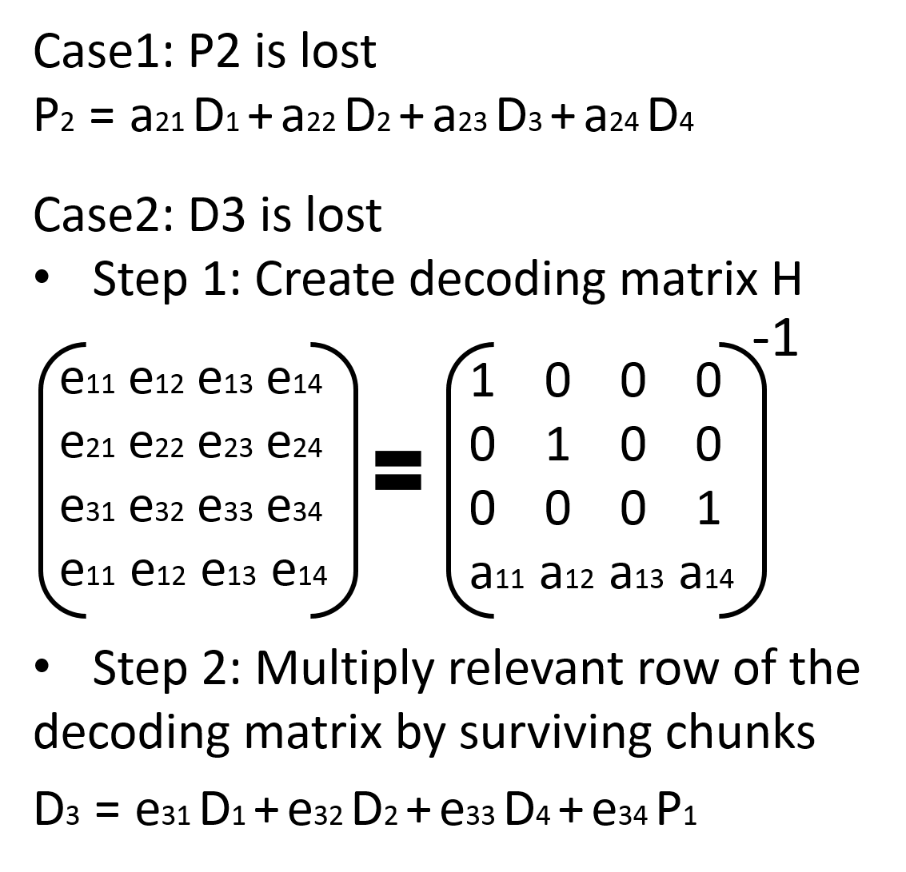
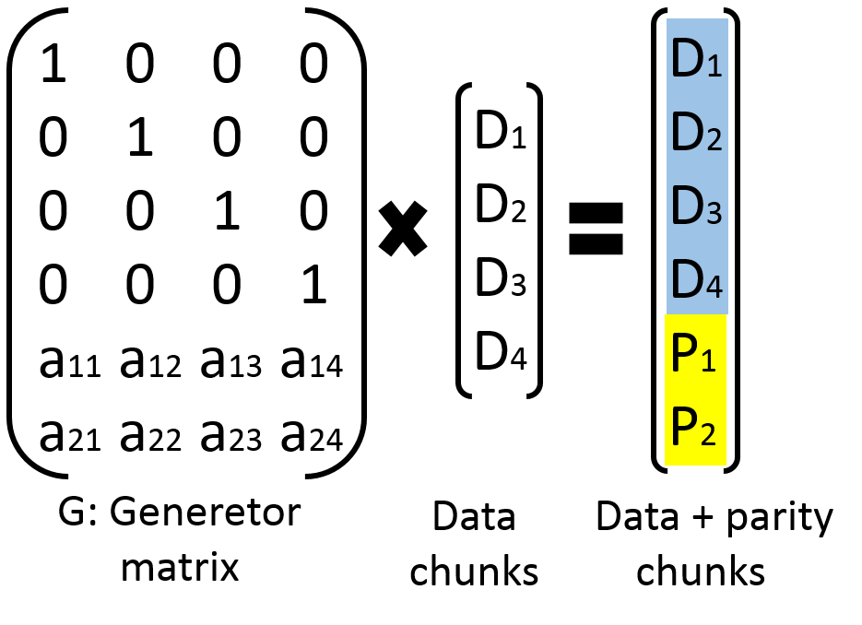
Key Insight: Partial Calculations
Encoding
Repair
Equations are associative
Individual terms can be calculated in parallel
Notes:
Our solution is based on some insights of the mathematical calculations involved in Erasure coded storage.
Therefore, let me give you a quick overview of the mathematics involved here.
To encode the parity chunks, data chunks are multiplied by a matrix with some special coefficients.
During repair of a missing chunk, two kind of operations might happen depending on whether a parity chunk was lost.
If a parity chunk is lost, it is simply re-encoded using this equation. If a data chunk is lost, depending what are the surviving chunk, a set of coefficients are calculated and the lost chunk is reconstructed using existing chunk.
It can be seen, both the equations have similar form. Are associative and the terms can be calculated in parallel.

Slide 30
Partial Parallel Repair In Action
Traditional Repair
Partial Parallel Repair
Bottleneck
S1
S2
S3
S4
S5
S6
S7
S1
S2
S3
S4
S5
S6
S7
a₂C₂ + a₃C₃ + a₄C₄+ a₅C₅
a₂C₂
a₂C₂ + a₃C₃
a₄C₄
a₄C₄ + a₅C₅
a₂C₂ + a₃C₃+ a₄C₄ + a₅C₅
Notes:
Armed with this observation, we design a repair technique which is distributed over multiple nodes.
Recall the problem with traditional repair was many chunks were travelling over a particular link. Network bottleneck created because all the computation was being done in the new destination.
Our Partial Parallel Repair techniques involve few logical steps. In each such steps some partial results are calculated in parallel in multiple nodes and sent to a peer upstream node. You can see, not all “k” chunks are sent over any particular link, hence no bottleneck is created.

Slide 31
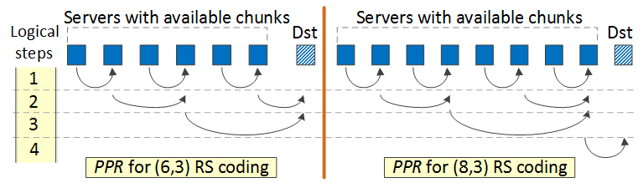
PPR Communication Patterns
 | Traditional Repair | PPR
Network transfer time | O(k) | O(log₂(k+1))
Repair traffic flow | Many to one | More evenly distributed
Amount of transferred data | Same | Same
Notes:
Here are more examples of the communication pattern involved in PPR . The main advantage of PPR comes from better distributing the repair traffic.
It can be shown PPR takes only about order of log(k) time to complete the network transfer instead of order k time as in the traditional case.
Although, it must be noted the total amount data transferred is exactly same as the traditional repair.

Slide 32
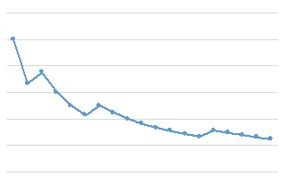
When is PPR Most Useful ?
Network transfer times during repair:
Traditional RS (k, m) (chunk size / bandwidth) * k
PPR (chunk size / bandwidth) * ⎡log₂(k+1)⎤
1.2
1.0
0.8
0.6
0.4
0.2
0.0
PPR is useful when
k is large
Network is the bottleneck
Chunk size is large
PPR / Traditional
2 4 6 8 10 12 14 16 18 20
k
Notes:
So when is PPR most useful ? These equations represent the theoretical calculation for network transfer time in Traditional and in PPR.
It can be seen the effectiveness of PPR increases for larger K. (FB uses k=10, Microsoft K=12, Some companies use K=20). A value is determined based on reliability analysis.
Since PPR reduced network transfer time, it is most useful if network is the bottleneck.
We found larger chunk size also tend to create network bottleneck, hence PPR is more useful with larger chunk sizes.

Slide 33
Additional Benefits of PPR
Maximum data transferred to/from any node is logarithmically lower
  Implications: Less repair bandwidth reservation per node
Computation is parallelized across multiple nodes
  Implications: Lower memory footprint per node and computation speedup
PPR works if encoding/decoding operations are associative
  - Implications: Compatible with a wide range of codes including RS, LRC, RS-Hitchhiker, Rotated-RS etc.
Notes:
With PPR, along with the improvement in network transfer time, we get 3 additional benefits.
Maximum data transferred to and from any node is logarithmically lower. This can attractive in Software-defined-storage where some bandwidth is reserved for the repair traffic.
Computations are parallelized over multiple nodes resulting in speedup and lower memory footprint per node.
PPR works with any associative code. That means it can work with a wide variety of codes proposed in the prior works.

Slide 34


Can We Reduce Repair Time Further?
Disk I/O is the second dominant factor in the total repair time
Use caching technique to bypass disk I/O time
chunkID | Last access time | Server
C1 | t1 | A
chunkID | Last access time
C1 | t1
C2 | t2 | B
Added C1
A
Read C1
Repair Manager
Added C2
Read C2
Client
chunkID | Last access time
C2 | t2
B
Notes:
Our goal is to reduce total repair time as much as possible to make Erasure coded storage a viable option. Can we do anything else to further reduce the repair time.
Disk I/O is the second dominant factor in the repair time.
We use a form of caching to reduce the repair time. Repair manager is a logically centralized entity which schedules the repairs corresponding to these failures.
This technique is not specific to PPR and can also be used by the traditional technique.

Slide 35
Multiple Concurrent Failures
m-PPR: a scheduling mechanism for running multiple PPR based jobs
Chunk Failures
C1
C2
C3
Repair Manager
Schedule repair | Chosen servers
C2 | < , , , >
C3 | < , , , >
C1 | < , , , >
A greedy approach. Attempts to minimize resource contention
Notes:
Nightmare of dependable systems designer.
It is likely that at any point there can be failures in multiple stripes across the datacenter.
We propose a simple greedy heuristic, called multi-PPR (or m-PPR) that would help the repair manager to prioritize these repairs and select the best source and destination servers. Our scheduling technique attempts to minimize the resource contention across multiple repairs. Details of this can be found in the paper.

Slide 36
Roadmap
Dependability basics
Context for our work
Dependability in data centers [Usenix ATC-18, Middleware-17, Eurosys-16]
  Problem of big data
  Problem of repair of big data
  Our solution: Partial parallel repair (PPR)
  Evaluation
Dependable sensing using crowds
Presentation available from: https://goo.gl/3X9mTz

Slide 37
Evaluation
Implemented on top of Quantcast File System (QFS)
  QFS has similar architecture to HDFS
Repair Manager implemented inside the Meta Server of QFS
Evaluated with various coding parameters and chunk sizes
Evaluated PPR with Reed-Solomon code and two other repair friendly codes (LRC and Rotated-RS)
Notes:
We implemented PPR on top of Quantcast Files System which has similar architecture as HDFS with an already existing support for Erasure codes.
Our Repair manager was implemented within the Meta-Server component of QFS. Meta-Server is similar to Name-Node in HDFS. We evaluated PPR with various coding parameters and chunk sizes. Most importantly we show its benefits when used two previously proposed repair friendly coding techniques.

Slide 38
Repair Time Improvements
PPR becomes more effective for higher values of “k”
Notes:
Y axis is the percentage reduction in repair time. PPR becomes more effective for higher K, as expected.
Higher chunk size creates more network traffic increasing the percentage of network transfer time. Thus the improvement becomes higher for larger chunk sizes.

Slide 39
Improvements for Degraded Reads
PPR becomes more effective under constrained network bandwidth
Notes:
For degraded reads PPR is also extremely useful. Y axis is the degraded read throughput.
Clients can have much less bandwidth. Here we show as the bandwidth available to the client decreases, PPR becomes more and more affective.
.

Slide 40
Compatibility with Existing Codes
PPR on top of LRC (Huang et al. in ATC-2012) provides 19% additional savings
PPR on top of Rotated Reed-Solomon (by Khan et al. in FAST-2012) provides 35% additional savings
Notes:
The most useful benefit of PPR is its compatibility to a wide variety of codes.
LRC and Rotated-RS are two codes proposed to reduce the repair traffic.
Here we show, PPR based technique can be used on top of those codes to get additional savings.

Slide 41
Takeaways: Recovering from Data Center Storage Failures
Partial Parallel Repair (PPR) a technique for distributing the repair task over multiple nodes to improve network utilization
Theoretically, PPR can logarithmically reduce the network transfer time
PPR is more attractive for higher “k” in (k, m) RS coding
PPR is compatible with any associative codes
Since this work appeared, patent filed jointly with AT&T and Purdue and commercialization of the technique (after reimplementation into Ceph)
Notes:
We introduced Partial Parallel Repair – a distributed repair technique for erasure coded storage.
PPR can reduce network transfer time, logarithmically.
PPR is more attractive for higher values of K and when the repair is constrained by the network transfer.
PPR work not only with Reed-Solomon coding but also with a wide variety of associative codes.

Slide 42
Roadmap
Dependability basics
Context for our work
Dependability in data centers [Usenix ATC-18, Middleware-17, Eurosys-16]
Dependable sensing using crowds [Sensys-18 (under submission), DSN-18, Middleware-17, CrowdSense-17]
Presentation available from: https://goo.gl/3X9mTz

Slide 43
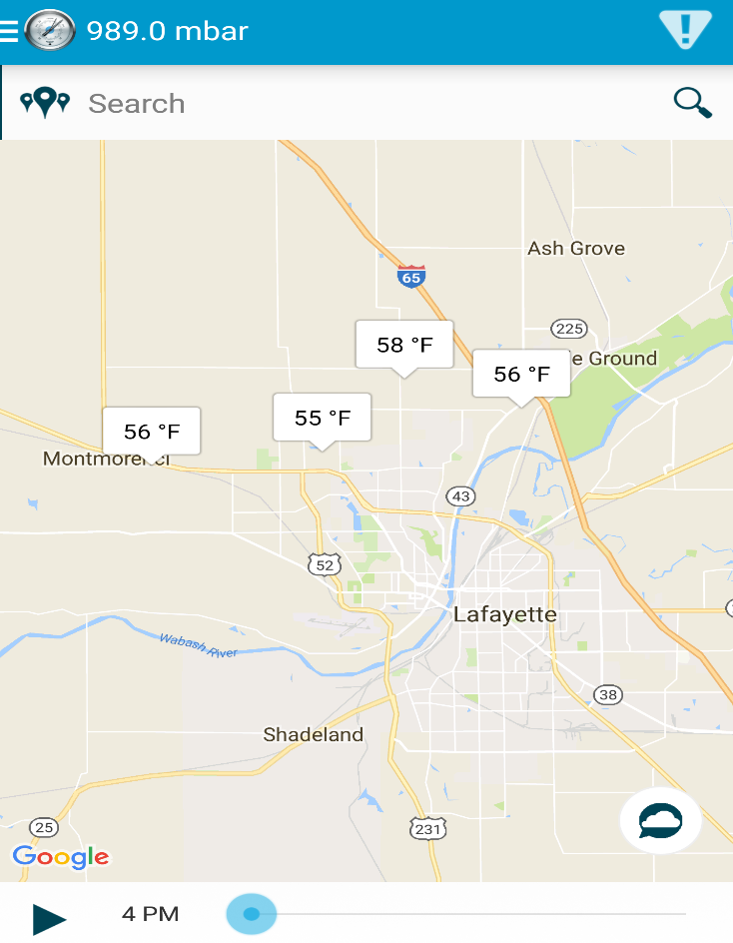
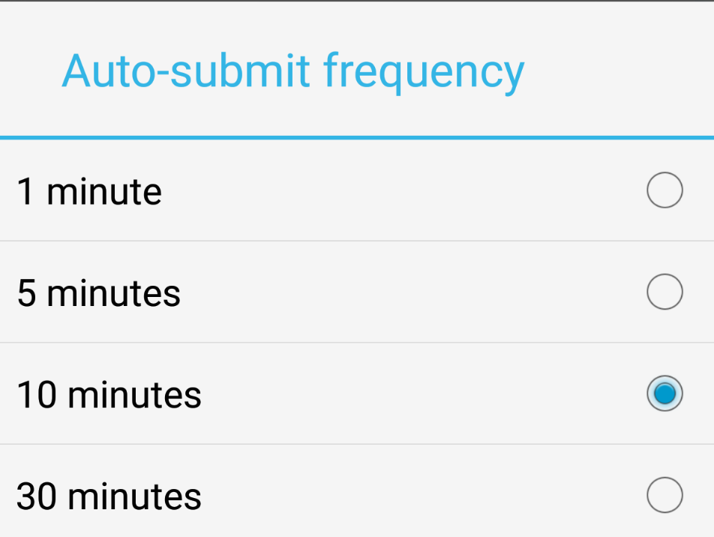
What is Mobile Crowdsensing (MCS)?
Synthesize knowledge from mobile device sensors (e.g., maps of noise, pressure, potholes)
Pressurenet
Periodic sensing and submit
Or manual submit

Slide 44
Why Mobile Crowdsensing?
Smartphones are ubiquitous and are equipped with highly sophisticated sensors
  Barometer, gyroscope, accelerometer, thermometer can be used for various applications
  Weather prediction, Noise pollution map, road and traffic condition reporting
Reported information is real-time and less costly
Cellular network support
  Fast, mostly reliable, and widely available
Notes:
Why we need it and why it can benefit people?

Slide 45
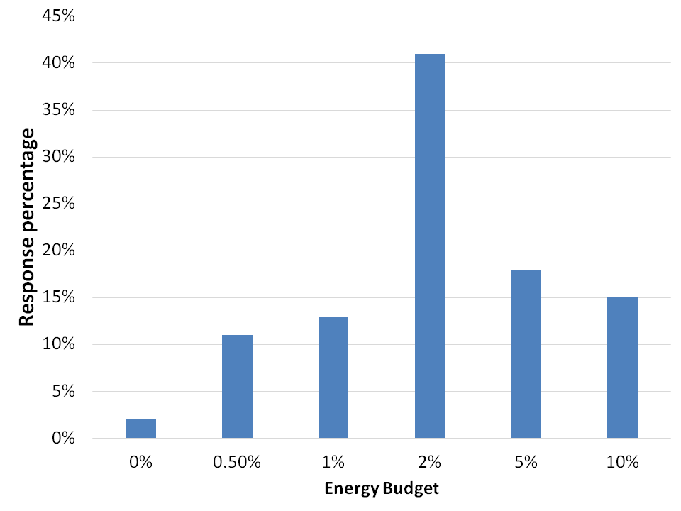
But … Clouds
Why do we care about energy consumption?
Result from survey of 109 college students from the U.S., China, and India about how much of their smartphone battery they are willing to sacrifice for a socially conscious MCS project
Goals:
  Save per device energy as well as total energy for all MCS tasks
  Ensure fairness among multiple devices
Insights:
  MCS tasks are delay tolerant
  There is spatial redundancy of users
  Smartphones have opportune moments for MCS communications

Slide 46
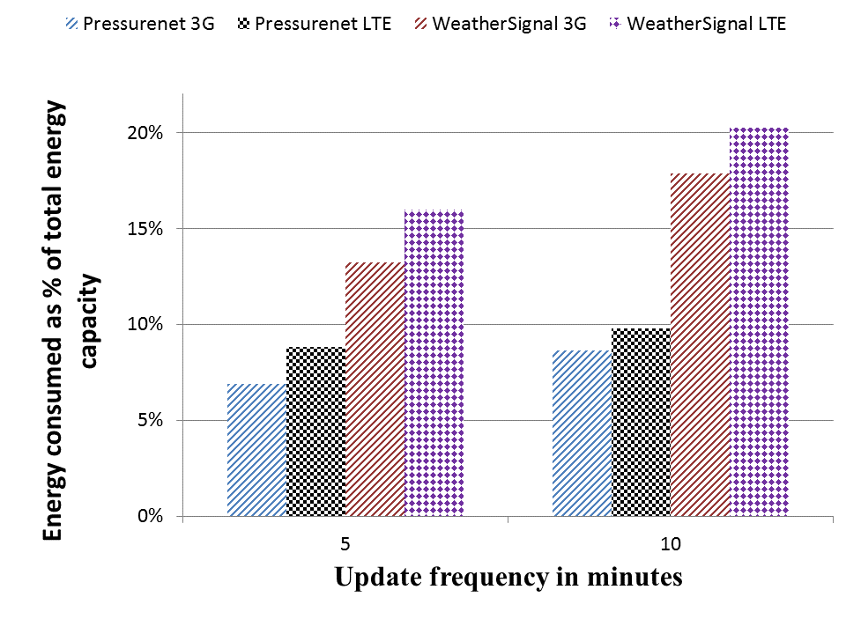
Is MCS Energy Efficient Enough Now?
NO!
4 hrs for 5 mins frequency & 8 hrs for 10 mins frequency
Pressurenet: barometer
WeatherSignal: temperature, magnetic, light, etc

Slide 47
Roadmap
Dependability basics
Context for our work
Dependability in data centers [Usenix ATC-18, Middleware-17, Eurosys-16]
Dependable sensing using crowds [Sensys-18 (under submission), DSN-18, Middleware-17, CrowdSense-17]
  What is mobile crowdsensing
  Problems with mobile crowdsensing
  Our solution: Sense-Aid
  Evaluation
Presentation available from: https://goo.gl/3X9mTz

Slide 48
Sense-Aid: MCS and Battery life in One
Our solution: Sense-Aid ─ A MCS infrastructure embedded at the edge of 4G network to provide energy-efficient crowdsensing service
Key techniques
  Piggyback MCS data packet
  Cellular radio state opportunity
  Orchestration among many devices

Slide 49
Sense-Aid Architecture
Pick device information that is available from MME and eNodeB
Path 1 if incoming traffic to eNodeB does not include MCS data. Also the backup when failure at Sense-Aid Server
Path 2 if MCS data in incoming traffic
Terminology
  Crowdsensing Application Server (Server of Pressurenet)
  Crowdsensing client application (Pressurenet)
  Sense-Aid Server (Scheduler)
A
C
B
B
C
A

Slide 50
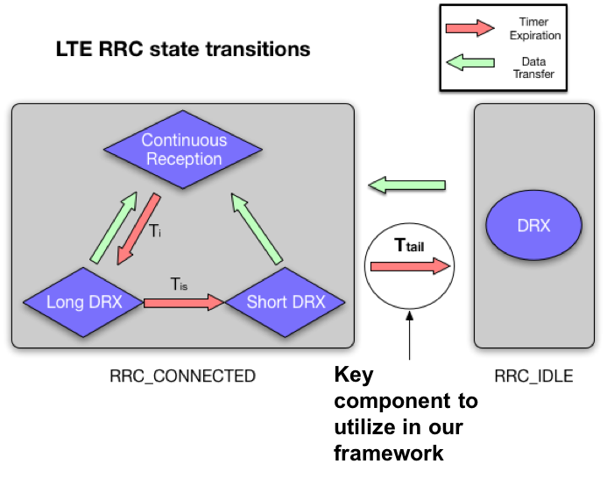
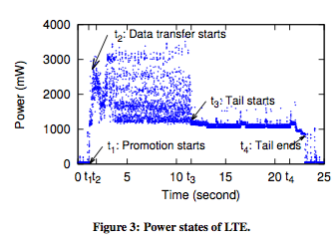
LTE State Machine
Radio state opportunity
  Tail time is roughly 11.5 secs in LTE (specified by RRC protocol)
  MCS traffic is short (600 bytes in our user study)
  Device RRC state is available in eNodeB
Notes:
The reason for tail time is to reduce state promotion then RAN overhead and delay in user during frequent network operation.
tail time → transition between connected and IDLE is too often. transition is very expensive. therefore tail time.
less time.

Slide 51
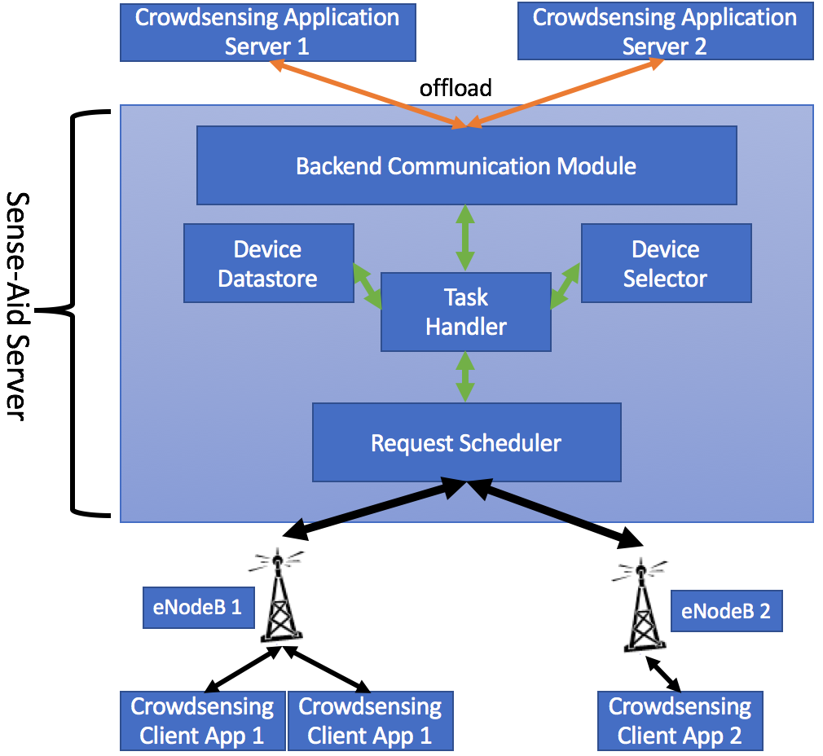
Sense-Aid Server Design
Task
Control Parameter | Description
int sensor_type | Specifies what sensor is wanted for a MCS task
int sampling_period | Specifies the period between two consecutive samples
int area_radius | Specifies the circular task area radius
int spatial_density | Specifies the number of users are required
Request 1
Request 2
Request 3
Req 1
Req 1
Req 2
Req 2
Req 3
Device 1
Device 2
Req 3
Device 3

Slide 52
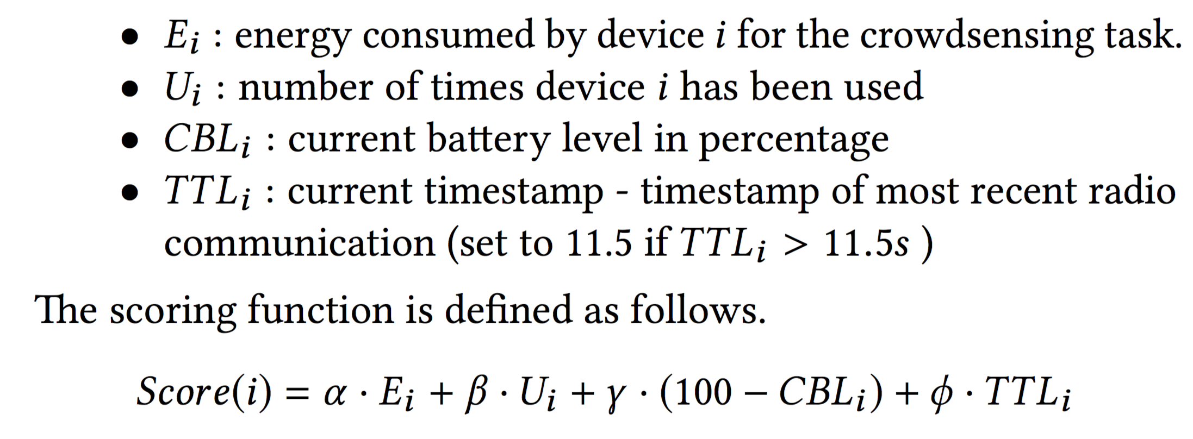
Sense-Aid Server Scheduling
Device selection (if n < N)
  Run scoring function over N (total available devices)
  Choose the lowest scored n (required number of devices ) devices
  Maintain overall fairness
Notes:
Three opportunities:
Tail→ TTL→ piggyback
orchestration → fairness.

Slide 53
Roadmap
Dependability basics
Context for our work
Dependability in data centers [Usenix ATC-18, Middleware-17, Eurosys-16]
Dependable sensing using crowds [Sensys-18 (under submission), DSN-18, Middleware-17, CrowdSense-17]
  What is mobile crowdsensing
  Problems with mobile crowdsensing
  Our solution: Sense-Aid
  Evaluation
Presentation available from: https://goo.gl/3X9mTz

Slide 54
Implementation
Sense-Aid Basic
  Resets tail timer
Sense-Aid Complete
  Does not reset tail timer
  Saves more energy
Baseline competition:
  Periodic: Periodic sensing and communication with MCS server
  PCS [Sensys-13]: Piggybacks the crowdsensed data to the PCS server based on prediction of the regular app usage on the device
Notes:
Why not always use complete.:
tail timer may not be tuned on some smartphones.
Near end tail time may crash long packet. e.g. tail left = 1s. but packet needs 2 seconds to send. Then just first half is sent and the second half is crashed.

Slide 55
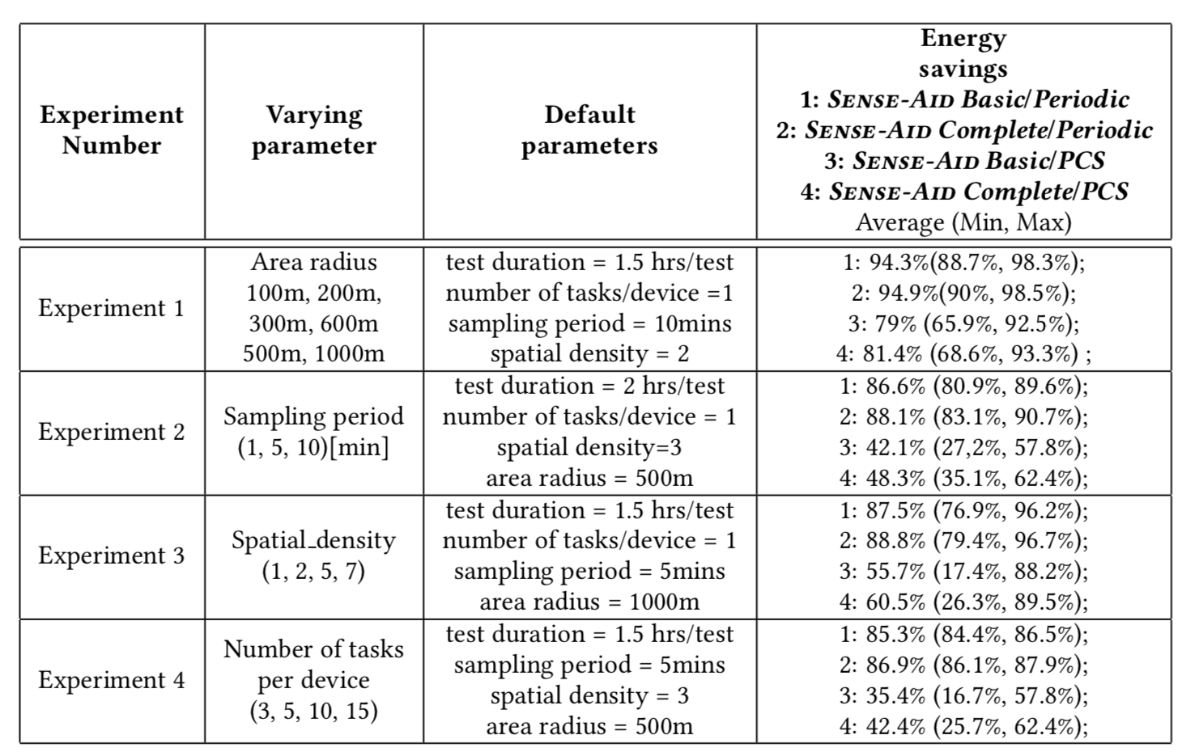
Evaluation
User study for 1 week.
  3 groups. 20 Purdue students in each group, doing their daily activities. Each group is running one of the three frameworks: Sense-Aid, PCS, Periodic

Slide 56
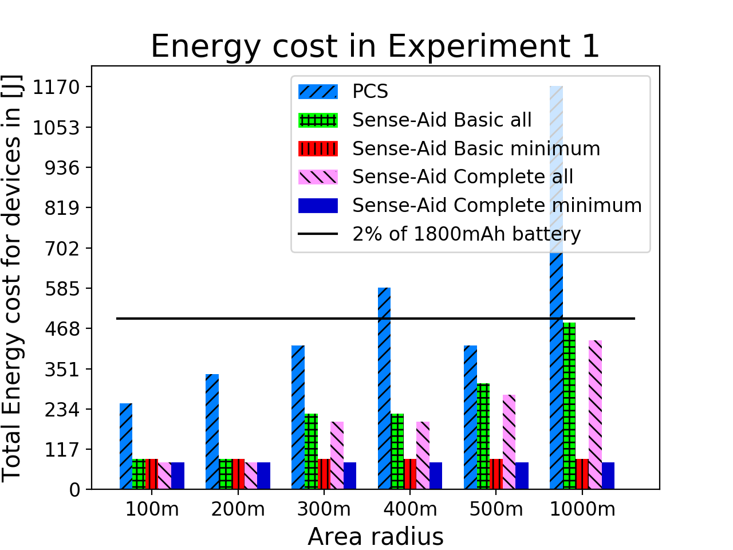
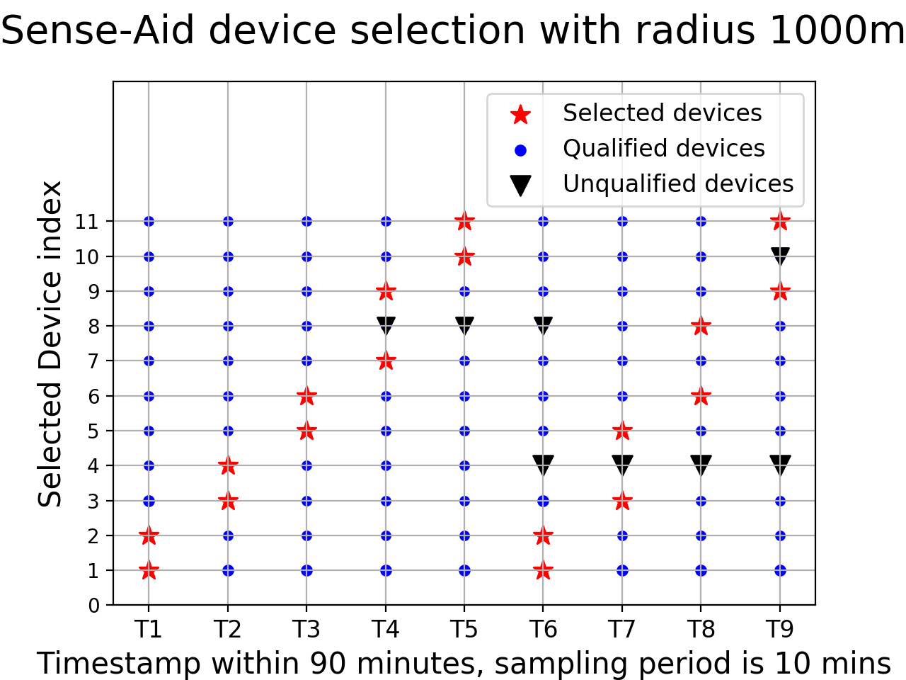
Evaluation: Varying Coverage Requirement
Orchestration → Fairness → Energy saving
  Overall energy cost
  Selection algorithm fairness
With more available users, benefits of Sense-Aid is more significant.
Users are fairly chosen.
Notes:
As radius increases, available users increase. PCS and periodic use all devices. Whereas Sense-Aid chooses minimum set of users therefore, more energy efficient. by the way, we can see users are fairly chosen. no one is over-chosen.

Slide 57
Evaluation: How Good Can Purely Local Decisions Be?
At the currently achievable accuracy of user usage prediction locally (41%), energy cost of PCS is 41% > Sense-Aid Basic and 58% > Sense-Aid Complete
When app prediction accuracy is perfect, PCS can achieve better performance than Sense-Aid Basic and Sense-Aid Complete
Notes:
In this ideal case, PCS costs 75.8% energy of Sense-Aid Basic and 85% energy of Sense-Aid Complete.

Slide 58
The Next Step: MPMCS
A resource efficient mobility prediction model
An event driven scheduling algorithm saves server resources while providing high task coverage, fair scheduling, and lower energy consumption
A development framework that eases development of mobile crowdsensing applications
Integrated system: Mobility Prediction-based Mobile CrowdSensing (MPMCS)

Slide 59
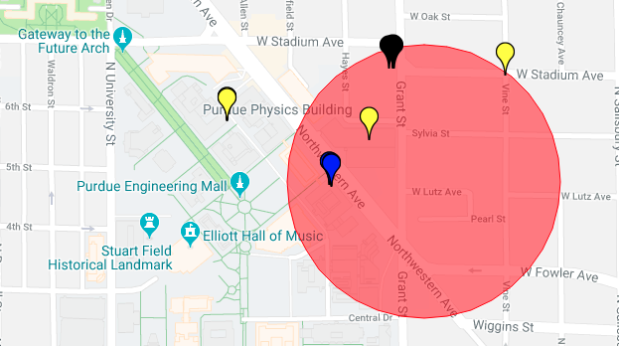
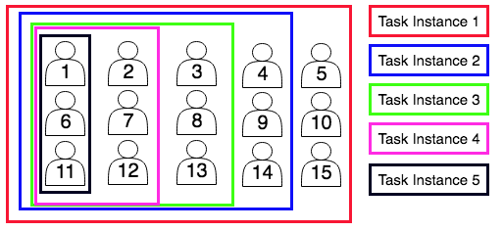
Key Distinguishing Features
Prior works are individual task based but we have a global view of many tasks
Mobility prediction helps perform fair scheduling
Smartphone energy cost is reduced because less tasks to serve as well as no holding at smartphone CPU
Event driven at server allowing scalability
Notes:
SB: I love this slide and the example shows MPMCS’ advantage very nicely.
Time order in which the tasks come in: Task instance 1, TI2, …. When scheduling TI1, MPMCS will select 5, 10, 15 because it knows that 4, 9, 14 will be needed for TI2. For TI2, it will select 4, 9, 14.
The yellow person walks through the task region. This is task with radius of 100 meters requiring 3 people. The other black and blue people are stationary. MPMCS will schedule the task to all three persons while PCS and Sense-Aid can only find 2 people.

Slide 60
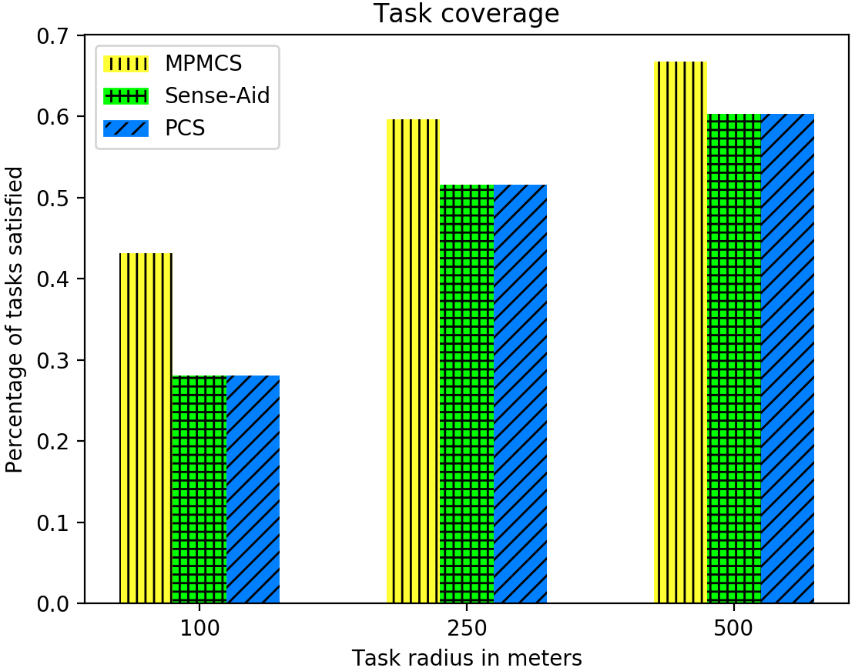
Task Coverage Results
Each radius variation was tested for one day from 9 a.m. to 5 p.m. with hundreds of tasks
Notes:
Overall, MPMCS is better than other algorithms in scheduling fairness
SB: How can I make a claim about scheduling fairness from here?
Heng: we are not claiming scheduling fairness here but the benefits of look-ahead and mobility prediction.
As the task radius increases, the advantage decreases because a larger area means that more users will be found in the region and they will take a longer time to across the region
Thus, it becomes easier for any MCS framework to satisfy the task
SB: Put % improvement (over Sense-Aid) on top of the MPMCS bar. See our Eurosys ‘16 paper for an example if needed.

Slide 61
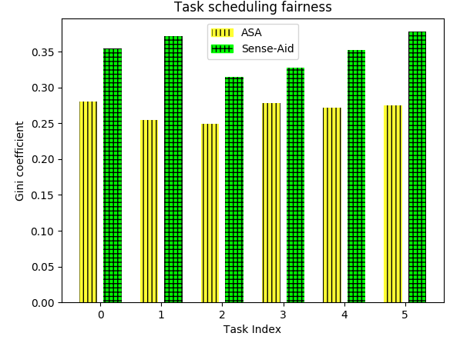
Fairness Result
MPMCS
Different tasks ran from 9 a.m. to 5 p.m. with 1000 meter radius at different places on Purdue campus
Notes:
SB: Add the % improvement on top of the MPMCS (rename from ASA) bars.
The Gini coefficient measures the inequality among values of a frequency distribution--the lower--the more equal
Overall, MPMCS < Sense-Aid
We did not compare fairness for PCS because there is no scheduling for PCS; it just chooses whoever is in task region and assign tasks to all of them
It is obvious that the gini coefficient of PCS will be very low especially in the case when most users are stationary
SB: But that is all the more reason we should give that value for PCS. It will prove that we are better than competition.
The high unfairness of PCS is not ideal because selecting a larger-than-necessary group of users will cause the total energy consumption to be very high

Slide 62
Takeaways: Dependable Mobile Crowdsensing
Take advantage of four opportunities for Mobile Crowdsensing (MCS)
  Piggyback MCS data packet
  Cellular radio state opportunity
  Orchestration among many devices
  Lookahead of users’ locations
Sense-Aid provides a generic framework for MCS development
  Energy cost is below users’ participation unwillingness threshold (2%)
  Devices are fairly chosen to participate
MPMCS does scheduling based on look-ahead
  Predicts mobility of users
  Evaluates future potential of a user to contribute MCS data

Slide 63
Concluding Insights: Context for our Work
Our approach: Dependable system design through data analytics and at large scales (large # processes, large amounts of data)
Dependability in the Small
  Secure and reliable operation of system of IoT nodes
  Dependable collection of “wisdom of the crowds”
Dependability in the Large
  Data centers and Edge computing
  Supercomputing applications
Details in the talk
Details in the talk

Slide 64


Concluding Insights
Our brave new world
  Smaller and cheaper devices, in large scales, will run critical functions
  Larger, heterogeneous, and increasingly power-constrained servers will run workloads generated by above class
Presentation available from: https://goo.gl/3X9mTz
Notes:
Brave New World is a dystopian novel by English author Aldous Huxley. Published in 1932, it propounds that economic chaos and unemployment will cause a radical reaction in the form of an international scientific empire that manufactures its citizens in the laboratory on a eugenic basis, without the need for human intercourse.

Slide 65
It Takes a Village
Purdue: [Faculty] Milind Kulkarni, Mathias Payer, Shreyas Sundaram, [Students] Abe Clements, Kanak Mahadik, Matt Creti, Nawanol Theera, Chris Wright
Argonne National Lab: Folker Meyer
Lawrence Livermore National Lab: Ignacio Laguna, Todd Gamblin, Bronis Supinski
AT&T Labs: Kaustubh Joshi, Rajesh Panta, Moo-Ryong Ra
Google: Greg Bronevetsky
Georgia Tech: Mostafa Ammar, Ellen Zegura
UIUC: Sasa Misailovic, Ravi Iyer, William Sanders

Slide 66
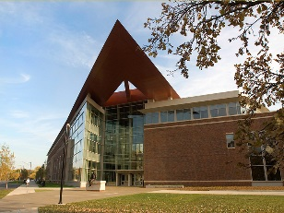
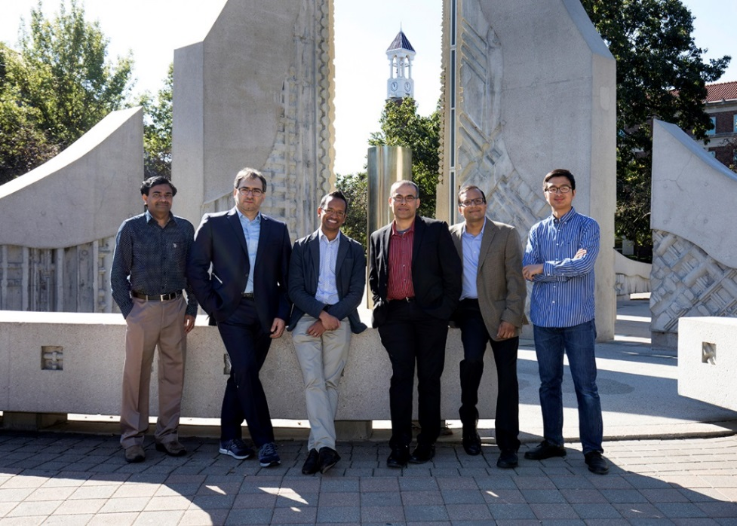
CRISP Center
CRISP: Center for Resilient Infrastructures, Systems, and Processes
Newly formed center at Purdue (2017) looking at resilient design and implementation principles in
  Cyber
  Cyber physical
  Socio-technical

Slide 67
Backup

Slide 68
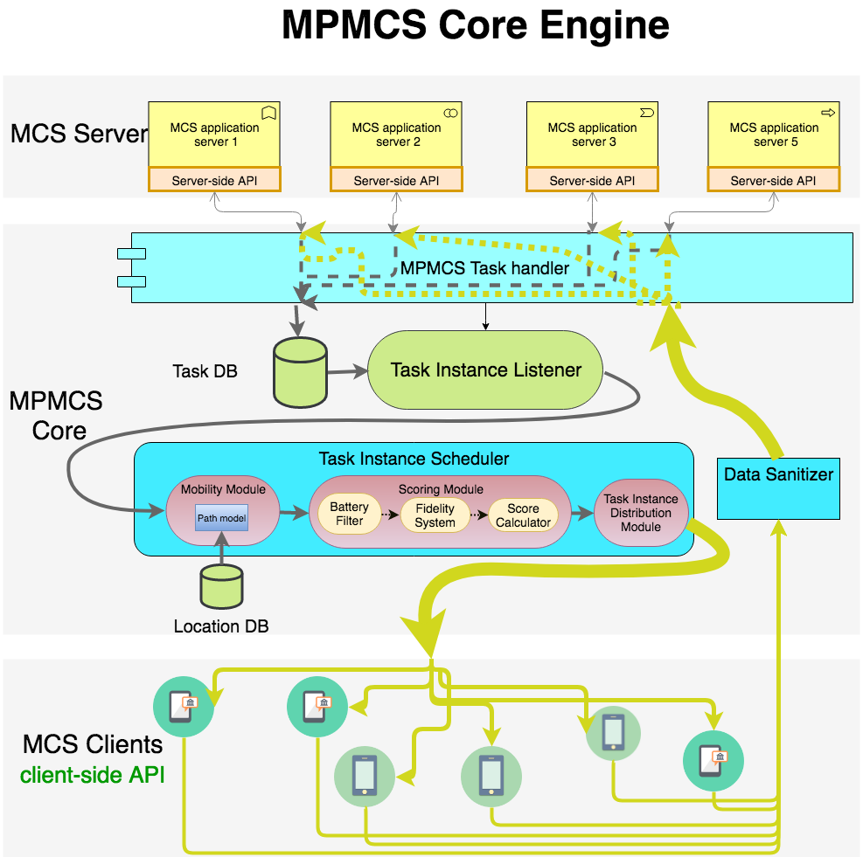
Workflow of MPMCS
MCS servers send tasks to MPMCS
MPMCS predicts users’ locations for tasks that are within the look-ahead window
Users are scored for each task by evaluating various factors and choose the lowest scored people
Notes:
Integration with cellular network - location of device, cellular state of the device.
SB: Scheduling algorithm with mobility prediction; Load balanced client selection.
Add MPMCS server-side and client-side API.

Slide 69
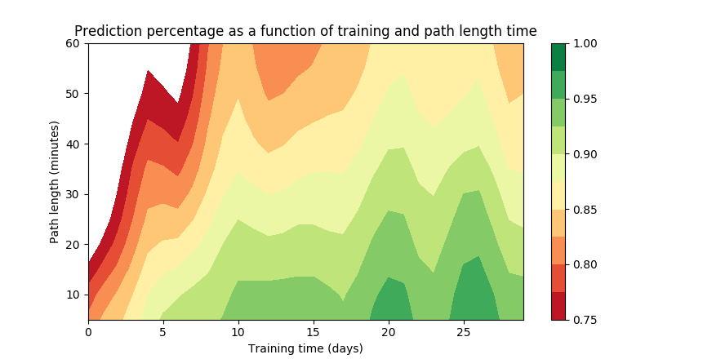
Path Model Results
Notes:
SB: Change the color scheme - blue is low value, red is high value. See for example: https://i.stack.imgur.com/9wKeX.png which is linked from: https://stackoverflow.com/questions/2369492/generate-a-heatmap-in-matplotlib-using-a-scatter-data-set
By the end of our user study, consisting of 60 undergraduate students, our path model was able to find a sufficiently similar trajectory 90% or more of the time for path lengths of 30 minutes or less
Of the times that it succeeded in finding such a trajectory, 90% of the predicted trajectories were found to be sufficiently similar to the actual trajectory taken by the user
The advantage here is that instead making incorrect prediction that will result in selecting users unsuitable for the task, the algorithm reports that it is unable to find a user.

