Slide 1
Stream: Low Overhead Wireless Reprogramming for Sensor Networks
Rajesh Krishna Panta
Issa Khalil
Saurabh Bagchi
Presentation at Infocom 2007

Slide 2

Introduction: What is sensor network reprogramming?
Notes:
SB: What is reprogramming and why it is necessary. Not feasible to bring the nodes back to the lab, reprogram and then go and deploy.
SB: Drop in-system reprogramming. Put picture showing bs and wireless reprogramming.

Slide 3
Motivation
In-System Programming (ISP) is not always feasible
  Large network
  Sensor nodes may be situated at places which are difficult to reach
Programming is not a one-time process
  Requirements from the network or the environment in which the sensor nodes are deployed may change
  May need to change certain parameters of the user application
  May require to change the logic of the application itself (e.g. inherent unreliability in the wireless links may cause failures and require changing the application itself)
Notes:
SB: What is reprogramming and why it is necessary. Not feasible to bring the nodes back to the lab, reprogram and then go and deploy.
SB: Drop in-system reprogramming. Put picture showing bs and wireless reprogramming.

Slide 4
Requirements of Network Reprogramming Protocol
All nodes in the network should receive the code completely
Code upload should be fast so that sensor nodes can resume their normal function
Minimize the resource cost of reprogramming – energy and bandwidth spent in disseminating code through the network
Notes:
SB: How to answer the question that reprogramming is very infrequent.

Slide 5
Network Reprogramming Protocols
First generation protocols
    XNP: Single hop
    MOAP: Multi hop; No pipelining of the segments of the code image
State-of-the-art protocols
    Deluge [Hui04]
      Three way handshake: advertisement-request-data
      Multi-hop
      Pipelines segments of the code image
    Freshet [Kras07]
      Built on top of Deluge
      Minimizes the energy consumption by putting the nodes to sleep during the time periods when they are not involved in reprogramming
[Hui04] J.W. Hui and D. Culler, “The dynamic behavior of a data dissemination protocol for network programming at scale.” SenSys 2004.
[Kras07] M.D. Krasniewski, R. Panta, S.Bagchi, C-L. Yang, W.J. Chappell,,”Energy-efficient, On-demand Reprogramming of Large-scale Sensor Networks,” Under revision for ACM Trans. On Sensor Networks (TOSN).
Notes:
SB: Details on Deluge with animation; pipelining with pages, packets; image.
SB: Tutorial on memory organization.

Slide 6
Deluge: Structure of Code Image
pages
…
Code Image
0
1
2
N
…
Page
0
1
2
47
packets
Notes:
SB: Details on Deluge with animation; pipelining with pages, packets; image.
SB: Tutorial on memory organization.

Slide 7
Deluge: Code Dissemination
Reboot from newly injected image
Adv (ver 1, 20 pages)
Req (ver 1, Page 1)
Data (Page 1)
Can send page 1
Through 3 way-handshake
Program memory
Flash
Page 1
Page 2
Injected
Image
Deluge
Injected
Image
RAM
Notes:
SB (1/31): In the last step of the process, you change the element in the program memory from Deluge to User Application Image. Isn’t it true though that what is resident always is Deluge + User App.

Slide 8
Problem with Existing Protocols
(Deluge and Freshet)
They attach user application with the reprogramming component into one image
Wirelessly transfer the entire image through the network
Rationale for this
  Enable the sensor nodes to receive future code updates
  Sensor nodes are not multi-tasking
Problems
  High reprogramming time – network’s functionality is degraded during
  the reprogramming period
  Large number of bytes means more energy spent on reprogramming
  the network

Slide 9
Goals of Stream
Reduce energy consumption during reprogramming: Through reducing the number of bytes transferred during reprogramming
Minimize reprogramming time
Portability across existing reprogramming protocols: Be independent of the core reprogramming protocol
Handle incremental node deployment: Be able to reprogram new nodes that join the network

Slide 10
Stream’s approach
Stream segments the program image into Stream-RS (Stream Reprogramming Support) and Stream-AS (Stream Application Support)
Stream-RS
  Core reprogramming component
  Preinstalled, before deployment, in all nodes
  Stored in each node’s Flash memory as image 0
Stream-AS
  A small subset of reprogramming component that is attached to the user application
  Instead of wirelessly transferring through the network user application plus the entire reprogramming component, Stream transfers Stream-AS plus the user application
  Stream-AS + user application is stored in each node’s Flash as image 1
Program memory
Flash
Stream-RS
(Image-0)
Currently executing program
Stream-AS
+
User application
(Image-1)
Unused portion

Slide 11
Protocol description: Getting ready for receiving code image
Attach new user application to Stream-AS
        components StreamASC;
        Main.StdControl->StreamASC;
Inject user application + Stream-AS as image 1 on the base node
In response to the reboot command from the user, all nodes in the network reboot from image 0. This is accomplished as follows:
    The base node executing image 1 initiates the process by generating a command to reboot from image 0. It broadcasts the reboot command to its one hop neighbors and itself reboots from image 0
    When a node running the user application receives the reboot command, it rebroadcasts the reboot command and itself reboots from image 0
Once reboot command reaches all nodes, they start running Stream-RS. Then the new application is injected into the network using Stream-RS
Img 1
Reboot from image 0
Img 0
Img 1
Reboot from image 0
Img 0
{
Reboot from image 0
Img 1
Img 0
Img 1
Img 0
Reboot from image 0
Stream-AS
Img 1
Img 0
Reboot from image 0
Reboot from image 0
Img 0 : Reprogramming component
Img 1 : Modified user application
Notes:
SB (1/31): For the first bullet, you should mention verbally that the change from adding Deluge to this is minimal.

Slide 12
Protocol Description: Three way handshake
Stream-RS reprograms the entire network. If built on Deluge, it does so by using the three way handshake method.
Img 0
Adv
Data
Adv
Req
Img 0
Data
Req
Adv
Img 0
Img 0
Adv
Img 0 : Reprogramming component
Img 1 : Modified user application
Img 0
Notes:
SB: Drop the details of Deluge from here and remind the audience of what they have seen before.

Slide 13
Protocol Description: Keeping all thy neighbors satisfied
Each node maintains a set S containing the id’s of the nodes from which it has received requests for the code
Once the node downloads the new code completely, it performs a single-hop broadcast of an ACK indicating that it has completed downloading
When a node n₁ receives the ACK from a node n₂, it removes the id of n₂ from its set S
When the set S is empty and download is complete, the node reboots from image 1.
Finally the entire network is reprogrammed and all nodes execute image 1 (Stream-AS + user application)

Slide 14
Handling incremental node deployments
Pull based approach instead of traditional push based approach to handle incremental node deployment
Img 1
Ver 10
Img 1
Ver 10
Img 1
Ver 10
Img 1
Ver 10
Img 1
Ver 10
Img 0
Img 1
Ver 10
Img 0
Adv
Ver 0
Adv
Ver 0
Send ver 10 through 3 way handshake
Send ver 10 through 3 way handshake
ACK
ACK
Img 1
Ver 10
Img 0
Notes:
SB (1/31): Show in the animation that initially, old node has version 10, new node advertises version 0. At the end of the process, all nodes have version 10.

Slide 15
Advantages of Stream: Reduction in Overhead Traffic
The exact reduction in the number of bytes transmitted by Stream over Deluge depends upon the user application
User application | Size of User application | User application + Deluge | User application + Stream-AS
No radio communication (rare case) | 1 page | 21 pages | 11 pages
Radio communication | 11 pages | 22 pages | 12 pages
1 Page=48 Packets
1 Packet=36 Bytes

Slide 16
Other Advantages of Stream
Reduction in reprogramming time and energy due to reduction in traffic that is uploaded through the network
All nodes automatically reboot from user application after reprogramming is complete
Less energy consumed by reprogramming component during quiescent phase
  Sensor nodes do not spend their energy in continuous broadcasting of advertisements in quiescent phase
  However, both new nodes joining the network and the new code pushed in by the base node are efficiently handled
More efficient use of RAM and program memory
Notes:
In our case memory usage is due to user application plus Stream-AS, in their case user application plus entire Deluge

Slide 17
Implementation and Experiments
We implemented Stream using nesC in TinyOS
We performed test bed experiments using mica2 motes for various grid and linear topologies and TOSSIM simulations for grid topologies
User application = 11 pages
User application + Stream-AS = 12 pages
User application + Deluge = 22 pages
Evaluation metrics
    Network reprogramming time
    Energy consumed during reprogramming (number of packets transmitted for reprogramming the network)

Slide 18
Test bed Experiments
Source node
Source node
2
. . .
n
1
1
10ft
10ft
10ft
2
.
.
.
.
.
.
.
.
.
. . .
n
n=2,3,4
n=2,3,4,5
Grid topology
Linear topology
Notes:
SB: Replace with two pictures.

Slide 19
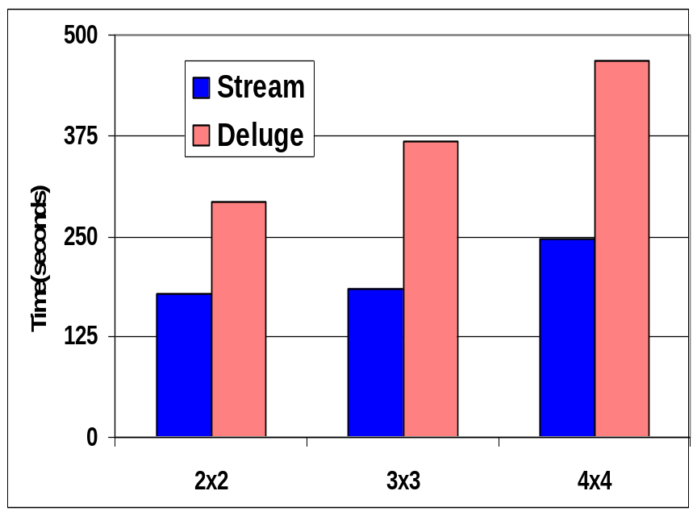
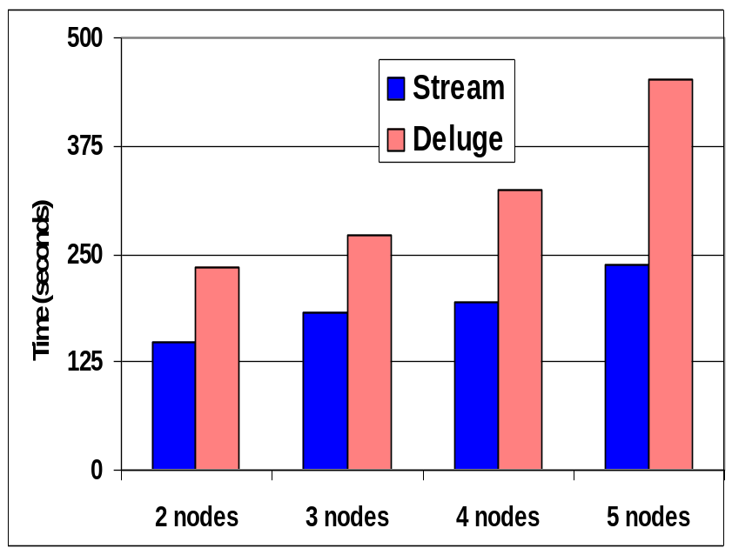
Test bed Results: Reprogramming Time
Up to 98% reduction in reprogramming time
Notes:
SB: Main result (% improvement) in a text box beneath the plot

Slide 20
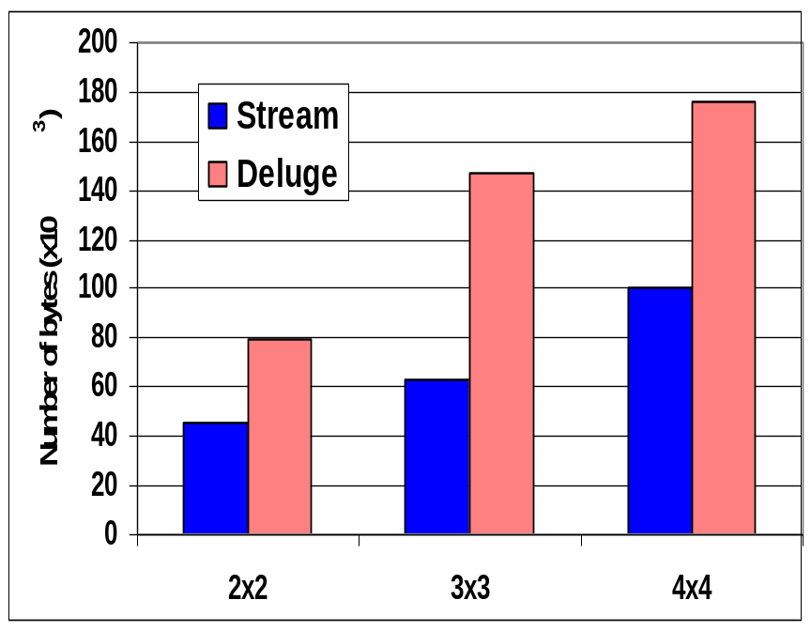
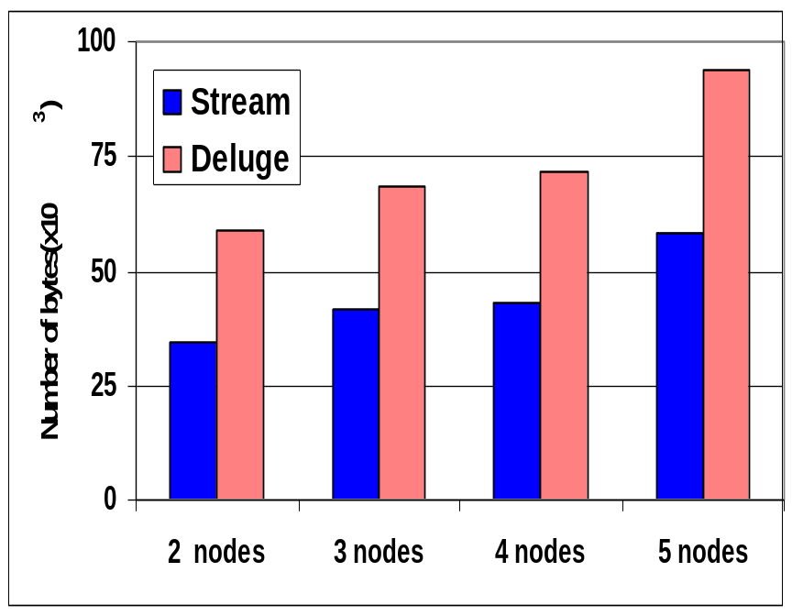
Test bed Results: Network Traffic
Up to 132% reduction in number of bytes transferred during reprogramming

Slide 21
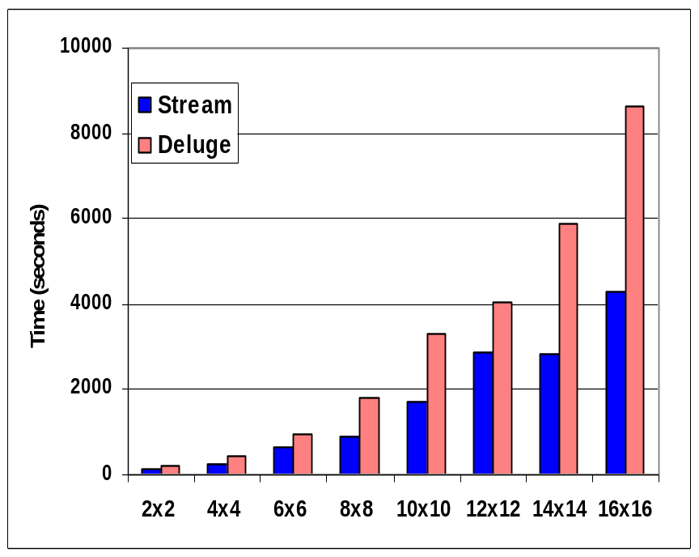
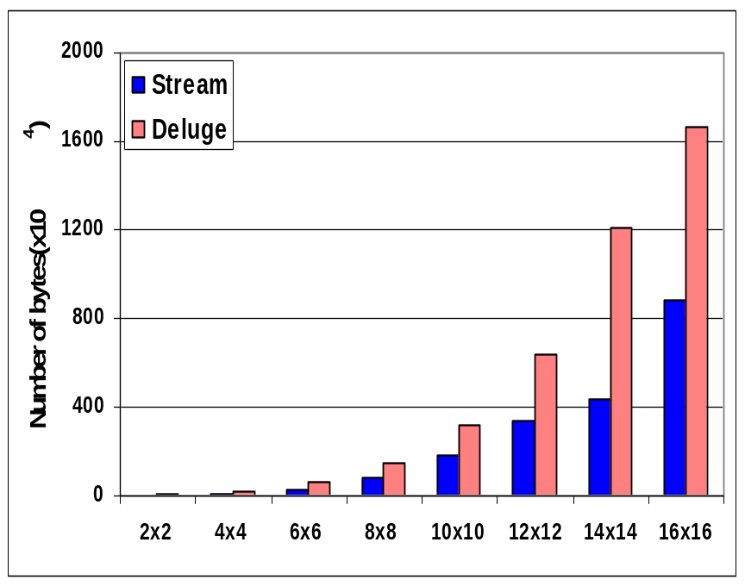
Simulation Results: Network Size
Grid Networks of various sizes with source situated at one
corner of the grid
Number of packets per page reduced from 48 to 24 packets
Up to 112% reduction in number of bytes transferred and 101% reduction in reprogramming time
Notes:
SB: All default parameter settings from TOSSIM

Slide 22
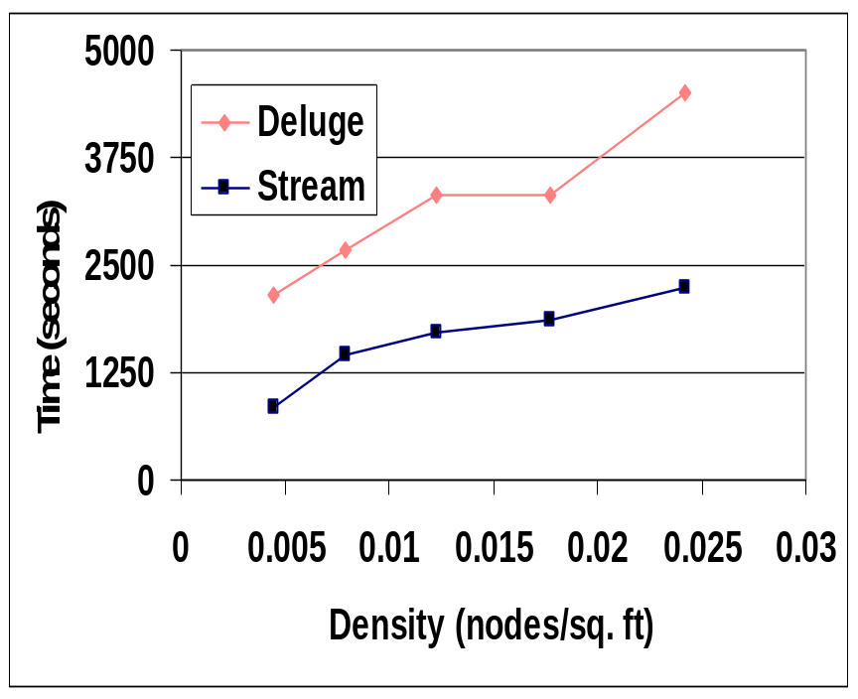
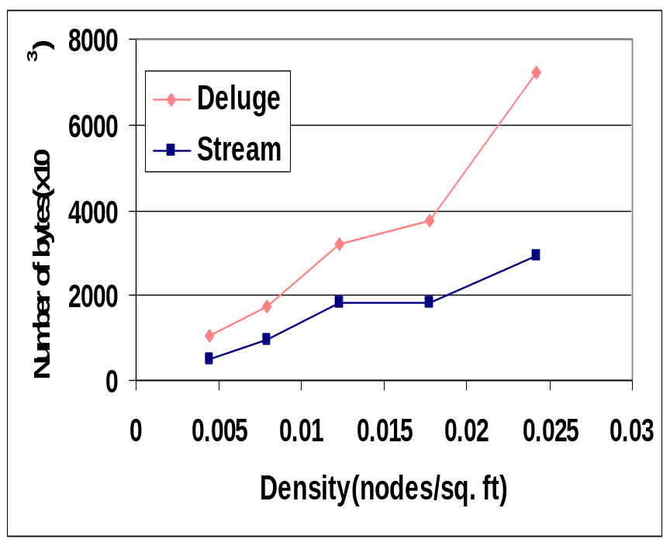
Simulation Results: Network Density
We vary the number of nodes in a 90ft x 90ft area
Nodes are arranged in grid fashion with uniform spacing
between adjacent nodes

Slide 23
Emnet deployment
RNode
Rnode
To next RNode
To next Rnode
Stoplight pole
Manhole cover antenna
Stoplight Pole
Manhole Cover Antenna
Inode
microprocessor
Sensor
Deployment plate

Slide 24
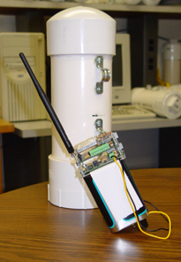
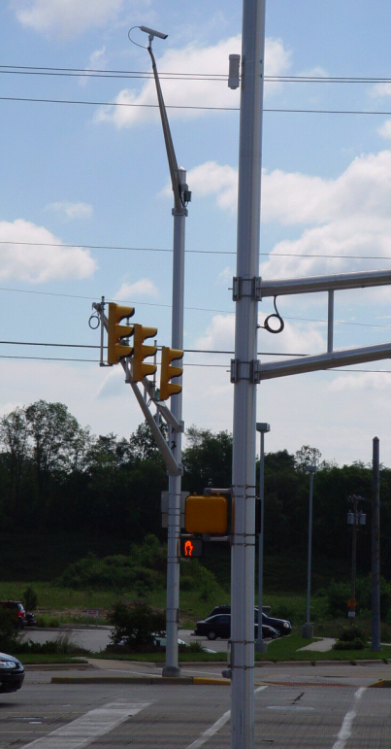
Emnet: Chasqui motes

Slide 25
Conclusion
Stream significantly reduces the number of bytes transmitted over the wireless medium for reprogramming- decreases reprogramming time and energy
Experiments conducted on test beds of mica2 nodes demonstrate up to 98% reduction in reprogramming time and 132% reduction in number of bytes transferred compared to Deluge. TOSSIM simulations show up to 101% reduction in reprogramming time and 112% reduction in number of bytes transferred compared to Deluge
Stream can show improvement on any current reprogramming protocol since all send the entire reprogramming component with the user application
Notes:
SB: Report the simulation result
SB: Slide called “take away lessons and future work”.

Slide 26
Take-away lessons and Future Work
Two important aspects of sensor network reprogramming: reprogramming time and energy
  Efficient interest based code dissemination in one hop: Solved problem (courtesy Deluge)
  So we cut down the number of bytes transferred through the wireless medium
Further work
  Multiple originators
  Heterogeneous network
  Incremental reprogramming

