Slide 1

Fault Tolerant and Energy Aware Data Dissemination Protocol for Sensor Networks
Gunjan Khanna, Yu-Sung Wu, Ethan Schuchman, Levent Ergun, Ravish Khosla, Saurabh Bagchi
Dependable Computing Systems Lab
School of Electrical and Computer Engineering
Purdue University
http://www.ece.purdue.edu/~dcsl

Slide 2
Outline
Motivation
Current Data Dissemination Protocols
SPMS : Design Features
Analytical Analysis and Theoretical Results
Experiments and Results
Failure Optimized SPMS
  Approach
  Results
Conclusions and Future work

Slide 3
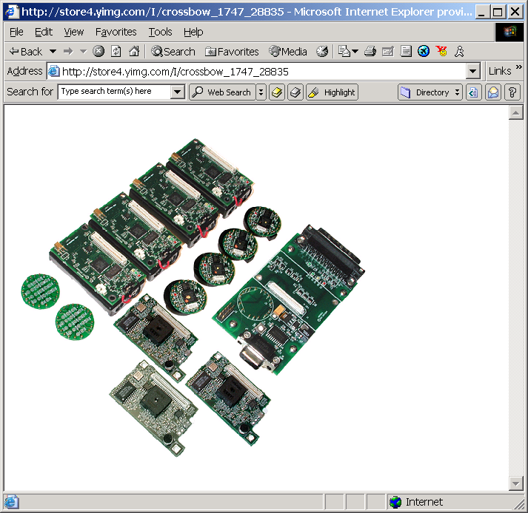
Sensor Nodes
Small processors and sensors with capability for sensing and processing data.
  512 Kb 4MHz Atmel processors
Berkley Motes
  MICA 2
  MICA DOT
Sensor Nodes are fast becoming a part of critical life applications
  Health Monitoring: Ault Farms
  Military Surveillance
  Emergency Services

Slide 4
Motivation : Reliability against Failures
Sensor Networks are susceptible to failures and attacks
  Deployed in Hostile Environments
  Due to natural causes or malicious causes
  Temporary or permanent failures of nodes or links
Reliability in data collection is important but hard to achieve
  Energy Constraints
  Delay Constraints
  Limited capabilities in terms of storage and processing
  Susceptible to collective failures
  Long paths which can have multiple failures.
Notes:
Do have correlateed failures. Give example of the failure where the nodes collective freeze in practical experience.

Slide 5
Existing Data Dissemination Protocols
Can be broadly classified into PUSH and PULL based
  PUSH : Sensors send the data at regular intervals to a sink node
  PULL : Sensors store the data and data is collected using a polling mechanism either by a sink node or by a passing object (like an aircraft).
Broadcast and Gossip have been used to provide reliability but use redundant transmission leading to wastage of energy.
POACH:
  Determine Servers to cache data in order to minimize the cost of data dissemination.
TTDD
  Sets up a grid structure and proactively determines routing from data source to sink
  At runtime, when sink needs data it locates a close by “dissemination point” which uses pre-computed route from source to sink
  Drawbacks: Cost of setting up entire routing grid

Slide 6
Example Protocols
SPIN
  Use meta data transmissions to reduce redundant transmissions
  Advertise the data prior to sending the data.
  Efficient in case of collisions.
  Mix of Push and Pull mechanisms.
SPIN
ADV
B
REQ
DAT
S: Sender
B: Interested node
C: Disinterested node
S
ADV
C
Notes:
SPIN should be on a separate slide with animation.

Slide 7
Example Protocols (Contd.)
LEACH
  Form clusters to send data collectively
  Rotate cluster heads
  Two level hierarchy
PEGASIS
  Extending LEACH to a three level hierarchy
  Single node sends data to the base station
Sink

Slide 8
Reliability in Existing Protocols
Current Protocols are not designed to address the issue of failures in the sensors
  Either the data is lost in case of a failure
  Broadcast and Gossip do address failures but are wasteful in terms of resources
Protocols use direct communication between the nodes and the base stations
  Not feasible in practical larger sensor networks
  Direct communication leads to more energy consumption. eg: SPIN, LEACH
Several times a central controller (agency) is employed leading to a fall of the distributed nature of the protocol
  Setting up Grid structure in the TTDD
Solutions have addressed attacks in sensor networks but addressing simple and most common issue of natural failures seems to be lacking
Notes:
This slide appears rather unsatisfactory. What you want to bring out here is that existing protocols have several defects. Say what class of protocol has what kind of defect.

Slide 9
Shortest Path Minded SPIN (SPMS)
3
4
REQ
ADV
ADV
ADV
ADV
1
ADV
DAT
6
DAT
5
REQ
REQ
2
ADV
DAT
ADV

Slide 10
Shortest Path Minded SPIN: Design Features
Zone of 1
Zone
  Maximum distance a node can reach using the maximum power level
  Node can adjust its power levels to reach all nodes (neighbors) in its zone
  Routing tables for Neighbors in the zone using Bellman Ford
  Tables contain the power level for each neighbor
Zone of 6
3
4
1
5
6
2
7
Timers
  TimeOut_ADV : Nodes wait for the data to come to the nearest node before sending REQ
  TimeOut_DAT: Nodes wait for the data after sending the REQ packet
Notes:
You want to introduce SPMS in two slides. In the first slide, have animation showing the multi-hop nature of REQ and DATA transmissions. The simple high level view.
Next slide introduce the concept of zone and the timers. For each component introduced say what the purpose is. For example, TimeOut_ADV is motivated by the fact that getting the data from a nearby node is more energy efficient.
After the failure free components, introduce the components that deal with failures. Introduce PRONE and SCONE there.

Slide 11
Sample Zones
B
G
F
K
A
c
L
D
E
M

Slide 12
SPMS Protocol : Failure Scenario
Failure of an intermediate node
  Could take place before or after sending the ADV
  Not ADV a data can also be misinterpreted as failures and vice versa
  Node stores the neighbors which have advertised the data
    PRONE : Primary Originator Node
    SCONE : Secondary Originator Node
Resilience to Failures
  After a TimeOut_ADV node sends the request for data to PRONE through the shortest path
  DATA is also received using the same path if there is no failure
  Incase of a failure :TimeOut_DAT occurs
  Node directly sends the REQ packet to PRONE
  In case PRONE is also not responding then the REQ is sent to SCONE
Notes:
The high level bullets of “Failure of a Relay Node” and “Failure: Be Optimistic” appear incongruous. I would as well leave out these headings and plunge into how the failure is handled.
Have a slide showing the delay incurred in 1-2 simple failure free situations and 1 simple failure situation. Use animation.

Slide 13
SPMS : Failure Scenario
3
4
ADV
ADV
ADV
ADV
1
ADV
6
TimeOut_ADV
TimeOut_DAT
REQ
DATA
REQ
5
2

Slide 14
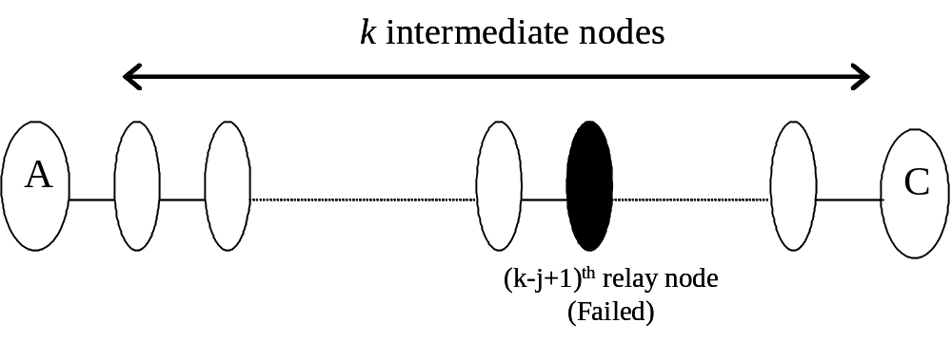
General Failure Scenario
In a K intermediate node scenario, consider j^{th} node from last failing.
Let TOut_{ADV} be the waiting time after a node hears an ADV packet.
& TOut_{DAT} be the waiting time after sending a REQ packet
G.n² is the CSMA delay in accessing a channel
Define,

Slide 15
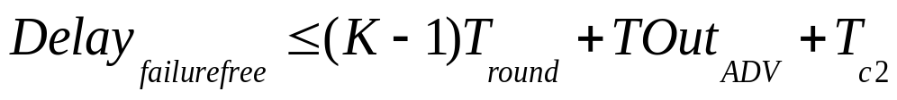
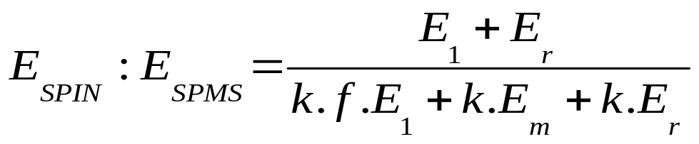
Energy and Delay: Analytical Analysis
In case of K relay nodes between two nodes the delay in receiving the packet can be calculated using the inequality below
The ratio of energy between SPIN and SPMS can be given by :

Slide 16
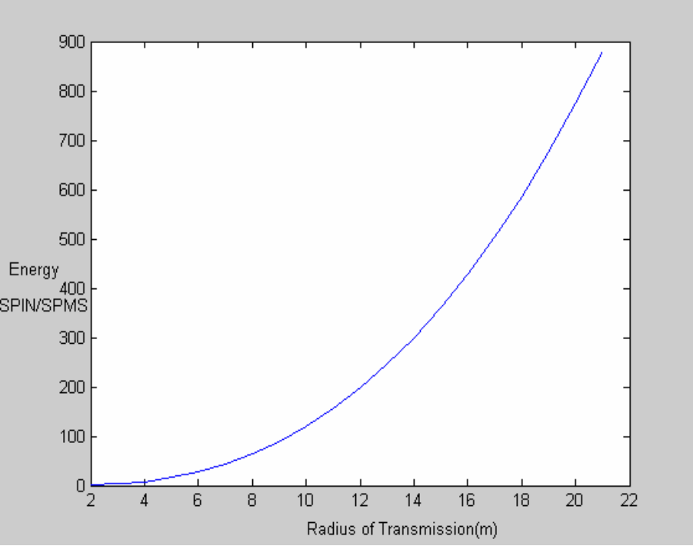
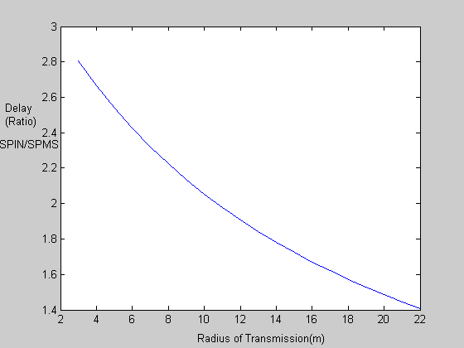
Energy and Delay Comparisons: Equation Plots
SPIN uses more energy than SPMS
as relay nodes increase.
Delay increases in SPIN than SPMS
as relay nodes increase.

Slide 17
Simulations
SPMS protocol is implemented and compared with SPIN
  Uniform density of Nodes which are placed on a Grid.
  We vary the transmission radii and the number of nodes.
Crossbow data sheet is used to calculate the Power spent in transmission and receiving packets.
  Nodes can only transmit at 5 energy levels considered in our experiments
  ADV and REQ packet are considered to be 2 bytes and DATA packets are 40 bytes long
  Inter Packet arrival time is Exponential
Experiments are carried out for two topologies
  All to All communication : Every node requests every other nodes data.
  Cluster Based Hierarchical Communication: Cluster Heads collect the data and send it to the sink using SPMS.
Experiments for failure free and failure scenarios
  Failures are transient and follow exponential inter-arrival times

Slide 18

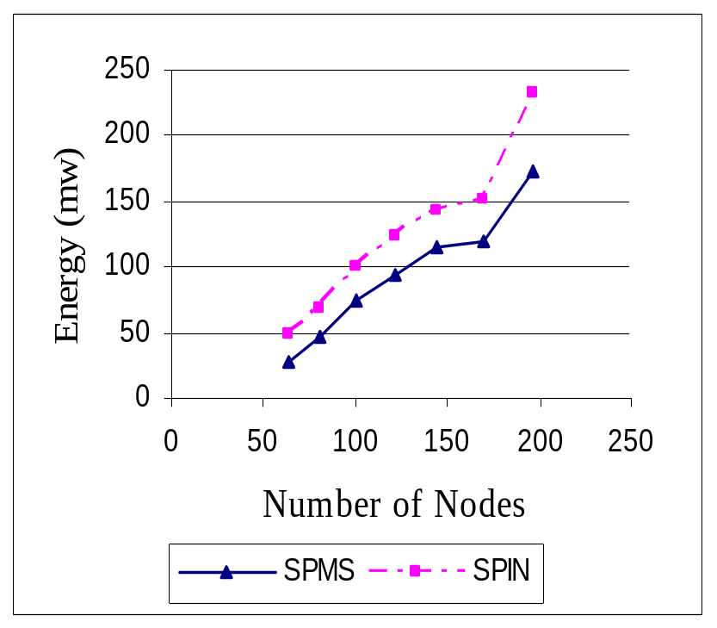
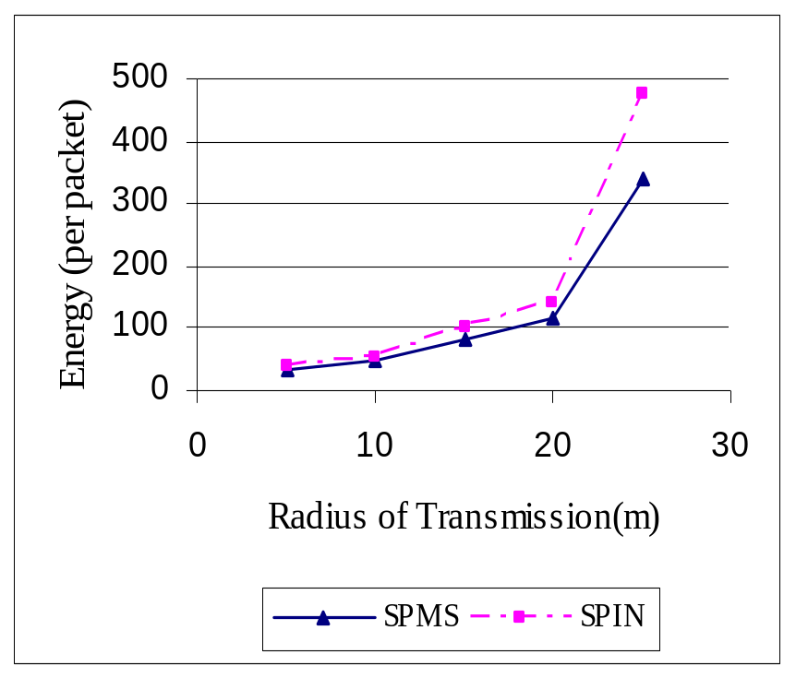
Results for Failure Free Scenario: Energy Metric
SPMS saves about 23-46% energy compared to SPIN
with varying number of nodes

Slide 19
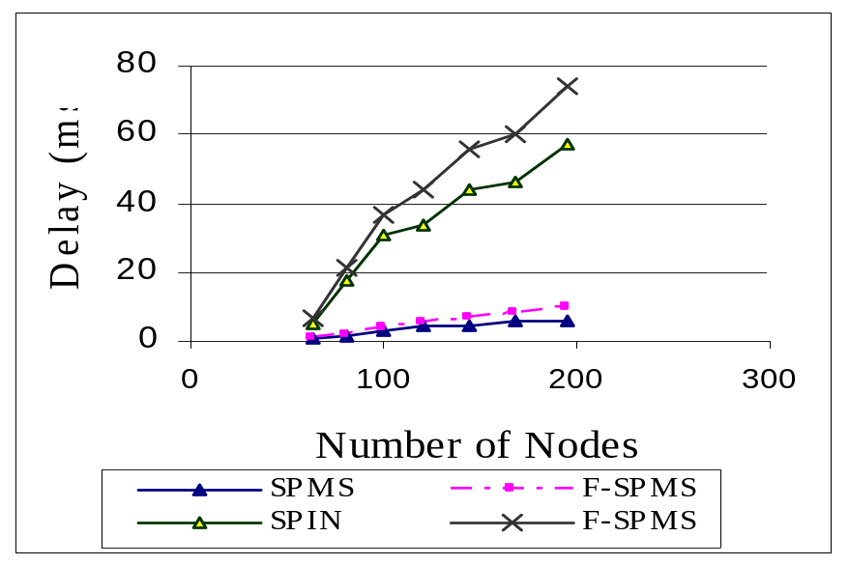
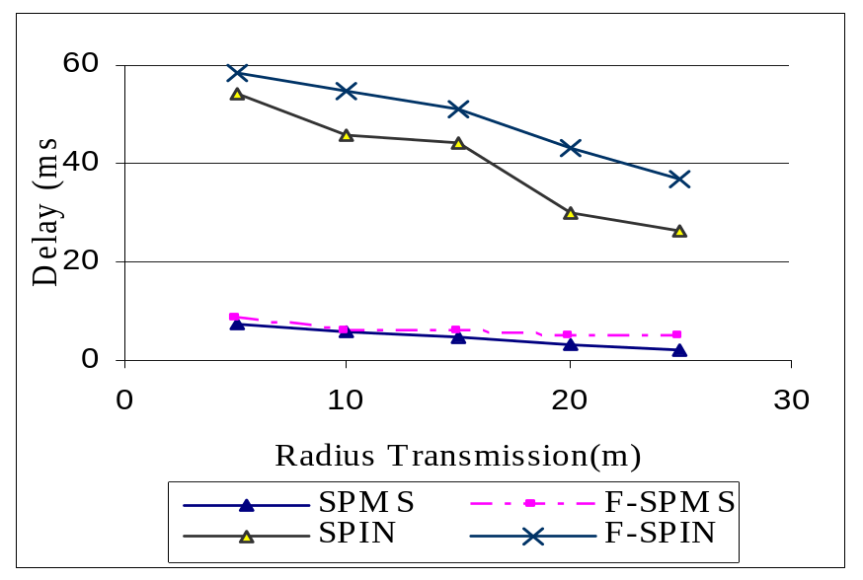
Results for Failure Free and Failure Scenario: Delay Metric
SPIN incurs
10 times more delay
Delay gradient is steeper for SPIN with increasing number of nodes.
Delay difference decreases with radius of transmission for both SPIN and SPMS.
SPMS disseminates data much faster compared to SPIN in both failure and failure free scenarios.
Notes:
Now have slides with plots for the failure scenarios. Like the ones for the failure-free scenario.

Slide 20
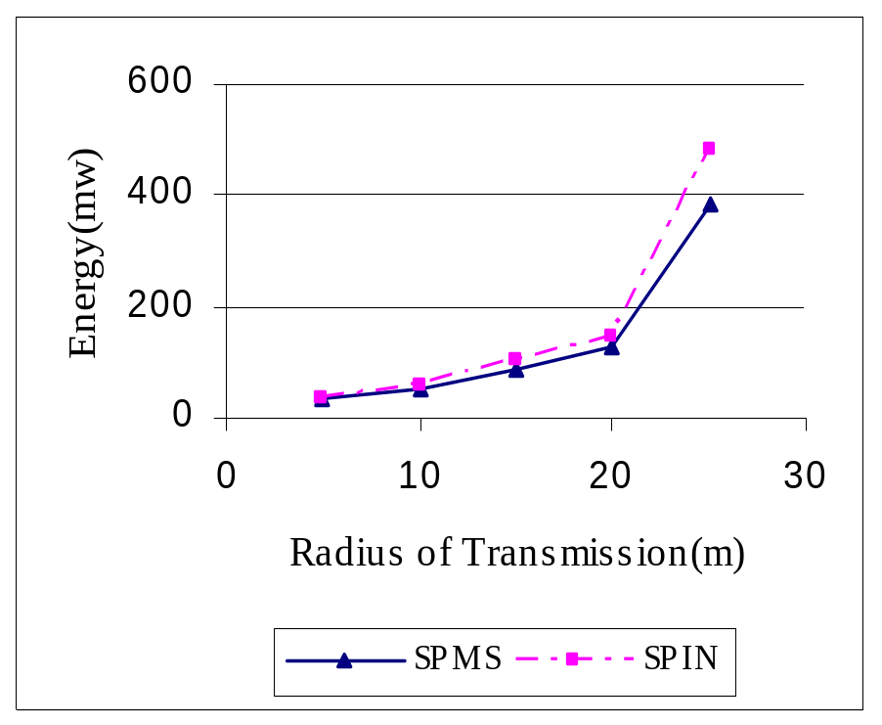
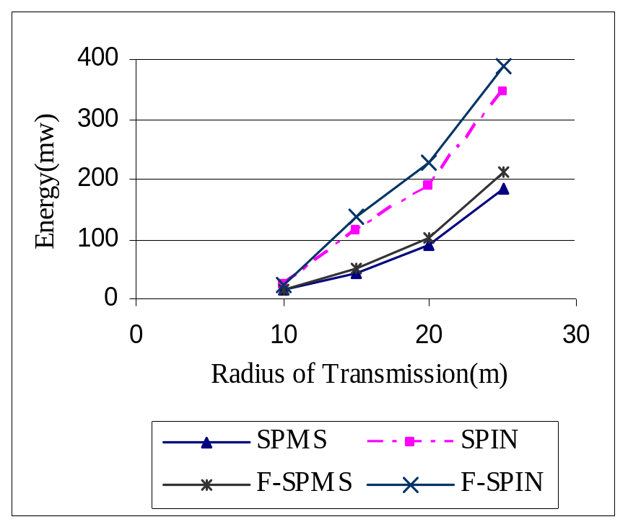
Energy Metric : Mobile Nodes and Cluster Based Communication
Mobile Nodes
Cluster Mechanism
SPMS saves about 21% energy compared to SPIN even with mobility.
SPMS saves 59% energy in Cluster Based Hierarchical communication.

Slide 21
Extending SPMS to Optimize Failure
Distributed Bellman Ford used for route updation
  Can be wasteful of energy
In case of long/permanent failures nodes end up using a long route forever
  Nodes do not have knowledge of failed routes : Can neighbors help ?
  DBF could be used periodically : very costly
Currently only crash failures are considered
  Can it be extended somehow to counter Byzantine failures ?

Slide 22
Detecting Failures
Timers can help detecting a path failure
  Impossible to detect which node in the particular path has failed
  Requires several Ack’s
Hard to relate failure in one route to another failure
  Could be a failure of a hot-spot
Keep a FailCount for each route
  Remember how many times the route was detected as failed
  Measured by repeatedly detecting failed response to a REQ
  Mark a route as permanently failed if FailCount is beyond a threshold

Slide 23
Failure Optimized SPMS
Avoid paths which are marked as failed
  Storing state in the node avoids extra message transmissions in failures
  Node D will take a costly path
Information about the failed path can also be relayed to other nodes
1
B
A
1
3
C
5
1
D
F
B
G
A
C
D
E

Slide 24
Learning Routes
Eliminate Bellman Ford algorithm
  Wasteful of Energy in case of Mobility
Allow packets to contain information about the cost of transmission
  Packets can contain the power level required to reach the advertiser of the packet
  All Nodes listening to the advertised packets update their routes
Route formation gets delayed
  Wait for a while before routes stabilize.

Slide 25
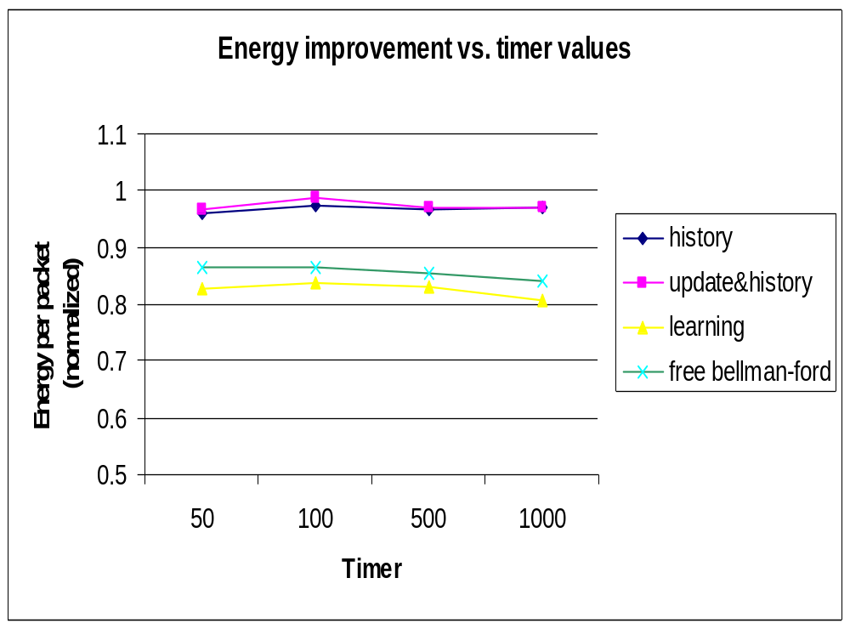
Simulation Results : Failure Optimized SPMS

Slide 26
Publications
“Fault Tolerant Energy Aware Data Dissemination Protocol in Sensor Network,” Gunjan Khanna, Saurabh Bagchi, Yu-Sung Wu. At IEEE Dependable Systems and Networks Conference (DSN 2004), June 28-July 1, 2004, Florence, Italy.
"Data Dissemination Protocol in Sensor Networks to Tolerate Node and Link Failures," Gunjan Khanna, Yu-Sung Wu. Appeared as a Fast Abstract in DSN July, 2003, San Francisco, USA.

Slide 27
Contributions and Conclusions
Proposed an efficient protocol multi-hop protocol
  Provide energy and delay savings
  Operate in a distributed fashion
  Resilience to Failures of intermediate nodes.
  Failure Optimized SPMS
Provided Theoretical and Simulation results
  Both results are in agreement
Can be effectively used with most applications
  Adaptively used in many existing data dissemination
  Varying from cluster-based to even ad-hoc networks
Notes:
This looks alright even without the extension.

Slide 28
Future Work
Implementation on actual Motes (TinyOS)
  Evaluation can be carried out through a practical study
Evaluation of the Failure Optimized SPMS
Extending to compensate for Byzantine Failures.

Slide 29
Thank You !

