Slide 1

Disruption Tolerance in Distributed E-Commerce Environments
Yu-Sung Wu, Bingrui Foo, Blake Matheny, Tyler Olsen, Saurabh Bagchi
Dependable Computing Systems Lab
School of Electrical and Computer Engineering
Purdue University
http://shay.ecn.purdue.edu/~dcsl

Slide 2
Dependable Computing Systems Lab
Sponsors
  National Science Foundation
  Purdue Research Foundation
  Avaya Labs
  Motorola Labs
  Intel
Members
  Nipoon Malhotra − Bingrui Foo
  Gunjan Khanna − Blake Matheny
  Padma Varadharajan − Tyler Olsen
  Yu-Sung Wu
  Issa Khalil
  Mark Krasniewski
  Yen-Shiang Shue
  Jin-Yi Wang

Slide 3
Outline
What is disruption tolerance & Motivation
Adaptive Disruption Tolerant System
Disruption Detection
Our Approach
System Design
Results
Disruption Containment and Response
Results
Conclusions
Notes:
32

Slide 4
What is Disruption Tolerance?
Causes of system downtime
  Naturally occurring failures: hardware, software, interfaces
  Malicious intrusions: internal, external
Disruption = Failure + Intrusion
Similarities in approach to tolerate the two causes
  Both cause system to be unavailable or degraded in functionality
  Sometimes root cause cannot be distinguished
  Sometimes response is identical (e.g., take component offline and bring in a diverse spare)
Dissimilarities in approach to tolerate the two causes
  Number of coincident events
  Counter-response
Notes:
Similarities:
Buffer overflow because of a software bug and a naturally ill-formed URL or a maliciously input URL – telling motive is impossible.
If a service has been compromised and it sees a hardware failure, no need to recover it.
Dissimilarities:
- Counter response may be to re-execute same function again, but if service has been compromised then that is unlikely to be effective

Slide 5
Motivation
Handling failures and intrusions under same framework gives the following advantages
  Reduce overhead: Example – A separate detection routine for each sub-system is not required
  Leverage synergy between two actions: Example – A component that is compromised due to an intrusion need not be recovered from a natural fault
What is tolerating disruption?
  Not enough to simply detect: Large volume of intrusion detection systems, error detection protocols
  Need to address the other phases of the process: Diagnosis, Containment, Response
  The phases are closely coupled in their cost metrics: A pinpointed diagnosis reduces the cost of recovery

Slide 6
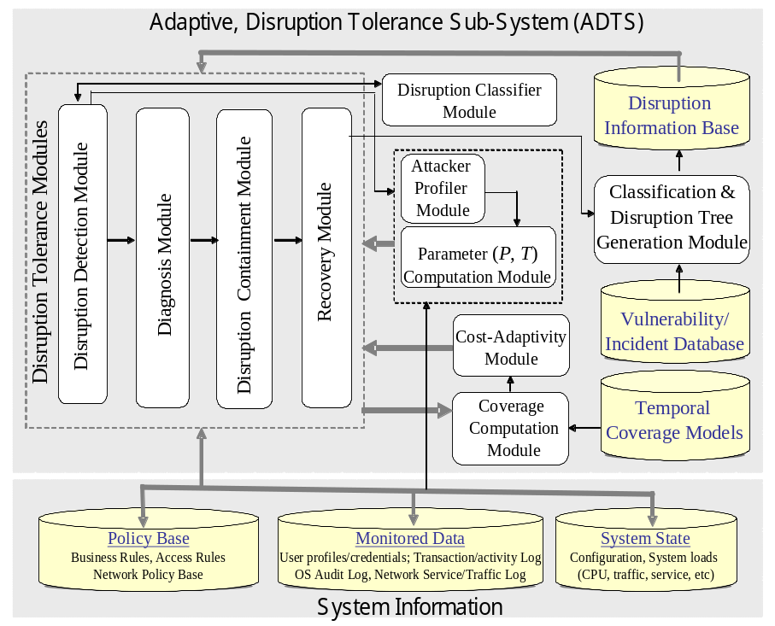
Our Approach: Adaptive Disruption Tolerant System (ADTS)
System
Information
Application
Layer
Information
Systems
Layer
ADTS
Network
Layer
Response
Action

Slide 7
Disruption Detection
Initial phase of disruption tolerance process
Based on previous approach to intrusion detection systems (IDS)
IDSs are based on two alternative choices
  Anomaly based: Specify the normal behavior
  Misuse based: Specify the patterns of attacks
Metrics for evaluating IDSs
  False positives, or False alarms
  False negatives, or Missing alarms
Our approach: Collaborative Disruption Detection Systems (CODDS)
  Multiple detectors specialized for different parts of system
  Manager infrastructure for combining alarms from multiple detectors
  Rulebase at manager to decide on appropriate response

Slide 8
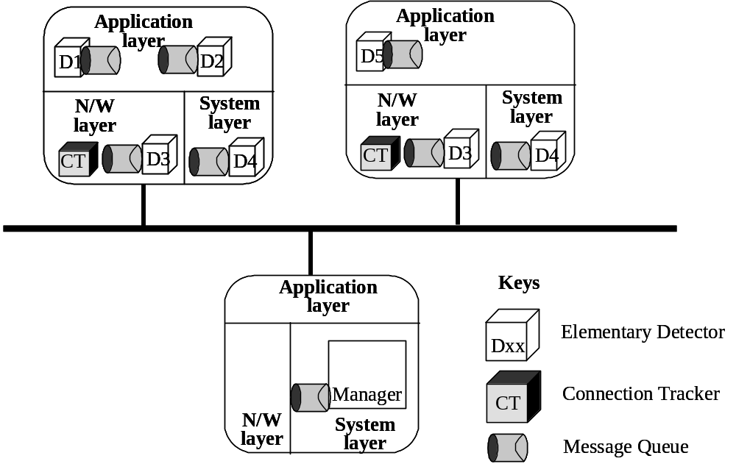
CODDS Approach
Motivation
  Single IDS can have false positives (false alarms) or false negatives (missed alarms)
  Single IDS is specialized for certain kinds of attacks
  Timing based correlation from multiple detectors may indicate useful characteristics of attack such as propagation speed

Slide 9
CODDS Components
Elementary Detectors (EDs): Specialized detectors distributed through the system
  The EDs maybe off-the-shelf and minimal change is required for integration into CODDS
  Different hosts may have different configurations of EDs
Message Queue (MQ): Communication layer for multiple CODDS components
  Secure through a shared key and hash digest
Connection Tracker (CT): Kernel level entity to track which process has active connection on which port
Manager: Workhorse of CODDS responsible for collating alerts from EDs and generating a combined alert which is expected to be more accurate
  Can take into account local alerts from individual hosts to make a global determination

Slide 10
Manager Architecture
Manager communicates with other entities through MQ and has shared key with each ED
Manager components are
  Translation engine: Translates native alert formats into CODDS format
  Event dispatcher: Dispatches the event to the appropriate host’s Inference Engine instance
  Inference Engine: Matches the received events against the Rule Objects to come up with a determination of disruption.
    A separate instance of the Local Inference Engine for each host
    A Global Inference Engine for correlating the results from the local engines
    Rule Objects store the rules, one for each class of disruption
  Combining Engine: If multiple types of inference engine, this combines the detection decision from each

Slide 11
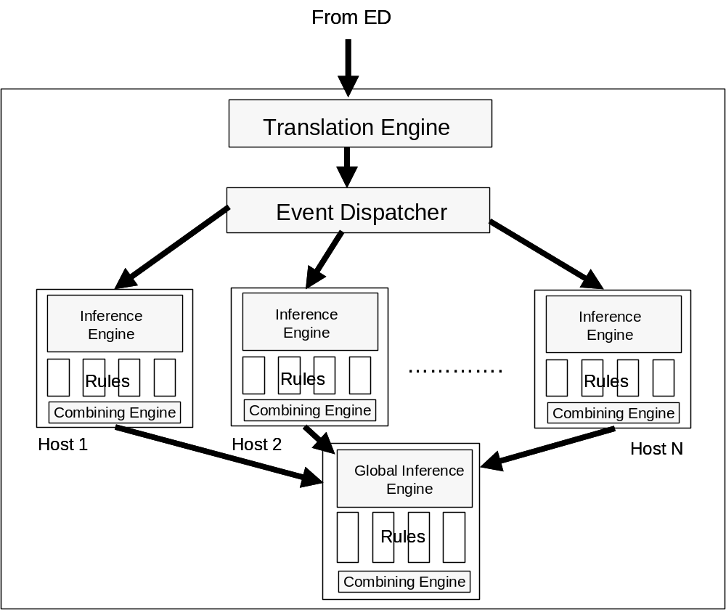
Manager Architecture

Slide 12
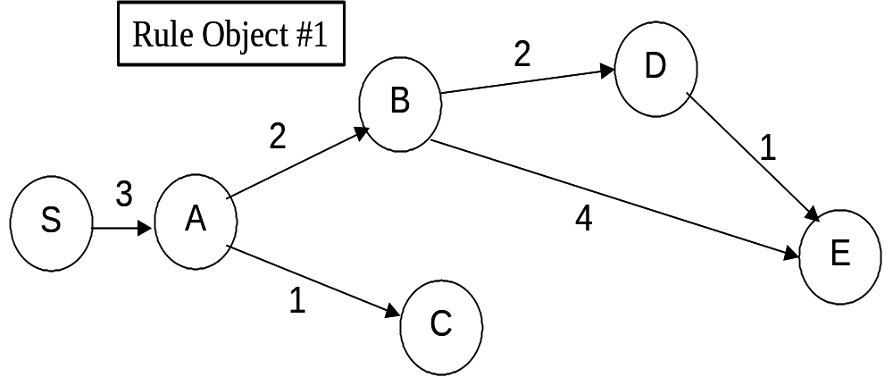
Graph-Based Inference Engine
Rules are represented as graphs
Nodes are events and Edges represent sequencing of events
Edge weights represent assurance values indicating likelihood of sequence
Assurance Value (AV) for a disruption given by sum of edge weights
An event is matched with a rule object if it is fusionable, i.e., belongs to the same disruption instance
Discounted Assurance Value (DAV) for partial matches

Slide 13
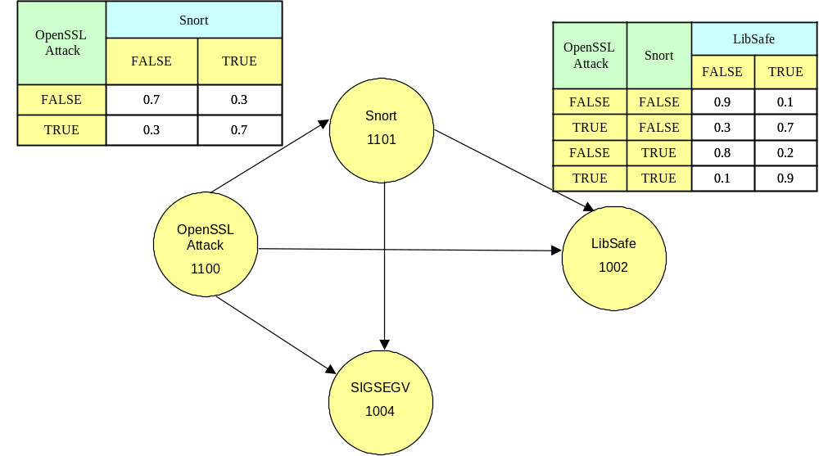
Bayesian Network Based Inference Engine
In a Bayesian Network, the nodes represent random variables and edges the direct influence of one variable on another
Three step process for creating rule object
  Nodes to represent events
  Edges to represent conditional probability relations among the events
  Creation of table with conditional probability values
Bayesian Network toolbox used for solving
Input is fusionable event stream
Output is conditional probability of root (the disruption)

Slide 14
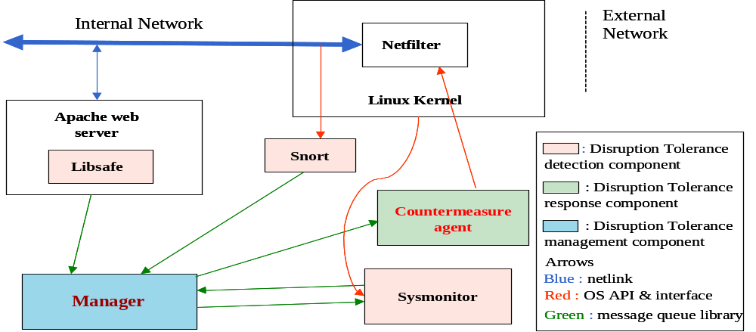
CODDS System: Current Implementation
1. Create profile
2. Browse catalog
3. Create shopping cart
4. Check out shopping cart
Web
Server
Appl.
Server
Database
Web Client

Slide 15
CODDS Elementary Detectors
Application level: Libsafe. Middleware to intercept “unsafe” C function calls and prevent stack overflow attacks.
Network level: Snort. Sniffs on incoming network packets and matches against rulebase to perform misuse based detection.
Kernel level: Sysmon. Home-grown new detector.
  Intercepts system calls for file accesses and executions.
  Takes a set of rules for disallowed accesses or executions
    Can be specified using wildcards or directory tree
  Intercepts signals of interest that can flag illegal operations.
    SIG_SEGV to indicate segmentation violation that may be caused by buffer overflow

Slide 16
Simulated Disruptions
Disruptions which are of type intrusions are simulated for our experiments.
Three classes of disruptions, multiple types within each class, and multiple variants within each type
  Buffer overflow: Can be used to overwrite parts of stack and write and execute malicious code
    Apache chunk attack
    Open SSL attack
  Flooding: Overwhelm the network with redundant or malicious packets causing a denial of service
    Ping flood
    Smurf
  Script based: Exploit poorly written scripts which do not do input validation to execute arbitrary commands
    Used unchecked open() and system() calls

Slide 17
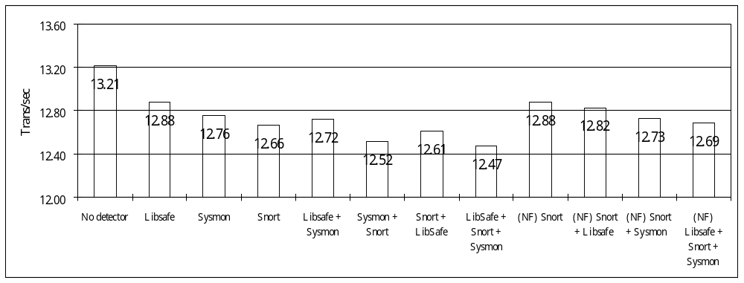
Results: Performance – Without Disruptions
Measured without and with disruptions
30 web clients running concurrently
Transactions per second of workload transaction measured
When multiple EDs present, manager with both Inference Engines is deployed
No Disruption
Degradation overall: 3.95% with Snort rules modified, 5.60% without
Degradation due to Sysmon alone: 3.46%

Slide 18
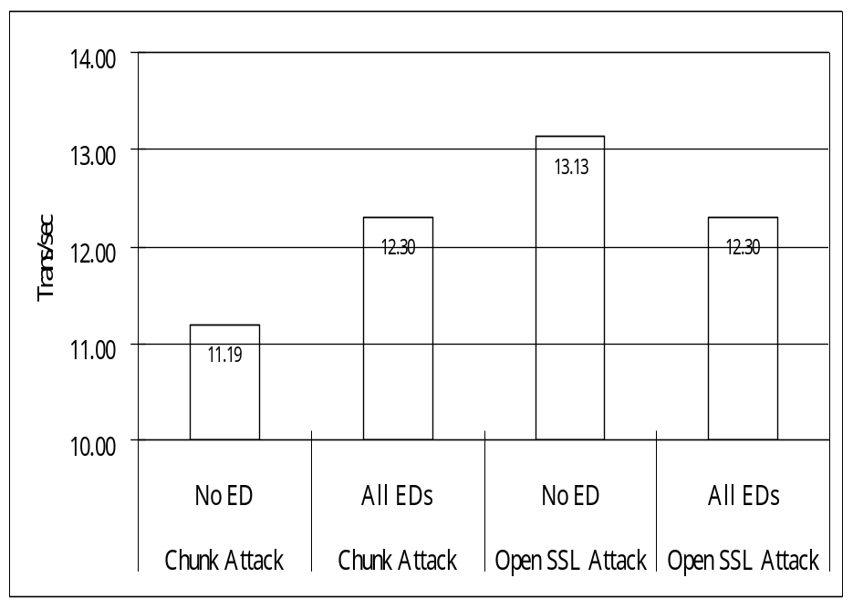
Results: Performance – With Disruptions
OpenSSL Attack performance degradation is 6.33%
Chunk Attack performance improves!!!
  Having Libsafe prevents core dumping
Highest performance degradation due to Matlab Bayesian Network toolbox

Slide 19
Results: Accuracy of Detection
Snort
Libsafe
Sysmon (Signal)
Sysmon (File)
CIDS
No attacks
Yes (1807,1933)
No
No
No
No attack
Open SSL
Yes (1881,1887)
No
Yes
R1
Yes
Open SSL variant
No
No
Yes
R1
Yes
Apache Chunk
Yes (1807, 1808, 1809)
Yes
Yes
R1
Yes
Smurf 1000
Yes (499)
No
No
No
Yes
Smurf 500
No
No
No
No
No
Ping Flooding
Yes (523, 1322)
No
No
No
Yes
Script
No
No
No
Yes
Yes
Yes: Detected. Figures in parentheses are the rule numbers within Snort. Sysmon(File) is the file access detection part, Sysmon(Signal) is the illegal signal detection part; R1: The attack was not successful in creating a file.

Slide 20
Disruption Containment
Goals
  Contain the disruption to subset of services while remaining services operate
  Take responses, both preventive and reactive, to reduce effect of current disruption and prevent future disruptions
Evaluation Metric
  Survivability – The portion of the functionality of the system that is available when subjected to disruptions
  Survivability is a probabilistic measure
  Example: Survivability of the Amazon.com service under a defined set of disruptions is 0.98 with a probability of 0.95!

Slide 21
Representation Model
Disruption DAG
  Nodes are goals
  Parent node can be “achieved” if any or all children nodes are “achieved”
  Example:
    To obtain root access on a machine, there needs to be Windows NT running on the machine and Windows Messenger v. 4 needs to be compromised
A₁
A₂
AND arc
CSS
{S1,S2}
ESS
{S3,S4,S5}
B₁
C₁
B₂
C₂
Node Class | Response Class | Disruptivity Index
{Strong candidate, Weak candidate, Very weak candidate, Non candidate} | {R1, R2, R3, R4} | {1, 2, 3, 4}
D₁
Y₁
Z₁
M
D₂
OR arc
V₁
X₁
Response Table
X
Y
X₂
Y₂

Slide 22
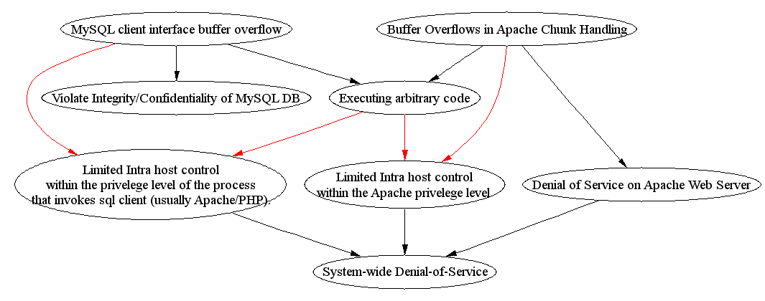
Example of Instantiation of D-DAG
Disable DB write
Restart Apache
Kill processes
AND-arc
OR-arc

Slide 23
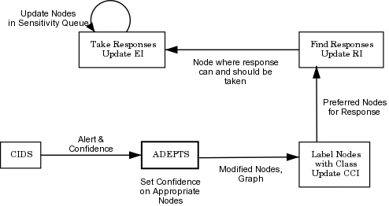
Flow for Containment & Response
Algo #3
Algo #2
Algo #1

Slide 24
Algo #1: Classifying Node as Candidate for Response
Compromised Confidence Index (CCI) = f(f′(CCI_{i}), Confidence in Detection)
D
E
Before
(Confidence values of
other nodes are 0)
A
B
C
Confidence = 0.7
Confidence = 0.6
After
CCI = 0
D
E
CCI = 0.45
CCI = 0.7
A
B
C
CCI = 0.9
CCI = 0
In this example, f computes the average of the inputs

Slide 25
Candidate Labeling (top down approach)
Before
CCI = 0
D
E
CCI = 0.45
CCI = 0.7
A
B
C
CCI = 0.9
CCI = 0
SC: Strong Candidate
WC: Weak Candidate
VWC: Very Weak
Candidate
NC: No Candidate
After
(Assuming threshold
of each node is 0.4)
NC
SC
D
E
SC
A
B
VWC
C
SC
Response set = {A, E}
For present implementation, only the top SC nodes in a path and all WC nodes are
put in the response set.

Slide 26
Algo #2: Decision on Response
Response Index (RI) calculated for each node
Depends on (summation of)
  Node class
  Disruptivity of response (More disruptive ⇒ Lower value)
  Compromised Confidence Index (CCI)
  Effectiveness Index (EI) of response action
0   ≤ RI ≤ 4. Higher value implies node more suitable for response
Responses are classified into 5 classes
    Disable access to service for all users
    Disable access to service for subset of users
    Reduce functionality to service for all users
    Reduce functionality to service for subset of users
    Apply patch
Less
Disruptive

Slide 27
Algo #3: Calculating Effectiveness Index (EI) for Response
History of attack nodes being reached in the DDAG maintained in a sensitivity queue for a sensitivity period.
  Another alert implies response was not successful
Preventive
Response
Attack goal reached
Reactive
Response
Higher level goal
Currently active responses are maintained in an Activation Response Table
  Currently active responses are not executed again
When an attack is detected and a response action taken, the feedback algorithm:
  Searches for failed preventive responses (decrease EI if found)
  Searches for failed reactive responses of responsible children
  (decrease EI of parent(s) response if found)
  Searches for multiple occurrences of the same attack
  (force more drastic response to prevent further EI degradation)
Every hour the queue is examined for expired sensitivity periods
  If the response was successful, the EI for that response is increased

Slide 28
E-Commerce System
Client | Microsoft IE 6.0
Web Server | Apache 1.3.23
App Server | Zope 2.6.2
Directory Server | Open LDAP 2.1.22
Web
Server
Application
Server
Directory
Server
See
Details
Later
Front-
end
Back-
end
See
Details
Later
IS layer
Directory db
IS layer
N/W layer
IS layer
N/W layer
N/W layer
Client
HTML &
JSP
Front-end
DB Server | MySQL 4.0.1
Portal Server | Zope 2.6.2
Mail Server | Sendmail 8.12.5
Portal
Server
Database
Server
SOAP client proxy
Personalization
EJB
Container
Information
Systems layer
Integration
Publish &
Subscribe
Entity
bean
Database
Network layer
E-commerce
Portal
CRM
Portal
JDBC layer
IS layer
IS layer
N/W layer
N/W layer

Slide 29
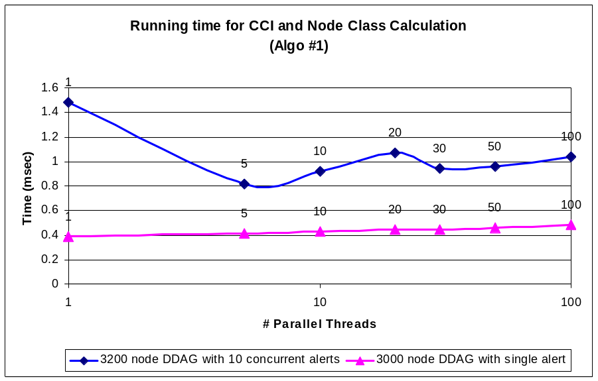
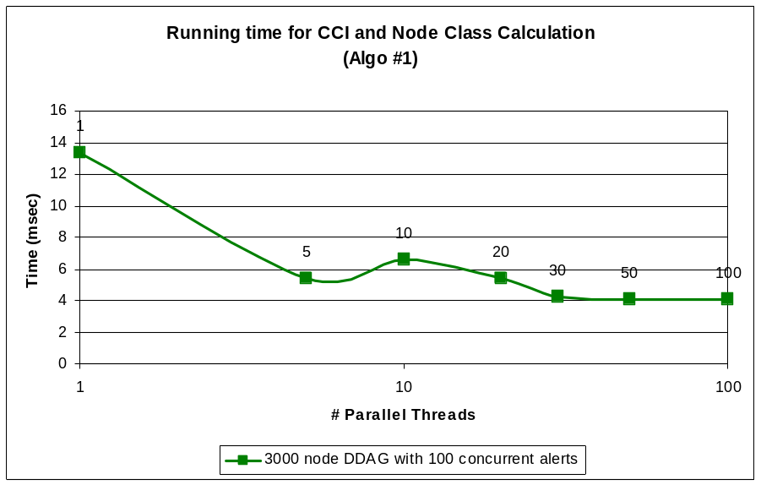
Results: Performance of Algo #1
Algo #1’s CCI calculation & node classification is parallelized
Thread pool with queue of jobs that are shared among the threads
Conclusions
  High parallelism is desirable for large DDAGs and large number of concurrent alerts
  Smaller size and fewer alerts biases decision against multiple threads due to overhead of access to shared job queue

Slide 30
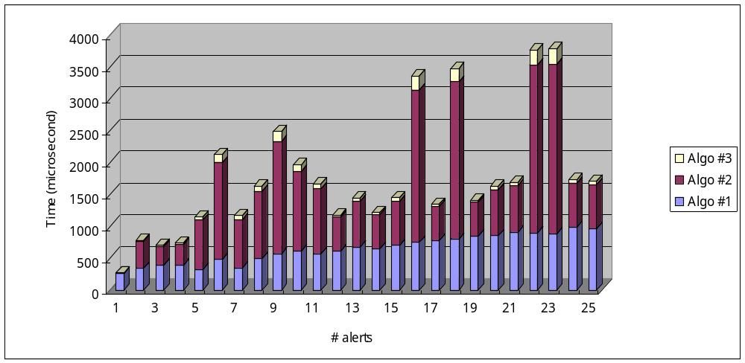
Results: Performance of ADTS System
Conclusions
  Algo #1 & #2 dominate the system time
  The irregularity is seen because of difference in algo #2’s running time
  Irregularity is caused by different number of responses
  The relationship between the number of alerts and the number of responses depends on structure of DDAG and is difficult to predict analytically

Slide 31
Conclusion
Building an infrastructure for distributed e-commerce platforms for running reliably and securely
Can accommodate best-of-breed detection techniques and provides management and correlation facility
Algorithm to contain disruption to subset of services and take response action to improve system survivability
System’s effectiveness demonstrated on real e-commerce platform

