Slide 1

Robust Communication in Sensor Networks Resistant to Node Compromise and Failures
Saurabh Bagchi
Dependable Computing Systems Lab
School of Electrical and Computer Engineering
Purdue University
Joint work with: Issa Khalil, Gunjan Khanna, Ravish Khosla, Ness Shroff
http://shay.ecn.purdue.edu/~dcsl

Slide 2
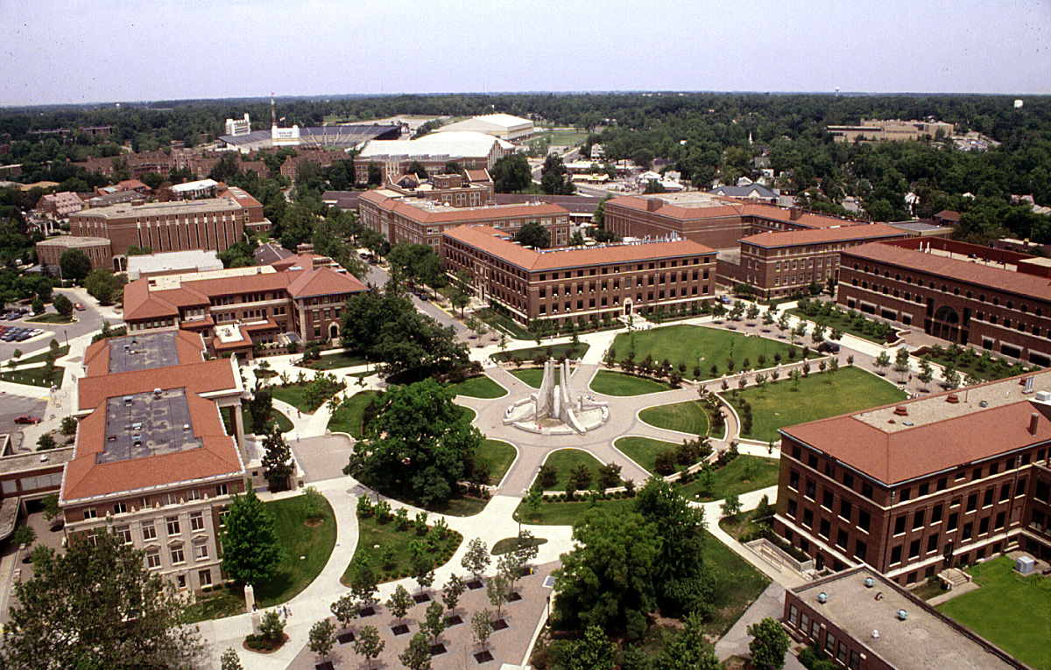
Greetings come to you from …

Slide 3
Outline
Motivation
Robust data dissemination
  Background
  Example protocol: SPIN
  Our protocol: SPMS
  SPMS: Failure scenario
  Energy and delay analysis
  Simulation results
Secure communication
  Background: Key management in sensors
  Our protocol: SECOS
  SECOS: Key elements
  Communication within control group
  Communication across control group
  Analysis
  Simulation results
Take away lessons

Slide 4
Outline
Motivation
Robust data dissemination
  Background
  Example protocol: SPIN
  Our protocol: SPMS
  SPMS: Failure scenario
  Energy and delay analysis
  Simulation results
Secure communication
  Background: Key management in sensors
  Our protocol: SECOS
  SECOS: Key elements
  Communication within control group
  Communication across control group
  Analysis
  Simulation results
Take away lessons

Slide 5
Motivation
Sensor networks being deployed in critical military and civilian situations
  Hostile environment with adversaries in military domain
  Privacy concerns in civilian domain
  Tamper proof communication for emergency rescue and relief
  It is important for sensed data to make its way to command and control center
Therefore, dependable sensor networks
Notes:
Cause of temporary failures.
Cause of permanent failures.

Slide 6
Dependable Sensor Networking
Dependability is the property of a system to tolerate failures, be it from natural errors or malicious errors, aka security attacks
Dependability
Resilience to natural errors, i.e., Reliability
Resilience to malicious errors, i.e., Security
Why for Sensors?
Why for Sensors?
The nodes are failure prone
The wireless links are failure prone
Placed in hazardous environments
Sometimes used for detection of critical events
Placed in hostile environments
Adversaries have huge gains from compromising sensor network
Low cost rules out tamper proof hardware
Omni-directional wireless links
Notes:
Nodes because of miniaturization, light-weight packaging, low cost are failure-prone.
The nodes may fail in a transient manner or permanent manner.

Slide 7
Motivation
Reliability in data collection is important but hard to achieve
  Small energy source
  Low bandwidth
  Large scale (ten’s of thousands of nodes) with long paths which can have multiple failures
  Some constraints that technology may partially remove for us (compute cycle, memory)
  Susceptible to collective failures
Securing communication is important but hard to achieve
  Traditionally use cryptography techniques for securing communication
  Cryptography involves keys
  Key management requires trusted entities
  Key management requires powerful entities
Notes:
Energy constraints argue against broadcast kind of protocol which lead to flooding.
Sensed data is time sensitive. Delay constraints argue against traditional fault tolerant technique of time redundancy where operation is retried if it fails.
Nodes have limited storage capabilities and processing power. 128 KB of program storage, 512 KB of data storage, 4 MHz of Atmel processor. We expect these limits are going to be raised fast, but they will still be at least an order of magnitude more constrained than regular wired nodes.
Key management needs trusted entities that can act as repositories of keys and verifiers of identity, such as certification authorities.
Key management needs powerful entities that can field lots of key requests.

Slide 8
Outline
Motivation
Robust data dissemination
  Background
  Example protocol: SPIN
  Our protocol: SPMS
  SPMS: Failure scenario
  Energy and delay analysis
  Simulation results
Secure communication
  Background: Key management in sensors
  Our protocol: SECOS
  SECOS: Key elements
  Communication within control group
  Communication across control group
  Analysis
  Simulation results
Take away lessons

Slide 9
What is data dissemination?
There are some sources of sensory data
  Possibly sources with overlapping sensing regions
There are some nodes interested in sensory data
  Maybe resource constrained nodes themselves
  Can be cluster heads in hierarchical communication
  Alternately, can be a moving data collector
Control center
Cluster heads
Sensor nodes

Slide 10
Existing Data Dissemination Protocols
Data dissemination in sensor networks is a topic receiving enormous interest in the research community
However, data dissemination in a delay sensitive and energy conserving manner with fault tolerance concerns has received far less attention
Protocols can be broadly classified into PUSH and PULL based
  PUSH : Sensors send the data at regular intervals to a sink node
  PULL : Sensors store the data and data is collected using a polling mechanism
Notes:
Polling can be done by the destination node.
Gossip provides reliability by increasing the fan-out that is the number of neighbors to gossip to.

Slide 11
Existing Data Dissemination Protocols
Broadcast and Gossip have been used to provide reliability but use redundant transmission leading to wastage of energy
TTDD [Zhang et al.]
  Protocol for data collection by mobile collectors from static sources
  Sets up a grid structure and proactively determines routing from data source to sink
  At runtime, when sink needs data it locates a close by “dissemination point” which uses pre-computed route from source to sink
  Drawbacks: Cost of setting up entire routing grid

Slide 12
Outline
Motivation
Robust data dissemination
  Background
  Example protocol: SPIN
  Our protocol: SPMS
  SPMS: Failure scenario
  Energy and delay analysis
  Simulation results
Secure communication
  Background: Key management in sensors
  Our protocol: SECOS
  SECOS: Key elements
  Communication within control group
  Communication across control group
  Analysis
  Simulation results
Take away lessons

Slide 13
Example Protocols
SPIN (Sensor Protocols for Information via Negotiation) [Balakrishnan et al.]
  Use meta data transmissions to reduce redundant transmissions
  Advertise the data prior to sending the data
  Efficient in case of collisions
  Mix of Push and Pull mechanisms
ADV
B
REQ
DAT
S: Sender
B: Interested node
C: Disinterested node
S
ADV
C
Notes:
Meta-data is a descriptor for the data, e.g., the geographical region that the data pertains to and the time.
Works if the meta-data is smaller than actual data.
Collisions reduced because only interested nodes are querying for the longer length data.

Slide 14
Reliability in Existing Protocols
Current protocols are not designed to address the issue of failures in the sensors
  Either the data is lost in case of a failure
  Broadcast and Gossip do address failures as by-products but are wasteful in terms of resources
Protocols use direct communication between the nodes and the base stations
  Not feasible in practical larger sensor networks
Several times a central controller is employed leading to a violation the distributed nature of the protocol
  Setting up grid structure in the TTDD

Slide 15
Outline
Motivation
Robust data dissemination
  Background
  Example protocol: SPIN
  Our protocol: SPMS
  SPMS: Failure scenario
  Energy and delay analysis
  Simulation results
Secure communication
  Background: Key management in sensors
  Our protocol: SECOS
  SECOS: Key elements
  Communication within control group
  Communication across control group
  Analysis
  Simulation results
Take away lessons

Slide 16
Shortest Path Minded SPIN (SPMS)
3
4
REQ
ADV
ADV
ADV
ADV
1
ADV
DAT
6
DAT
5
REQ
REQ
2
ADV
DAT
ADV
Notes:
Request and data get sent through multi-hops using the shortest path routing.

Slide 17
Shortest Path Minded SPIN: Design Features
Zone of 1
Zone
  Maximum distance a node can reach using the maximum power level
  Node can adjust its power levels to reach all nodes (neighbors) in its zone
  Routing tables for neighbors in the zone using Bellman Ford
  Tables contain the power level for each neighbor
Zone of 6
3
4
1
5
6
2
7
Timers
  TimeOut_{ADV} : Nodes wait for the data to come to the nearest node before sending REQ
  TimeOut_{DAT}: Nodes wait for the data after sending the REQ packet
Notes:
TimeOut_ADV is motivated by the fact that getting the data from a nearby node is more energy efficient.
TimeOut_DAT is to deal with failures of the data source or of nodes in the path.

Slide 18
SPMS Protocol : Failure Scenario
Failure of an intermediate node
  Could take place before or after sending the ADV
  Not sending an ADV can be misinterpreted as failure
  Node stores the neighbors which have advertised the data
    PRONE : Primary Originator Node
    SCONE : Secondary Originator Node
Resilience to Failures
  After a TimeOut_{ADV} expires, node sends the request to PRONE through the shortest path
  DATA is received using the same path if there is no failure
  Incase of a failure TimeOut_{DAT} occurs
  Node directly sends the REQ packet to PRONE
  In case PRONE is also not responding then the REQ is sent to SCONE
Notes:
PRONE is the first choice for getting the data – close by node.
SCONE is the second choice for getting the data.

Slide 19
SPMS : Failure Scenario
3
4
ADV
ADV
ADV
ADV
1
ADV
6
TimeOut_ADV
TimeOut_DAT
REQ
DATA
REQ
5
2

Slide 20
Outline
Motivation
Robust data dissemination
  Background
  Example protocol: SPIN
  Our protocol: SPMS
  SPMS: Failure scenario
  Energy and delay analysis
  Simulation results
Secure communication
  Background: Key management in sensors
  Our protocol: SECOS
  SECOS: Key elements
  Communication within control group
  Communication across control group
  Analysis
  Simulation results
Take away lessons

Slide 21
Energy and Delay Analysis
Time to get data from source to adjacent destination is defined as T_{round}
ADV
D
REQ
DAT
S
T_{round} = G.n₁² + A.T_{tx} + T_{proc} + G.n_{s}² + R.T_{tx} + T_{proc} + G.n_{s}² + D.T_{tx}
T_{round} = G.n₁² + (A+R+D).T_{tx} + 2T_{proc} + 2G.n_{s}²

Slide 22
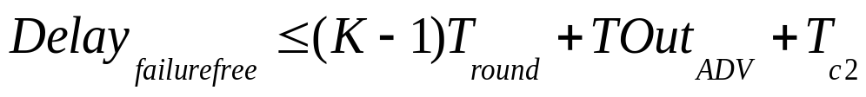
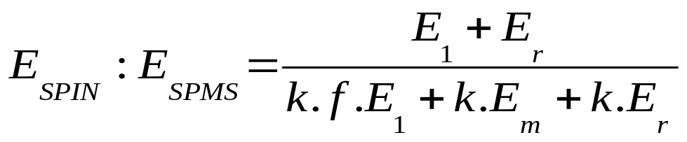
Energy and Delay Analysis
In case of K relay nodes between two nodes
k
k
intermediate nodes
intermediate nodes
S
A
C
D
th
(k
th
(k
-
-
j+1)
j+1)
relay node
relay node
(Failed)
(Failed)
The ratio of energy between SPIN and SPMS can be given by :
E_{SPIN} = (A+D+R).E₁ + (A+D+R).E_{r}
E_{SPMS} = k.A.E₁ + k.(D+R).E_{m}+k.(A+D+R).E_{r}
Notes:
The reception by uninterested nodes is not taken into account.
E_m = E_r

Slide 23
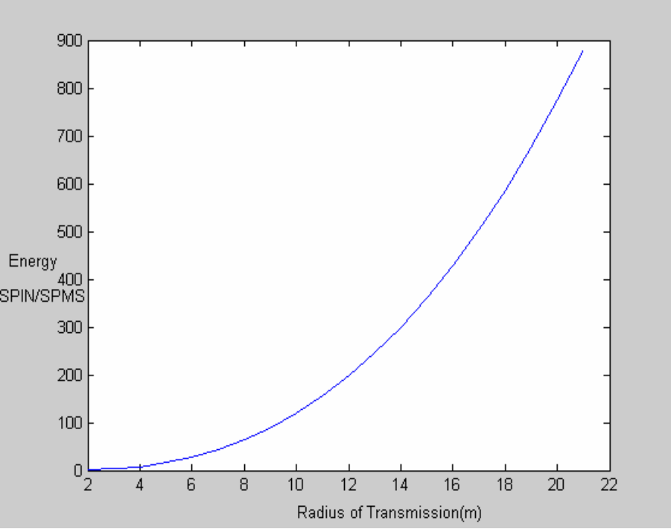
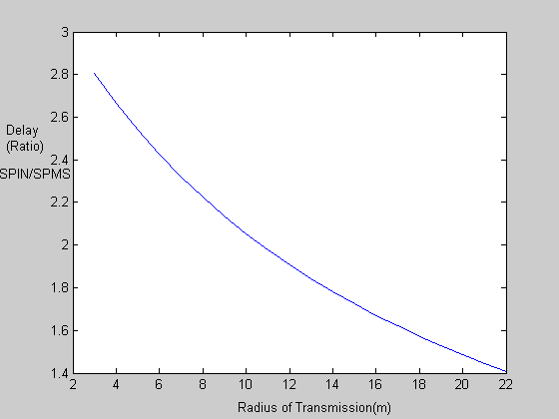
Energy and Delay Comparisons: Equation Plots
SPIN uses more energy than SPMS
as relay nodes increase.
Delay advantage of SPMS decreases
as relay nodes increase.

Slide 24
Outline
Motivation
Robust data dissemination
  Background
  Example protocol: SPIN
  Our protocol: SPMS
  SPMS: Failure scenario
  Energy and delay analysis
  Simulation results
Secure communication
  Background: Key management in sensors
  Our protocol: SECOS
  SECOS: Key elements
  Communication within control group
  Communication across control group
  Analysis
  Simulation results
Take away lessons

Slide 25
Simulations
SPMS protocol is simulated in ns-2 and compared with SPIN
  We vary the transmission radius and the number of nodes
Crossbow data sheet is used to calculate the power spent in transmission and receiving packets.
  Nodes can only transmit at 5 energy levels considered in our experiments
  ADV and REQ packet are considered to be 2 bytes and DATA packets are 40 bytes long
  Inter packet arrival time is exponential
Experiments are carried out for two topologies
  All to All communication : Every node requests data from every other data
  Cluster Based Hierarchical Communication: Cluster heads collect the data and send it to the sink using SPMS
Experiments for failure free and failure scenarios
  Failures are transient and follow exponential inter-arrival times
Notes:
Uniform density of nodes which are placed on a grid.

Slide 26

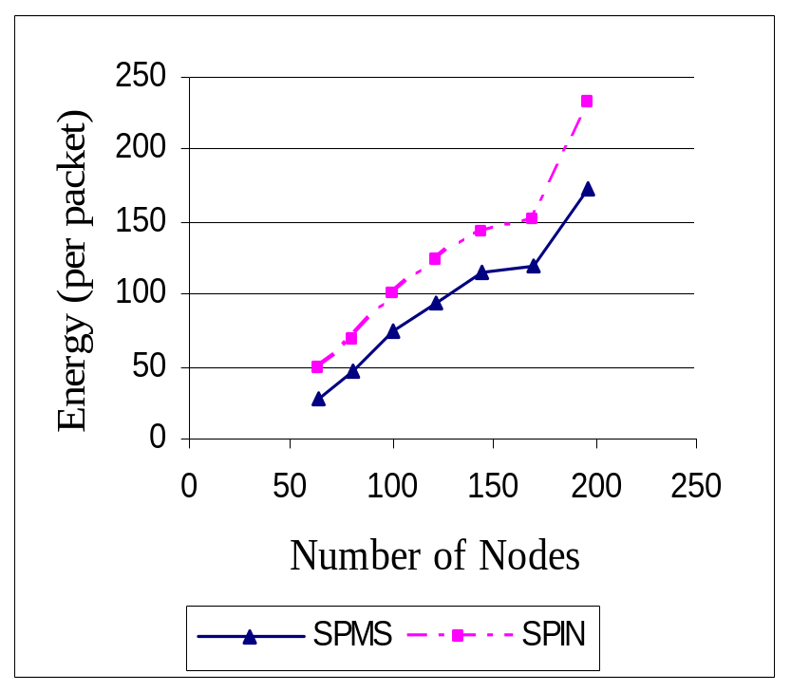
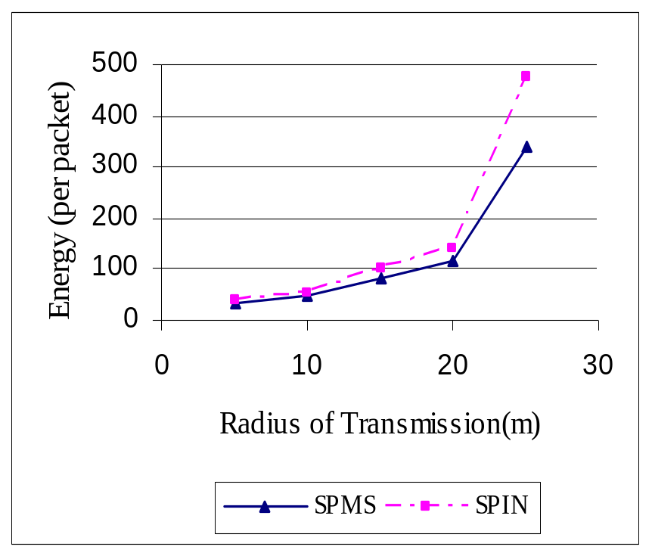
Results for Failure Free Scenario: Energy Metric
SPMS saves about 23-46% energy compared to SPIN
with varying number of nodes
Notes:
Increase in # nodes => Increase in sensor field size. Slope of energy with size is steeper for SPIN and therefore the difference increases.
Increase in radius of transmission => increase in the number of hops. Multi-hop communication in SPMS saves energy compared to SPIN. At low radius, both are the same since small number of zone neighbors, mostly one hop away. This advantage for SPMS is taking care of the fact that SPMS expends energy in BF routing table calculation within zone.

Slide 27
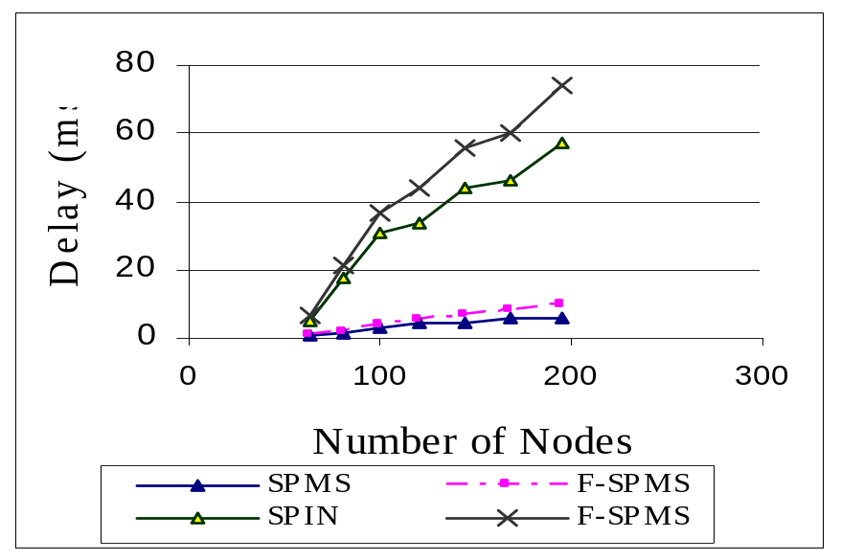
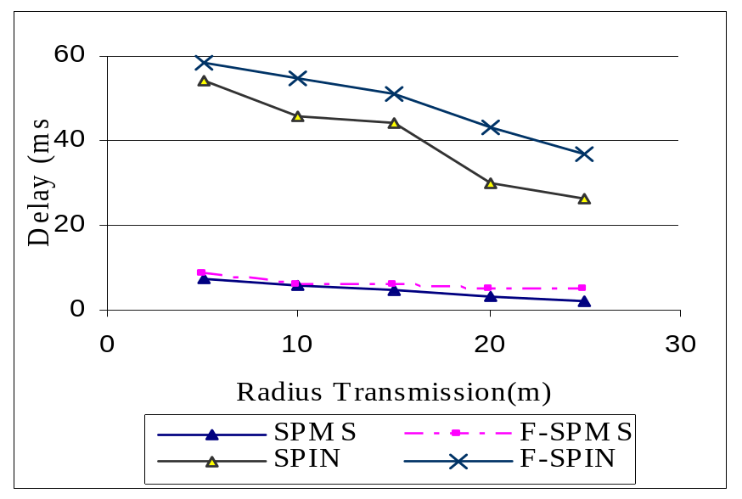
Results for Failure Free and Failure Scenario: Delay Metric
SPIN incurs
10 times more delay
Delay gradient is steeper for SPIN with increasing number of nodes
Delay decreases with radius of transmission
SPMS disseminates data much faster compared to SPIN in both failure and failure free scenarios.
Notes:
Each round takes longer in SPIN and therefore more # nodes => more # rounds => more delay.
Failures affect SPMS more than SPIN but SPMS is still better.
Failure behavior sensitive to time out value. The time out is tuned with a safety factor of 1.4.
The delay incurred to MAC contention outweighs the drawback of multiple hop communication.

Slide 28
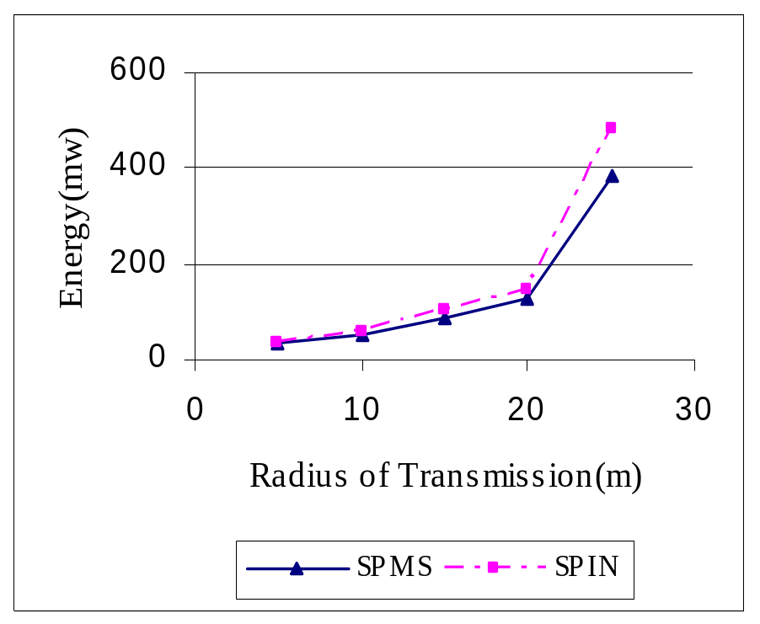
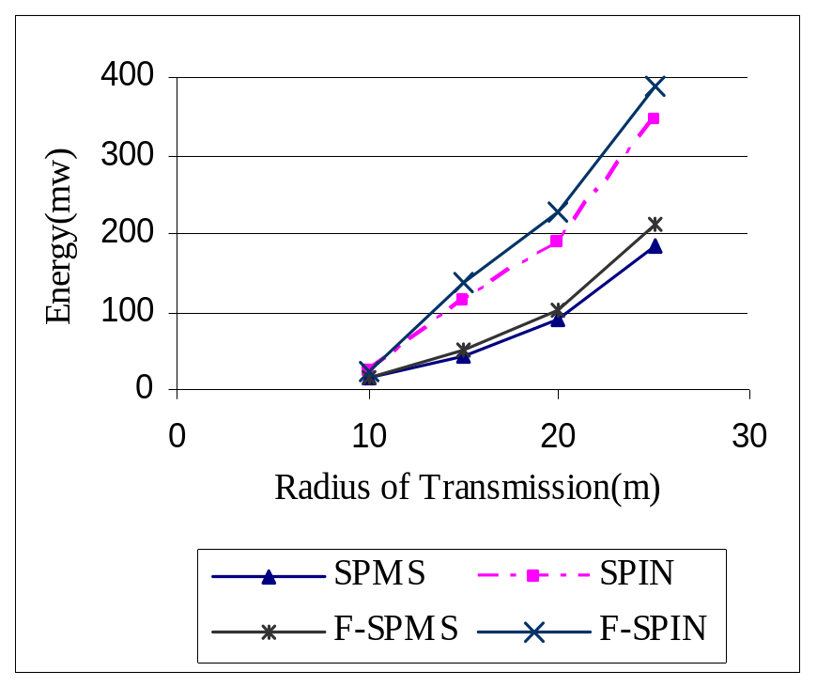
Energy Metric : Mobile Nodes and Cluster Based Communication
Mobile Nodes
Cluster Mechanism
SPMS saves about 21% energy compared to SPIN even with mobility.
SPMS saves 59% energy in Cluster Based Hierarchical communication.

Slide 29
Current Work … Coming Soon
Failure optimized SPMS
  Avoid sending REQ through a suspected failed path
  Inform neighbors of suspected failed path
  This is more timely than route updates
Mobility optimized SPMS
  Avoid Bellman Ford on entire zone if node moves in
  Incremental computation in a lazy manner

Slide 30
Outline
Motivation
Robust data dissemination
  Background
  Example protocol: SPIN
  Our protocol: SPMS
  SPMS: Failure scenario
  Energy and delay analysis
  Simulation results
Secure communication
  Background: Key management in sensors
  Our protocol: SECOS
  SECOS: Key elements
  Communication within control group
  Communication across control group
  Analysis
  Simulation results
Take away lessons

Slide 31
Key Management in Sensor Networks
Most nodes have resource constraints
Dynamic environment where network partitions and failures of nodes and links are not unlikely
Individual nodes may be compromised
Two traditional approaches
Key predistribution: Two extreme examples are
  Unique key for each node pair
  Single key for the entire network
Kerberos-like client-server approach: Privileged nodes distributed in the network for key management functionality
Notes:
Resource constraints of bandwidth, computational power, energy, storage, and transmission range. Say which ones are a matter of riding the technology curve.

Slide 32
Our Design Goals
Provide scalable secure key management obeying the constraints of the sensor node
Remove the requirement of specialized nodes
Make the protocol resilient to eavesdropping, denial of service, and node compromise attack and natural failures
Reduce the end-to-end latency of secure data communication
These goals realized in protocol called SECOS

Slide 33
Outline
Motivation
Robust data dissemination
  Background
  Example protocol: SPIN
  Our protocol: SPMS
  SPMS: Failure scenario
  Energy and delay analysis
  Simulation results
Secure communication
  Background: Key management in sensors
  Our protocol: SECOS
  SECOS: Key elements
  Communication within control group
  Communication across control group
  Analysis
  Simulation results
Take away lessons

Slide 34
SECOS: High Level Approach
Divide the sensor field into multiple control groups, each with a control node
Symmetric cryptographic primitive used, such as DES
Communication within a group happens using key exchanged through the control node
Communication across groups happens using key exchanged through multiple control nodes
  Communication between control nodes happens using key exchanged through base station
Notes:
With the demise of DES pronounced by NIST and AES being heralded, that would be more suited.

Slide 35
SECOS: High Level Approach
M
. . .
C₁
C₂
C_{B}
. . .
S
. . .
S
S
. . .
S
S
. . .
S
S
: Sensing Node
C_{i}
: Control Node
M
: Base Station
Notes:
Three level hierarchy of nodes – single base station, multiple control nodes, many many sensor nodes

Slide 36
Outline
Motivation
Robust data dissemination
  Background
  Example protocol: SPIN
  Our protocol: SPMS
  SPMS: Failure scenario
  Energy and delay analysis
  Simulation results
Secure communication
  Background: Key management in sensors
  Our protocol: SECOS
  SECOS: Key elements
  Communication within control group
  Communication across control group
  Analysis
  Simulation results
Take away lessons

Slide 37
Failure and Resource Model
Base station is fixed, secure, and has no resource constraints
All other nodes are generic sensor nodes and have all the typical resource constraints
Links may be subjected to eavesdropping and message tampering
Nodes may be subjected to denial of service attacks and may be compromised
  “Don’t trust thy neighbor”

Slide 38
Building Blocks for SECOS
Purging key caches: Caches provide benefits in latency and energy consumption but lead to vulnerability
Key refreshment: Either periodically or when triggered by anomalous event
Rotate privileged node role: Since we do not assume specialized protected nodes for key management functionality
Notes:
Cache purging only protects old messages.
Key refresh: cryptanalyzing key
Rotating => more equal drain of energy, cannot perform DoS against targeted nodes
Neighbor watch: Can watch communication in and out of neighbor node
Neighbor watch: May not be able to observe payload in case it is encrypted, but can observe the header and the presence or absence of packet

Slide 39
Keys used in SECOS
Master key: Unique key shared between each node and the base station
  Burnt in at time of deployment
Volatile secret key: Used for key generation of other keys such as session key
  Provided to a node at deployment time
  Changed after each key generation
Session key: Used for secure communication between two end points
  K_{XY(2)} = MAC _{KXY(1)} (counter_{XY} ⊕ K_{XY(v)} || 1)
MAC key and random number generator key: Not discussed here
Counters for semantic security
Notes:
Master key not used for communication.
Old volatile secret key is purged.

Slide 40
Outline
Motivation
Robust data dissemination
  Background
  Example protocol: SPIN
  Our protocol: SPMS
  SPMS: Failure scenario
  Energy and delay analysis
  Simulation results
Secure communication
  Background: Key management in sensors
  Our protocol: SECOS
  SECOS: Key elements
  Communication within control group
  Communication across control group
  Analysis
  Simulation results
Take away lessons

Slide 41
Communication within Control Group: Soln I
Control node establishment and establishment of secure channel between control node and other nodes done
C
K
K
A
B
Con: Compromised control node can expose communication between A and B
Notes:
For the time for which C remains the control node.
Control nodes are picked at random from several candidates with high trust values.

Slide 42

Communication within Control Group: Soln II
C
K
K
A
B
Extract K′ from K(K′)
K(K′)
Control node has access to K but not K(K′)
Hence, it cannot get K′, the session key between A and B
Con: If C colludes with a node that is on the path from A to B and gets K(K′)
Notes:
C is deliberately picked such that it is not a neighbor of A or B.
Collusion is raising the bar on the kind of security attack that needs to be launched.

Slide 43
Communication within Control Group: Soln III
C
K
K
Extract K′ from K(K′)
A
B
Use K′′ from earlier control node. Session key is K′′⊕K′
K(K′)
 | C₁ | C₂ | … | C_{n}
K₀ | K₁′ | K₂′ |  | K_{n}′
 | K₁= K₀ ⊕ K₁′ | K₂= K₁ ⊕ K₂′ |  | K_{n}= K_{n-1} ⊕ K_{n}′
Con: If adversary crypt-analyzes K₀ and compromises C₁, …, C_{n}
Notes:
C is deliberately picked such that it is not a neighbor of A or B.
Collusion is raising the bar on the kind of security attack that needs to be launched.

Slide 44
Outline
Motivation
Robust data dissemination
  Background
  Example protocol: SPIN
  Our protocol: SPMS
  SPMS: Failure scenario
  Energy and delay analysis
  Simulation results
Secure communication
  Background: Key management in sensors
  Our protocol: SECOS
  SECOS: Key elements
  Communication within control group
  Communication across control group
  Analysis
  Simulation results
Take away lessons

Slide 45
Communication across Control Group
K_{C1C2}
M
K_{C1C2}
C₂
C₁
K
K
K
Extract K′ from K(K′)
A
B
K(K′)
Expensive communication protocol
Note asymmetry in the two phases

Slide 46
Outline
Motivation
Robust data dissemination
  Background
  Example protocol: SPIN
  Our protocol: SPMS
  SPMS: Failure scenario
  Energy and delay analysis
  Simulation results
Secure communication
  Background: Key management in sensors
  Our protocol: SECOS
  SECOS: Key elements
  Communication within control group
  Communication across control group
  Analysis
  Simulation results
Take away lessons

Slide 47
Control Group Size
Upper bound imposed by the resource constraint on control node
Energy wise optimal control group size determination has two opposing pulls
  Larger size avoids expensive inter-group communication
  Smaller size minimizes the number of hops to the control node
  Control cache comes to the rescue
Energy curve is discontinuous due to different cases
  Hit in regular cache
  Miss in regular cache, communication within control group
  Miss in regular cache, outside control group, hit in control cache
  Miss in regular cache, outside control group, miss in control cache

Slide 48
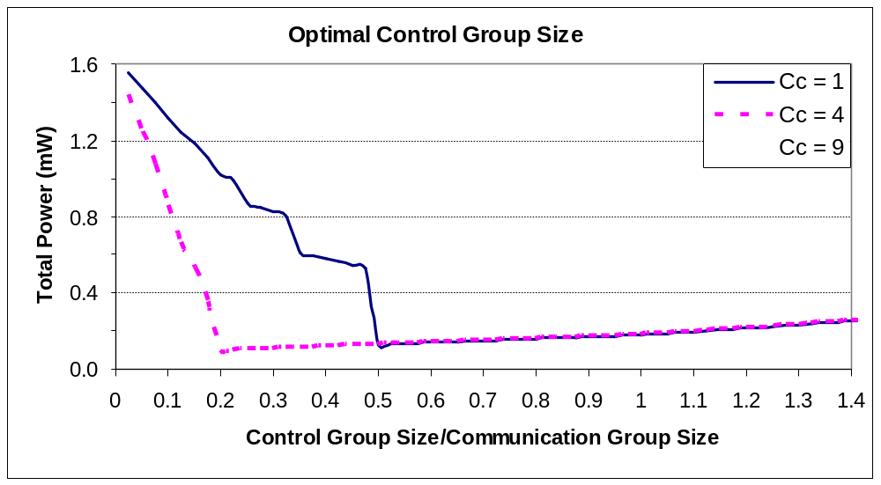
Analytical Result
N = 2000 nodes, H_{m} = 100, H = 10, G_{c} = 200, β_{c} = 0.2, E = 100 pJ, R = 128 bit
Estimate for optimal point is size of control cache = number of control groups in a communication group – 1
Operating point determined by energy wise optimal size and the max size given by resource constraints
Notes:
Assumed linear pattern due to the assumption that the number of hops is linear in the size of the control group.

Slide 49
Outline
Motivation
Robust data dissemination
  Background
  Example protocol: SPIN
  Our protocol: SPMS
  SPMS: Failure scenario
  Energy and delay analysis
  Simulation results
Secure communication
  Background: Key management in sensors
  Our protocol: SECOS
  SECOS: Key elements
  Communication within control group
  Communication across control group
  Analysis
  Simulation results
Take away lessons

Slide 50
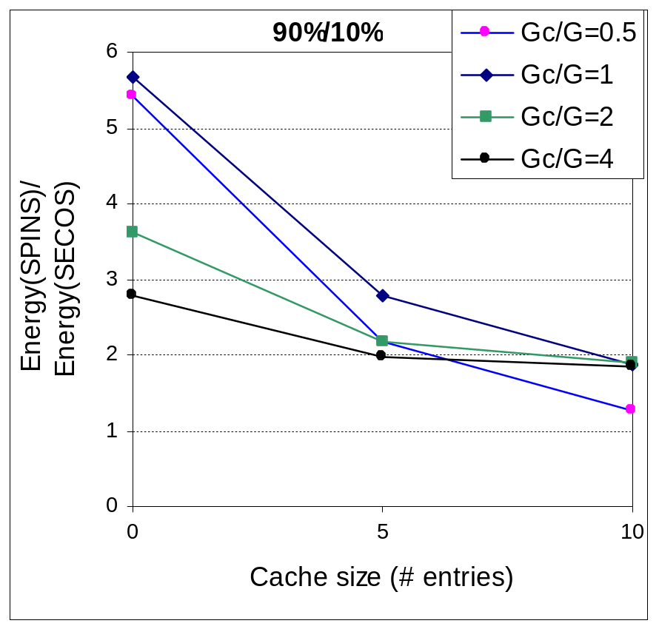
Simulation Results
Comparison with SPINS which uses base station as intermediary for node to node communication
N=200, μ=20 s, λ=5 s, G=10, C_{C}=5, τ_{C}=200 s, τ_{S}=200 s
As cache size increases, SECOS and SPINS perform similarly
Inter-group communication is more expensive in SECOS than SPINS
It is important to choose the control cache size carefully
Notes:
This incorporates session key refresh and control node change.
Per key cache hit, SPINS saves more than SECOS.

Slide 51
Conclusion
Demonstrated a protocol called SECOS for energy efficient key management in sensor networks
SECOS is resilient to different kinds of attacks – eavesdropping (discussed here), denial of service, and node compromise (discussed here)
Claim: Compromising any number of nodes in the network does not compromise the session between two legitimate nodes
Future Work:
  Impact of neighbor watch on the energy efficiency of the protocol
  Secure topology building and maintenance with SECOS

Slide 52
Outline
Motivation
Robust data dissemination
  Background
  Example protocol: SPIN
  Our protocol: SPMS
  SPMS: Failure scenario
  Energy and delay analysis
  Simulation results
Secure communication
  Background: Key management in sensors
  Our protocol: SECOS
  SECOS: Key elements
  Communication within control group
  Communication across control group
  Analysis
  Simulation results
Take away lessons

Slide 53
Take Away Lessons
Communication protocols in sensor networks have to be designed with
  Failures in mind
  Node compromise in mind
Trade-offs exist between latency and energy consumption and customizable protocols that fit different regions of trade-off curve are desirable
Desirable characteristics of large class of sensor network communication protocols
  No privileged nodes
  No node trusted completely

Slide 54



Questions Anyone?
Issa Khalil
Gunjan Khanna
Ness Shroff
“Fault Tolerant Energy Aware Data Dissemination Protocol in Sensor Network,” Gunjan Khanna, Saurabh Bagchi, Yu-Sung Wu. At IEEE Dependable Systems and Networks Conference (DSN 2004), June 28-July 1, 2004, Florence, Italy.
“Analysis and Evaluation of SECOS, A Protocol for Energy Efficient and Secure Communication in Sensor Networks,” Issa Khalil, Saurabh Bagchi, Ness Shroff. Submitted to Ad-hoc Networks Journal, September 2004. Available as CERIAS Tech Report from home page.

