Slide 1


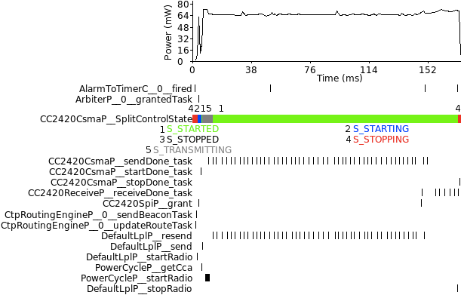
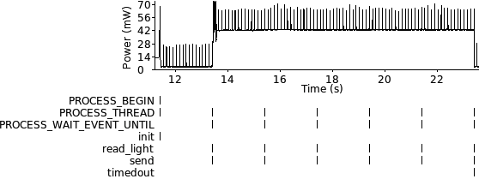
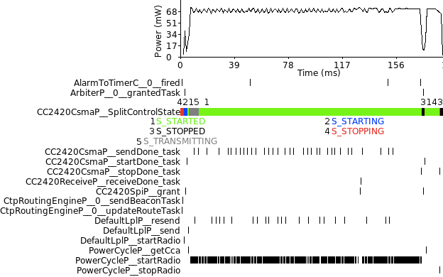
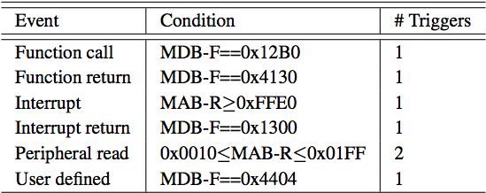
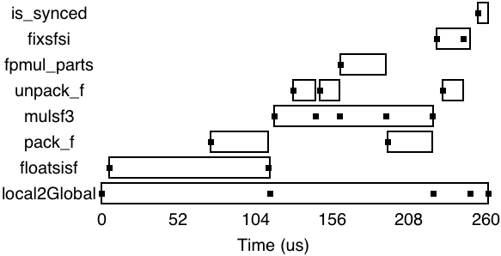
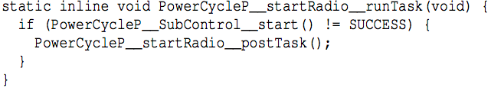
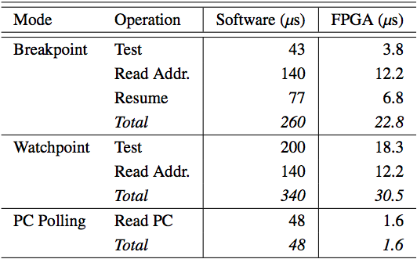
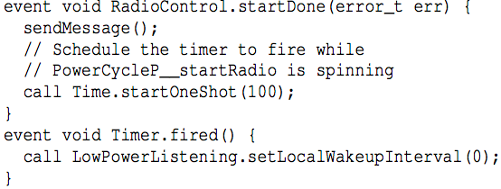
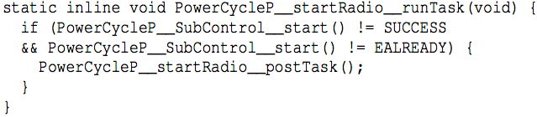
AVEKSHA: A Hardware-Software Approach for Non-intrusive Tracing and Profiling of Wireless Embedded Systems
Matthew Tancreti, Mohammad Sajjad Hossain, Saurabh Bagchi, Vijay Raghunathan
School of Electrical and Computer Engineering, Purdue University
Problem Statement
What is JTAG?
Design
Bug Fixed
Current approaches to debugging deployed Wireless Sensor Networks (WSN) can be improved
Software: affects application timing and is OS specific
Hardware: bench debuggers not suitable for deployment
How can we perform tracing and profiling that is
Non-intrusive
Able to trace with high spatial and temporal granularity
Low energy
Low cost
Easy to integrate and deploy
JTAG is a protocol
TDO data output
TDI data input
TMS select mode
TCK clock
The MSP430 comes with a JTAG accessible debug module that provides
Processor emulation
Breakpoint and watchpoint triggers
State-storage (data and address bus) on trigger
FPGA for polling JTAG and filtering events
Would require MCU at much higher clock frequency
MCU for initialization and coordination
USB connectivity to stream data to host PC
Solution Approach
AVEKSHA is a hardware/software approach
Exploit the JTAG debug module
Comes free on every chip (e.g. MSP430 EEM)
Asynchronous with the main processor
Has advanced features: complex breakpoints and watchpoints, triggered state-storage
Approach
Poll processor state over JTAG
Filter for important events
Tag event with energy reading (may not be casually related)
Store to flash or stream over USB
MSP430 has 8 triggers slots that are conditions based on
data or address bus (MDB/MAB)
read, write, or instruction fetch (-R/-W/-F)
Combination of triggers
8 entry circular state-storage captures address and data bus after a trigger is fired
Goal is to poll JTAG at maximum possible speed
For PC polling pipeline stages are: poll PC address, binary search for function pointer, filter: is this a new function, output buffer
OS Agnostic
PowerCycleP Re-post Bug
Methods for Tracing and Profiling Applications
Watchpoint polling
Triggers can be set for generic events e.g. function call and return
A nop insturction can be used to by the programmer to specify arbitrary trigger locations in code
What We Built: The Telos Debug Board
We can change from debugging TinyOS tasks to Contiki processes without reprogramming the board
Profiling With PC Polling
PC polling
Poll the PC counter
Binary search to find code block that PC counter belongs
Accidentally discovered bug when tracing all tasks
PowerCycleP_startRadio re-posts itself when SubControl_start() != SUCCESS
When radio is already started SubControl__start() = EALREADY
MCU for initialization and configuration
FPGA for high speed polling and filtering pipeline
Connects to mote IO and JTAG interfaces
Provides power to mote from battery or USB
Speed of Polling
Our Contributions
PC polling down to granularity of 7 mote cycles
Usually enough to catch every function transition
Knowledge of call graph required to convert polled PC data into profile
Reverse engineered an important JTAG protocol (MSP430)
A common low-power sensor network MCU
Profiling and tracing not just for Arm CoreSight class chips
Designed a JTAG debugger suitable for deployed WSNs
Non-intrusive (does not change timing)
OS/compiler agnostic
Low power
No significant hardware modification to mote
Easy to deploy (does not need to be programed in advance)
Verified our design
Tracing and profiling in TinyOS and Contiki
Found resource consuming bug in TinyOS low-power-listening radio stack
Re-post could be permanent with following hypothetical code
Acknowledgements
Watchpoint Polling
TDB polls buffer at rate of 30.5us
Cannot exceed burst of 8 events in 976 mote cycles
Suitable for tasks and states, but not function call granularity
PC Polling
Cannot do PC polling and watchpoint triggers together
1 PC poll takes 7 mote cycles
Suitable for function call granularity
This work was supported in part by NSF grants CNS- 0953468, ECCS-0925851, and CNS-0716271. The views expressed represent those of the authors and do not necessarily reflect the views of the sponsoring agency.
Simple fix
Reference
M. Tancreti, M. S. Hossain, S. Bagchi, V. Raghunathan, “AVEKSHA: A Hardware-Software Approach for Non-intrusive Tracing and Profiling of Wireless Embedded Systems,” in Proceedings of the 9th ACM Conference on Embedded Networked Sensor Systems, SenSys ’11, ACM, 2011.
Now patched in TinyOS repository (see issue 51)

