Slide 1

The Search for Optimality in Automated Intrusion Response
Yu-Sung Wu and Saurabh Bagchi
Dependable Computing Systems Lab (DCSL) &
The Center for Education and Research in Information Assurance and Security (CERIAS)
School of Electrical and Computer Engineering
Purdue University
Work supported by:
Purdue Research
Foundation, Avaya, CERIAS

Slide 2
Survivable Systems and Intrusion Response
Modern life heavily depends on computer systems
Intrusions/security breaches to these systems occur
Ways to make a system survivable
  At design/implementation phase
    Eliminate vulnerabilities
    Policy/Access Control/Cryptography/Formal Verification
  In production phase
    Use IDS (system logs checking/network packet sniffing/virus, worms scanning, detecting files modifications…) to identify misuses/anomalies
    Perform incident/intrusion response (IRS) to detected misuses/anomalies
      Containment and Recovery
Focus of this work

Slide 3
Intrusion Response System
The need for IRS
  A survivable system needs to provide functionality through intrusions
  Human intervention after IDS alert can be costly and slow
  IRS takes reports from IDS (usually bundled together), processes it, and carries out actions to counter the intrusion
Existing examples of IRS
  Anti-virus software which disables access to worm executables or files infected with virus
  Routers/firewalls which actively block worm traffic
  Laptops equipped with motion sensor and TPM module that can lock up the computer when unauthorized movement (usually occurs when the laptop is being stolen) is detected

Slide 4
Intrusion Response System
Summary on existing IRS
  Most of them are stand-alone and are tied with one single and specific detector (IDS)
  Target mostly at one machine box only
IRS for Distributed Systems
  An environment of multiple interconnected boxes with heterogeneous and cooperating services
  Few general-purpose IRS solutions exist for distributed systems
  The most common way is to use the stand-alone solutions separately and independently on the boxes
    E.g., Have McAfee anti-virus software installed on the workstation boxes, and CISCO IPS on the network joints.

Slide 5
IRS for Distributed Systems
Drawback of the “common way”
  Each IRS/IDS pair does not leverage the detection reports from the other IDSs
    Existing research on correlation IDS have shown clear advantages of doing so
  The IRS/IDS pair does not consider the effects from
  the response actions carried out by the other IRS/IDS pairs
    This can lead to redundant response actions and denial-of-service of the system at worst.
  At best, locally optimal decisions from each IRS/IDS pair
  There is no guarantee of system-wide global optimality

Slide 6
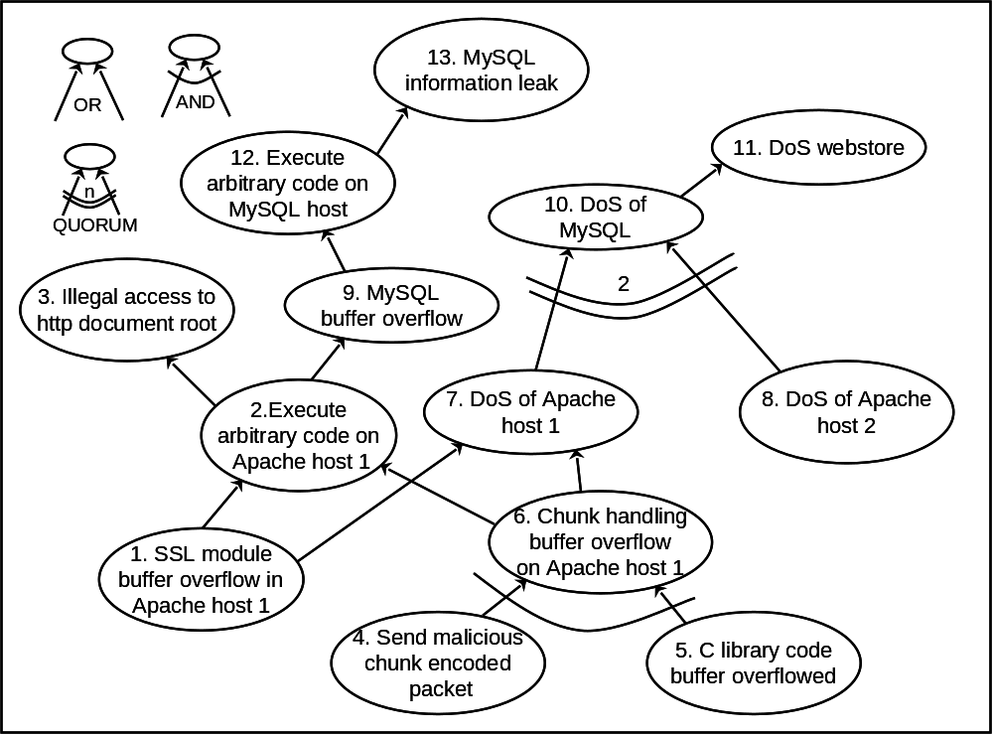
ADEPTS IRS: Basics
Specifically designed for distributed systems
Use I-GRAPH (a variant of attack graph) as the core binding between detectors (stand-alone IDSs) and response actions (stand-alone IRSs)
A detector is associated with an I-GRAPH node to tell the confidence index of that node being compromised
The compromise confidence index of nodes without associated detectors can be inferred through the graph structure
Response actions are associated with edges
A response is meant to stop the progression of the intrusion from the source node to the destination node
Response Y
Detector C
Detector B
Response Z
Detector D
Response X
Detector A

Slide 7
Attack Phases
The dynamics between intrusion and response
y
I-GRAPH
v
w
h
d
b
c
a
f
X
Y
d
Z
d
h
b
b
c
b
c
a
a
a
R_{X}
R_{Y}
f
R_{Z}
Assuming an attack includes three “snapshots” X, Y, and Z – called attack phases
Each snapshot includes I-GRAPH nodes which have been achieved as part of the attack thus far
Following each snapshot k, ADEPTS determines a set of response actions R_{k} for deployment

Slide 8
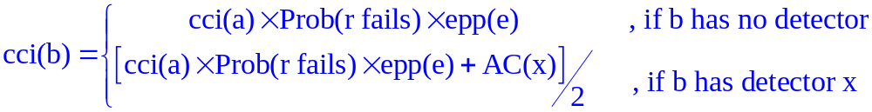
Diagnosis of Achieved I-GRAPH Nodes
Responses in I-GRAPH
Detector X
A.C. = 1
e.p.p =
0.8
e.p.p = 0.8
Detector Y
A.C. = 0.6
Password keystroke recorded
Change
grades
recorded
Malware
downloaded to staff
computer
r_{x}
r_{y}
CCI = 0.16
CCI = 0.33
CCI = 1
Assume: Prob(r_{x} fails) = 0.2 Prob(r_{y} fails) = 0.4
For an edge e connecting node a to b in I-GRAPH with response r :
epp(e) : The edge propagation probability of edge e. This models an adversary’s likelihood of taking this edge
ADEPTS deploys responses on the attack phase based on the CCI value of a node

Slide 9
Impact Vector
A system has transaction goals and security goals that it needs to meet through the time of operation
  Example: providing e-mail service and ensuring the confidentiality of sensitive data
Attacks are meant to impact some of these goals
Deployed responses also impact some of these goals
Assume the impact from an attack to the system can be quantified through a vector IV with each element in the IV corresponding to the impact on each transaction/security goal ∈ [0, 1]
  Impact vector for adversary reaching I-GRAPH node n_{k} is IV(n_{k})
  Impact vector for response r_{k} is IV(r_{k})

Slide 10
Optimality of Response Actions
We formally define the cost for a response combination (a set of response actions) RC_{i} as:
The response combination RC_{i} is said to be optimal for the given attack if it achieves minimum Cost(RC_{i})
In our attack graph model, Prob(n_{k}) is estimated as CCI(n_{k})
Accurately speaking, Prob(n_{k}) is conditioned on many factors, and determining its value is by itself a challenging research problem

Slide 11
Types of Response Actions
Given a snapshot s and I-GRAPH G
  In terms of containment, ADEPTS should consider all response actions applicable to the graph (G-s)
  In terms of recovery, ADEPTS should consider all response actions applicable to the graph s
s is typically not huge, as its size is linear in the number of detectable steps in a multi-stage attack
But (G-s) can be huge
  A function of applicable attack steps (vulnerabilities) in all services in the application system
  However, for nodes in (G-s) which are far away from s, the likelihood of them being reached is lower than for closer ones

Slide 12
Domain Graph
Our solution is to limit the response search space for a snapshot s to a subset of (G-s), namely the domain graph D(s)
D(s) includes critical nodes from I-GRAPH
  A node n is critical if CCI_{n}*IV_{n} is greater than a given threshold
Domain Graph D(S)
g
The current snapshot S (achieved attack stages)
d
h
b
c
i
a
e
j
f
: achieved
k
: non-achieved / critical
: non-achieved / non-critical

Slide 13
Approximate O.R.D. with Genetic Algorithm
Optimal Response Determination is proved to be NP-hard by mapping the Set Covering Problem to it
Domain Graph D(S)
g
The current snapshot S (achieved attack stages)
d
h
b
i
c
a
e
j
: achieved
f
: non-achieved / critical
: non-achieved / non-critical
k
Apply Genetic Algorithm Solver: Crossover/Mutation/Elitism
Pick the best chromosome (the best response combination) as the approximate solution to ORD.
Encode the set R of responses applicable within D(S) into chromosomes;
Fitness of chromosome related to cost
Preserve the top chromosomes for future attacks that have similar snapshots as s
Notes:
Why choose G.A.?
Derivative based optimization techniques do not work as our objective function is discrete

Slide 14
Genetic Algorithm based Solver for ORD
Why choose G.A.?
  Derivative based optimization techniques do not work as our objective function is discrete
  Since exact problem is NP-hard, one has to look for approximate search
Trade-off between the optimality of the solutions and the computational expense is adjustable by controlling the size of the domain graph and the number of evolutions in the GA based solver
Good solutions (response combinations) from previous instances are preserved into the chromosome population for future instances of similar attacks
  This speeds up the search of good response combinations for future attacks which are similar to the current one

Slide 15
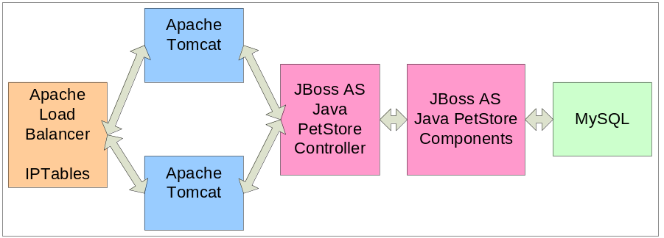
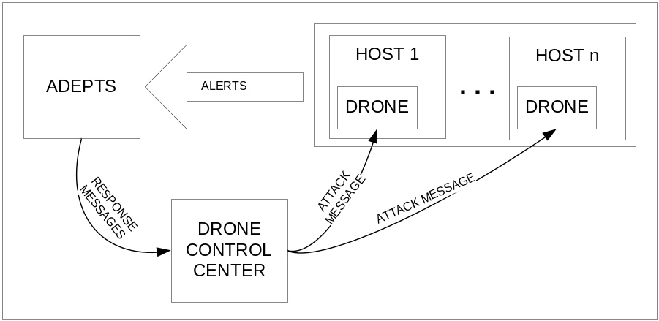
Experiment and preliminary results
The testbed
  A three-tier eCommerce system as the reference basis for constructing attack scenarios.
  A drone based testing framework

Slide 16
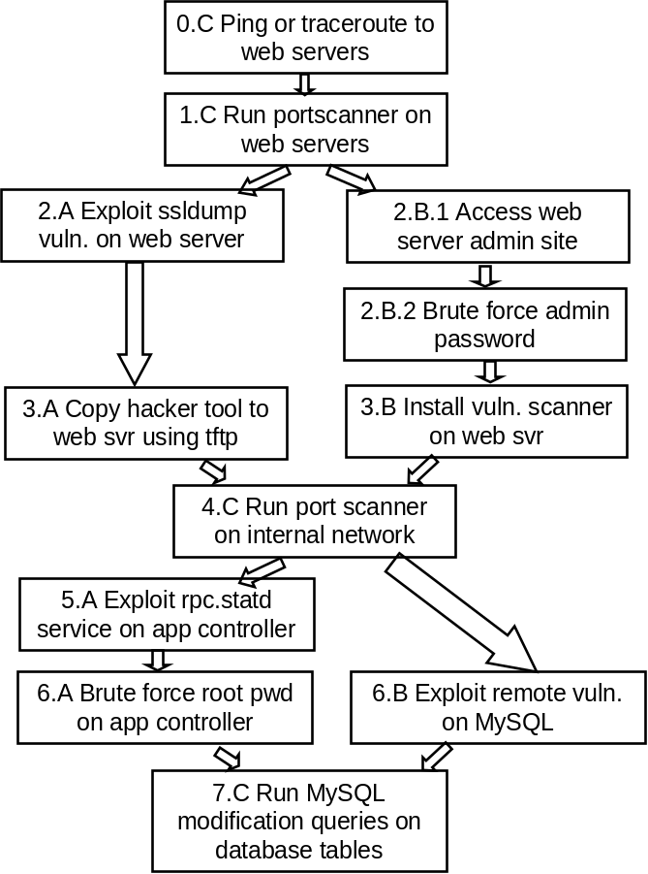
Experiment and Preliminary results
Attack scenarios
Attack scenarios 3 and 4, used for experimental evaluation. Boxes with A and B denote the stages for scenario 3 and 4 respectively, while C denotes stages common to both.

Slide 17
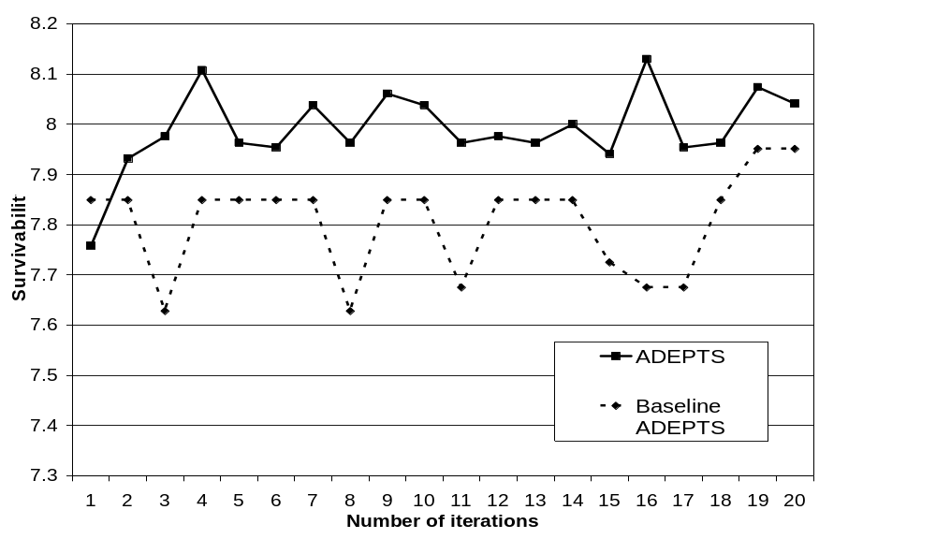
Experiment – Comparison against Baseline
ADEPTS vs. the baseline (locally optimized responses)

Slide 18
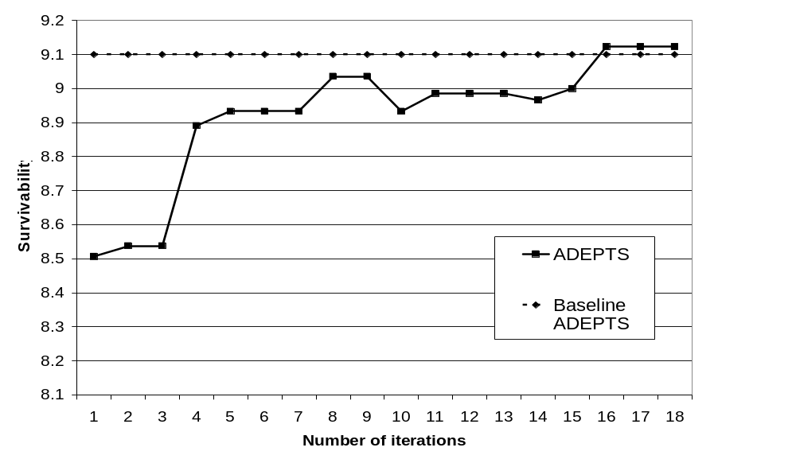
Experiment – Incorrect Initial Conditions
ADEPTS where initial settings (effectiveness of responses, IV values, etc.) are incorrect, say due to inexperienced sysadmin
After 16 iterations of the attack, the effect of incorrect initial parameters disappears

Slide 19
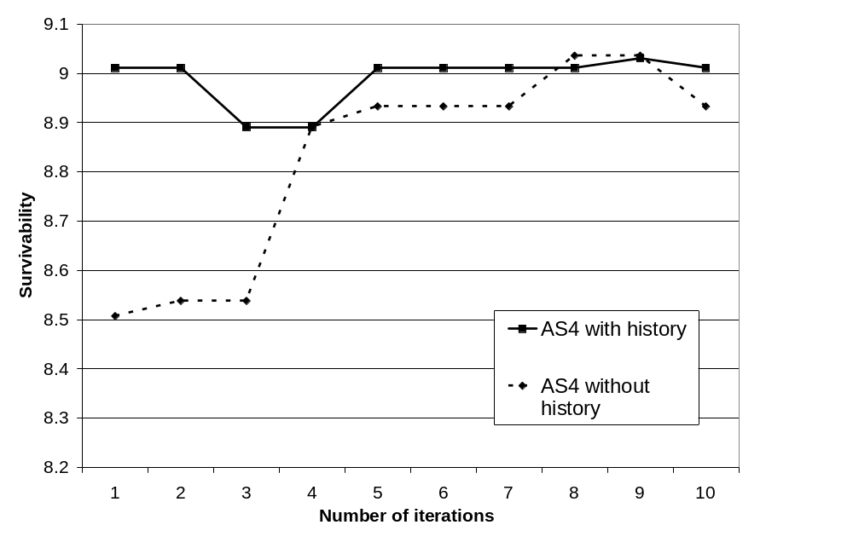
Experiment – Learning from Similarity
Utilizing the information (chromosomes) from similar attacks
For one case, AS4 is run after running its variant AS3 and generating history. For the other, AS4 is run without such history. It takes 8 iterations for the latter to catch up.

Slide 20
Wrap-up
Defined a framework to reason about optimality of intrusion responses in distributed systems
The framework is implemented using genetic algorithm based solver since exact solution is NP-hard
Experiments with real multi-stage attacks indicate that globally optimizing response choices is beneficial
What’s coming next:
  How can the number of evolutions of the GA be determined?
  What happens if some detectors are misconfigured and attack phases are incomplete?
  How to handle incomplete I-GRAPHs?

