Slide 1


Sample Presentation – Format and Structural Tips
LITEWORP: A Lightweight Countermeasure for the Wormhole Attack in Multihop Wireless Networks
Issa Khalil, Saurabh Bagchi, Ness Shroff
Dependable Computing Systems Lab (DCSL)
School of Electrical and Computer Engineering
Purdue University

Slide 2
Structural Points for a Presentation: Intro & Design
Toward the beginning you have to motivate your problem. This means a separate motivation slide.
This should be followed by a contribution – 3-4 bullets on the main things that you have achieved in the paper
Related Work typically comes toward the end of the presentation. But if there is a protocol, say P_{A}, that you are building on and showing you are better than P_{A}, then you have to describe P_{A} as background material
Before you describe your protocol, you should list out all the assumptions about the underlying system and the assumptions made by your protocol
In describing your protocol, before the gory details, have an intuitive explanation of the protocol. In other words, what is the cool new idea. An animation is often helpful here.

Slide 3
Structural Points for a Presentation: Design & Evaluation
When you describe your protocol, separate the important parts of it. For example, a part of your protocol handles fail silent faults (the simpler case) and another handles Byzantine faults. Go from simpler to more complex.
Use animation whenever possible to show the different steps of your protocol.
Analysis: You almost never give the detailed derivation on the slides. Instead, give the important results and the implications of each result.
Experiments: Describe the application, the testbed, the simulation model. Give a table with all the parameter values.

Slide 4
Structural Points for a Presentation: Evaluation
In each result slide, you will have a plot. Make sure the axes labels, different plot labels are clearly visible
For each plot
  There should optionally be a text box above the plot which states what you did for the experiment and the objective of the experiment
  There should always be a text box below the plot which says what the main results from the experiment is
For the plots, make sure that the line styles, colors, markers, etc. are consistent
  If you have used pink with a conical marker for denoting protocol P_{A} and blue with a square marker for denoting protocol P_{B} in one slide, that should be used in all slides that have P_{A} and P_{B}
  Also if you have used one style for denoting P_{A} in one slide, do not reuse the same style for something else in another slide
  You should only use solid lines, not dotted lines

Slide 5
Structural Points for a Presentation: Conclusion & Further Work
In the end you should have a conclusion that summarizes the main contributions of the work; You may include the most startling quantitative result
You can have a take-away lesson slide in which you provide the high level lesson from the work; e.g., push-based mechanism is worse than pull-based
You can have a separate further work slide, or combine that with the conclusion slide
  In it you lay out the big new directions for this work, not minor extensions that you will do

Slide 6
Outline
Introduction
  What is the wormhole attack?
  Wormhole attack against DSR and TinyOS beaconing
  Wormhole attack modes
Motivation
Related work
LITEWORP protocol description
Conclusion & take away lessons

Slide 7
What is the Wormhole Attack?
Colluding nodes tunnel packets received in one place of the network to a distant location where they are replayed
Can be launched without having any cryptographic keys
Puts the attacker in a powerful position to play havoc with the traffic
  Insinuate attacker in a route and then manipulate data traffic
    Example: Selectively drop data packets
  Routing disruptions
    Example: Prevent discovery of legitimate route
  Traffic analysis
    Example: Observe traffic patterns as a way of leaking information
Notes:
During the attack, a malicious node captures packets from one location in the network, and “tunnels” them to another malicious node at a distant point, which replays them locally. The tunnel can be established in many different ways, such as through an out-of-band hidden channel (e.g., a wired link), packet encapsulation, or high powered transmission. This tunnel makes the tunneled packet arrive either sooner or with lesser number of hops compared to the packets transmitted over normal multihop routes. This creates the illusion that the two end points of the tunnel are very close to each other. A wormhole tunnel can actually be useful if used for forwarding all the packets. However, in its malicious incarnation, it is used by attacking nodes to subvert the correct operation of ad-hoc and sensor network routing protocols.

Slide 8

Wormhole Attack Against DSR
S has two routes to D
  S→A→B→C→D (4 hops)
  S→X→Y→D (3 hops)
  S selects the shortest available route
B
A
C
D
S
X
Y

Slide 9
Wormhole Attack Against TinyOS Beaconing
Sensors collect data and forward it to the base station
TinyOS beaconing for routing
Tree routing rooted at the base station
Used in TinyOS for Berkeley motes
Attacker tunnels packets to a colluding party
The colluding party replays them
Most packets will be routed to the wormhole
The attacker can drop packets or more subtly, selectively forward packets to avoid detection
Notes:
Wormholes can attack the routing algorithm. Since node chooses its parent based on the first copy of the beacon it receives. If an adversary can tunnel the beacon to distant parts of the network faster than it would reach there through normal multi-hop transmission, then the adversary can influence a node’s choice of its parent.

Slide 10
How Wormhole Attack can be Launched?
The wormhole attack can be launched by many different ways
Wormhole modes differ in the level of sophistication needed by the adversary
We study five different wormhole attack modes, namely
  Mode 1: Packet encapsulation
    No specialized hardware
    At least two attacker nodes
  Mode 2: Out-of-band channel
    Requires specialized hardware
    Needs at least two attacker nodes
  Mode 3: High power transmission
  Mode 4: Packet relay
  Mode 5: Protocol deviation
X
U
V
W
Z
S
B
E
Y
C
D
Good node
Malicious node

Slide 11
Motivation
We need to mitigate the wormhole attack
  In resource constrained environments, such as sensor networks
    In particular, needs to limit communication overhead to conserve bandwidth and energy
  Without the use of specialized hardware
  Existing approaches do not address all the modes of the wormhole attack
  Not just detect the attack but also perform response action

Slide 12
Previous Countermeasures of the Wormhole Attack
Packet Leashes
  Geographical Leashes
    Requires location determination (e.g. GPS H/W)
    Require loose time synchronization
    Attach P_{s} and t_{s} and limit the distance based on P_{r} and t_{r}
  Temporal Leashes
    Require tight time synchronization
    Uses t_{s} and t_{r} and the speed of light to limit the distance traveled by the packet
  Problems
    Inaccurate due to unpredictable processing time and channel availability
    Expensive (GPS or tight time synchronization)
    Does not provide diagnosis and isolation
    Can not prevent DoS attacks against route establishment
Directional antennas
  Requires specialized hardware (e.g., directional antenna)
  Fail to mitigate most of the modes of the attack
Notes:
[Move related work to between motivation and assumptions.]
RF Watermarking authenticates a wireless transmission by modulating the RF waveform in a way known only to authorized nodes. Relies on keeping the modulation scheme secret. Also, if the waveform is perfectly captured, tunneled and replicated at the far end of a wormhole then the signal level of the resulting watermark is independent of the distance traveled.
When packet leashes are used, the first node to receive the packet after it leaves the wormhole detects that the packet has traveled too far. packet leashes Restrict a packet’s maximum transmission distance.
The sender includes it’s own location and the current time in each packet. At the receiving end, the timestamp is compared to the current time. If the sender and receiver are synchronized to within the required range and the maximum velocity of any node is known then the receiver can calculate the upper bound on the distance between the sender and any valid receiver. If the receiver is valid, the packet is accepted, otherwise it is dropped.
An attacker who pretends to reside at multiple locations can be caught and blacklisted when geographical packet leashes are used in conjunction with digital signatures. A legitimate node overhears the attacker claiming to be in different locations that would only be possible if the attacker could travel faster than the maximum node velocity. The evidence can then be presented to other nodes.
The sender includes a packet expiration time in each packet. The expiration time is calculated based on the desired length of the packet leash and the speed of light. This value is compared to the current time at the receiving node. If the expiration time has passed the packet is dropped.
Tight synchronization can be provided by a number of currently available technologies including GPS.
Leashes are expensive and therefore not applicable to sensor networks.
One issue arises when contention-based MAC protocols, such as IEEE 802.11, are used. In this case the user cannot know the exact transmission time far enough in advance to generate a digital signatures. A very efficient signature must be used in this case.
For the Hu and Evans scheme with directional antennas, only the packet relay mode can be detected.

Slide 13
Outline
Introduction
Motivation
LITEWORP protocol description
  Assumptions and attack model
  Neighbor discovery
  Local monitoring
  Local response
Example of wormhole attack mitigation using LITEWORP
Conclusion & take away lessons

Slide 14
Assumptions & Model
System assumptions
  Existing key distribution mechanism
  Static networks
  Bi-directional links
  A node cannot be compromised instantly
  Attack-free environment during the deployment phase
Attack model
  Links may be subjected to eavesdropping and message tampering
  Attacker can replace a compromised node by a more powerful network entity, and can establish out-of-band fast channels
  External adversary nodes
  Internal adversary nodes aka compromised nodes
  Byzantine behavior
  Arbitrary Collusion
  Brute force denial of service attacks are not considered
Notes:
Last one is not relevant.

Slide 15
Neighbor Discovery
Build a secure list of first and second hop neighbors
Started as soon as a node is deployed in the field
Used in local monitoring
Build a list of one-hop neighbors, R₁
  Each node sends out clear-text one-hop HELLO broadcast
  Each neighbor sends authenticated unicast reply
Build list of second hop neighbors, R₂
  We use one-to-one authentication broadcast
  Saves communication over multiple authentication unicast
A
R₁=[A||C||K_{commit}],E(K_{BA},R₁),E(K_{BC},R₁)
B
R₁=[A||C||K_{commit}],E(K_{BA},R₁),E(K_{BC},R₁)
C
B, C, … , Z
R₁
K_{AB}
K_{AC}
K_{AZ}

Slide 16
Local Monitoring
X
A
M
Y
B
X
A
D
The transmission range of node Y
S
N
A collaborative detection strategy in which a node monitors the traffic going in and out of its neighbors.
Requires each node to include the ID of the prev-hop in the forwarded packet
A guard of a node A for the link from X to A is any node that lies within the transmission range of both X and A
M, X, and N are the guards of node A for the link from X to A
A guard saves information about incoming packets in a watch buffer
Matches an output packet with information in buffer

Slide 17
Local monitoring: Details
Local monitoring can be used to detect different kinds of control attacks by changing the information maintained in the buffer and the kind of checking that goes on
The different kinds of malicious activity that can be done by a node
  Fabrication
  Modification
  Delay
  Drop
Correspondingly the kind of checking that needs to be done are:
  An outgoing packet that has no corresponding incoming info
  Difference between the incoming and ingoing packet fields
  Forwards after a threshold time
  Not forwarding within a maximum acceptable timeout threshold
X
A
M
S
B
X
A
D
N

Slide 18
Local Response
Propagate detection knowledge to isolate malicious nodes
When a guard G detects a malicious event by node M
  G increments a counter Mal_{C}(G,M)
  Different malicious activities cause different increments
When Mal_{C}(G,M) crosses a threshold
  G revokes M
  G sends an authenticated alert to the neighbors of M
When N receives an alert about a neighbor M
  Collects alert information from multiple guards
  When the number of alerts reaches the detection confidence (γ), N revokes M
Notes:
When Mal_{C}(G,M) crosses a threshold this is taken as evidence by G that the node is misbehaving.
When N receives an alert about a neighbor M, it does not conclude M to be misbehaving to avoid the possibility of blackmailing.

Slide 19
Outline
Introduction
Motivation
Contribution
LITEWORP protocol description
Wormhole attack mitigation
  Detection details
  Analytical results
  Simulation results
  Cost analysis
Conclusion & take away lessons

Slide 20
Detection Using Local Monitoring
Attacker goal: including malicious nodes in the route
L
R
P
M₁
M₂
S
Z
X
B
N
Q
W
D
C
A
E
F
Detection strategy
All the neighbors of M₁ (S,R,P,Z,Q,B) detect this malicious activity, because they know that M₂ is not a neighbor of M₁
Choice#1
M₁ claims that the R_{REP} is from M₂
Detection strategy
The guards of M₁ over the link Z→M₁, (P,Z,Q) detect this malicious behavior, because they have nothing in their watch buffers about R_{REP} coming from Z
Choice#2
M₁ claims that the R_{REP} comes from one of its neighbors, say Z
These detection approaches require the guards to monitor the route reply (R_{REP}) packets
Notes:
Add the part of the story after M1 gets it. Two options.
Pop-up “M1 is a bad guy” from all those that detect.

Slide 21
Detection Using Local Monitoring
Attacker goal: disrupting route establishment
L
R
P
M₁
M₂
S
Z
X
B
N
Q
W
D
C
A
E
F
Choice#1
M₂ claims that the R_{REQ} comes from M₁
Choice#2
M₂ claims that the R_{REQ} comes from one of its neighbors, say X
Detection strategy
All the neighbors of M₂ (X,L,N,D,W) detect this malicious activity, because they know that M₁ is not a neighbor of M₂
Detection strategy
The guards of M₂ over the link X→M₂, (N,X,L) detect this malicious behavior, because they have nothing in their watch buffers about R_{REQ} coming from X1
These detection strategies require the guards to monitor the route request (R_{REQ}) packets, which are more in number than the R_{REP} packets and incur more overhead
Notes:
Add the part of the story after M1 gets it. Two options.
Pop-up “M1 is a bad guy” from all those that detect.

Slide 22

Analysis: Detection Coverage
Due to collision the following may occur
Missed detection: A malicious event goes undetected
  Collision at the guard (G) when the node (D) transmits
False detection: A normal event is detected as a malicious event
  Collision at the guard (G) when the sender (S) transmits a packet
  Detection at the guard when the monitored node (D) forwards the packet
X
G
G missed the packet sent by S
G falsely accuse D
G Missed the fabrication of D
S
D
Notes:
Define missed and false detection. Why it happens?
Confidence index.
Tie up equation to plot.
Follow template for results – plots, followed by main explanations.

Slide 23
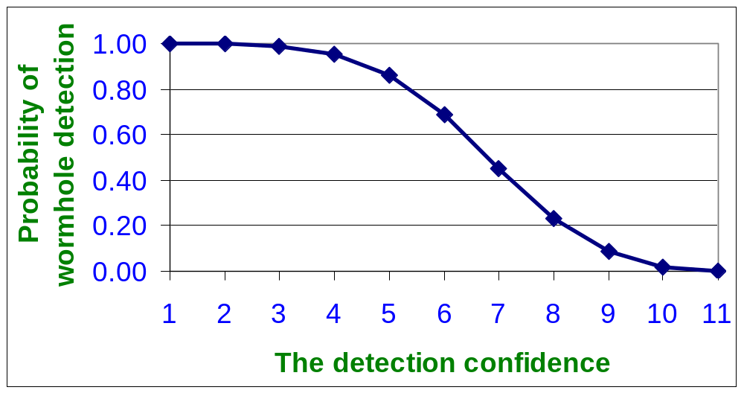
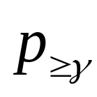
Analysis: Detection Coverage
γ
Node density = 20
As the detection confidence increases, it becomes more difficult to get an alert from all the monitors
Notes:
Define missed and false detection. Why it happens?
Confidence index.
Tie up equation to plot.
Follow template for results – plots, followed by main explanations.

Slide 24
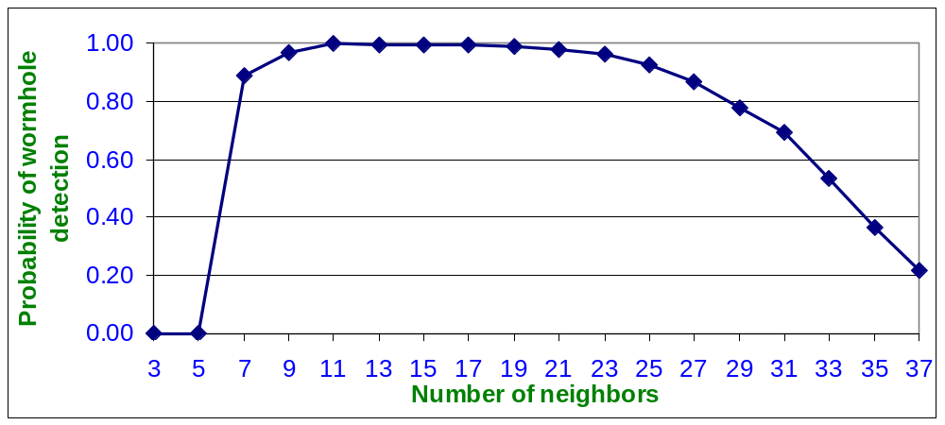
Detection Coverage …
The detection confidence = 3
Initial increase due to more available guards
Then decrease due to collision

Slide 25
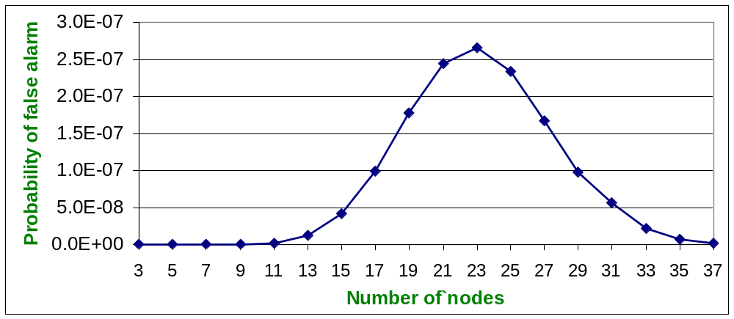
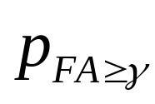
Analysis: False Detection
The detection confidence = 3
Initial increase due to increasing the number of possible guards which makes it easier to get more than γ false alarms (correlated collisions)
Decrease due to collision
Notes:
Follow template.

Slide 26
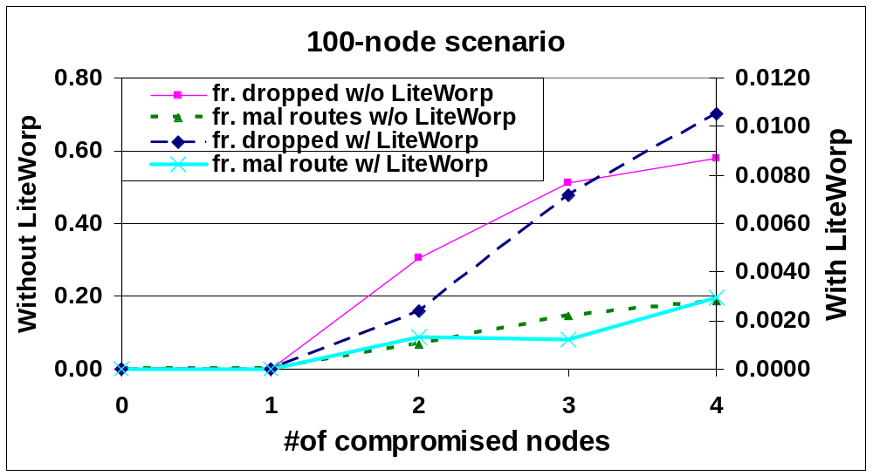
Simulation Results
A snapshot
at T =2000
The relationship between number of malicious routes and number of dropped packets is not linear due to the aggressive nature of the wormhole
Over time, LITEWORP results levels off to zero since malicious nodes are isolated
Over time, base case results stabilize to a certain value depending on the number of the malicious nodes
Notes:
Have main message under the figure on the same slide.
SRPS ----------- Lite|Worp

Slide 27
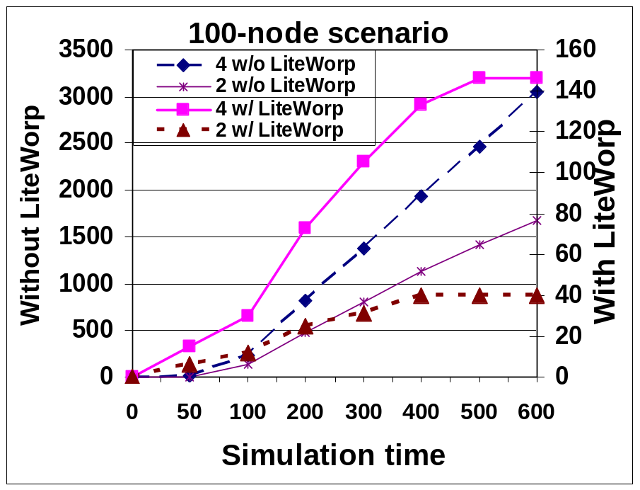
Simulation Results
#
packets dropped
w/o LITEWORP
#
packets dropped
w/ LITEWORP
LITEWORP packet drop stabilizes with time since malicious nodes are identified and isolated
Base case packet drop continues to increase steadily with time

Slide 28
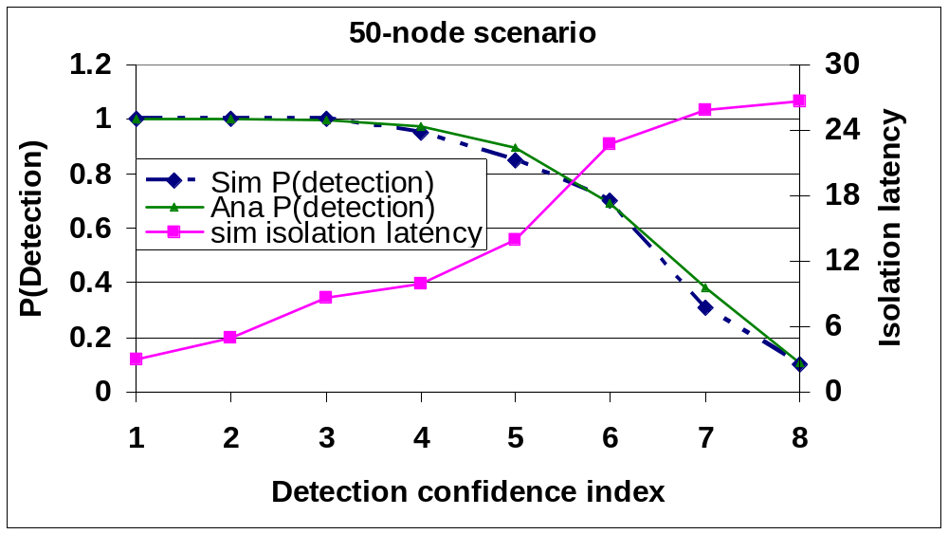
Simulation Results
The isolation latency is not very significant even for high confidence index value
Notes:
The isolation latency is the time elapsed from the first guard detection of a malicious node until it is completely isolated by all its neighbors

Slide 29
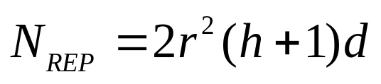
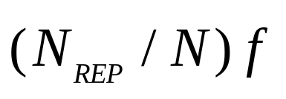
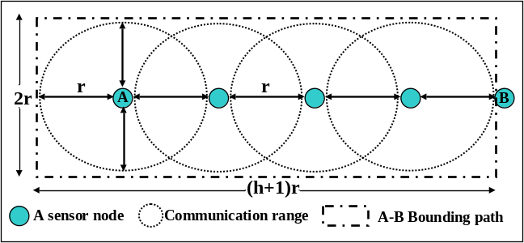
Cost Analysis
Memory
  Number of nodes involved in monitoring a route reply
  The number of replies a node is involved in per unit of time
  For example, if N=100 nodes, h = 4 hops, and f = 1 route every 4 time units, then N_{REP} = 17, and each node watches only 4 route replies every 100 time units
Computation
  Managing a small buffer (add, delete, search)
Bandwidth
  Only at startup during neighbor discovery
  Upon the detection of a malicious node
Notes:
Put a qualitative statement or two about each point. Give a representative number without showing analysis.
[Put this analysis after the simulation results.]
The low resource consumption would make this suitable for resource constrained environments, such as sensor networks.

Slide 30
Conclusion
Proposed a generic strategy for cooperative distributed detection of the wormhole traffic
Proposed a generic strategy for locally isolating the malicious nodes
Demonstrated the mitigation approach is conservative in resource consumption
Future Work:
  Guard scheduling to work with sleep scheduling algorithms
  Extension to mobile ad hoc networks
Notes:
Efficient cryptographic primitive cannot solve this and many other control flow attacks in ad hoc networks.
The wormhole attack directed at control flow traffic is relatively easy to launch since they do not need possession of any keys.
Detection of attack should be followed by prompt response.

Slide 31

Thanks
Questions?

