Slide 1


Dependable Middleware for Wireless Sensor and Mesh Networks
Saurabh Bagchi
Dependable Computing Systems Lab (DCSL)
& Center for Wireless Systems and Applications (CWSA)
School of Electrical and Computer Engineering
Purdue University
sbagchi@purdue.edu
http://www.ece.purdue.edu/~dcsl
Work supported by:
NSF, Indiana 21st Century Fund, Purdue Research Foundation

Slide 2
Challenges to Providing Dependability
Open communication media
  Snooping is easy
Hostile environment
  Attackers everywhere
Limited resources
  Bandwidth and energy resources are constrained
  Can not tolerate high overhead measures
  Easy to launch attacks (cheap devices, no tamper-proof)
Lack of infrastructure and difficult-to-reach deployments
  Difficult to manage and control
  Nodes are easy to access and capture by attackers
Mobility
  Dynamic topology
  Frequent link failures

Slide 3
Security Attacks
Two classes of attacks
  Attacks that can be defeated by crypto mechanisms
    Eavesdropping: Solved by encryption
    Message tampering: Solved by authentication
  Attacks that subvert the functionality of the network
    Control attacks: Manipulating control traffic (e.g., routing traffic) to disrupt data traffic
      Examples: ID spoofing and Sybil, sinkhole, rushing, wormhole
    Data Attacks: Directly manipulate data traffic
      Examples: Blackhole, grayhole
    This class cannot be prevented by cryptographic mechanisms alone
We focus on the second class
Notes:
For the first class, I have developed a key management protocol
since it represents a larger domain of unsolved problems

Slide 4
Local Monitoring: Background
X
A
M
Y
B
X
A
D
The transmission range of node Y
S
N
A collaborative detection strategy in which a node monitors the traffic going in and out of its neighbors
Assumptions
  Each node knows its first-hop and second-hop neighbors
  Each node includes the ID of the prev-hop in the forwarded packet
A guard of a node A over the link X → A is any node that lies within the transmission range of both X and A
  Example: M, X, and N are the guards of node A for the link from X to A
A guard saves information about incoming packets in a watch buffer
Matches an output packet with information in buffer
Notes:
Local monitoring serves as the core primitive in our solution to mitigate control and data traffic attacks in WAHAS network

Slide 5
Local Monitoring Details: Background
Local monitoring can be used to detect different kinds of attacks by changing the information maintained in the buffer and the kind of checking that goes on
The different kinds of malicious activity that can be done by a node
  Fabrication
  Modification
  Delay
  Drop
  Misrouting
Correspondingly the kind of checking that needs to be done are:
  An outgoing packet that has no matching packet in watch buffer
  Difference between incoming and outgoing packet
  Forwards after a threshold time
  Not forwarding within a maximum acceptable timeout threshold
  Forwarding to a wrong next-hop
X
A
M
S
B
X
A
D
N

Slide 6
Focus of the Work
We consider mitigating control and data traffic attacks in WAHAS networks through
  Detection and diagnosis (local monitoring)
  Isolating malicious nodes (local & global responses)
We provide low-latency and low-overhead detection and isolation different kinds of WAHAS networks
  Mobile adversaries
  Sleep-wake enabled networks
LITEWORP: DSN ’05, Computer Networks ’07
Mobile adversaries: Securecomm ’06, Ad hoc Networks ’07
Sleep-wake networks: DSN ‘07
Notes:
Through out this thesis work, we consider, ….
We bear in mind while developing these mechanisms that many WAHAS network nodes in some WAHAS deployment scenarios are resource-constrained, therefore we provided low-latency, low-overhead mechanism that can be applied to such network. The best example of these networks is “sensor networks”

Slide 7
Distributed Response
Propagate detection knowledge to isolate malicious nodes
When a guard G detects a malicious event by node M
  G increments a counter MalC(M,G)
  Different malicious activities can be considered at different levels of criticality
When the MalC(M,G) crosses a threshold
  G revokes M
  G sends an authenticated alert to the neighbors of M
When N receives an alert about a neighbor M
  Collects alert information from multiple guards
  When the number of alerts reaches the detection confidence, N revokes M
When a node N revokes node M
  N does not send any traffic through M
  N does not forward any of M’s traffic

Slide 8
Sample Application of Local Monitoring: Wormhole Attack
Tunnel packets received in one place of the network and replayed in another place
Can be launched without having any cryptographic keys
Puts the attacker in a powerful position to play havoc with the traffic
  Insinuate attacker in a route and then manipulate data traffic
    Example: Selectively drop data packets
  Routing disruptions
    Example: Prevent discovery of legitimate route
  Traffic analysis
    Example: Observe traffic patterns as a way of leaking information
Notes:
During the attack, a malicious node captures packets from one location in the network, and “tunnels” them to another malicious node at a distant point, which replays them locally. The tunnel can be established in many different ways, such as through an out-of-band hidden channel (e.g., a wired link), packet encapsulation, or high powered transmission. This tunnel makes the tunneled packet arrive either sooner or with lesser number of hops compared to the packets transmitted over normal multihop routes. This creates the illusion that the two end points of the tunnel are very close to each other. A wormhole tunnel can actually be useful if used for forwarding all the packets. However, in its malicious incarnation, it is used by attacking nodes to subvert the correct operation of ad-hoc and sensor network routing protocols.

Slide 9
Wormhole Attack Against TinyOS Beaconing
Sensors collect data and forward it to the base station
TinyOS beaconing for routing
Tree routing rooted at the base station
Used in TinyOS for Berkeley motes
Attacker tunnels packets to a colluding party
The colluding party replays them
Most packets will be routed to the wormhole
The attacker can drop packets or more subtly, selectively forward packets to avoid detection
Notes:
Wormholes can attack the routing algorithm. Since node chooses its parent based on the first copy of the beacon it receives. If an adversary can tunnel the beacon to distant parts of the network faster than it would reach there through normal multi-hop transmission, then the adversary can influence a node’s choice of its parent.

Slide 10
Detection Using Local Monitoring
Attacker goal: including malicious nodes in the route
L
R
P
M₁
M₂
S
Z
X
B
N
Q
W
D
C
A
E
F
Detection strategy
All the neighbors of M₁ (S,R,P,Z,Q,B) detect this malicious activity, because they know that M₂ is not a neighbor of M₁
Choice#1
M₁ claims that the R_{REP} is from M₂
Detection strategy
The guards of M₁ over the link Z→M₁, (P,Z,Q) detect this malicious behavior, because they have nothing in their watch buffers about R_{REP} coming from Z
Choice#2
M₁ claims that the R_{REP} comes from one of its neighbors, say Z
These detection approaches require the guards to monitor the route reply (R_{REP}) packets
Notes:
Add the part of the story after M1 gets it. Two options.
Pop-up “M1 is a bad guy” from all those that detect.

Slide 11
Detection Using Local Monitoring
Attacker goal: disrupting route establishment
L
R
P
M₁
M₂
S
Z
X
B
N
Q
W
D
C
A
E
F
Choice#1
M₂ claims that the R_{REQ} comes from
M₁
Detection strategy
The guards of M₂ over the link X→M₂, (N,X,L) detect this malicious behavior, because they have nothing in their watch buffers about R_{REQ} coming from X
Choice#2
M₂ claims that the R_{REQ} comes from one of its neighbors, say X
Detection strategy
All the neighbors of M₂ (X,L,N,D,W) detect this malicious activity, because they know that M₁ is not a neighbor of M₂
These detection strategies require the guards to monitor the route request (R_{REQ}) packets, which are more in number than the R_{REP} packets and incur more overhead
Notes:
Add the part of the story after M1 gets it. Two options.
Pop-up “M1 is a bad guy” from all those that detect.

Slide 12

Analysis: Detection Coverage
Due to collision the following may occur
Missed detection: A malicious event goes undetected
  Collision at the guard (G) when the malicious node (D) transmits
False detection: A normal event is detected as a malicious event
  Collision at the guard (G) when the sender (S) transmits a packet
  Detection at the guard when the monitored node (D) forwards the packet
X
G
G missed the packet sent by S
G falsely accuse D
G Missed the fabrication of D
S
D
Notes:
Define missed and false detection. Why it happens?
Confidence index.
Tie up equation to plot.
Follow template for results – plots, followed by main explanations.

Slide 13
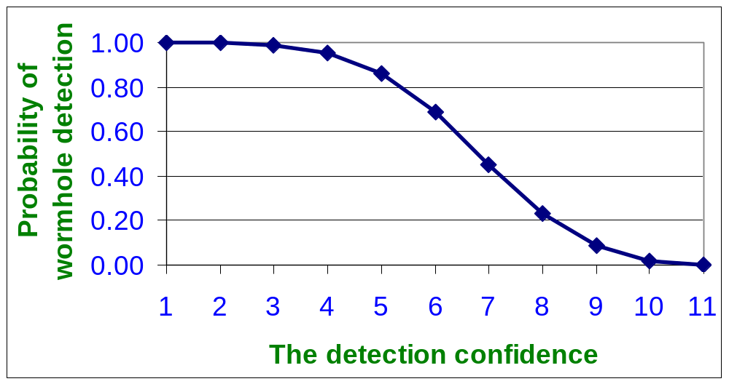
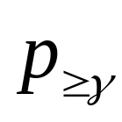
Analysis: Detection Coverage
γ
Node density = 20
As the detection confidence increases, it becomes more difficult to get an alert from all the monitors
Notes:
Define missed and false detection. Why it happens?
Confidence index.
Tie up equation to plot.
Follow template for results – plots, followed by main explanations.

Slide 14
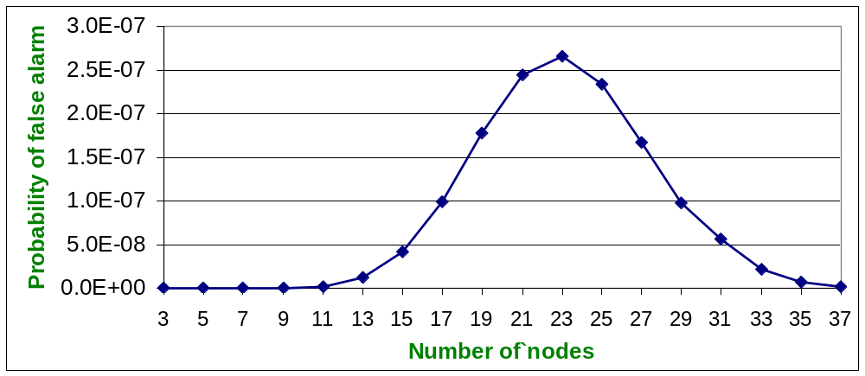
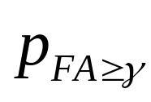
Analysis: False Detection
The detection confidence = 3
Initial increase due to increasing the number of possible guards which makes it easier to get more than Gamma FA (correlated collisions)
Decrease due to collision
Notes:
Follow template.

Slide 15
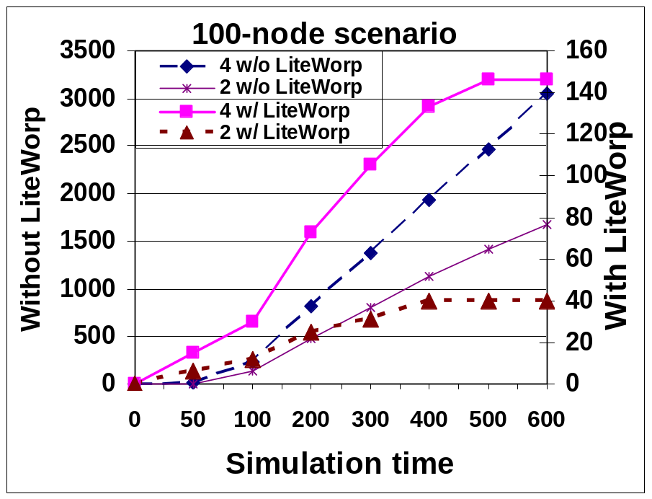
Simulation Results
The number of
packets dropped
Base case
The number of
packets dropped
LITEWORP
LITEWORP packet drop stabilizes with time since malicious nodes are identified and isolated
Base case packet drop continues to increase steadily with time

Slide 16
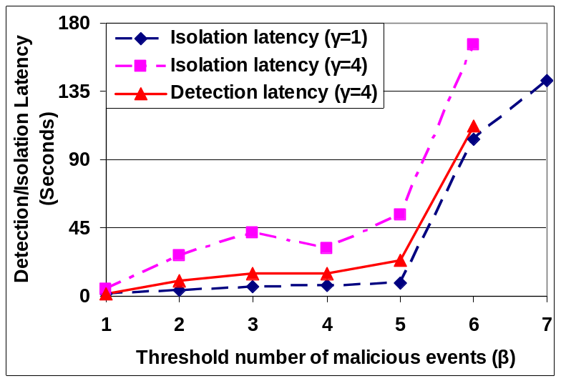
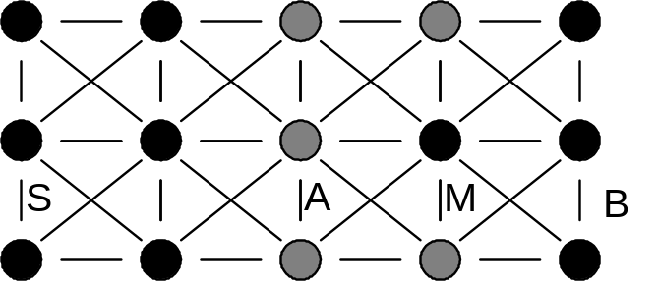
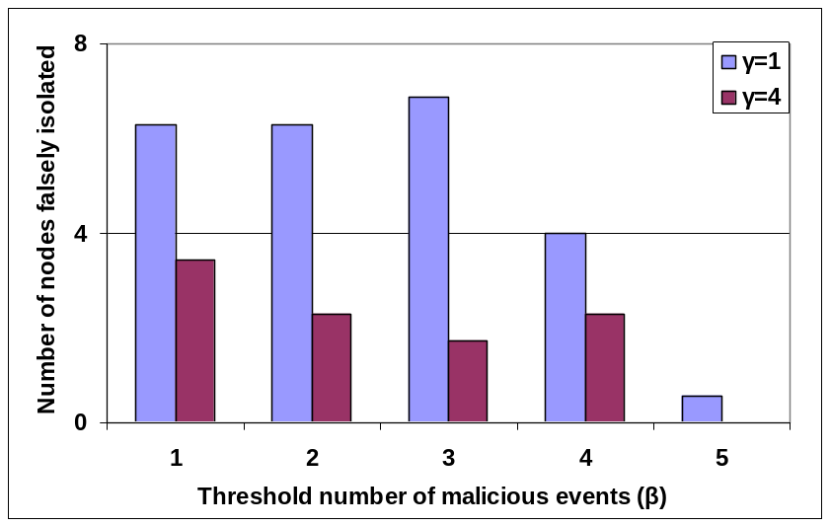
Experimental Results
Guards of M over link A→M
Malicious node M tunneling packets from S
15 node network topology for experiments
Detection/Isolation Latency for M
A judicious selection of β (threshold number of malicious events allowed in each window) and γ (number of nodes that need to alert) can optimize objective function of detection/isolation latency and false isolation
False Isolation of Legitimate Nodes

Slide 17
Local Monitoring Applied to Other Network Types
Mobile Adversaries
Goal: Prevent a peripatetic adversary from doing unbounded damage
  Local mechanisms alone will not suffice
  Any global control should be minimal
Approach
  Mobile node carries digest of MalC values from old location
  Digest has to be furnished at the new location or it has to win “trust” at the new location
Sleep-wake Capable Networks
Goal: Minimize energy overhead of monitoring
  Wake up guards only when needed
  However, we do not want to compromise security
Challenge: Perform the sleep/wake of guards securely and efficiently
  Required-guards should always be woken up
  Quality of detection should not be significantly affected
Approach
  Sleep/wake aware local monitoring whereby guards are woken up when necessary
  Most challenging: On-demand sleep/wake where nodes are sleeping and triggered to wake up when needed for communication
  Requires low-power or passive wakeup antenna
  Guards are also sent wake-up signal
  Showed analytically and experimentally security coverage is not impacted
Notes:
Therefore, our goal is to ….
we want to wake up …..
however, …
….
Our contribution in this work enable us to ..

Slide 18
Distributed Reputation System
A reputation system collects, distributes and aggregates feedback about participants’ past behavior
They are commonly used for rating the quality of users and content in Internet communities and websites
  eCommerce – eBay, Amazon
  Web 2.0 – Digg, YouTube
Advantages in sensor network context:
  Provides the ability to detect and isolate nodes behaving inappropriately
  Allows nodes that have not previously interacted to know about each other’s past behavior
Challenges
  Preventing false accusations or false praise by some nodes to alter the reputation of others
  Distinguishing faulty activity from natural error

Slide 19
Reputation & Local Monitoring
Local Monitoring generates reputation of a node regarding its communication activities
  Combined with reputation through sensing activities
Reports from guards “weighted” by the reputation scores
Applied to data aggregation
  Cluster heads generate reputation for nodes in the network
    Collect data from cluster nodes and estimate the event location
    Use estimated event location to measure accuracy of individual nodes’ sensor data values
    Generate a reputation report about each node
    Broadcast report to the cluster
  Cluster heads use reputation to improve accuracy
    Eliminate nodes with low reputation from the computation of event localization
  Cluster heads are also monitored through shadow cluster heads
TIBFIT: DSN ’05

Slide 20

Introduction: What is sensor network reprogramming?
Notes:
SB: What is reprogramming and why it is necessary. Not feasible to bring the nodes back to the lab, reprogram and then go and deploy.
SB: Drop in-system reprogramming. Put picture showing bs and wireless reprogramming.

Slide 21
Requirements of Network Reprogramming Protocol
All nodes in the network should receive the code completely
Code upload should be fast so that sensor nodes can resume their normal function
Minimize the resource cost of reprogramming – energy and bandwidth spent in disseminating code through the network
Notes:
SB: How to answer the question that reprogramming is very infrequent.

Slide 22
Deluge: Code Dissemination
Reboot from newly injected image
Adv (ver 1, 20 pages)
Req (ver 1, Page 1)
Data (Page 1)
Can send page 1
Through 3 way-handshake
Program memory
Flash
Page 1
Page 2
Injected
Image
Deluge
Injected
Image
RAM
Notes:
SB (1/31): In the last step of the process, you change the element in the program memory from Deluge to User Application Image. Isn’t it true though that what is resident always is Deluge + User App.

Slide 23
Problem with Existing Protocols
(Deluge and Freshet)
They attach user application with the reprogramming component into one image
Wirelessly transfer the entire image through the network
Rationale for this
  Enable the sensor nodes to receive future code updates
  Sensor nodes are not multi-tasking
Problems
  High reprogramming time – network’s functionality is degraded during
  the reprogramming period
  Large number of bytes means more energy spent on reprogramming
  the network

Slide 24
Goals of Stream
Reduce energy consumption during reprogramming: Through reducing the number of bytes transferred during reprogramming
Minimize reprogramming time
Portability across existing reprogramming protocols: Be independent of the core reprogramming protocol
Handle incremental node deployment: Be able to reprogram new nodes that join the network
Freshet: TOSN ’08
STREAM: Infocom ‘07

Slide 25
Stream’s approach
Stream segments the program image into Stream-RS (Stream Reprogramming Support) and Stream-AS (Stream Application Support)
Stream-RS
  Core reprogramming component
  Preinstalled, before deployment, in all nodes
  Stored in each node’s Flash memory as image 0
Stream-AS
  A small subset of reprogramming component that is attached to the user application
  Instead of wirelessly transferring through the network user application plus the entire reprogramming component, Stream transfers Stream-AS plus the user application
  Stream-AS + user application is stored in each node’s Flash as image 1
Program memory
Flash
Stream-RS
(Image-0)
Currently executing program
Stream-AS
+
User application
(Image-1)
Unused portion

Slide 26
Protocol description: Getting ready for receiving code image
Attach new user application to Stream-AS
        components StreamASC;
        Main.StdControl->StreamASC;
Inject user application + Stream-AS as image 1 on the base node
In response to the reboot command from the user, all nodes in the network reboot from image 0. This is accomplished as follows:
    The base node executing image 1 initiates the process by generating a command to reboot from image 0. It broadcasts the reboot command to its one hop neighbors and itself reboots from image 0
    When a node running the user application receives the reboot command, it rebroadcasts the reboot command and itself reboots from image 0
Once reboot command reaches all nodes, they start running Stream-RS. Then the new application is injected into the network using Stream-RS
Img 1
Reboot from image 0
Img 0
Img 1
Reboot from image 0
Img 0
{
Reboot from image 0
Img 1
Img 0
Img 1
Img 0
Reboot from image 0
Stream-AS
Img 1
Img 0
Reboot from image 0
Reboot from image 0
Img 0 : Reprogramming component
Img 1 : Modified user application
Notes:
SB (1/31): For the first bullet, you should mention verbally that the change from adding Deluge to this is minimal.

Slide 27
Protocol Description: Three way handshake
Stream-RS reprograms the entire network. If built on Deluge, it does so by using the three way handshake method.
Img 0
Adv
Data
Adv
Req
Img 0
Data
Req
Adv
Img 0
Img 0
Adv
Img 0 : Reprogramming component
Img 1 : Modified user application
Img 0
Notes:
SB: Drop the details of Deluge from here and remind the audience of what they have seen before.

Slide 28
Handling incremental node deployments
Pull based approach instead of traditional push based approach to handle incremental node deployment
Img 1
Ver 10
Img 1
Ver 10
Img 1
Ver 10
Img 1
Ver 10
Img 1
Ver 10
Img 0
Img 1
Ver 10
Img 0
Adv
Ver 0
Adv
Ver 0
Send ver 10 through 3 way handshake
Send ver 10 through 3 way handshake
ACK
ACK
Img 1
Ver 10
Img 0
Notes:
SB (1/31): Show in the animation that initially, old node has version 10, new node advertises version 0. At the end of the process, all nodes have version 10.

Slide 29
Advantages of Stream: Reduction in Overhead Traffic
The exact reduction in the number of bytes transmitted by Stream over Deluge depends upon the user application
User application | Size of User application | User application + Deluge | User application + Stream-AS
No radio communication (rare case) | 1 page | 21 pages | 11 pages
Radio communication | 11 pages | 22 pages | 12 pages
1 Page=48 Packets
1 Packet=36 Bytes

Slide 30
Test bed Experiments
Source node
Source node
2
. . .
n
1
1
10ft
10ft
10ft
2
.
.
.
.
.
.
.
.
.
. . .
n
n=2,3,4
n=2,3,4,5
Grid topology
Linear topology
Notes:
SB: Replace with two pictures.

Slide 31
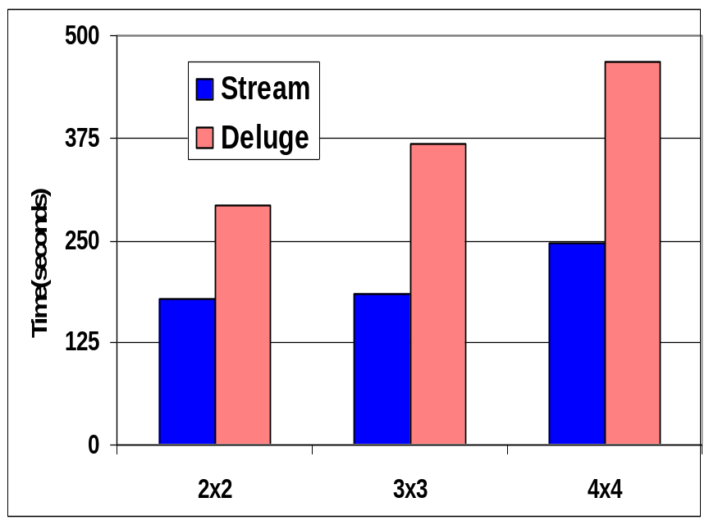
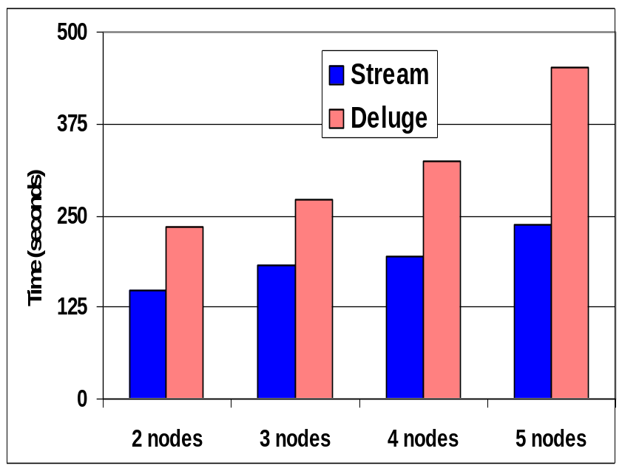
Test bed Results: Reprogramming Time
Up to 98% reduction in reprogramming time
Notes:
SB: Main result (% improvement) in a text box beneath the plot

Slide 32
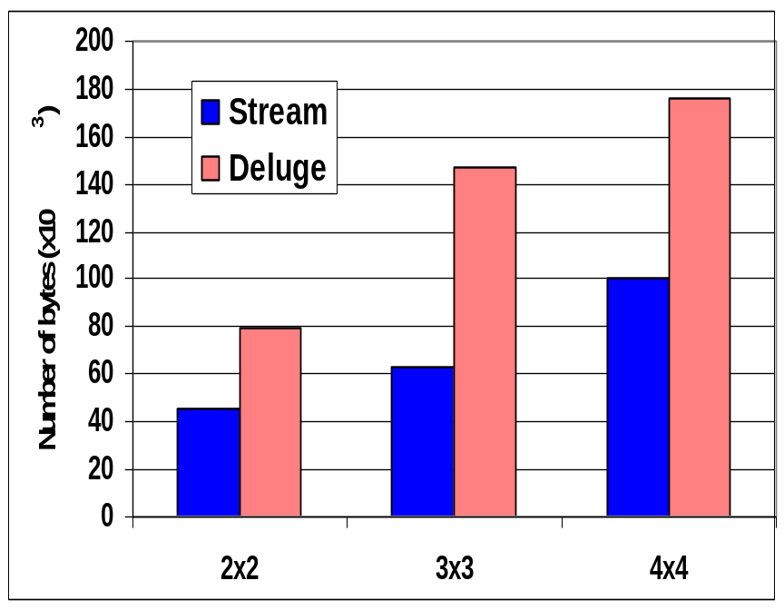
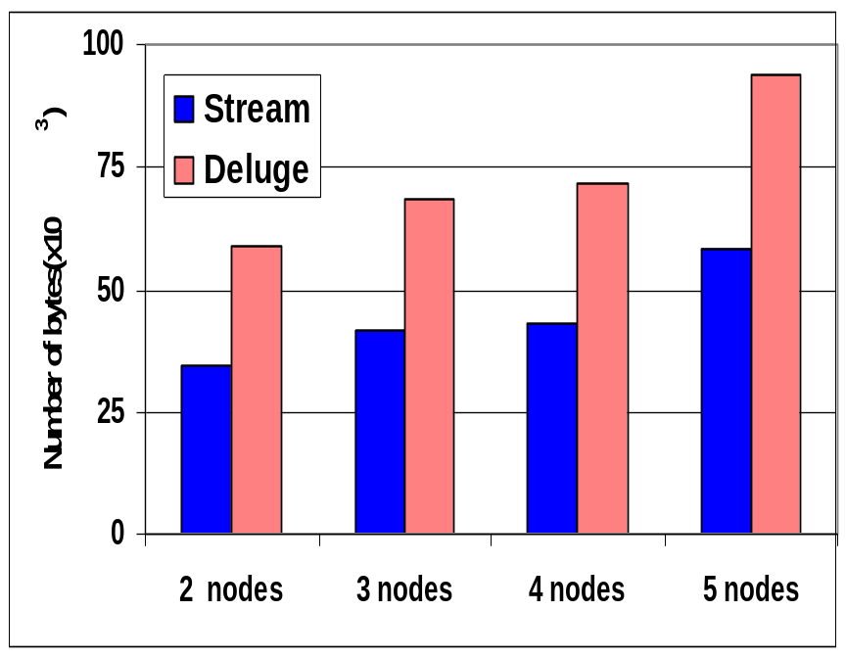
Test bed Results: Network Traffic
Up to 132% reduction in number of bytes transferred during reprogramming

Slide 33
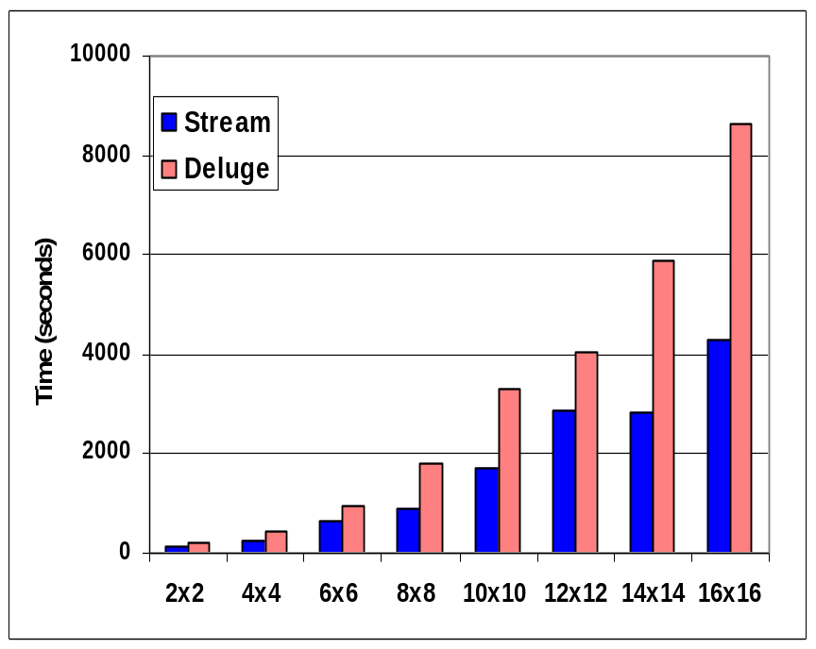
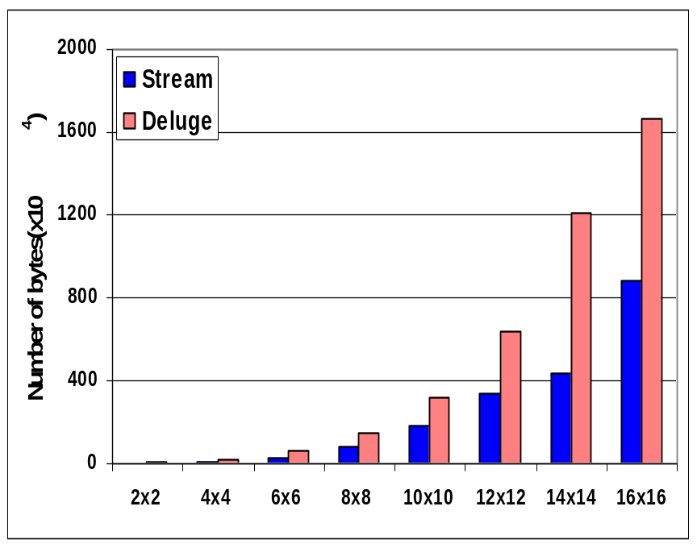
Simulation Results: Network Size
Grid Networks of various sizes with source situated at one
corner of the grid
Number of packets per page reduced from 48 to 24 packets
Up to 112% reduction in number of bytes transferred and 101% reduction in reprogramming time
Notes:
SB: All default parameter settings from TOSSIM

Slide 34

Sample Application: Combined Sewer Overflow

Slide 35

The Problem!

Slide 36
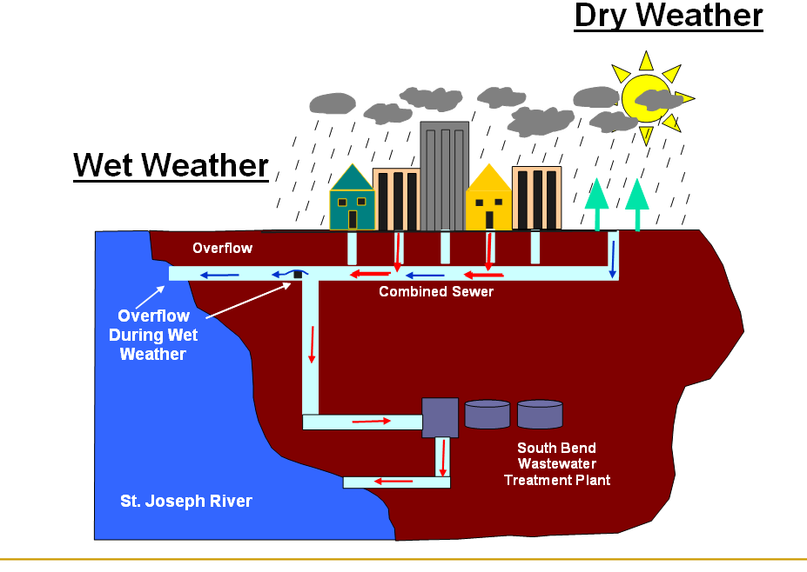
How do CSOs Work?

Slide 37
Emnet deployment
RNode
Rnode
To next RNode
To next Rnode
Stoplight pole
Manhole cover antenna
Stoplight Pole
Manhole Cover Antenna
Inode
microprocessor
Sensor
Deployment plate

Slide 38
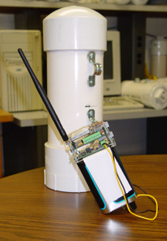
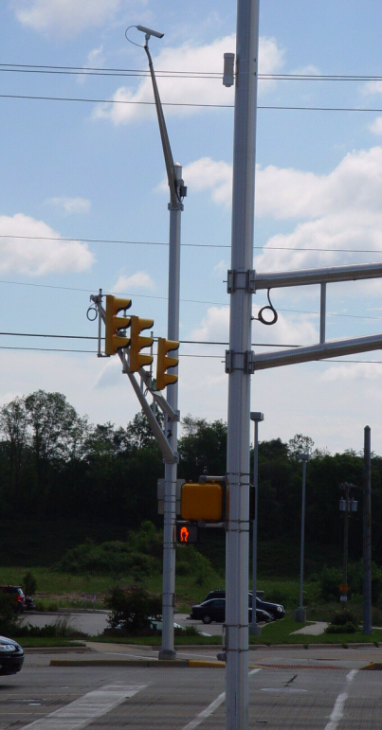
Emnet: Chasqui motes

Slide 39
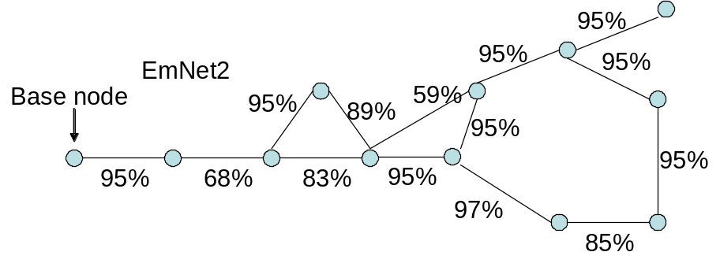
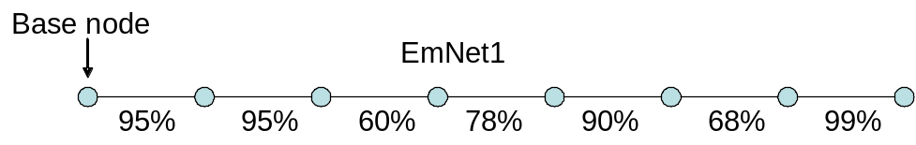
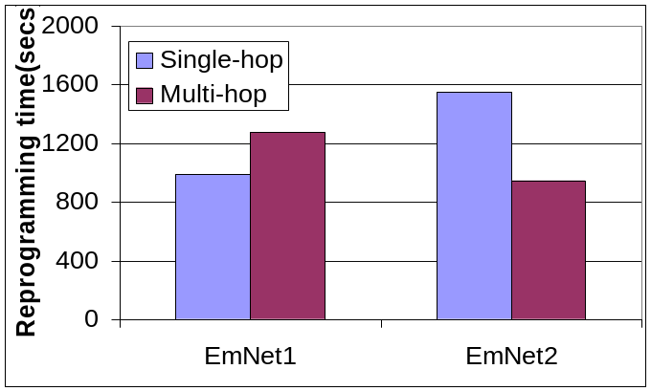
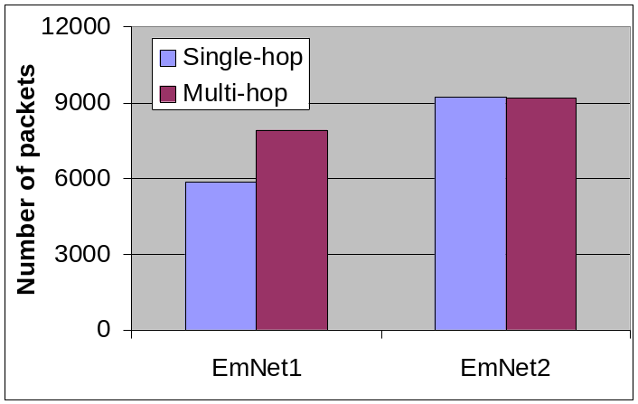
EmNet Deployment Results
Linear or near-linear networks favor single-hop
For grid like networks multi-hop is favored with advantage increasing with network size
Two contributory factors – multiple listening nodes and spatial multiplexing
EmNet reports a factor of 10 improvement in human cost due to wireless reprogramming

Slide 40
Take-Away Lessons
Work so far:
  Low overhead detection and isolation through limited overhearing
  Reputation system applied for high fidelity data gathering
  Reliable wireless reprogramming
Protocols in sensor networks have to be designed accounting for
  Natural node and link failures
  Physical node compromise
  Malicious external nodes
Trade-offs exist between latency and energy consumption and customizable protocols that fit different regions of trade-off curve are desirable
Desirable characteristics for security protocols
  No privileged nodes
  No node trusted completely

