Slide 1

Overview of Research in Dependable Computing Systems Lab
Saurabh Bagchi
Dependable Computing Systems Lab
School of Electrical and Computer Engineering
Purdue University
sbagchi@purdue.edu
http://shay.ecn.purdue.edu/~dcsl

Slide 2
Dependable Computing Systems Lab
Sponsors
  National Science Foundation
  Purdue Research Foundation
  Avaya Labs
  Motorola Labs
  Intel
Members
  Nipoon Malhotra − Bingrui Foo
  Gunjan Khanna − Blake Matheny
  Padma Varadharajan − Tyler Olsen
  Yu-Sung Wu
  Issa Khalil
  Mark Krasniewski
  Yen-Shiang Shue
  Jin-Yi Wang

Slide 3
Project #1: Distributed Disruption Tolerant System
Distributed e-commerce platform subjected to natural failures and malicious attacks to services
Disruptions = Attacks + Failures
Objective is to tolerate disruptions, not just detect
Different phases:
  Detection
  Diagnosis
  Containment
  Response
Project Members:
  Here: Arif Ghafoor, Eugene Spafford, Yu-Sung Wu, Bingrui Foo, Blake Matheny
  Outside: Tim Tsai, Sachin Garg, Navjot Singh (Avaya Labs)
Paper:
  "Collaborative Intrusion Detection System (CIDS): A Framework for Accurate and Efficient IDS” – Appearing in ACSAC, December 2003
  “ADEPTS: Adaptive Intrusion Containment and Response using Attack Graphs in an E-Commerce Environment” – To be submitted to IEEE Security & Privacy (Nov 5)

Slide 4
Project #2: Self-Checking Network Protocols
Goal is to provide highly available network services (e.g., SIP, reliable multicast) in distributed environment
Challenges in today’s distributed systems
  Large number of network protocol participants
  No access to source code or machine on which code is running
  Often soft real-time guarantees
Our Approach:
  Distributed monitor to observe external interactions and diagnose misbehavior or malfunction
  A rulebase using temporal logic and fast matching algorithms
  Hierarchical monitor structure to monitor local and global interactions
Project Members
  Here: Gunjan Khanna, Padma Varadharajan
Papers
  "Failure Handling in a Reliable Multicast Protocol for Improving Buffer Utilization and Accommodating Heterogeneous Receivers", Submitted to PRDC 2004.
  “Distributed Monitors for Detection of Misbehavior in Large Scale Distributed Systems”, To be submitted to DSN, 2004.

Slide 5
Project #3: Dependable Ad-hoc and Sensor Networks
Ad-hoc and sensor networks built of unreliable components and deployed in hostile or uncertain environments
Goal is to provide middleware that provides a robust platform keeping environment constraints in mind
  Energy constraint
  Computational power constraint
  Security constraint
Project Members:
  Here: Mikhail Atallah, Ness Shroff, Nipoon Malhotra, Michael Krasniewski, Longbi Lin, Issa Khalil
Papers:
  “Analysis and Evaluation of Topological and Application Characteristics of Unreliable Mobile Wireless Ad-hoc Network”, Submitted to PRDC 04.
  "Fault Tolerant Energy Aware Data Dissemination Protocol in Sensor Networks”, Submitted to ICDCS 04.

Slide 6
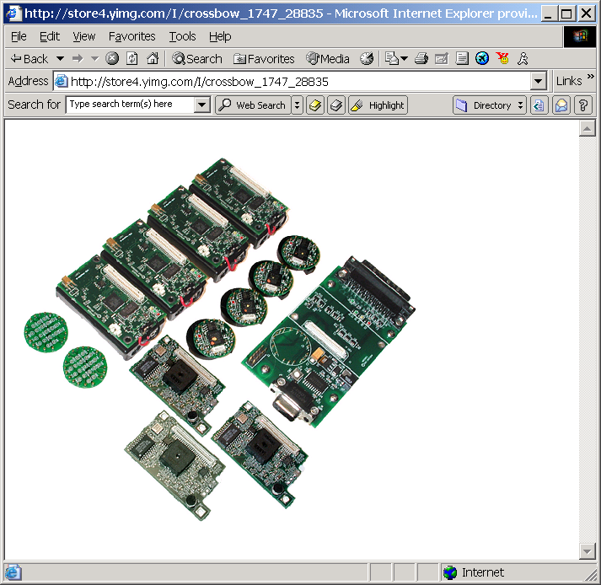
Project #3: Dependable Ad-hoc and Sensor Networks
Mobility to help network characteristics
  Intelligent mobility patterns to improve connectivity, coverage, diameter
Robust data aggregation from sensor nodes to base station
  Robust to failures of intermediate nodes and compromised nodes
  Sensitive to energy budget of each node
Secure message communication in sensor networks
  Efficient protocol for encryption of messages
  Scalable and energy parsimonious key distribution protocol
Testbed of 20 Berkeley motes

Slide 7
Project #4: Architecture Approach to Software Robustness
Goal: Use idle hardware resources, such as additional execution contexts in SMT or CMP, for checking software
Memory checks are biggest bang for buck
  Large class of software errors
  Easy to automate
Approach
  Devise detection routines
  Minimize synchronization between detection and application routine
  Devise hardware extensions that enable fast information transfer from one to the other
Story so far:
  SMT based simulator created for simple monitoring routines
  Performance results show substantial improvement over baselines – all monitoring in software running in same execution context
Project Members: Prof. T. N. Vijaykumar, Yen-Shiang Shue, Jin-Yi Wang, Yu-Sung Wu

Slide 8
Disruption Tolerance in Distributed E-Commerce Environments
Yu-Sung Wu, Bingrui Foo, Blake Matheny, Tyler Olsen, Saurabh Bagchi
Dependable Computing Systems Lab
School of Electrical and Computer Engineering
Purdue University
http://shay.ecn.purdue.edu/~dcsl

Slide 9
Outline
What is disruption tolerance & Motivation
Adaptive Disruption Tolerant System
Disruption Detection
Our Approach
System Design
Results
Disruption Containment and Response
Conclusions
Notes:
32

Slide 10
What is Disruption Tolerance?
Causes of system downtime
  Naturally occurring failures: hardware, software, interfaces
  Malicious intrusions: internal, external
Disruption = Failure + Intrusion
Similarities in approach to tolerate the two causes
  Both cause system to be unavailable or degraded in functionality
  Sometimes root cause cannot be distinguished
  Sometimes response is identical (e.g., take component offline and bring in a diverse spare)
Dissimilarities in approach to tolerate the two causes
  Number of coincident events
  Counter-response
Notes:
Similarities:
Buffer overflow because of a software bug and a naturally ill-formed URL or a maliciously input URL – telling motive is impossible.
If a service has been compromised and it sees a hardware failure, no need to recover it.
Dissimilarities:
- Counter response may be to re-execute same function again, but if service has been compromised then that is unlikely to be effective

Slide 11
Motivation
Handling failures and intrusions under same framework gives the following advantages
  Reduce overhead: Example – A separate detection routine for each sub-system is not required
  Leverage synergy between two actions: Example – A component that is compromised due to an intrusion need not be recovered from a natural fault
What is tolerating disruption?
  Not enough to simply detect: Large volume of intrusion detection systems, error detection protocols
  Need to address the other phases of the process: Diagnosis, Containment, Response
  The phases are closely coupled in their cost metrics: A pinpointed diagnosis reduces the cost of recovery

Slide 12
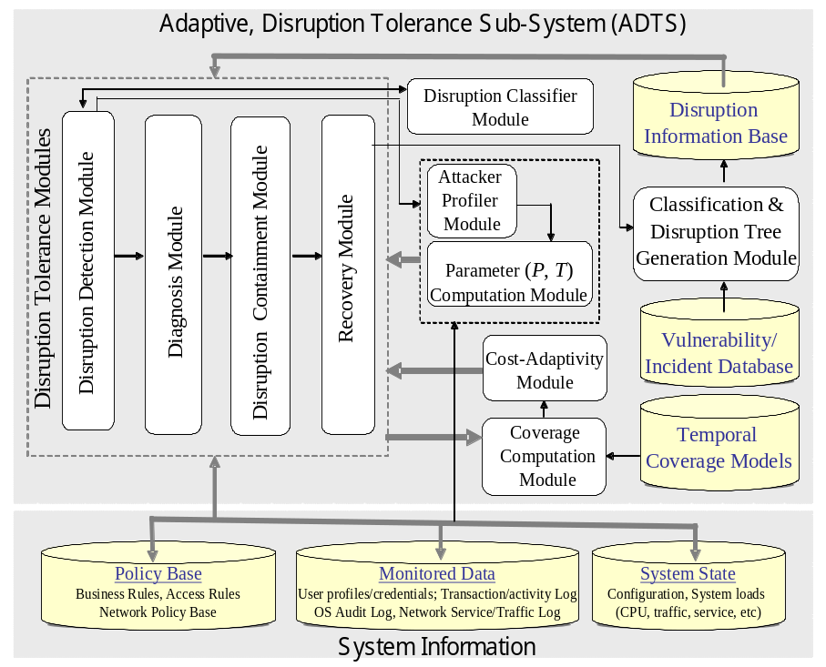
Our Approach: Adaptive Disruption Tolerant System (ADTS)
System
Information
Application
Layer
Information
Systems
Layer
ADTS
Network
Layer
Response
Data

Slide 13
Disruption Detection
Initial phase of disruption tolerance process
Based on previous approach to intrusion detection systems (IDS)
IDSs are based on two alternative choices
  Anomaly based: Specify the normal behavior
  Misuse based: Specify the patterns of attacks
Metrics for evaluating IDSs
  False positives, or False alarms
  False negatives, or Missing alarms
Our approach: Collaborative Disruption Detection Systems (CODDS)
  Multiple detectors specialized for different parts of system
  Manager infrastructure for combining alarms from multiple detectors
  Rulebase at manager to decide on appropriate response

Slide 14
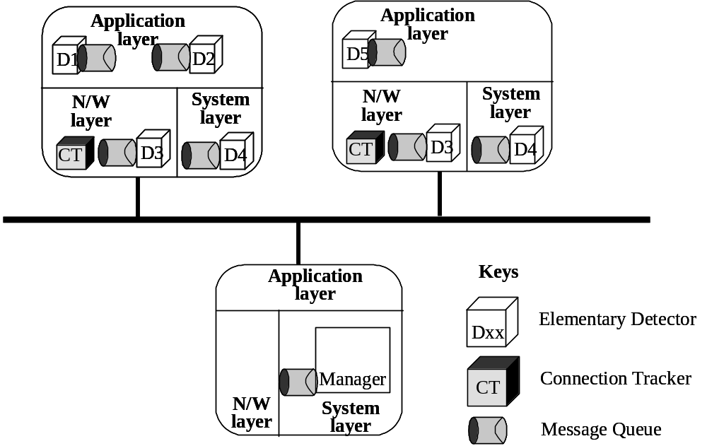
CODDS Approach
Motivation
  Single IDS can have false positives (false alarms) or false negatives (missed alarms)
  Single IDS is specialized for certain kinds of attacks
  Timing based correlation from multiple detectors may indicate useful characteristics of attack such as propagation speed

Slide 15
CODDS Components
Elementary Detectors (EDs): Specialized detectors distributed through the system
  The EDs maybe off-the-shelf and minimal change is required for integration into CODDS
  Different hosts may have different configurations of EDs
Message Queue (MQ): Communication layer for multiple CODDS components
  Secure through a shared key and hash digest
Connection Tracker (CT): Kernel level entity to track which process has active connection on which port
Manager: Workhorse of CODDS responsible for collating alerts from EDs and generating a combined alert which is expected to be more accurate
  Can take into account local alerts from individual hosts to make a global determination

Slide 16
Manager Architecture
Manager communicates with other entities through MQ and has shared key with each ED
Manager components are
  Translation engine: Translates native alert formats into CODDS format
  Event dispatcher: Dispatches the event to the appropriate host’s Inference Engine instance
  Inference Engine: Matches the received events against the Rule Objects to come up with a determination of disruption.
    A separate instance of the Local Inference Engine for each host
    A Global Inference Engine for correlating the results from the local engines
    Rule Objects store the rules, one for each class of disruption
  Combining Engine: If multiple types of inference engine, this combines the detection decision from each

Slide 17
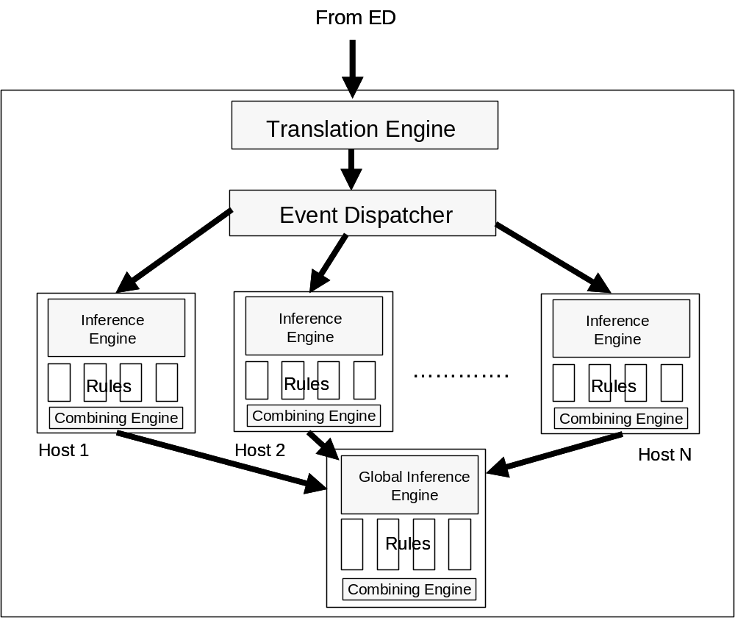
Manager Architecture

Slide 18
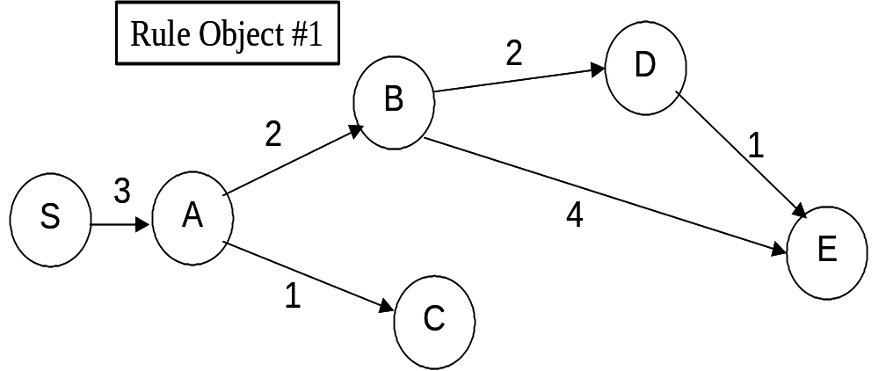
Graph-Based Inference Engine
Rules are represented as graphs
Nodes are events and Edges represent sequencing of events
Edge weights represent assurance values indicating likelihood of sequence
Assurance Value (AV) for a disruption given by sum of edge weights
An event is matched with a rule object if it is fusionable, i.e., belongs to the same disruption instance
Discounted Assurance Value (DAV) for partial matches

Slide 19
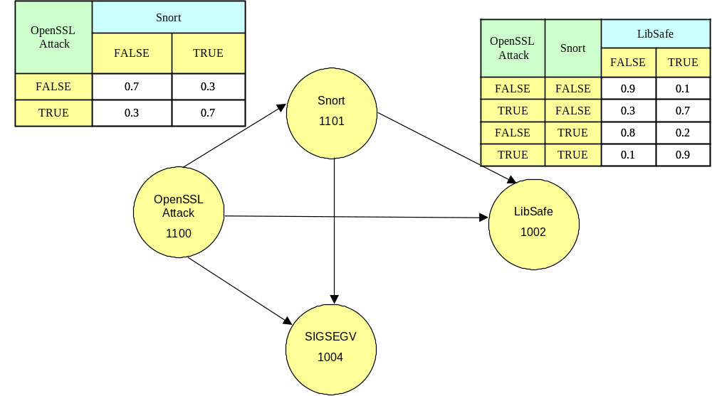
Bayesian Network Based Inference Engine
In a Bayesian Network, the nodes represent random variables and edges the direct influence of one variable on another
Three step process for creating rule object
  Nodes to represent events
  Edges to represent conditional probability relations among the events
  Creation of table with conditional probability values
Bayesian Network toolbox used for solving
Input is fusionable event stream
Output is conditional probability of root (the disruption)

Slide 20
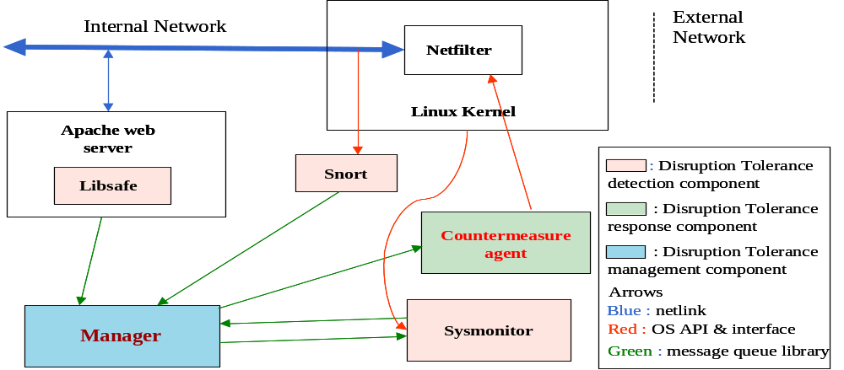
CODDS System: Current Implementation
1. Create profile
2. Browse catalog
3. Create shopping cart
4. Check out shopping cart
Web
Server
Appl.
Server
Database
Web Client

Slide 21
CODDS Elementary Detectors
Application level: Libsafe. Middleware to intercept “unsafe” C function calls and prevent stack overflow attacks.
Network level: Snort. Sniffs on incoming network packets and matches against rulebase to perform misuse based detection.
Kernel level: Sysmon. Home-grown new detector.
  Intercepts system calls for file accesses and executions.
  Takes a set of rules for disallowed accesses or executions
    Can be specified using wildcards or directory tree
  Intercepts signals of interest that can flag illegal operations.
    SIG_SEGV to indicate segmentation violation that may be caused by buffer overflow

Slide 22
Simulated Disruptions
Disruptions which are of type intrusions are simulated for our experiments.
Three classes of disruptions, multiple types within each class, and multiple variants within each type
  Buffer overflow: Can be used to overwrite parts of stack and write and execute malicious code
    Apache chunk attack
    Open SSL attack
  Flooding: Overwhelm the network with redundant or malicious packets causing a denial of service
    Ping flood
    Smurf
  Script based: Exploit poorly written scripts which do not do input validation to execute arbitrary commands
    Used unchecked open() and system() calls

Slide 23
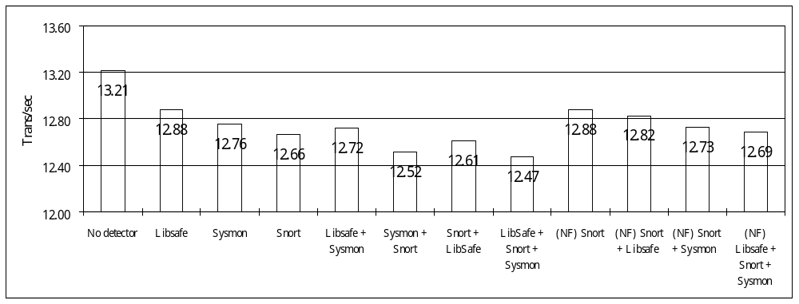
Results: Performance – Without Disruptions
Measured without and with disruptions
30 web clients running concurrently
Transactions per second of workload transaction measured
When multiple EDs present, manager with both Inference Engines is deployed
No Disruption
Degradation overall: 3.95% with Snort rules modified, 5.60% without
Degradation due to Sysmon alone: 3.46%

Slide 24
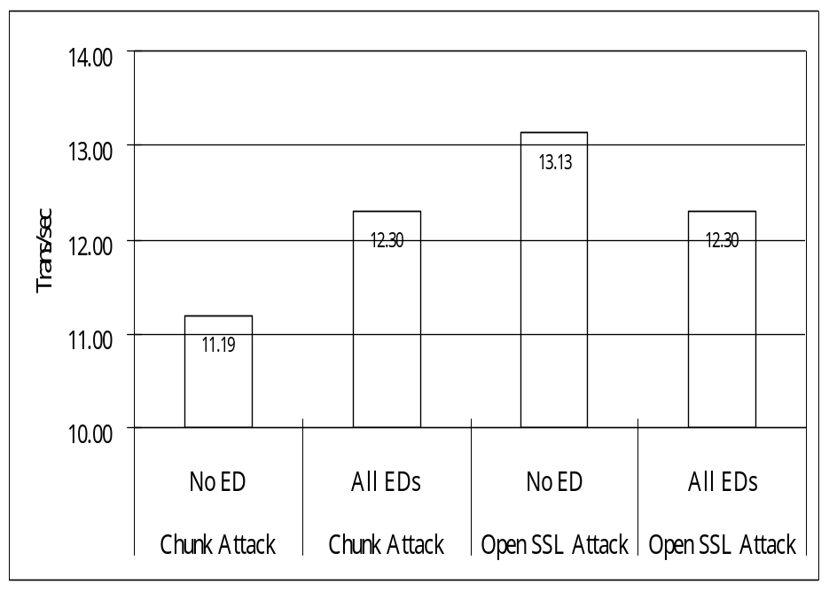
Results: Performance – With Disruptions
OpenSSL Attack performance degradation is 6.33%
Chunk Attack performance improves!!!
  Having Libsafe prevents core dumping
Highest performance degradation due to Matlab Bayesian Network toolbox

Slide 25
Results: Accuracy of Detection
Snort
Libsafe
Sysmon (Signal)
Sysmon (File)
CIDS
No attacks
Yes (1807,1933)
No
No
No
No attack
Open SSL
Yes (1881,1887)
No
Yes
R1
Yes
Open SSL variant
No
No
Yes
R1
Yes
Apache Chunk
Yes (1807, 1808, 1809)
Yes
Yes
R1
Yes
Smurf 1000
Yes (499)
No
No
No
Yes
Smurf 500
No
No
No
No
No
Ping Flooding
Yes (523, 1322)
No
No
No
Yes
Script
No
No
No
Yes
Yes
Yes: Detected. Figures in parentheses are the rule numbers within Snort. Sysmon(File) is the file access detection part, Sysmon(Signal) is the illegal signal detection part; R1: The attack was not successful in creating a file.

Slide 26
Disruption Containment
Goals
  Contain the disruption to subset of services while remaining services operate
  Take responses, both preventive and reactive, to reduce effect of current disruption and prevent future disruptions
Evaluation Metric
  Survivability – The portion of the functionality of the system that is available when subjected to disruptions
  Survivability is a probabilistic measure
  Example: Survivability of the Amazon.com service under a defined set of disruptions is 0.98 with a probability of 0.95!

Slide 27
Representation Model
Disruption DAG
  Nodes are goals
  Parent node can be “achieved” if any or all children nodes are “achieved”
  Example:
    To obtain root access on a machine, there needs to be Windows NT running on the machine and Windows Messenger v. 4 needs to be compromised
A₁
A₂
AND arc
CSS
{S1,S2}
ESS
{S3,S4,S5}
B₁
C₁
B₂
C₂
Node
Class
Response
Disruptivity
Index
D₁
Y₁
Z₁
M
D₂
SC
R1
1
OR arc
WC
R2
2
V₁
X₁
Response Table
X
Y
X₂
Y₂
VWC
R3
3
NC
R4
4

Slide 28
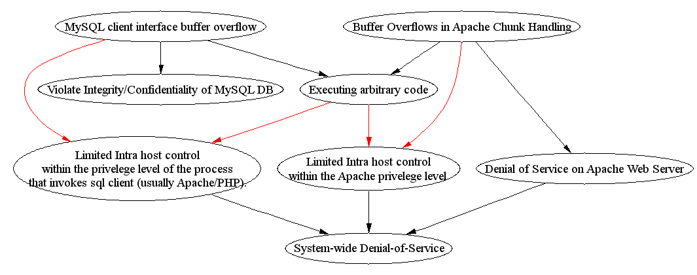
Example of Instantiation of D-DAG
Disable DB write
Restart Apache
Kill processes

Slide 29
Algo #1: Classifying Node as Candidate for Response
Compromised Confidence Index (CCI) = f(f′(CCI_{i}), Confidence in Detection)
D
E
Before
(Confidence values of
other nodes are 0)
A
B
C
Confidence = 0.7
Confidence = 0.6
After
CCI = 0
D
E
CCI = 0.45
CCI = 0.7
A
B
C
CCI = 0.9
CCI = 0
In this example, f computes the average of the inputs

Slide 30
Candidate Labeling (top down approach)
Before
CCI = 0
D
E
CCI = 0.45
CCI = 0.7
A
B
C
CCI = 0.9
CCI = 0
SC: Strong Candidate
WC: Weak Candidate
VWC: Very Weak
Candidate
NC: No Candidate
After
(Assuming threshold
of each node is 0.4)
NC
SC
D
E
SC
A
B
VWC
C
SC
Response set = {A, E}
For present implementation, only the top SC nodes in a path and all WC nodes are
put in the response set.

Slide 31
Algo #2: Decision on Response
Response Index (RI) calculated for each node
Depends on (summation of)
  Node class
  Disruptivity of response (More disruptive ⇒ Lower value)
  Compromised Confidence Index (CCI)
  Effectiveness Index (EI) of response action
0   ≤ RI ≤ 4. Higher value implies node more suitable for response
Responses are classified into 5 classes
    Disable access to service for all users
    Disable access to service for subset of users
    Reduce functionality to service for all users
    Reduce functionality to service for subset of users
    Apply patch
Less
Disruptive

Slide 32
Calculating Effectiveness Index for Response
History of attack nodes being reached in the DDAG maintained in the sensitivity period.
Preventive
Response
Attack goal reached
Reactive
Response
Higher level goal
History of attack nodes being reached in the DDAG are kept in a sensitivity queue for a sensitivity period.
When an attack is detected and a response action taken, the feedback algorithm:
  Searches for failed preventive responses (decrease EI if found)
  Searches for failed preventive or reactive responses of responsible parents
  (decrease EI of parent(s) response if found)
  Searches for multiple occurrences of the same attack
  (force more drastic response to prevent further EI degradation)
Every hour the queue is examined for expired sensitivity periods
  If the response was successful, the EI for that response will be increased

Slide 33
Monitor-Based Detection of Misbehavior in Distributed Protocols
Padma Varadharajan, Gunjan Khanna, Saurabh Bagchi
Dependable Computing Systems Lab
School of Electrical and Computer Engineering
Purdue University
http://shay.ecn.purdue.edu/~dcsl

Slide 34
Motivation
Goal is to provide highly available network services (e.g., SIP, reliable multicast) in distributed environment
  Detect Disruptions in protocol operation
  Design should be generally applicable to large class of protocols
  Should be applicable to applications with no source code available
  Minimum Expertise required at the user level.
Challenges in today’s distributed systems
  Large number of network protocol participants
  No access to source code or machine on which code is running.
    Coordinated Detection
  Often soft real-time guarantees
  Masquerading Intruders
  Slow and Malicious Receivers

Slide 35
Monitor Based Approach
Self Checking Network Protocols
  Using an External Monitor to detect network protocol errors.
  Monitor could be co-located or in vicinity.
  Observe Messages Exchanged.
Monitor
Monitor
Monitor
Monitor
RuleBase
Rulebase
Network service component
Network service component
Monitoring interactions among service components
Network service component
Monitoring interactions among service components
Monitoring interactions among service components
Interaction among service components
Interaction among service components

Slide 36
Role of Monitor
Monitor
Goal is to tolerate failure of entities and intrusions such as
  Denial of Service (DOS)
  Malicious Receivers
Implemented as a FSM. Monitor will snoop over inter-process communications
  For example: M1, M2 and M3 are visible to the monitor and gets matched in the rule base at the monitor
Extend to Hierarchical Monitoring.
E₁₁
E₂₁
M₁
E₁₂
M₂
E₂₂
E₁₃
M₃
E₂₃
FSM for two entities E1 and E2 in a networked environment

Slide 37
Monitor Architecture
Data
Capture
Rule
Classifier
Matching
Algorithm
State
Maintainer
Decision
Maker

Slide 38
Motivation for Hierarchical Monitor
A single monitor could be a single point of failure
Lone monitor can get overwhelmed by messages
  Will affect latency of detection
Protocol entities have different behavior when looked at individually compared to collective picture
Increased Coverage

Slide 39
Example Protocols
TRAM (Tree Based Reliable Multicast Protocol)
  Single sender
  Logical structure is hierarchical with Repair Heads (RH) at intermediate levels providing local repairs.
TRAM++
  Resilient to Malicious receivers
Sender
Sender
RH
RH
RH
RH
RH
RH
R
RH
RH
R
R
R
R
R
R
R
R
R
Data Flow
Acks & Nacks

Slide 40
Running Example: TRAM Monitors
GM
GR
GR
IR₁₂₃
IR₁₂
LM₀
IM₁₂₃
IR₁₂₃
LR₀
C₀
LR₀
C₀
LM₃
LR₃
C₃
C₃
IR₁₂
LM₁
LM₂
LR₁
C₁
C₂
LR₁
C₁
C₂
LR₂
LR₂
TRAM
Monitor Hierarchy
Legend
C: Cluster; LR: Local Rule; IR: Intermediate Rule; GR: Global Rule; LM: Local Monitor; IM: Intermediate Monitor; GM: Global Monitor; : Rule repository

Slide 41
Rule Classification
Local Rules
  The rules which need to be checked at the local monitor
  These rules are further broken down into Processable and Non Processable rules
    Processable : Rules which will be matched
    Non-Processable : Rules for which a packet will not be matched and will be sent to the Global Monitor
  Example: The Number of Nacks in a certain given interval (interval should be defined in terms of number of ack windows) should be restricted by N_{max} << N_{individual_max} * Max number of members.
Global Rules
  The rules are matched at the global monitor
  Example: The average data rate should be > D_{min}
The rule classifier takes as input the rule set and the participants being monitored and classifies the rules

Slide 42
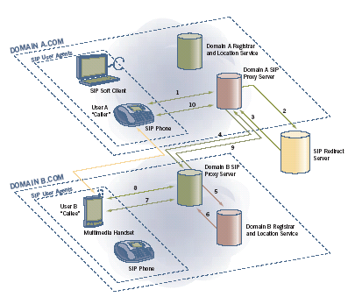
SIP

Slide 43
Examples of SIP Rules
Next transaction immediately after a 2XX receipt cannot be a BYE more than ‘n’ times in time duration t for a station.
If a proxy server receives a 2XX response to a request that it has sent, it has to forward the same response upstream, and cannot generate a non-2XX response.
Another Classification
Configuration Error: Error occurring during set up phase.
  The RX level should be not more than 2 apart in left and right subtree. 0≤ |RDt| ≤ 2 R where RDt is the difference in Rx level of right and left sub-tree.
Runtime Error: Error occurring during the running of the protocol.
  The Sending Rate should be maintained at a minimum S_{min}. S_{min}≤ |S_{rate}| ≤ S_{max} R (Combinational Rule)

Slide 44



Temporal Rules
RULE 1:
If state is V between time t to (t+k), then state remains B in all time between time T and (T+r), where T>t.
(t_{i},t_{i}+k) V_{t} B_{q} (T_{i},T_{i}+r)
RULE 2:
Given state V at time t, then state at time t is not equal to state at time t+∆.
V: V_{t} ≠ V_{t}+∆

Slide 45
Temporal Rules
RULE 3:
Between time t and time (t+k), number of times an event occurs is lower bound by L and upper bound by U.
L<|V_{t}|<U , (t_{i},t_{i}+k)
RULE 4:
If event V occurs ‘n’ number of times in time t to (t+k) where n is lower bound by L and upper bound by U, then event B occurs ‘N’ number of times between time T and time (T+r), where N is upper bound by U’ and lower bound by L’.
(t_{i},t_{i}+k) L ≤ |V_{t}| ≤ U
L’ ≤ |B_{q}| ≤ U’
(T_{i},T_{i}+r)

Slide 46
Matching Algorithm : Combinatorial
Represent Combinatorial rule as a Tree
  State variables at leaf nodes & boolean operators at intermediate nodes.
Make an Ordered tree
  Nodes in the left sub-tree have higher frequency of change compared to nodes places on right.
Each intermediate node stores the variable in the left and right sub-tree.
a
&
b
c
1
0
V
d
a
b
c
e
f

Slide 47
Proposed Evaluation
Injecting Failures into the system using NFTAPE.
  Plan to inject failures into the two application protocols
  Measure monitor’s ability to detect non fail silent errors
Performance Metric
  Latency of Detection
  Resource utilization by monitor (CPU, bandwidth)

Slide 48
Conclusion
ADTS Project
  Building an infrastructure for distributed e-commerce platforms for running reliably and securely
  Can accommodate best-of-breed detection techniques and provides management and correlation facility
  Algorithm to contain disruption to subset of services and take response action to improve system survivability
  Demonstrated on real e-commerce platform
Monitor Project
  Monitor based detection of misbehavior in large-scale distributed systems where applications may be black-box
  Hierarchical monitor structure for monitoring local or global interactions
  Rule base of combinatorial and temporal rules and matching algorithms!

