Slide 1



Summary of Impact
2019-Present
Saurabh Bagchi
Purdue University
School of Electrical and Computer Engineering
Department of Computer Science
Director, Center for Resilient Infrastructures, Systems and Processes (CRISP)
Director, ARL Assured Autonomy Innovation Institute (A2I2)

Slide 2
About Me
Director, NSF CISE Center Chorus (2024-29)
Founding Director, Army Research Lab Assured Autonomy Innovation Institute (A2I2) (2020-25)
Founding Director, Purdue Center for Resilient Infrastructures, Systems, and Processes (CRISP) (2018-now)
Leadership role in 3 centers, WHIN Co-Lead ($20M; 2018-22), CERIAS Assistant Director (2011-14), NSF NEES Center Thrust Lead (2009-14)
Co-founder & CTO, KeyByte, startup on cloud DB (2022-now)
IEEE Computer Society Board of Governors (2017-20; 2022-24)
Co-founder, SensorHound Inc., startup on reliable & secure IoT (2012-14)
Faculty, Purdue University ECE & CS
Research Staff Member, IBM T. J. Watson Research
MS and PhD, University of Illinois at Urbana-Champaign, Computer Science
BTech, Indian Institute of Technology Kharagpur, Computer Science

Slide 3
Significant Recognitions
June 2024: Won an NSF Center as PI, from the Computing Directorate. This is a $7M Center on Resilient Cyber-Physical Systems called Chorus.
September 2023: Selected to be Lead of the IEEE Computer Society Student Challenge Competition. This is the only global student challenge competition organized by IEEE Computer Society and is funded by the Society.
June 2023: Selected to Chair the USENIX Annual Technical Conference 2024, the flagship conference of the USENIX professional society.
June 2023: Selected to the Steering Committee of the ACM/IFIP Middleware Conference. This is a conference in the computer systems area, running since 1998.
June 2022: Elevated to Fellow of the Institute of Engineering and Technology (IET). The grade represents only 5% of the active members of IET, which numbers 147,000 engineering and technology professionals.
Keynote speaker at 10+ conferences and symposia. Most recent one is IEEE Intl. Conference on Contemporary Computing and Communication (InC4), March 2024.
August 2022: Selected a Purdue Societal Impact Fellow, one of seven from across campus. This annual recognition is for faculty whose proposed activities in research, learning, or engagement most strongly demonstrate the potential for societal impact.

Slide 4
Significant Recognitions
June 2022: Awarded the Test-of-Time at the IEEE International Symposium on Dependable Systems and Networks (DSN). DSN is the most prestigious conference in the area of dependability and the flagship conference organized by the IEEE Technical Committee on Dependable Computing and Fault Tolerance (TCFT). This award is given to the work published in the conference 10 years back that has had the greatest impact in the area of dependable computing.
September 2021: Elected to the IEEE Computer Society Board of Governors. Each board member serves a three-year term, mine is from 2022 to 2024.
October 2021: Our vulnerability discovered in Android TV and our resultant fix are accepted by Google and lead to changes to the OS and gets a CVE, CVE-2021-0889.
September 2021: Selected by the National Science Foundation (NSF) to organize the Grand Challenges in Resilience Workshop, 2023.
April 2021: Awarded the Amazon Research Award in the Applied Machine Learning category.
Best papers at ACM Sigmetrics (2022), ACM International Conference on Embedded Wireless Systems and Networks (EWSN) (2020), International Supercomputing Conference (ISC) (2019), IEEE ICST (2019),
December 2020: Selected as IEEE Computer Society Distinguished Visitor (DV) for January 2021 through December 2023. These are selected as “the most accomplished leaders in tech” who are sponsored by IEEE to be speakers at IEEE chapter events.
July 2020: Selected as member of the International Federation for Information Processing (IFIP), Working Group on Dependable Computing and Fault Tolerance. The group consists of a select set of research leaders in the field of dependable computing. Membership is by invitation only, upon the nomination of a group member, discussion and a majority vote by the members. Its current membership is at 60 with 1-2 new members being added each year.

Slide 5
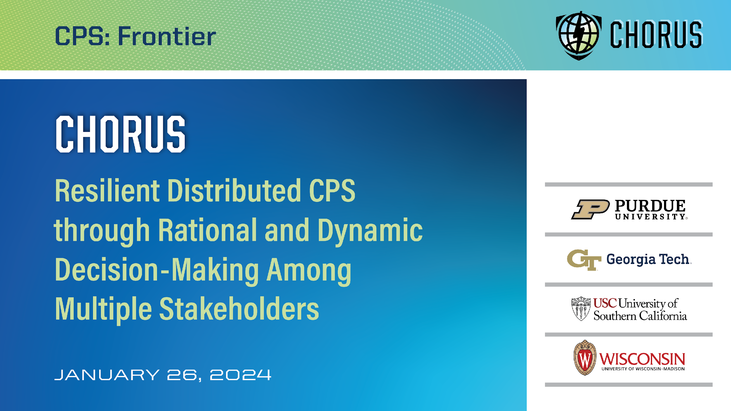

Slide 6
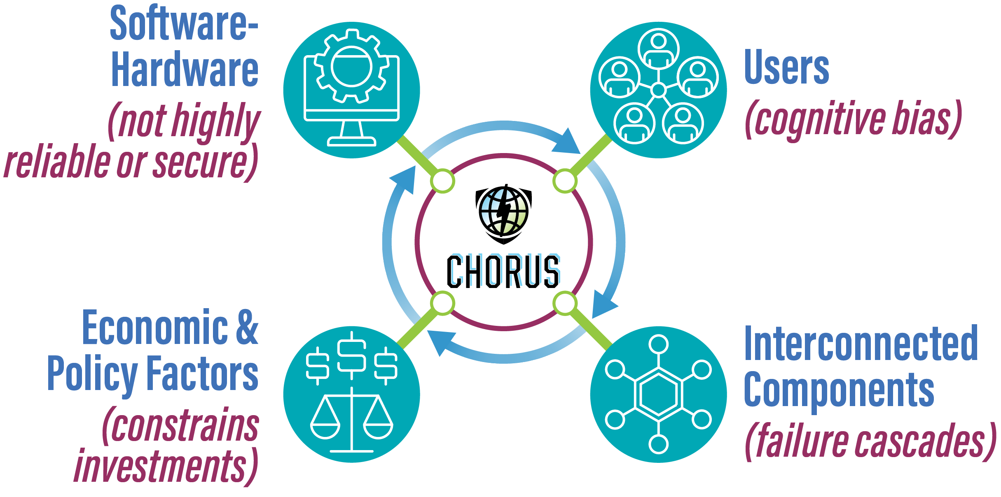
Why Chorus?
Why Chorus?
CPS are often composed of hardware and software blocks that are not highly reliable themselves, have users and operators with cognitive biases
However, we want to create CPS for application domains that demand high criticality, even when operated at large scale
Thus, our fundamental challenge is:
How do we create safety-critical, secure autonomous systems with multiple stakeholders and legacy assets?
Notes:
CPS applications are often built out of hardware and software blocks that are inherently unreliable or insecure and the users and operators of such systems have intrinsic human cognitive biases. Due to economic and legacy reasons, even critical CPS applications are built out of such building blocks. Thus, the grand challenge problem before us, how do we create such CPS applications out of a mix of existing CPS elements, often intrinsically unreliable, and with the human decision makers often cognitively biased, such that we can invest resources strategically to make them fundamentally resilient?

Slide 7
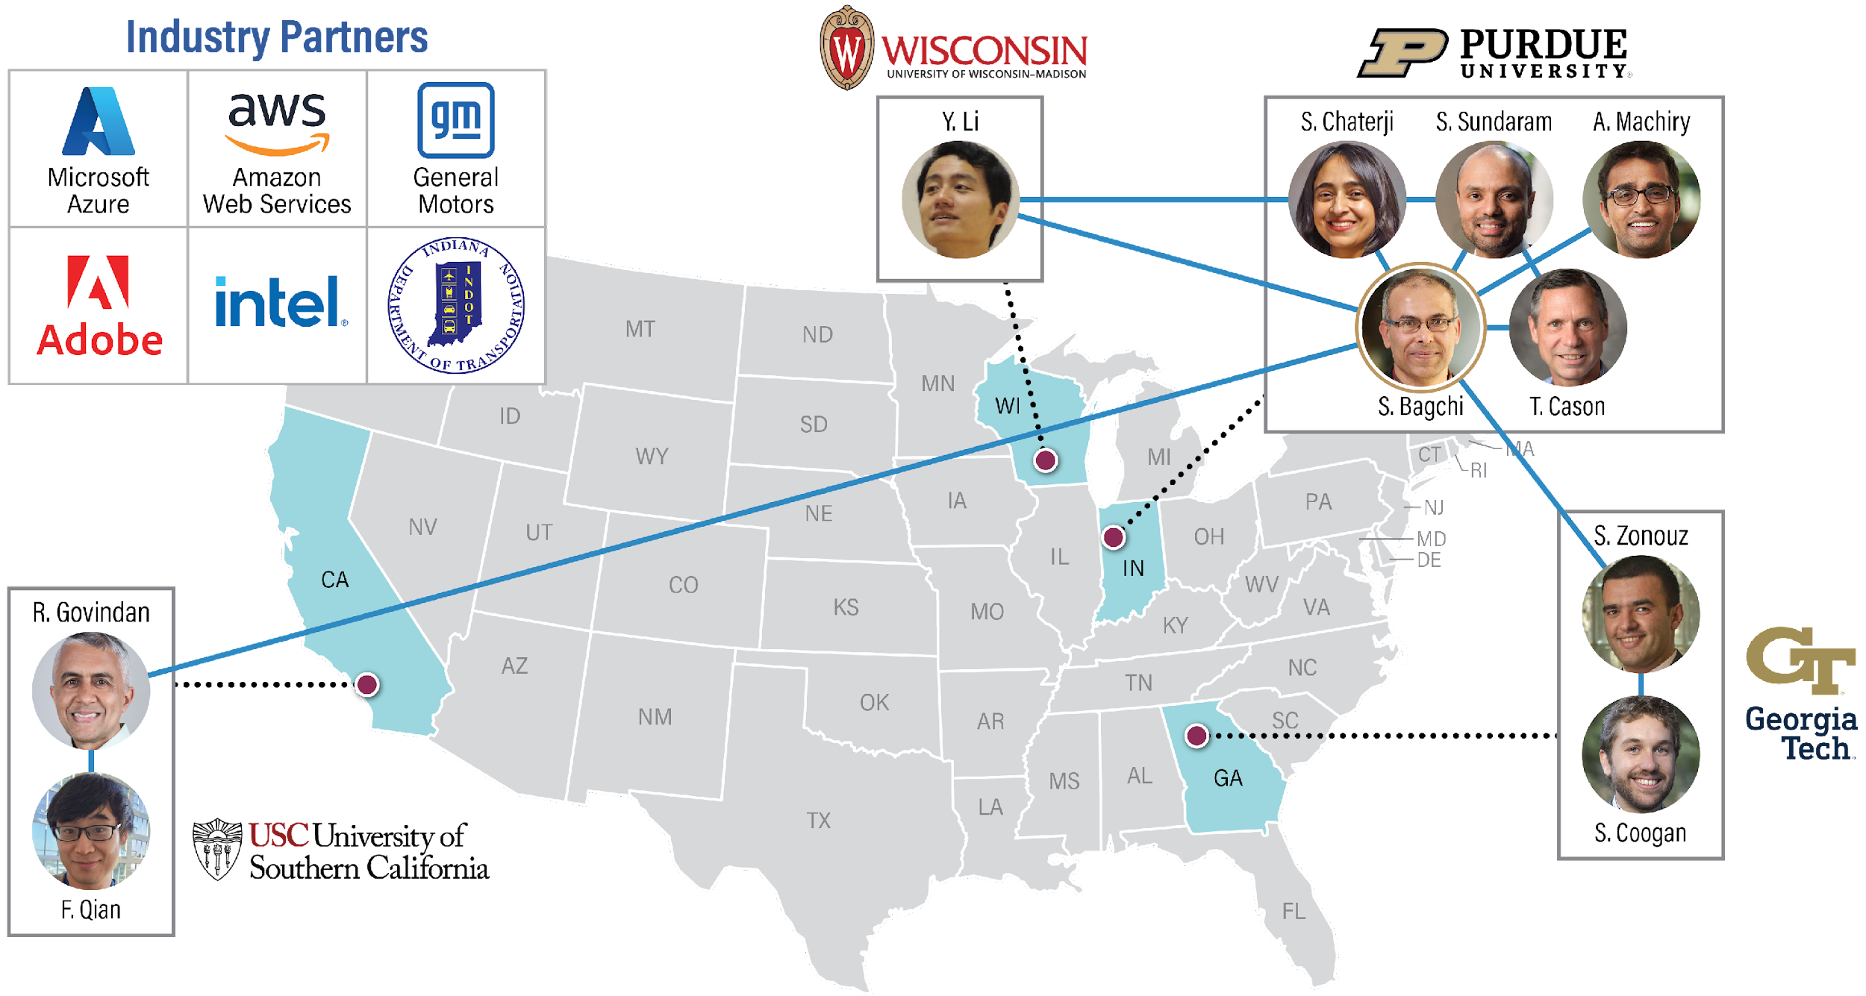
Chorus Team
Chorus Team
Notes:
This vision will be realized through our team across four institutions and with complementary expertise and track record of working together, aided by active partnerships with industry and regulators.

Slide 8
High-Level Context of Research
Dependability: Property that the computer system meets its specification despite the presence of faults
  Faults can be due to natural causes (software bugs, defects in hardware)
  Maliciously induced (attacks from external or internal sources)
Our approach: Dependable system design through data analytics and at large scales (large # processes, large amounts of data)
Dependability driven by 2 emerging trends
  Execution environments are changing: “All components are developed in‐house, are open source and well‐understood” → “Systems are made up of third‐party software components, some of which are partially opaque to the system owner and interactions amongst the components have many evolving patterns”
  Dependability solutions are found fragile: “Rule-based, always on, not adaptive to dynamic workloads” → “Data analytics-based monitoring, root cause analysis, and mitigation, which adapt to heterogeneous architectures and new workloads”

Slide 9


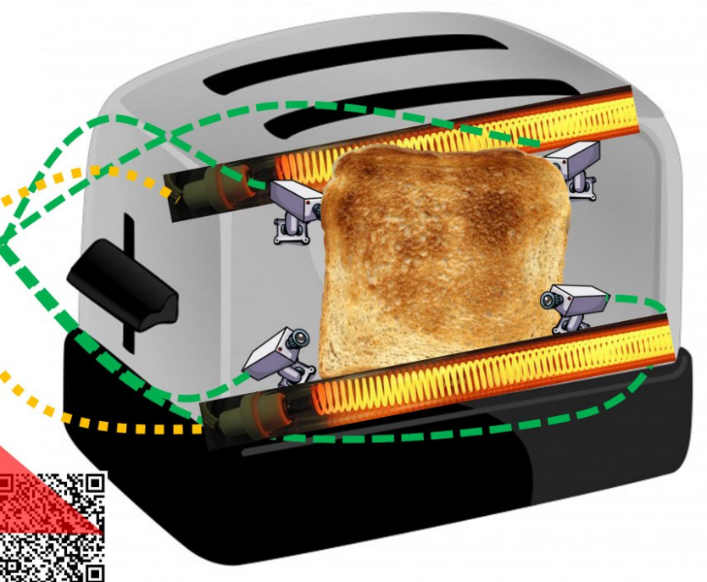

Foundation and Applications of Our Work
Application Domains (Current)
Wearable & Mobile
Edge computing
Autonomous Transportation
Distributed ML
CPS
Application Domains (Current)
Foundational Pieces
Secure System Design
Interpretable Data Analytics
Distributed Software
Hetero-geneity

Slide 10
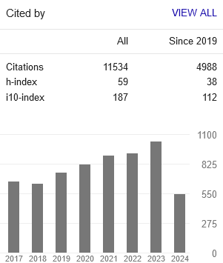
Counting The Beans
# Citations = 11,534 (07/24)
H-index = (59, 38)
  Highest among all researchers in the technical area “Dependable computing”, 3rd highest in “Dependable systems”
13 best paper awards or runner-up awards at IEEE/ACM conferences
  1 Test of Time award
Funding record of > $1M/year (individual) for 5+ years

Slide 11
Dependability in the Small: Record, Replay, Reprogram
Objective:
Embedded systems can suffer from many unpredictable errors in the field
Maintain as much of the execution trace in the field as possible
Goal is to enable record and replay:
  Capture remote execution (control flow and data flow)
  Faulty execution can be replayed through traces in a gdb-like environment
Understand and mitigate new failure modes due to wearables and AR/VR devices
Technical Contributions:
First lossless system-level record & replay purely in software
  No timing perturbation to embedded application
  Led to detection of subtle timing bugs in distributed protocols for time synchronization and data collection; also used to detect inefficiency in network protocol stack
Fastest wireless reprogramming protocol
  Compiler and runtime techniques to minimize amount of network traffic generated due to network reprogramming
  Delta sent over and recreated on node without use of linker and loader
Failure characterization of smartphones, wearables, and IoT
  Changes to software architecture of Android (20130 and Android Wear (2021)
  IoT device security characterization through static and dynamic analyses
Historical Context:
Extreme resource constraints – energy, network bandwidth, memory
Close interactions with surrounding physical environment and other sources of non-determinism
Complementary techniques for embedded system debugging:
Simulation and emulation; Formal verification; Language-enforced safety
Easy to compromise devices:
Many hardware-software protections from server-class nodes are unavailable
Monoculture allows cascading failures
Non-expert human users can make non-security conscious choices
Impact/Milestones:
Co-lead on large project on community IoT testbeds for smart agriculture and smart manufacturing: $38.9M (2018-2022) funded by Lilly Endowment and a consortium of companies
Large city-wide wireless mesh network testbed for environmental monitoring in South Bend, IN (2008-current) operated by private organization EmNet LLC with support for reprogramming from our lab
Startup company out of the lab: Sensorhound Inc. (2012-15); 2 US patents
Google bug bounty, CVE created
Significant publications (last 5 years): CVPR, Eurosys, ACM TODAES
Include one telling breakthrough image

Slide 12
Dependability in the Small: Secure IoT Nodes and Networks
Objective:
Proliferation of Internet of Things (IoT) is bringing new levels of connectivity and automation to embedded systems
Exposes embedded systems to network-based attacks
Interconnection among nodes in large-scale CPS applications lead to attack cascades
Well-understood server-class protections are difficult to apply
  Tight resource constraints and no availability of virtual memory, MMU, etc.
  Software design pattern that shuns abstractions and allows all code to access all data and peripherals
Apply behavioral economics to see how humans decide to invest in security for connected CPS with different owners
Technical Contributions:
Privilege separation and compartmentalization
  Automatically provided through static analysis & dynamic compartment switching
  Does not require application modification and applies to legacy code
  Leverages software pattern of embedded applications
Optimal defense computation for large-scale CPS with interconnected assets belonging to multiple owners
  Game-theoretic framework enables one-shot & moving target defense
  Decentralized computation with imperfect knowledge, using hypergames
Energy-efficient secure distributed protocols
  Most energy-efficient Byzantine-resilient state machine replication
  First approximate agreement protocol in CPS with Byzantine nodes
Historical Context:
Conventional security principles, e.g., least privileges or process isolation are missing in low-end embedded systems
  Functionality and non-functional properties (e.g., security) are deeply entangled thus hampering adoption
Little effort at compartmentalization of software components; recent efforts (e.g., ARM mBedOS) are too coarse
Strategic decision making needed to decide on security investments for interconnected CPS
  Decision making under imperfect knowledge of threats & other stakeholders’ decisions
  Prior work assumes perfect rationality and knowledge
Impact/Milestones:
Director of NSF Center on Resilient CPS (2024-29)
Triggered commercial effort at ARM (μVisor)
New method for examining firmware for security vulnerabilities; developed with and transferred to Sandia
WSJ coverage of interconnected CPS security (2022)
Co-lead of WHIN center for IoT; Production testbeds in 10 Indiana counties, for digital Ag & smart manufacturing (2018-23)
Significant publications (last 5 years): CCS-24, DSN-24, TKDD-24, S&P-22, AsiaCCS-21
Include one telling breakthrough image

Slide 13
Dependability in the Large: Data Centers and Edge Computing
Objective:
Software for data centers have many configuration options
  Large search space & dependencies among parameters
  Static configurations are not optimal with changing workloads
  Distributed software must be reconfigured with cost-benefit analysis (cost: degradation due to reconfig; benefit: better fit for new workload)
Perform rapid root cause analysis when failures do happen
  Significant monitoring available data but sparse failure data
  Distributed applications have many interacting components
Some bugs surface only at large scale
  Detecting and diagnosing such bugs is challenging
  How to recover scalably from multiple concurrent failures, e.g., in storage subsystem
Technical Contributions:
Distributed reconfiguration of data center software
  Configuration predictor demonstrated for NoSQL datastore for HPC and genomics workloads; Extended to handle distributed NoSQL clusters preserving consistency and availability guarantees
  Configuration predictor for application-level configuration demonstrated which can mitigate effect of interference due to co-location of VMs
Causal theory-based root cause diagnosis technique
  Can diagnose in microservice-based cloud applications
  Data sample efficient and lowest compute complexity of all solutions
Scale-dependent bugs and correlated failure handling
  Data analytic model developed to predict when scale-dependent bugs crop up at runtime; inversion of model allows for root cause analysis
  Distributed software to deal with data center scale failures in storage subsystem; relieves pressure on network due to repair traffic
Historical Context:
Configuring distributed data center software was done automatically based on predicted workload
  When workload changes, some automated tools can predict new optimal parameters – domain-specific techniques
  Often switching to new configuration without considering cost of the switch degrades performance
Root cause detection is an ongoing industry challenge
  Data-driven, stochastic applications have rendered many traditional techniques obsolete
  Site Reliability Engineers are actively looking for tooling support
Scale-dependent bug handling in ad-hoc manner
  Little theory for detection & diagnosis of scale-dependent bugs
  Repair in storage sub-system of data centers can lead to very high repair network traffic
Impact/Milestones:
Startup on NoSQL cloud DB: KeyByte (2022 – present)
Visioning committee lead for NSF and ACE-led critical infrastructure resilience work
Newly funded NSF Center on resilience in large-scale critical infrastructures
Significant publications (last 5 years): OSDI-22, NeurIPS22, Sigmetrics-22 (Best paper), Usenix ATC-21, NeurIPS-20.
Include one telling breakthrough image

Slide 14
Dependability in the Large: Supercomputing Applications
Objective:
Current techniques for resilience are insufficient for exascale
  Radical changes are needed across the entire software stack because the rate of errors system-wide will rise
  Otherwise, exascale systems will often compute unreliable scientific results
Replication‐based approaches in software have promise
  But blind replication of all tasks will blow the performance and energy budget
  A less blunt instrument is needed; Allow large‐scale runtime to isolate regions where faults occur and replicate only those parts
Monitoring for subtle errors at scale
  Detecting and diagnosing errors such as data corruptions, cascading performance degradation, etc. is challenging
  How to do this in heterogeneous architecture machines is unknown
Technical Contributions:
Scalable and flexible techniques to detect errors (Heisenbugs, anomalies in runtime execution environment)
  Technique to accurately identify silent data corruptions based on the simple insight that there exist spatial and temporal locality within most variables in a parallel program (Sirius)
  Technique for root cause analysis of hangs through determining relative progress among parallel tasks via dynamic analysis (Prodometer)
  Practical tools can scale to sizes of the large supercomputing applications
Application portability to CPU-GPU clusters while preserving resilience
  Developed Domain Specific Language (DSL) and toolset for development of scalable computational genomics applications
  Scalable algorithm to correct errors due to sequencing instruments, without needing a reference dataset
  Identification of optimal parameters for GPU kernels in such applications
Historical Context:
Debugging large-scale parallel applications is a daunting task
  Human cognition cannot cope with large number of execution units
  Active work in the last ~8 years to provide semi-automated tools (starting with our DSN-10, SC-11 papers)
  Key insight: Although there is a large # tasks in a large-scale application, # behavioral equivalence classes is much smaller and does not grow with the scale of the application (i.e., task counts and input data)
  Behavioral equivalence classes can be identified using control flow graph
  Isolate any task, or tasks, that deviates from its assigned behavior class due to bug or anomaly in runtime environment
Application portability while preserving resilience
  How to port applications to heterogeneous computing environments while ensuring they still compute correctly
  Application focus on scaling out genomics applications that need to use the large supercomputing clusters due to sharp increase in data sizes
Impact/Milestones:
Prodometer and AutomaDeD are part of standard software stack on DOE supercomputers (LLNL, ANL); 2013 Gordon Bell Prize was given for the largest fluid dynamics simulation run at LLNL and AutomaDeD was acknowledged as the debugging tool [ WWW ]
Part of the DOE-organized committee that wrote the report on “Addressing failures in exascale computing” (2014)
Best paper award: ACM BCB (2015) – on distributed, fault-tolerant software for pattern mining in genomics data
Significant publications (last 5 years): ISC-19, ICS-19 (Best paper), BCB-15 & 17, ICS-16, PLDI-14, PACT-12, TPDS-15, Nucleic Acids Research-15
CACM Contributed Article “Debugging High-Performance Computing Applications at Massive Scales” with community of co-authors (2015)
Funding from DOE and NIH R01
Include one telling breakthrough image

Slide 15
Dependability in Learning: Robust Decentralized Learning & Inferencing
Objective:
Enable learning in distributed setting of IoT devices
  Decentralized learning and decentralized inferencing
Goal is to learn from the physical world:
  Unanticipated variations in characteristics of the physical environment or people in them
  Evolving data with time, sometime with abrupt changes
Goal is to infer close to the source of data:
  Inferencing at the speed of data generation
  Reduce bottleneck of compute and network resources
Technical Contributions:
First approximate inferencing for demanding ML algorithms
  Object detection, Activity recognition
  Approximation in content- and contention-aware manner
  Inferencing at the speed of generation on mobile GPUs
Privacy breaches in federated learning
  Even when SOTA and SOTP cryptographic techniques are used
  Relies on a new threat vector: Server sending maliciously manipulated models to the clients
Split learning between sensor-edge-server
  Sensor data stream processed partly at the sensor, then intermediate features are compressed, and transported
  Heavyweight compute offloaded to edge/server, in content-aware manner
Historical Context:
Learning happens at massive server farms
Batch mode learning
Homogeneous, well-resourced servers
Inferencing happens at massive server farms
Streams of sensor data have to be transported
Round trip latencies >~100 ms
Assumption of secure control and data planes
Control plane runs the training and the inferencing
Data plane generates and transports the data
Impact/Milestones:
First FL protocol for mobile GPUs, under asynchronous network
Work with Amazon and NVIDIA on privacy of FL
Efficient computation demonstrated to NVIDIA on their mobile GPUs
Community created on robust FL learning across academia and industry; SecureFL workshop, vision paper
Significant publications (last 5 years): CVPR (3), Eurosys, S&P, DSN, TOSN
Include one telling breakthrough image

