Slide 1
Fast Gravitational waveform generation
By Jordan Moncrieff
Course: ISC505
Date: 20/07/2022

Slide 2
Background and motivation

Slide 3
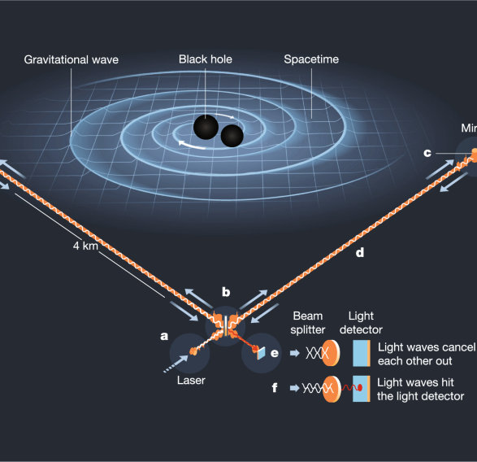
Gravitational waves (GWs)
Distortions in space time that are sent as a wave through space at the speed of light
Predicted by General relativity, GWs result from accelerating masses, with the largest signals originating from the coalescence of two compact objects (e.g., neutron stars and black holes)
Can be detected by the change in length of two points in space as a Gravitational wave passes through (as in LIGO-Virgo GW detectors)
Gravitational waves are proving incredibly important to astronomy, allowing study of phenomena that otherwise would go undetected by conventional means
Image credit: Image credit: ©Johan Jarnestad/The Royal Swedish Academy of Sciences.

Slide 4
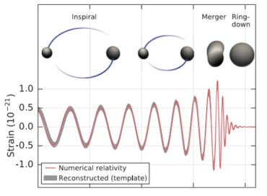
GW waveforms
Merger of Binary Black Holes (BBHs) results in a GW signal of characteristic form, with the exact shape depending on several parameters
Initially low frequency medium amplitude gravitational wave produced from orbiting black holes
Just before black holes merge, rotation frequency increases rapidly, and due to increased acceleration, higher amplitude GWs are produced
Once merged, “ring down” occurs, as seen in image, where amplitude rapidly drops toward zero
Resulting signal depends on several parameters, including mass ratio of Black Holes and their respective spin
Figure from [Abbott et al., 2016]

Slide 5
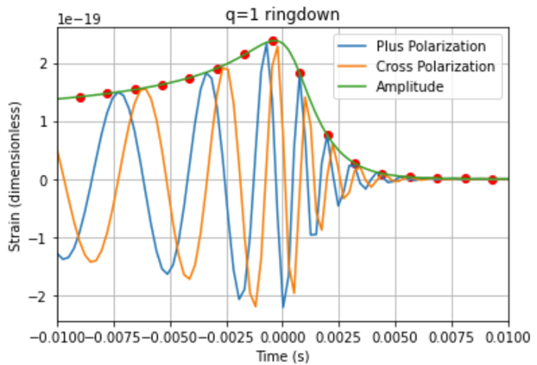
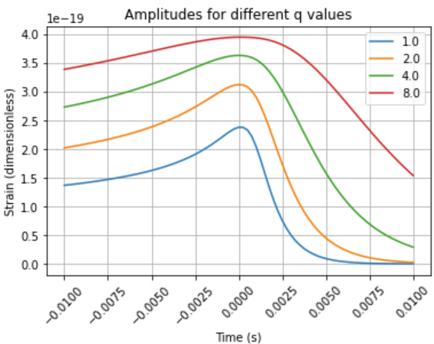
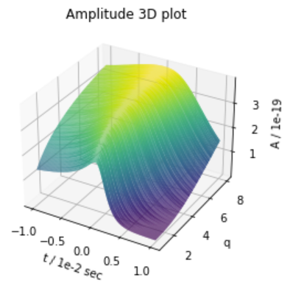
Modelling the waveforms
Understanding how the shape of a gravitational waveform depends on the parameters of the two black holes is a key step in using GW for Astronomy
Want to be able to detect a GW signal, and quickly infer the parameters of the BHs, such as mass ratio, and spins (parameter estimation)
Modelling waveform from first principals involves extremely complicated and computationally intensive numerical relativity simulations, can’t be done in real time – need more efficient modelling schemes

Slide 6
Knowledge gaps

Slide 7
What has been done in this field?
Reduced order and surrogate models (approximate models that are computationally cheaper) have significantly reduced computing time, with similar accuracy to traditional NR approach [Blackman et al., 2015]
Machine learning, particularly Artificial Neural Networks, have already successfully been employed to GW waveform modelling [Setyawati et al., 2020]
Has been shown that symbolic regression is highly effective in deriving simple Physics equations [Udrescu and Tegmark, 2020]
Symbolic regression has already been employed to predict waveforms of GWs in [Tiglio and Villanueva, 2021], using a genetic programming approach

Slide 8
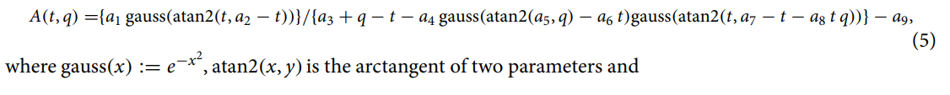
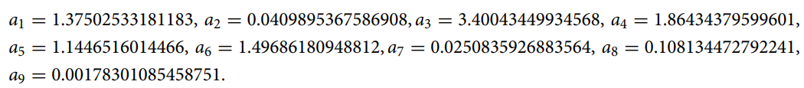
What remains to be solved?
Neural networks have not yet been able to successfully model full 7D parameter space of signal manifold [Chua et al., 2019]
The symbolic work that has been done has not been able to identify sparse models of GW waveforms, such as in [Tiglio and Villanueva, 2021]
Former gap in literature potentially amenable to parsimonious nature of SINDy

Slide 9
Project goal
Be able to efficiently compute GW waveforms - for the particular case of gravitational waves emitted during inspiral of binary black holes in case of no spin
Using SINDy, find a sparse and simple model for waveforms – identifying simple dynamics of the system
Using ANNs, produce an efficient model to quickly compute waveforms from given parameters of black hole system

Slide 10
Approach and study design

Slide 11
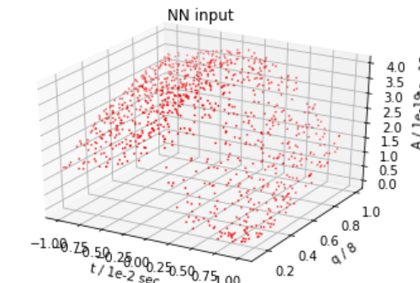
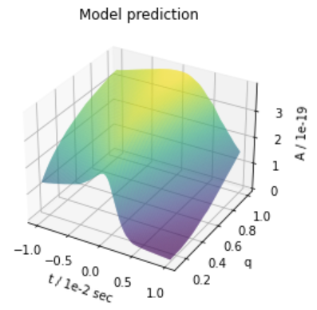
Approach and study design
Generate waveforms using PyCBC gravitational wave library [pycbc.org]
Build, train, and tune NN model to perform regression on generated data
Validate model
Tuning
ANN

Slide 12

Workflow
Data generation
Processing
Initial ANN
Hyperparameter tuning
Improved model
Model evaluation

Slide 13
Results and discussion

Slide 14

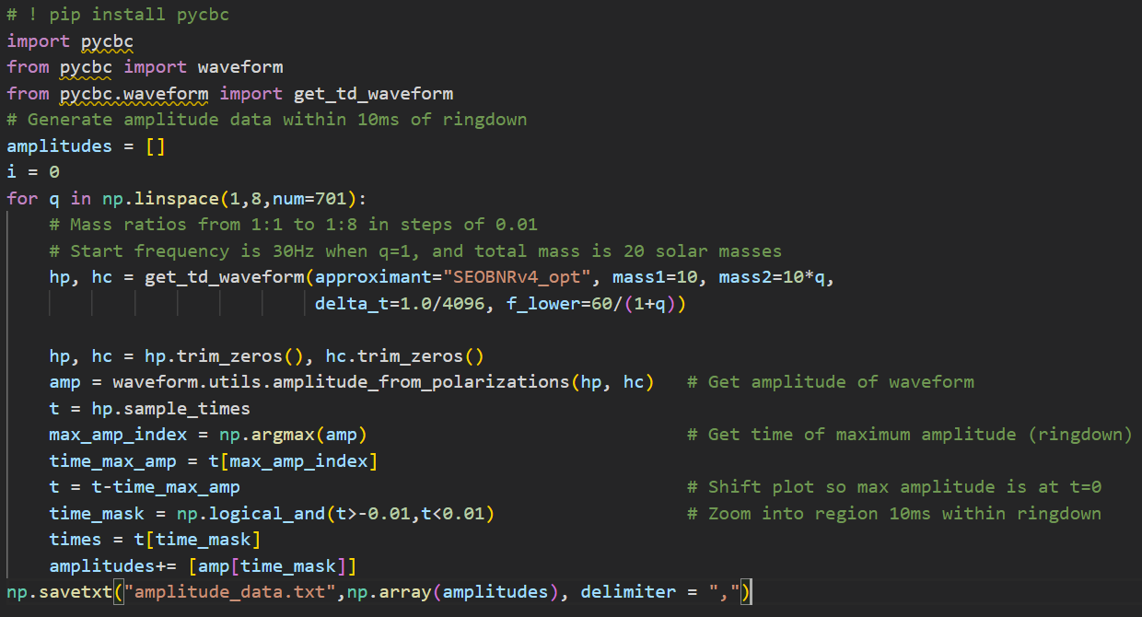


Data generation

Slide 15
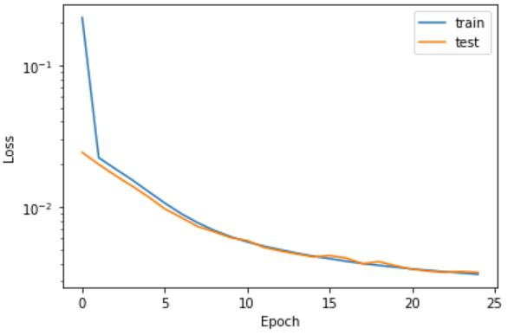
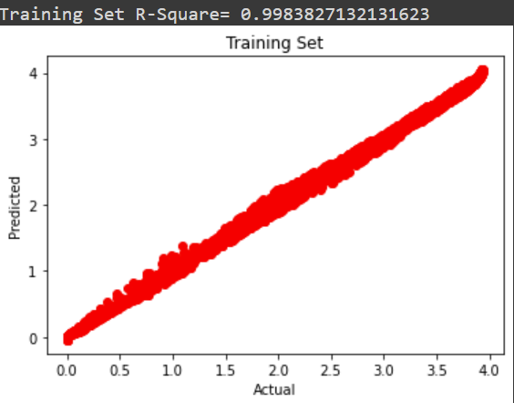
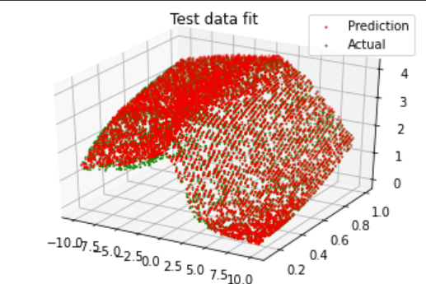
Initial model
Use MLP architecture, consisting of 2 hidden layers with 10 nodes each
Nesterov Accelerated Gradient optimization for the learning algorithm, with learning rate and momentum 0.01
ReLU activation for hidden layers, linear activation for output layer
MSE for loss function , RMSE for error metric
Input: q (mass ratio) and time (t); output: A(t) (amplitude)
Randomly split data into 70% training, 15% validation, and 15% testing data

Slide 16
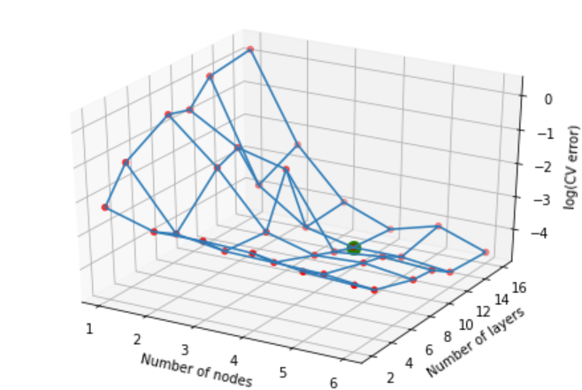
Hyper-parameter tuning
Grid search node values [1,2,3,4,5,6], and layer values [2,4,6,8,10,12]
Found cross validation error, averaging over 10 runs to reduce random error
Found optimal values 5 layers 16 nodes
Using this architecture, grid searched over momentum 0.0, 0.1, 0.2, 0.4, 0.6, 0.8 and learning rate 0.001, 0.01, 0.03, 0.06, 0.08
Found optimal learning rate of 0.01, and momentum 0.8

Slide 17
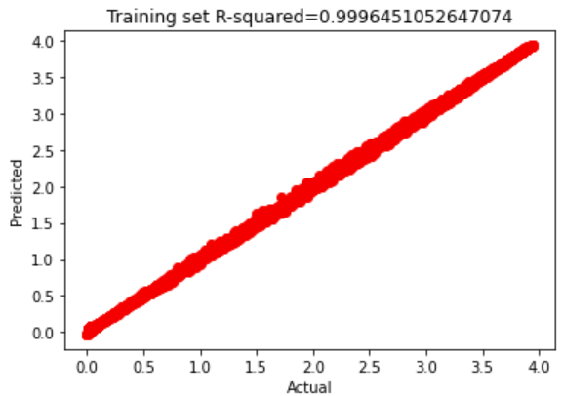
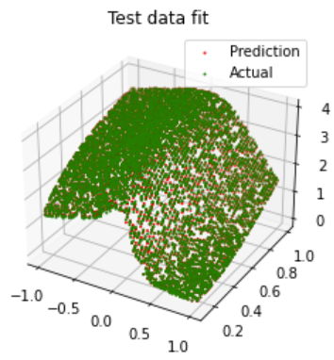
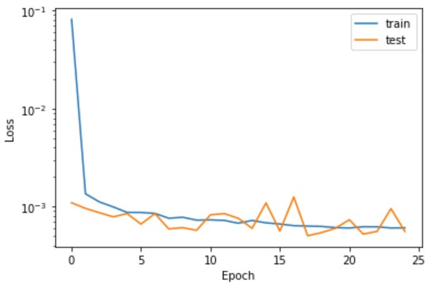

New model
Used 5 layers, with 16 nodes each
Learning rate 0.01, momentum 0.8
Significant drop in testing loss
$R^{2}$ increased to 0.99965
Training still quite quick, less than a minute

Slide 18

Model vs built in function
PyCBC function takes over a minute to compute data, model takes 3 seconds.
Model can be trained and evaluate data faster than can be generated in PyCBC

Slide 19
Conclusion
Summary
Performed regression on GW waveform data using an ANN
Used this model to efficiently reproduce waveform
Impact
Faster generation of GW waveforms in within domain
Could be applied to real time parameter estimation of GW signals, with numerous applications in Astronomy

Slide 20
Path forward
Apply same methods to find phase of GW, which combined with amplitude forms the complete signal
Increase number of input parameters to include spin of black holes, but just adding more nodes within input layer (more computationally intensive, but same in principle)
Combine model with other tools for fast parameter estimation of BH mergers – applications in multi-messenger astronomy

Slide 21
References
[Blackman et al., 2015] Blackman, J., Field, S. E., Galley, C. R., Szil ́agyi, B., Scheel, M. A., Tiglio,M., and Hemberger, D. A. (2015). Fast and accurate prediction of numerical relativity waveforms from binary black hole coalescences using surrogate models. Physical review letters, 115(12):121102.
[Tiglio and Villanueva, 2021] Tiglio, M. and Villanueva, A. (2021). On ab initio-based, free and closed-form expressions for gravitational waves. Scientific Reports, 11(1):1–11.
[Tiglio and Villanueva, 2022] Tiglio, M. and Villanueva, A. (2022). Reduced order and surrogate models for gravitational waves. Living Reviews in Relativity, 25(1):1–97
[Udrescu and Tegmark, 2020] Udrescu, S.-M. and Tegmark, M. (2020). Ai feynman: A physics-inspired method for symbolic regression. Science Advances, 6(16):eaay2631.
[Abbott et al., 2016] Abbott, B. P., Abbott, R., Abbott, T., Abernathy, M., Acernese, F., Ackley, K., Adams, C., Adams, T., Addesso, P., Adhikari, R., et al. (2016). Observation of gravitational waves from a binary black hole merger. Physical review letters, 116(6):061102
[Setyawati et al., 2020] Setyawati, Y., P ̈urrer, M., and Ohme, F. (2020). Regression methods in wave-form modeling: a comparative study. Classical and Quantum Gravity, 37(7):075012
[de Silva et al., 2020] de Silva, B. M., Champion, K., Quade, M., Loiseau, J.-C., Kutz, J. N., and Brunton, S. L. (2020). Pysindy: a python package for the sparse identification of nonlinear dynamics from data.
[Chua et al., 2019] Chua, A. J., Galley, C. R., and Vallisneri, M. (2019). Reduced-order modeling with artificial neurons for gravitational-wave inference. Physical review letters, 122(21):211101

