Slide 1
virtual-hom
7 October 2016
Notes:
v-hom lib GHCJS does two things: Haskell implementation of virtual-dom +”components” inspired by react
Why v-hom?
Use reactJS + scalaJS at work, they are good but have some problems that can be addressed in a pure haskell impl.
Popularity of react, maybe even re-use existing components
Principal idea: use lenses everywhere and as much as we can
So we are using the to construct the vdom elements but also … (NEXT SLIDE)

Slide 2
Composition with lenses
Given a View a = a -> HTML (Callback a)
And a Lens’ b a
Make a View b
Notes:
Use lens to turn a view of the part (b) into a view of the whole (a)
3 important types (to come)

Slide 3
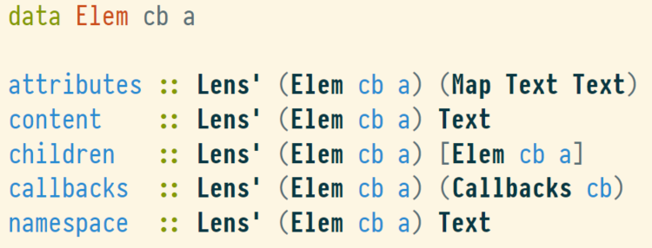
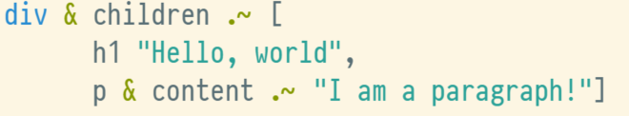
Types Elements

Slide 4
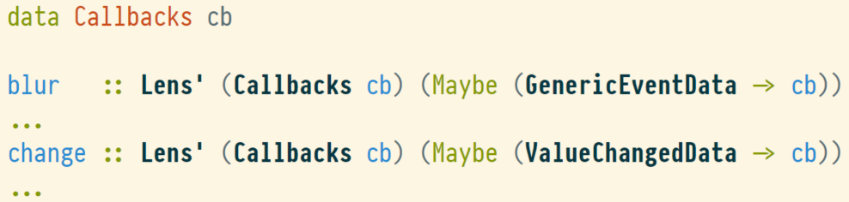
Types Callbacks

Slide 5
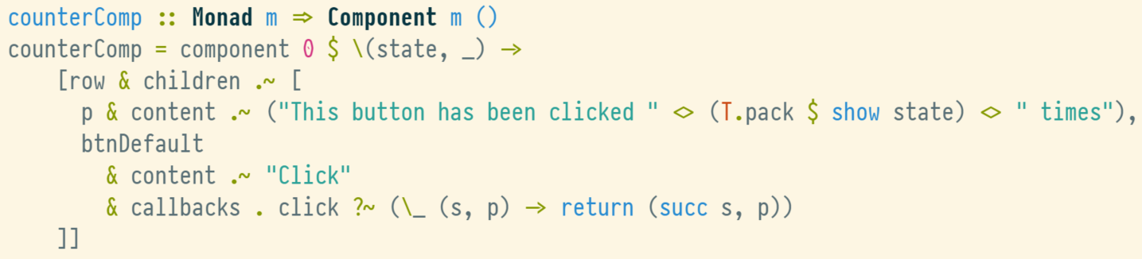
Types Components
Notes:
P for “Props” (but different from react because components can modify their props
* row, btnDefault are aliases

Slide 6
Types Combining Components
… and others

Slide 7
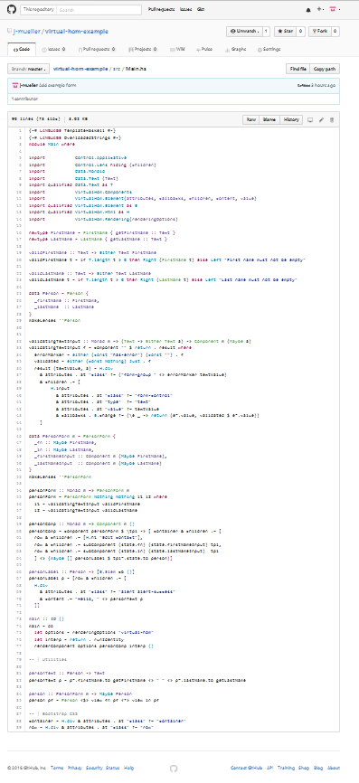
Example

Slide 8
Resources
Github: https://github.com/j-mueller/virtual-hom
Example app: https://github.com/j-mueller/virtual-hom-example
Related work
https://arianvp.me/lenses-and-prisms-for-modular-clientside-apps/
https://github.com/zrho/purescript-optic-ui
Notes:
Plans for future:
Better client server interaction
Traversals & nicer syntax
Performance benchmarks + improvements
Allow for some kind of limited commutativity

