Slide 1
Stream Processing
With Kafka, scalaz, fs2 – experience report
9 December 2016
Notes:
Experience report
Will look at some code for stream processing
Then try to generalise it a little

Slide 2
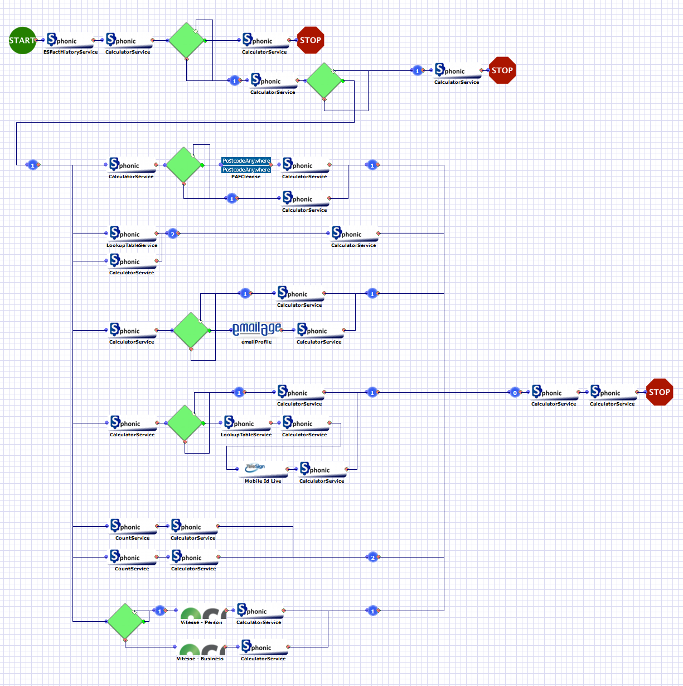
What we do
Fraud risk management
Address & age verification, anti-money laundering etc.
Connect to ~60 3rd party APIs
Custom workflows for each client
Graphical editor + expression DSL
Notes:
Fraud and risk management
Workflows tailored to clients needs/industry & country templates/etc

Slide 3
Scala @ Sphonic
Current workflow engine:
Akka / FSM
Hard to debug, does not scale etc.
Goal: Stream processing for everything
Need to be able to run the same workflows
Notes:
Kafka currently only used after a transaction has happened (aggregation etc)
Why kafka??
New interpreter

Slide 4
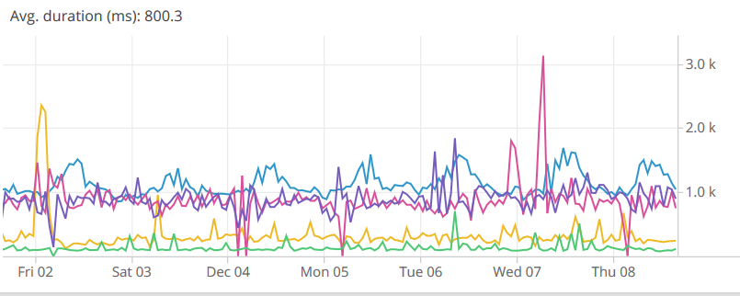
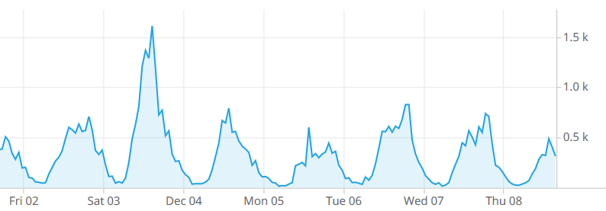
Performance & Scale
Relatively low tps (<10 on average), high variance
Batches
Seasonal/time-of-day
Latency highly dependent on API calls
Most time is spent waiting for other services
Notes:
Not exactly big data
Can compute perf. Characteristics of workflow based on AST and historical data

Slide 5
Implementation Overview
In this part we look at some code examples (time series, workflows, …)
Data types
Finger tree for storing time series
FSM for workflows
Other types…?
How are they represented in libraries (eg. fs2)
How to handle
Backpressure
Component failure

Slide 6

Implementation Bounded data structures
How to ensure that the state does not grow indefinitely?
Bounded list (prune after every $n$ events)
Bounded map (com.twitter.util.LruMap if you are already using twitter-util)

Slide 7




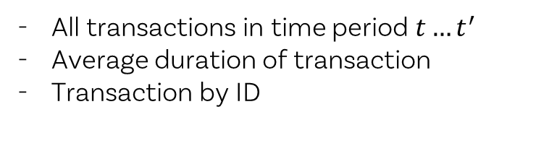




Implementation Time series
Stream:
Queries:
All transactions in time period $t…t^{′}$
Average duration of transaction
Transaction by ID
$$e_{1}$$
$$e_{2}$$
$$e_{3}$$
$$e_{4}$$
$$e_{5}$$
$$e_{6}$$
$$e_{7}$$
$$e_{8}$$
Incoming stream of events
Ordered by time
All events of same type (here: Transaction)
Notes:
*

Slide 8








Implementation Time series
Stream:
Solution:
Map each transaction to a
$$e_{1}$$
$$e_{2}$$
$$e_{3}$$
$$e_{4}$$
$$e_{5}$$
$$e_{6}$$
$$e_{7}$$
$$e_{8}$$
case class TransactionMeasure(
timestamp: Option[DateTime],
duration: Option[Long],
count: Long)
def measure(t: Transaction): TransactionMeasure = …
$$m_{1}$$
$$m_{2}$$
$$m_{3}$$
$$m_{4}$$
$$m_{5}$$
$$m_{6}$$
$$m_{7}$$
$$m_{8}$$

Slide 9
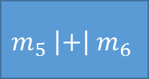

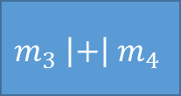


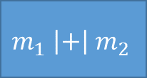
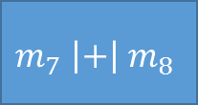
Implementation Time series
Stream:
Solution:
Map each transaction to a TransactionMeasure
Implement monoid
$$e_{1}$$
$$e_{2}$$
$$e_{3}$$
$$e_{4}$$
$$e_{5}$$
$$e_{6}$$
$$e_{7}$$
$$e_{8}$$
$$m_{1}$$
$$m_{2}$$
$$m_{3}$$
$$m_{4}$$
$$m_{5}$$
$$m_{6}$$
$$m_{7}$$
$$m_{8}$$
implicit val i = new Monoid[TransactionMeasure] {
def append(
l: TransactionMeasure,
r: => TransactionMeasure) = {
TransactionMeasure(
min(l.timestamp, r.timestamp),
l.duration + r.duration,
l.count + r.count)
}
val empty: TransactionMeasure = …
}
$$m_{1} \left|+\right|{ m}_{2}$$
$$m_{3} \left|+\right|{ m}_{4}$$
$$m_{5} \left|+\right|{ m}_{6}$$
$$m_{7} \left|+\right|{ m}_{8}$$
$$m_{1′} \left|+\right|{ m}_{2′}$$
$$m_{3′} \left|+\right|{ m}_{4′}$$
$$m_{1′′} \left|+\right|{ m}_{2′′}$$
Notes:
Monoid gives us an associative operation for combining two elements
We can use these step-wise aggregations to annotate the nodes of a tree
BUT trees are tedious (rebalancing etc.)
So

Slide 10
Implementation Time series
Stream:
Solution:
Map each transaction to a TransactionMeasure
Implement monoid and reducer
Create a scalaz.FingerTree
Maintain order of events!
Additional indices by ID etc.
$$e_{1}$$
$$e_{2}$$
$$e_{3}$$
$$e_{4}$$
$$e_{5}$$
$$e_{6}$$
$$e_{7}$$
$$e_{8}$$
$$m_{1}$$
$$m_{2}$$
$$m_{3}$$
$$m_{4}$$
$$m_{5}$$
$$m_{6}$$
$$m_{7}$$
$$m_{8}$$
$$m_{1} \left|+\right|{ m}_{2}$$
$$m_{3} \left|+\right|{ m}_{4}$$
$$m_{5} \left|+\right|{ m}_{6}$$
$$m_{7} \left|+\right|{ m}_{8}$$
implicit val txnReducer =
UnitReducer[Transaction, TransactionMeasure](…)
$$m_{1′} \left|+\right|{ m}_{2′}$$
$$m_{3′} \left|+\right|{ m}_{4′}$$
$$m_{1′′} \left|+\right|{ m}_{2′′}$$
Notes:
Use scalaz.fingerTree
Implement reducer as well (can just use UnitReducer)
* This diagram shows a binary tree (actual implementation uses a tree with up to four children)

Slide 11
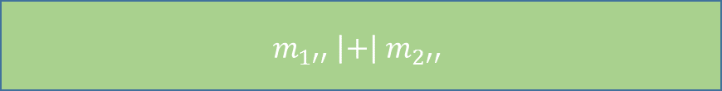
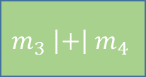

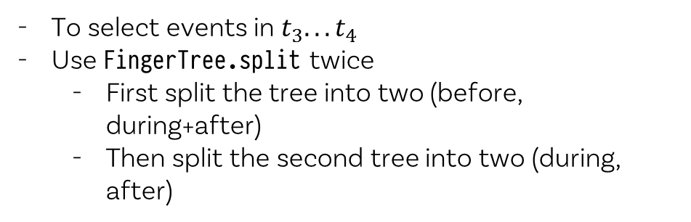
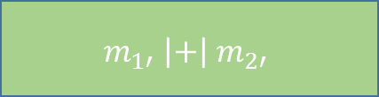



Implementation Time series
Stream:
Solution:
before
during
after
To select events in $t_{3}.. . t_{4}$
Use FingerTree.split twice
First split the tree into two (before, during+after)
Then split the second tree into two (during, after)
$$e_{1}$$
$$e_{2}$$
$$e_{3}$$
$$e_{4}$$
$$e_{5}$$
$$e_{6}$$
$$e_{7}$$
$$e_{8}$$
$$m_{1}$$
$$m_{2}$$
$$m_{3}$$
$$m_{4}$$
$$m_{5}$$
$$m_{6}$$
$$m_{7}$$
$$m_{8}$$
$$m_{1} \left|+\right|{ m}_{2}$$
$$m_{3} \left|+\right|{ m}_{4}$$
$$m_{5} \left|+\right|{ m}_{6}$$
$$m_{7} \left|+\right|{ m}_{8}$$
$$m_{1′} \left|+\right|{ m}_{2′}$$
$$m_{3′} \left|+\right|{ m}_{4′}$$
$$m_{1′′} \left|+\right|{ m}_{2′′}$$
Notes:
*

Slide 12
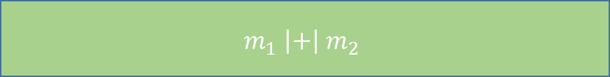
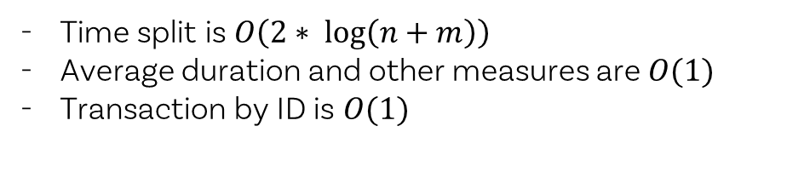
Implementation Time series
Stream:
Solution:
Time split is $O\left(2∗ \log\left(n+m\right)\right)$
Average duration and other measures are $O(1)$
Transaction by ID is $O(1)$
$$e_{1}$$
$$e_{2}$$
$$e_{3}$$
$$e_{4}$$
$$e_{5}$$
$$e_{6}$$
$$e_{7}$$
$$e_{8}$$
$$m_{1}$$
$$m_{2}$$
$$m_{3}$$
$$m_{4}$$
$$m_{5}$$
$$m_{6}$$
$$m_{7}$$
$$m_{8}$$
$$m_{1} \left|+\right|{ m}_{2}$$
$$m_{3} \left|+\right|{ m}_{4}$$
$$m_{5} \left|+\right|{ m}_{6}$$
$$m_{7} \left|+\right|{ m}_{8}$$
$$m_{1′} \left|+\right|{ m}_{2′}$$
$$m_{3′} \left|+\right|{ m}_{4′}$$
$$m_{1} \left|+\right|{ m}_{2}$$
Notes:
*

Slide 13
Implementation Time series
Stream:
$$e_{1}$$
$$e_{2}$$
$$e_{3}$$
$$e_{4}$$
$$e_{5}$$
$$e_{6}$$
$$e_{7}$$
$$e_{8}$$
Notes:
*

Slide 14
Implementation Workflow (state machine)
Call #1
End
Init
Call #2
Notes:
*

Slide 15


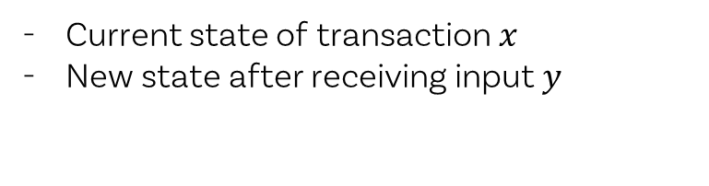



Implementation Workflow (state machine)
Stream:
Queries:
Current state of transaction $x$
New state after receiving input $y$
$$e_{1}$$
$$e_{2}$$
$$e_{3}$$
$$e_{4}$$
$$e_{5}$$
$$e_{6}$$
$$e_{7}$$
$$e_{8}$$
Incoming stream of events
Ordered by time
Indexed by transaction
Union of event types (here: InitTransaction, ServiceResponse, …)
Notes:
*

Slide 16




Implementation Workflow (state machine)
Concurrent Transactions:
Call #1
Call #1
$$e_{3}$$
$$e_{6}$$
Init
$$e_{5}$$
End
Init
End
$$e_{8}$$
Call #2
Call #2

Slide 17
Implementation Workflow (state machine)
trait FSM[-E, +S] {
def apply(input: E): FSM[E, S]
def getState: S
}

Slide 18
Abstraction
In this part we generalise the examples from the previous part
How to reason about streams
Reactive/FRP model? Expressive but cannot prove very much
Just use monoid/semigroup instead
Monoid homomorphism
Action on monoid
Idempotent operations to deal with “at least once” delivery

Slide 19
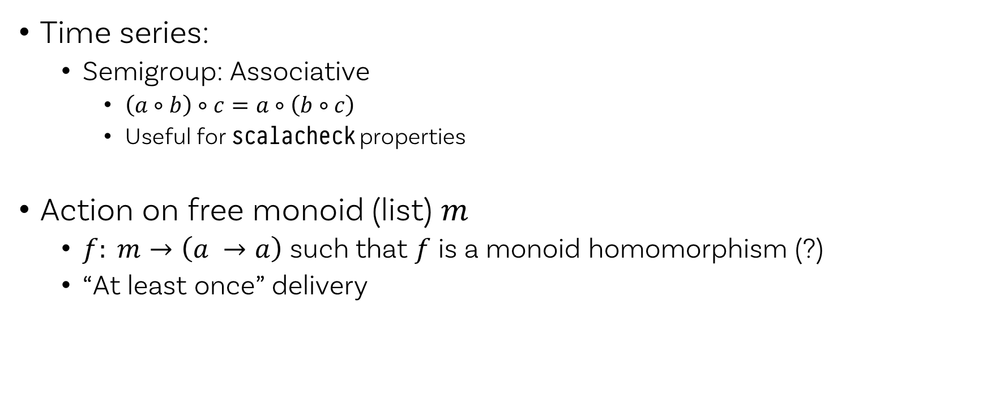
Abstraction
Time series:
Semigroup: Associative
$\left(a∘b\right)∘c=a∘\left(b∘c\right)$
Useful for scalacheck properties
Action on free monoid (list) $m$
$f: m→\left(a →a\right)$ such that $f$ is a monoid homomorphism (?)
“At least once” delivery

Slide 20
Abstraction
Semigroup/
Monoid
FSM
Parser

Slide 21
Notes etc.
https://izbicki.me/blog/the-categorical-distributions-algebraic-structure
https://izbicki.me/blog/functors-and-monads-for-analyzing-data
https://izbicki.me/blog/markov-networks-monoids-and-futurama

