Slide 1
Bike Sharing
By: Tyler Tarabocchia, Ryan Guidotti, Joe Nasr

Slide 2
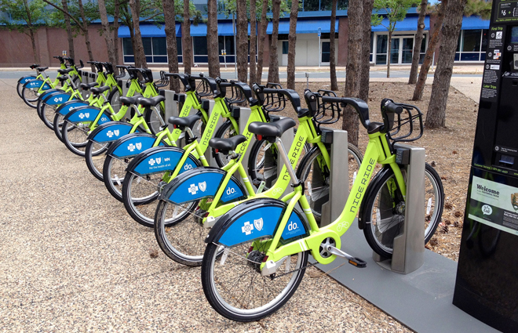
Our dataset
The dataset we chose is called Bike Sharing. This dataset contains the hourly and daily count of rental bikes between years 2011 and 2012 in Capital bikeshare system with the corresponding weather and seasonal information. This dataset was found on UCI Machine Learning Repository. There are 11 variables with 731 observations. This is a Regression dataset.

Slide 3
Variable Name | Description | Role
Season | 1= Winter, 2= Spring, 3= Summer, 4= Fall | Predictor
Year | 0 = 2011, 1=2012 | Predictor
Month | Month 1-12, 1=January, 2=February… | Predictor
Weekday | Day of the week, 0 = Sun, 1 = Mon… | Predictor
Working Day | If neither a weekend or holiday, = 1, Otherwise 0. | Predictor
Weather Situation | 1 = Clear, 2 = Cloudy, 3 = Rain | Predictor
Temperature | Temperature in Celsius | Predictor
Feel like temperature | Normalized feeling in celsius | Predictor
Humidity | Normalized humidity in celsius | Predictor
Windspeed | Normalized wind speed. Values divided by 67 | Predictor
Count | Total rides (casual and registered users) | Response Variable

Slide 4
Explaining our code and what we left out and why
In Excel, we removed variables such as the date, hour, holiday, casual and registered bike renters. This is because the date had characters such as “/” which would not affect our data.
In R/Python
Imported dataset
Removed missing values
Rescaled response if needed
Verified data type

Slide 5
Variable Name | Estimated Coefficient | P-Value
Season | 0.48943 | 1.90e-12 ***
Year | 2.06712 | <2e-16 ***
Month | -0.03342 | 0.11620
Weekday | 0.05503 | 0.00603 **
Working Day | 0.14324 | 0.09130
Weather Situation | -0.54344 | 7.26e-08 ***
Temperature | 2.35733 | 0.11881
Feel like temperature | 3.18965 | 0.06234
Humidity | -1.12575 | 0.00475 **
Windspeed | -2.49310 | 5.89e-06 ***
Count | 1.47052 | 5.24e-07 ***

Slide 6
Model | Variables Included
Model 1 | Season, Year, Month, Weekday, Workday, Weather Situation, Temperature, Feel Like Temperature, Humidity, Windspeed
Model 2 | Season, Year, Weekday, Weather Situation, Humidity, Windspeed
Model 3 | Season, Year, Month, Weekday, Working Day, Weather Situation, Temperature, Feel Like Temperature, Humidity, Wind Speed * humidity + Temperature * Weather Situation
Model 4 | Season, Year, Month, Weekday, Working Day, Weather Situation, Temperature, Feel Like Temperature, Humidity, Feel Like Temperature ^2, Humidity ^2.
Model 5 | Weather Situation

Slide 7
Models | Validation Set MSE (100 Inter.) | Validation Set MSE (200 Inter.)
Model 1 | 0.7562 | 0.8924
Model 2 | 2.9003 | 2.8673
Model 3 | 0.7663 | 0.8811
Model 4 | 0.6154 | 0.7349
Model 5 | 3.2531 | 3.2526

Slide 8
Models | LOOCV MSE | 5-Fold CV MSE | 10-Fold CV MSE
Model 1 | 0.7981 | 0.8158 | 0.7999
Model 2 | 3.0306 | 3.0091 | 3.0318
Model 3 | 0.7980 | 0.7983 | 0.8125
Model 4 | 0.6345 | 0.6441 | 0.6399
Model 5 | 3.4343 | 3.4500 | 3.4343

Slide 9
Key Insights From Our Analysis
Bike usage is highly influenced by seasonal patterns and weather conditions.
Year-over-year growth shows an increase in ridership from 2011 to 2012.
- Weekday trends suggest commuting patterns, with consistent use on weekdays and spikes on weekends.

Slide 10
Model MSE Explanations + Best Model
When the MSE is a lower value, it if a better fit for the data.
Given our data, Models 1, 3, and 4 are better model predictors than models 2 and 5.
Out of the the three best models, Model 4 is the most significant.

Slide 11

Conclusion
Season, Year, Weekday, Windspeed, Weather Situation, and Humidity were the strongest predictors (p < 0.05)
Model 4 had the lowest MSE across all validation methods indicating the best generalization performance across all 5 models.
The MSE values from validation, LOOCV, and k-fold CV indicate that model 4 provides reasonably accurate predictions of daily bike sharing usage.

