Slide 1
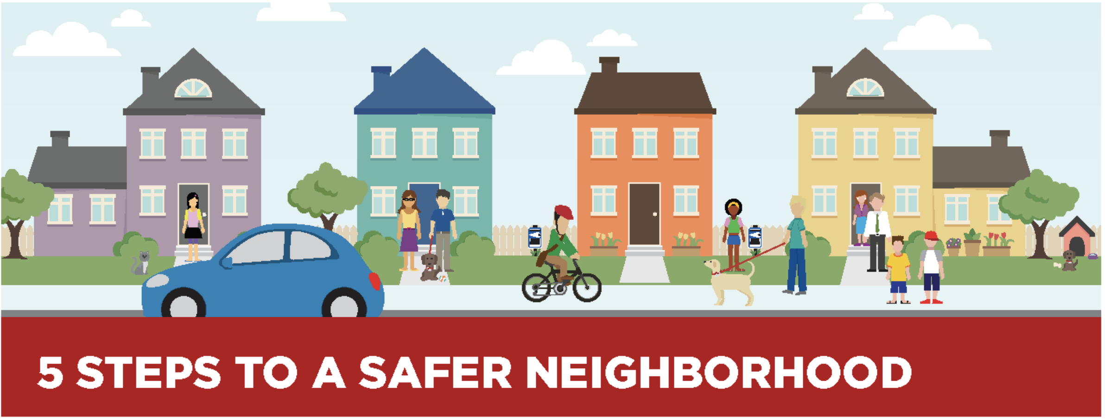
Step 1
Step 3
Get to Know Your Neighbors
Report Suspicious Activity
Exchange phone numbers (home, work, mobile).
Learn each other’s routines (work schedules, vacation plans, guests’ visits, scheduled workers).
Regularly check on elderly neighbors.
Volunteer to pick up your neighbor’s newspapers when they are gone.
Organize or join a Neighborhood Watch Group for your community.
Call 410-887-0872 whenever something looks unusual (strange cars with people in them in front of houses; strangers checking out houses or cars.
Have a pen and paper handy to write down details that could help police
Step 4
Get out and About
Walk around your neighborhood or sit on your front porch as much as possible
Encourage you neighbors to get out with you
Step 2
Don’t be a Target
Have plenty of lighting around your home; use motion sensors if possible.
Don’t leave windows or doors open, even on a hot day if you’re not home.
Leave lights on inside your home or use timers when you’re gone.
Lock your car and keep valuables out of sight.
Secure gates and fences that are easily accessible.
Have keys ready when coming home; don’t fumble around at your door
Check your surroundings when approaching your door at night.
Be wary of solicitors at your door, even in the daytime.
Solitary Females and the elderly are more likely to be targets after dark. If you don’t have to be out, stay home with the doors locked.
Step 5
Keep our Neighborhoods Neat and Clean
Pick up trash, even if it’s not yours or in front of your house.
Keep yards maintained and looking good.
Trim hedges that can be used as hiding places
If you are interested in participation in Citizens on Patrol (COP)
contact BCPD: 410-887-5165
If you see suspicious person or activity, call the police at 410-887-0872. Also let your neighbors know at NextDoor.com

