Slide 1




(21CC505PC) SOFTWARE ENGINEERING
UPPAL CAMPUS
NARAYANGUDA
IBRAHIMPATNAM
LAB EXERCISE - 1
SRS DOCUMENT
TOPIC -2
IEEE – SRS (SOFTWARE REQUIREMENTS SPECIFICATION)
BY
B MADHURIKA
Assistant Professor
CSE

Slide 2

SOFTWARE ENGINEERING LAB
(21CC505PC)
BY
MADHURIKA BUDARAJU
ASSISTANT PROFESSOR
CSE
KMIT

Slide 3
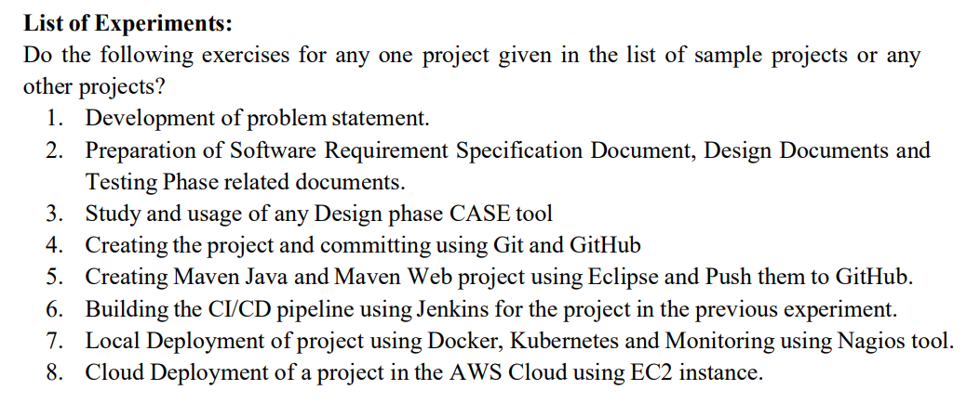
SYLLABUS

Slide 4
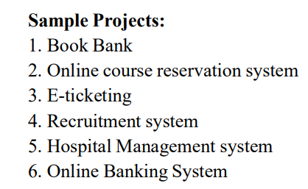
SYLLABUS

Slide 5
What is an SRS Document?
SRS stands for Software Requirements Specification.
It is a detailed document that describes what a software product is supposed to do.
Think of it as a blueprint for software development, much like an architect's plan for a building.

Slide 6
Why is an SRS Document Needed?
Clarity and Understanding
Guides Development
Communication Tool
Manages Changes
Helps in Testing

Slide 7
IEEE - SRS
IEEE SRS stands for Software Requirements Specification as defined by the Institute of Electrical and Electronics Engineers (IEEE).
It is a standardized format for writing an SRS document, ensuring that all important aspects are covered.
IEEE-SRS-Template

Slide 8
IEEE - SRS
Example document:
Sample_SRS-Document

