Slide 1




(21CC505PC) SOFTWARE ENGINEERING LAB
UPPAL CAMPUS
NARAYANGUDA
IBRAHIMPATNAM
LAB EXERCISE - 3
CASE TOOL
TOPIC -1
CONCEPTUAL MODEL OF UML
BY
B MADHURIKA
Assistant Professor
CSE

Slide 2

SOFTWARE ENGINEERING LAB
(21CC505PC)
BY
MADHURIKA BUDARAJU
ASSISTANT PROFESSOR
CSE
KMIT

Slide 3
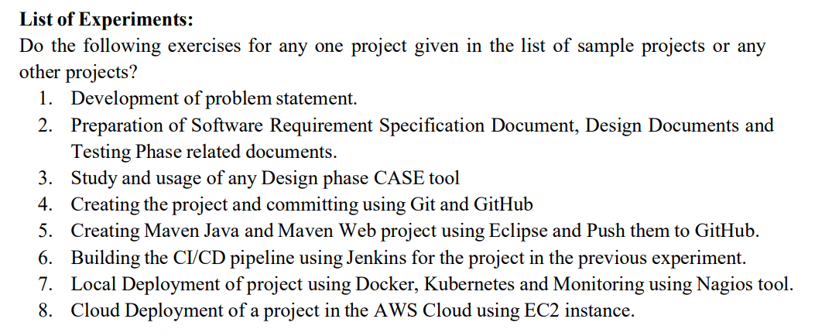
SYLLABUS

Slide 4
What is UML?
UML, or Unified Modeling Language, is like a set of blueprints for designing software.
It helps people understand how a software system works by using simple pictures (called diagrams) to show different parts of the system and how they connect.
Imagine you want to build a house – you’d use a blueprint to plan where the rooms, doors, and windows go.
UML does the same thing for software, helping developers and others visualize and plan how the software is built and how it will work before they start coding.

Slide 5
Case Tools
Commonly used CASE (Computer-Aided Software Engineering) tools for designing software projects:
Rational Rose
Enterprise Architect
Microsoft Visio
Lucidchart
ArgoUML
Visual Paradigm
SmartDraw
StarUML
Balsamiq
Creately
Umbrella

Slide 6
Conceptual Model of UML
The conceptual model of UML is about how we think of a system using diagrams. It has three main parts:
Things/Objects: These are the things in a system, like people, data, or actions.
Relationships: These show how objects connect and interact with each other.
Diagrams: These are the pictures we use to represent the objects and their relationships. Each type of diagram shows a different view, like how parts work together or how things change over time.

Slide 7
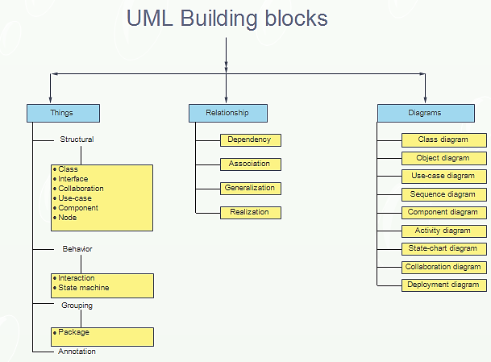
Conceptual Model of UML

Slide 8
Things in UML
These are the main elements that exist in a system, such as objects, components, or behaviors.
"Things" are categorized into:
Structural Things
Behavioral Things
Grouping Things
Annotational Things

Slide 9




Structural Things (Static parts of the system)
These represent the static aspects of a system. They describe what things are made of.
Class: Defines objects with common features.
Example: A “Car” class has features like color, make, model.
Interface: Lists methods for classes to use.
Example: A “Drivable” interface ensures the Car class has a “drive” method.
Component: A piece of the system.
Example: A “Payment” component handles all payment processing.
Node: Picture a computer that runs an app. This computer (or server) is a "Node" where the software is working.
Example, a "Database Server" node stores all the app's information.

Slide 10
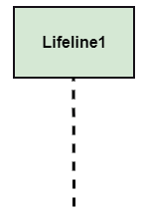

Behavioral Things (How the system acts)
These represent the dynamic aspects of a system. They show how the system behaves and changes over time.
Interaction: Shows messages exchanged between parts.
Example: A customer asks for products; the system responds.
State Machine: Represents different stages an object can be in.
Example: A door can be “Open” or “Closed”.

Slide 11

Grouping Things
These help organize and group various elements in a system.
Package: Groups related elements (like classes or interfaces) into a logical collection.
Example: A "User Management" package can contain classes for users, roles, and permissions.

Slide 12

Annotational Things
These provide additional information or notes. Extra notes or comments on the design.
Annotation: Comments or constraints that provide further explanation. Example: A comment on a class diagram explaining why a certain method is important.

Slide 13
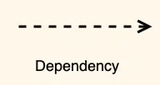
Relationships in UML
These define how different "things" are connected or interact with each other.
Dependency: One element depends on another.
Symbol:
Example: A "Car" class depends on an "Engine" class to function.

Slide 14
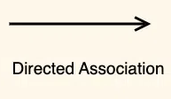

Relationships in UML
Association: A general connection between two things (often called objects or classes)..
Example: A teacher teaches a student, and a student learns from a teacher.
Symbol:
An "Order" depends on a "Product" to exist because an order is placed for products.
A "Doctor" can treat many "Patients," and a "Patient" can see many different "Doctors." Both have a connection (doctor-patient relationship), but they can exist separately.

Slide 15


Relationships in UML
Generalization: This represents inheritance. One element is a more general version of another.
Example: A "Car" class is a generalized version of a "Sedan" or "SUV" class. The Sedan and SUV inherit attributes from the Car.
Symbol:
Realization: A class implements the behavior defined by an interface.
Example: Imagine there is a "Flyable" interface that says every class using it must have a method called "fly." The "Bird" class would realize the "Flyable" interface by implementing the "fly" method.

Slide 16
Diagrams in UML
Types of Diagrams in UML:
Class Diagram
Object Diagram
Use-case Diagram
Sequence Diagram
Component Diagram
Activity Diagram
State-chart Diagram
Collaboration Diagram
Deployment Diagram

Slide 17
Diagrams in UML
Class Diagram: Shows types of things in the system, and how they relate.
Example: An "ATM" class connected to a "Card" class that handles money requests.
2. Object Diagram: A snapshot of real items, like a specific "Debit Card," at one moment.
Example: A "Debit Card" showing details for one user.
3. Use-case Diagram: Shows how people use the system, like withdrawing cash or checking balance.
Example: A user withdrawing cash or checking their balance.

Slide 18
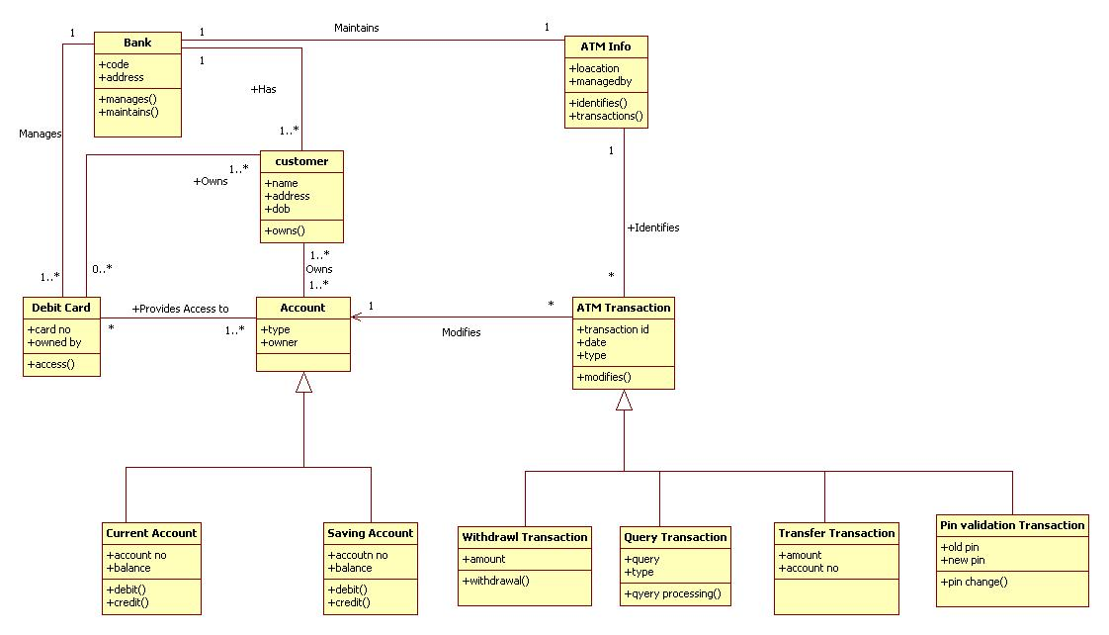
Class Diagram in UML

Slide 19
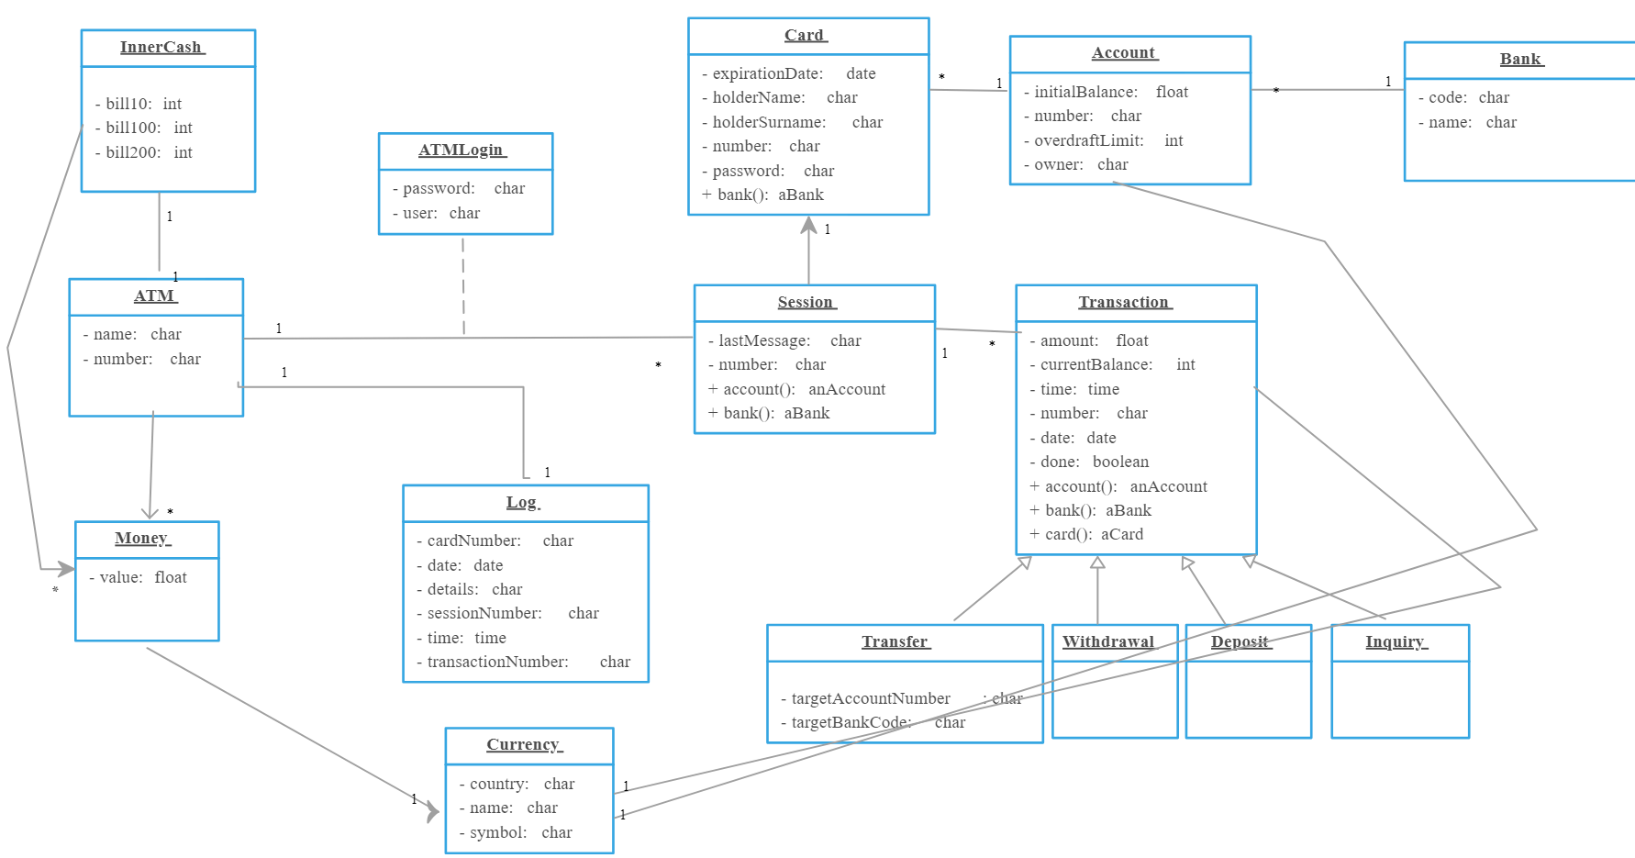
Object Diagram in UML

Slide 20
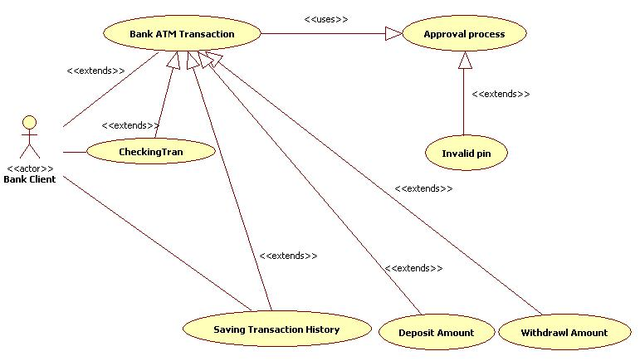
Usecase Diagram in UML

Slide 21
Diagrams in UML
4. Sequence Diagram: Shows how different things talk to each other step by step
Example: A user requests cash, the machine talks to the bank, and cash is given.
5. Component Diagram: Displays how parts of a system work together.
Example: The machine, its software, and the bank's database working together to process a transaction.
6. Activity Diagram: Shows the steps a user takes.
Example: Steps to withdraw cash, such as inserting the card, entering the PIN, and getting

Slide 22
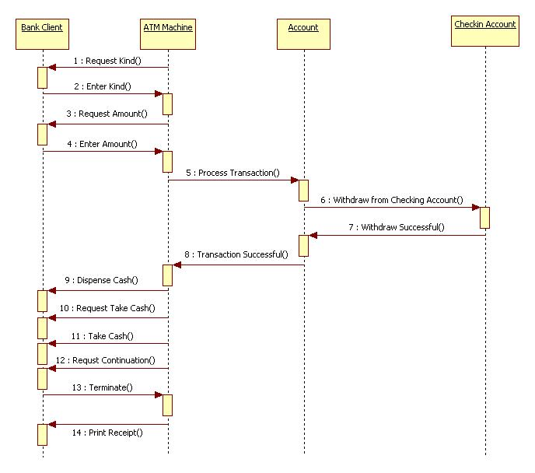
Sequence Diagram in UML

Slide 23
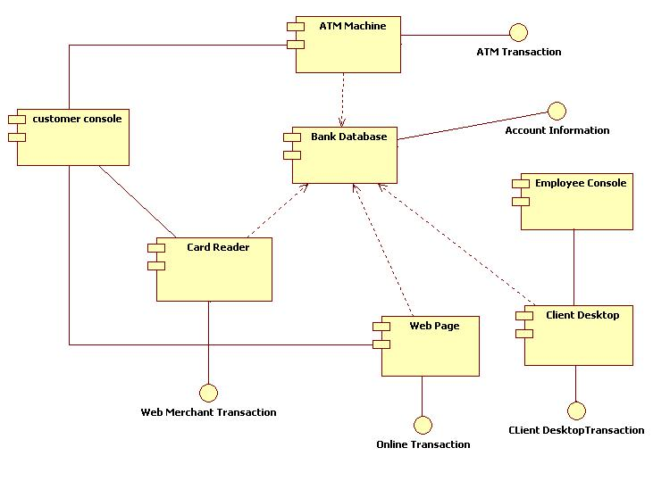
Component Diagram in UML

Slide 24
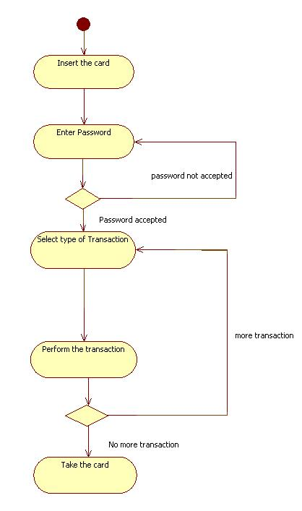
Activity Diagram in UML

Slide 25
Diagrams in UML
7. State-chart Diagram: Shows the different states an object can be in.
Example: The ATM machine can be "Idle" when not in use or "Dispensing Cash" when giving money.
8. Collaboration Diagram: Focuses on how different parts work together during a transaction.
Example: How the user, machine, and bank work together during a withdrawal.
9. Deployment Diagram: Shows where the physical parts are located and connected.
Example: An ATM machine at a local bank connects to a central bank server in another city to process transactions. The diagram shows the ATM and the server as two physical locations that are linked to work together.

Slide 26
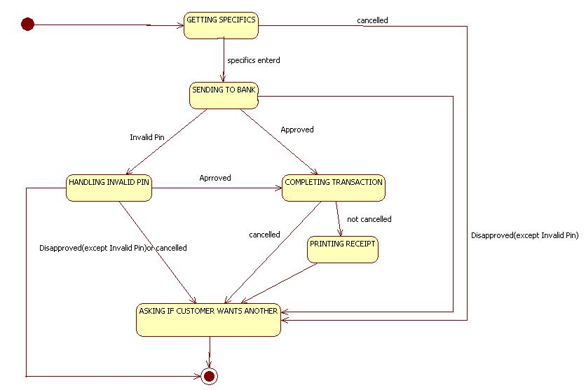
Statechart Diagram in UML

Slide 27
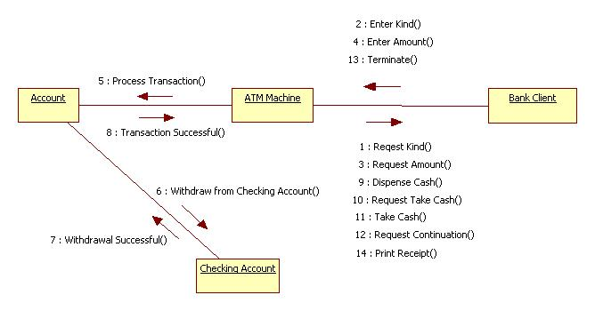
Collaboration Diagram in UML

Slide 28
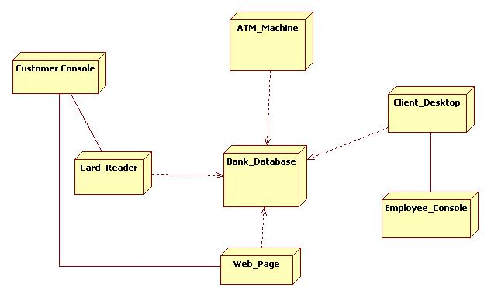
Deployment Diagram in UML

