Slide 1




(21CC505PC) SOFTWARE ENGINEERING LAB
UPPAL CAMPUS
NARAYANGUDA
IBRAHIMPATNAM
LAB EXERCISE - 3
CASE TOOL
TOPIC -2
UML DIAGRAMS - USECASE
BY
B MADHURIKA
Assistant Professor
CSE

Slide 2

SOFTWARE ENGINEERING LAB
(21CC505PC)
BY
MADHURIKA BUDARAJU
ASSISTANT PROFESSOR
CSE
KMIT

Slide 3
Usecase Diagram
A Use Case Diagram is a visual representation of how a system interacts with its external users (actors).
It illustrates the system's functional requirements and how the system behaves from a user perspective.

Slide 4
Purpose of a Use Case Diagram
Identifies actors who interact with the system.
Describes interactions (use cases) between the system and its actors.
Shows system boundaries (what is inside or outside of the system).
Useful for understanding the functionality of a system at a high level.

Slide 5

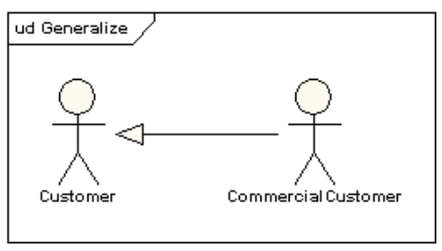
Key Symbols in a Use Case Diagram
Actor: Represents anyone or anything that interacts with the system (usually a human user or external system).
Symbol: Stick figure.
Actors can generalize other actors

Slide 6
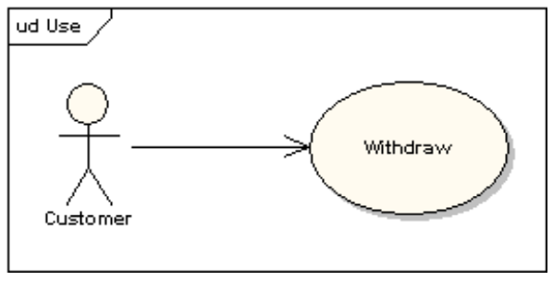
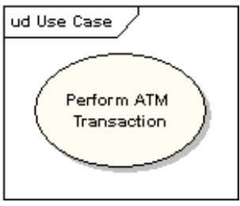
Key Symbols in a Use Case Diagram
Use Case: Describes a specific action or function that the actor performs with the system (like withdrawing money or checking balance).
Symbol: An oval with the name of the use case inside.

Slide 7
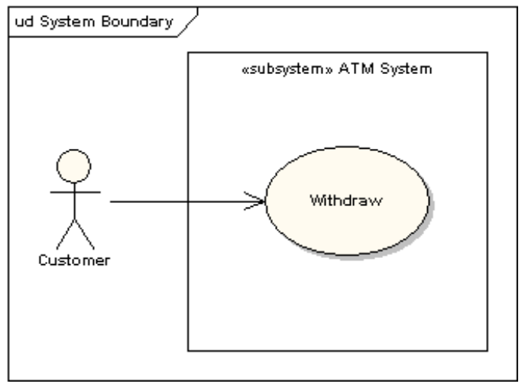
Key Symbols in a Use Case Diagram
System Boundary: Defines the boundary of the system and separates what is inside the system (functions) from the outside (actors).
Symbol: A rectangle enclosing the use cases.

Slide 8
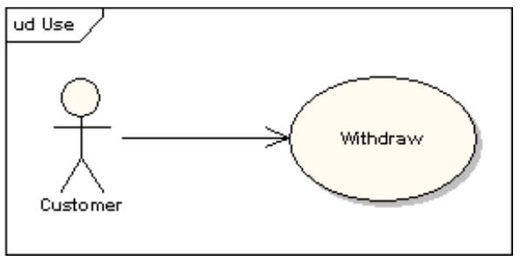
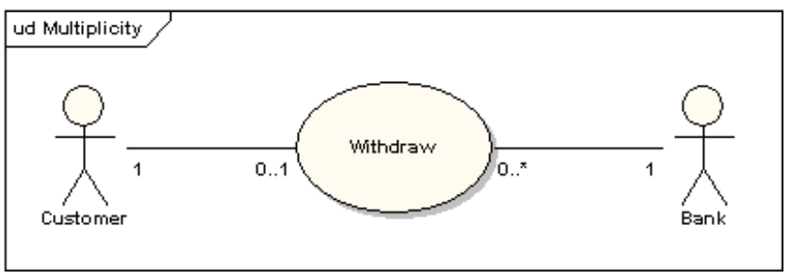
Key Symbols in a Use Case Diagram
Associations (Lines): Represents a relationship between an actor and a use case. It shows that the actor interacts with the use case.
Symbol: A simple line.

Slide 9
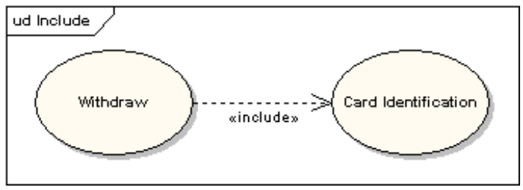
Key Symbols in a Use Case Diagram
Include: Denotes that one use case must always use another use case to complete its task.
Symbol: A dashed arrow labeled <<include>>.
Example: Card identification is always required before withdrawing cash.

Slide 10
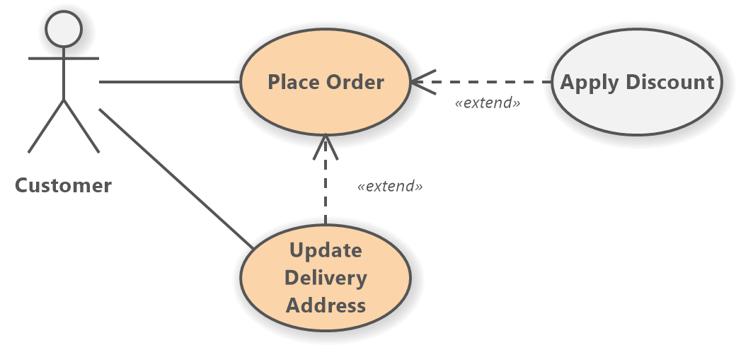
Key Symbols in a Use Case Diagram
Extend: Indicates that one use case can add extra features to another use case, but only if needed or under certain conditions.
Symbol: A dashed arrow labeled <<extend>>.

Slide 11
Steps to Draw a Use Case Diagram for an ATM System
Identify Actors:
Customer: A person who uses the ATM machine to perform tasks like withdrawing money, checking balance, etc.
Bank: Represents the banking system that processes the customer’s requests.

Slide 12
Steps to Draw a Use Case Diagram for an ATM System
Identify Use Cases:
Withdraw Cash
Check Balance
Deposit Cash
Transfer Funds
Change PIN

Slide 13
Steps to Draw a Use Case Diagram for an ATM System
Draw the Diagram:
Start by drawing the system boundary (a rectangle) labeled "ATM System.“
Inside the rectangle, draw ovals representing each use case (Withdraw Cash, Check Balance, etc.).
Place the actors (Customer, Bank) outside the system boundary.
Connect the actors to the relevant use cases using straight lines (associations).

Slide 14
Steps to Draw a Use Case Diagram for an ATM System
Use of Include and Extend:
Include: The "Withdraw Cash" use case might always include "Authenticate User" (since the user must always authenticate before withdrawing money). This means an <<include>> relationship between these use cases.
Extend: The "Check Balance" use case might extend "Withdraw Cash" because, optionally, the user might want to check the balance after withdrawing. This creates an <<extend>> relationship between these use cases.

Slide 15
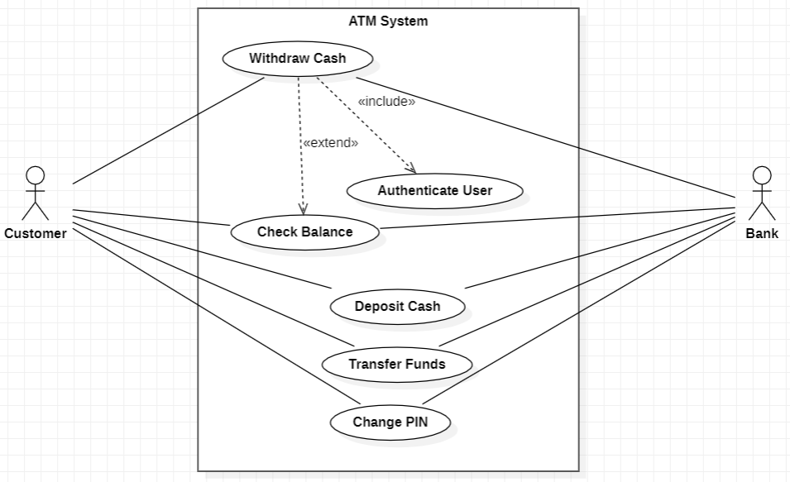
Use Case Diagram for an ATM System

