Slide 1




(21CC505PC) SOFTWARE ENGINEERING LAB
UPPAL CAMPUS
NARAYANGUDA
IBRAHIMPATNAM
LAB EXERCISE - 3
CASE TOOL
TOPIC -3
UML DIAGRAMS - CLASS
BY
B MADHURIKA
Assistant Professor
CSE

Slide 2

SOFTWARE ENGINEERING LAB
(21CC505PC)
BY
MADHURIKA BUDARAJU
ASSISTANT PROFESSOR
CSE
KMIT

Slide 3
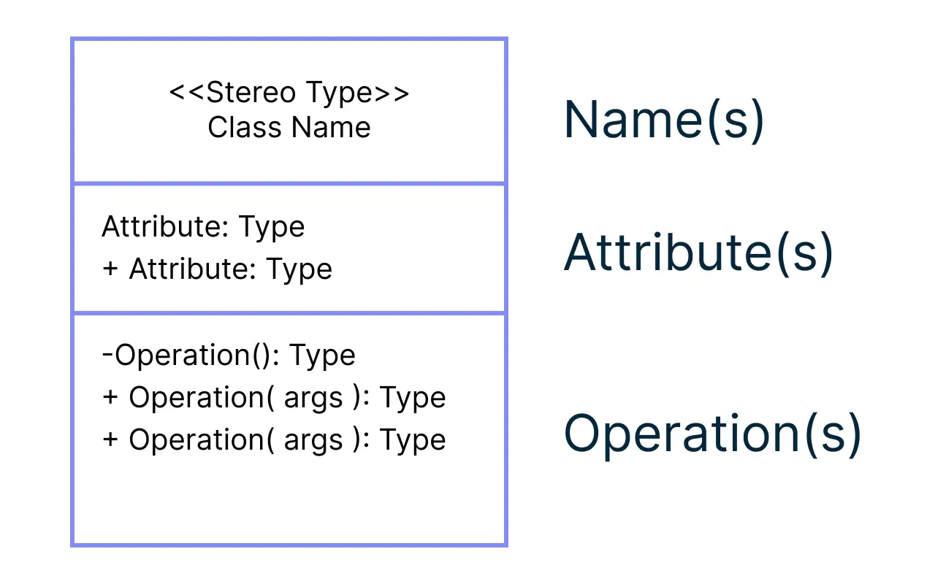
Class Diagram
A class diagram represents the structure of a system by showing its classes, their attributes, operations, and the relationships among objects.

Slide 4
Purpose of a Use Case Diagram
A class diagram shows how parts of a system are connected.
It helps to understand how different things (called classes) work together.
Each class has
Attributes (details like color or size) and
Methods (actions it can do, like drive or stop).
The lines between classes show how they relate to each other.

Slide 5
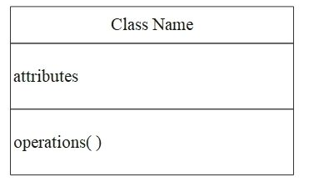
Class Diagram
What is a Class?
A class is like a blueprint for an object (example: Car, Person, Dog).
It has two main parts:
Attributes: Details or characteristics (example: color, name, age).
Methods: Things the class can do (example: drive, walk, bark).

Slide 6
Class Diagram
Attributes:
Attributes are the details about a class.
Example:
For a Car: color, model, speed.
For a Student: name, age, grade.

Slide 7
Class Diagram
Methods:
Methods are actions the class can do.
Example:
For a Car: drive(), stop().
For a Student: study(), enroll().

Slide 8


Relationships
Classes can be connected to each other:
Association:
Shows how classes work together (example: Teacher and Student).
Inheritance/Generalization:
One class can inherit details from another (example: Dog inherits from Animal).

Slide 9
Relationships
Inheritance:
Inheritance allows a class to use the properties of another class.
Example:
Animal class (with legs and eyes).
Dog class (inherits from Animal but adds barking).

Slide 10
Relationships
Relationships that can be used are:
Association
Aggregation
Composition
Inheritance (Generalization)
Dependency
Realization

Slide 11
Steps to Draw a Use Case Diagram for an ATM System
Identify the Main Classes:
Think about the main parts of the ATM system. These will be your classes.
Example classes:
ATM (the machine itself)
Customer (the person using the ATM)
Bank Account (the account connected to the ATM)
Withdrawal (action performed by the customer)

Slide 12
Steps to Draw a Use Case Diagram for an ATM System
Define Attributes for Each Class:
List the details or properties each class should have.
Example:
ATM: location, ATM_ID
Customer: name, customerID
BankAccount: accountNumber, balance

Slide 13
Steps to Draw a Use Case Diagram for an ATM System
Define Methods for Each Class:
Identify what each class can do.
Example:
ATM: authenticateUser(), dispenseCash()
Customer: insertCard(), enterPIN()
BankAccount: checkBalance(), withdrawMoney()

Slide 14
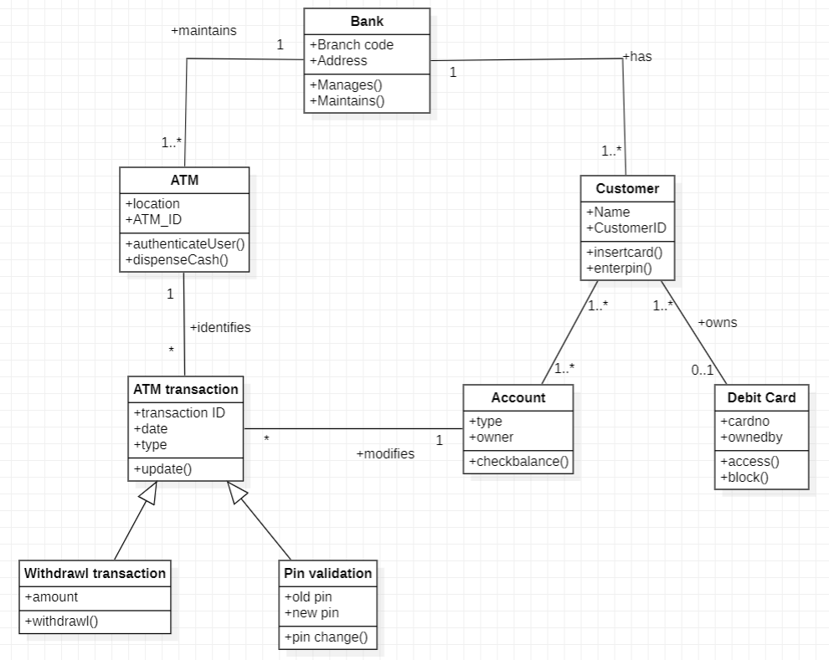
Class Diagram for an ATM System

