Slide 1




(21CC505PC) SOFTWARE ENGINEERING LAB
UPPAL CAMPUS
NARAYANGUDA
IBRAHIMPATNAM
LAB EXERCISE - 3
CASE TOOL
TOPIC -4
UML DIAGRAMS - SEQUENCE
BY
B MADHURIKA
Assistant Professor
CSE

Slide 2

SOFTWARE ENGINEERING LAB
(21CC505PC)
BY
MADHURIKA BUDARAJU
ASSISTANT PROFESSOR
CSE
KMIT

Slide 3
Sequence Diagram
A sequence diagram shows how objects communicate with each other.
It describes the order of messages between objects.
Useful for understanding the flow of interactions in a system.

Slide 4

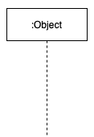
Components of Sequence Diagram
Actors: People or external systems interacting with your system.
Objects: Parts of the system that perform actions.

Slide 5
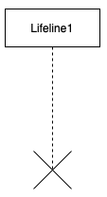

Components of Sequence Diagram
Lifelines: A dotted line under each object showing its existence over time, with an activation box (show when an object is actively performing a task).
Messages: Arrows between objects showing how they communicate.

Slide 6
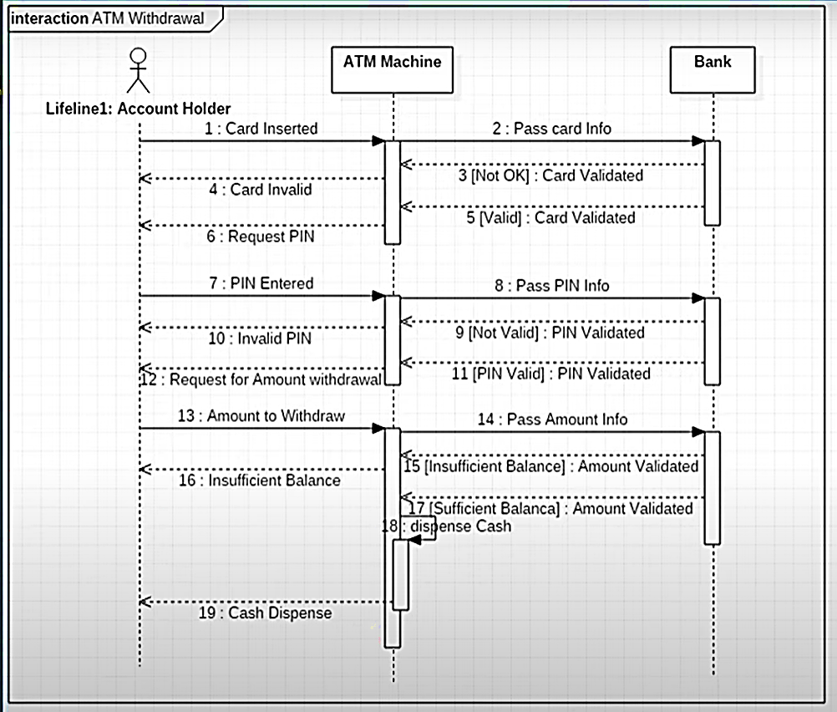
Sequence Diagram for an ATM System

