Slide 1




(21CC505PC) SOFTWARE ENGINEERING LAB
UPPAL CAMPUS
NARAYANGUDA
IBRAHIMPATNAM
LAB EXERCISE - 3
CASE TOOL
TOPIC -5
UML DIAGRAMS - COMPONENT
BY
B MADHURIKA
Assistant Professor
CSE

Slide 2

SOFTWARE ENGINEERING LAB
(21CC505PC)
BY
MADHURIKA BUDARAJU
ASSISTANT PROFESSOR
CSE
KMIT

Slide 3
Component Diagram
A Component Diagram shows how a system is organized into separate, smaller parts called components.
It highlights the structure of the system and the connections between these parts.
It’s useful for understanding how different parts of the system work together.

Slide 4
What are Components?
Components are the individual building blocks of a system.
Each component is like a self-contained unit that performs specific tasks or functions.
Components interact with each other through interfaces (defined connection points).
Example: In a car, the engine, brakes, and transmission are all components that work together to make the car function.

Slide 5
Characteristics of Components
Reusable: Components can often be used in different parts of a system or even in other systems.
Replaceable: If one component fails or needs to be upgraded, it can be replaced without affecting the rest of the system.
Modular: Components are designed to work independently, which makes systems easier to maintain and scale.

Slide 6
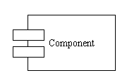
Symbols of Component Diagram
Component: It represents a piece of software or a part of a system, like a login system or database.
Symbol: A rectangle with two smaller rectangles (like a tab) sticking out on the left side.

Slide 7

Symbols of Component Diagram
Interface: This shows how a component can interact with other parts, like a button to talk to another system.
Symbol: A small circle (called a "lollipop") connected to a component.

Slide 8
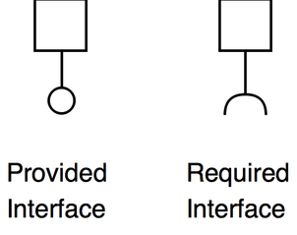
Symbols of Component Diagram
Provided Interface: This means the component is providing a way for others to use its functionality.
Symbol: A lollipop (circle) connected to a component.
Required Interface: This means the component needs something from another part of the system to work.
Symbol: A half-circle (called a socket) connected to a component.

Slide 9
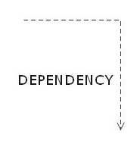
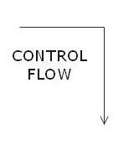
Symbols of Component Diagram
Dependency: It shows that one component depends on another to function properly.
Symbol: A dashed arrow.
Connector: It shows a connection or communication between two components.
Symbol: A solid line with an arrow.

Slide 10
Key Components of an ATM System
ATM Machine (Main Component):This is the physical machine you see and interact with. It includes parts like the screen, buttons, card reader, and cash dispenser.
User Interface (Sub-Component of ATM Machine):This is the screen where you see options like "Withdraw" or "Check Balance" and interact with the machine.
Card Reader (Sub-Component of ATM Machine):This is the slot where you insert your card. It reads the card's information, like your account details.
Cash Dispenser (Sub-Component of ATM Machine):This is the part that gives you money after a successful withdrawal.

Slide 11
Key Components of an ATM System
Bank Database (Main Component):This is the server that holds all your account information, like your balance and transaction history. It confirms whether you have enough money for a withdrawal.
Network (Main Component):This is like the communication line between the ATM machine and the bank database. It sends your withdrawal request from the ATM to the bank’s system and receives confirmation back.

Slide 12
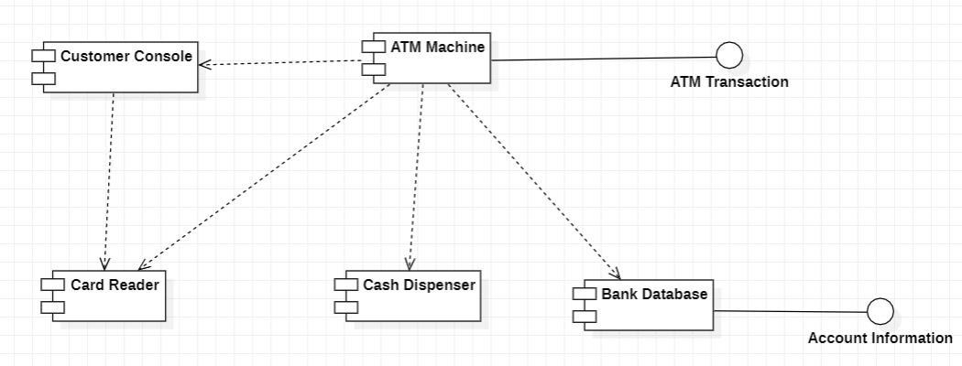
Component Diagram for an ATM System

