Slide 1




(21CC505PC) SOFTWARE ENGINEERING LAB
UPPAL CAMPUS
NARAYANGUDA
IBRAHIMPATNAM
LAB EXERCISE - 6
CONTINUOUS INTEGRATION TOOLS
TOPIC -3
BUILDING THE CI/CD SCRIPTED PIPELINE USING JENKINS FOR MAVEN JAVA PROJECT WITH POLL SCM
BY
B MADHURIKA(Ph.D.)
Assistant Professor
CSE

Slide 2

SOFTWARE ENGINEERING LAB
(21CC505PC)
BY
MADHURIKA BUDARAJU(Ph.D.)
ASSISTANT PROFESSOR
CSE
KMIT

Slide 3
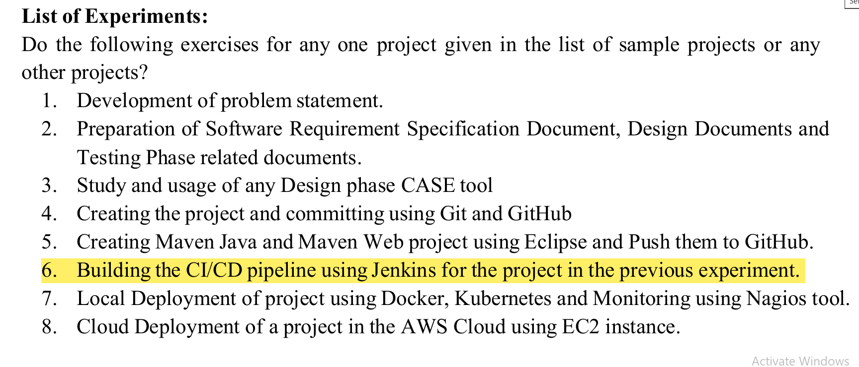

Slide 4
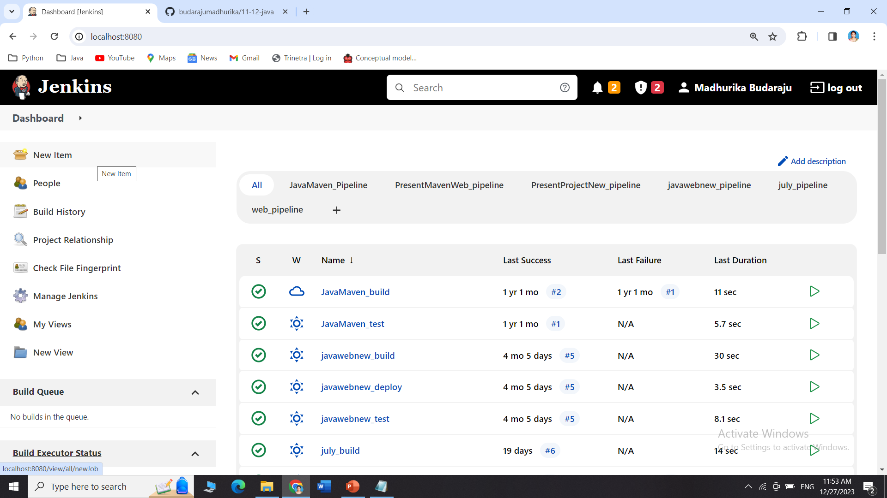
Go to Jenkins dashboard → click on new item

Slide 5
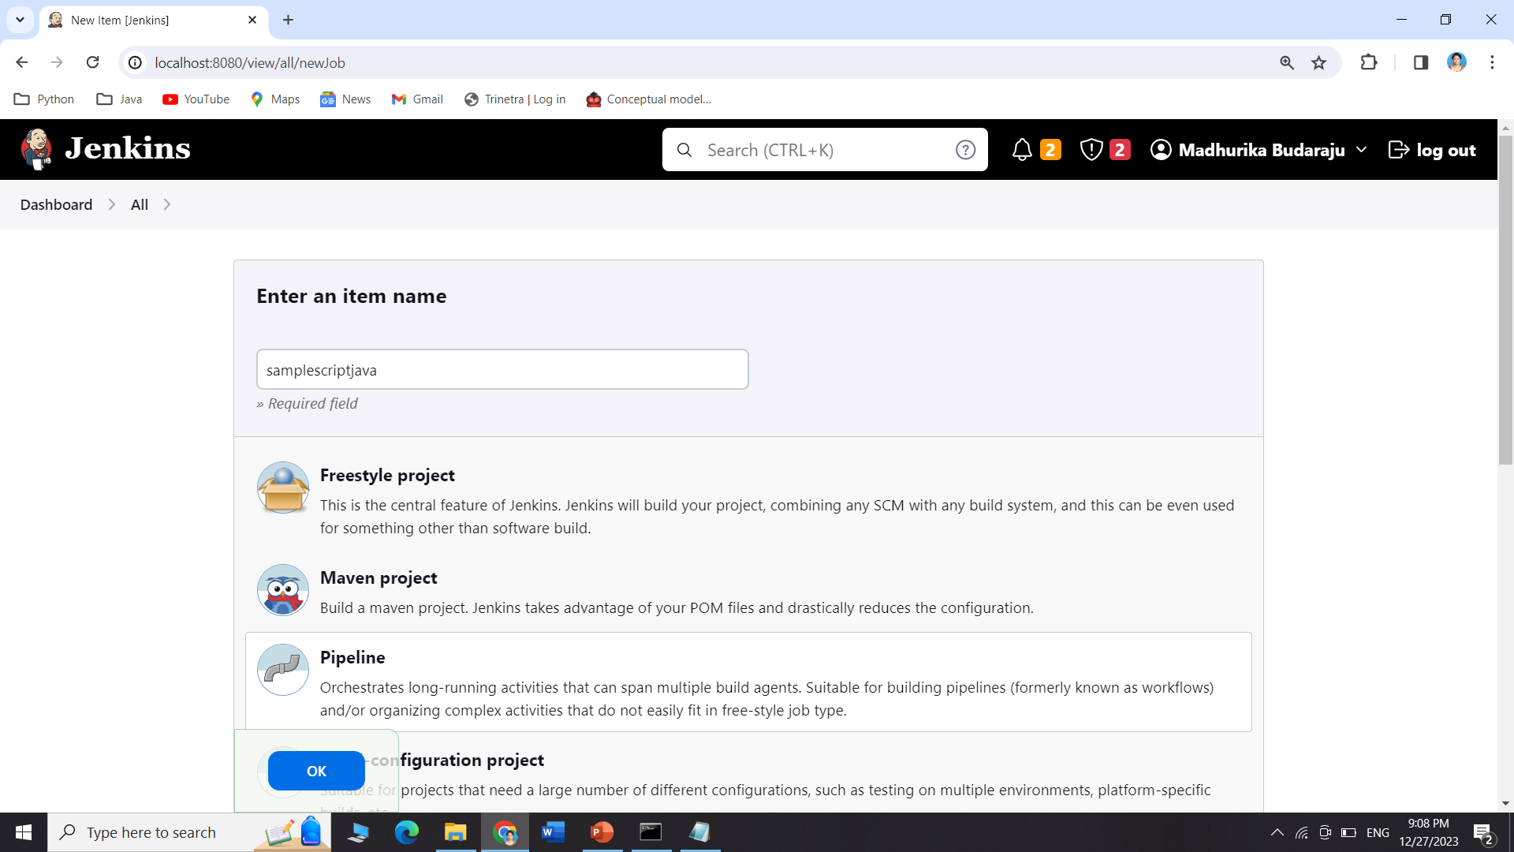
Give a name → select 3rd option pipeline → click ok

Slide 6
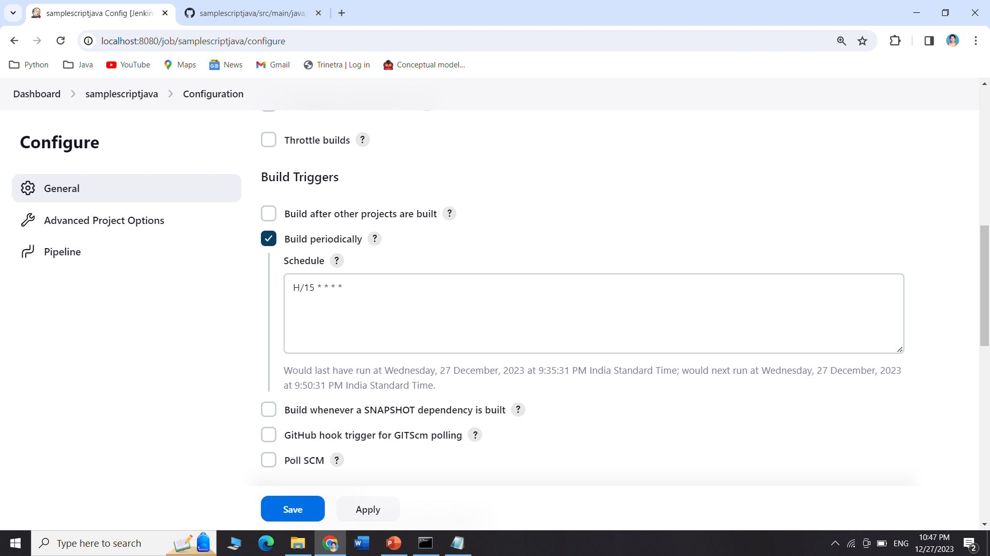
The pipeline dashboard looks like this → scroll to build triggers -> select build periodically

Slide 7
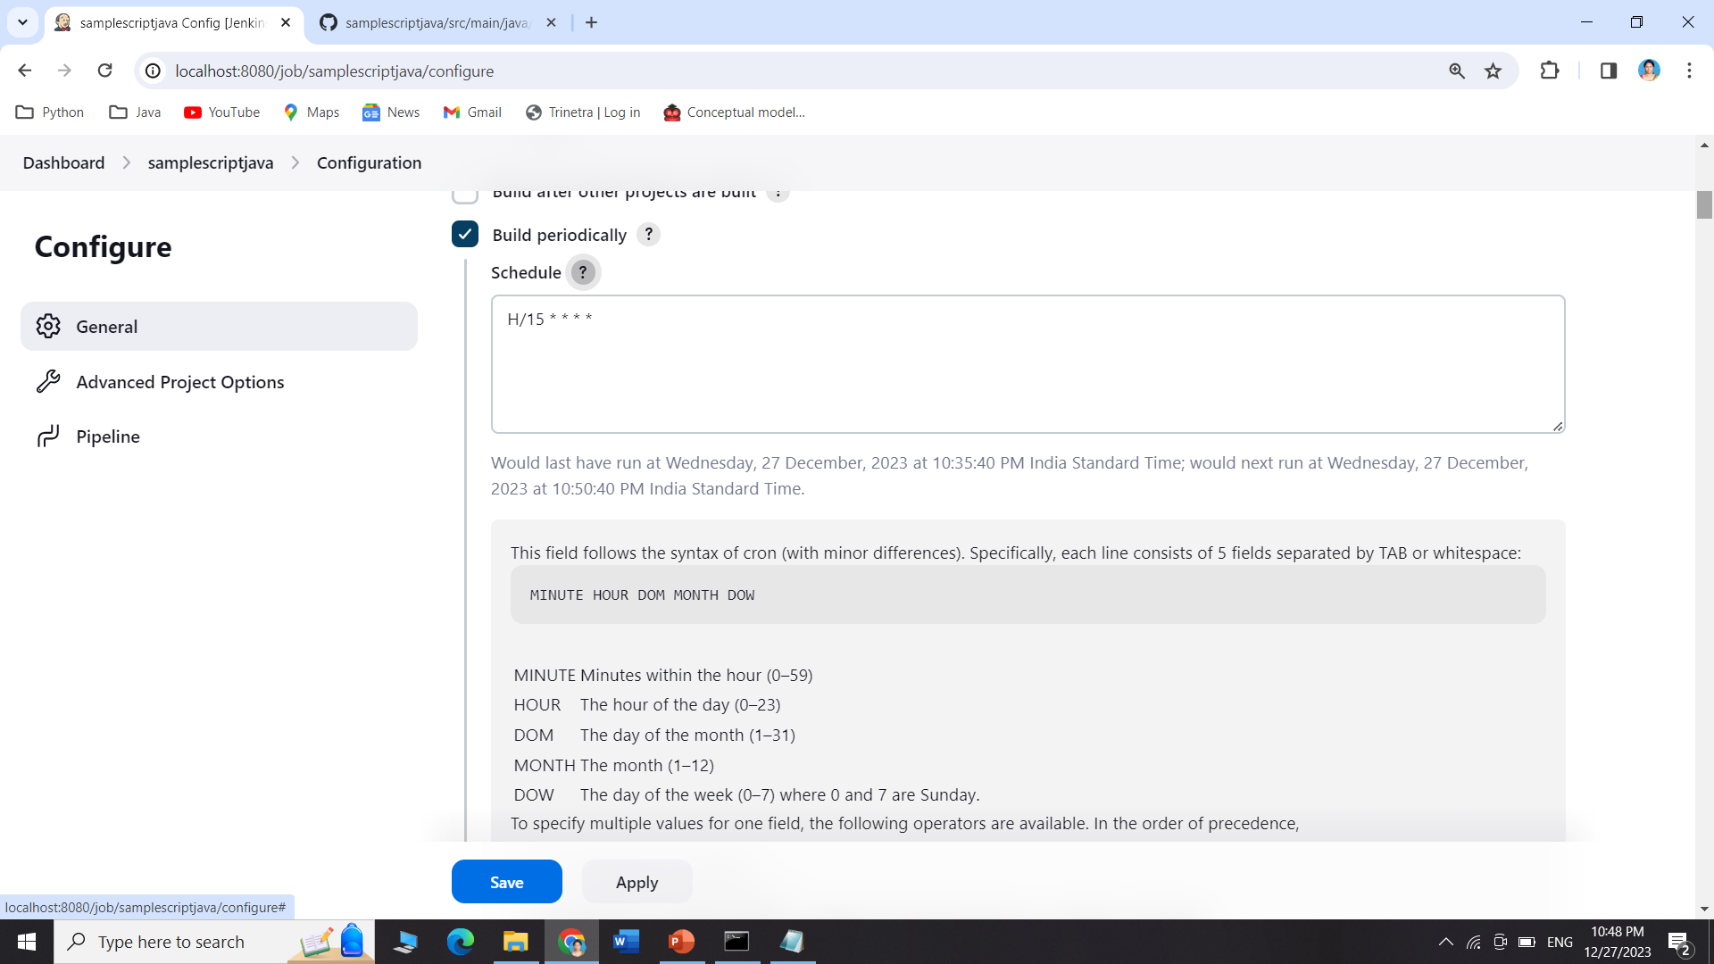
Click on schedule to know more about how to build periodically "Build Periodically" refers to a feature that allows you to schedule and automate the execution of a build job at regular intervals. It's a way to ensure that certain tasks, such as compiling code, running tests, or deploying software, are performed automatically and on a recurring basis.

Slide 8
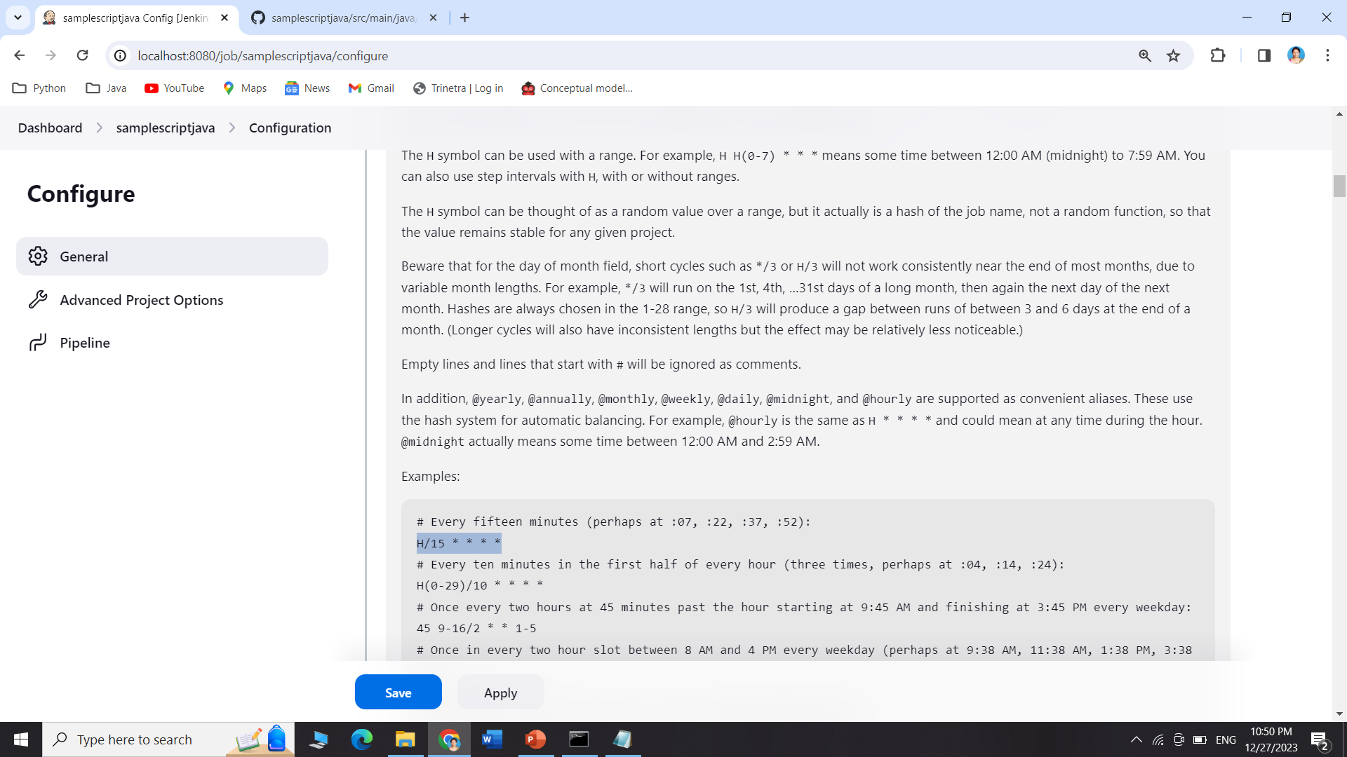
The highlighted text helps us to build / trigger every 15 min i.e. for every 15 min it will trigger the build automatically even if there are no changes in the project.

Slide 9
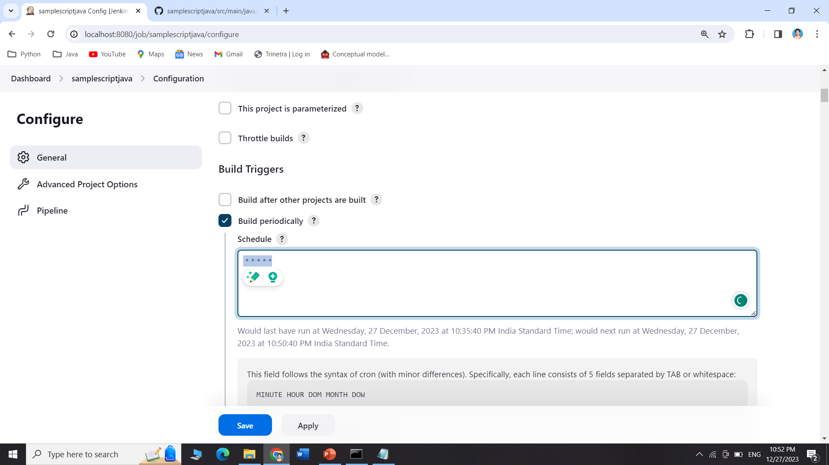
The highlighted text helps us to build / trigger every Min

Slide 10
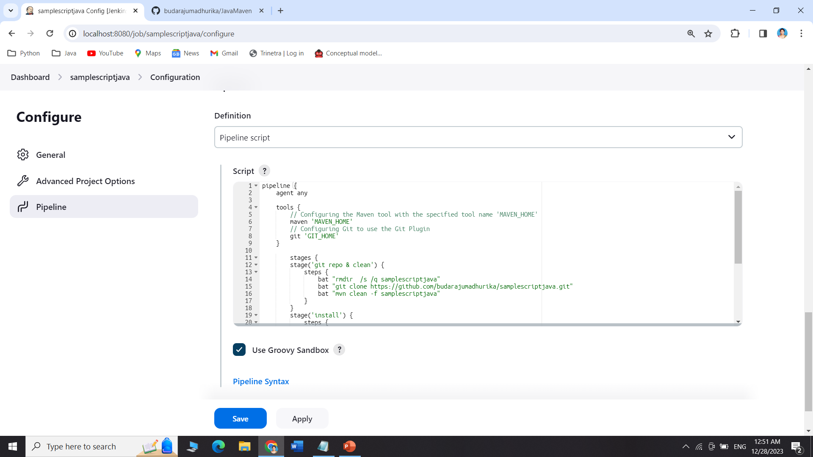
Scroll down and go to pipeline and paste the script here

Slide 11
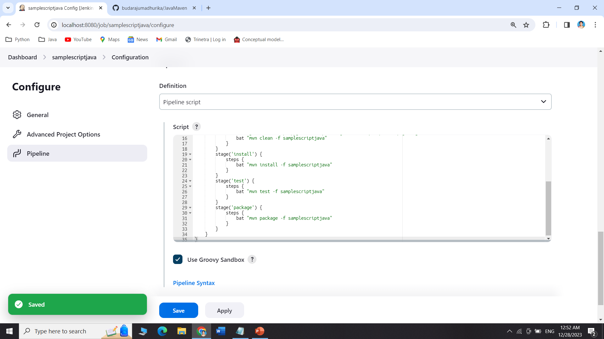
Apply and save

Slide 12
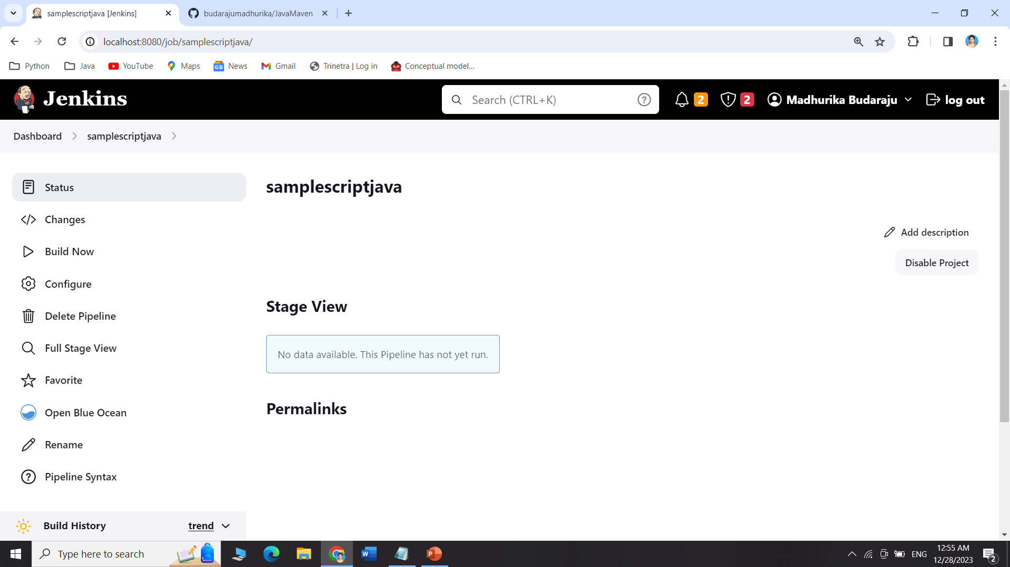
Click on build now

Slide 13
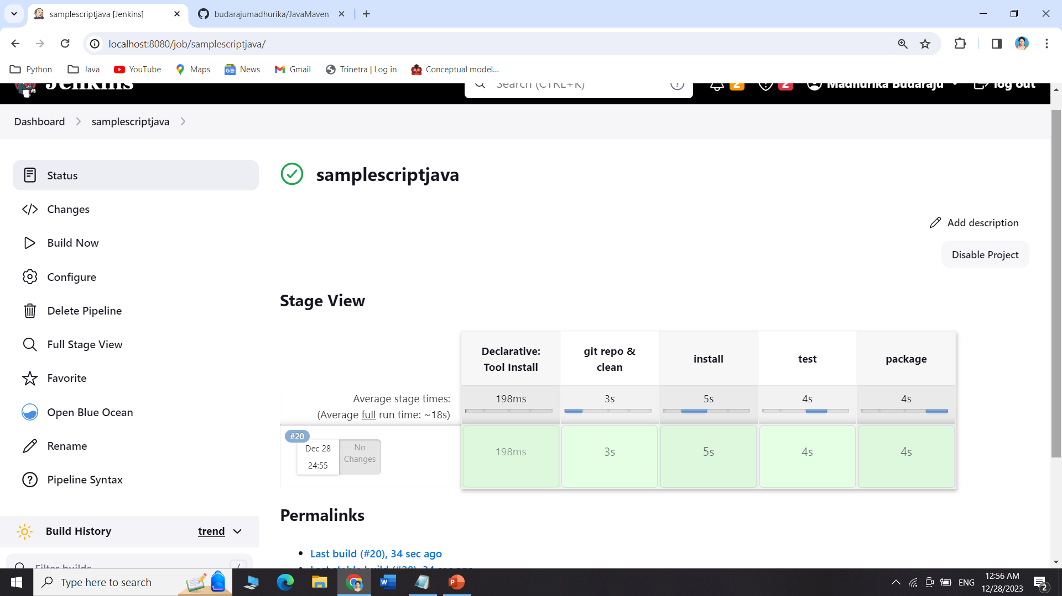
The build is successful

Slide 14
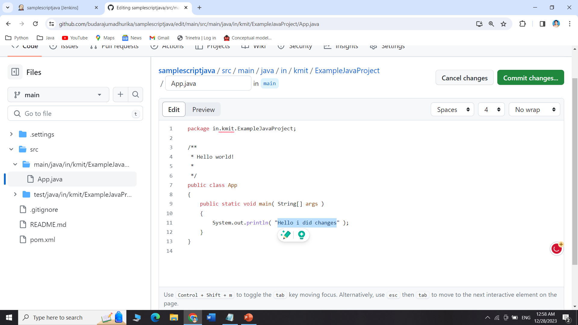
I changed my code in GitHub as shown

Slide 15
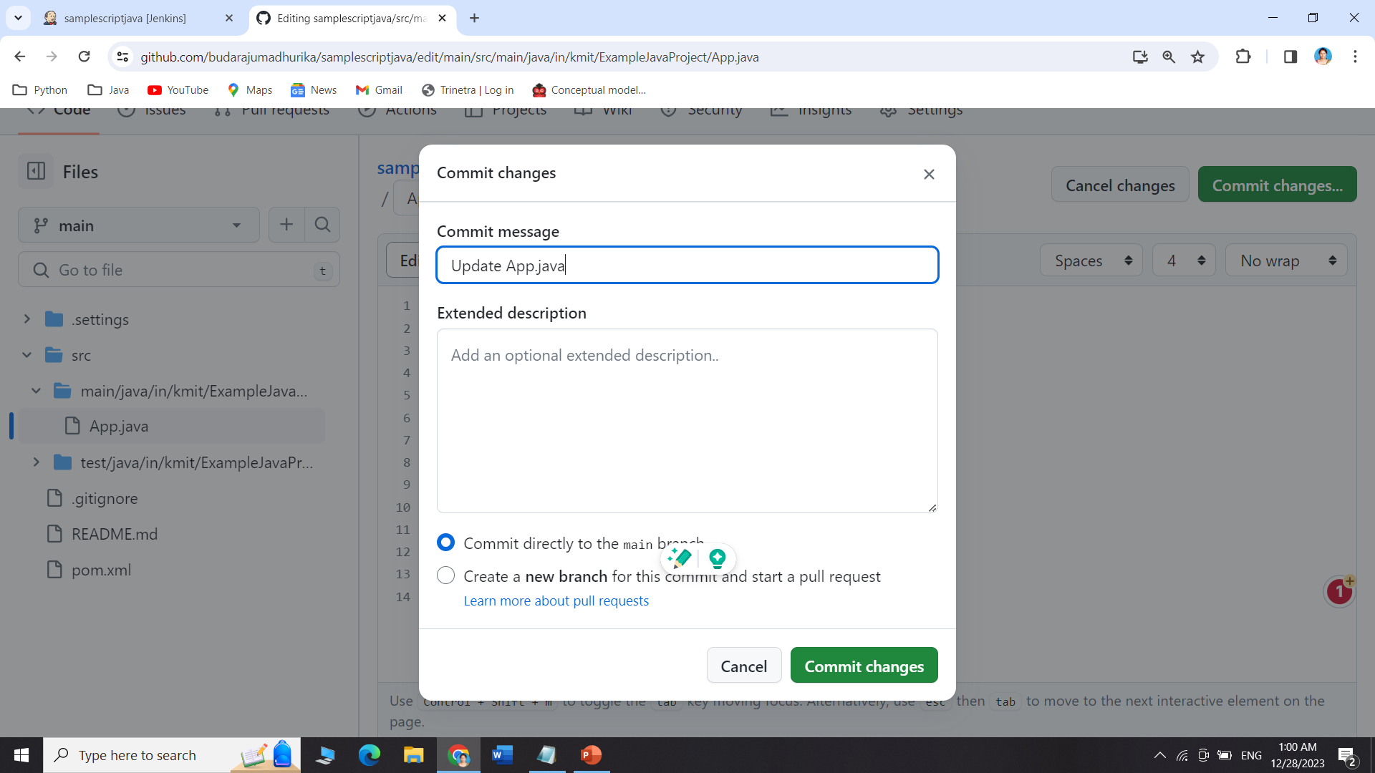
Commit the changes

Slide 16
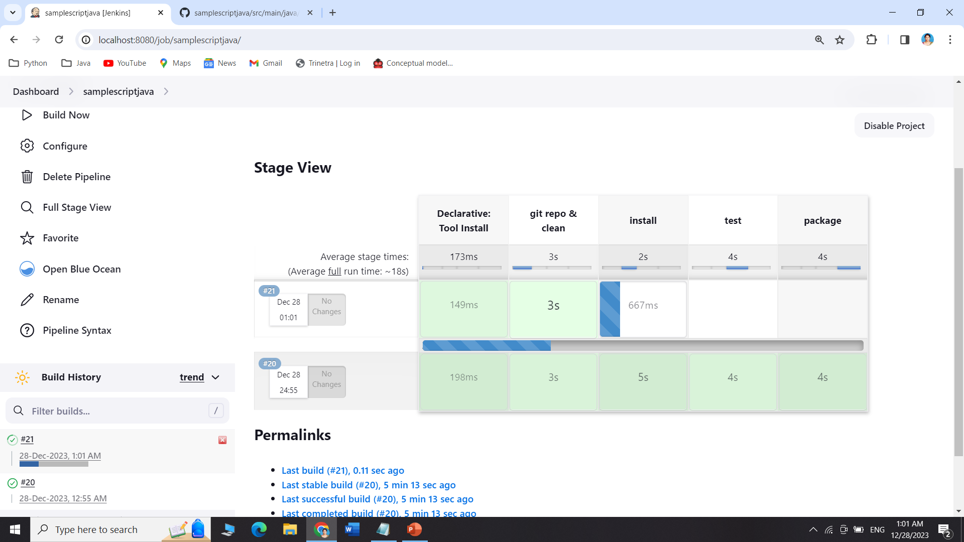
Even if we do changes or not, every minute a new build is triggered as shown

Slide 17
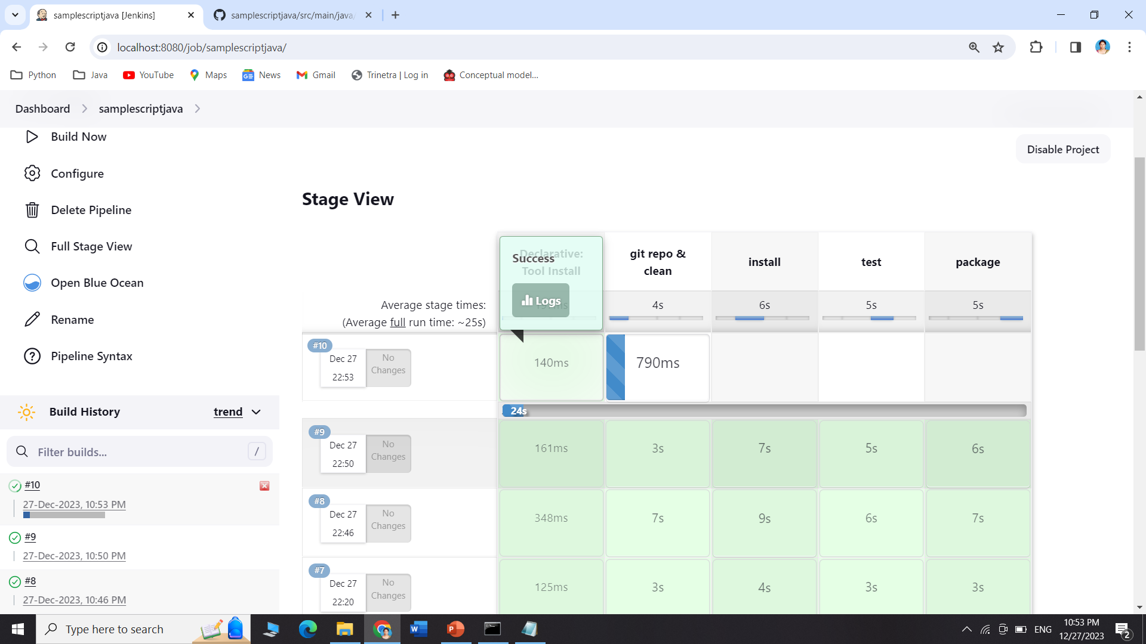
This is how it automatically builds → but let's leave it H/15 * * * * (to trigger every 15 min) or H * * 3 * (to trigger every 3 months)

