Slide 1
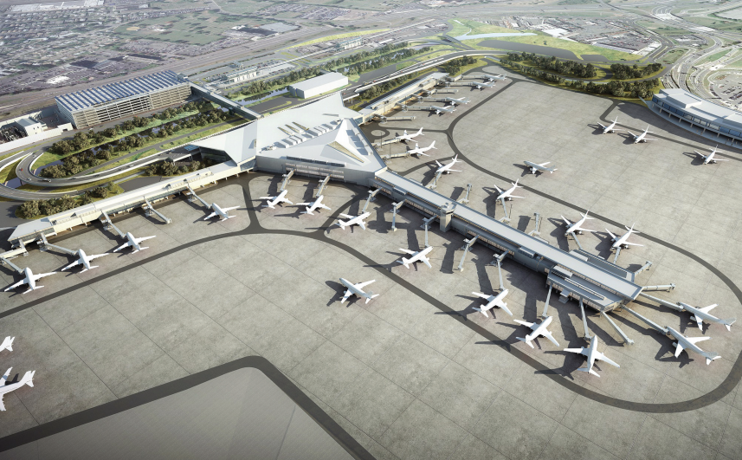
Newark LIBERTY International Airport
Investigating delays and
improving the customer experience
James Pritchard – OCTOBER 2023

Slide 2
Background
One of New York City’s three major airports
21.6 million departing passengers in 2017
70% of departures serve US destinations
Features regularly in lists of US “worst” airports
Delays, cancellations, poor amenities and inconvenient location

Slide 3
Business Questions
Is the number of delayed flights at Newark significantly greater than at other New York airports?
To what extent does extreme weather coincide with disruption of travel? Is weather a main cause of cancellations?
Can the airport use weather forecasts to improve passenger experience?

Slide 4
DATA
Flight records for 2017 on domestic departures from Newark, JFK and LaGuardia along with weather, plane, airline and airport data
Weather data provided was not complete; additional data sourced from NASA and National Centers for Environmental Information
“Significant weather events” sourced from the National Weather Service archive

Slide 5
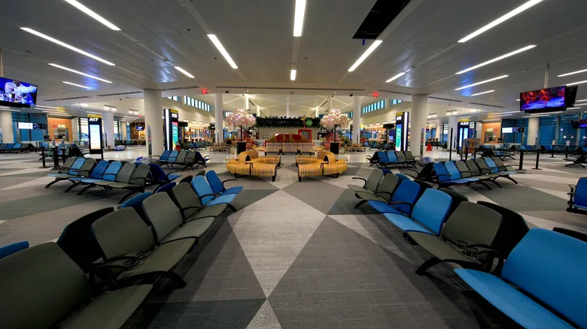
FLIGHT DELAYS
Is Newark WORSE than other NYC airports?

Slide 6
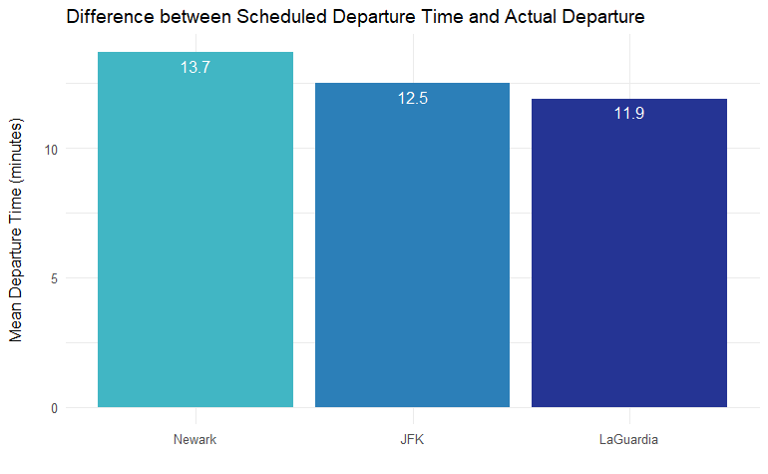
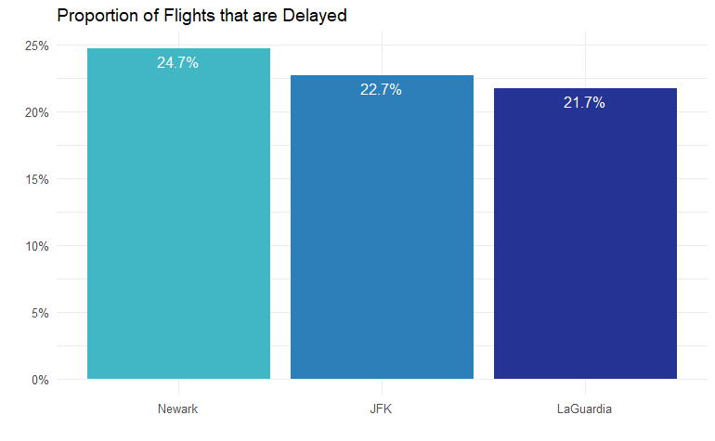
Average DEPARTURE time
Newark was found to have a mean departure time that exceeded JFK by 1.2 minutes and LaGuardia by 1.8 minutes.
Almost a quarter of flights from Newark were delayed by at least 15 minutes; worse than at other NYC airports.

Slide 7
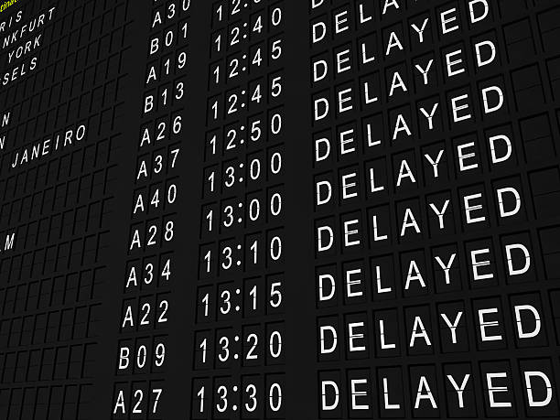
Significantly greater chance of delay
You were more likely to be delayed if flying from Newark than other NYC airports

Slide 8
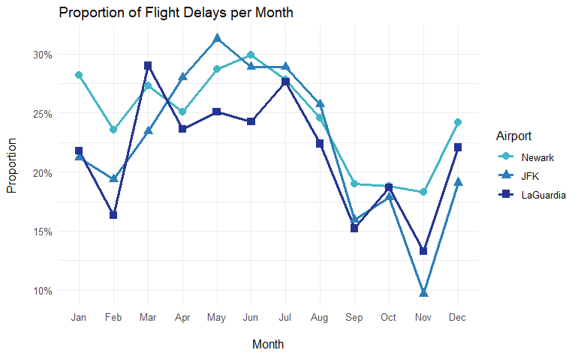
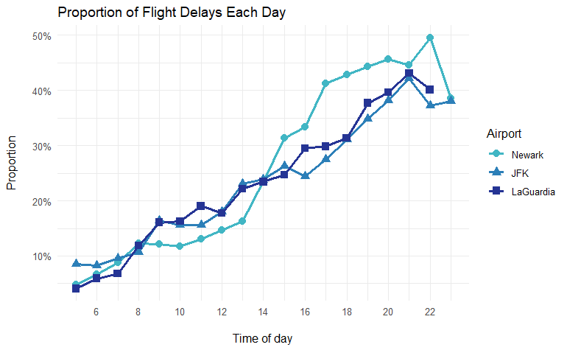
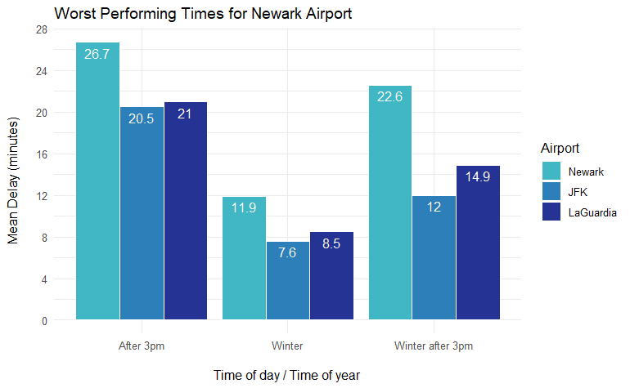
When DOES NEWARK PERFORM WORSE?
In Winter and after 3pm, Newark performed worse than other NYC airports.
Need to further investigate the cause of delays.

Slide 9
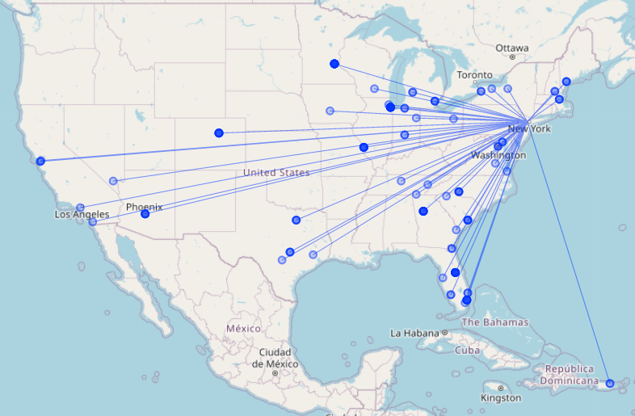
WORST Delayed ROUTES
There were 138 regular routes from Newark that suffered delays on most of their journeys. These accounted for 35% of Newark delays.

Slide 10
Are NEWARK DELAYS WORSE THAN OTHER NYC AIRPORTS?
Findings
Recommendations
On average delays were longer, especially in winter or after 3 pm
Greater proportion of flights delayed at Newark
Significantly greater likelihood to be delayed at Newark
Certain routes contributed a disproportionate number of delays
Allow more time on schedules, starting with routes that are most frequently delayed
Increase ground staff in winter and after 3 pm
Further investigation into reasons for delays

Slide 11
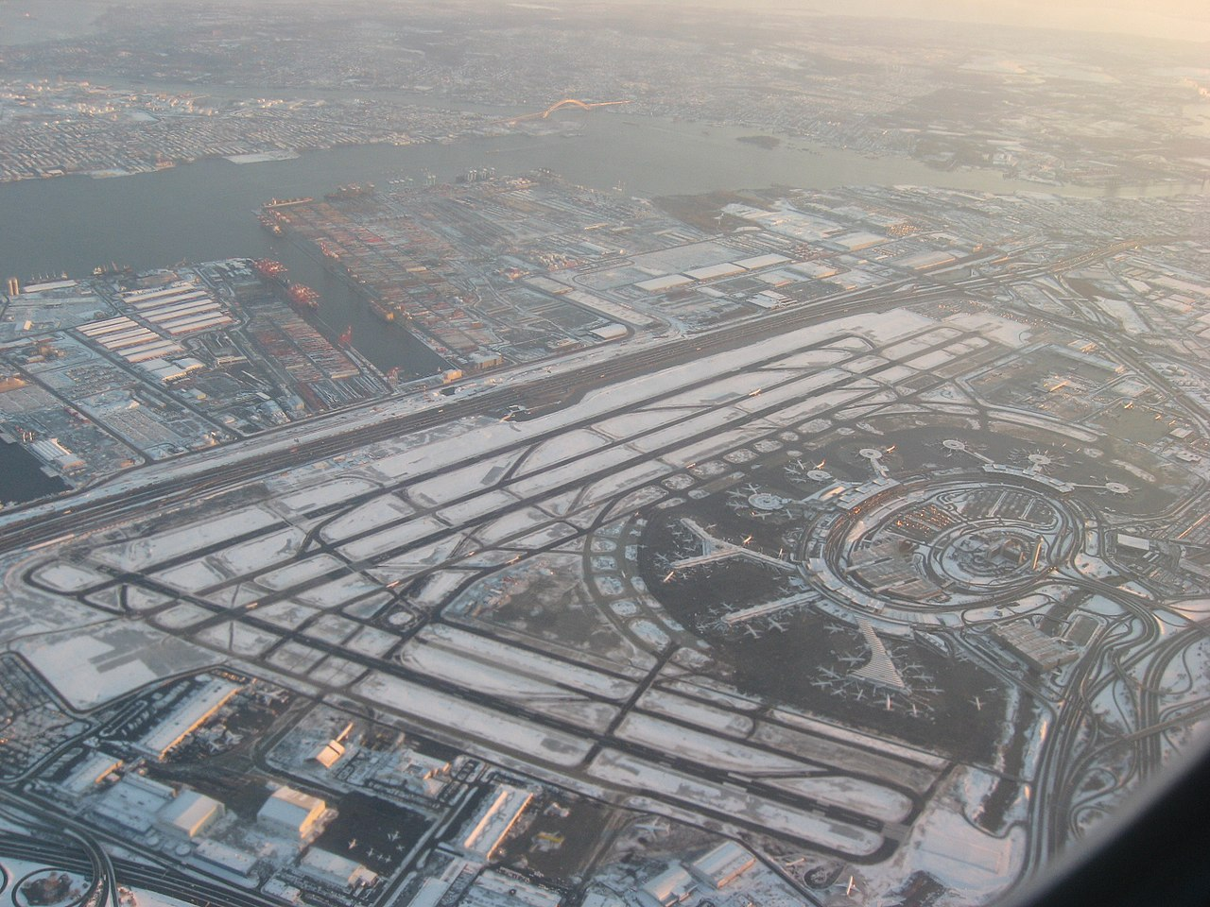
Weather Disruption
To what extent does disruption coincide with bad weather?

Slide 12
DELAYS and Cancellations
Data for Newark contained:
115,968 flights
27,900 delayed flights
2,901 cancelled flights
44 days identified as having severe weather
The following analysis is on domestic flights departing Newark. A flight was considered disrupted when it was cancelled or delayed.

Slide 13
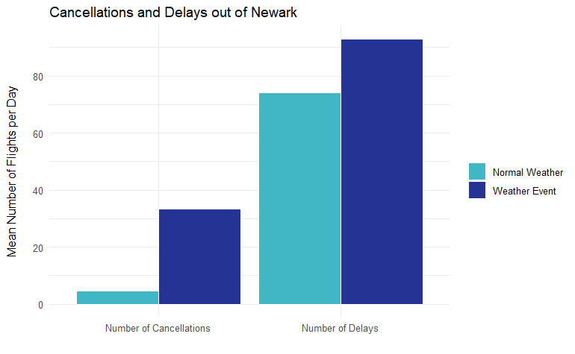
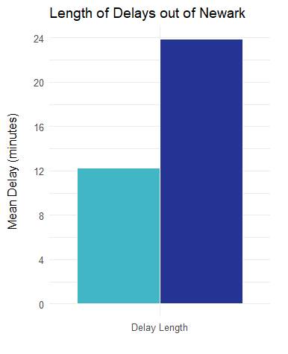
severe weather events
Severe weather events led to more cancellations, more delays and a greater average length of delay.
There is a significantly greater chance of disruption when there was a severe weather event.

Slide 14
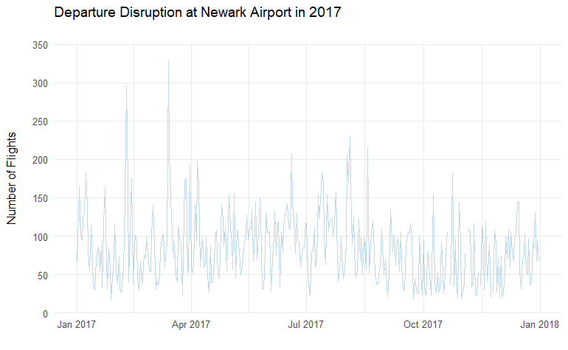
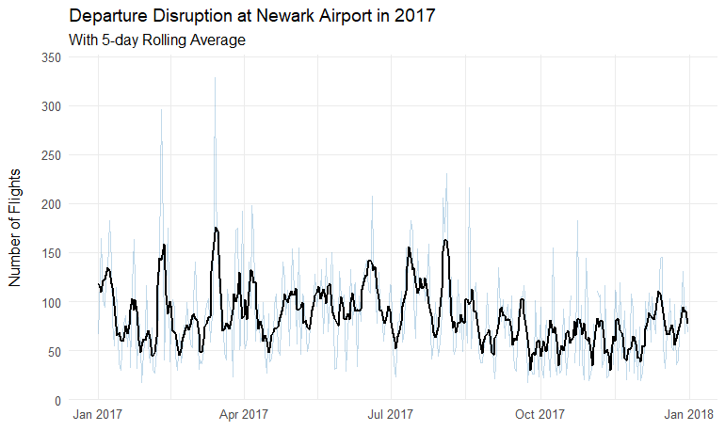
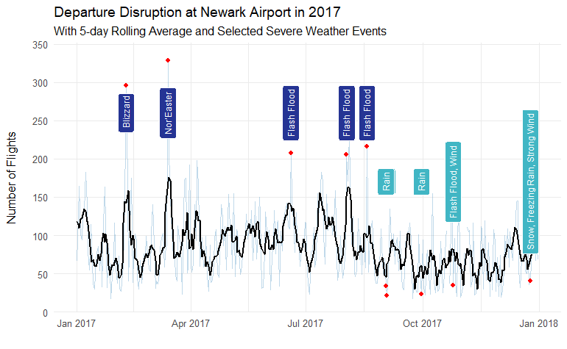
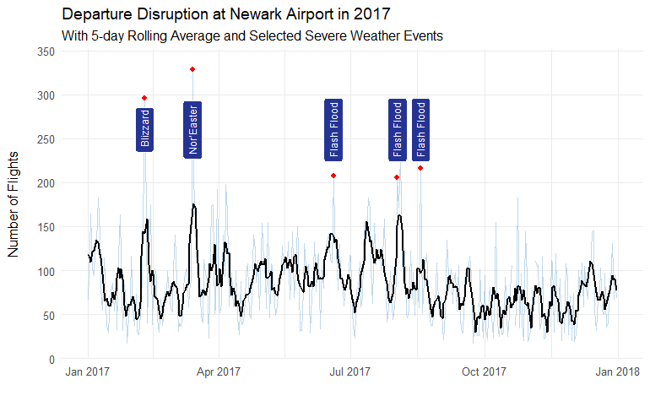
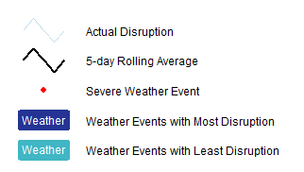
severe weather events
We would expect the days with most disruption to align with severe weather events.
Even with the benefit of hindsight, not all severe weather events can be directly linked to disruption.

Slide 15
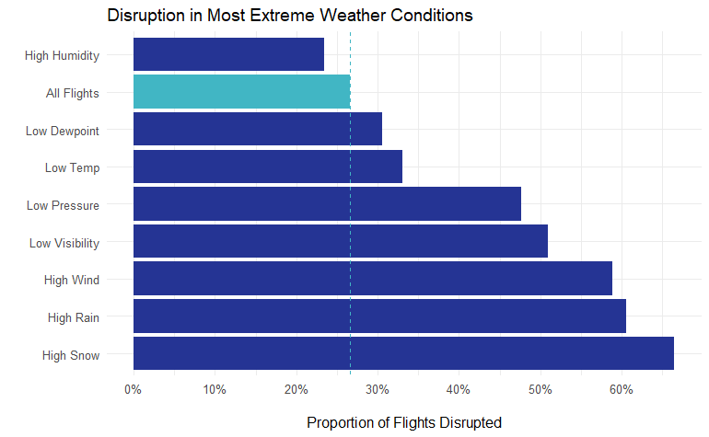
SNOWIEST, wettest, windiest
Using the weather data, we can isolate the flights that were scheduled to depart at times that experienced the most extreme weather.
The graph shows the most extreme 1% of each weather condition.

Slide 16
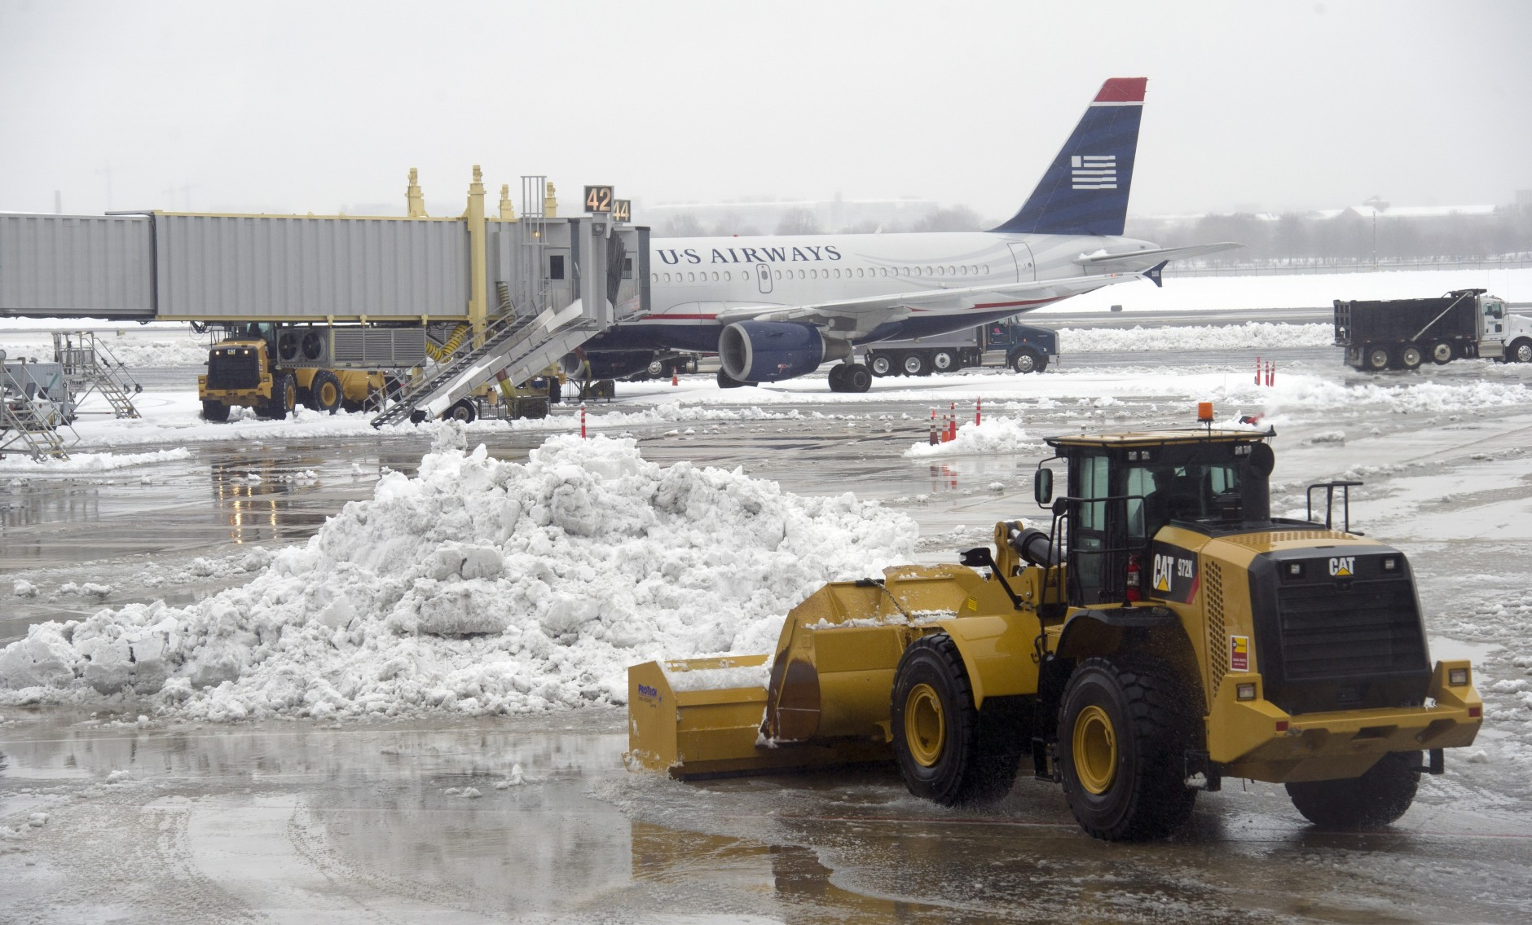
Weather CANCELLATIONS
Is bad weather the main cause of cancellations?

Slide 17
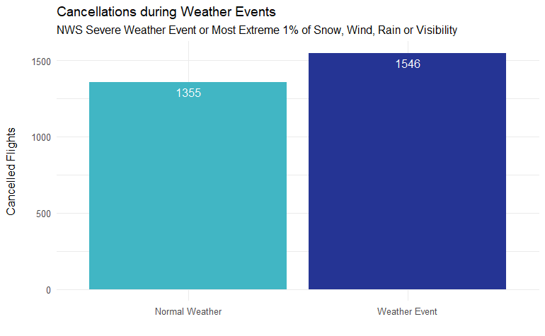
Weather Event Cancellations
More cancellations on days when severe weather was recorded.

Slide 18
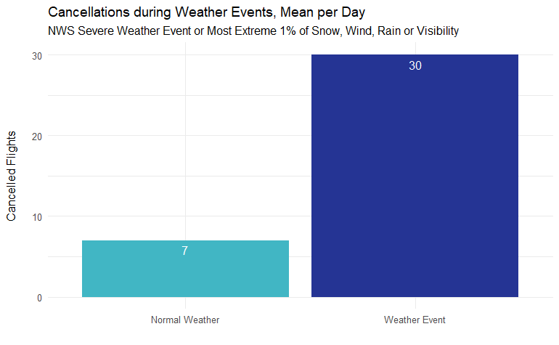
Weather Event Cancellations
Many more cancellations per day on days when severe weather was recorded.

Slide 19
extreme weather & disruption; MAIN cause of Cancellations?
Findings
Recommendations
When severe weather occurs, on average we see more delays, longer delays and many more cancellations
Not every severe weather event leads to disruption
When extreme weather is forecast
increase ground crew to help keep runways clear and safe
bring in extra airport/airline staff in anticipation of cancellations and rerouting
reduce the number of outgoing flights as a pre-emptive measure to relieve pressure

Slide 20
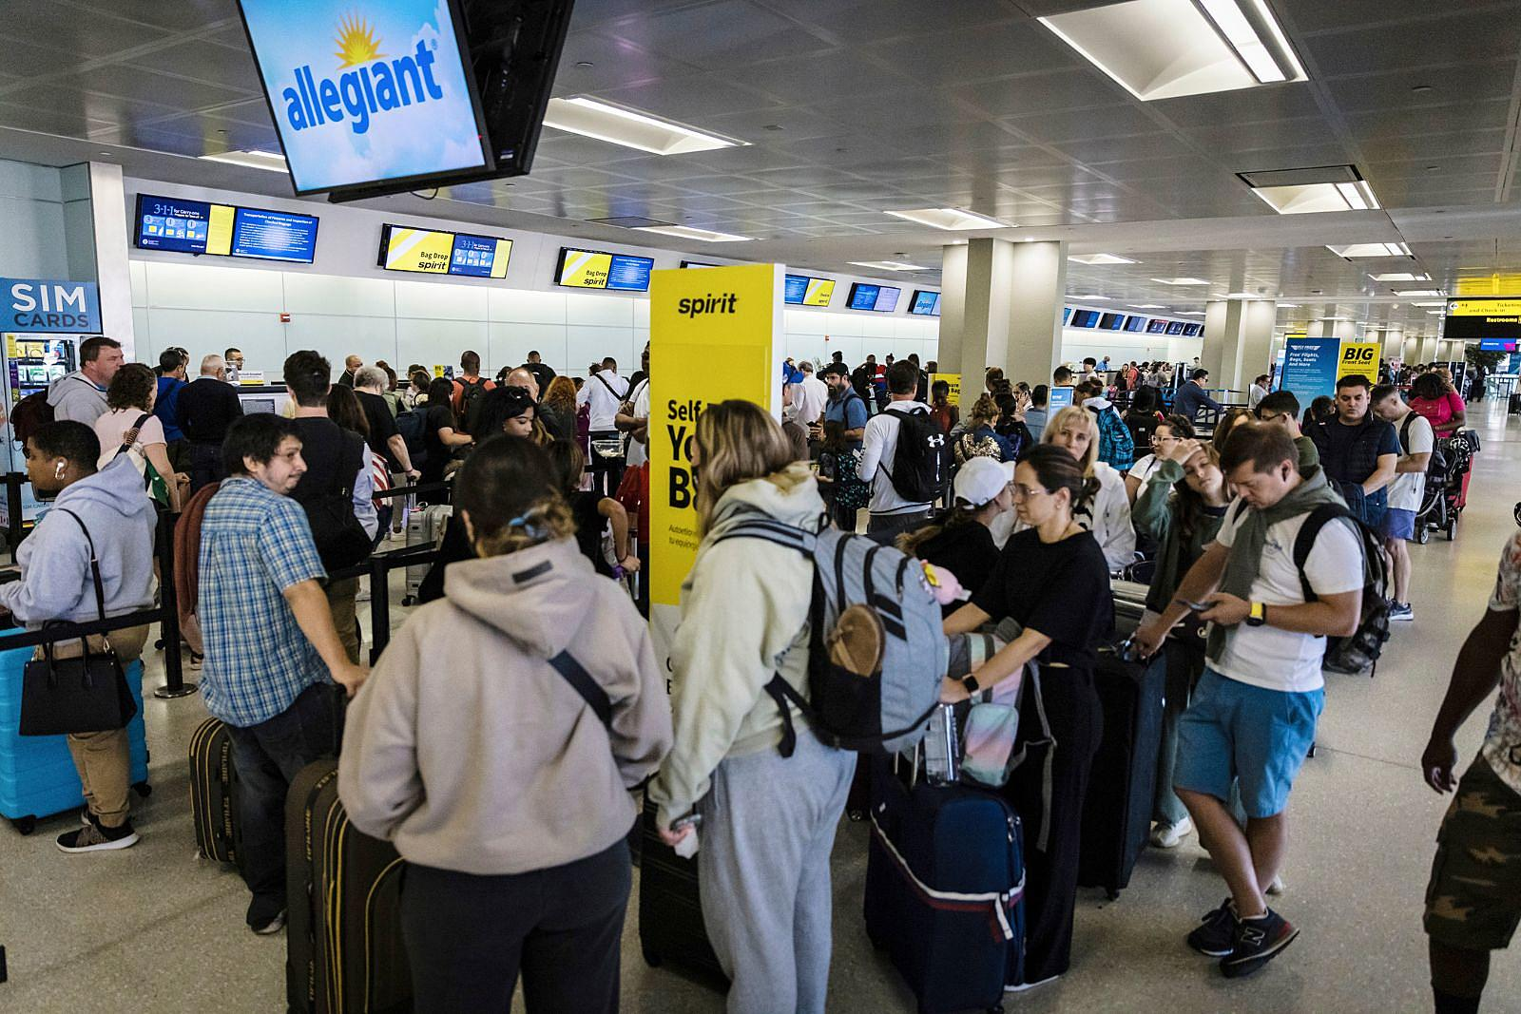
PREDICTING DISRUPTION
CAN WEATHER PREDICTIONS IMPROVE THE CUSTOMER EXPERIENCE?

Slide 21
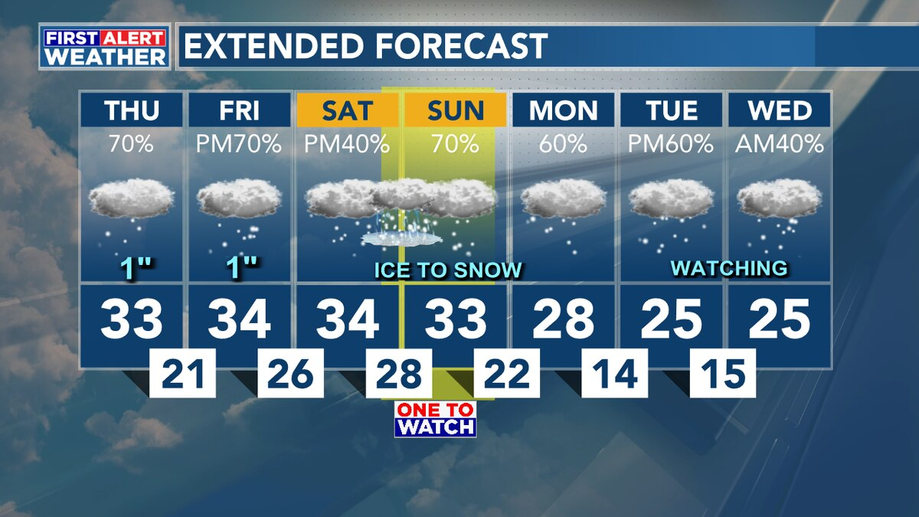
Regression Modelling
If the airport can predict extreme weather in advance, it would help them prepare contingencies for delayed and cancelled flights.

Slide 22
Regression models
Several modelling methods attempted
Started with nine weather predictors
Logistic regression models struggled (best AUC, ~65%)
Random forests had low precision
Models were better when time and airline were included alongside weather
Models improved when trained on days with high disruption

Slide 23
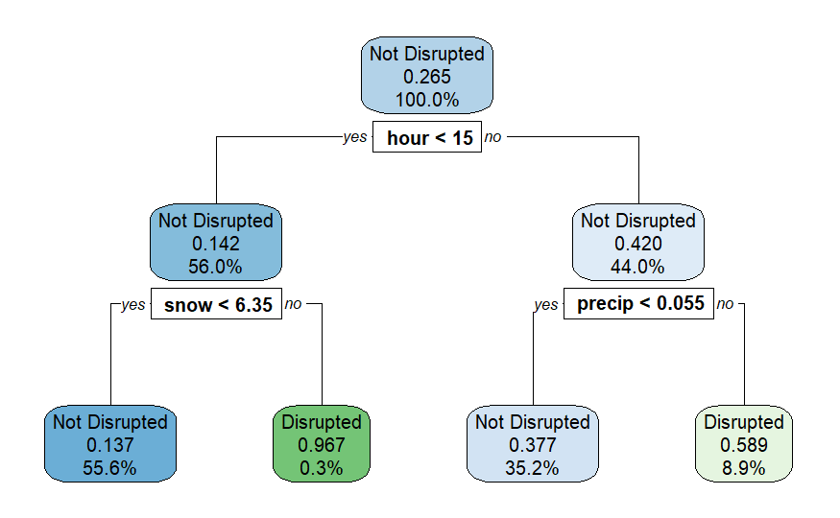
Regression models
Best model was a random forest
Training data was 80% of flights from the worst 20 days of disruption at Newark
Test data was the other 20%
Against test data:
Precision ≈ 83%
Recall ≈ 78%
F_{0.5} measure ≈ 0.82
Against other 2017 data:
Precision ≈ 83%
Recall ≈ 33%
F_{0.5} measure ≈ 0.64
We should expect the model to perform less well on future data

Slide 24
Can weather predictions improve passenger experience?
Findings
Recommendations
With the data supplied we are able to build a reasonable model
We can predict when a flight would have been disrupted in 2017 with reasonable accuracy
The model may help the airport increase staffing on days when disruptions are likely
Need clearer information from the airport on the causes of delays and cancellations
The model should continue to be refined as more data is collected

Slide 25
Business Questions
Is the number of delayed flights at Newark significantly greater than at other New York airports? Yes, especially in winter and after 3 pm
To what extent does extreme weather coincide with disruption of travel? Is weather a main cause of cancellations? Extreme weather increases cancellations and lengthens delays
Can the airport use weather forecasts to improve passenger experience? Carefully constructed models can have some predictive value but should be applied with caution

Slide 26
Recommendations
Greater time on schedules; target routes that are frequently delayed
Increase ground crew in winter and after 3 pm
Further investigation into reasons for delays
Continue to refine predictive model
Anticipate cancellations and rerouting; increase staffing accordingly
Take steps to improve customer experience in the event of delay

Slide 27
Newark LIBERTY International Airport
Investigating delays and
improving the customer experience
James Pritchard – OCTOBER 2023

