Slide 1
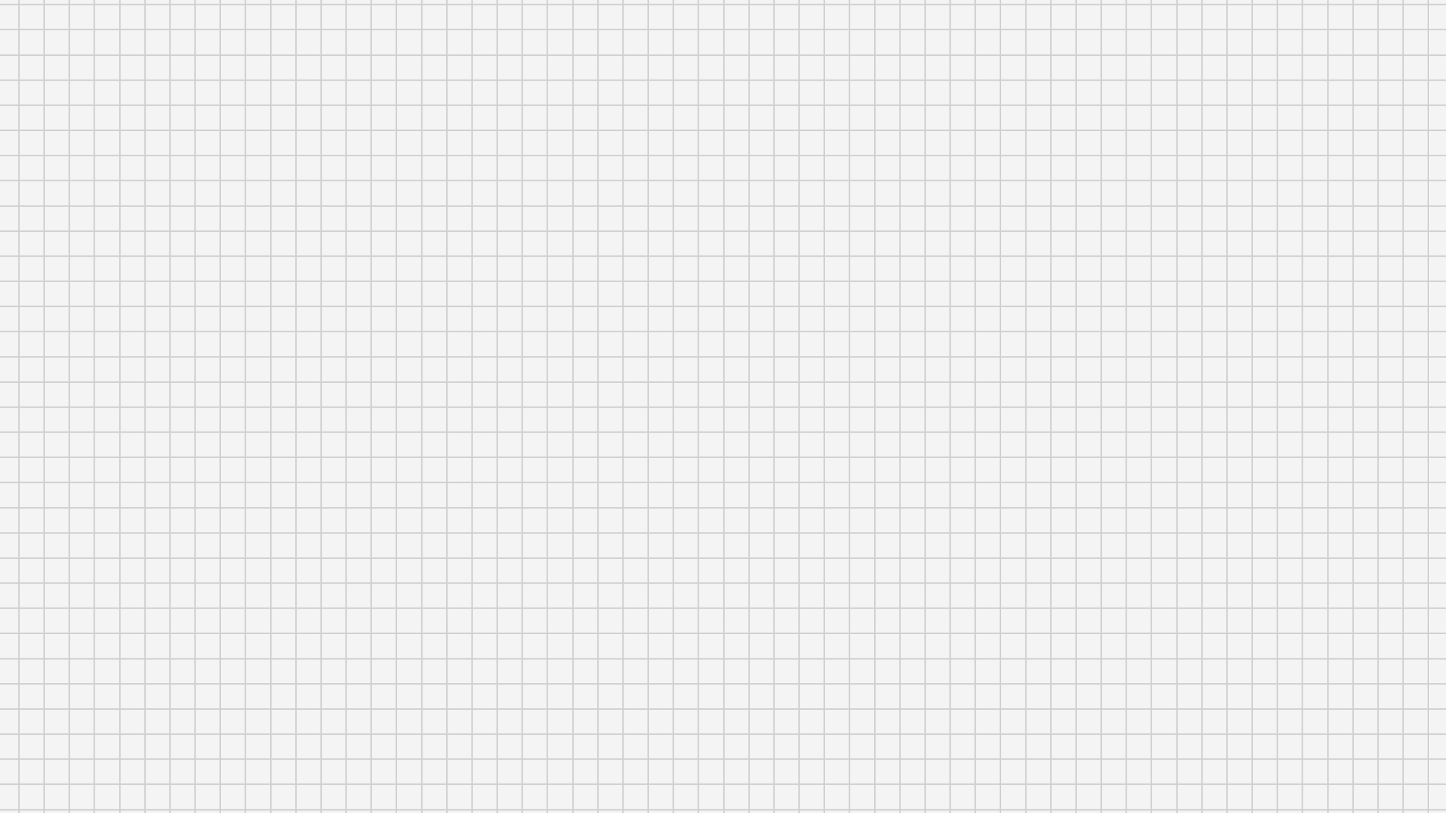
Batch – 11
Nikhil Dhaka – 19Z334
Niranjan S – 19Z335
Priyadharshini J – 19Z339
R M Venkatram – 19Z340
Srikanth K R – 19Z349
Swetha M – 19Z355
A Simple Trading Platform
OTS
Online Trading System

Slide 2

Description
The Online Trading System is a modest project developed by a group of amateur programmers which was made possible using Python. It stays on par with almost all the major stock trading websites by having the basic functionalities of buy, sell, quote stocks and much more, with the added benefit of visualizing the trend of the stock that one buys, graphically, on a sweet UI that’s easy on eyes.

Slide 3
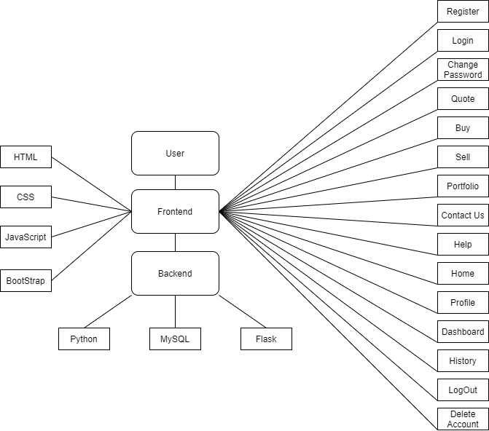
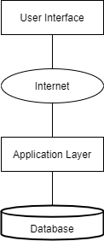
Block Diagram
System Architecture

Slide 4


Features Available
Search
Basic Features of any Trading Website (Register, Login, Buy, Quote, Sell, User guide, Contact us)
View current watchlist
History of transaction
Logout, delete account
Terms and condition agreement
Portfolio
Visualized Data
e-Mail Confirmation for the various features available here
Account Management
Save
Cancel

Slide 5








Frontend
Backend
Tools Used

Slide 6
Work Split
Team Member | Contribution | Challenges Faced
Nikhil Dhaka | Contact us, history,dashboard,graph
Niranjan S | Logout, Help, graph, terms&condition
Priyadharshini J | Buy stocks, sell stocks, email, delete account, graph | Connection to SMTP, importing real world data
R M Venkatram | Front End, database creation, OTS front page | Conflicting ideas on page designs
Srikanth K R | Register, Login page, DB connection, Help, Portfolio
Swetha M | Profile, Change password, Graph | Importing accurate data

Slide 7

References:
https://www.nseindia.com/
https://zerodha.com/
https://en.wikipedia.org/wiki/Stock_market
https://www.xenonstack.com/blog/python-flask-framework
https://apimetrics.io/api-knowledge-base/apis-for-dummies/

