Slide 1
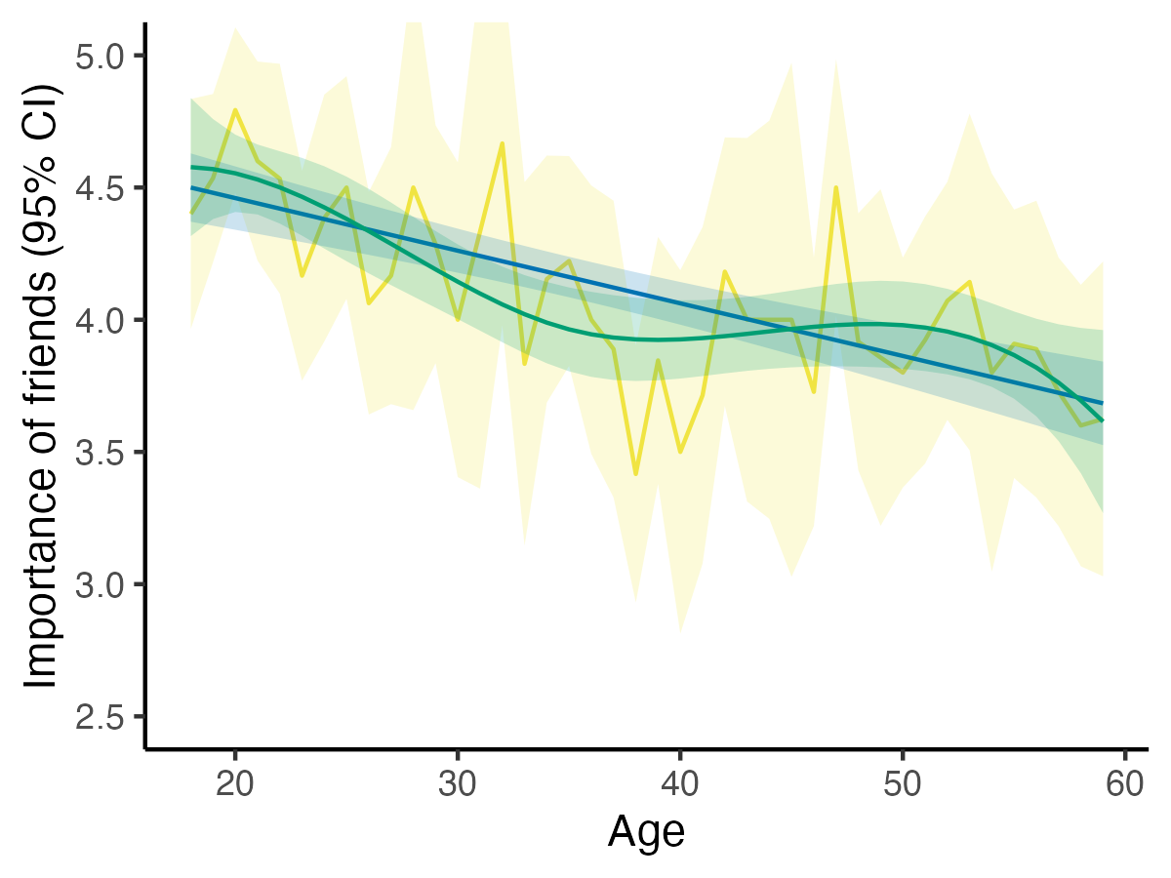
Age as linear predictor
Imposes linear trajectory,
low uncertainty
Age as categorical predictor
Follows the data exactly,
high uncertainty
Age splines
Smoothly follow the data,
medium uncertainty

