Slide 1
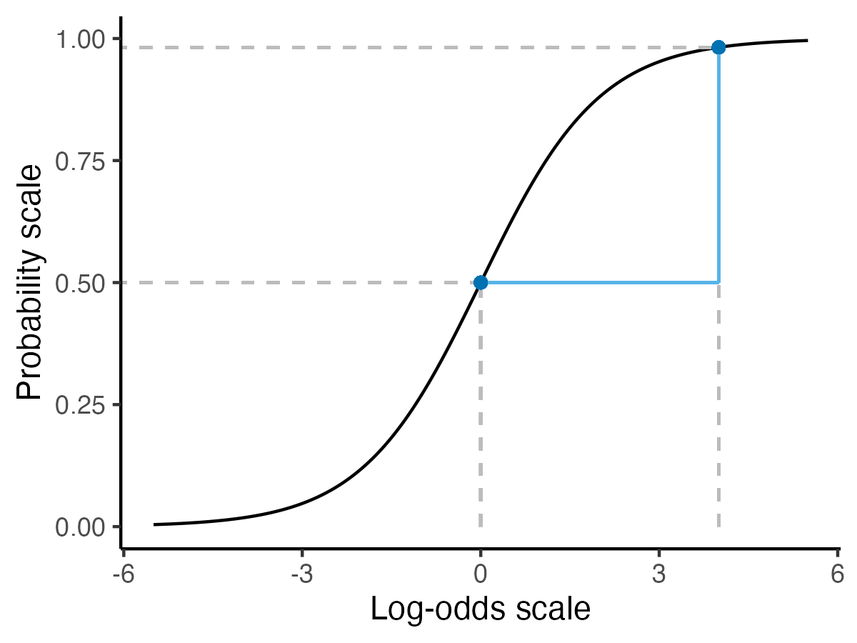
Predicted probability = 0.98
Risk difference of 0.98 – 0.50 = 0.48 percentage points
Risk ratio of 0.98/0.50 = 1.96
Predicted probability = 0.50
Log odds difference of 4 – 0 =
4 log odds
Odds ratio of e⁴ ≈ 54.6
Predicted
Log odds = 0
Predicted
Log odds = 4

