Slide 1
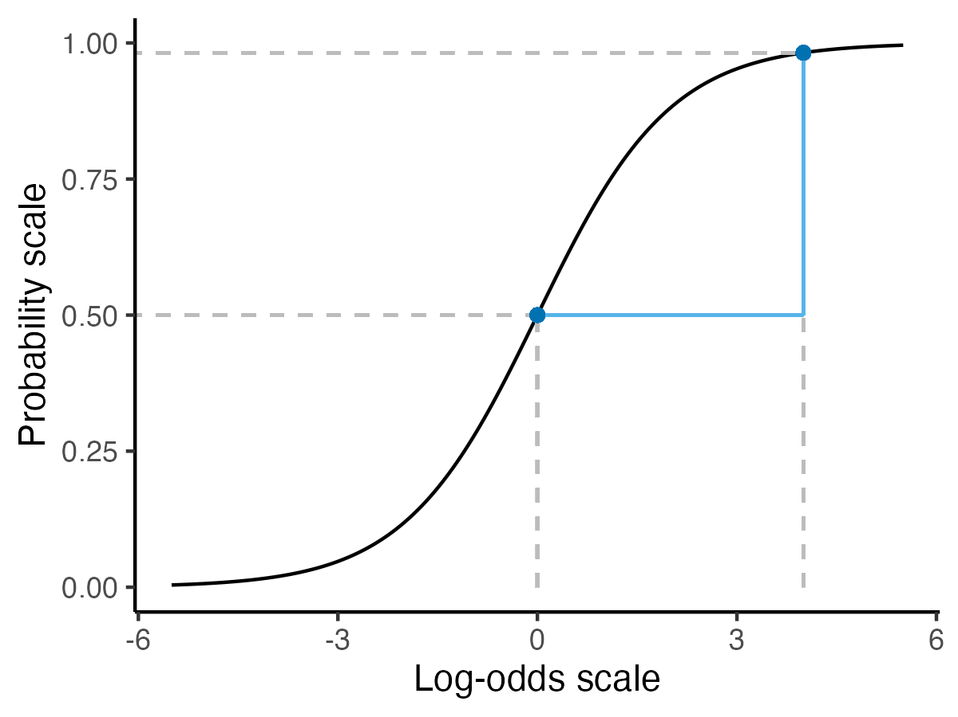
Predicted probability = 0.98
Comparison results in difference of 0.98 – 0.50 = 0.48 percentage points
Relative risk of 0.98/0.50 = 1.96
Predicted probability = 0.50
Comparison results in difference of 4 – 0 =
4 log odds
Odds ratio of e⁴ ≈ 54.6
Predicted
Log odds = 0
Predicted
Log odds = 4

