Slide 1
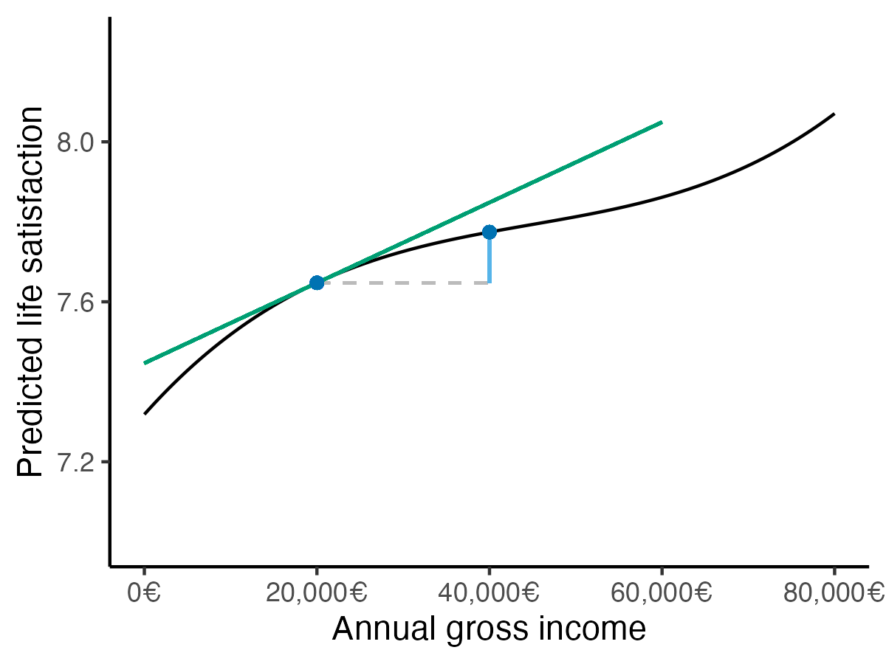
slope
Steepness of the curve of predictions
predictions
Model-implied outcomes
comparison
Contrast (e.g., difference) between predictions

