Slide 1
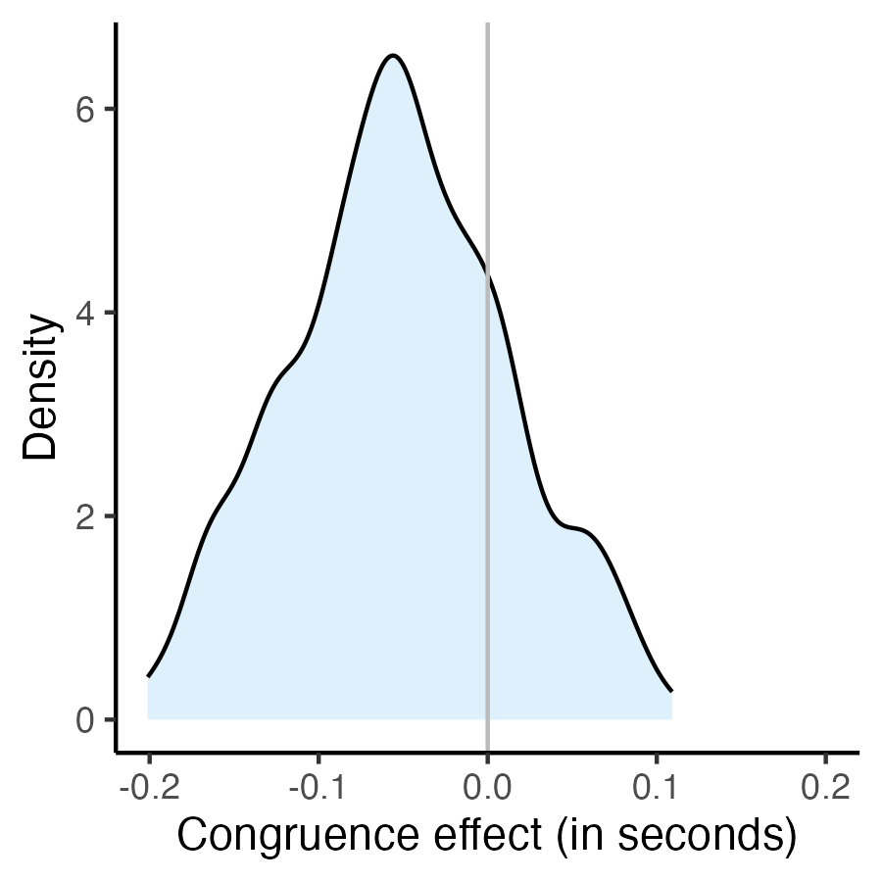
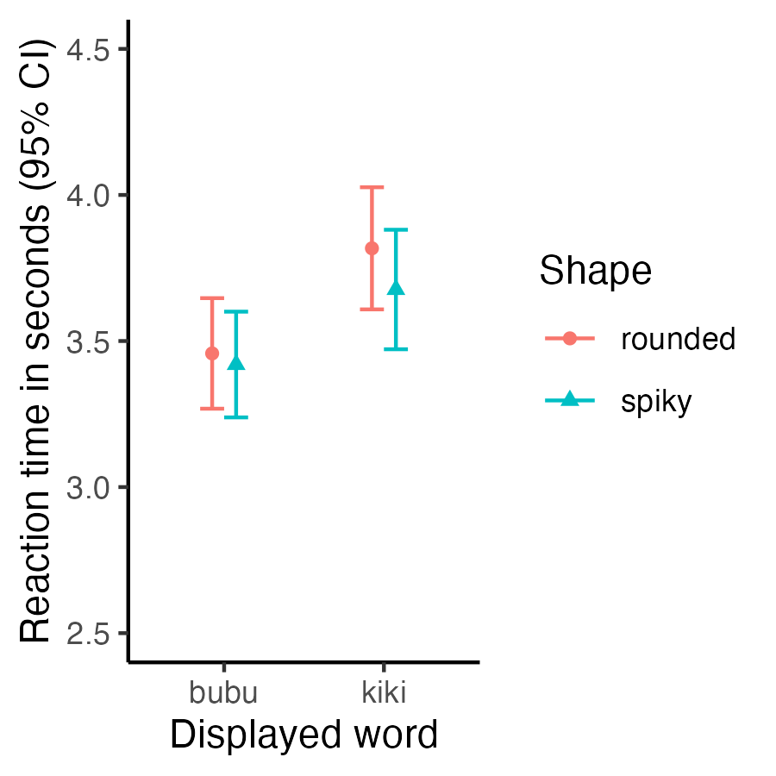
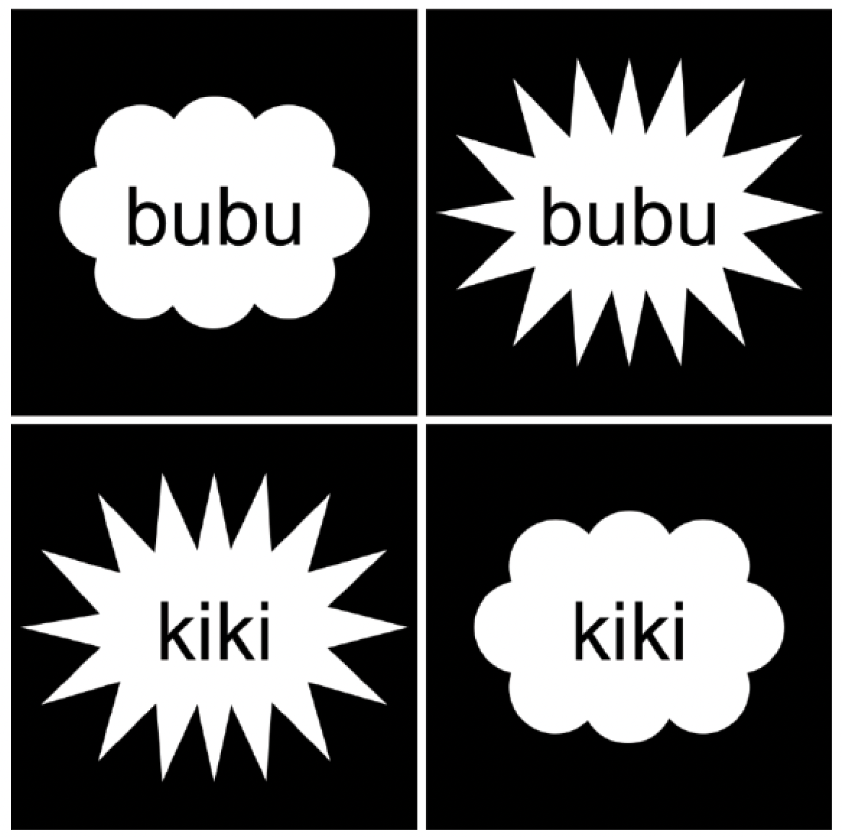
a
b
c
Stimuli with congruent sound-shape mapping, which should reduce reaction times
Congruent stimuli
Stimuli with incongruent sound-shape mapping
Incongruent stimuli

