Slide 1
An enhancement in accuracy in forecasting sales using XG boost and decision tree algorithm
Capstone Project
ITA0658- Machine Learning for India
Done By-
K. Madhan Kumar (192211186)
J. Sai Chandu (192211216)

Slide 2
ABSTRACT
Aim: This study aims to enhance the accuracy of sales forecasting by leveraging machine learning techniques, specifically XG-Boost and Decision Tree algorithms, to analyze historical sales data. The goal is to determine which model provides superior predictive performance.
Problem: Traditional sales forecasting models often struggle with accuracy due to data complexity and non-linearity. By comparing XG-Boost and Decision Tree, we evaluate their effectiveness in improving prediction accuracy and handling diverse sales patterns.
Methodology: The dataset is preprocessed and split into training and testing sets. XG-Boost and Decision Tree models are implemented and trained on the data. Their predictive performance is assessed using the R² score to measure accuracy.
Result: The selected XG Boost Algorithm shows improved accuracy of approximately 0.9758% and Decision Tree shows accuracy of 0.7833%

Slide 3
Introduction:
Accurate sales forecasting plays a crucial role in business decision-making, helping organizations optimize inventory, pricing strategies, and resource allocation. Traditional forecasting methods often struggle with complex, non-linear relationships in sales data. Machine learning techniques like XG-Boost (Extreme Gradient Boosting) and Decision Tree Regression have emerged as powerful tools to improve predictive accuracy. XG-Boost, known for its high performance and efficiency, enhances prediction through boosting techniques that reduce bias and variance. On the other hand, Decision Tree Regression provides a simpler, interpretable model by splitting data based on feature importance. By leveraging these algorithms, businesses can gain deeper insights into sales patterns, leading to more informed strategic decisions. This study aims to compare the effectiveness of XG-Boost and Decision Tree Regression in forecasting sales, highlighting improvements in accuracy and predictive capabilities.

Slide 4
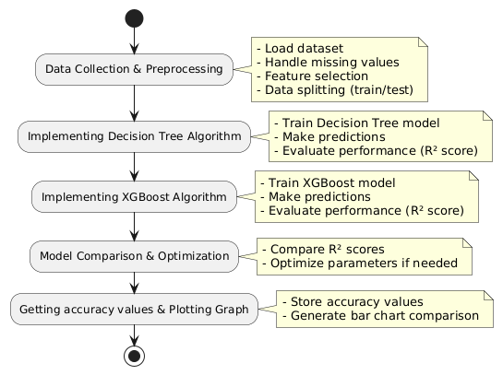
Flow diagram
Data Collection & Preprocessing
Implementing Decision Tree Algorithm
Implementing XG-Boost Algorithm
Model Comparison & Optimization
Getting accuracy values of each algorithms and Plotting them in Graphs

Slide 5
XG BOOST ALGORITHM:
XGBoost (Extreme Gradient Boosting) is an advanced machine learning algorithm based on the gradient boosting framework. It improves predictive accuracy by building multiple decision trees sequentially, with each tree correcting the errors of the previous ones. The process starts with a simple decision tree acting as a weak learner. Instead of predicting the target variable directly, XGBoost predicts the residual errors (the difference between actual and predicted values) from the previous model. This allows the next tree to focus on minimizing these errors, refining the overall prediction.

Slide 6
Decision tree Algorithm
A Decision Tree is a supervised machine learning algorithm used for classification and regression tasks. It works by splitting the dataset into smaller subsets based on conditions, creating a tree-like structure of decisions. The goal is to find the best way to divide the data to make accurate predictions.
To avoid overfitting, techniques like pruning (removing unnecessary branches) and setting constraints (maximum depth, minimum samples per split) are applied. Decision Trees are easy to interpret and work well with structured data, but they can become complex and prone to overfitting if not properly tuned.

Slide 7
Pseudocode:
Import necessary libraries (Pandas, Scikit-learn, XGBoost, Matplotlib).
Load the dataset from a CSV file.
Extract the target variable (last column of the dataset).
Separate features (X) and target variable (y) by dropping the target column.
Split the dataset into training (80%) and testing (40%) sets.
Initialize an XGBoost regressor with n_estimators=10.
Train the XGBoost model using the training data.
Make predictions on the test set using the trained XGBoost model.
Calculate R² score for XGBoost predictions.
Initialize a Decision Tree Regressor with max_depth=3.
Train the Decision Tree model using the training data.
Make predictions on the test set using the trained Decision Tree model.
Calculate R² score for Decision Tree predictions.
Plot a bar chart comparing the R² scores of both models.

Slide 8
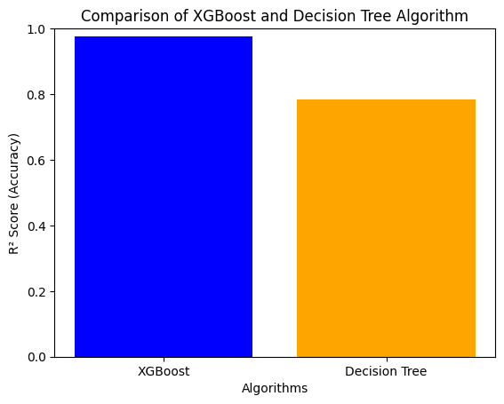
Output Comparison

Slide 9
CONCLUSION:
In this study, we implemented and compared XGBoost and Decision Tree algorithms to forecast sales based on historical data. The results demonstrated that both models effectively captured patterns in the dataset, but with notable differences in performance.
The results confirm that XGBoost serves as a powerful enhancement over traditional Decision Tree algorithms for sales forecasting tasks. Its ability to handle non-linearity, optimize performance through boosting, and generalize better to unseen data makes it a preferred choice for improving forecasting accuracy. However, the selection of the model should be based on factors such as data complexity, computational resources, and interpretability requirements.

Slide 10
Thank you

