Slide 1
Bleach marks One month after…

Slide 2
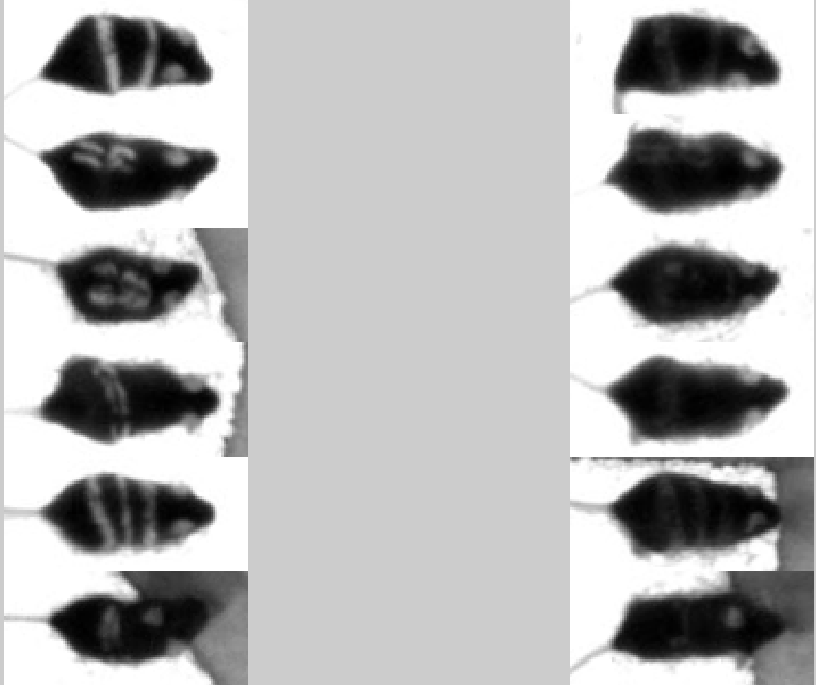
Nov Dec

Slide 3
Classifier’s Performance
1.1850 0.1400 1.4450 80.3400 0.3100 16.5800
0.2000 28.5500 0.8950 51.8050 0.1500 18.4000
0.4150 0.9250 2.3450 32.6700 0.3800 63.2650
1.2250 0.4950 0.9850 77.5500 0.1150 19.6300
0.1700 0.0150 0.4400 85.2150 0.3150 13.8450
0.2250 0.5250 0.6900 7.1750 0.0750 91.3100

Slide 4
Feature projection

