Slide 1
Campaign Analytics Report
Heven Abraha, Haotian Du, Rutendo Nyoka, Julia See

Slide 2
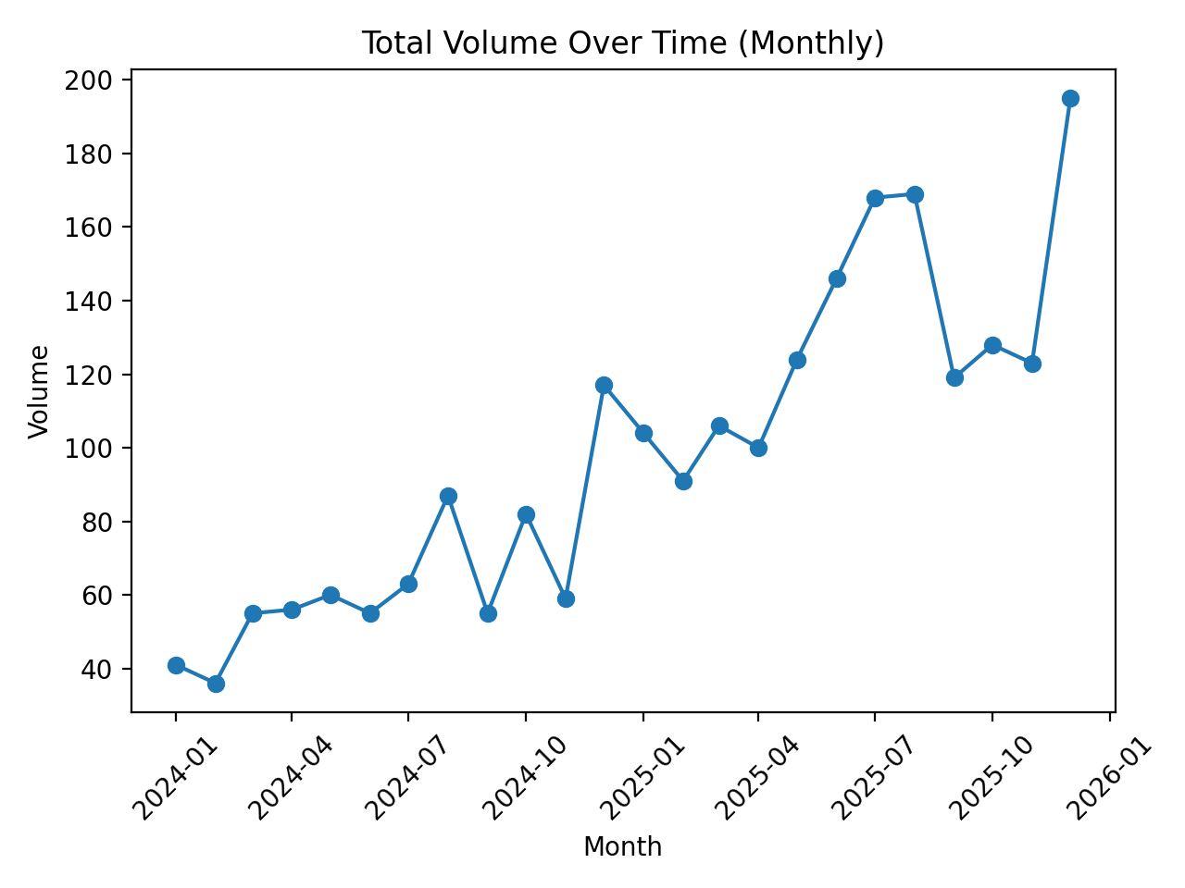
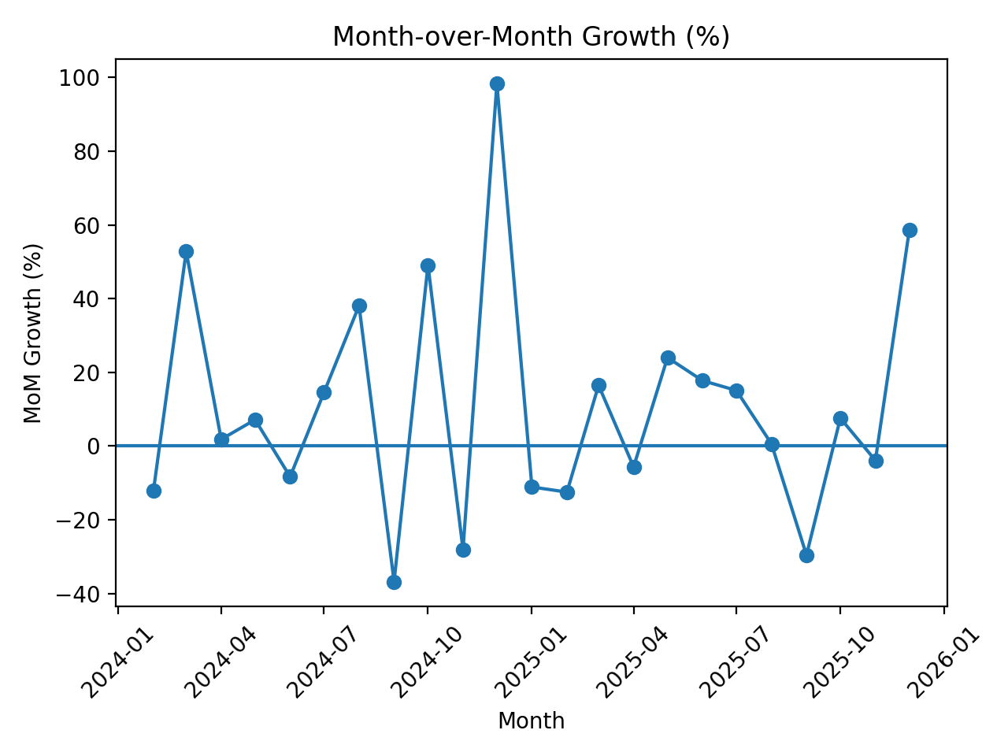
Q1: How Has Campaign Volume Changed?
Key Findings
- Total campaign volume more than doubled from 2024 to 2025, surging by 105.4% to reach 1,573 deployments compared to 766 in the prior year.
- This rapid historical scaling implies a significantly higher operational load on the deployment team, highlighting strong business adoption of campaign services while underscoring the necessity of process automation to sustain such throughput.

Slide 3
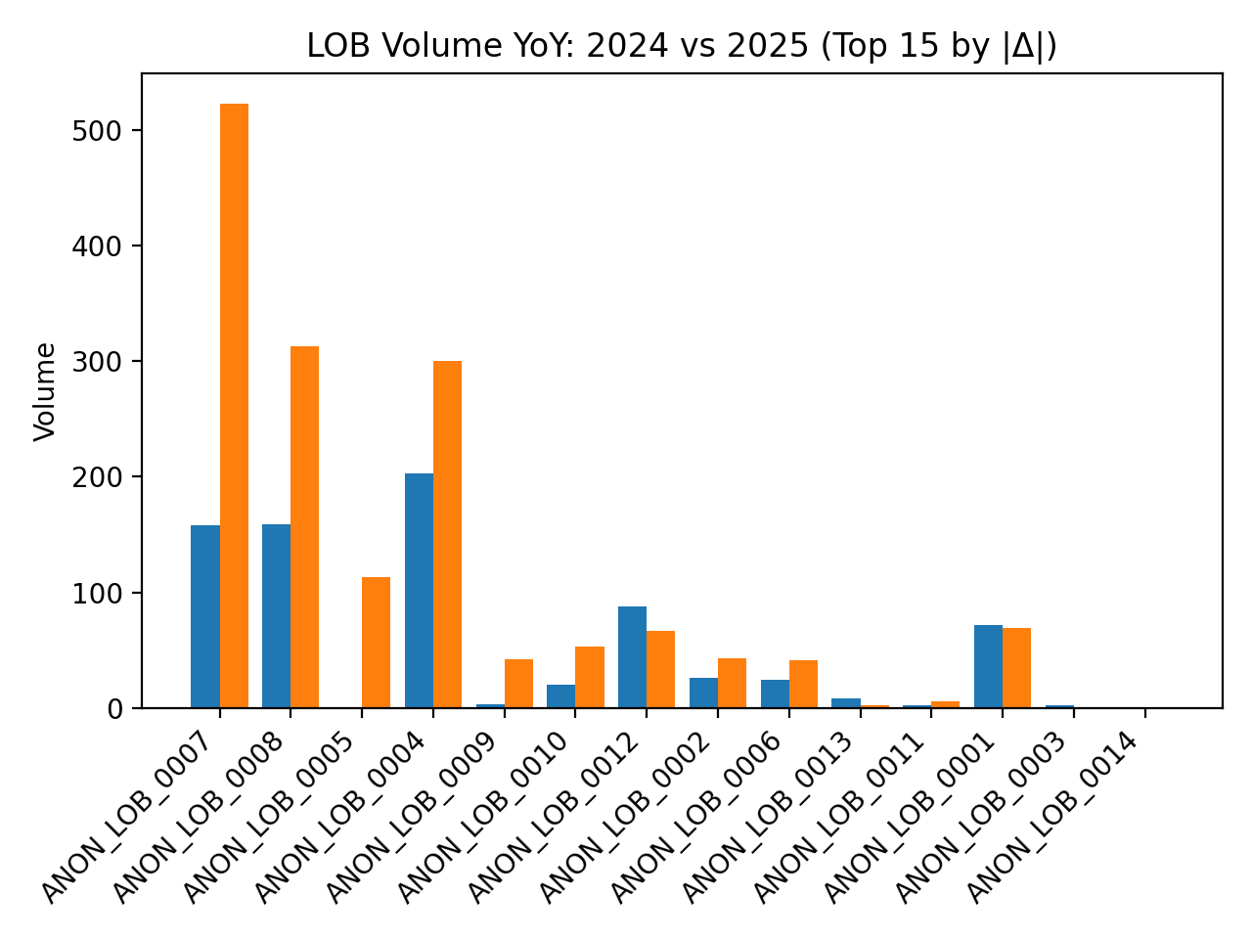
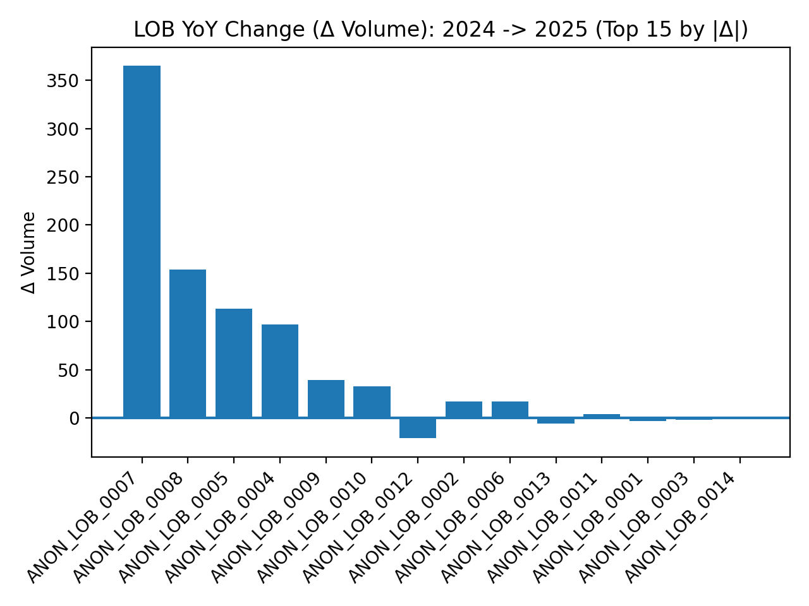
Q2: Which Lines of Business Drive Volume?
Key Findings
- ANON_LOB_0007 was the primary catalyst for 2025 growth, adding 365 campaigns year-over-year and accounting for 45.2% of the total volume increase, followed by notable gains from ANON_LOB_0008 and ANON_LOB_0005.
- The disproportionate concentration of volume growth in a few top LOBs indicates that marketing demand became increasingly localized, suggesting a business case for dedicated resource alignment and specialized support for these high-utilization groups.

Slide 4
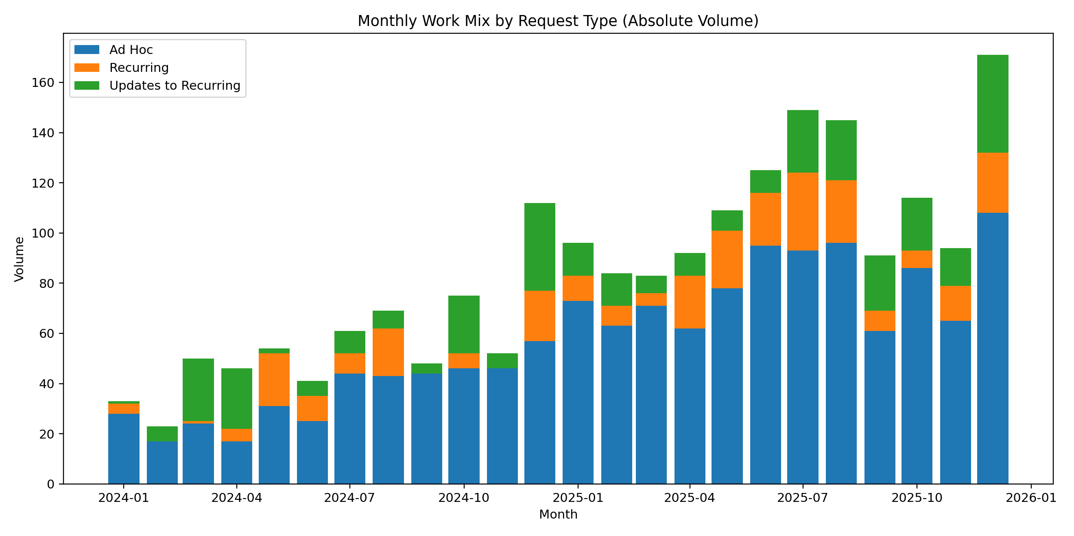
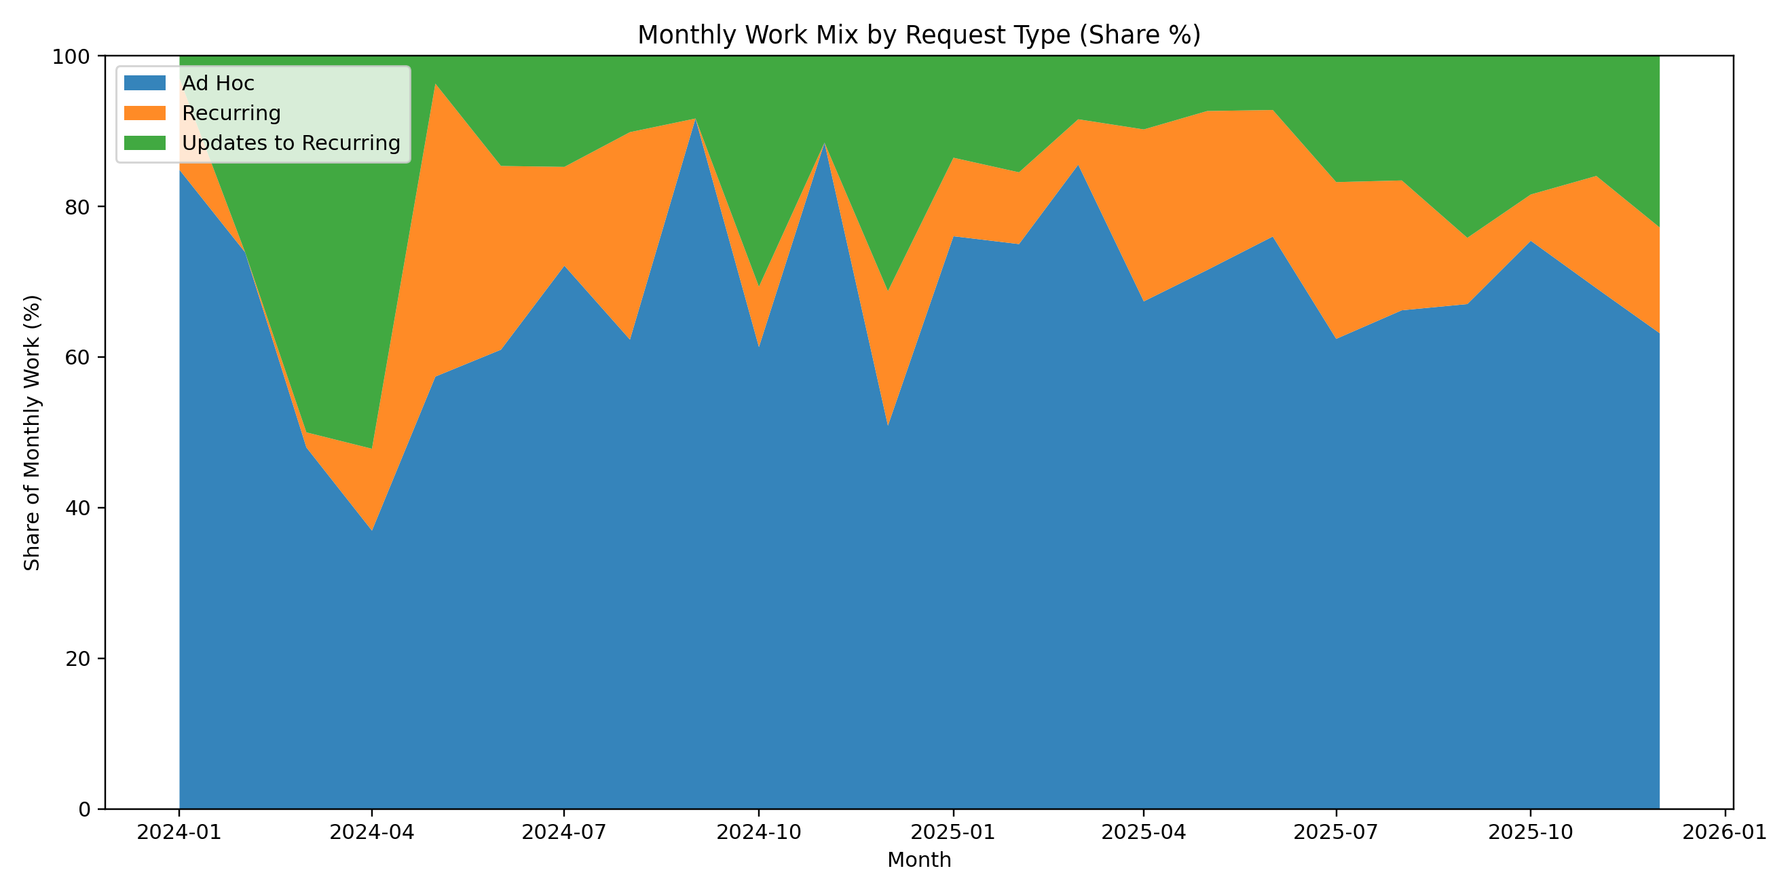
Q3: How Is the Work Mix Shifting?
Key Findings
- Ad Hoc campaigns dominated the historical request mix and expanded their majority share from 63.6% in 2024 to 70.3% in 2025, while the share of updates to recurring campaigns declined from 22.3% to 15.2%.
- The expanding reliance on Ad Hoc deployments highlights a highly reactive marketing strategy during 2025, which likely introduced greater workflow unpredictability and planning friction for execution teams compared to standardized recurring campaigns.

Slide 5
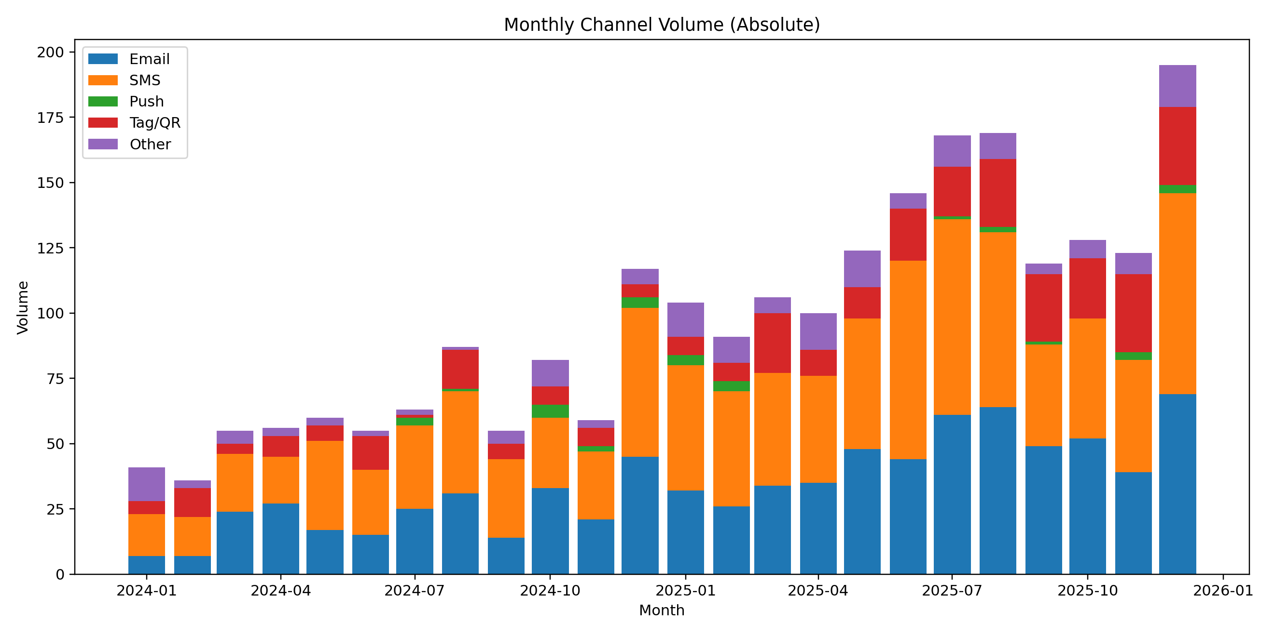
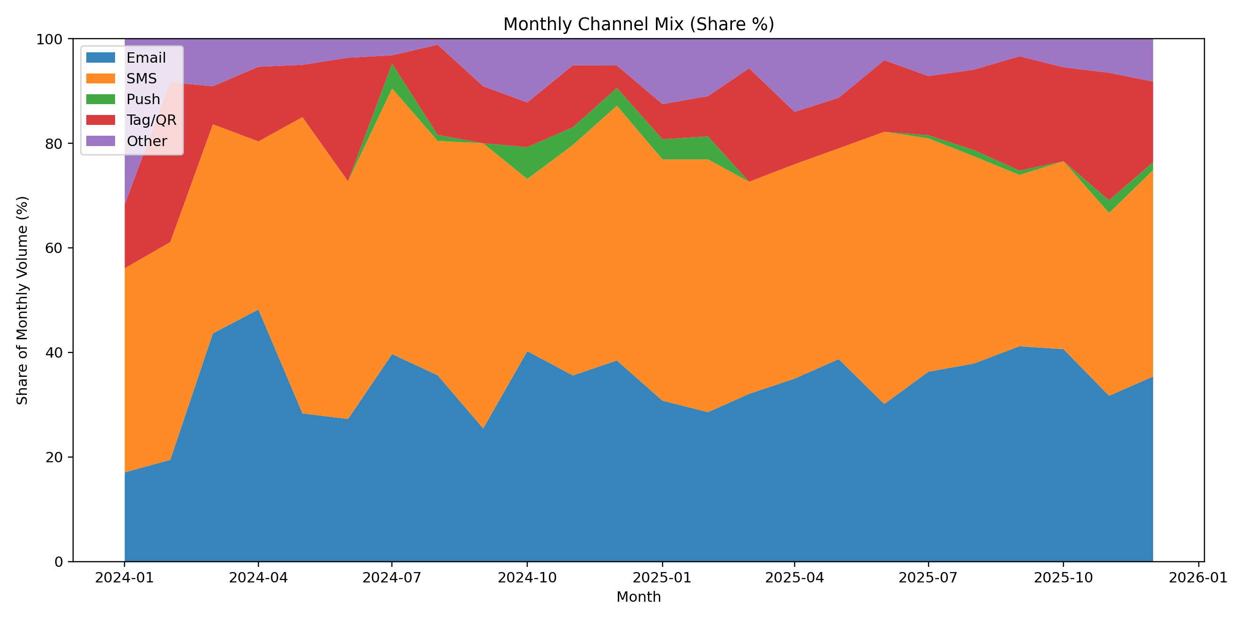
Q4: How Is Volume Distributed by Channel?
Key Findings
- SMS and Email maintained their status as the core deployment channels across both years, combined representing over 76% of all campaigns in 2025, while Tag/QR deployments saw a modest share increase from 11.5% to 14.8%.
- The steady historical reliance on direct-messaging channels (SMS and Email) points to an established, proven engagement strategy, whereas the measurable growth in Tag/QR indicates an effective diversification into offline-to-online customer touchpoints.

Slide 6
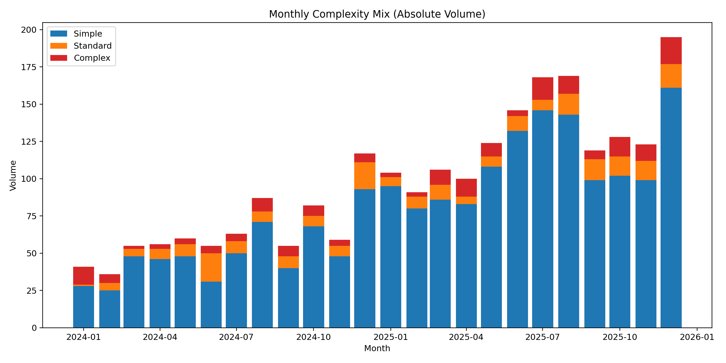
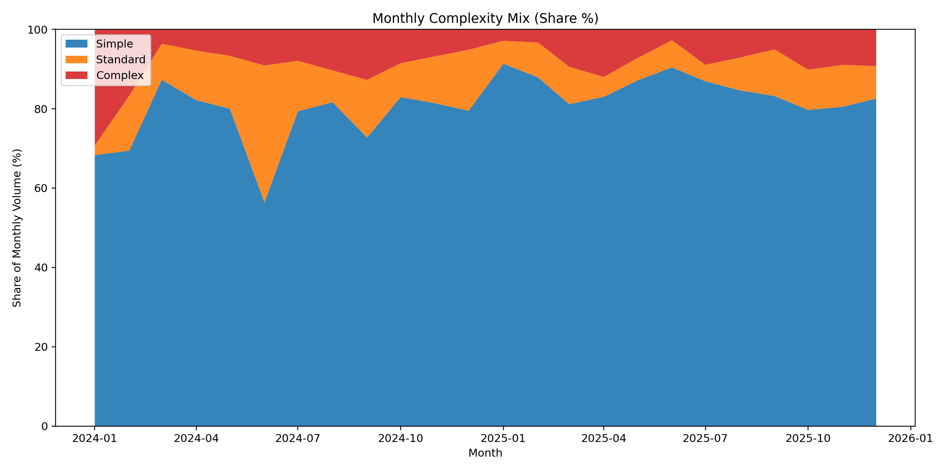
Q5: Is Complexity Mix Shifting Over Time?
Key Findings
- The proportion of "Simple" tier campaigns increased markedly, rising from 77.8% of deployments in 2024 to 84.8% in 2025, simultaneously compressing the share of "Standard" and "Complex" request types.
- This historical shift toward simpler execution types suggests that teams successfully streamlined their deliverables or leaned heavily into easily repeatable templates to manage the 105% surge in overall campaign volume without bottlenecking technical resources.

Slide 7
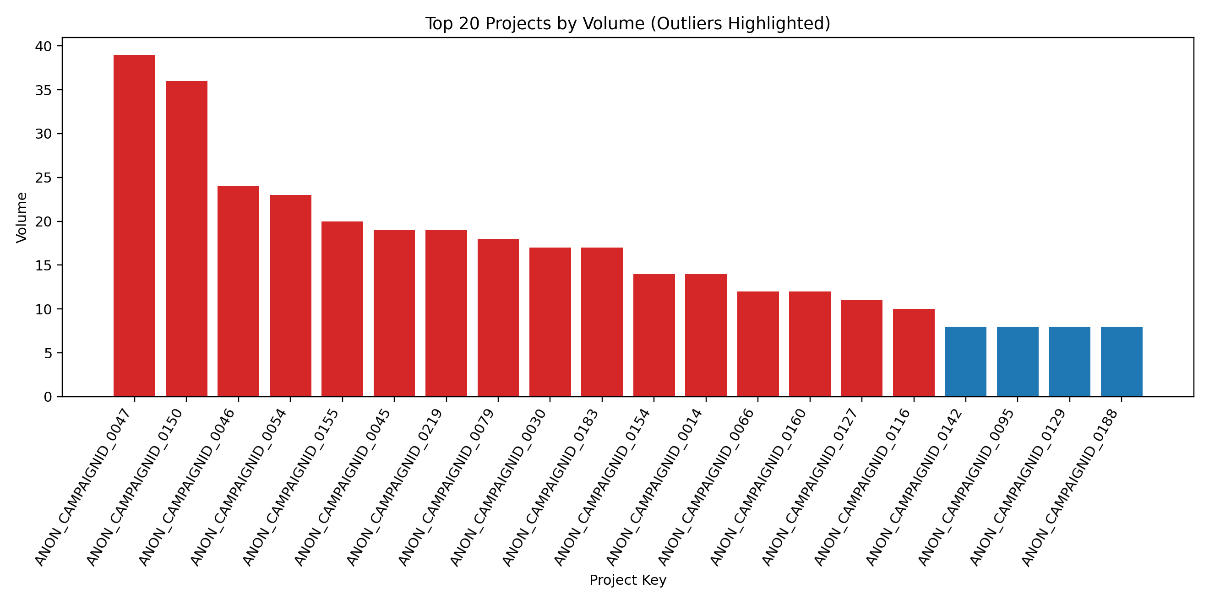
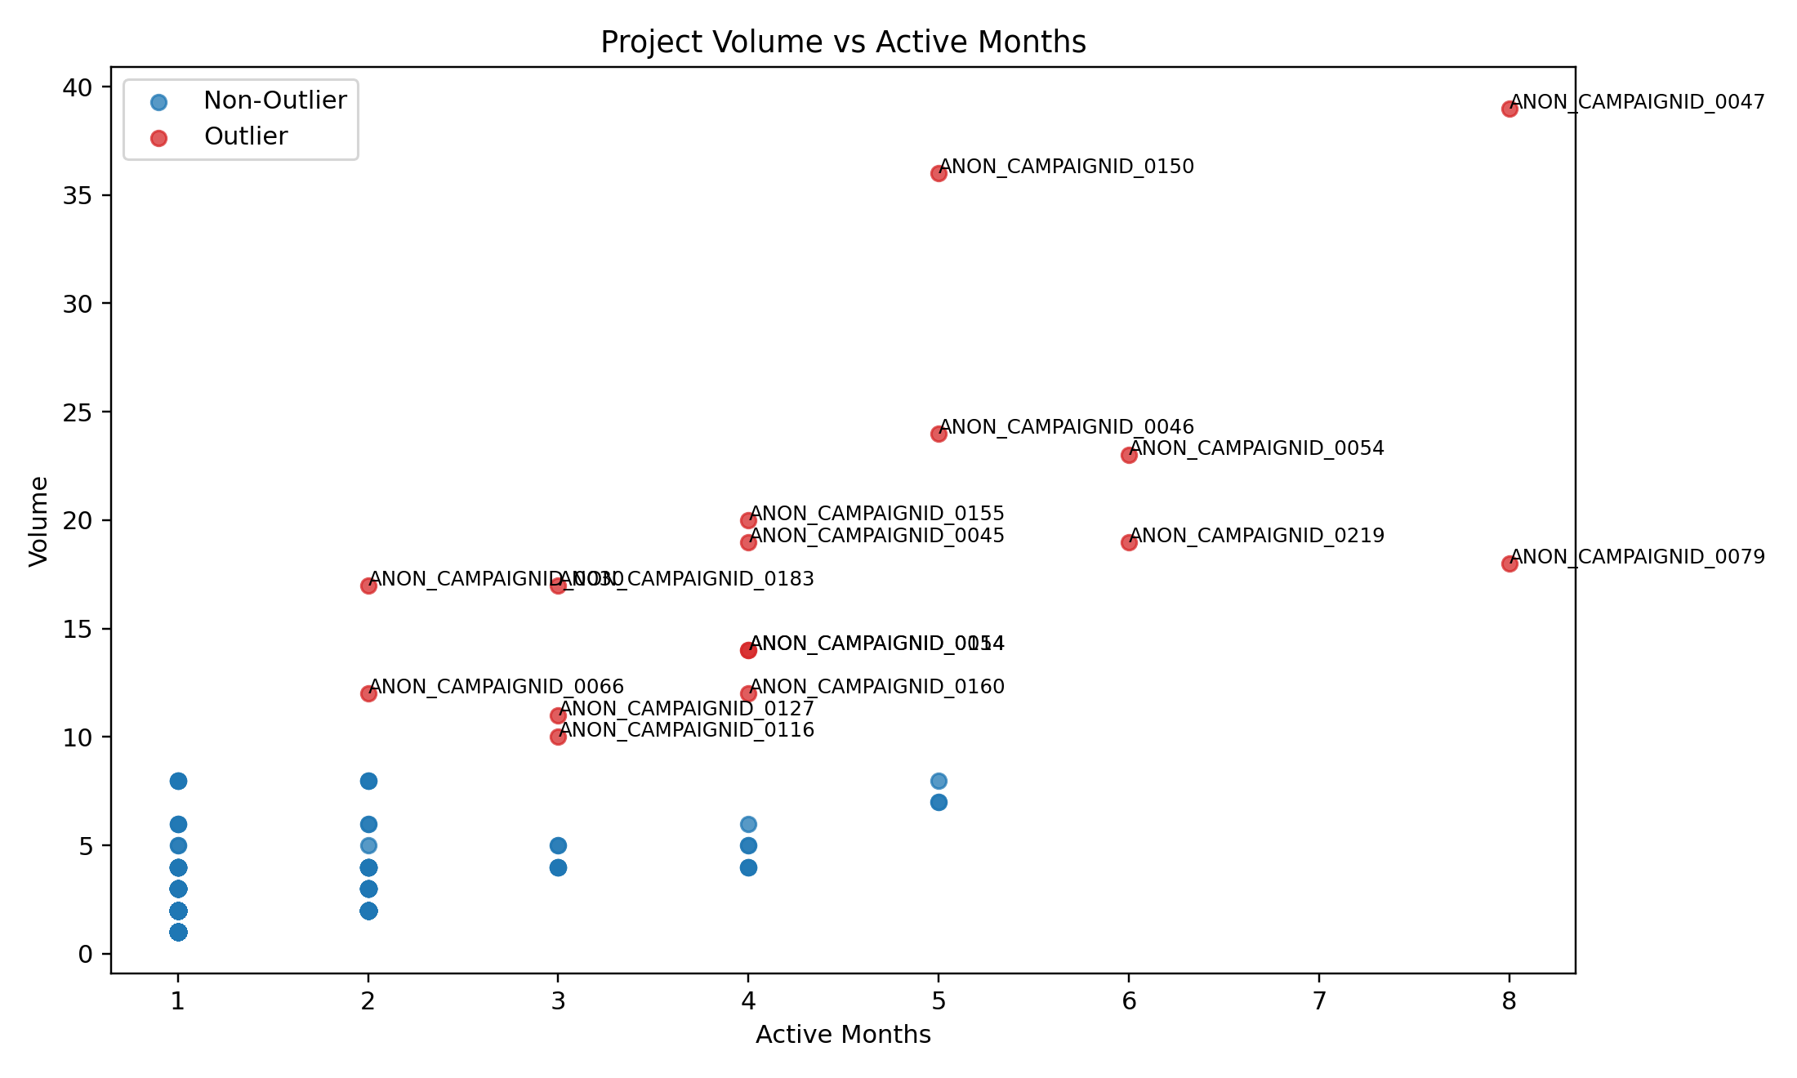
Q6: What Are the Biggest Outlier Projects?
Key Findings
- High-frequency outlier projects, such as ANON_CAMPAIGNID_0047 (39 deployments), heavily over-indexed in "recurring - update" requests (3.06x share lift) and were notably concentrated in ANON_LOB_0004 (3.43x share lift).
- The distinct profile of these historical outliers reveals that systemic repetition largely stemmed from frequent, iterative modifications to existing campaigns within specific LOBs, identifying where dynamic content automation could have reduced redundant manual touches.

Slide 8
AI Follow-up Questions (1/2)
1. Which specific LOBs drove the 105% year-over-year volume growth in 2025?
- Can answer now: Yes
- Current insight: Volume growth was heavily concentrated in three areas: ANON_LOB_0007 accounted for 45.2% of the increase (+365 requests), followed by ANON_LOB_0008 at 19.1% (+154 requests), and ANON_LOB_0005 at 14.0% (+113 requests).
2. Which characteristics are most over-represented among the high-frequency outlier campaigns?
- Can answer now: Yes
- Current insight: The attributes with the highest likelihood of appearing in outlier projects compared to the baseline are the LOB 'ANON_LOB_0004' (3.43x share lift), 'recurring - update' request types (3.06x share lift), LOB 'ANON_LOB_0005' (3.05x share lift), and the 'Complex EM' channel (2.79x share lift).

Slide 9
AI Follow-up Questions (2/2)
3. Why did ANON_LOB_0007 experience such a significant surge in volume in 2025 without becoming a major driver of outlier campaigns?
- Can answer now: No
- Direction: Interview the Channel Lead and stakeholders for ANON_LOB_0007 to document their campaign planning and submission process, aiming to scale their practices to inefficient LOBs like ANON_LOB_0004.
4. What is causing ANON_LOB_0004 to submit such highly fragmented recurring updates, driving massive outlier volume?
- Can answer now: No
- Direction: Review the specific request logs and brief notes for ANON_LOB_0004's recurring updates to determine if they are submitting by region, audience slice, or due to errors, and implement a consolidation rule.

