Slide 1
Kasole secrets
INTERNATIONAL BUSINESS AGILITY LAB
CASE STUDY 2026

Slide 2
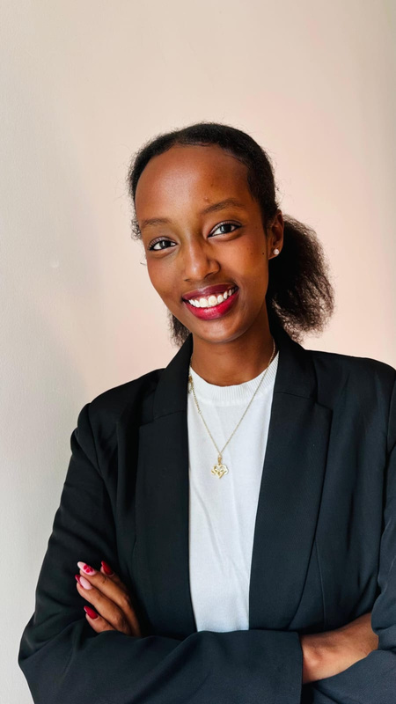




Our team
Aditya Agarwal
Julia See
Danilo Stanic
Jaylynne Yang
Rufo Abraham
01

Slide 3
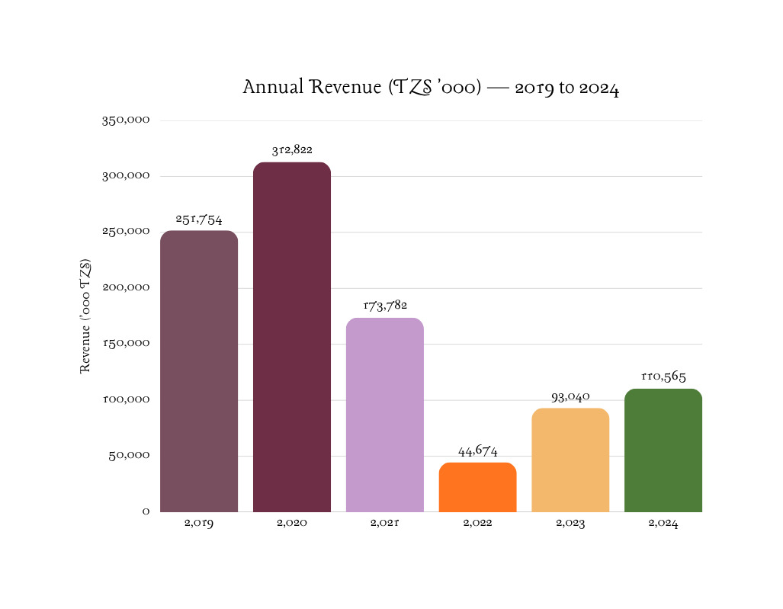
Executive Summary
~50%
Gross Margin Held
Every year 2019–2024. The unit economics never broke.
91%
Volume Lost
109K packets → 10K. Distribution collapsed, not the product.
0.3%
Tanzania Market Share
1$13.16M import market. Massive room to grow.

Slide 4
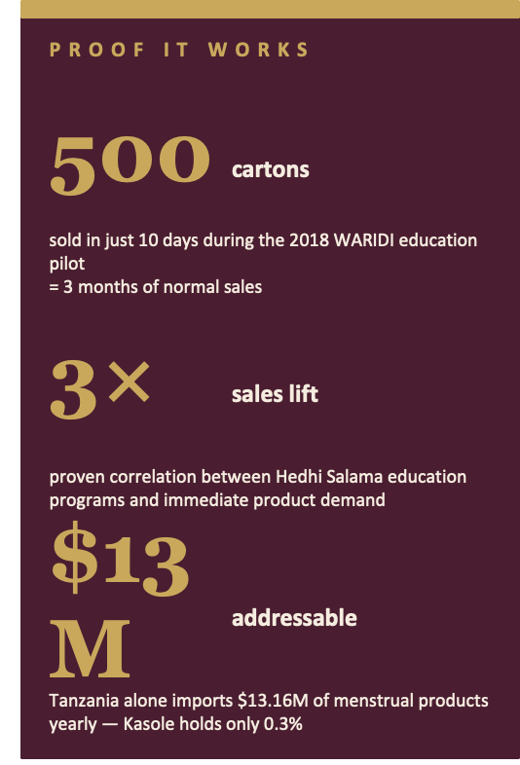
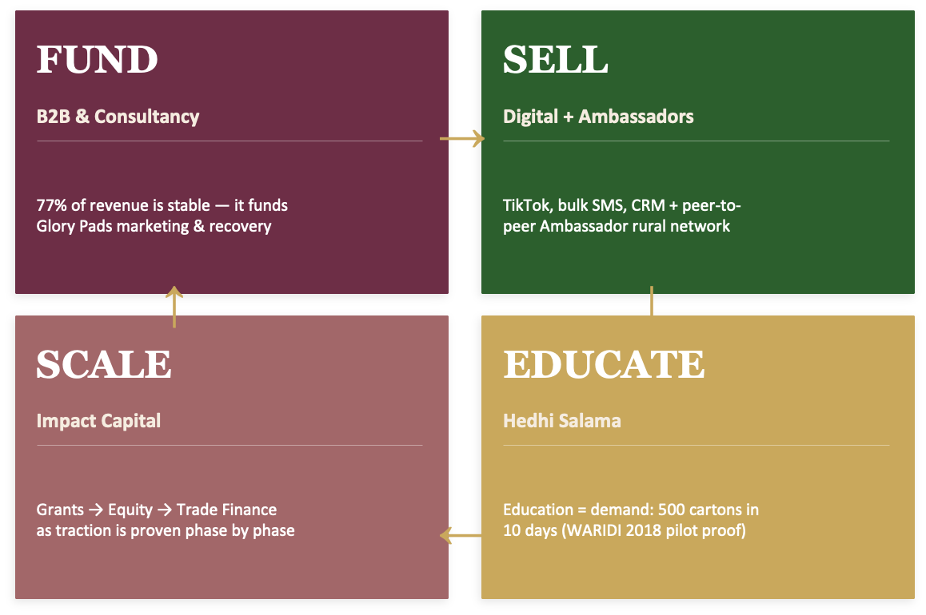
The Strategy: A Self-Funding Growth
Flywheel

Slide 5

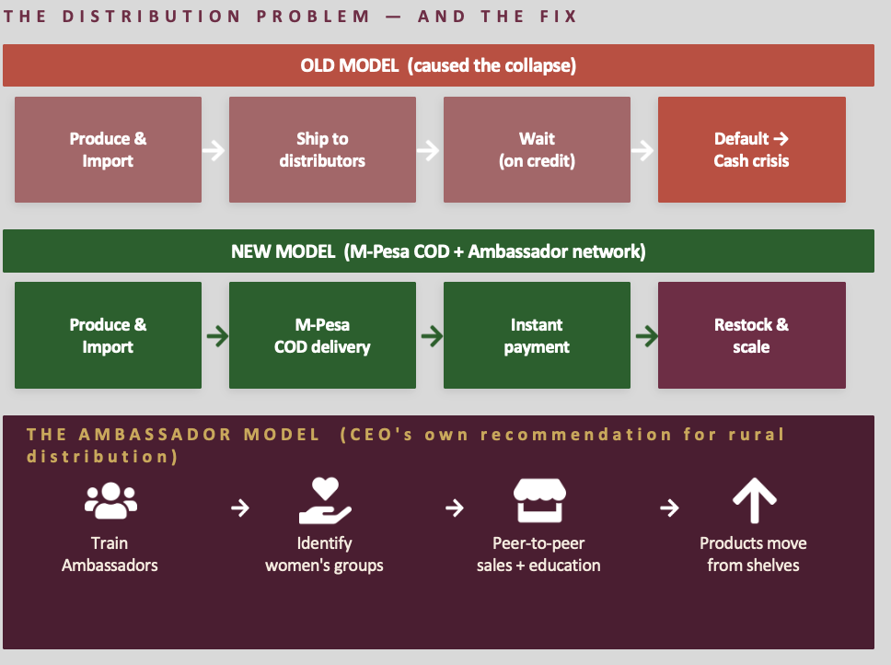
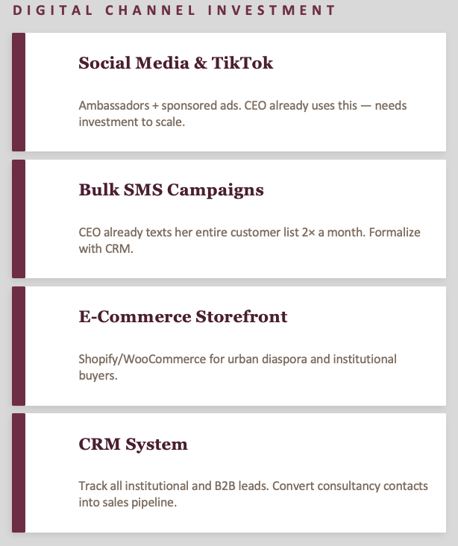

Slide 6

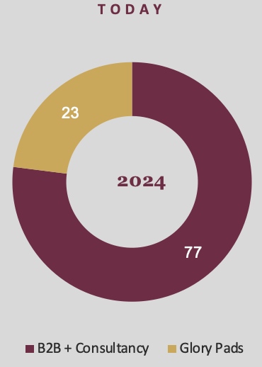
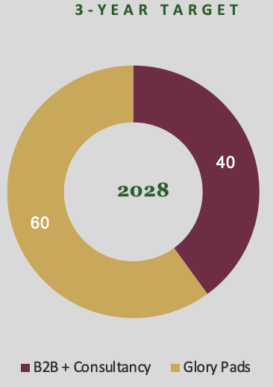

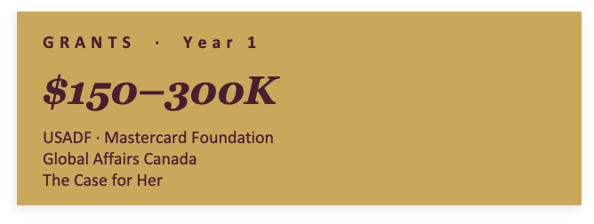

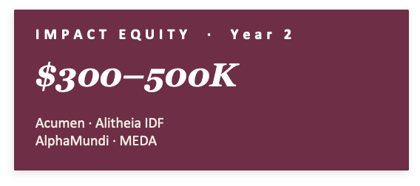
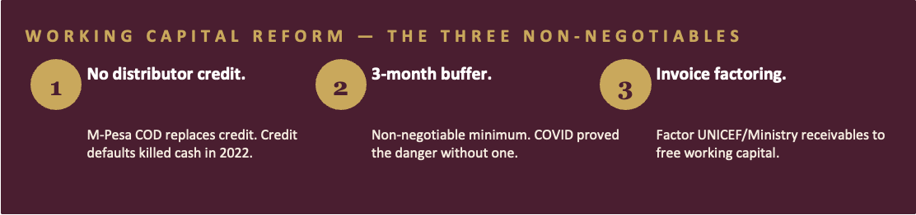
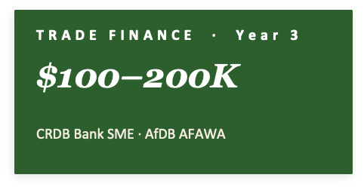

Slide 7

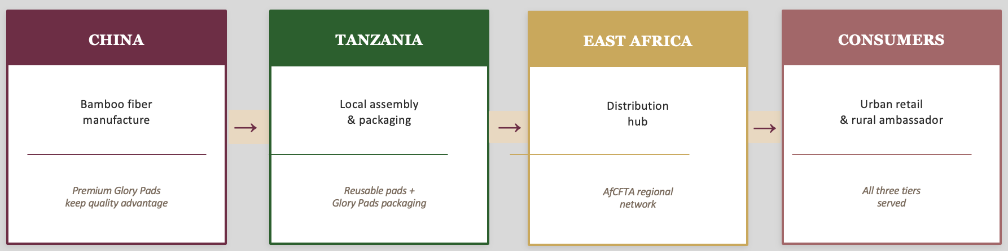
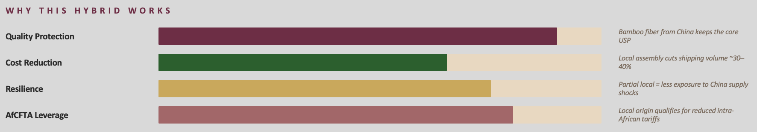

Slide 8
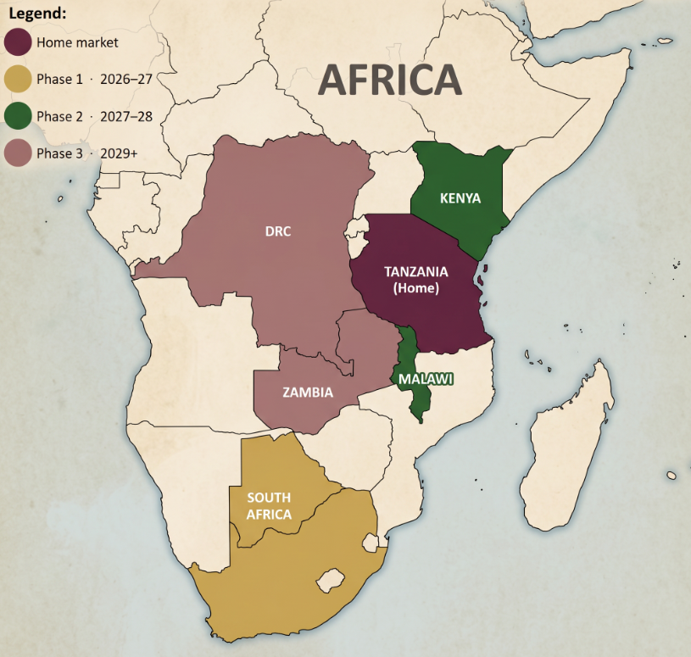
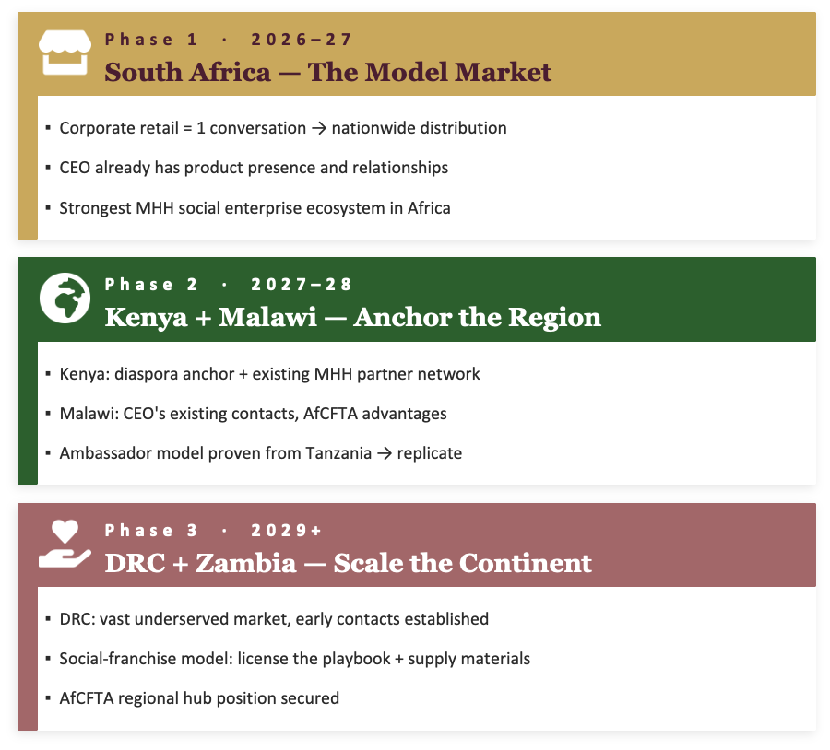

Slide 9
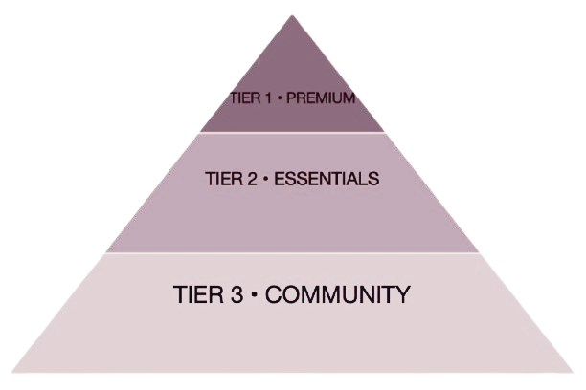
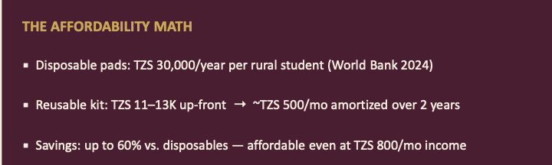
5) Sustainable access model for low-income & underserved communities
TWO HIGH-IMPACT INNOVATIONS
1.Revive the School Supply Program
• Schools receive subsidized pads
• Those who can afford pay; those who can't get free
• Schools = distribution + education hubs
• Impact:Reach 60–70% of unreached rural girls
2.Male Allyship as a Sales Driver
Men often control household budgets in rural Tanzania
Hedhi Salama already educates boys and men to break stigma
When men understand menstrual health, they support spending on quality products instead of blocking it
Result: Removes the "gatekeeper barrier" and turns men into active buyers and supporters

Slide 10
