Slide 1
Building an Expected Goals (xG) Model From Shot-Event Data
Jayanth Nair
A Springboard Capstone Project

Slide 2
Overview
What is xG ?
Data wrangling
Data exploration
Predictive modeling
Model applications

Slide 3
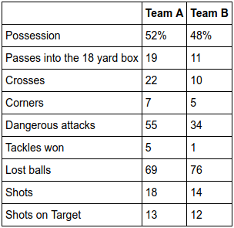
What is xG ?
Probability of a shot to be scored
Part of a statistical revolution in soccer
Courtesy – Football Hackers, by Christoph Biermann

Slide 4
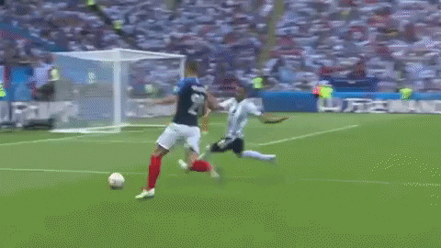
xG in Real Life

Slide 5
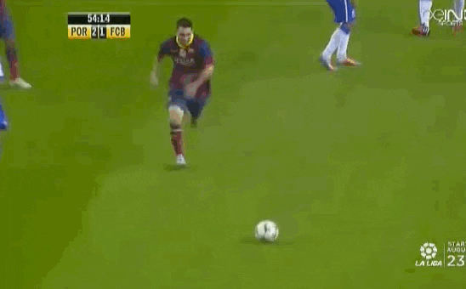
xG in Real Life

Slide 6
Data Wrangling
StatsBomb Open Data – Women’s Soccer
  3 leagues, 1 world cup
JSON format
Event level data
  Over 5900 shots

Slide 7
Data Wrangling
Directly extracted
  Shot location
  Pass info
  Defense info
  Body part involved in shot
  Shot outcome
  StatsBomb xG
  …..

Slide 8
Data Wrangling
Engineered
  Shot distance
  Shot angle
  Packing density
(goal_x1, goal_y1)
(goal_x2, goal_y2)
player_locations
(shot_x, shot_y)

Slide 9
Data Wrangling
Missing Values
  Key pass information
  Shot angle

Slide 10
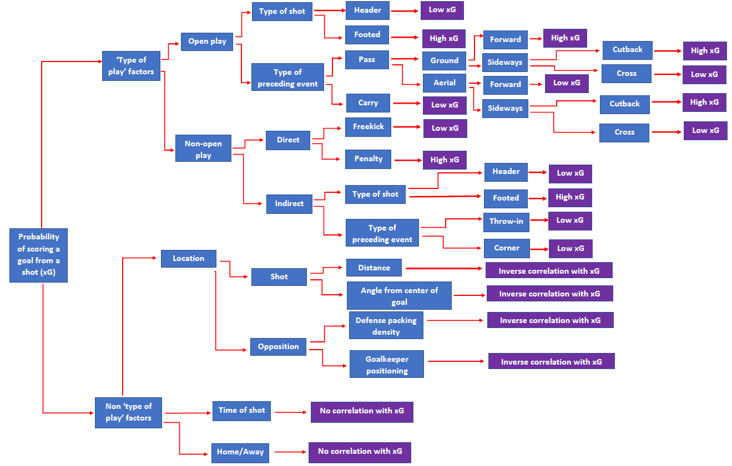
Data Exploration

Slide 11
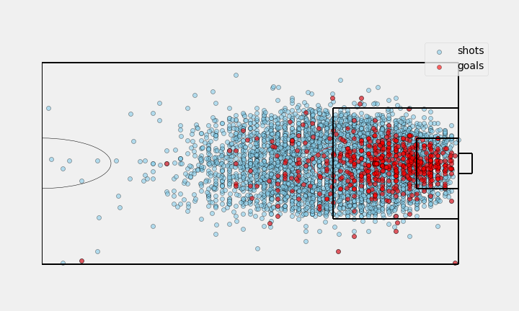
Data Exploration

Slide 12
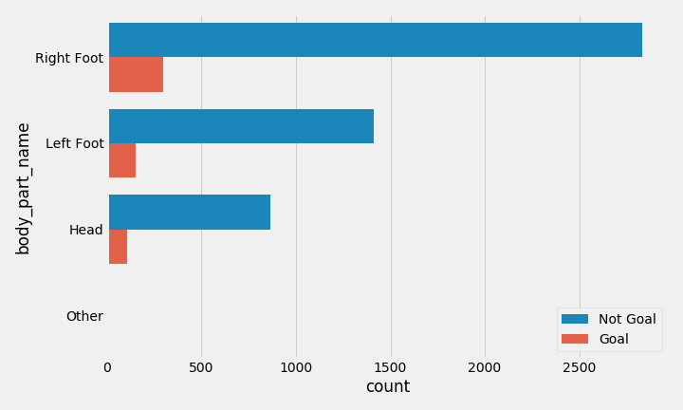
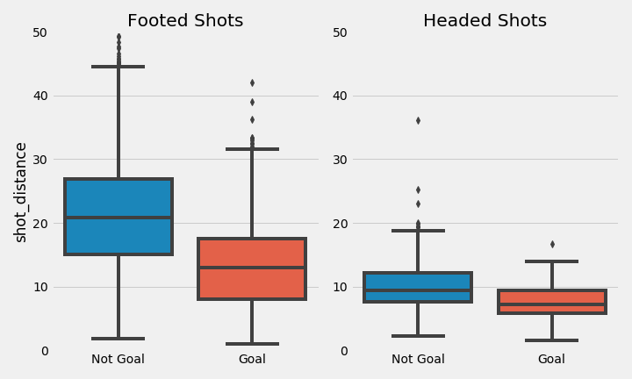
Data Exploration
Within penalty box conversion probabilities
Footed shots – 17%
Headed shots – 11%
Statistically significant (A/B testing)

Slide 13
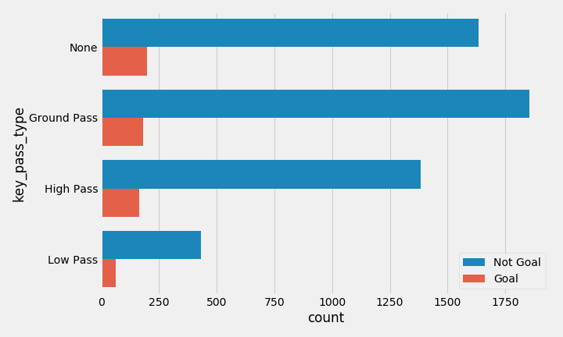
Data Exploration
Conversion probabilities of resultant shots
Ground passes – 9%
High passes – 11%
Low passes – 13%
Difference between low and ground passes – Statistically significant

Slide 14
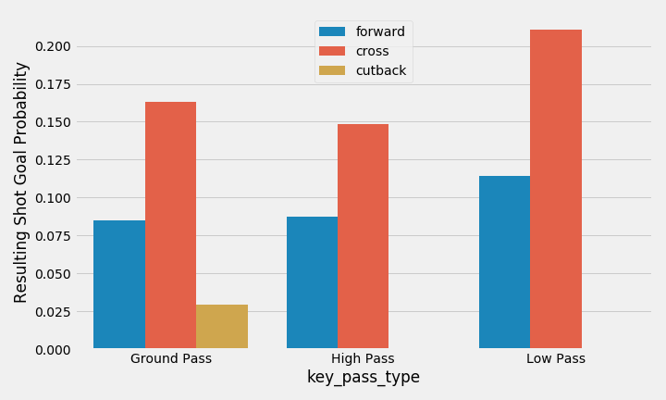
Data Exploration
Low sample sizes for cutbacks – dropped from data

Slide 15
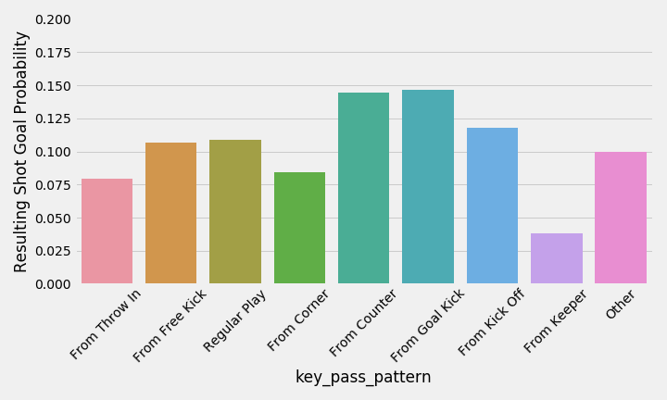
Data Exploration
Low sample sizes for many patterns – grouped into regular and non-regular patterns

Slide 16
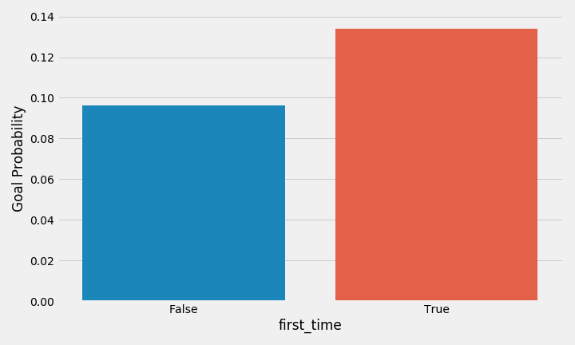
Data Exploration
Statistically significant from A/B testing

Slide 17
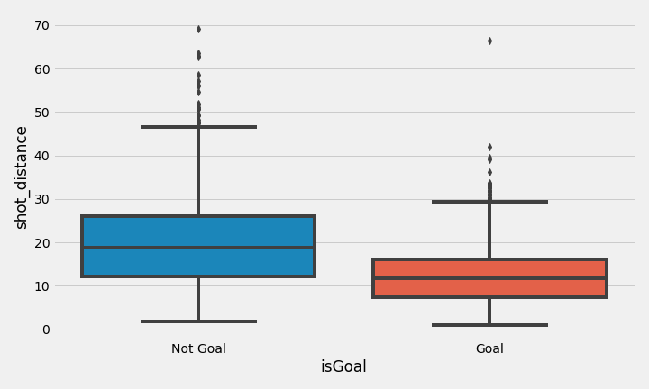
Data Exploration
Statistically significant from A/B testing

Slide 18
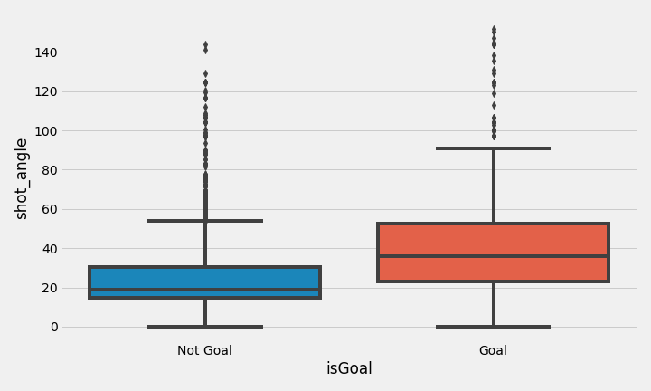
Data Exploration

Slide 19
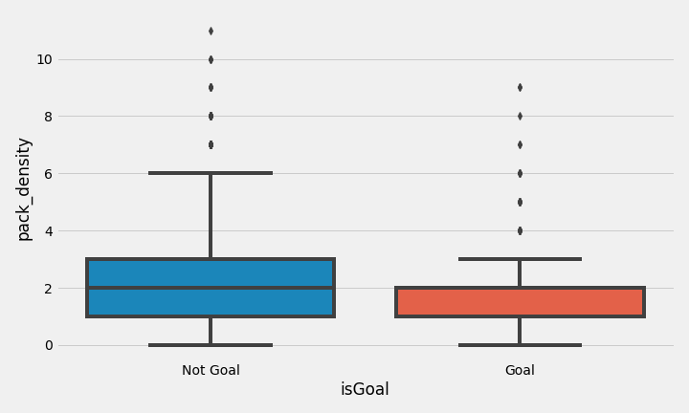
Data Exploration
Statistically significant from A/B testing

Slide 20
Predictive Modeling
Aim – estimate probabilities
Preprocessing
  Feature selection
    8 features and 5615 samples
  Categorical (text) features - 5
    OneHotEncoder
  Numerical features – 3
    StandardScaler
ColumnTransformer

Slide 21
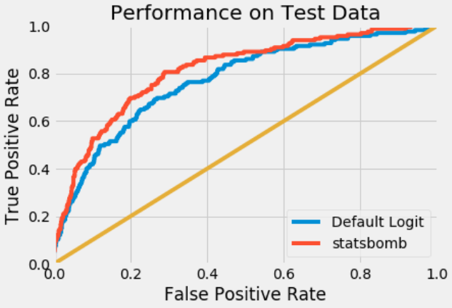
Predictive Modeling
Models tested:
  Logistic Regression
  SVC
  Random Forest
  Bagging
  AdaBoost
  Gradient Boosting
  KNN
  XGBoost
Benchmark – StatsBomb xG model
  0.81 AUC score on test set
‘Rough’ grid search for hyperparameter tuning

Slide 22
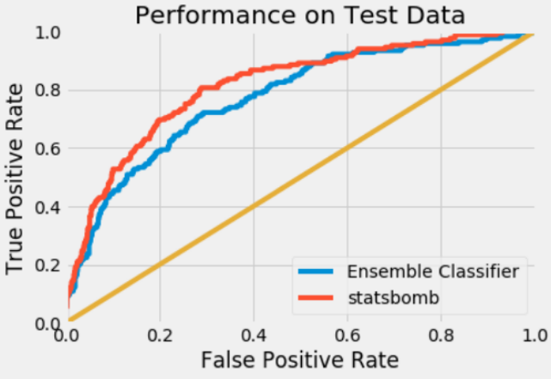
Predictive Modeling
Model | AUC Score | Rank
Logistic Regression | 0.771 | 1
XGBoost | 0.769 | 2
Gradient Boost | 0.769 | 3
SVC – RBF Kernel | 0.762 | 4
Random Forest | 0.761 | 5
AdaBoost | 0.761 | 6
Bagging | 0.753 | 7
KNN | 0.752 | 8
SVC – Polynomial Kernel | 0.68 | 9
Ensemble Classifier
AUC Score – 0.773

Slide 23
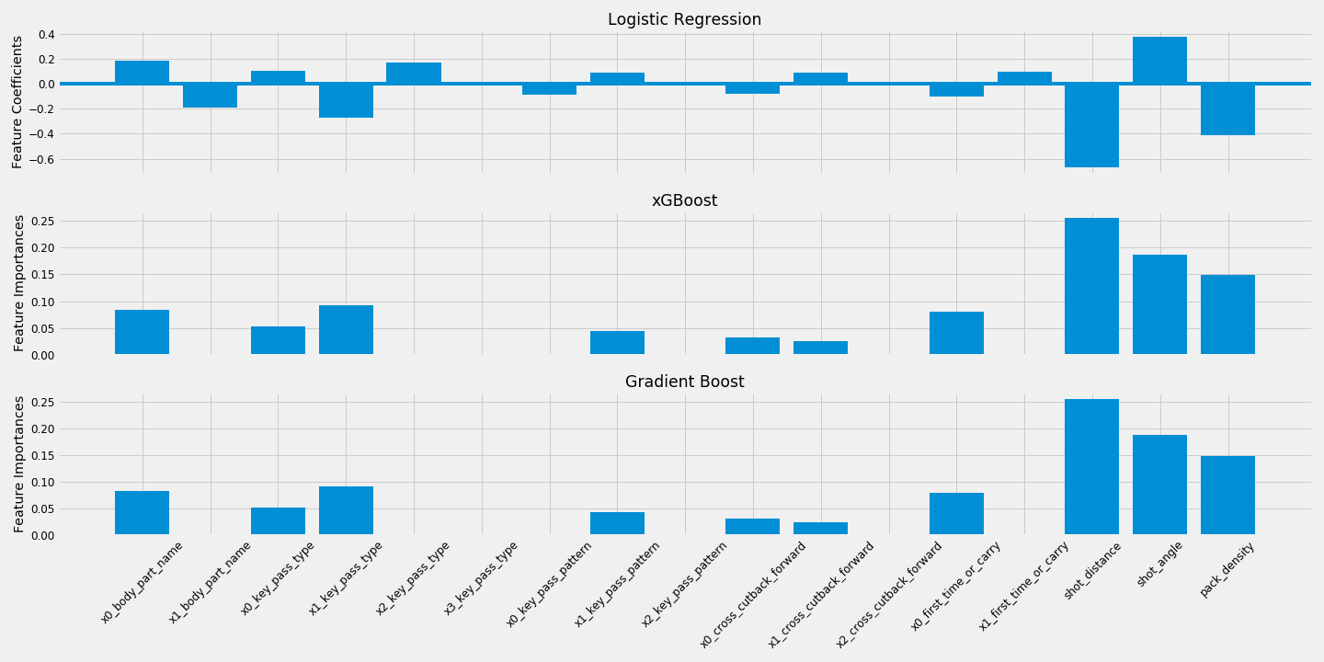
Predictive Modeling

Slide 24
Model Application
WSL 2018-2019 Season
  Player
  Match
  Team

Slide 25
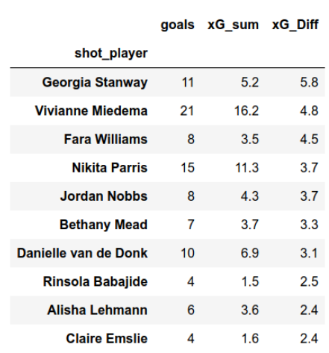
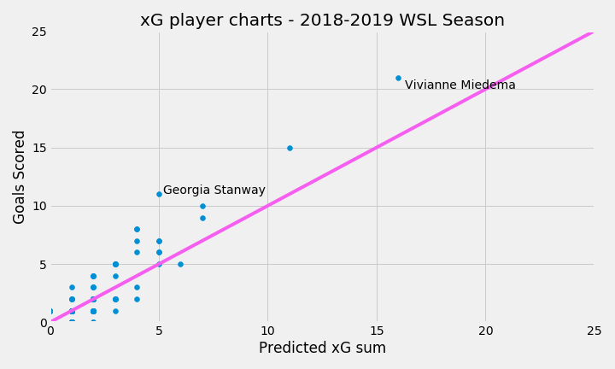
Model Application

Slide 26
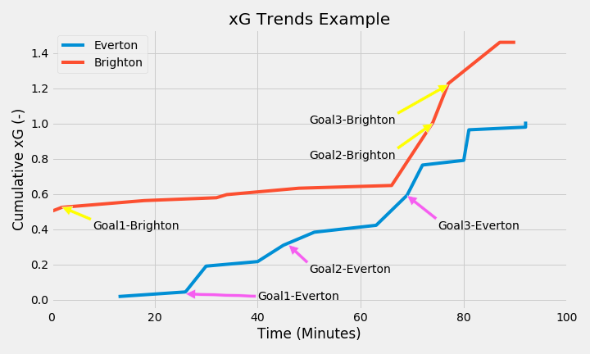
Model Application

Slide 27
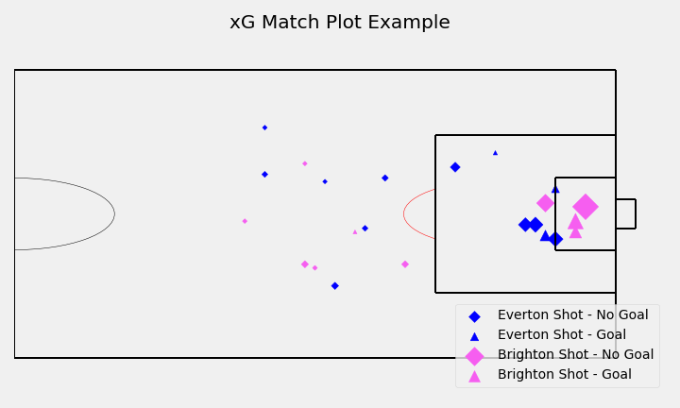
Model Application

Slide 28
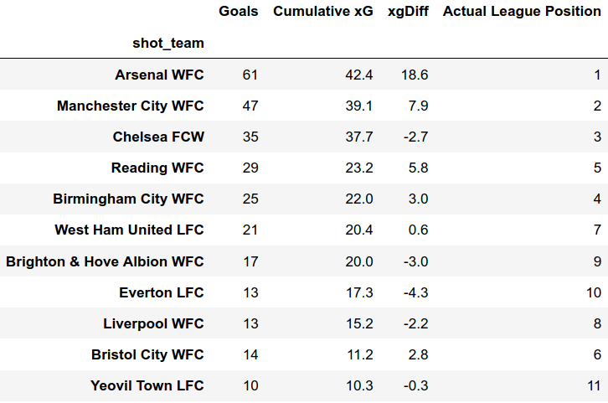
Model Application

Slide 29
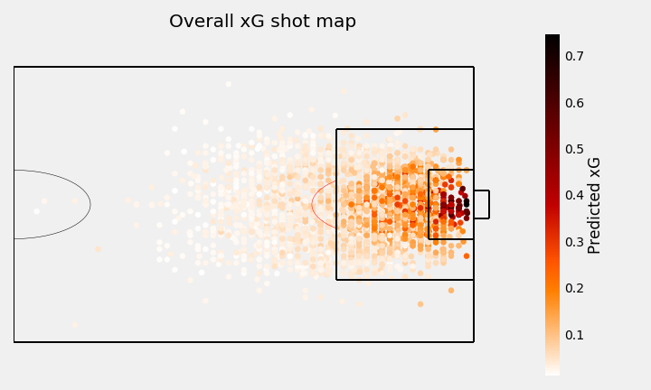
Model Application

Slide 30
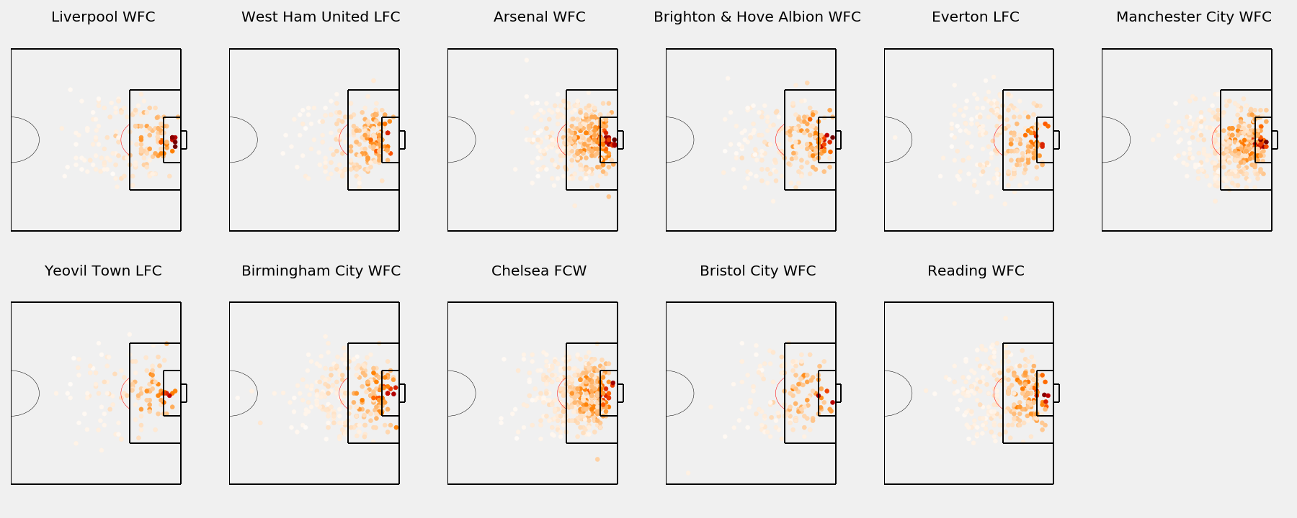
Model Application

Slide 31
Acknowledgments
Ankur Verma, Springboard Mentor
Springboard Community
StatsBomb

