Slide 1
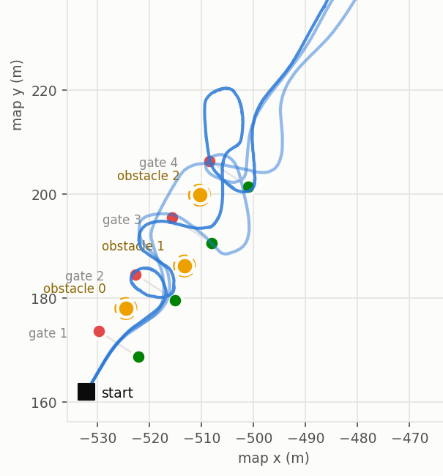
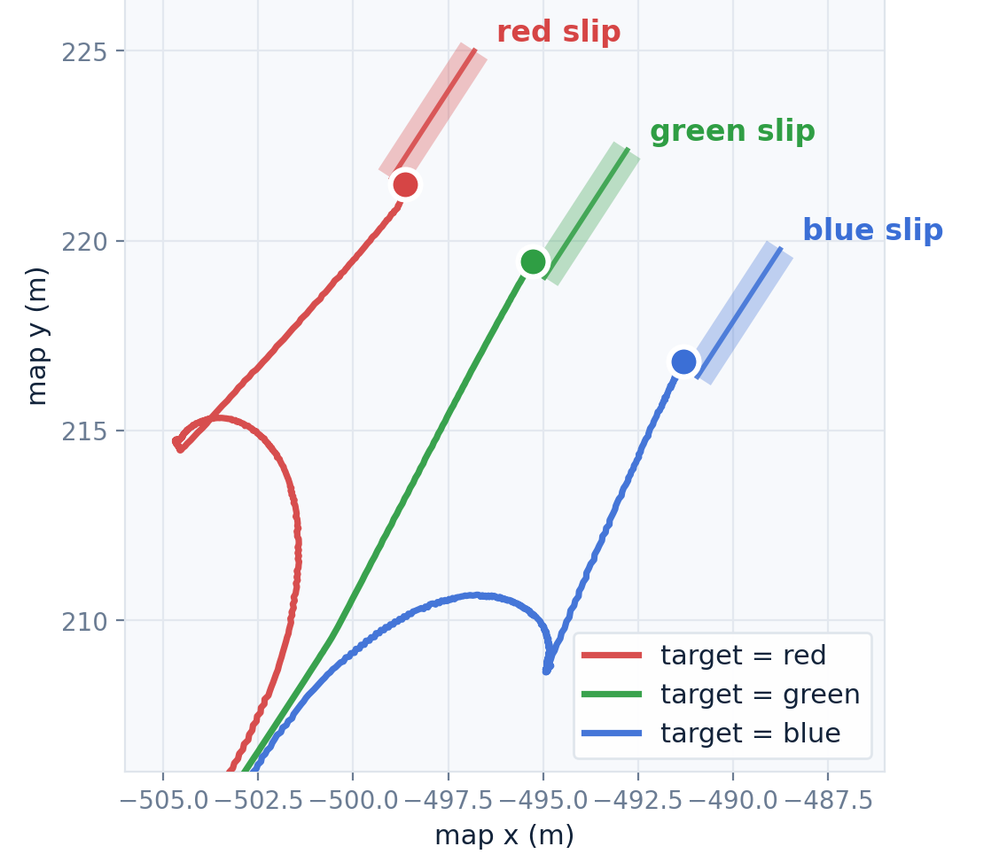

¿Something with boats?
J. Vaught; Mech. Engr.; Dr. Yi Wang
Notes:
1

Slide 2
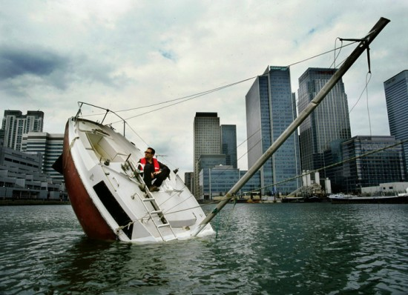
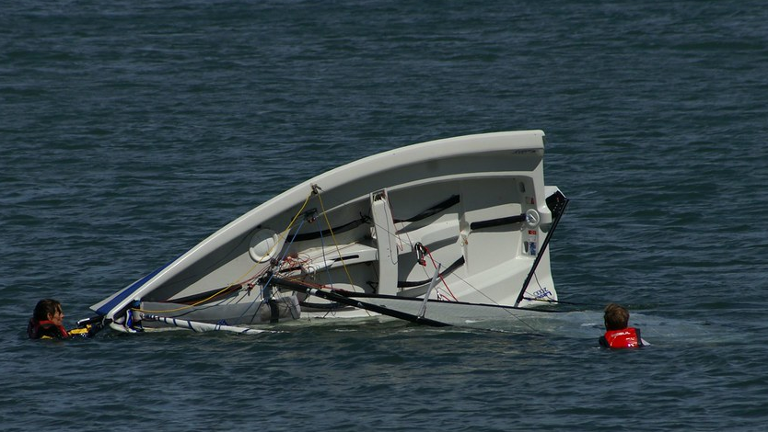
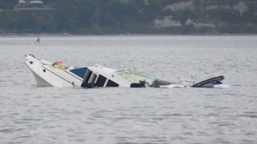
General Project Overview
Q: What system is being studied?
A: An autonomous boat system, specifically thrust control.
Q: Why does it matter?
A: Important for a boat to reject wind, water, and non-linear disturbances
Q: What should it eventually do?
A: Reject disturbances and follow a defined target(moving or stationary)

Slide 3
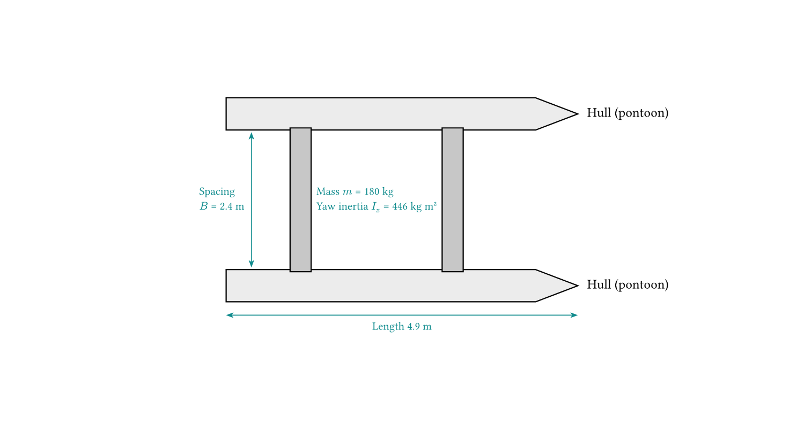
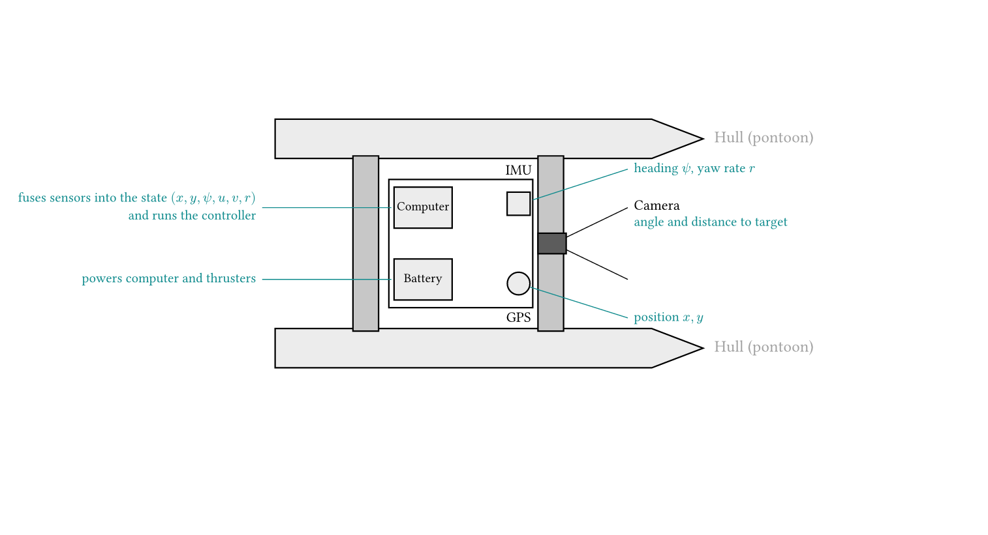
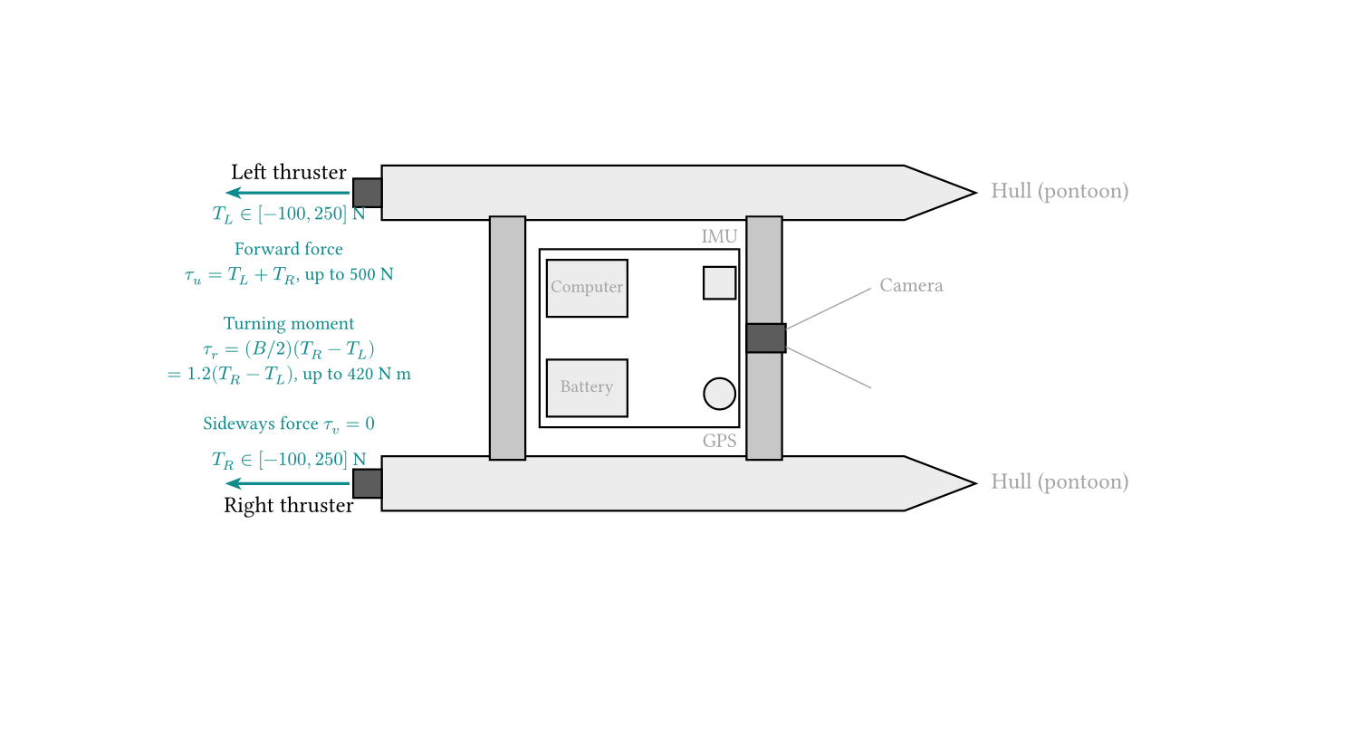
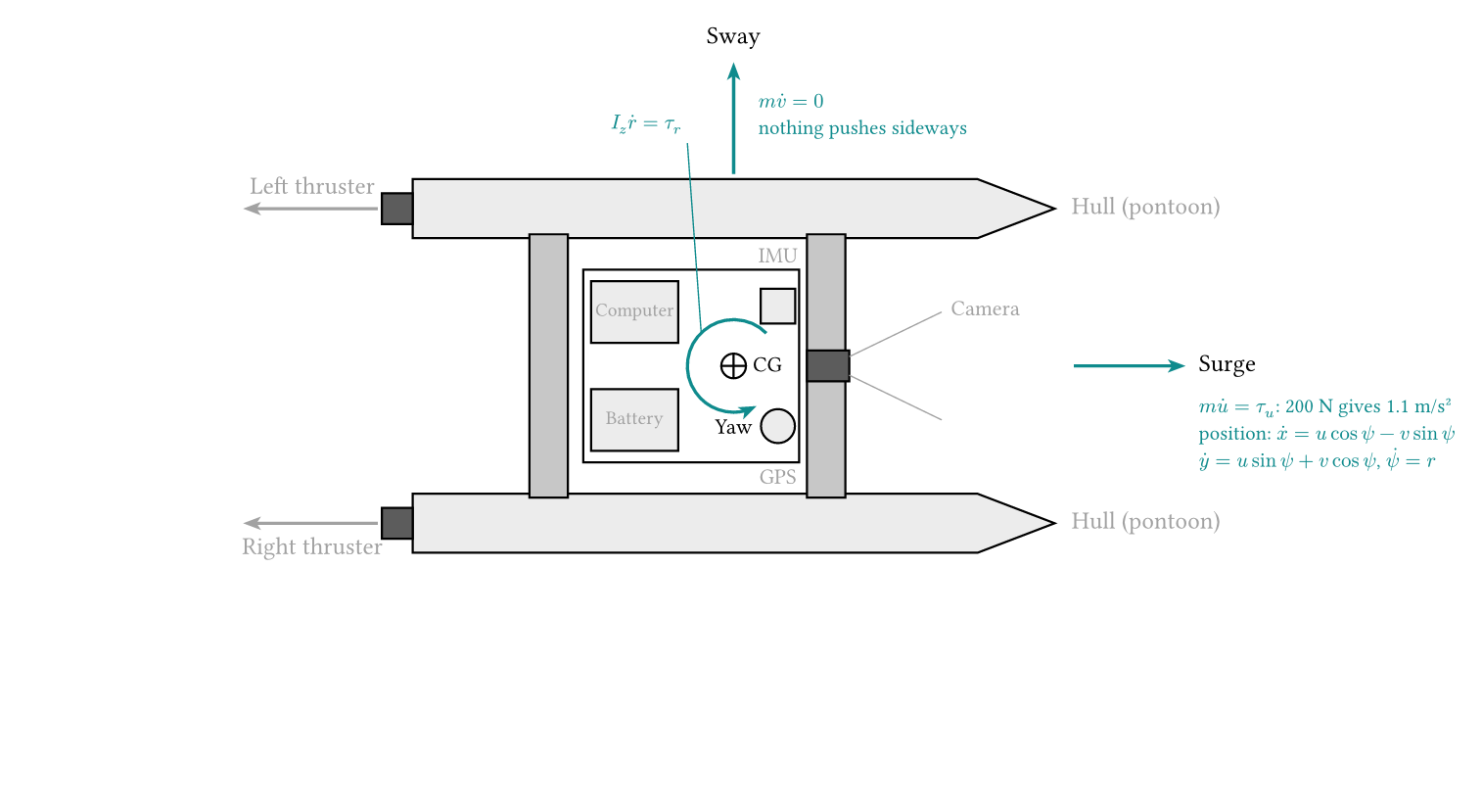
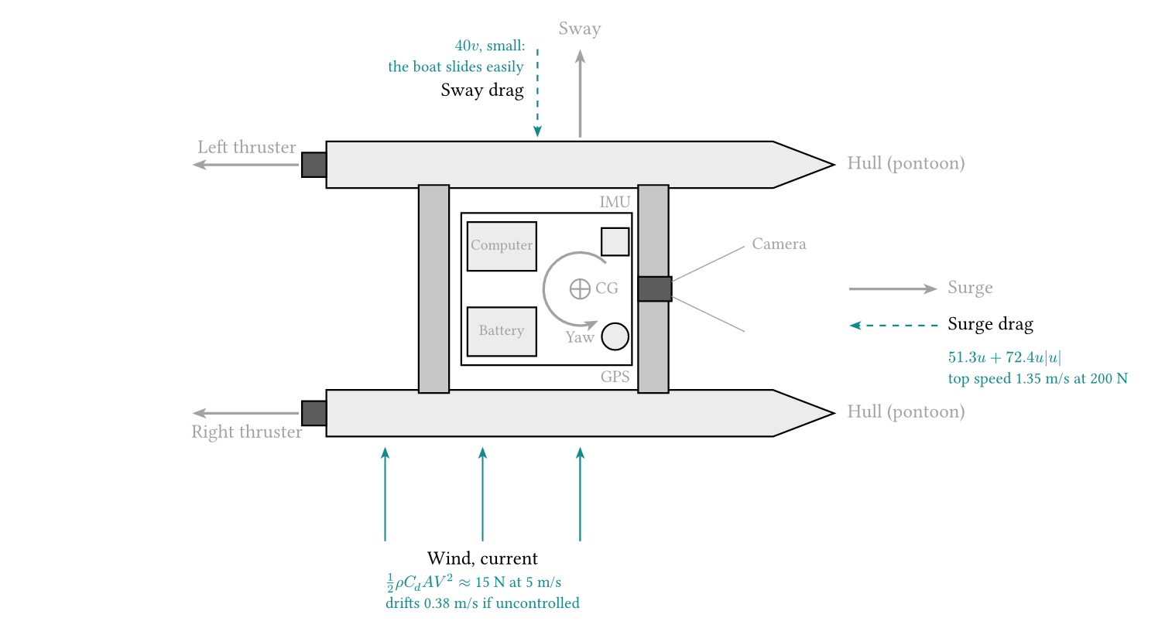
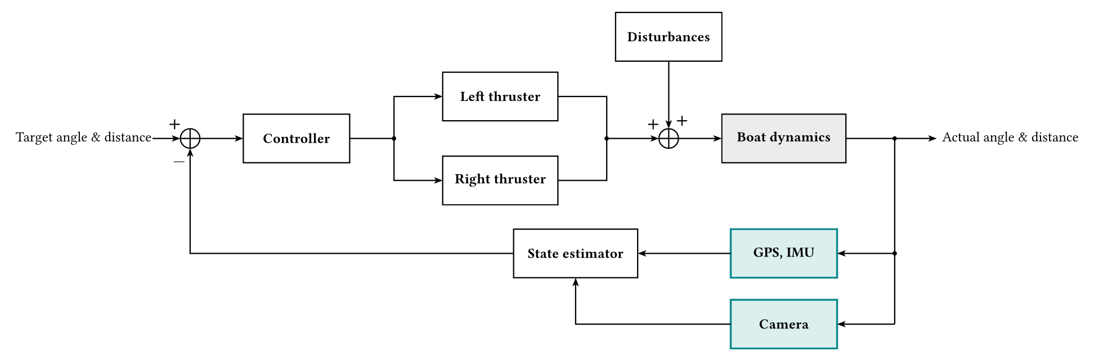
System to be Controlled
Notes:
Mass from water
Waves/periodic motion
Rol/pitch/heave
Hydrodynamics of thruster
Sensor latency
Combined wind/current
Wind yaw/moment
Quadratic sway and yaw…

Slide 4
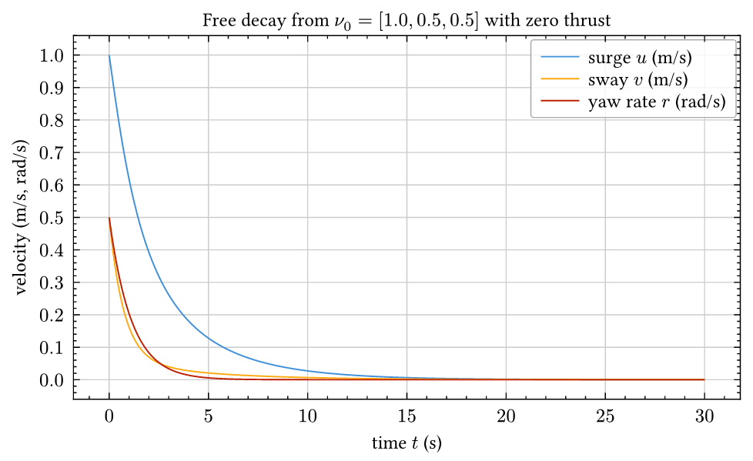
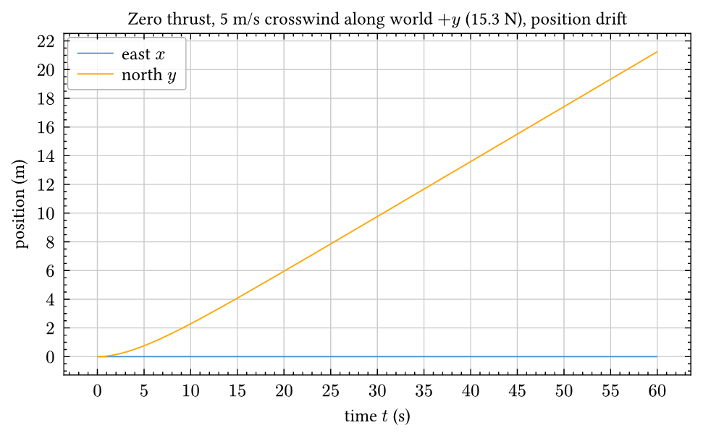
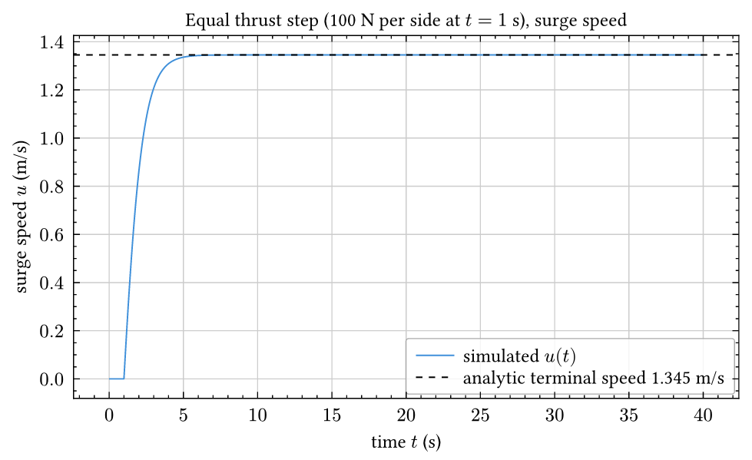
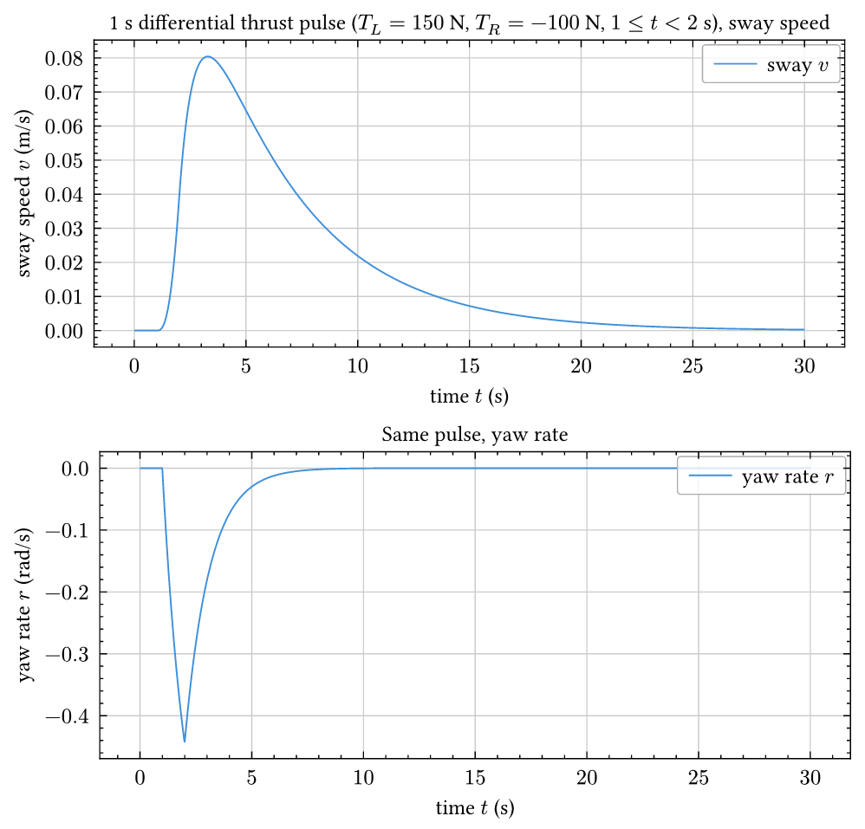
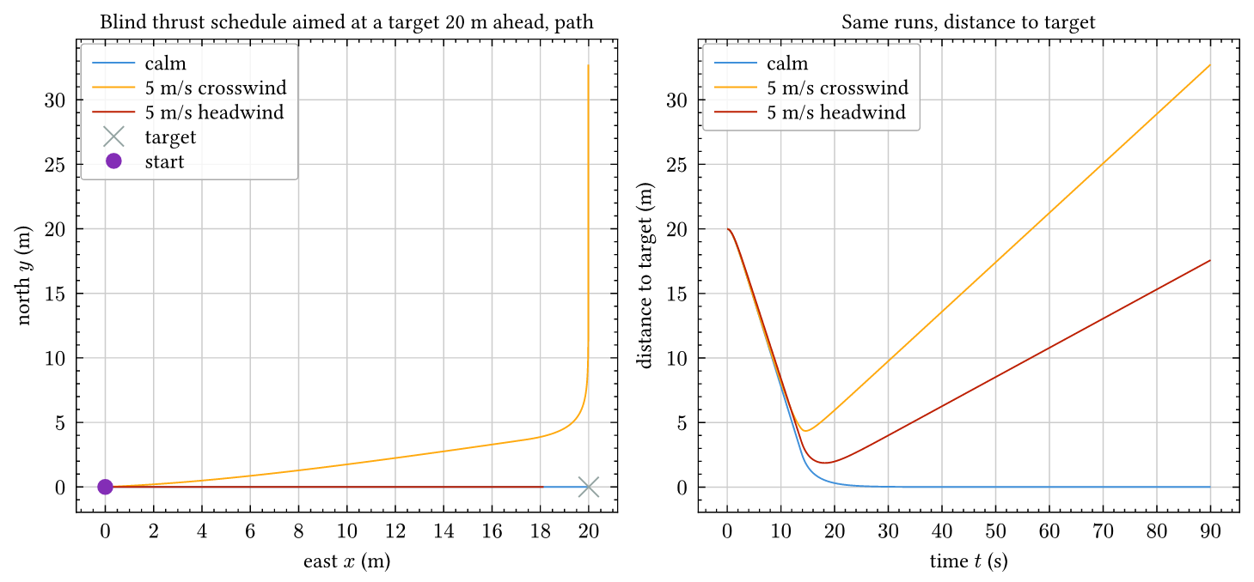
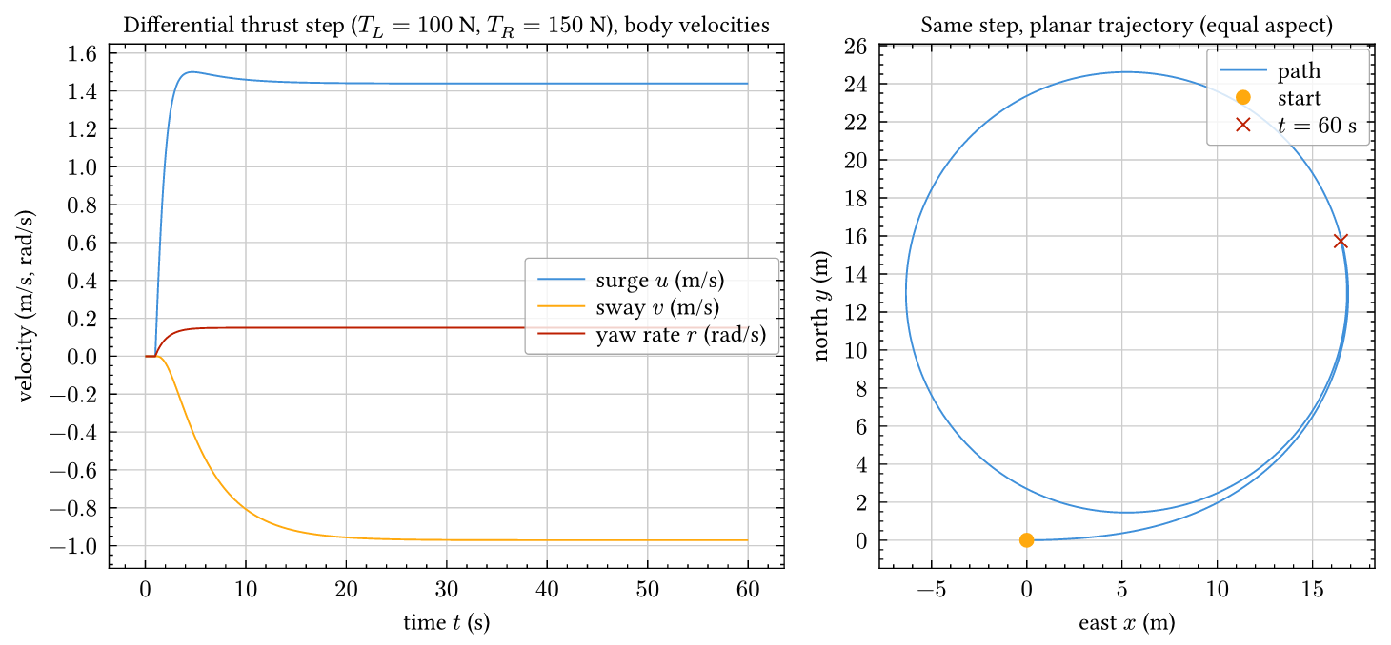
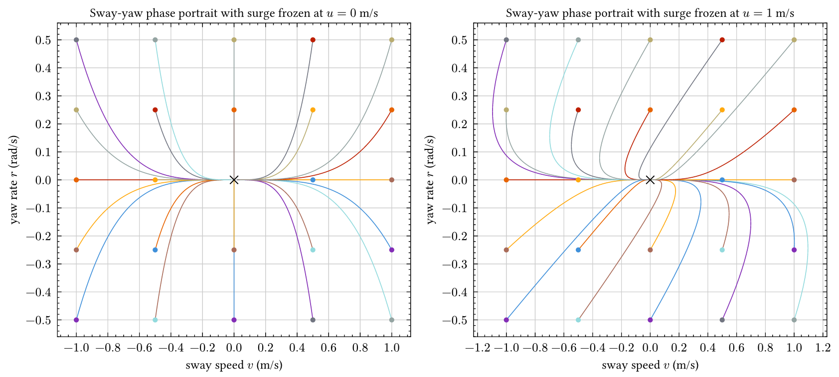
Open-Loop Dynamics Exploration

Slide 5
Control Problem to be Solved
Q: Regulation or tracking? A: Regulation? Depends.
Q: Linear or nonlinear? A: Non-linear. (unfortunate.)
Q: Single or multi-input? A: Multi-input and output
Q: Open-loop stable? A: Marginally. Velocity decay but pos. drifts.
Q: Measured directly? A: Not really. Simplify model via Estimator
Q: Settling time? A: Under 30 s from 5 m, 30 degrees.
Q: Overshoot? A: Under 10 percent.
Q: Steady-state error? A: Under 0.3 m and 15 degrees in 5 m/s wind.
Q: Control effort? A: Thrusters within limits
Q: Method? A: LQR

Slide 6

Thanks!

