Slide 1
EMCH 368 Lab 10
Exercise #2 Directions
-Jacob Vaught, Spring 2024

Slide 2
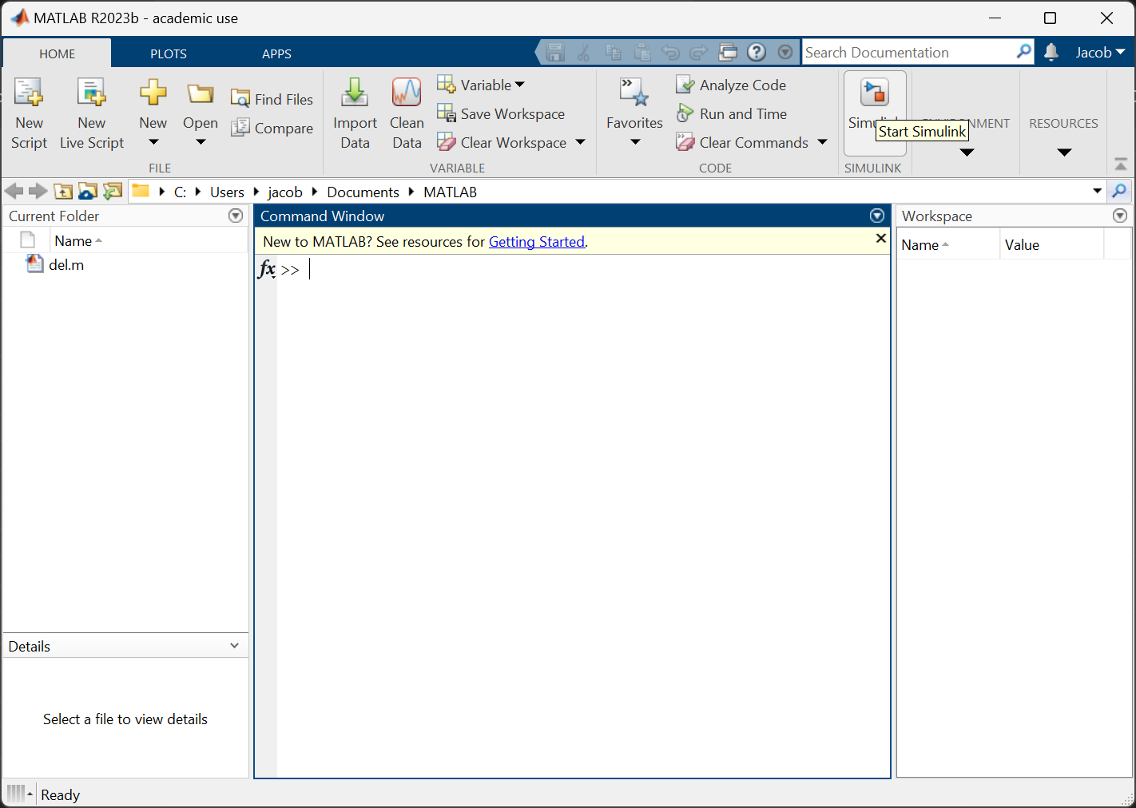
Open Matlab
Start SimuLink

Slide 3
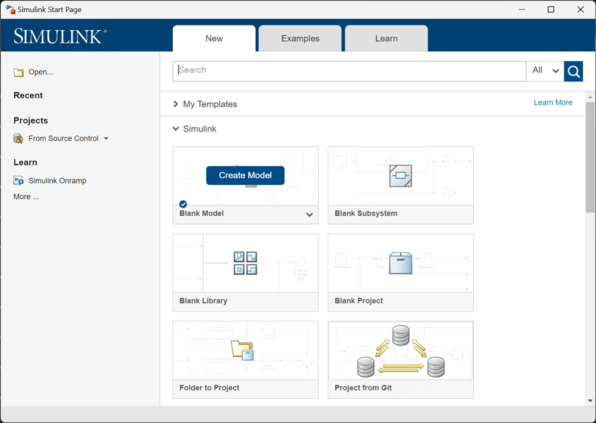
Create a new model once the simulink window appears.
This process can take upwards of 10 minutes depending on your machine.

Slide 4
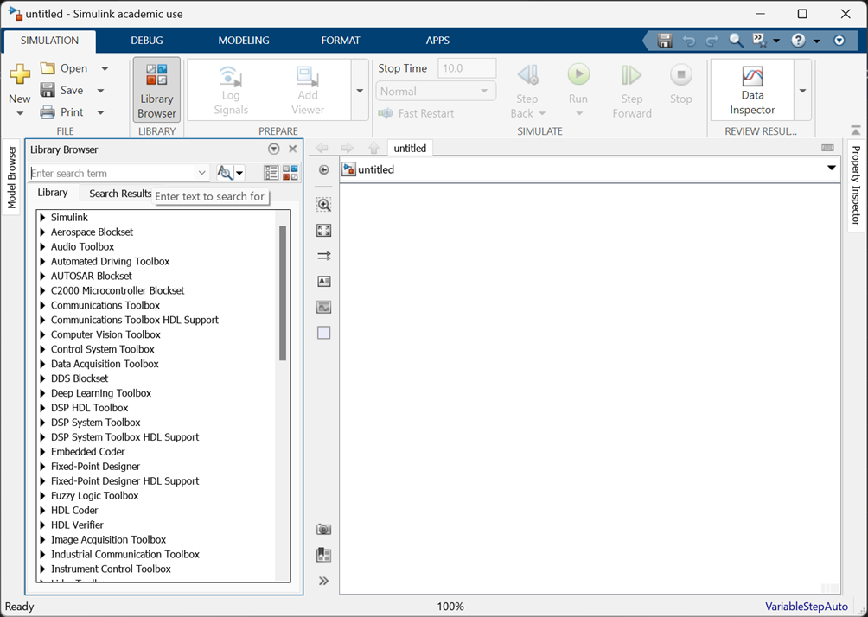
Open the Library Browser once the Blank Model is loaded.

Slide 5
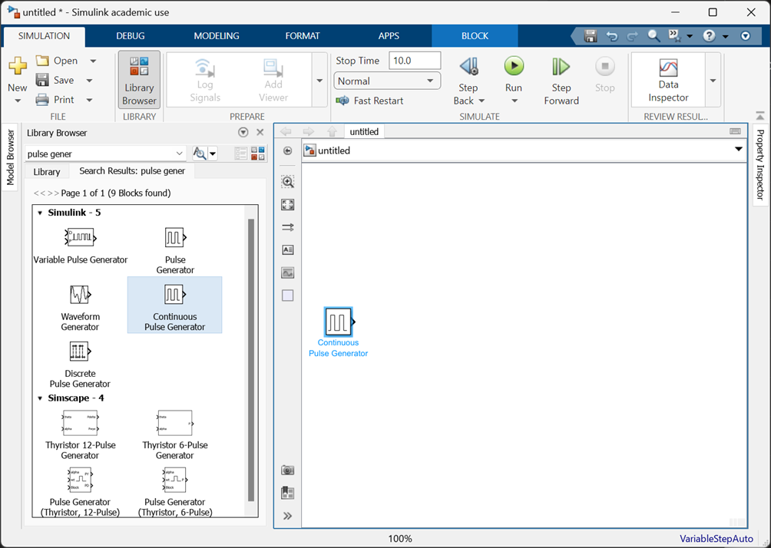
Our first component is the 'Continuous Pulse Generator’
To place on the screen, click, hold, and drag into the desired location

Slide 6
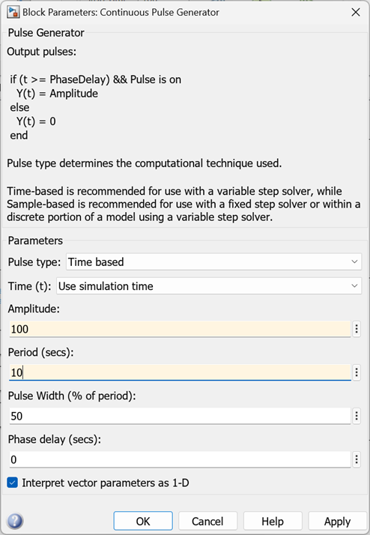
Our first component is the 'Continuous Pulse Generator’
Set the amplitude to 100
Set the period to 10 secs
Set the Puse Width to 50%

Slide 7
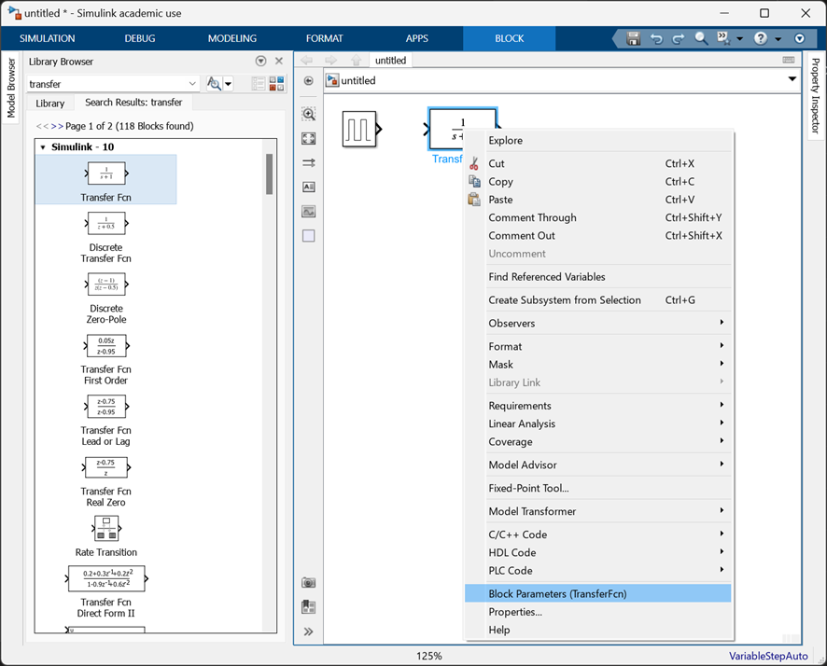
Our next component is the Transfer Function.
To modify values of the component, we double-click, OR right-click and select parameters
Set Numerator to [1]
Set Denominator to [0.1 1]

Slide 8
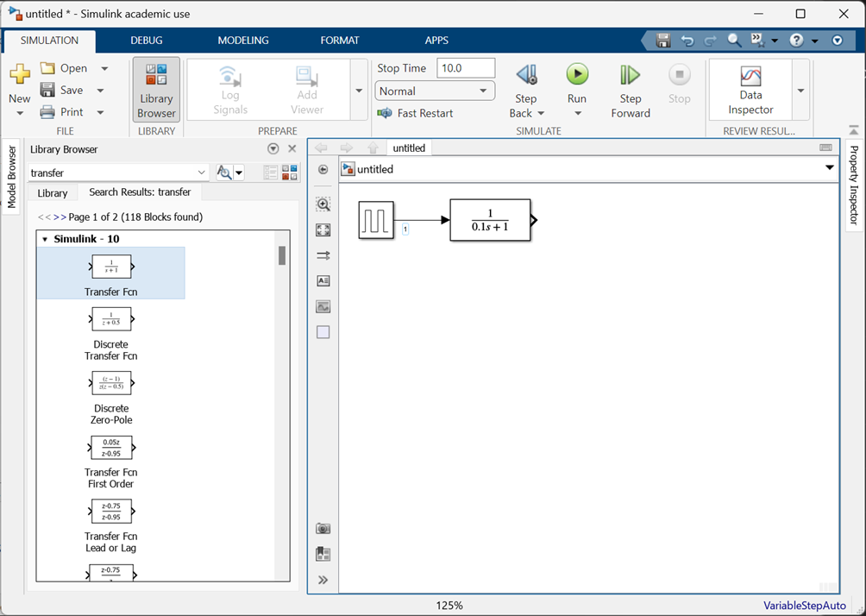
We click, drag and hold to create a connection between blocks

Slide 9
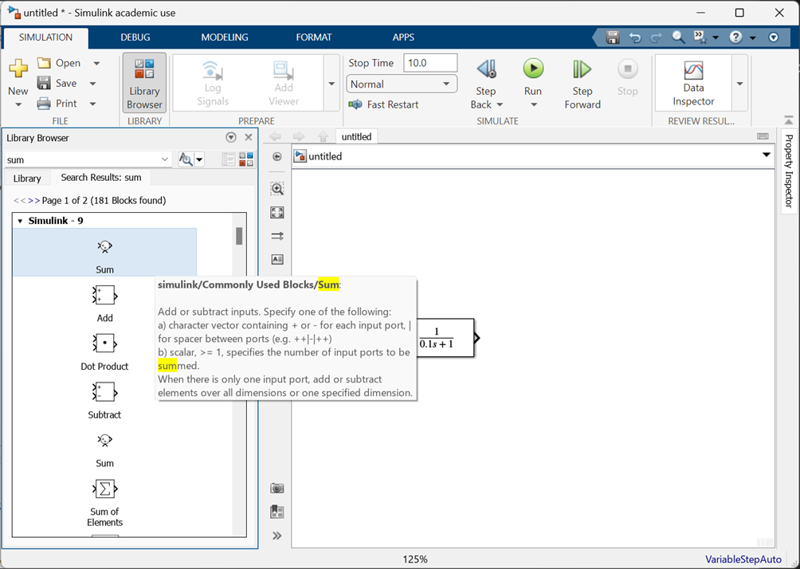
Add a sum to the model.
Set the List of Signs in the parameters to |+-

Slide 10
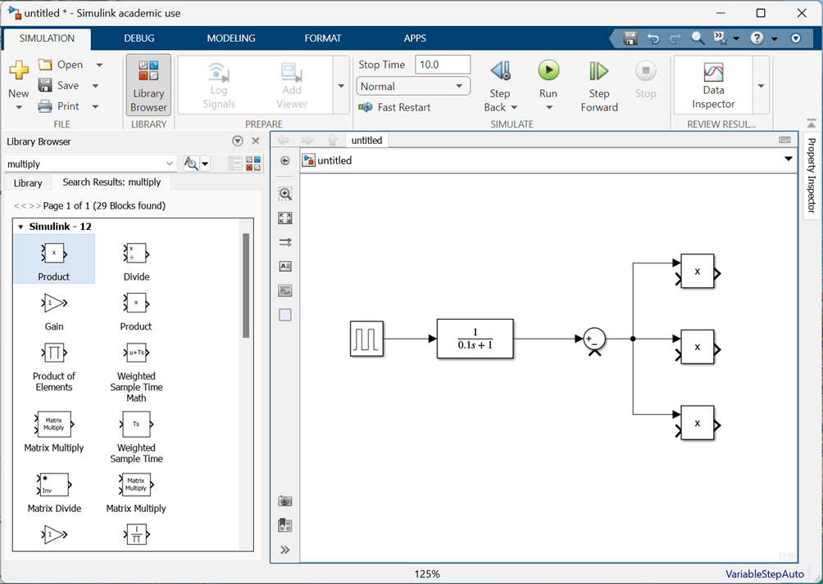
Now we want to add 3 product blocks for each of the PID controller components.

Slide 11
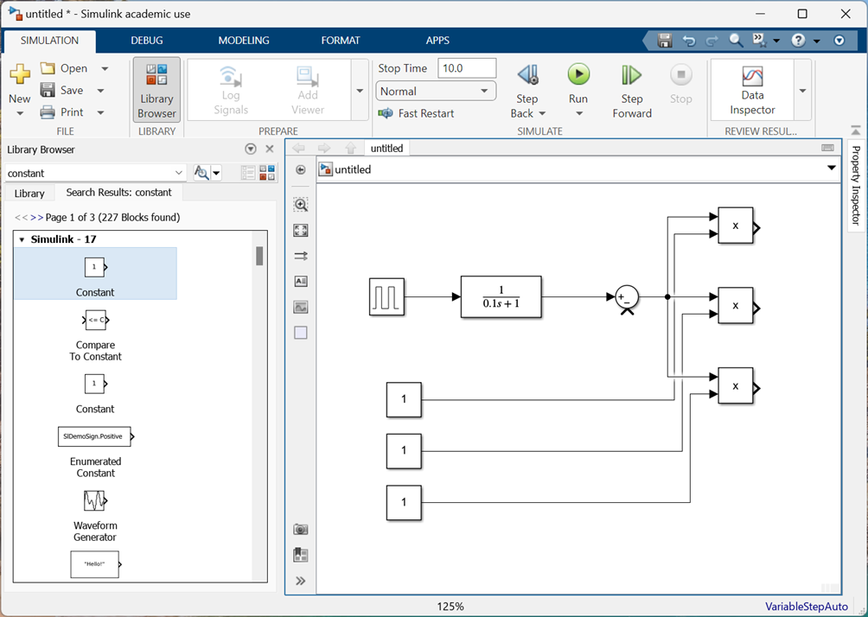
Now we will want to add some constants for the PID Controller.
Note that holindg the spacebar for a second will auto-scale the screen to your model.
Space + left-mouse is to move the screen around

Slide 12
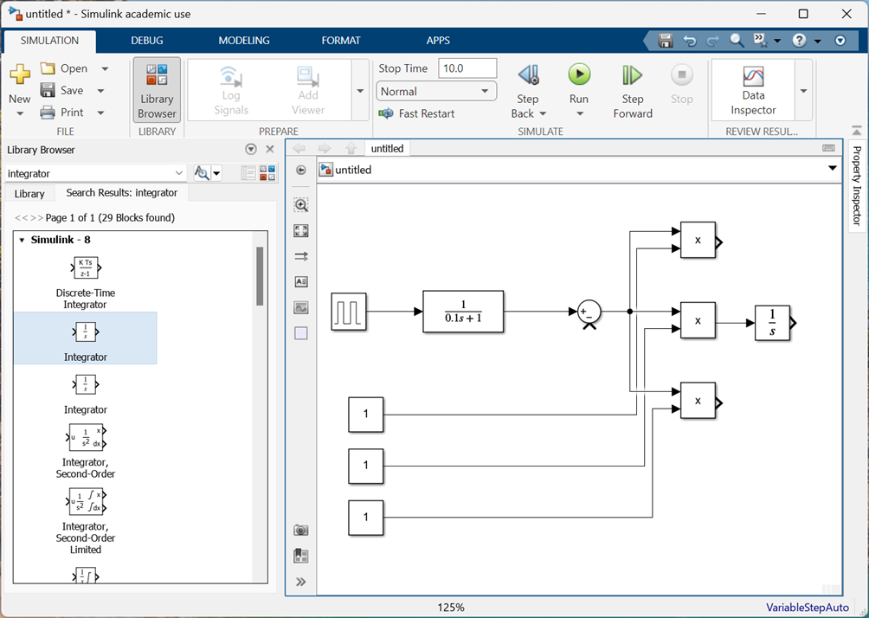
We will add the integrator for the Integral component of the PID controller.

Slide 13
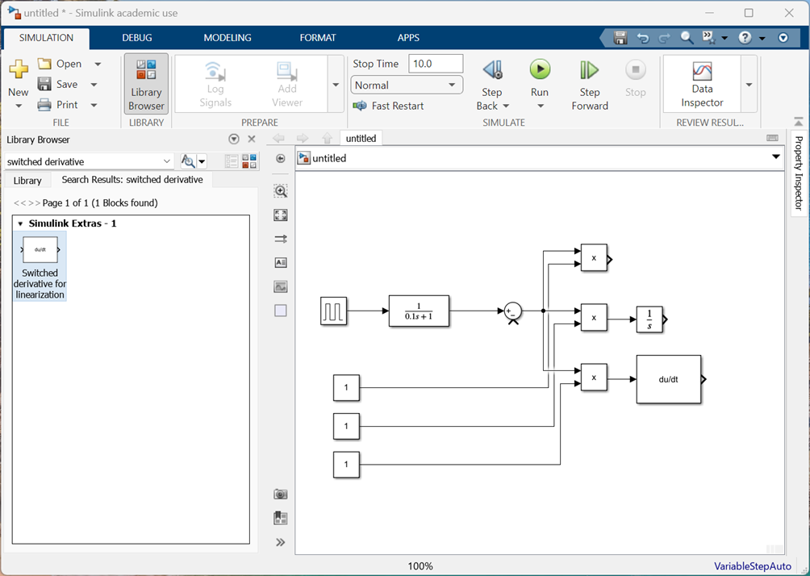
We will add the Derivator for the derivative component of the PID controller.

Slide 14
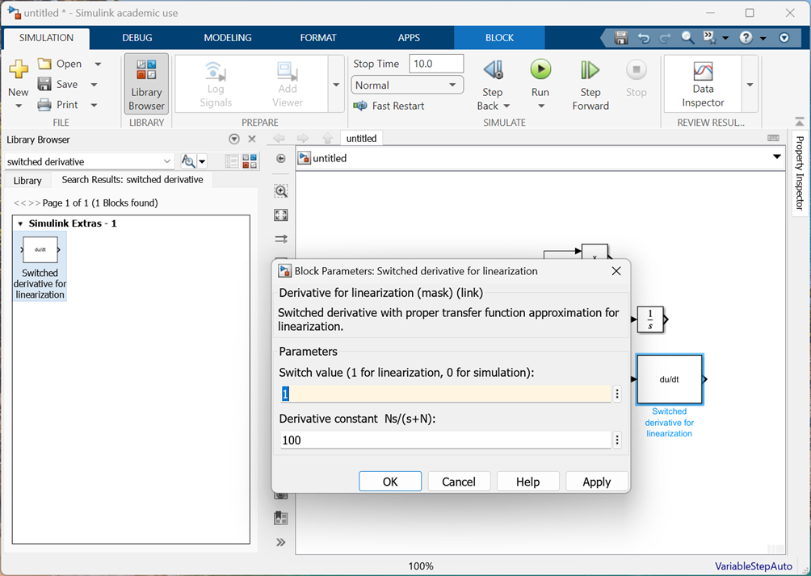
Change the switch value to a 1 for linearization.

Slide 15
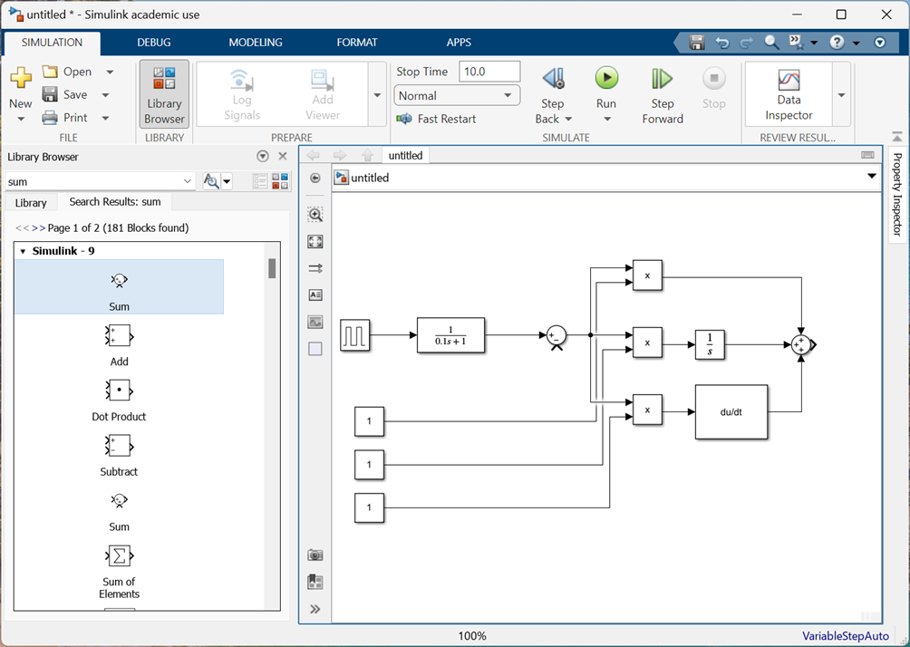
Add a summing component, and set the List of Signs to +++

Slide 16
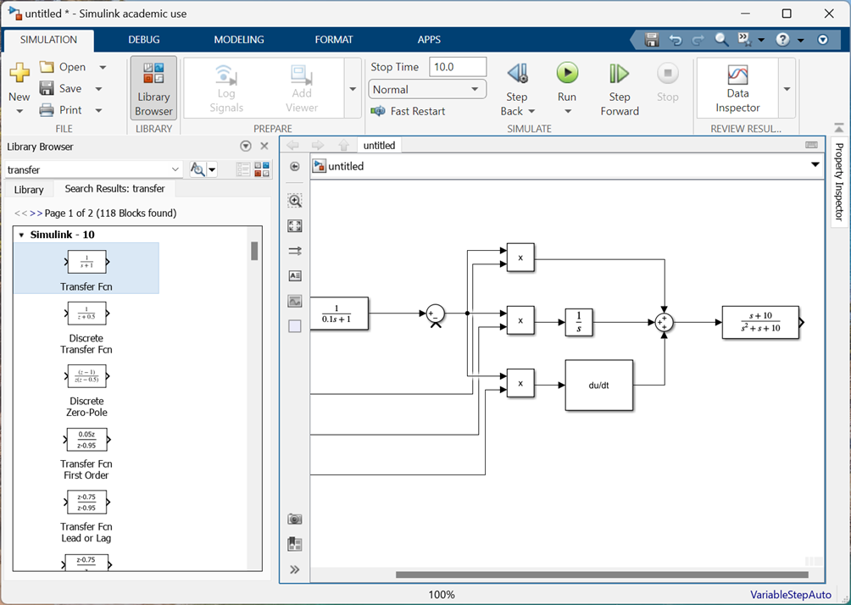
Add the system Transfer Function
Set Numerator to [1 10]
Set Denominator to [1 1 10]

Slide 17
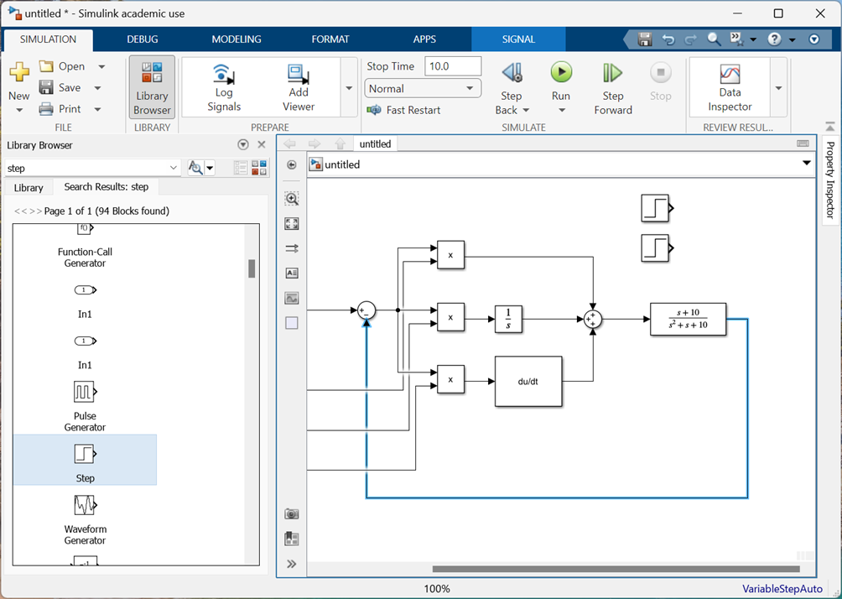
Add 2 step functions to represent the maximum and minimum error.
Connect the original sum to the output of the transfer function.
Set the Step Time to 0 for both.
Set the Final Value to 90 for one and 110 for the other.

Slide 18
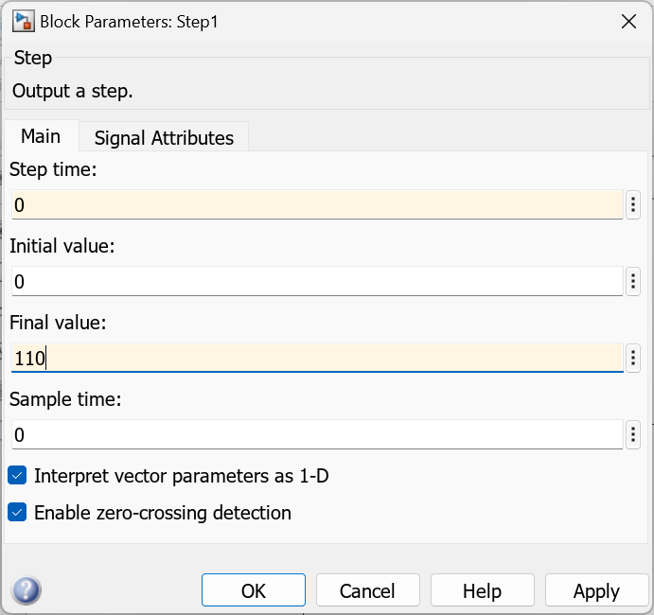
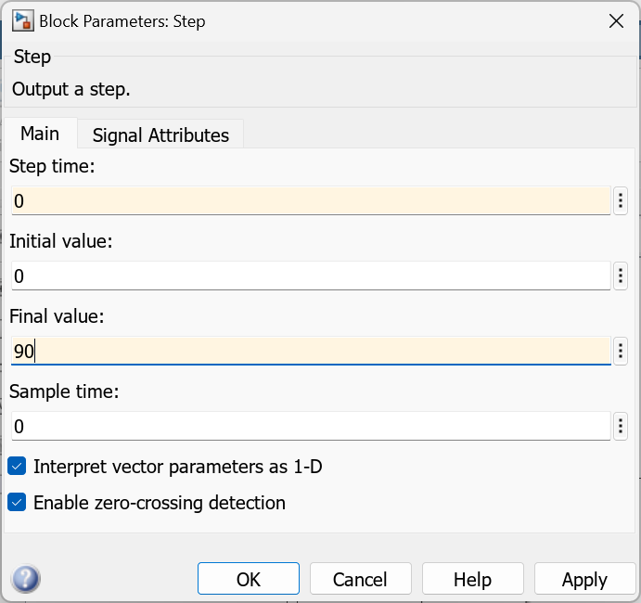
Set the Step Time to 0 for both.
Set the Final Value to 90 for one and 110 for the other.

Slide 19
Add 2 step functions to represent the maximum and minimum error.
Connect the original sum to the output of the transfer function.
Set the Step Time to 0 for both.
Set the Final Value to 90 for one and 110 for the other.

Slide 20
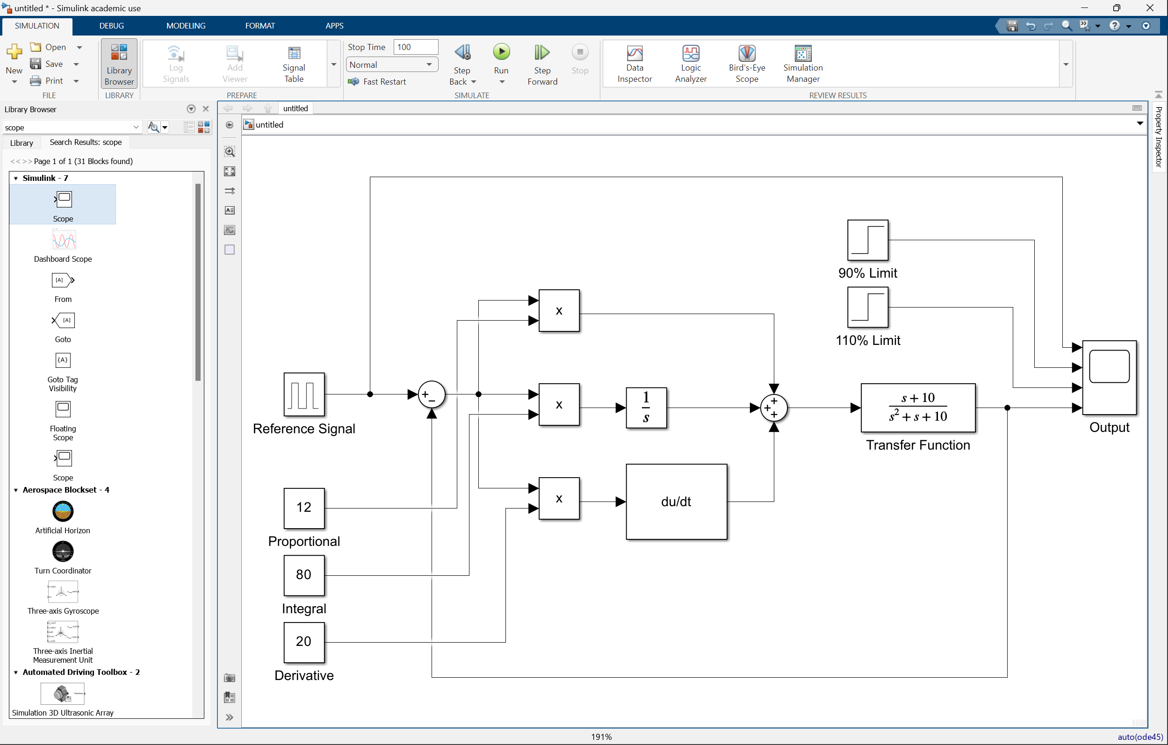
Add a scope to view the outputs of the system. It should connect to
2 step blocks
Output of the system
And the reference
To tune the system, adjust the block parameters of each of the constants.

Slide 21
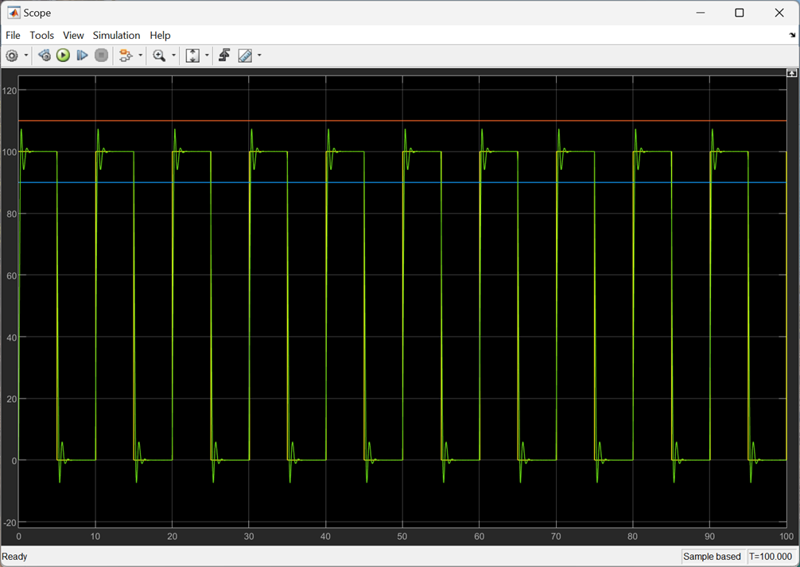
Double-click on the scope, and press the run button.
The graph should appear.

Slide 22
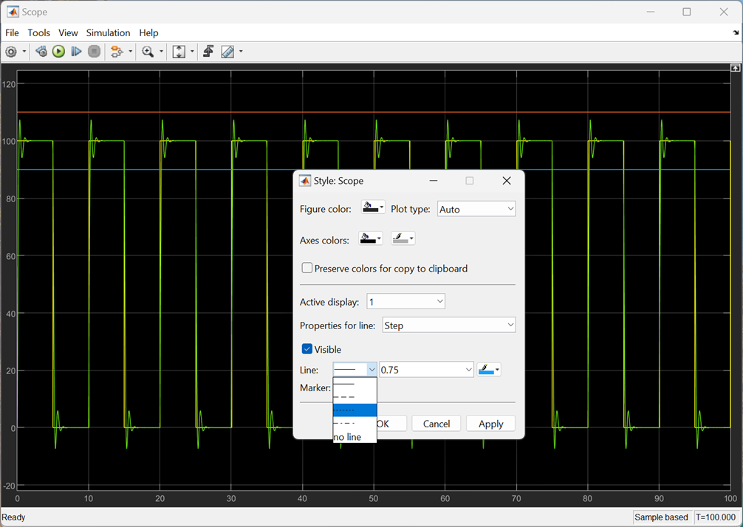
We want a dashed line for the 90% and 110%.
Select the Properties for the step blocks
Then change the line-type to dashed
Then change the width to 2.0

