Slide 1
Decision Tree Diagram
Height <= 160
Yes
No
Predict Female
Weight <= 80
Yes
No
Predict Female
Predict Male

Slide 2
Random Forest Diagram
Decision Tree 1
Decision Tree 2
Decision Tree 3
OUTPUT
[Most Common Result or Average]

Slide 3
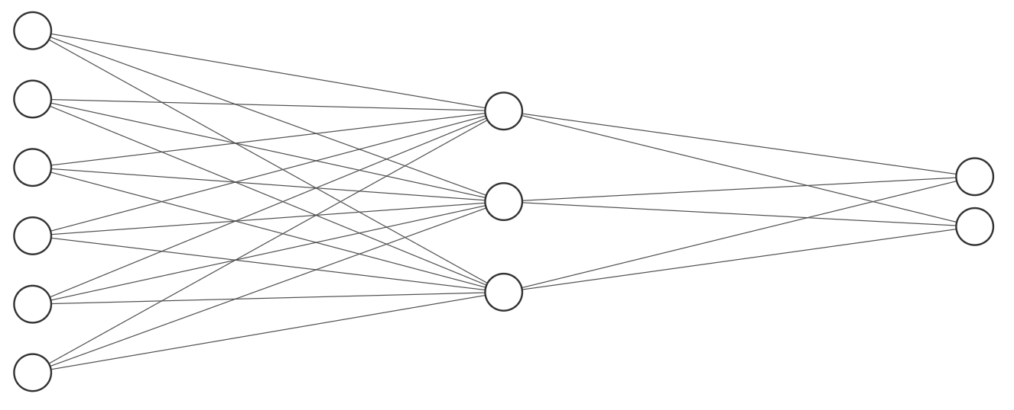
Neural Networks
Each “connection”/ pathway has a weight associated with it
Each neuron’s value is the sum of input values to it.
Classification is decided by comparing final layer neuron outputs. The neuron with the highest value indicates the predicted class.
Output Neurons
Hidden Neurons
Input Neurons

Slide 4
Convolutional Neural Networks
Broad Overview
Image Input
Convolution Layer
This section will feed into another section like itself if there are additional layers
Rectified Linear Unit (ReLU)
Pooling Layer (reducing size)
Flattened Vector
Neural Network
Result

Slide 5
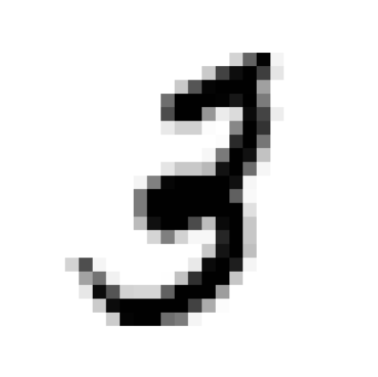
Convolutional Neural Networks
Input Image [28x28]
Convolved Layer(s) [24x24]
ReLU Layer(s) [24x24]
Pooled Layer(s) [12x12]
ReLU, defined as f(x) = max(0, x), adds non-linearity and lowers overfitting.
Each filter, also known as a "kernel," generates a distinct "feature map."
Pooling reduces feature map sizes by selecting prominent features from each map.
Filter [3x3]
ReLU Process
[de-linearization]
Pooling 2x2 blocks to 1x1 blocks

Slide 6
Convolutional Neural Networks
Feature Maps [12x12]
Vectorized Feature Maps[128x1]
Classification of Features
Classification Results
NEURAL NETWORK
OUTPUT
Vectorization typically converts 2D feature maps to a 1D format and aligns them sequentially. Often, a final pooling step is applied to simplify the model.

Slide 7
Data #1 Output
Input #1 = 0
Output= 0
Input #1 | Input #2 | True Output
0 | 0 | 0
0 | 1 | 0
1 | 0 | 1
1 | 1 | 1
Weight #1= 0.1
Input #2 = 0
Weight #2 = 0.1
Because the answer from the system is the correct one, the weights are ‘correct’ and no backpropagation is needed.

Slide 8
Data #1 Output
Input #1 = 0
Output = 0.1
Input #1 | Input #2 | True Output
0 | 0 | 0
0 | 1 | 0
1 | 0 | 1
1 | 1 | 1
Weight #1= 0.1
Input #2 = 1
Weight #2 = 0.1
Because the answer from the system is the WRONG one, the weights are incorrect, and the system needs to adjust the weights.
From the formula: $Out=W_{2}∗I_{2}+W_{1}∗I_{1}$, and knowing that I1=0, and O = 0, we can calculate W2 as:
$\frac{Out}{I_{2}}=\frac{0}{1}=0$. This is the fundamental of Back-propagation.

Slide 9
Data #1 Output
Input #1 = 1
Output = 0.1
Input #1 | Input #2 | True Output
0 | 0 | 0
0 | 1 | 0
1 | 0 | 1
1 | 1 | 1
Weight #1= 0.1
Input #2 = 0
Weight #2 = 0
Because the answer from the system is the WRONG one, the weights are incorrect, and the system needs to adjust the weights again.
From the formula: $Out=W_{2}∗I_{2}+W_{1}∗I_{1}$, and knowing that I2=0, and O = 1, we can calculate W1 as:
$\frac{Out}{I_{1}}=\frac{1}{1}=1$.

Slide 10
Data #1 Output
Input #1 = 1
Output = ?
Input #1 | Input #2 | True Output
0 | 0 | 0
0 | 1 | 0
1 | 0 | 1
1 | 1 | 1
Weight #1= 1
Input #2 = 0
Weight #2 = 0
Because the answer from the system is the WRONG one, the weights are incorrect, and the system needs to adjust the weights again.
From the formula: $Out=W_{2}∗I_{2}+W_{1}∗I_{1}$, and knowing that I2=0, and O = 1, we can calculate W1 as:
$\frac{Out}{I_{1}}=\frac{1}{1}=1$.

Slide 11
Data #1 Output
Input #1 = 1
Output = 1
Input #1 | Input #2 | True Output
0 | 0 | 0
0 | 1 | 0
1 | 0 | 1
1 | 1 | 1
Weight #1= 1
Input #2 = 1
Weight #2 = 0
Because the answer from the system is the correct one, and we have exhausted our data set, we can conclude the model is completely trained.

