Slide 1
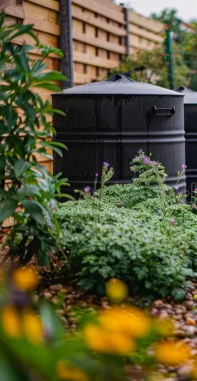
Conceptual Design Review
USC Facilities:
Rainwater Barrel Project

Slide 2

Project Background
Green Quad: First LEED-certified building on campus, focuses on sustainability.
USC Office of Sustainability: Promotes eco-friendly initiatives and resource conservation.

Slide 3
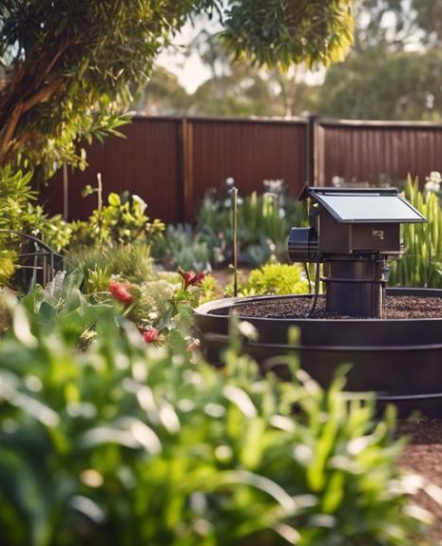
Project Background
Industry Relevance:
Aligns with sustainable urban agriculture practices.
Connection to Challenges:
Addressing efficient water delivery while maintaining environmental stewardship.
Team Members:
Tanner Harmon, William Wenzel, Presston McConnell, Jacob Vaught

Slide 4
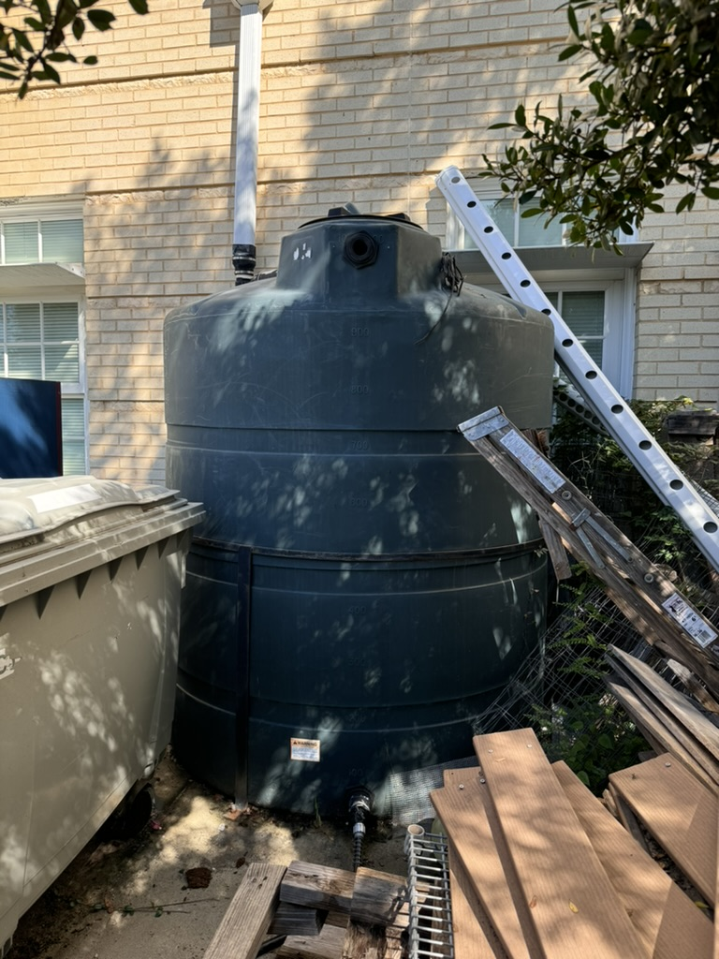
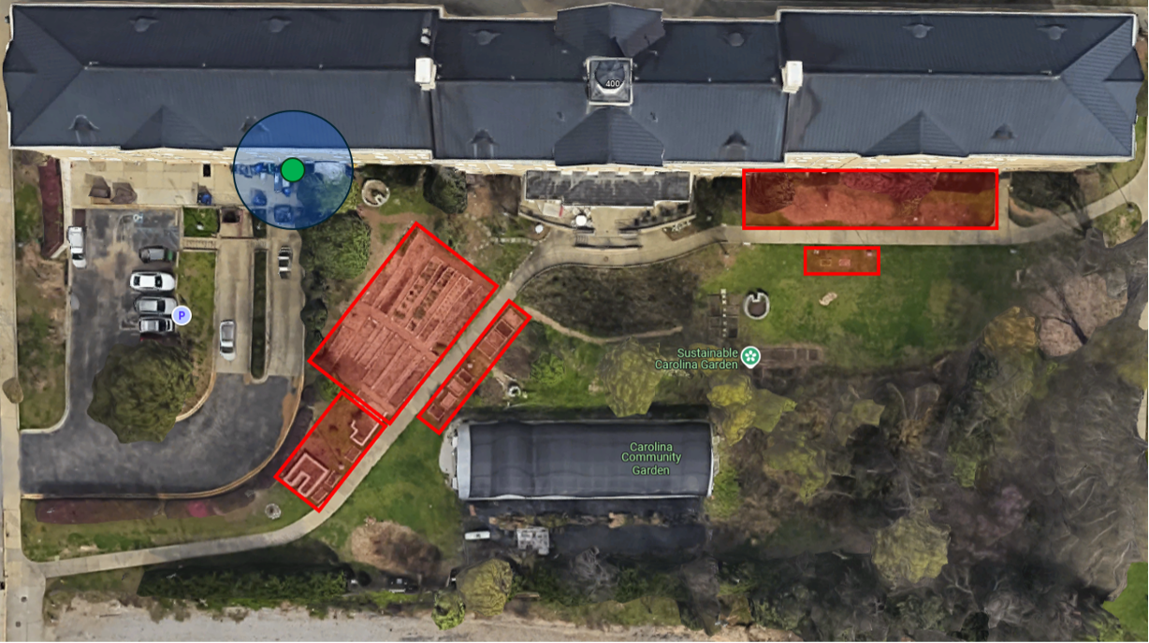
Current Watering Solution
Water is transferred manually using small watering cans, taking upwards of 1-minute, which is inconvenient for daily garden needs.

Slide 5
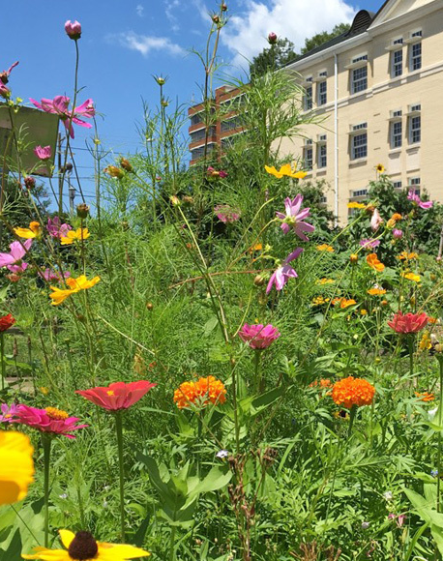
Customer Needs
Current system:
Manual watering with 2-gallon cans (55 seconds per fill).
Labor-intensive and inefficient for frequent use.
Stakeholder observations:
Need for faster, easier water transfer.
Desire for an eco-friendly solution that aligns with sustainability goals.
Preference for a low-maintenance system usable by anyone.
User goals:
Consistent water delivery with minimal physical effort.
Flexibility for varying schedules and garden needs.
Notes:
Emphasize how the current system is time-consuming and labor-intensive, particularly with multiple watering days per week.
Highlight stakeholder priorities for sustainability and ease of use.
Point out the mismatch between user needs and the current system.

Slide 6
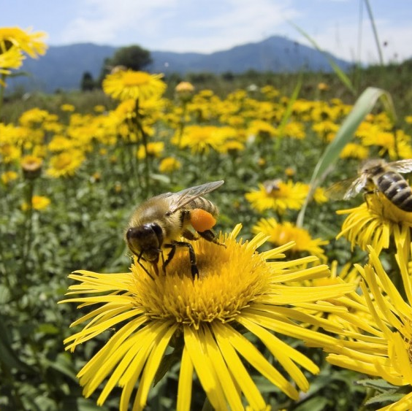
Critical to Quality Needs
1. Efficiency
5. Safety
4. Sustainability
3. Noise
2. Pressure
Notes:
Why are these critical to quality?

Slide 7
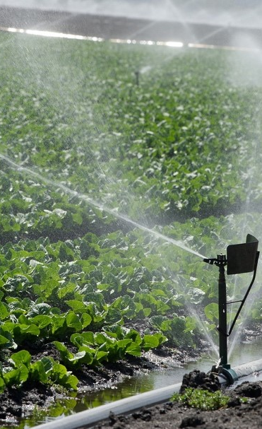
Product Mission Statement
Mission Statement:
Create a water distribution system that transfers water quickly, provides sufficient pressure for effective delivery, ensures adequate flow for all watering methods, covers the entire garden area efficiently, and complies with relevant safety standards.
Key Objectives:
Reduce water transfer time.
Deliver consistent water pressure across all garden zones.
Ensure simplicity and low maintenance for long-term usability.
Incorporate sustainable and recyclable materials.
Notes:
Introduce the mission statement as a synthesis of the stakeholders’ needs and project goals.
Highlight how the mission reflects sustainability, efficiency, and ease of use.
Conclude by explaining how this mission sets the direction for the design process.

Slide 8
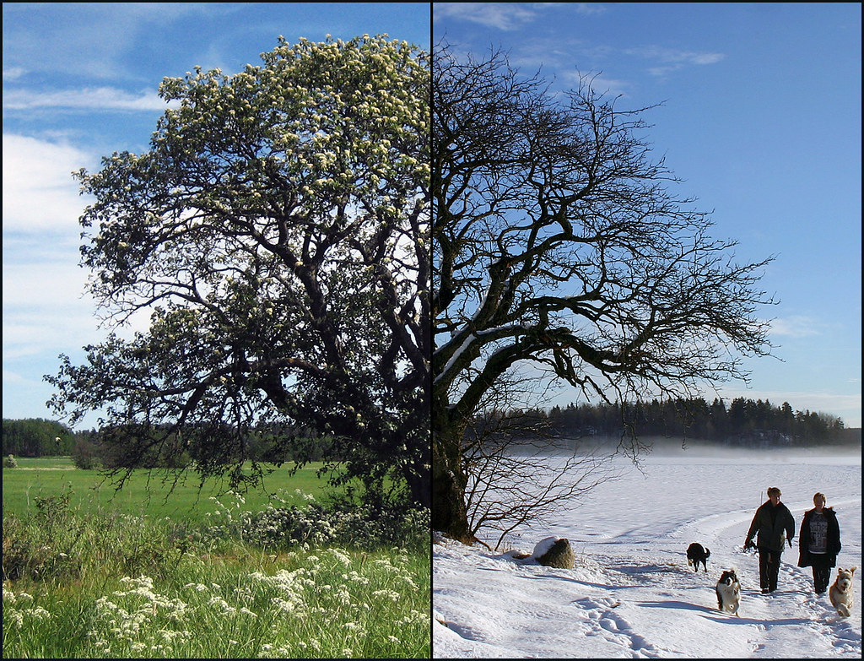
Specifications: Needs vs Metrics
Top Prioritized Needs:
Quick and efficient water transfer
Sufficient water pressure
Minimize manual labor through user-friendly operation.
Minimize environmental impact with eco-friendly materials.
Durability to last at least 10 years under outdoor conditions.
Metrics Tracked:
Water transfer rate, flow rate consistency, operational effort time, noise level
Notes:
Highlight how metrics like flow rate and pressure directly tie to prioritized needs.
Mention the importance of aligning specifications with customer-defined targets for both performance and sustainability.
Explain trade-offs, such as pressure vs. energy consumption, identified in the analysis. {BS on the spot is fine}

Slide 9
Target vs Fallback Specifications
Target Specifications:
Flow rate: 50–60 L/min.
Water pressure: 300–400 kPa.
Noise: ≤50 dB at 1m.
Operating cost: ≤$50/year.
Expected lifespan: 10+ years.
Fallback Specifications:
Flow rate: 30–49 L/min.
Water pressure: 200–300 kPa.
Noise: ≤70 dB at 1m.
Operating cost: ≤$100/year.
Expected lifespan: 5 years.
Trade-offs Identified:
Higher flow and pressure may increase energy consumption.
Noise reduction could raise costs.
Notes:
Note: 100 kPa ~ 15 psi; city water ~ 40-80 psi
Note: 4 liter ~ 1 gallon
Emphasize how the target specifications are based on competitor benchmarking and stakeholder expectations.
Explain fallback values as acceptable thresholds for performance in case of technical or budget constraints.

Slide 10
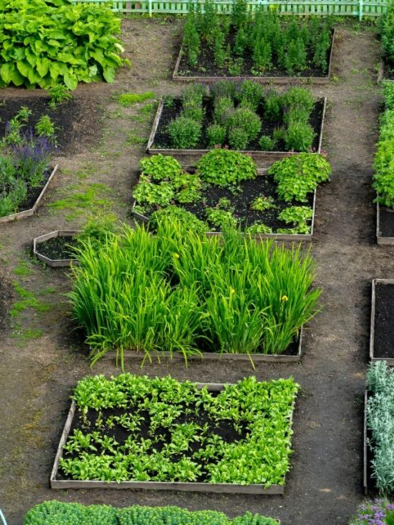
Functional Decomposition
Functional decomposition breaks a complex system into smaller, manageable functions to simplify analysis and design.
Identifies all system operations needed to achieve the project goals.
Helps pinpoint critical components and dependencies.
Ensures no functionality is overlooked during the design process.
Highlights interactions between subsystems.
Notes:
Explain that functional decomposition helps designers understand how the system will operate at every stage.
Use an analogy: "It’s like dividing a garden into sections based on plant types or their specific needs to ensure everything thrives.”
Mention its role in identifying potential failure points or inefficiencies early in the design process.

Slide 11
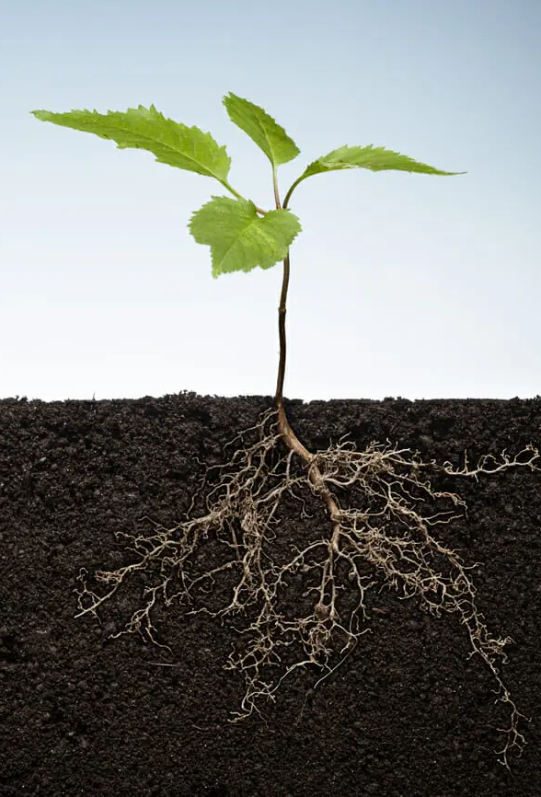
Essential Functions
Receiving Power
Activation of Transfer
Adjusting Flow Rate
Controlling Flow Rate
Transferring Water
Storing Water
Delivering Water
Irrigating the Garden
Notes:
Receiving Power: From the energy source (solar, battery, or grid).
Activation of Transfer: Starting the pump or opening a valve.
Adjusting Flow Rate: Using a valve or pump control.
Controlling Flow Rate: Ensuring consistent delivery.
Transferring Water: Moving water from the tank to the distribution system.
Storing Water: Temporary holding in a tank or pressure system.
Delivering Water: Final delivery to the garden or irrigation system.
Irrigating the Garden: Dispersing water effectively across the area.

Slide 12
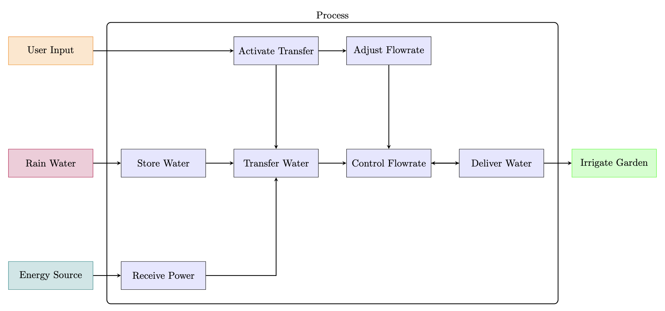
Functional Decomposition
Notes:
Explain what this is.

Slide 13
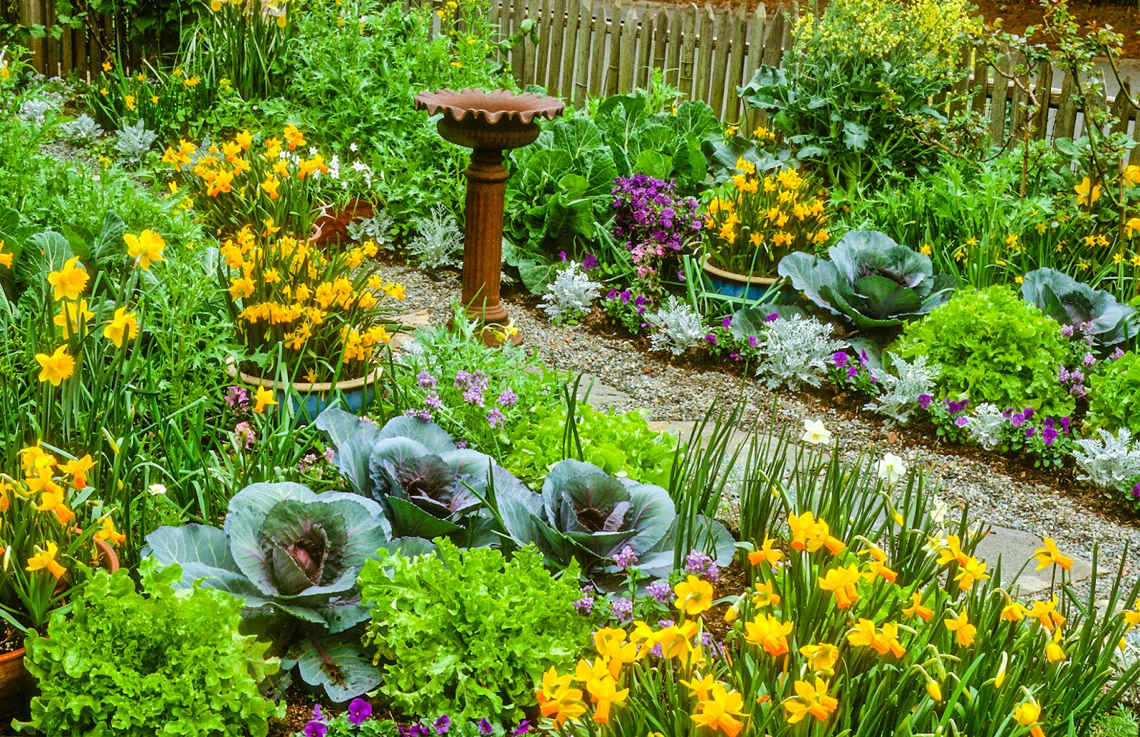
Concept Combination
Concept Combination is the process of mixing and matching different solutions for individual system functions to create an optimal overall design.
The Concept Combination Table (CCT) serves as a systematic tool to explore these combinations, ensuring that every function is addressed and all innovative possibilities are considered
Notes:
What is concept combination? explain

Slide 14
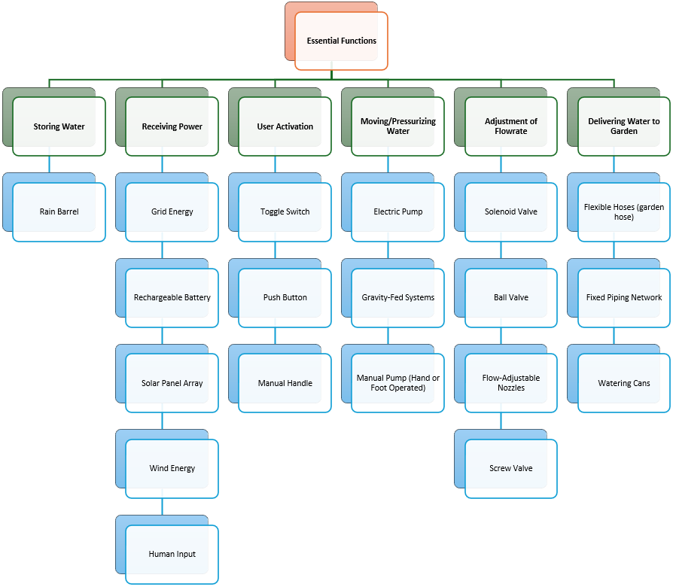
Concept Combination Table
Notes:
Explain what this shows.

Slide 15
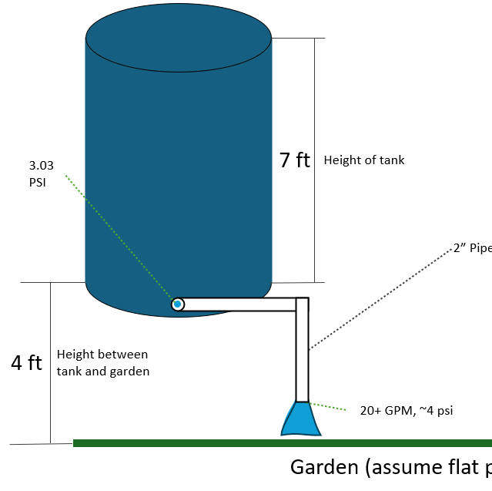
C1: Changing Pipe Diameter
Good: Cheap. Easy to operate. Reliable
Bad: No hose. Not versatile. Will not work with sprinkler. Limited capabilities

Slide 16
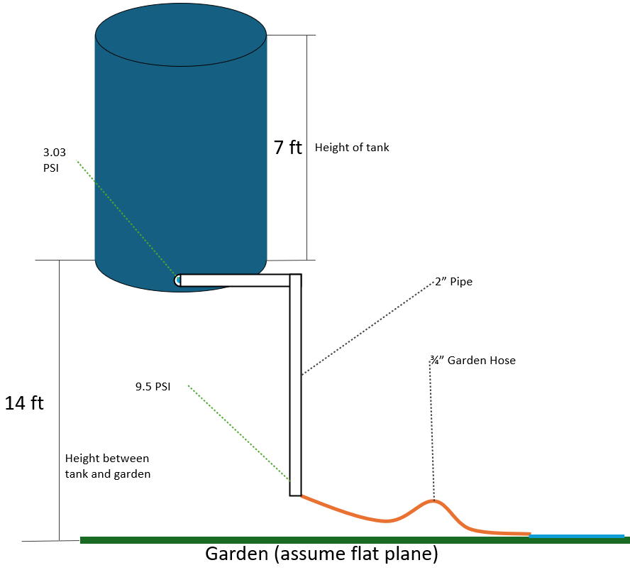
C2: Raising Tank
Good: Cheap. Easy to operate. Reliable. Works with hose
Bad: Raised Tank is ugly. Won’t provide enough pressure to run sprinkler. Will be hard to do maintenance on

Slide 17
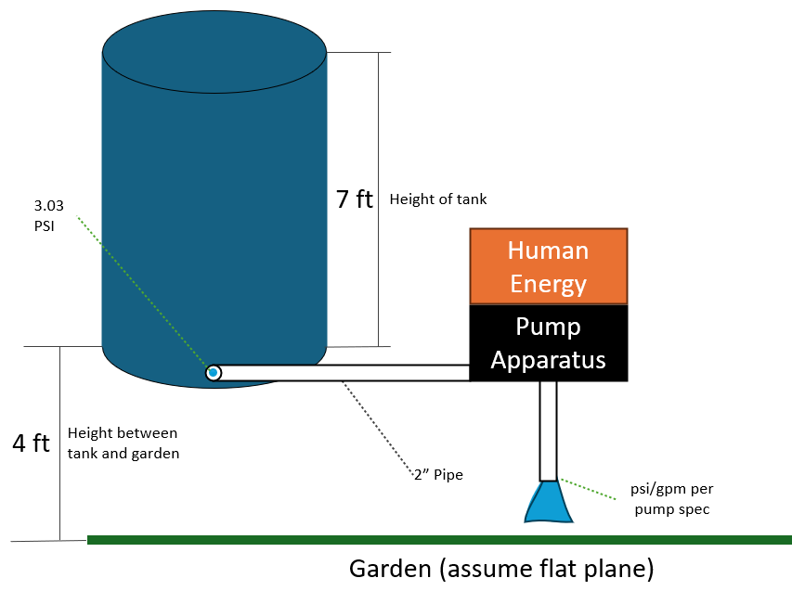
C3: Manual Pump
Good: Simple to operate. Reliable. Easy to maintain
Bad: Either low pressure or low flowrate. Requires manual labor. Medium maintenance

Slide 18
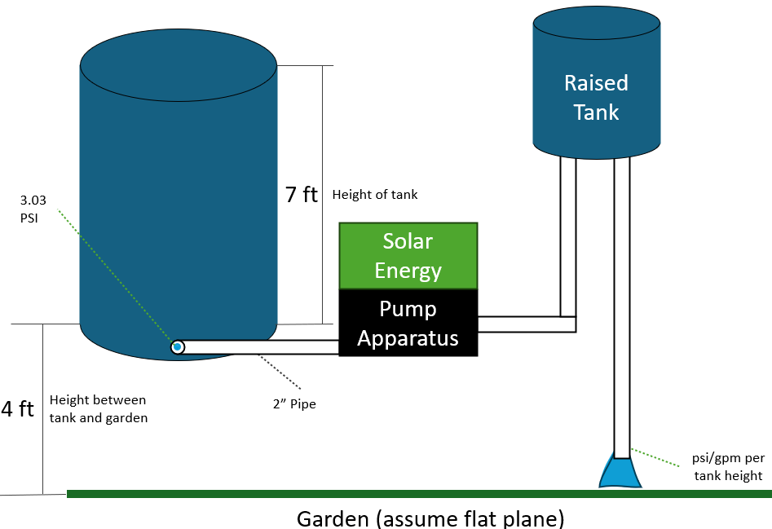
C4: Solar Pump + Raised Tank
Good: No manual Labor. Good pressure.
Bad: Raised tank is unsightly. Solar energy dependent on sun. More expensive.

Slide 19
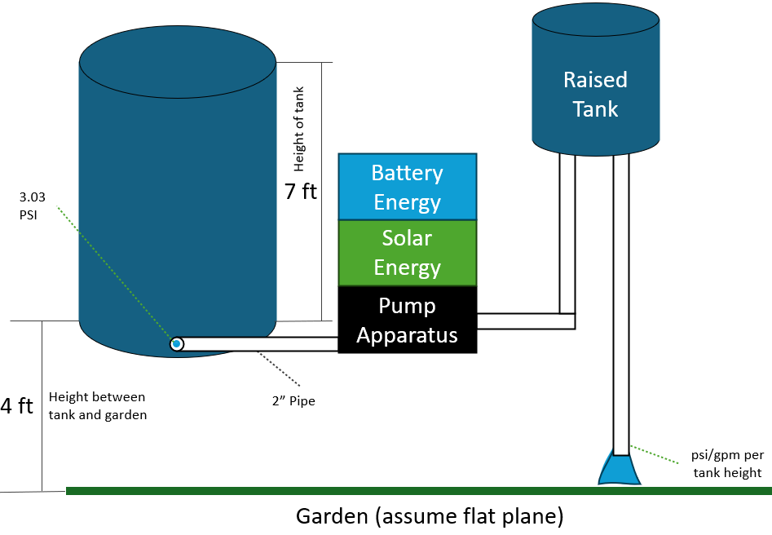
C5: Solar + Battery + Raised
Good: No manual Labor. Good pressure. More reliable
Bad: Raised tank is unsightly. Solar energy dependent on sun. More expensive.

Slide 20
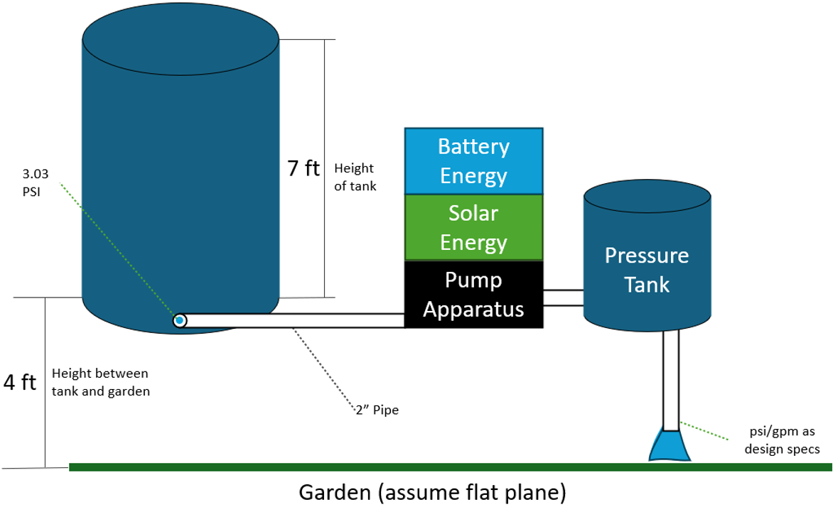
C6: Solar + Battery + Pressure
Good: No manual Labor. Best pressure. Mostly reliable
Bad: Complex engineering. Most expensive. Hardest to maintain.

Slide 21
Summary of Viable Solutions

Slide 22
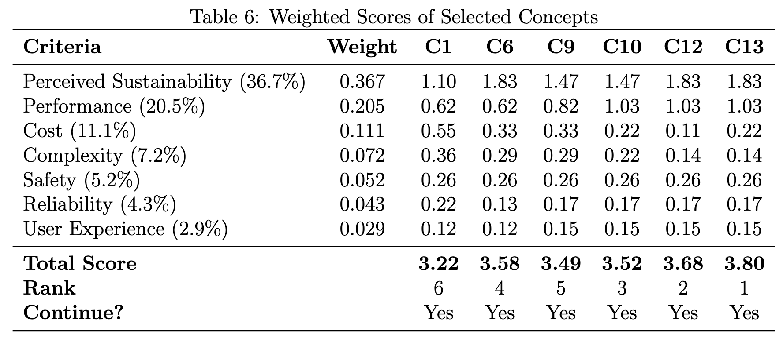
Concept Selection Matrix
Notes:
What does this table say?
solution(raised+solar+battery) is the number one pick!!!
After changing the values to account for the price differential, the Pressure tank wins out, but this assumes we have a solar and battery system that works.

Slide 23
Top Concept
Sustainable and Reliable: Combines solar energy and battery storage for eco-friendly, uninterrupted operation.
Efficient Water Delivery: Pressurized tank ensures steady flow with minimal energy waste.
Cost-Effective: Long-term savings from renewable energy offset initial investment.
Adaptable and Scalable: Modular design supports future expansion and upgrades.
Notes:
Top concept is the Pressure tank+battery+solar

Slide 24
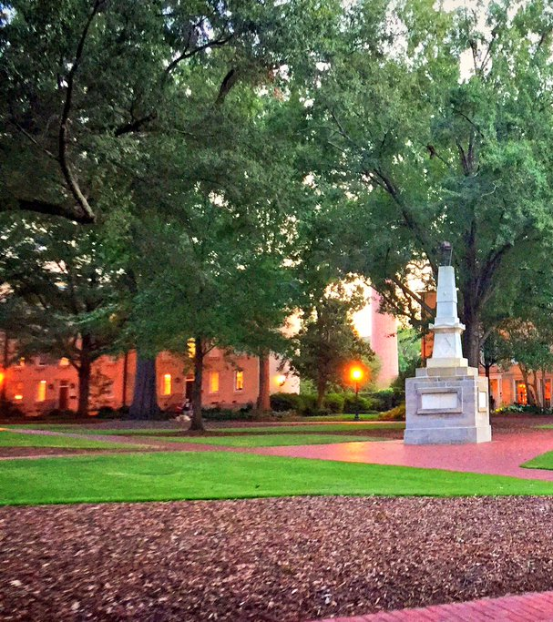
Refinements to the Top Concept
Cost Optimization: Reuse of solar panels, batteries, and pump significantly reduced material and budget requirements.
Standardized Components: Simplified maintenance with a uniform 2-inch PVC pipe design for easy repair and replacement.
Compact and Efficient Design: Optimized layout of reused components to conserve space and facilitate straightforward installation.

Slide 25

End of Slides
References:
Needs Report
Product Specifications Report
Functional Decomposition Report
Concept Selection Report
USC Office of Sustainability

